Slide 1


Nest.JS
Winter - 2022
Mostafavi
08 – Middlewares & swagger

Slide 2
Course Structure
Add Request Logging with Middlewares
Create Custom Param Decorators
Generating OpenAPI Specifications
Introducing the Swagger Module
Enabling CLI Plugin
Decorating Model Properties
Adding Example Responses
Using Tags to Group Resources

Slide 3
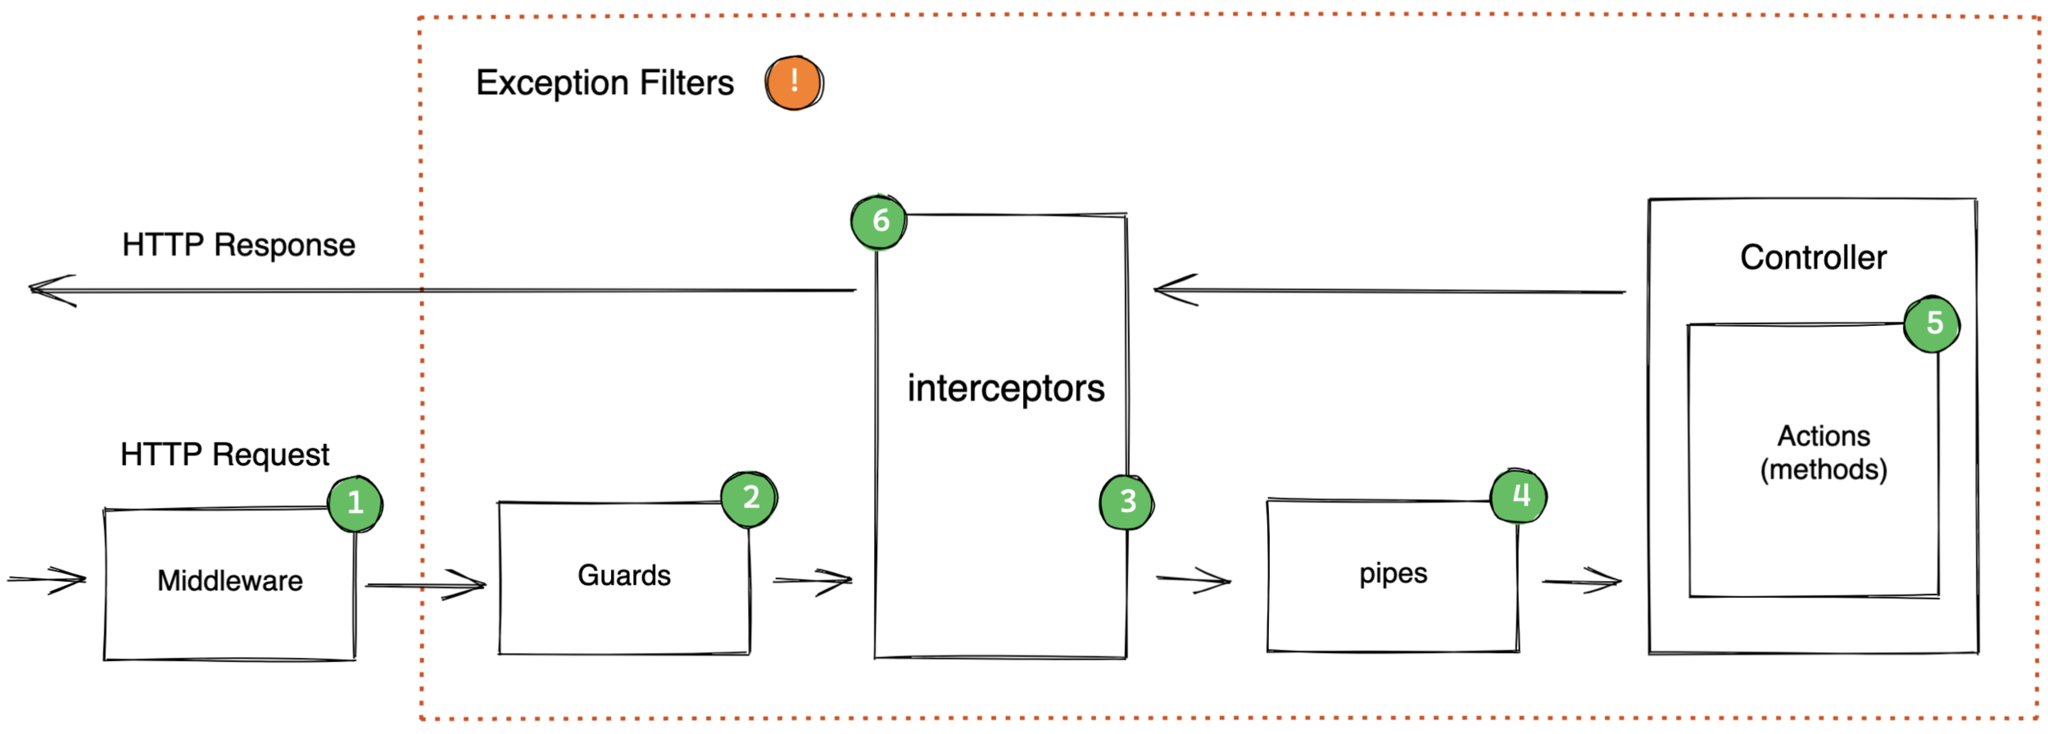
Request Lifecycle in Nest.js
Notes:
Link for more info: https://hotovo.com/2021/06/30/inside-nestjs-project

Slide 4
New requirement
Dev:
Log every request duration, we want this to measure our performance ☺

Slide 5
Demo
Middleware:
They have access to req and res objects
Benefits:
Making changes to req, res
Ending req, res cycle
You have to call next method
How to create them:
nest g middleware <path-to-your-class>
Function Middlewares are stateless, buy class Middlewares is able to have state

Slide 6
Demo
How to use them?
Middlewares are not bind to any methods, but instead to routes so
You can’t inject them, you have to change your module structure as follows
Implements NestModule interface
Require you to define configure() function with a consumer
consumer.apply(your-middleware).forRoutes(‘*’)
You can exclude() some routes
Res object has some useful events
Add our callback to finish event on res

Slide 7
New requirement
Dev:
We use paginated query a lot, create some custom decorator, so use it everywhere we need.

Slide 8
Demo
Custom decorator
createParamDecorator
You can access context and therefore request object, Hoora ☺

Slide 9
New important requirement
Your frontend:
Please, provide a documentation for me, to know how to work with your backend ☺

Slide 10
OpenApi Specification
It is somehow, a language agnostic definition format, useful for describing RESTFul apis.
We can describe our api:
Operations
Input parameters
Responses
Authentication
Nest provide a dedicate module: SwaggerModule
npm install @nestjs/swagger swagger-ui-express

Slide 11
Demo
Run the ui
DocumentBuilder is our tool ☺
It sets the swagger properties (options)
Title
Description
Version
And finally build()
const options = new DocumentBuilder().setTitle()…
Then create the document by this options
const document = SwaggerModule.createDocument(app, options);
Then wire all of them together
SwaggerModule.setup(‘docs’, app, document);

Slide 12
Demo
Oh, maybe you have some issue with swagger@5
nest update -f -t latest, fix everything ☺
We don’t see any information about our dtos in swagger UI, why?
Typescript metadata reflection system has several limitation to determine:
What properties a class consist of
Or a property required or not
We can declare them manually but
We can fix some of them at compilation time:
Some compilerOptions inside nest-cli.json
Notes:
"compilerOptions": {
"deleteOutDir": true,
"plugins": ["@nestjs/swagger/plugin"]
}

Slide 13
Demo
How to be more descriptive:
@ApiProperty()
Default
Description
…
@ApiResponse()
Additional responses
Like exceptions
@ApiForbiddenResponse

Slide 14
Demo
Tags
Group our resources
@ApiTags(‘your-tag’)
Controller level and method level ☺

Slide 15
Exercise
Required:
Exercise all we speak
Create your swagger ui
Notes:
Hint: loggerService better to be transient
☺ For you (The seeker is the finder):
https://www.brunnerliv.io/articles/advanced-nestjs-dymaic-providers

