Slide 1


Nest.JS
Winter - 2022
Mostafavi
10 – Authentication

Slide 2
Course Structure
Authentication
Sessions
JWT Token
JWT Strategy
Authorization
What is role? What is RBAC?
Create guard for authorization purposes

Slide 3
Demo
How about other protected route?
We can’t pass the username, password of the user in each request, IT ISN’T SECURE!!!!!!!!
There it comes some ways to store user logins
Session, stores user session inside server
Introduce states, we have to store that in server side (db, redis, …)
Cloud services don’t have any states ☹
Tokens, JWT tokens are stored in client side
They are validating server side
There isn’t any state, and cloud are welcome us ☺

Slide 4
Demo
Sessions
With session, we just store the key of storage client side (in cookies), but the real user information are stored back server side (redis, db, in-memory, …)
npm install express-session
npm i -D @types/express-session
Create a simple guard for our purpose, return request.isAuthenticated()
main.ts
app.use(session({
secret, resave, saveUninitialized, cookie :{}
}));
app.use(passport.initialize());
app.use(passport.session());

Slide 5
Demo
Sessions
Create a session serializer
Extends PassportSerializer
serializeUser()
deserializeUser()
Implementation of this two method is up to you
Don’t forget to Provide the serializer in your AuthModule
PassportModule.register({ session: true })
In LocalAuthGuard add some custom canActivate function that
super.canActivate, super.login()

Slide 6
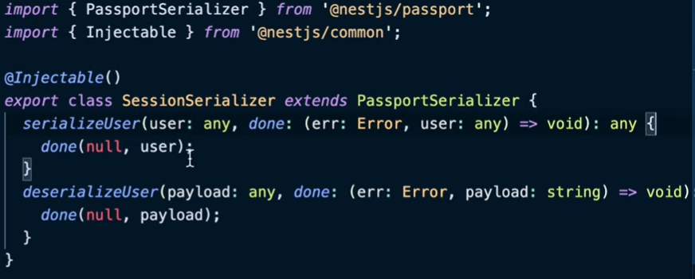
serializer

Slide 7
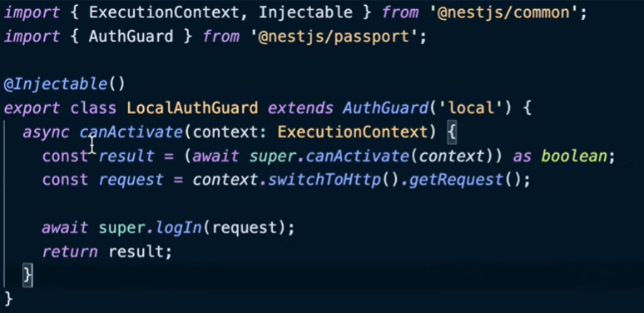
Change in LocalAuthGuard

Slide 8
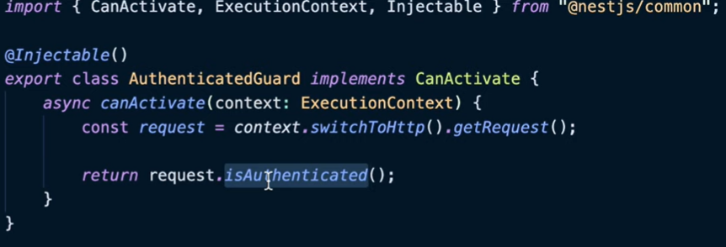
SessionAuthenticatedGuard

Slide 9
Demo
Create a simple guard for our purpose, return request.isAuthenticated()
It will check if user authenticated.
Has cookie with sessionId
Is there any record in our session store
If it expired or not
If everything is ok, then you are welcome to use the route
Test our session
See the cookies
The cookies are sent after they are saved (browser handle it automatically)

Slide 10
Session Summary
You have to implement these stuff:
Use session inside main.ts
Create a SessionSerializer
Create a simple login auth guard to call login() method
Create a guard to call request.isAuthenticated()

Slide 11
Demo
Tokens:
On login route, return the JWT access token
On protected route, require a Bearer Auth token
npm install @nestjs/jwt passport-jwt
npm i --save-dev @nestjs/jwt @types/passport-jwt
In AuthService, use JwtService to create JWT token (signing)
Login method for signing JWT token
Import JwtModule (by register function, secret, expiresIn ?)
Secret is so important, don’t expose it to anybody
Check your JWT token in https://jwt.io

Slide 12
Demo
Create your new strategy
Extends PassportStrategy(Strategy)
Two step:
Configuration through constructor (super method)
secretOrKey
ignoreExpiration
How to get that access token? jwtFromRequest: ExtractJwt.fromAuthHeaderAsBearerToken();
Validation
We have the payload (decrypted) here
Return our user object, what you return in this function stored in req.user
Don’t forget to provide your new JwtStrategy

Slide 13
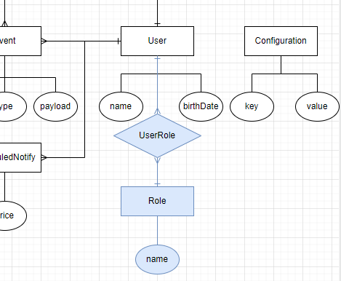
RBAC
Every user has roles, and by their roles, they can do some stuff.
Entity
User
Roles

Slide 14
Demo
Create an enum for our roles
Admin
Users
…

Slide 15
Demo
Add metadata to routes
SetMetadata(key, value)
Check user against this metadata through guards
RolesGuard extends CanActivate
Extract metadata with reflect module
Does this user is authorized for this role?
We can extract user from request.
Finally: roles.some(ourExctractedUser.roles.include(the-route-role))
Don’t forget to let it pass if the metadata for roles is empty ☺

Slide 16
Exercise
Required:
Exercise all we speak
Create your own session and token based authentication
Do some authorization ☺
Optional:
We have Refresh token to improve the token based strategies, What are they?
Implement your own refresh token based authentication with passport in nest.js
Notes:
Hint: loggerService better to be transient
☺ For you (The seeker is the finder):
https://www.brunnerliv.io/articles/advanced-nestjs-dymaic-providers

