Slide 1


Nest.JS
Winter - 2022
Mostafavi
03 – TypeORM

Slide 2
Course Structure
TypeORM in NestJS
Introducing the TypeORM Module
Creating a TypeORM Entity
Use Repository to Access Database
Create a Relation between two Entities
Retrieve Entities with their Relations
Using Cascading Inserts and Updates
Adding Pagination
Setting up migrations

Slide 3
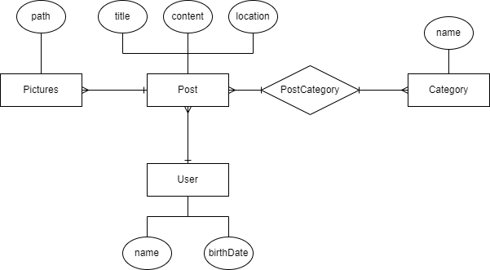
ER
Notes:
nodejs-basics\divar-er.drawio

Slide 4
Demo
Add TypeORM Module
npm install @nestjs/typeorm typeorm mssql
Nest.js added a TypeORM Module that made adding TypeORM is so easy
TypeOrmModule.forRoot({typeorm configs})

Slide 5
Demo
Entities
@Entity
@PrimaryGeneratedColumn
@Column
How to register entity
forFeature

Slide 6
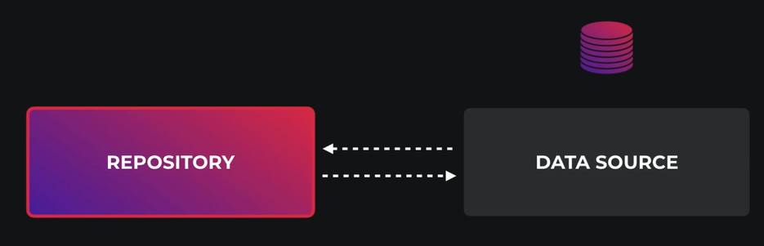
Demo
Repositories
@InjectRepository(entityName)
Remember we use data mapper pattern here
Earlier we use active record
Update old codes with typeorm
find
findOne
Create, Save
Preload
Remove
Notes:
https://orkhan.gitbook.io/typeorm/docs/active-record-data-mapper

Slide 7
Demo
Create relations
OneToOne
OneToMany, ManyToOne
JoinColumn
ManyToMany
JoinTable

Slide 8
Demo
Create and get entity with their relations
Relation are not eagerly loaded by default
You have to tell the TypeOrm to populate them
relations field inside find method do this for us
How to create relations after inserting the entity (cascading inserts?)
Create entities with their relations
And then save it, just like that ☺

Slide 9
Demo
Pagination in TypeOrm
First of all, create a dto for pagination
Type conversions
In a specific class
Globally enabling: transformOptions: { enableImplicitConversion: true }

Slide 10
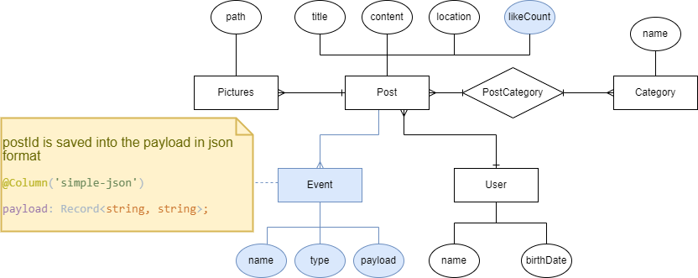
A new requirement arrived ☺

Slide 11
Demo
Transactions
An independent unit of work
Are a reliable way to accomplish multiple tasks independent of other transactions
Query class and Use connection class
this.queryRunner = this.connection.createQueryRunner();
await queryRunner.connect();
await queryRunner.startTransaction();
try {queryRunner.manager.save(); await queryRunner.commitTransaction();}
catch() {await queryRunner.rollbackTransaction();}
finally {await queryRunner.release();}

Slide 12
Excercise
Required:
Exercise all the stuff we discuss in this session yourself
Optional:
How to avoid a use from liking a post twice.
Complete other relations and entities

