Slide 1


Nest.JS
Winter - 2022
Mostafavi
04 – DI

Slide 2
Course Structure
TypeORM in NestJS
Setting up migrations
Dependency Injection
Understand Dependency Injection
Control NestJS Module Encapsulation
Diving Into Custom Providers
Value based providers
Non-class-based Provider Tokens
Class Providers
Factory Providers
Leverage Async Providers
Create a Dynamic Module
Control Providers Scope
Diving Deeper Into Request-Scoped providers

Slide 3
Demo
Migration
Create ormconfig.js for TypeORM cli config
Create migration manually:
npx typeorm migration:create <your-change-script-name>
Run migration:
npx typeorm migration:run
Revet migration:
npx typeorm migration:revert
Create migration automatically:
npx typeorm migration:generate <your-migration-script-name>
It will compare your entities with the desired db, and create up and down query respectively

Slide 4
Demo
What does exports do in module?
It will give you full control on your module about what is public and what is not?
Nest.js encapsulate its providers in a module and they cannot be used by other modules,
If you want to use a provider inside another module you have to explicitly declare it inside the exports array
Let’s Create another module and use its service inside other modules

Slide 5
Demo
Custom providers
Use other types (constants, symbols) as token in providers
Ways to provide token:
useClass
useValue
useExisting
useFactory
CREATE PROVIDERS DYNAMICALLY
Can be extremely useful if you need to base the provider’s value on various other dependencies’ values, …
Factory function can able to inject other providers

Slide 6
Demo
Async providers
Suppose your dependency has to be created through some sort API (like database)
Your bootstrapping process will not going further until this dependency is met.
Employ useFactory with async callback

Slide 7
Demo
Dynamic module
Static modules can’t have their providers be configured by a module that consuming it.
Why does that matter?
For general purpose modules ☺, that needs to behave differently in different circumstances
Use static method with some names like: register, forRoot, …
Return a DynamicModule object inside that function
Module: just like your module name
Providers: needed providers that you add them inside your static function

Slide 8
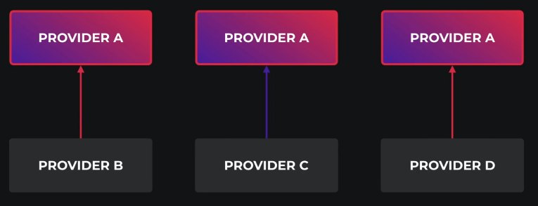
Demo
Other scopes than singleton:
All singleton providers instaniated when the program bootstrapped
Transient
Every time it will instantiated
There is two place to tell nest our provider scope:
@Injectable
Inside providers array in module

Slide 9
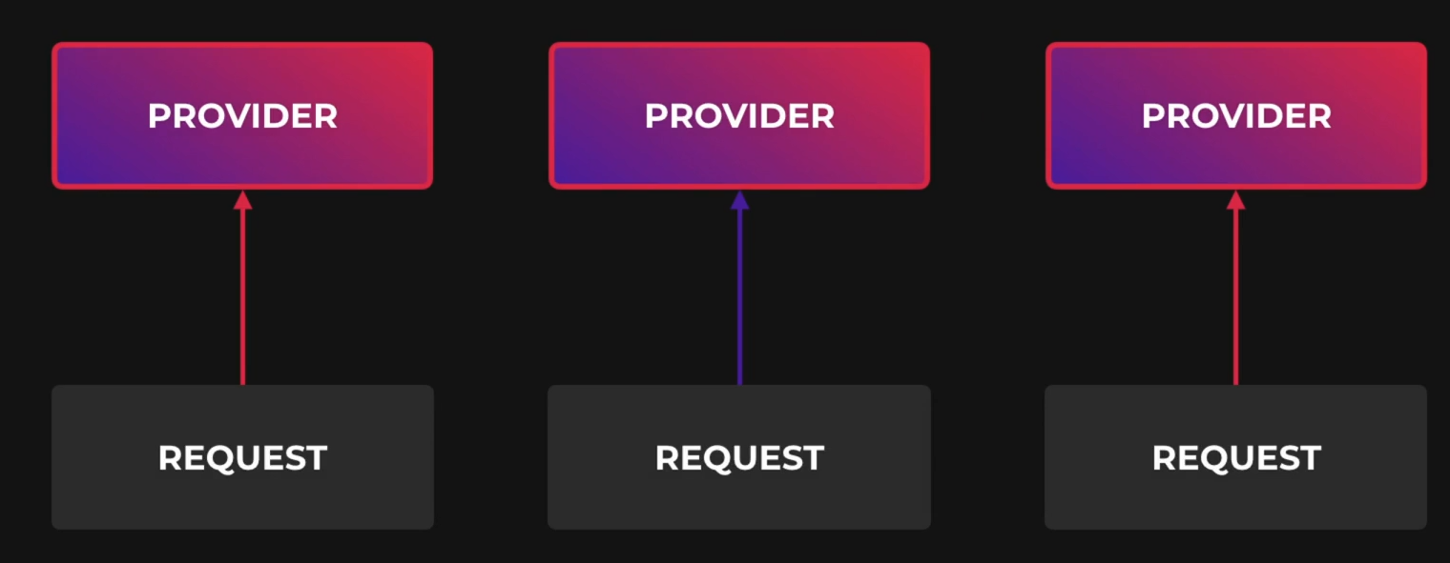
Demo
Request scoped providers
They are instantiated whenever a new request is received
And They are automatically garbage collected after the request finished
Don’t forget the bubbling ☺
Your services which uses a request scoped service will become a request scoped service implicitly
Request scoped providers can inject the request object
It is useful if you want access request fields like headers, …
@Inject(REQUEST)
Request scoped providers may impact your program performance
It will slightly decrease your avg response time
Unless a provider must be request scope, it is always recommended to use the default (singleton) scope

Slide 10
Excercise
Required:
Exercise all we speak
Optional:
Create a helper module for logging, It has an option for the first letter of each log, and then has a service that simple generate logs like these:
<firs-letter> <passed-argument>
> some logging

