Slide 1


Nest.JS
Winter - 2022
Mostafavi
04 – DI

Slide 2
Course Structure
TypeORM in NestJS
Setting up migrations
Dependency Injection
Understand Dependency Injection
Control NestJS Module Encapsulation
Diving Into Custom Providers
Value based providers
Non-class-based Provider Tokens
Class Providers
Factory Providers
Leverage Async Providers
Create a Dynamic Module
Control Providers Scope
Diving Deeper Into Request-Scoped providers

Slide 3
Demo
Migration
Create ormconfig.json for TypeORM cli config
Create migration manually:
npx typeorm migration:create <your-change-script-name>
Run migration:
npx typeorm migration:run
Revet migration:
npx typeorm migration:revert
Create migration automatically:
npx typeorm migration:generate <your-migration-script-name>
It will compare your entities with the desired db, and create up and down query respectively
Specially useful for the first generation script against an empty db.
Notes:
ormconfig.json
{
"type": "mssql",
"host": "localhost",
"port": 1433,
"username": "user",
"password": "",
"database": "typeorm",
"extra": {
"trustServerCertificate": true
},
"entities": [
"dist/**/*.entity.js"
],
"migrations": [
"dist/migration/*.js"
],
"cli": {
"migrationsDir": "src/migration"
}
}

Slide 4
Development lifecycle (as a sample not recommended)
Develop with syncing: true
Sync production database:
migration:run
New release:
migration:generate
Against production db
Important notice:
Always check generated sql scripts, sometimes they are wrong

Slide 5
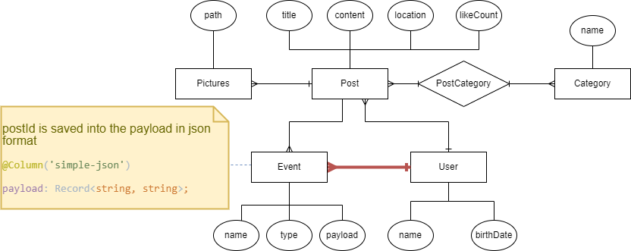
New requirement

Slide 6
Demo
What does exports do in module?
It will give you full control on your module about what is public and what is not?
Nest.js encapsulate its providers in a module and they cannot be used by other modules,
If you want to use a provider inside another module you have to explicitly declare it inside the exports array
Let’s Create another module and use its service inside other modules
Suppose we want to check if the user liked a post, don’t like it twice ☺

Slide 7
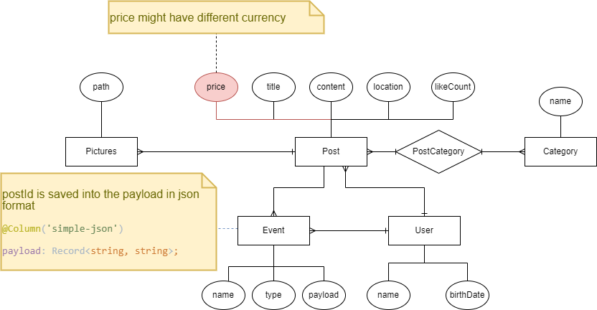
New requirement
Each post has prices, and we use different currencies (Euro, Dollar, …), return prices by their currency appropriately

Slide 8
Demo
Custom providers
Use other types (strings, symbols, enums) as token in providers
Ways to provide token:
useClass
useValue
useFactory
CREATE PROVIDERS DYNAMICALLY
Can be extremely useful if you need to base the provider’s value on various other dependencies’ values, …
Factory function can able to inject other providers
Notes:
$
€ £
﷼

Slide 9
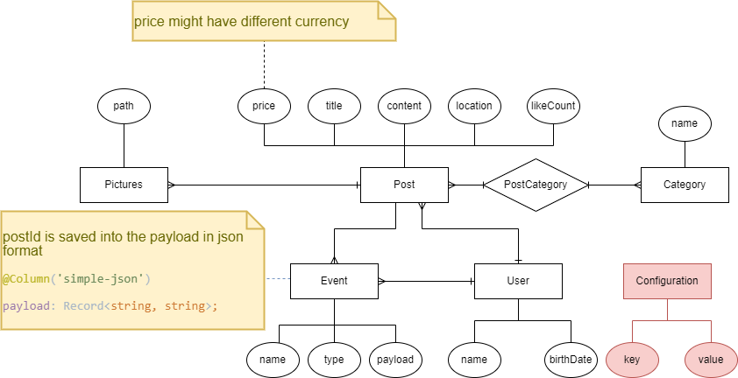
New requirement
Get currency from config (inside db)

Slide 10
Demo
Async providers
Suppose your dependency has to be created through some sort API (like database)
Your bootstrapping process will not going further until this dependency is met.
Employ useFactory with async callback

Slide 11
Demo
Dynamic module
Static modules can’t have their providers be configured by a module that consuming it.
Why does that matter?
For general purpose modules ☺, that needs to behave differently in different circumstances
Use static method with some names like: register, forRoot, …
Return a DynamicModule object inside that function
Module: just like your module name
Providers: needed providers that you add them inside your static function

Slide 12
New requirement
Dev requirement: we need a logger service

Slide 13
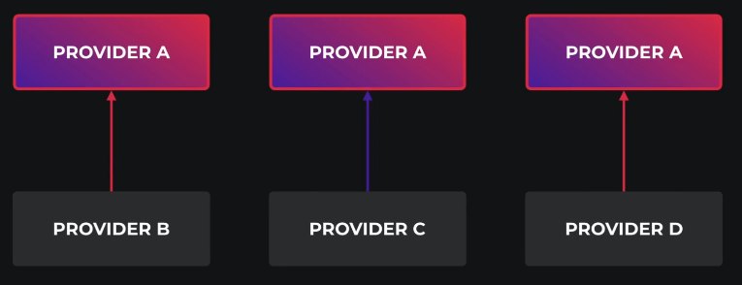
Demo
Other scopes than singleton:
All singleton providers instantiated when the program bootstrapped
Transient
Every time it will instantiated
There is two place to tell nest our provider scope:
@Injectable
Inside providers array in module
What is the benefit of transient?
Each class has its own state
Suppose logger class with different prefixes.

Slide 14

New requirement
We need a new route to show a banner to user, but it must translated Based on the request header (accept-language).

Slide 15
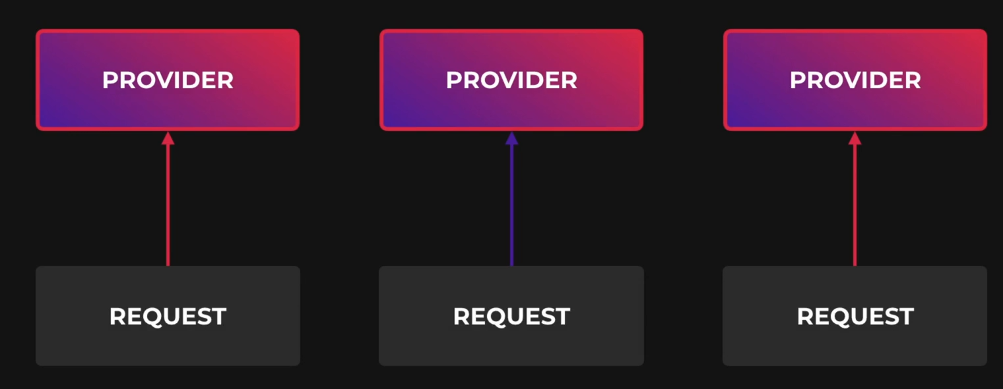
Demo
Request scoped providers
They are instantiated whenever a new request is received
And They are automatically garbage collected after the request finished
Don’t forget the bubbling ☺
Your services which uses a request scoped service will become a request scoped service implicitly
Request scoped providers can inject the request object
It is useful if you want access request fields like headers, …
@Inject(REQUEST)
Request scoped providers may impact your program performance
It will slightly decrease your avg response time
Unless a provider must be request scope, it is always recommended to use the default (singleton) scope

Slide 16
Exercise
Required:
Exercise all we speak
Optional:
Create a helper module for logging, It has an option for the first letter of each log, and then has a service that simply generate logs like these:
<firs-letter> <passed-argument>
> some logging
We can inject this logger service in our services and do logging stuffs.
Notes:
Hint: loggerService better to be transient
☺ For you (The seeker is the finder):
https://www.brunnerliv.io/articles/advanced-nestjs-dymaic-providers

