Slide 1


Nest.JS
Winter - 2022
Mostafavi
06 – Other building blocks

Slide 2
Course Structure
Add Pointcuts with Interceptors
Handling Timeouts with Interceptors
Creating Custom Pipes
Add Request Logging with Middlewares

Slide 3
New requirement
Wrap all responses inside an object with a filed called data.
Also add a timeout for all requests (make it configurable for me)

Slide 4
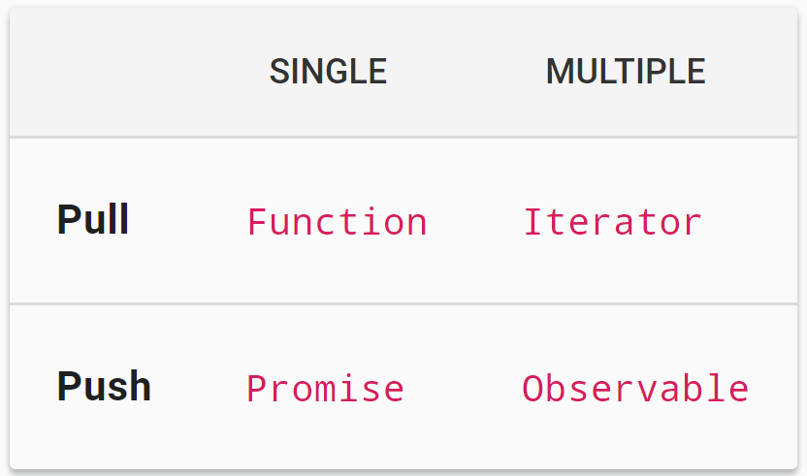
Talk a little about rxjs
What is observable?

Slide 5
Demo
Create a simple observable
const observable = new Observable(subscriber => {
subscriber.next(<some-value>);
subscriber.complete(<some-value>);
});
Subscribe to an observable:
observable.subscribe({
next(x) { console.log('got value ' + x); },
error(err) { console.error('something wrong occurred: ' + err); },
complete() { console.log('done'); }
});

Slide 6
Demo
Operators:
Creation
From
throwError
pipe
Transformation
map
Utility
tap
timeout
Error handling
catchError
retry
And may more, take a look here: https://rxjs.dev/guide/operators

Slide 7
Demo
Benefits of interceptors:
Bind extra logics before or after method execution
Transform the result returned from a method
Transform the exceptions throwed from a method
Extend basic method behavior
Completely override a method depending on specific condition (caching)
How to create interceptor
nest g interceptor <path-to-your-class>
You should implement intercept method

Slide 8
Demo
We say that we can access before and after request, where are them?
Before: previous to return
After: You can pipe to the observable returned from the nest.handle() function
How to add multiple interceptor
Arrays are your friend man ☺

Slide 9
New requirement
User can create schedule notify for a specific price in a category and we will inform him/her whenever a better price is ready
We have to ensure that user don’t pass incorrect price, so Remove all commas from prices and then pass it to the service

Slide 10
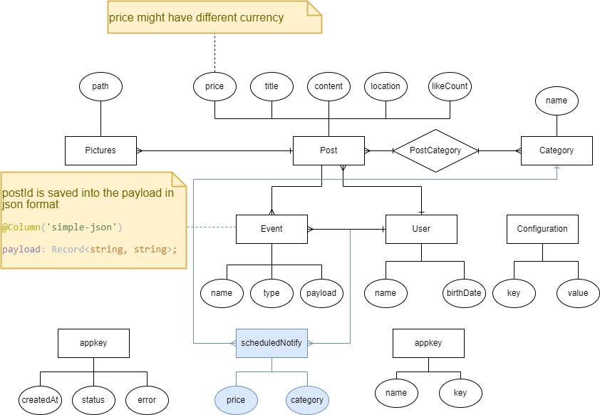
ER

Slide 11
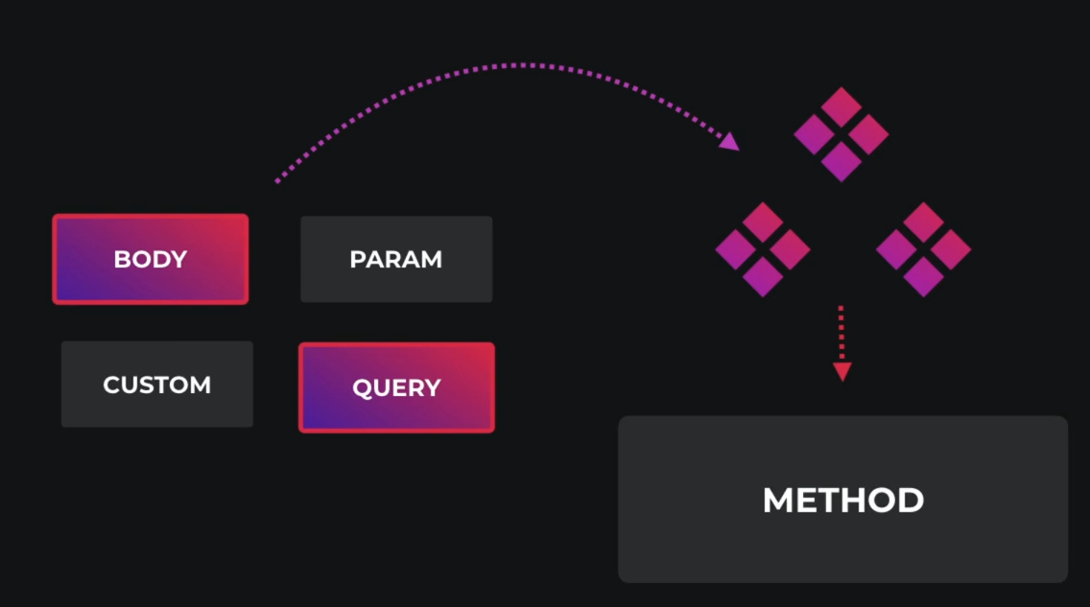
Demo
Benefit of pipes:
They have two typical use cases:
Transformation: transform input data to the desired output,
Validation: evaluate input data, if valid pass it, otherwise throw an exception

Slide 12
Demo
How to create a pipe:
nest g pipe <path-to-your-class>
You should implement transform method
Input1: value
Input2: metadata, is the metadata of the currently processed argument
What you return is override the value ☺ as simple as you see

Slide 13
New requirement
Dev:
Log every request duration, we want this to measure our performance ☺

Slide 14
Demo
Middleware:
They have access to req and res objects
Benefits:
Making changes to req, res
Ending req, res cycle
You have to call next method
How to create them:
nest g middleware <path-to-your-class>
Function Middlewares are stateless, buy class Middlewares is able to have state

Slide 15
Demo
How to use them?
Middlewares are not bind to any methods, but instead to routes so
You can’t inject them, you have to change your module structure as follows
Implements NestModule interface
Require you to define configure() function with a consumer
consumer.apply(your-middleware).forRoutes(‘*’)
You can exclude() some routes
Add our callback to finish event on res

Slide 16
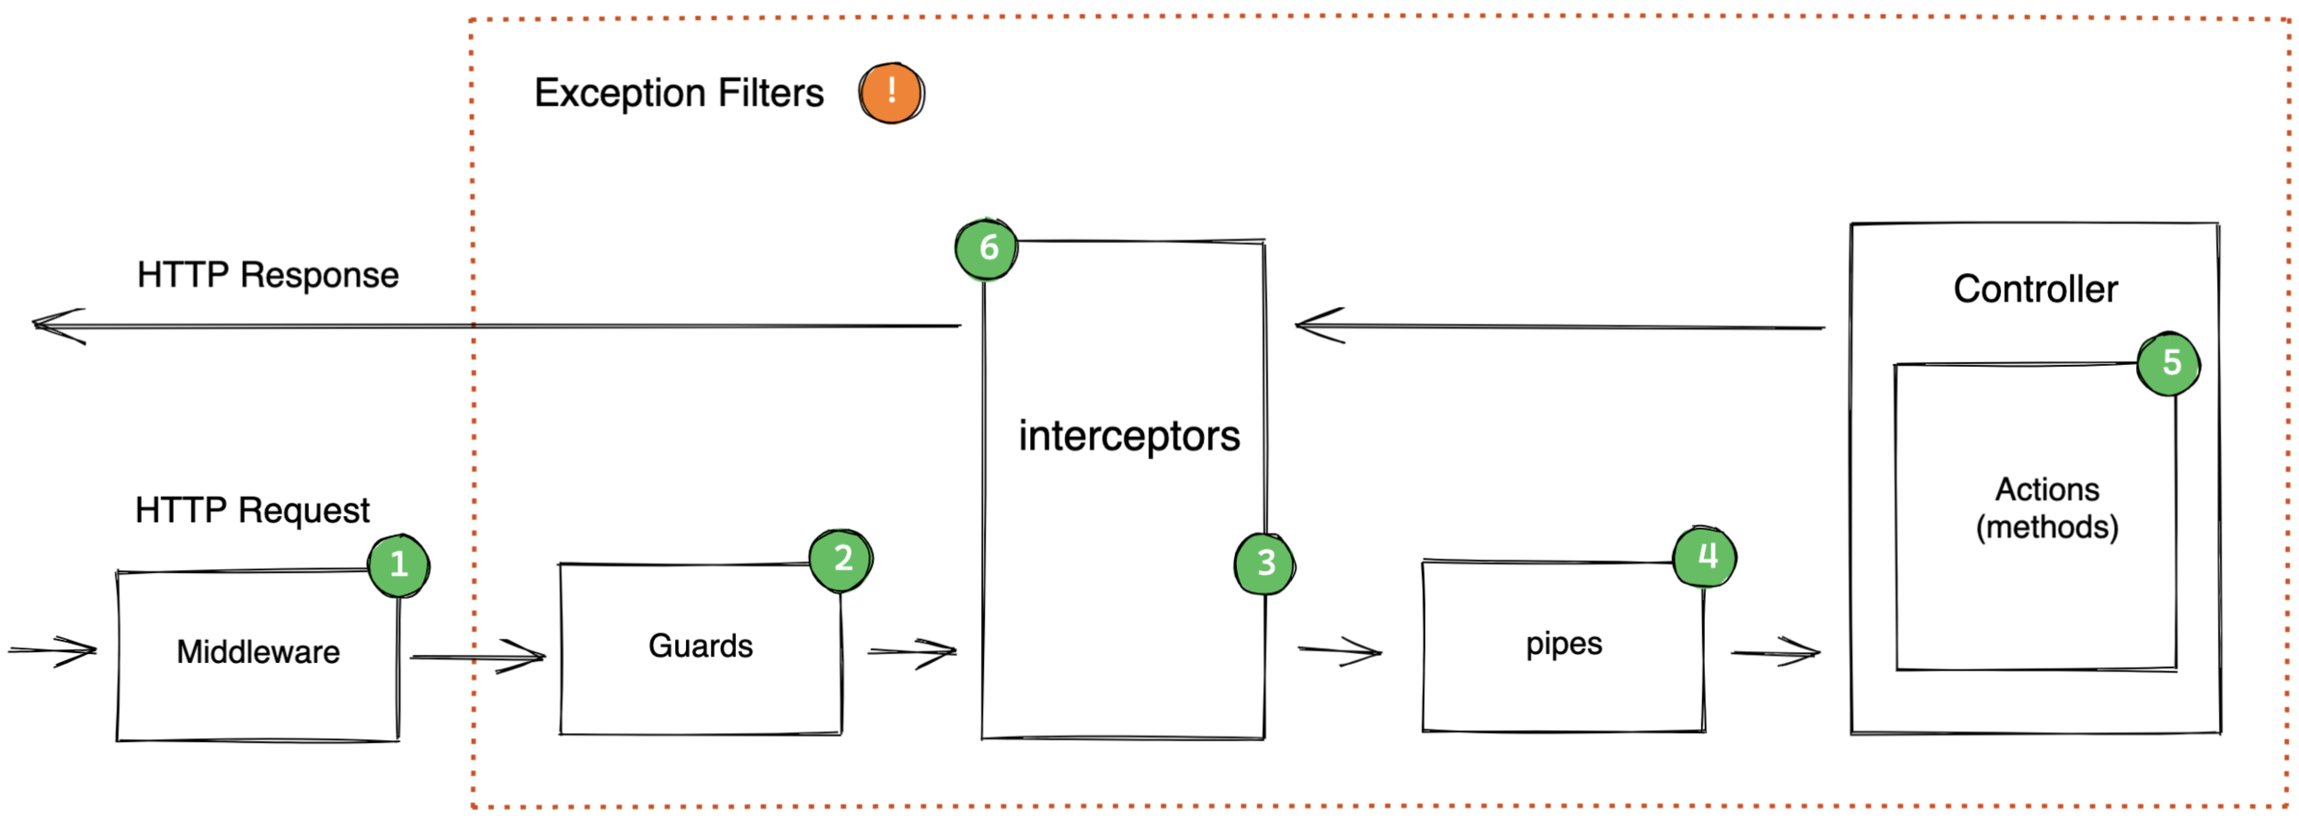
Request Lifecycle in Nest.js
Notes:
Link for more info: https://hotovo.com/2021/06/30/inside-nestjs-project

Slide 17
Exercise
Required:
Exercise all we speak
Optional:
Notify user whenever a lower price available
You can add your setInterval inside main.ts
Suppose that user inquire you every 5 second.
Notes:
Hint: loggerService better to be transient
☺ For you (The seeker is the finder):
https://www.brunnerliv.io/articles/advanced-nestjs-dymaic-providers

