Slide 1


Object Relational Mapping
Autumn – 2021
Mostafavi
02 – Relationships

Slide 2
Course Structure
ORM (Intro)
Setup
Connecting to the DB
Entities
Relationships
Inserting Data
Forming Relationships
Deleting Data
Fetching Data

Slide 3
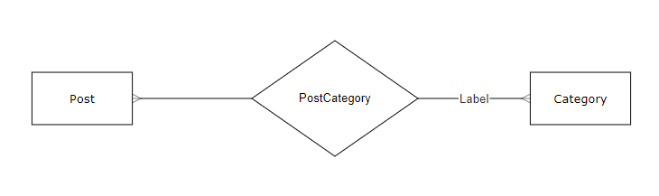

Divar ER diagram

Slide 4
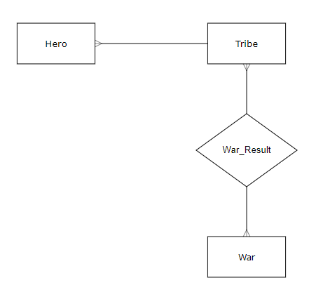
RPG ER Diagram

Slide 5
Relationship
Type of relationship:
One to Many
Many to Many
One to One
What is foreign key?

Slide 6
Demo
Relationship
ManyToOne
JoinColumn
OneToMany
ManyToMany
JoinTable

Slide 7
Demo
Configure express
Take a look at previous course about express
BaseEntity has some function for CRUD operation
Create
create(): creates the object
You have to call save() on that object to save it to the db.

Slide 8
Demo
Forming relationship
Pass the related object not the id
OneToMany
ManyToMany

Slide 9
Excercise
Required
Save your project data inside the MSSQL
Optional
Add new feature to your projects
RPG:
Create a new table to save user profile and their related tribes and heroes
Divar:
Create a new table to save user profile and their desired categories
Create your project ER Diagram

