Slide 1


Object Oriented Programming
Autumn – 2021
Mostafavi
01 – What is oop?

Slide 2
Course Structure
What is oop?
Understanding objects
Encapsulation and private variables
Inheritance
Polymorphism Intro, Polymorphism and abstraction
Multiple inheritance and interfaces
Composition vs inheritance
Constructor, Static, Parameter, and Read-only properties.
Handling and Logging Errors

Slide 3
What is OOP?
Suppose we have a problem about a game:
Each character has some ability.
Move
There is two approach to solve the problem
Through functions
Through classes

Slide 4


Our main characters
They all move and has some sound
All of their sound are stored in a .mp3 file

Slide 5

Our main characters
They all move and some sound
Bird sound are stored in .wav file

Slide 6
A change in specs are came in
They all move in a specific way
Crawl
Fly
Walk

Slide 7

There are a lot of duplication

Slide 8
Demo
Functional programming
const addEmoji = (val) => toString(val) + ‘☺’;
const appendEmoji = (fixed) => (dynamic) => fixed + dynamic;
const happy = appendEmoji(‘☺’);
console.log(happy(`I’m`)); // I’m ☺
Notes:
https://www.youtube.com/watch?v=fsVL_xrYO0w

Slide 9
Demo
Convert functional programming to classes
Create a class to generate texts by passing emojis.
We can change emoji by changing its state.

Slide 10
Understanding objects
What is heap?
Objects are instances of their specific classes
How about primitive types?
What happens when we instantiates a class
new keyword
What is the difference between pass by value vs pass by reference
Notes:
https://felixgerschau.com/javascript-memory-management/

Slide 11
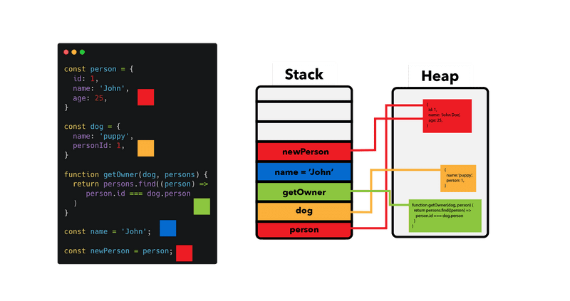

Slide 12
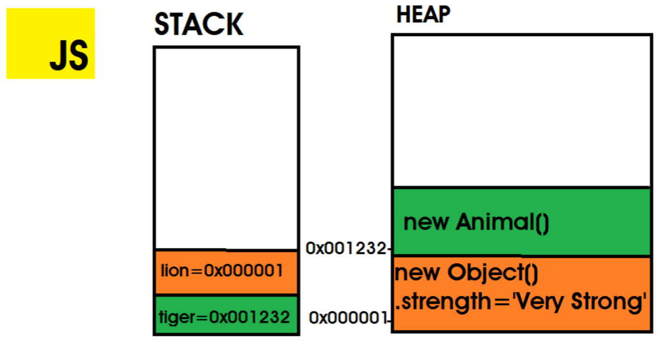

Slide 13
Demo
What is cohesion theory?
Don’t expose internal things to the outside
Sometimes negative variables are not legal
Javascript default scope is public
Use private wherever is needed.
What is setters and getters?
They help us to implement encapsulation
get, set in typescripts

