Slide 1


Nest.JS
Winter - 2022
Mostafavi
08 – Middlewares & swagger

Slide 2
Course Structure
Add Request Logging with Middlewares
Create Custom Param Decorators
Generating OpenAPI Specifications
Introducing the Swagger Module
Enabling CLI Plugin
Decorating Model Properties
Adding Example Responses
Using Tags to Group Resources

Slide 3
New requirement
Dev:
Log every request duration, we want this to measure our performance ☺

Slide 4
Demo
Middleware:
They have access to req and res objects
Benefits:
Making changes to req, res
Ending req, res cycle
You have to call next method
How to create them:
nest g middleware <path-to-your-class>
Function Middlewares are stateless, buy class Middlewares is able to have state

Slide 5
Demo
How to use them?
Middlewares are not bind to any methods, but instead to routes so
You can’t inject them, you have to change your module structure as follows
Implements NestModule interface
Require you to define configure() function with a consumer
consumer.apply(your-middleware).forRoutes(‘*’)
You can exclude() some routes
Res object has some useful events
Add our callback to finish event on res

Slide 6
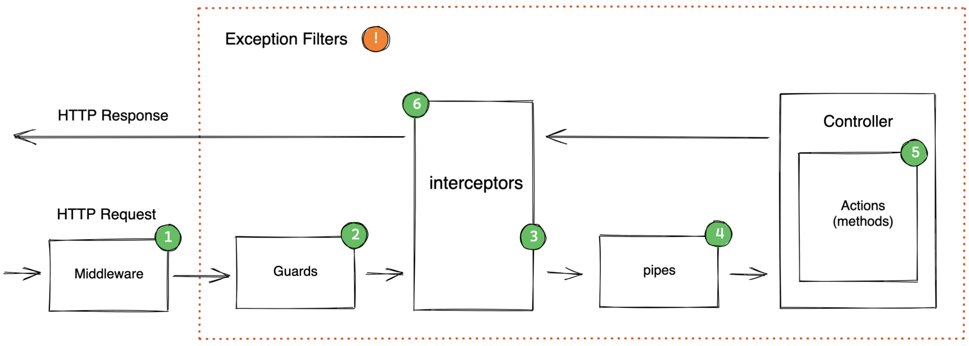
Request Lifecycle in Nest.js
Notes:
Link for more info: https://hotovo.com/2021/06/30/inside-nestjs-project

Slide 7
Exercise
Required:
Exercise all we speak
Optional:
Notes:
Hint: loggerService better to be transient
☺ For you (The seeker is the finder):
https://www.brunnerliv.io/articles/advanced-nestjs-dymaic-providers

