Slide 1


Object Oriented Programming
Autumn – 2021
Mostafavi
01 – What is oop?

Slide 2
Course Structure
What is oop?
Understanding objects
Encapsulation and private variables
Inheritance
Polymorphism Intro
Polymorphism and abstraction
Multiple inheritance and interfaces
Composition vs inheritance
Constructor, Static, Parameter, and Read-only properties.

Slide 3
What is OOP?
Suppose we have a problem about a game:
Each character has some ability.
Move
There is two approach to solve the problem
Through functions
Through classes

Slide 4
Demo
Functional programming
const addEmoji = (val) => toString(val) + ‘☺’;
const appendEmoji = (fixed) => (dynamic) => fixed + dynamic;
const happy = appendEmoji(‘☺’);
console.log(happy(`I’m`)); // I’m ☺
Notes:
https://www.youtube.com/watch?v=fsVL_xrYO0w

Slide 5
Understanding objects
What is heap?
Objects are instances of their specific classes
How about primitive types?
What happens when we instantiates a class
Notes:
https://felixgerschau.com/javascript-memory-management/

Slide 6
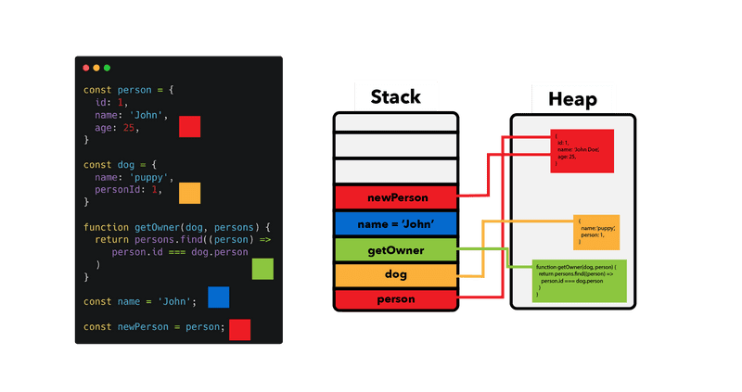

Slide 7
