Slide 1


Nest.JS
Winter - 2022
Mostafavi
09 – Authentication

Slide 2
Course Structure
Authentication
How to save our use credentials in db?
Introduce passport
Session vs Token?
Local strategy
Auth Guard
Sessions
JWT Token
JWT Strategy

Slide 3
User Entity
Username
Password
Passwords are stored in database in a way that no one can find them
There it comes hash functions
Md5
Sha256
Bcrypt

Slide 4
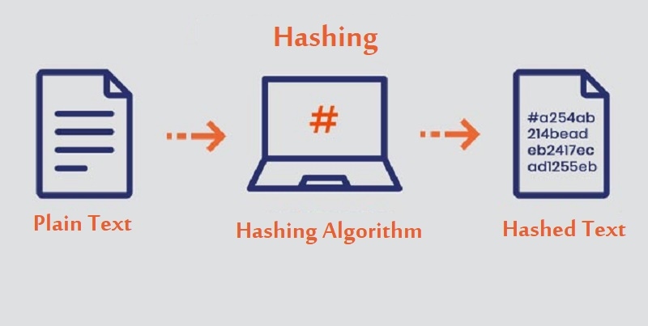
What is a hash function?

Slide 5
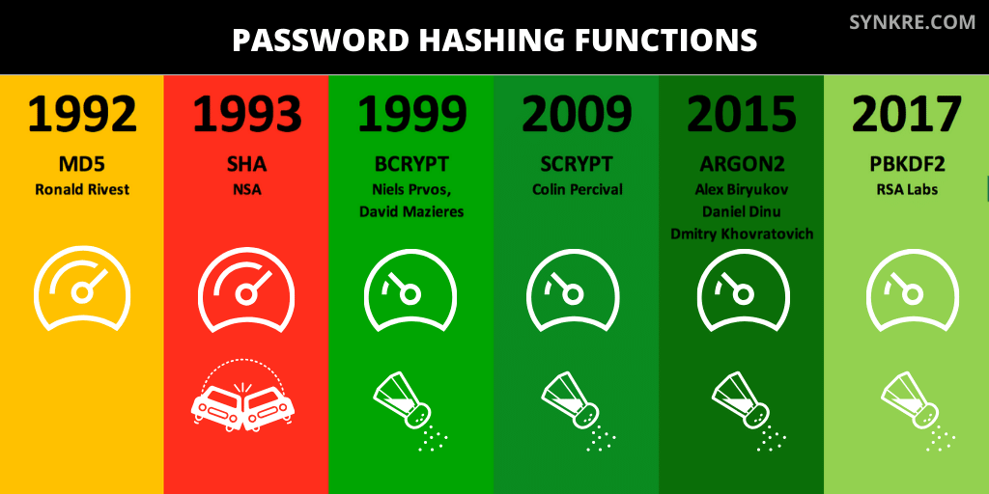
Algorithms

Slide 6
bcrypt
npm install bcrypt
import { hashSync, compare } from 'bcrypt';
export function hashPassword(password: string) {
const hashSaltRounds = 10;
return hashSync(password, hashSaltRounds);
}
export function comparePassword(password: string, hashPassword: string) {
return compare(password, hashPassword)
}
Notes:
https://virgool.io/Software/bcrypt-sjj46uhqjx88

Slide 7
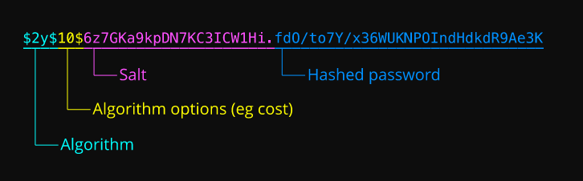
bcrypt
Notes:
https://en.wikipedia.org/wiki/Bcrypt

Slide 8
What is passport?
https://Passportjs.org
Passport gives you the basic layer, and you can implement your own strategy
Nest.js creates its own authentication strategy that wraps this packages

Slide 9
Demo
Install it:
npm install @nestjs/passport passport
Strategies:
Very simple strategy
npm install passport-local
npm install --save-dev @types/passport-local

Slide 10
Demo
Create an auth module for our authentication purposes
Auth service:
It will inject User Service
validateUser()
If user exists and password correct?
Find use by username
Check if the given password matches the real one in db (don’t forget to hash it)
If user validated return it
DON’T FORGET to remove password field!
@exclude() is your friend in these situations

Slide 11
Demo
Next step, create our first strategy, local strategy
Extends PassportStrategy(Strategy)
The one that exists in passport-local package (you installed it before)
Each strategy has two main thing:
Configuration (through super method in constructor)
Validate (if user validated or not, using our authService which has been injected)
This method should return user
Remember to throw UnauthorizedException if user does not exist
This validate method will map to the Verify callback in passport
Remember: this function input data may vary from strategy to another strategy, for local strategy, inputs are: username and password
NOTE: It is important to PassportModule and provide LocalStrategy

Slide 12
Demo
How to use this newly created guard?
@UseGuard(AuthGuard(‘local’))
Like old times ☺ passport.authenticate(‘local’)
Once the use validated, then the request object has a new object called: user
return req.user;
Don’t forget to pass the { username, password } body

Slide 13
Demo
How about other protected route?
We can’t pass the username, password of the user in each request, IT ISN’T SECURE!!!!!!!!
There it comes some ways to store user logins
Session, stores user session inside server
Introduce states, we have to store that in server side (db, redis, …)
Cloud services don’t have any states ☹
Tokens, JWT tokens are stored in client side
They are validating server side
There isn’t any state, and cloud are welcome us ☺

Slide 14
Demo
Sessions
With session, we just store the key of storage client side (in cookies), but the real user information are stored back server side (redis, db, in-memory, …)
npm install express-session
Create a simple guard for our purpose, return request.isAuthenticated()
main.ts
app.use(session({
secret, resave, saveUninitialized, cookie :{}
}));
app.use(passport.initialize());
app.use(passport.session());

Slide 15
Demo
Sessions
Create a session serializer
Extends PassportSerializer
serializeUser()
deserializeUser()
Implementation of this two method is up to you
Provide the serializer
PassportModule.register({ session: true })
In LocalAuthGuard add some custom canActivate function that
Super.canActivate, super.login()

Slide 16
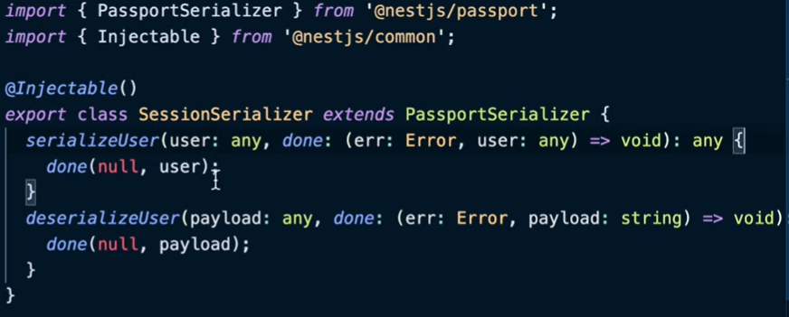
serializer

Slide 17
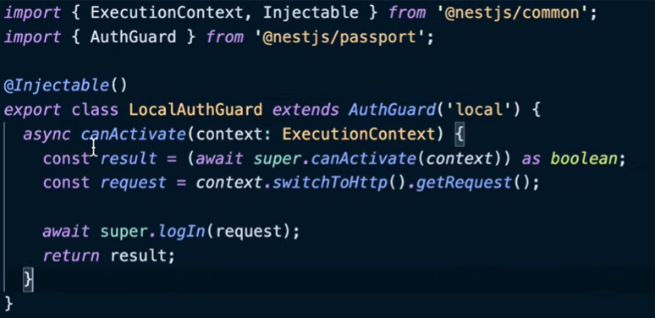
Change in LocalAuthGuard

Slide 18
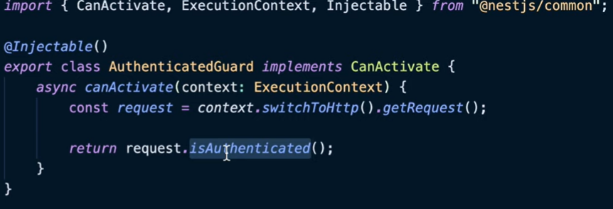
SessionAuthenticatedGuard

Slide 19
Demo
Create a simple guard for our purpose, return request.isAuthenticated()
It will check if user authenticated.
Has cookie with sessionId
Is there any record in our session store
If it expired or not
If everything is ok, then you are welcome to use the route
Test our session
See the cookies
The cookies are sent after they are saved (browser handle it automatically)

Slide 20
Demo
Tokens:
On login route, return the JWT access token
On protected route, require a Bearer Auth token
npm install @nestjs/jwt passport-jwt
In AuthService, use JwtService to create JWT token (signing)
Login method for signing JWT token
Import JwtModule (by register function, secret, expiresIn ?)
Secret is so important, don’t expose it to anybody
Check your JWT token in https://jwt.io

Slide 21
Demo
Create your new strategy
Extends PassportStrategy(‘jwt’)
Two step:
Configuration through constructor (super method)
secretOrKey
ignoreExpiration
How to get that access token? jwtFromRequest: ExtractJwt.fromAuthHeaderAsBearerToken();
Validation
We have the payload (decrypted) here
Return our user object, what you return in this function stored in req.user
Don’t forget to provide you new JwtStrategy

Slide 22
Exercise
Required:
Exercise all we speak
Create your own session and token based authentication
Optional:
We have Refresh token to improve the token based strategies, What are they?
Implement your own refresh token based authentication with passport in nest.js
Notes:
Hint: loggerService better to be transient
☺ For you (The seeker is the finder):
https://www.brunnerliv.io/articles/advanced-nestjs-dymaic-providers

