Slide 1


Nest.JS
Winter - 2022
Mostafavi
01 – Intro

Slide 2
Course Structure
Create a REST API Application (continue)
Creating a basic service
Send User-friendly Error Messages
Encompass business-Domain in Modules
Introduction to Data Transfer Objects (DTOs)
Validate Input Data with DTO
Handling Malicious Request Data
Auto-transform Payloads to DTO instances
TypeORM in NestJS
Introducing the TypeORM Module
Creating a TypeORM Entity
Use Repository to Access Database
Create a Relation between two Entities

Slide 3
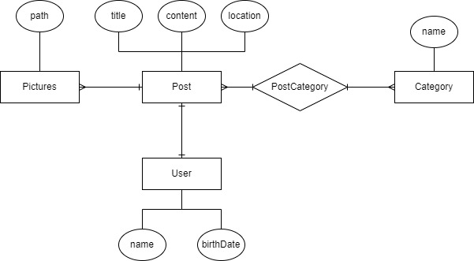
ER
Notes:
nodejs-basics\divar-er.drawio

Slide 4
Demo
Services
Separate our business logic from controllers
So our services are reusable inside other controllers
nest generate service
--no-spec
--dry-run
Providers?????
Inject dependencies
Nest runtime system will control the di
@Injectable
Where to inject them? Through constructor
It’s better to define the class in constructor as readonly

Slide 5
Demo
Resolving the service is through it’s class name
Services are handle the business logic through database
Use an array as our db
Entities folder for the shape of our resource (like the typeorm)
Write CRUD operation inside the service
findAll
findOne
create
update
remove

Slide 6
Demo
Application errors
HttpExceptions
throw new HttpException(‘your message’, HttpStatus.NOT_FOUND);
Helper classes:
NotFoundException
How about unhandled exception (like divide by zero?)
It’s so useful

Slide 7
Demo
Group our business parts of our application inside modules
nest generate module <name>
Nest will add it inside the closest module (import)
@Module
controllers
routes
exports
Available for other modules
Imports
Other modules that this module required
Providers
Register our token for di container

Slide 8
Demo
DTOs
Define interfaces for our input and outputs
They are simply classes
nest g class <path>
--no-spec
Remember to add .dto extension

Slide 9
Demo
Validating input data with DTOs
Validation pipes
main.ts
app.useGlobalPipes(new ValidationPipe());
npm install class-validator class-transformer
@IsString
class-validator
each: true
Automatically throw bad request exception

Slide 10
Demo
Transforming
npm install @nestjs/mapped-types
extends PartialType(class)
With all validations

Slide 11
Demo
What about Malicious datas?
whitelist: true
Avoid users to pass unwanted data
forbidNonWhitelited: true
Throw error (Bad Request)

Slide 12
Demo
Payload type transforming
instanceof ?
Payloads are not the class itself
transform: true
Now try instanceof again
Every query or path params are strings
Use typeof to test

Slide 13
Demo
Add TypeORM Module
npm install @nestjs/typeorm typeorm mssql
Nest.js added a TypeORM Module that made adding TypeORM is so easy
TypeOrmModule.forRoot({typeorm configs})

Slide 14
Demo
Entities
@Entity
@PrimaryGeneratedColumn
@Column
How to register entity
forFeature

Slide 15
Demo
Repositories
@InjectRepository(entityName)
Update old codes with typeorm
Save
Preload
Remove

Slide 16
Demo
Create relations
OneToOne
OneToMany, ManyToOne
JoinColumn
ManyToMany
JoinTable

Slide 17
Excercise
Required:
Install nest.js and practice all we speak in this session
Optional:
Create a validator to check if the string length is more than 3 character or not

