Slide 1


Design Patterns
Winter – 2022
Mostafavi
01 – Intro

Slide 2
Course Structure
What is design pattern?
Singleton
Factory
Observer
Proxy
MVC, MVVM
Implement IoC through dependency injection

Slide 3
What is design pattern?
Typical solutions to common problems
Each pattern is like a blueprint that you can customize to solve a particular design problem in your code.
Categories:
Creational
Factory, Singleton, …
Structural
Proxy, …
Behavioral
Observer, …
For more detail take a look at: https://refactoring.guru/design-patterns

Slide 4
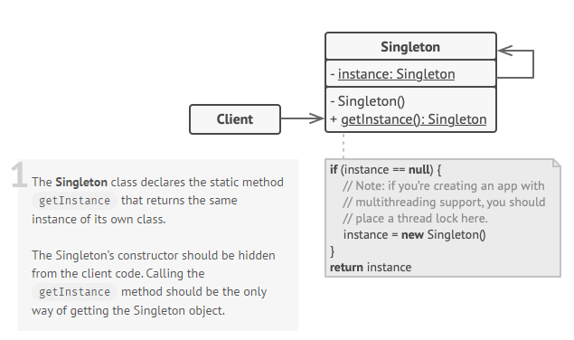
Singleton
Solves two problems:
Ensure that a class has just a single instance
Provide a global access point to that instance
Notes:
Real word example:
The government is an excellent example of the Singleton pattern. A country can have only one official government. Regardless of the personal identities of the individuals who form governments, the title, “The Government of X”, is a global point of access that identifies the group of people in charge.

Slide 5
Demo
Singleton with TypeScript
Using static fields and functions

Slide 6
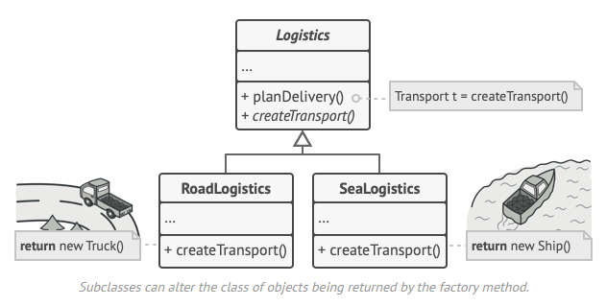
Factory
The Factory Method pattern suggests that you replace direct object construction calls (using the new operator) with calls to a special factory method.

Slide 7
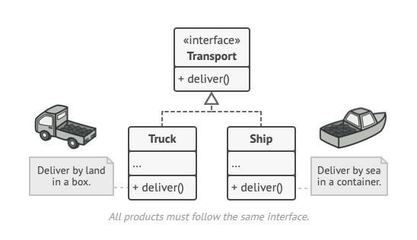
Factory

Slide 8
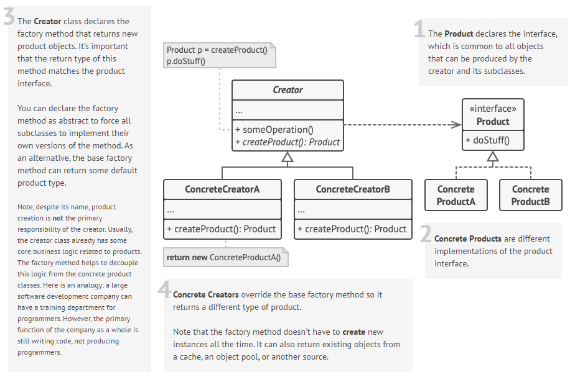

Slide 9
Demo
Factory method with TypeScript

Slide 10
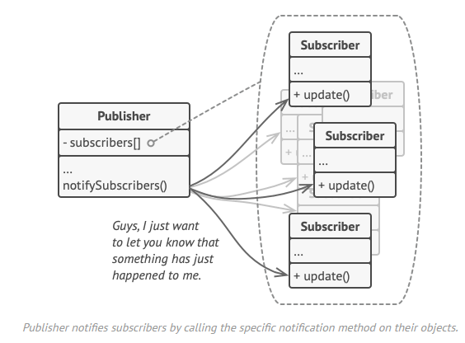
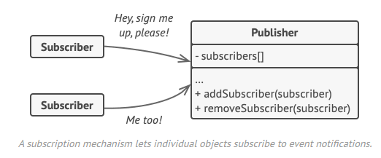
Observer
The object that has some interesting state is often called subject
but since it’s also going to notify other objects about the changes to its state, we’ll call it publisher.
All other objects that want to track changes to the publisher’s state are called subscribers.
Notes:
Real world example:
If you subscribe to a newspaper or magazine, you no longer need to go to the store to check if the next issue is available. Instead, the publisher sends new issues directly to your mailbox right after publication or even in advance.
The publisher maintains a list of subscribers and knows which magazines they’re interested in. Subscribers can leave the list at any time when they wish to stop the publisher sending new magazine issues to them.

Slide 11
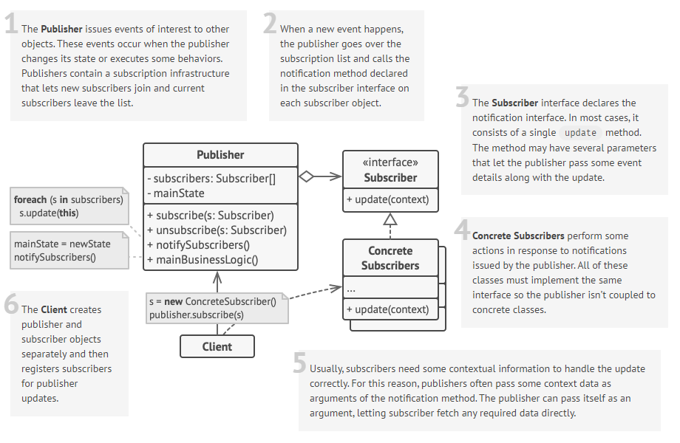

Slide 12
Demo
Observer with TypeScript

Slide 13
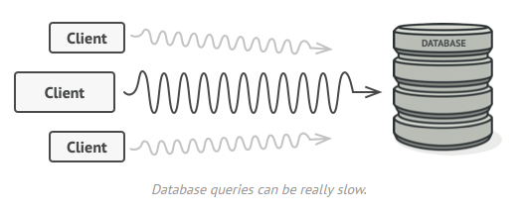
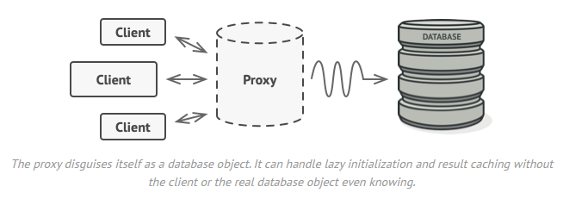
Proxy
The Proxy pattern suggests that you create a new proxy class with the same interface as an original service object.
Then you update your app so that it passes the proxy object to all of the original object’s clients. Upon receiving a request from a client, the proxy creates a real service object and delegates all the work to it.
Notes:
Real world example:
A credit card is a proxy for a bank account, which is a proxy for a bundle of cash. Both implement the same interface: they can be used for making a payment. A consumer feels great because there’s no need to carry loads of cash around. A shop owner is also happy since the income from a transaction gets added electronically to the shop’s bank account without the risk of losing the deposit or getting robbed on the way to the bank.

Slide 14
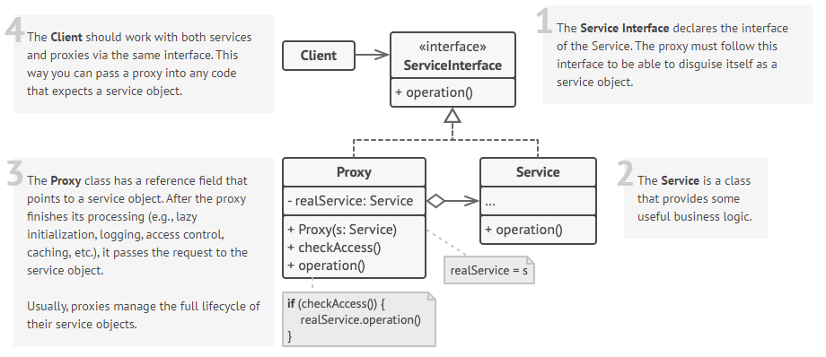

Slide 15
Demo
Proxy with TypeScript

Slide 16
Excercise
Research about these design patterns:
Builder
Decorator
Strategy

