Slide 1


Design Patterns
Winter – 2022
Mostafavi
02 – more pattern

Slide 2
Course Structure
What is design pattern?
Singleton
Factory
Observer
Proxy
MVC, MVVM
Implement IoC through dependency injection

Slide 3
Are mvc, mvvm a design pattern?
No, they are architectural pattern, mostly relates to the UI/interaction layer of an application.

Slide 4
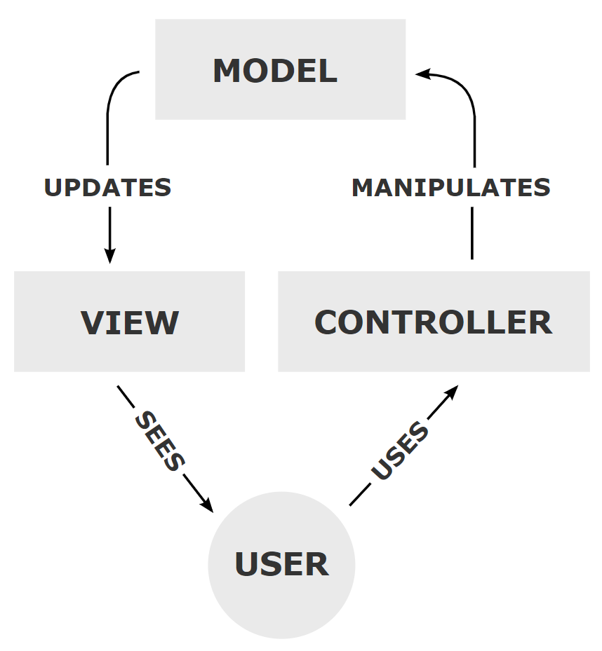
MVC
Notes:
https://en.wikipedia.org/wiki/Model%E2%80%93view%E2%80%93controller

Slide 5
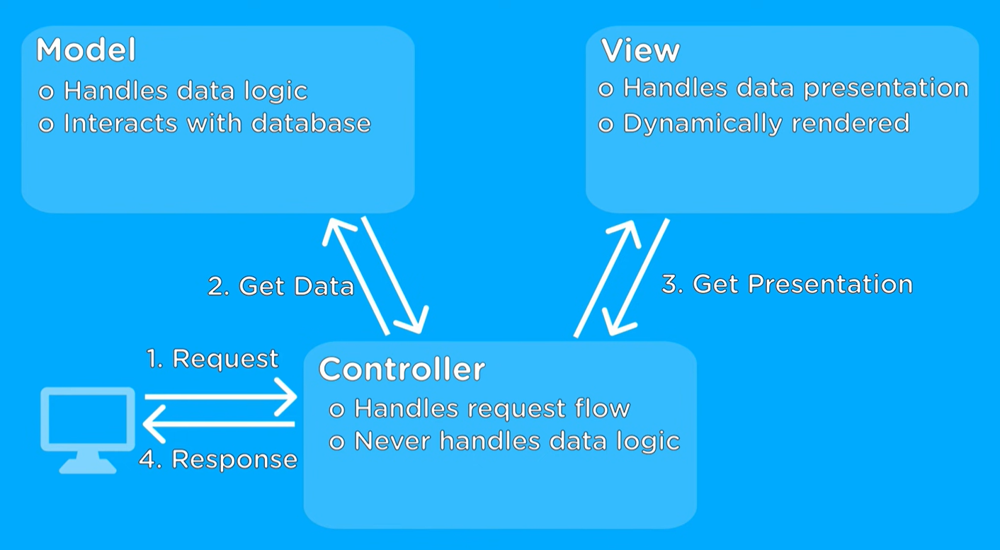
Notes:
https://www.youtube.com/watch?v=DUg2SWWK18I

Slide 6
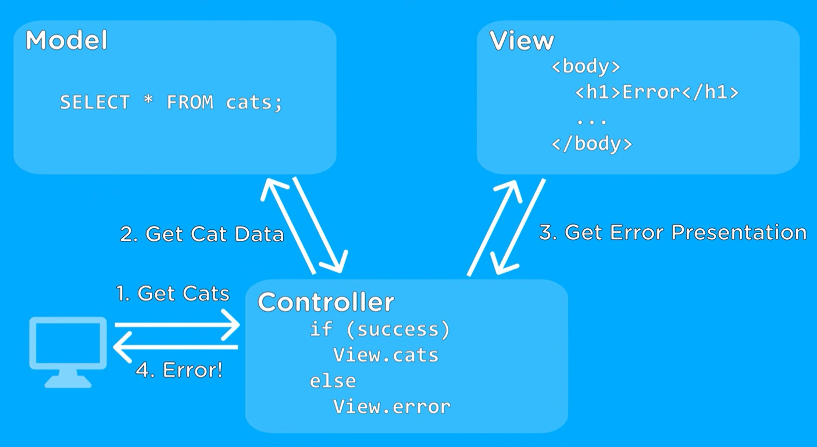
Notes:
https://www.youtube.com/watch?v=DUg2SWWK18I

Slide 7
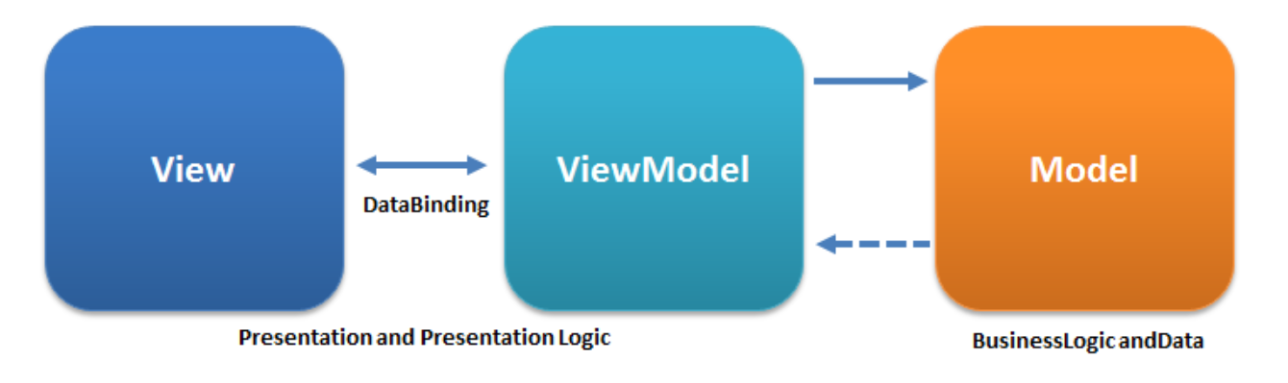
MVVM
Notes:
https://en.wikipedia.org/wiki/Model%E2%80%93view%E2%80%93viewmodel

Slide 8
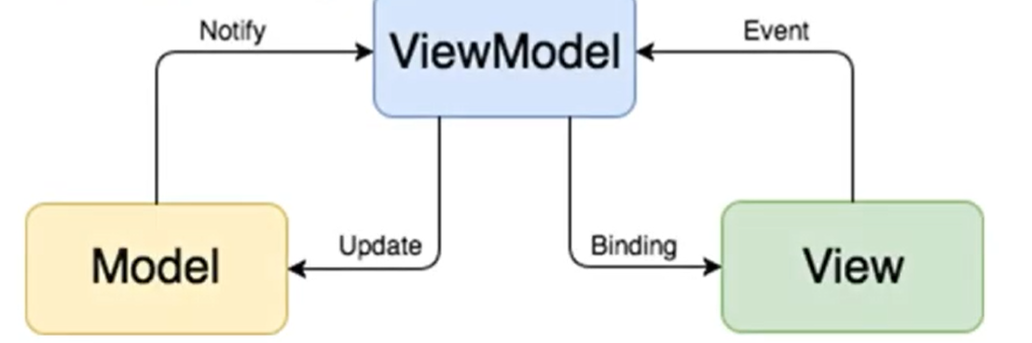
MVVM

Slide 9
Demo
MVC in express
Remember when we use controller folder in ORM sessions
MVVM
We as backend developers have nothing to do with this issue, but be aware that Frontend needs this.

Slide 10
IoC
Inversion of Control,

