Slide 1


Design Patterns
Winter – 2022
Mostafavi
02 – more pattern

Slide 2
Course Structure
What is design pattern?
Singleton
Factory
Observer
Proxy
MVC, MVVM
Implement IoC through dependency injection

Slide 3
Are mvc, mvvm a design pattern?
No, they are architectural pattern, mostly relates to the UI/interaction layer of an application.
They are architectural patterns.

Slide 4
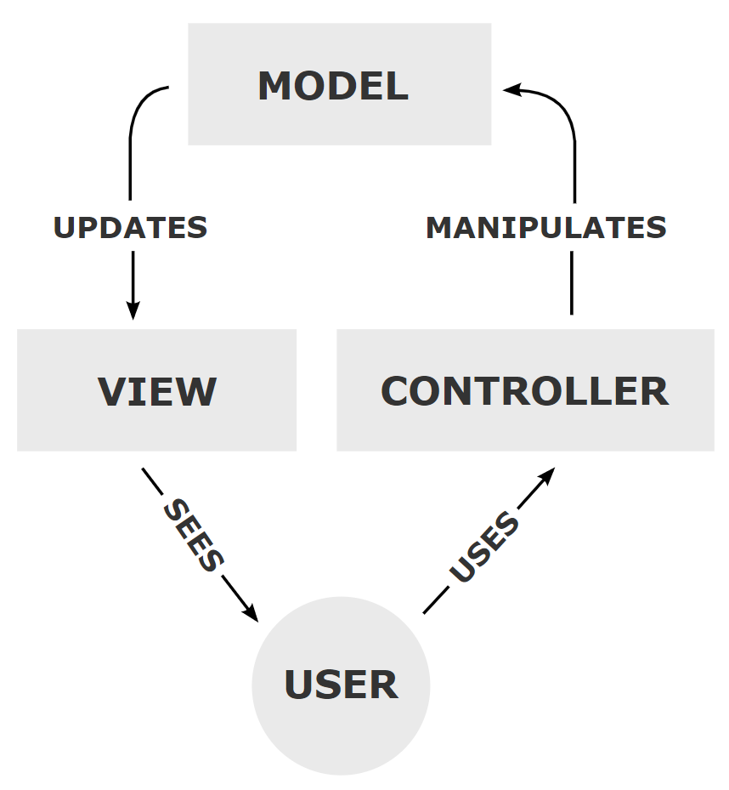
MVC
Notes:
https://en.wikipedia.org/wiki/Model%E2%80%93view%E2%80%93controller

Slide 5
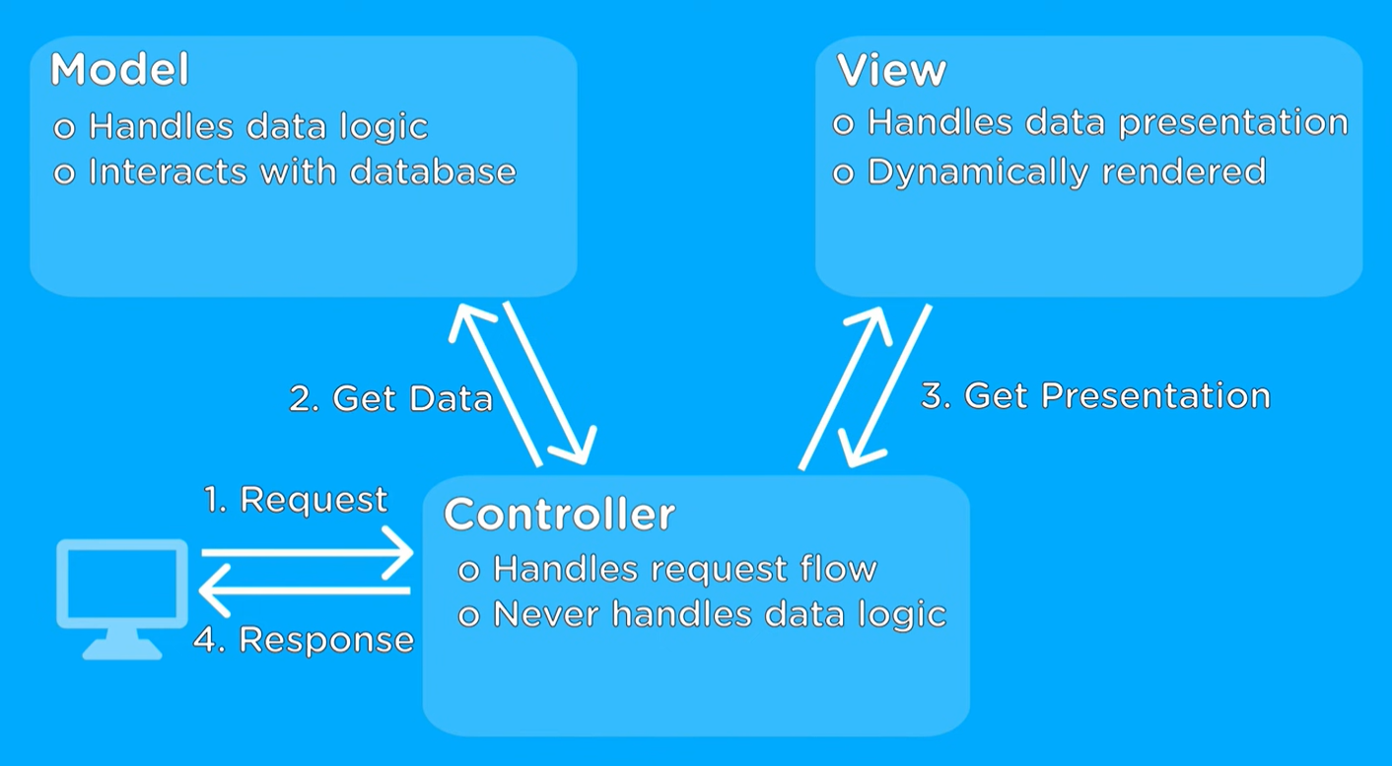
Notes:
https://www.youtube.com/watch?v=DUg2SWWK18I

Slide 6
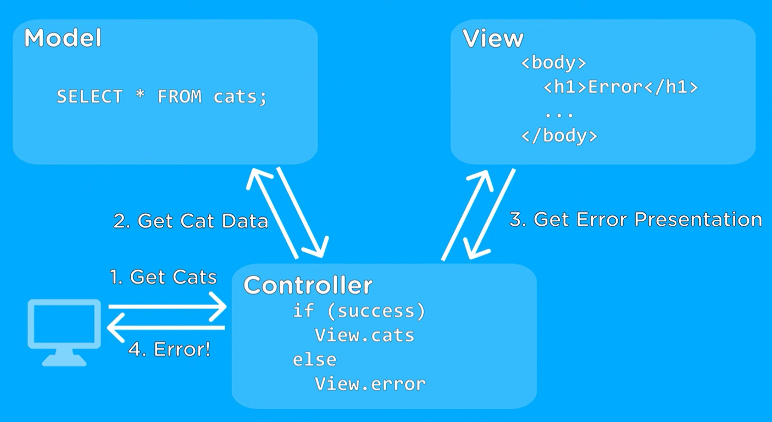
Notes:
https://www.youtube.com/watch?v=DUg2SWWK18I

Slide 7
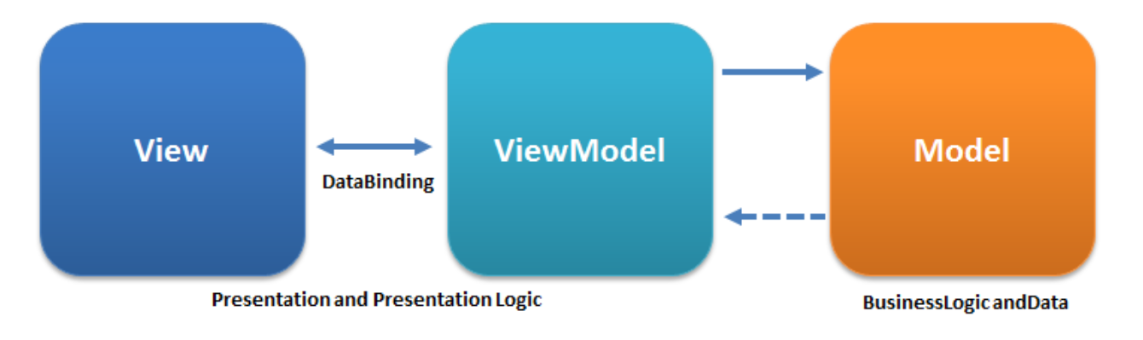
MVVM
Notes:
https://en.wikipedia.org/wiki/Model%E2%80%93view%E2%80%93viewmodel

Slide 8
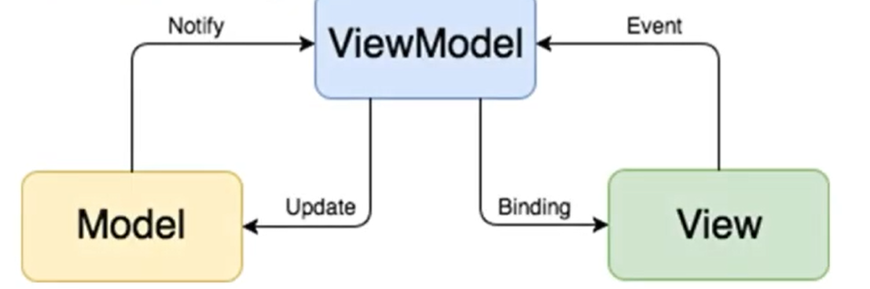
MVVM

Slide 9
IoC
Inversion of Control is a design principle
imagine you are the CEO of a company and going to visit an important business partner.
You can definitely drive a car yourself. In this case, you control the car.
On the other hand, you can also hire a driver to drive the car for you instead. The control of the car is inverted from you to the driver now.

Slide 10
IoC
What is the benefit?
Well, the execution of the driving task is decoupled from implementation,
you don’t need to care how exactly the driver drives the car as long as the driver can take you to the destination on time.
Moreover, the driver can also be easily replaced without any impact on the mission you are mainly responsible for.
With hiring the driver, you can focus on thinking of how to convince the potential partner to cooperate with you on the way to the partner’s office.
After all, that’s your main responsibility as a CEO, isn’t it? The driving is not supposed to be your concern.

Slide 11
Demo
Implements the CEO example
Bad way:
However, do you notice that the CEO still controls the hire (creation) of a driver?
This is also not supposed to be the CEO’s responsibility.
In addition, from the code’s perspective, the Driver is the dependent object of Ceo and the Ceo is tightly coupled to it.
The Ceo is difficult to be tested because the Driver instance is created inside the Ceo. You are not able to replace the Driver with a mock one when you are testing the Ceo
Best way, inverting the control of creating driver:
Dependency Injection
By applying dependency injection, Ceo is fully decoupled from Driver now and the control of constructing a driver is inverted from Ceo to Injector.

Slide 12
Dependency Injection
One way to implement IoC.

Slide 13
SOLID
Single-responsibility principle
There should never be more than one reason for a class to change.
every class should have only one responsibility.
Open-closed principle
Software entities ... should be open for extension, but closed for modification.
Liskov substitution principle
Functions that use pointers or references to base classes must be able to use objects of derived classes without knowing it.
Interface segregation principle
Many client-specific interfaces are better than one general-purpose interface.
Dependency inversion principle
Notes:
https://www.digitalocean.com/community/conceptual_articles/s-o-l-i-d-the-first-five-principles-of-object-oriented-design

Slide 14
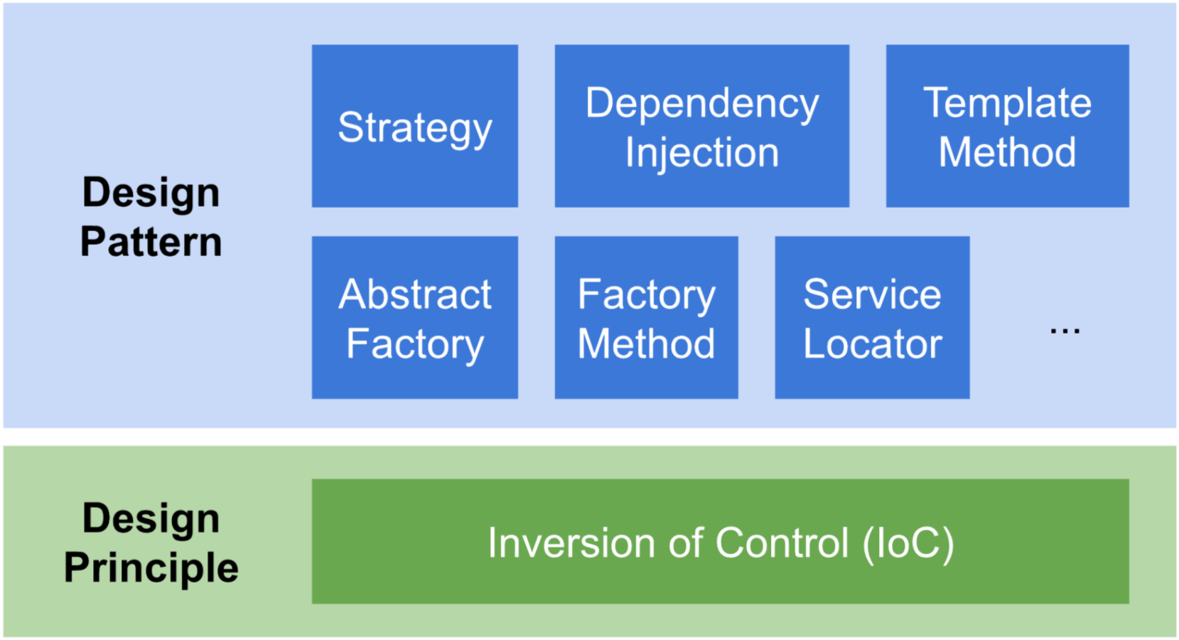

Slide 15
What about a lot of dependency?
That's good, however, this injection is not convenient.
We have to manually inject every dependency,
We have to keep the dependencies order when injecting.
In reality, we would want to automate it. There is a way to do that, and it's called a DI-container.
a DI-container is a module that does only one thing—it provides dependencies to every other module in a system.
Container knows exactly which dependencies a module needs, and injects them when needed.
Thus we free other modules of figuring out this stuff, and the control goes to a special place.
Notes:
https://stackoverflow.com/questions/50718586/what-is-a-di-container

Slide 16
DI-container
// P S E U D O C O D E:
// Hey, container!
// When you're asked of an object that implements
// `SomeInterface` you should give access to
// an instance of `SomeClass`.
container.register(SomeInterface, SomeClass);

Slide 17
Exercise
Required:
Implement dependency injection by
Constructor
Setter
Optional:
Use some package to automate the process of injection in a container

