Slide 1


Nest.JS
Winter - 2022
Mostafavi
04 – DI

Slide 2
Course Structure
TypeORM in NestJS
Setting up migrations
Dependency Injection
Understand Dependency Injection
Control NestJS Module Encapsulation
Diving Into Custom Providers
Value based providers
Non-class-based Provider Tokens
Class Providers
Factory Providers
Leverage Async Providers

Slide 3
Demo
Migration
Create ormconfig.json for TypeORM cli config
Create migration manually:
npx typeorm migration:create <your-change-script-name>
Run migration:
npx typeorm migration:run
Revet migration:
npx typeorm migration:revert
Create migration automatically:
npx typeorm migration:generate <your-migration-script-name>
It will compare your entities with the desired db, and create up and down query respectively
Specially useful for the first generation script against an empty db.
Notes:
ormconfig.json
{
"type": "mssql",
"host": "localhost",
"port": 1433,
"username": "user",
"password": "",
"database": "typeorm",
"extra": {
"trustServerCertificate": true
},
"entities": [
"dist/**/*.entity.js"
],
"migrations": [
"dist/migration/*.js"
],
"cli": {
"migrationsDir": "src/migration"
}
}

Slide 4
Development lifecycle (as a sample not recommended)
Develop with syncing: true
Sync production database:
migration:run
New release:
migration:generate
Against production db
Important notice:
Always check generated sql scripts, sometimes they are wrong

Slide 5
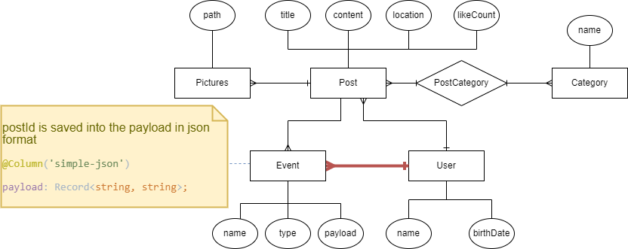
New requirement

Slide 6
Demo
What does exports do in module?
It will give you full control on your module about what is public and what is not?
Nest.js encapsulate its providers in a module and they cannot be used by other modules,
If you want to use a provider inside another module you have to explicitly declare it inside the exports array
Let’s Create another module and use its service inside other modules
Suppose we want to check if the user liked a post, don’t like it twice ☺

Slide 7
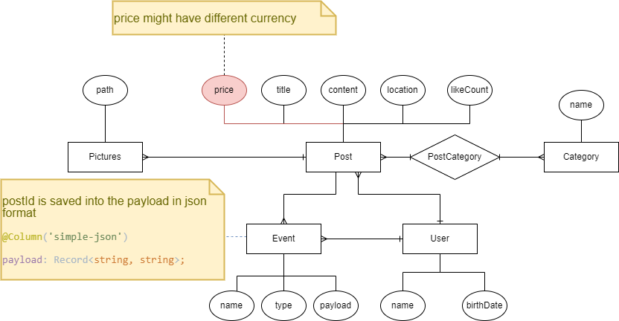
New requirement
Each post has prices, and we use different currencies (Euro, Dollar, …), return prices by their currency appropriately

Slide 8
Demo
Custom providers
Use other types (strings, symbols, enums) as token in providers
Ways to provide token:
useClass
useValue
useFactory
CREATE PROVIDERS DYNAMICALLY
Can be extremely useful if you need to base the provider’s value on various other dependencies’ values, …
Factory function can able to inject other providers
Notes:
$
€ £
﷼

Slide 9
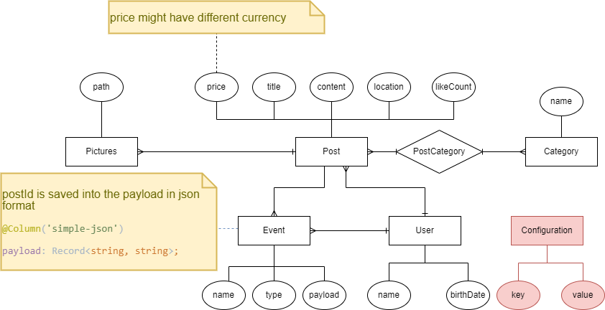
New requirement
Get currency from config (inside db)

Slide 10
Demo
Async providers
Suppose your dependency has to be created through some sort API (like database)
Your bootstrapping process will not going further until this dependency is met.
Employ useFactory with async callback

Slide 11
Exercise
Required:
Exercise all we speak
Notes:
Hint: loggerService better to be transient
☺ For you (The seeker is the finder):
https://www.brunnerliv.io/articles/advanced-nestjs-dymaic-providers

