Slide 1


Nest.JS
Winter - 2022
Mostafavi
04 – Configuration

Slide 2
Course Structure
Dependency Injection
Create a Dynamic Module
Control Providers Scope
Diving Deeper Into Request-Scoped providers
Application Configuration
Introducing the Config Module
Custom Environment File Paths
Schema Validation
Using the Config Service
Asynchronously Configure Dynamic Modules

Slide 3
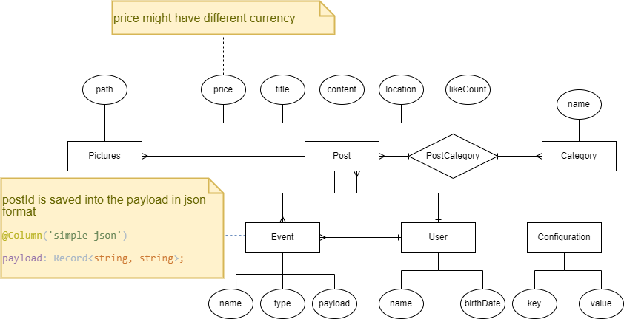
What was happened until now!

Slide 4
Demo
Dynamic module
Static modules can’t have their providers be configured by a module that consuming it.
Why does that matter?
For general purpose modules ☺, that needs to behave differently in different circumstances
Use static method with some names like: register, forRoot, …
Return a DynamicModule object inside that function
Module: just like your module name
Providers: needed providers that you add them inside your static function

Slide 5
New requirement
Dev requirement: we need a logger service

Slide 6
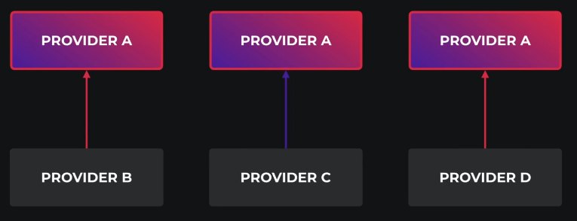
Demo
Other scopes than singleton:
All singleton providers instantiated when the program bootstrapped
Transient
Every time it will instantiated
There is two place to tell nest our provider scope:
@Injectable
Inside providers array in module
What is the benefit of transient?
Each class has its own state
Suppose logger class with different prefixes.

Slide 7

New requirement
We need a new route to show a banner to user, but it must translated Based on the request header (accept-language).

Slide 8
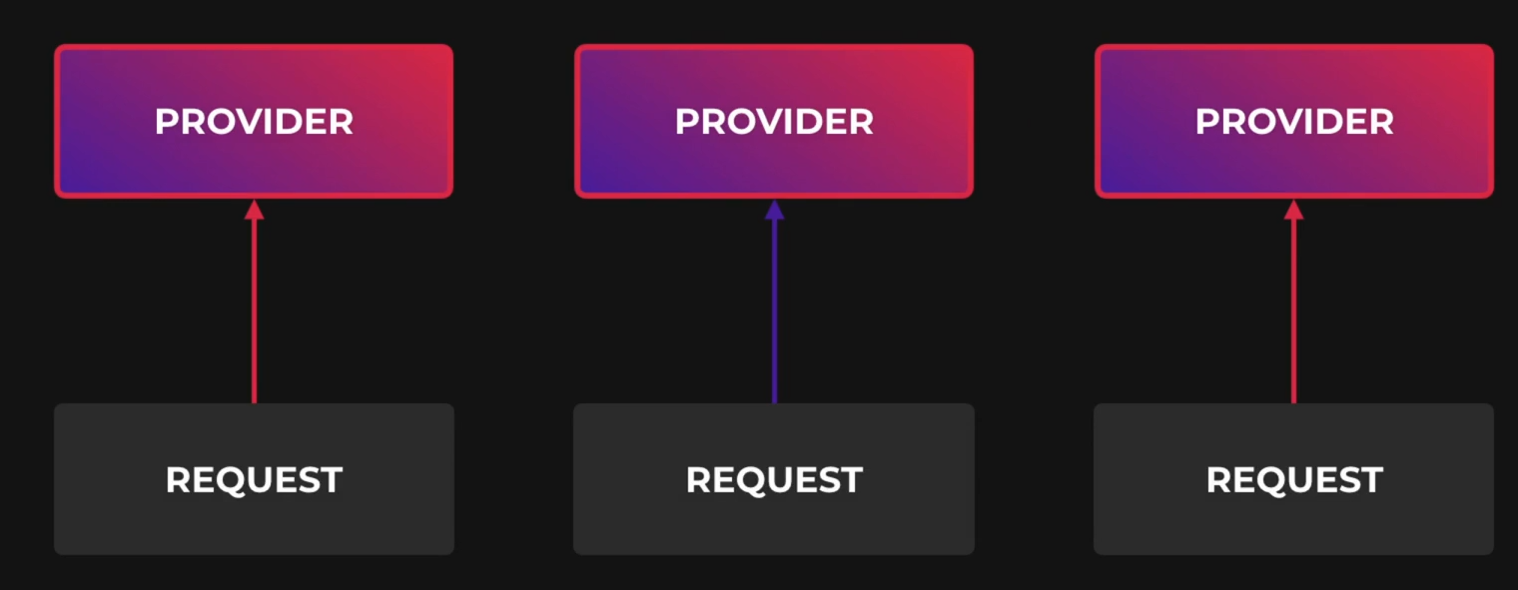
Demo
Request scoped providers
They are instantiated whenever a new request is received
And They are automatically garbage collected after the request finished
Don’t forget the bubbling ☺
Your services which uses a request scoped service will become a request scoped service implicitly
Request scoped providers can inject the request object
It is useful if you want access request fields like headers, …
@Inject(REQUEST)
Request scoped providers may impact your program performance
It will slightly decrease your avg response time
Unless a provider must be request scope, it is always recommended to use the default (singleton) scope

Slide 9
Exercise
Required:
Exercise all we speak
Optional:
Create a helper module for logging, It has an option for the first letter of each log, and then has a service that simply generate logs like these:
<firs-letter> <passed-argument>
> some logging
We can inject this logger service in our services and do logging stuffs.
Notes:
Hint: loggerService better to be transient
☺ For you (The seeker is the finder):
https://www.brunnerliv.io/articles/advanced-nestjs-dymaic-providers

