Slide 1


Nest.JS
Winter - 2022
Mostafavi
04 – Configuration

Slide 2
Course Structure
Dependency Injection
Create a Dynamic Module
Control Providers Scope
Diving Deeper Into Request-Scoped providers
Application Configuration
Introducing the Config Module
Custom Environment File Paths
Schema Validation
Using the Config Service
Asynchronously Configure Dynamic Modules

Slide 3
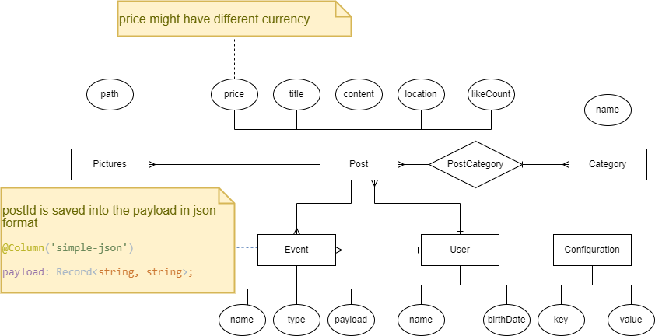
What was happened until now!

Slide 4
Demo
Dynamic module
Static modules can’t have their providers be configured by a module that consuming it.
Why does that matter?
For general purpose modules ☺, that needs to behave differently in different circumstances
Use static method with some names like: register, forRoot, …
Return a DynamicModule object inside that function
Module: just like your module name
Providers: needed providers that you add them inside your static function

Slide 5
New requirement
Dev requirement: we need a logger service

Slide 6
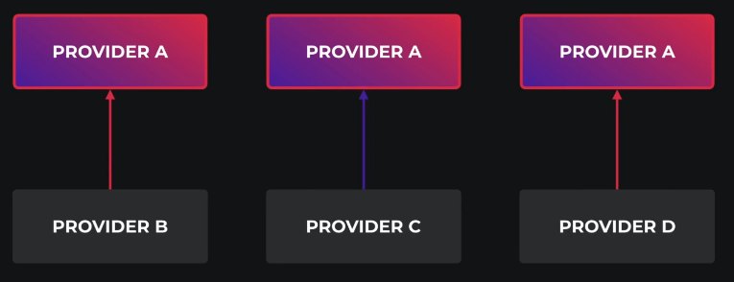
Demo
Other scopes than singleton:
All singleton providers instantiated when the program bootstrapped
Transient
Every time it will instantiated
There is two place to tell nest our provider scope:
@Injectable
Inside providers array in module
What is the benefit of transient?
Each class has its own state
Suppose logger class with different prefixes.

Slide 7

New requirement
We need a new route to show a banner to user, but it must translated Based on the request header (accept-language).

Slide 8
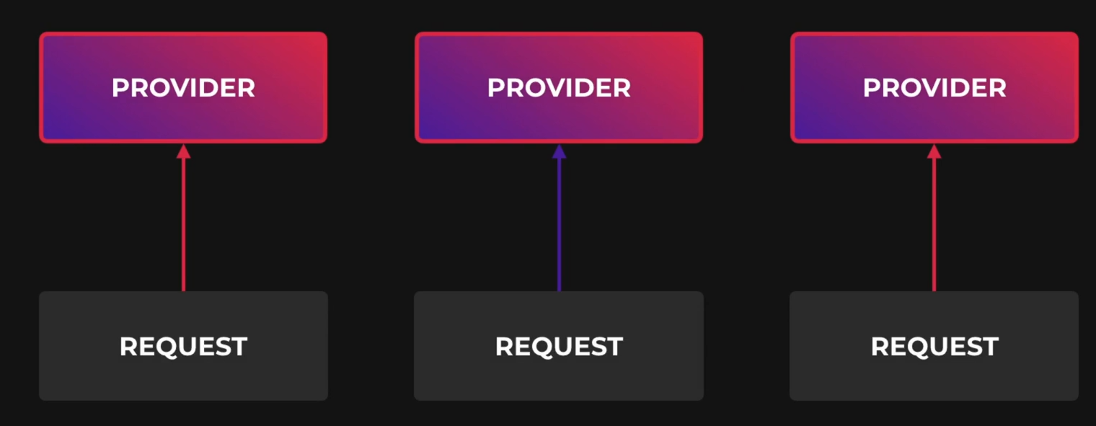
Demo
Request scoped providers
They are instantiated whenever a new request is received
And They are automatically garbage collected after the request finished
Don’t forget the bubbling ☺
Your services which uses a request scoped service will become a request scoped service implicitly
Request scoped providers can inject the request object
It is useful if you want access request fields like headers, …
@Inject(REQUEST)
Request scoped providers may impact your program performance
It will slightly decrease your avg response time
Unless a provider must be request scope, it is always recommended to use the default (singleton) scope

Slide 9
New requirement (dev)
12 factor says:
Use environment for your app configuration
Rewrite code to use environment variables

Slide 10
Demo
Our application needs to run on many environments
Development
Staging
Production
ConfigModule ☺ is the key
npm install @nestjs/config
Then add ConfigModule to the AppModule (forRoot static function)
Here process.env will initialized by your .env file
There it comes .env file ☺
Let’s add database config options to the .env file
.env file should not track by git
Add it to the .gitignore

Slide 11
Demp
ConfigModule
How to change the .env path from root to somewhere else?
envFilePath
But, how to disable loading from .env file completely?
ignoreEnvFile: true
What is the benefit?
When you load your environments from OS shell exports.

Slide 12
Demo
Schema validation (for our configs)
It is best practice to throw error while bootstrapping if configs are wrong syntactically (or not provided)
Here it comes joi ☺
In joi you can define schema and validate js objects against it.
npm install joi
How to use ConfigModule (and its service) inside other modules?
Just import it
Remember to always use .forRoot once (inside AppModule)
Config service has get method to return value of an environment variable
It has default value as the second argument

Slide 13
Demo
What about big projects with a lot configurations
Add namespaces and finally use Partial registration (.forFeature)
It allows you to register configs closer to their modules (rather than load each of them inside root module with .forRoot)
How to not use string notation
Use
@Inject(namespace.KEY)
private readonly config: ConfigType<typeof namespace>

Slide 14
Demo
Asynchronously configure dynamic modules
Remember that module import order are vital for process.env ☹
Here it comes async providers, they are loaded after all other providers are resolved (.forRootAsync), every general purpose module should has this type of dynamic module.
What happens if we don’t want to use process.env inside the TypeormModule (as an example?)
Here it comes useFactory ☺
Every module has async dynamic module that helps us to inject ConfigService inside that module as a dependency

Slide 15
Exercise
Required:
Exercise all we speak
Optional:
1- Create a helper module for logging, It has an option for the first letter of each log, and then has a service that simply generate logs like these:
<firs-letter> <passed-argument>
> some logging
2- We can inject this logger service in our services and do logging stuffs.
3- make this prefix optionally configurable for each module.
Notes:
Hint: loggerService better to be transient
☺ For you (The seeker is the finder):
https://www.brunnerliv.io/articles/advanced-nestjs-dymaic-providers

