Slide 1

Portfolio of Economic Concepts
The Twelve Competencies of Macroeconomics with Artifacts.
Document type: Informative Presentation
Written by, Shawn Stark; May 2009
Macroeconomics: Final Project
Instructor: Dr. Alex Birkholtz

Slide 2
Develop Analytical Skills Central To Economic Thinking
Section #1
        Scarcity
        Opportunity Costs
        Factors of Production
        Production Possibilities Curve
        What?, For Whom? & How?

Slide 3
Section #1:
Scarcity
  Scarcity is the underling control of economics.
  Material is not infinitive thus it should be reserved.
  Scarce resources are more valuable as they are harder to find.
  Knowing how scarcity works will help you make better economic decisions.
The full show from Prosperity Podcast highlighted on this slide, can be found at the link below.
("Do you have an underling belief in scarcity?", Prosperity Podcast: 2008)‏

Slide 4
Section #1:
Opportunity Costs
  For everything resources are spent on there are other opportune uses for the same resources that are foregone.
  Resources are scarce and their really is nothing for "free".
  Any thing provided that is "free" always ends up payed for in one way or another. Opportunities are foregone to provide these "free" products or services. Though it may seem free to you, remember that someone paid for it somewhere.
To hear the full podcast of the clip presented in this slide, please follow the link below.
(Chris Anderson & Russ Roberts, "Cris Anderson on Free"; Econtalk: May 2008)‏

Slide 5
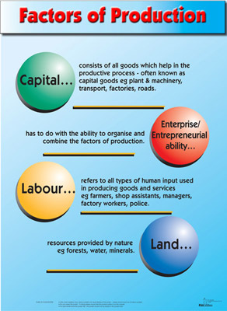
Section #1:
Factors of Production
        Land
        Labor
        Capital
        Entrepreneurship
        These are the four
        main resources used
        for production
Factors of Production Image

Slide 6
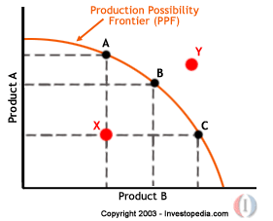
Section #1
Production Possibilities Curve
  The production possibilities curve
  is a graphical representation of all
  the different possible combinations
  of production with available resources.
  This curve helps a company or
  economy see the opportunity
  costs they must incur to change
  the quantity of production on any
  of their products.

Slide 7

Section #1
Core Economic Questions
  What to produce?
  When looking at the production
  possibilities curve you see that
  you have choices on what to
  produce and not to.
  How to produce?
  In the production of anything, the
  question how to produce it is key.
  Some companies choose to create
  a cheaper product catering to a
  larger market, while others choose
  to produce top of the line products.
  The answer to how to produce
  depends on available resources
  (Factors of Production) and demand
  For whom to produce?
  Also dependent on demand and what is being produced
Core Economic Questions

Slide 8
Use Supply & Demand Analysis
Section #2
        Circular Flow
        Demand Curve
        Supply Curve
        Equilibrium

Slide 9
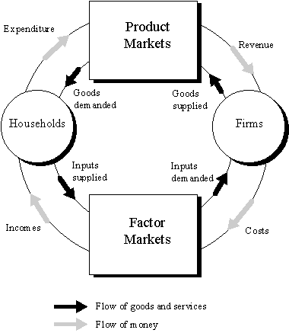
Section #2
Circular Flow
  Business firms
  purchase factors of
  production, and supply
  their goods and services
  to product markets.
  Consumers sell their
  services in the factor
  markets.
  The government
  acquires resources in
  the factor markets and
  provides services to
  consumers and businesses
  Imports and exports also take
  part in the circular flow.

Slide 10
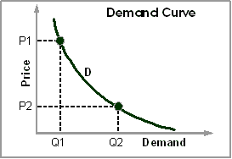
Section #2
Demand Curve
Demand Curve
  The demand curve relates
  demand with price.
  As price goes up demand goes
  down this is a movement along
  the curve. (ceteris paribus). The
  curve will not move at all, only
  the point on the curve will move.
  Desire, Other Goods and
  Services, Expectations, Income, Number of buyers,
  These are determinants that change overall demand, thus a demand shift. Increase or decrease in overall demand. This will make the demand curve shift left if overall demand goes down, and right if overall demand goes up.

Slide 11
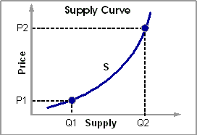
Section #2
Supply Curve
  The supply curve is
  a representation of
  sellers intentions to
  sell at different prices.
  As the quantity supplied
  for demand goes up so
  does the price. This is
  a movement along the
  supply curve
  (ceteris paribus)
  Changes in overall supply
  not just the quantity supplied will shift the supply curve; left when supply goes down, and right when it goes up. Thus the lower quantity of supply goes the more expensive a product will be. The higher the quantity of supply goes the less expensive the product will be.
Supply Curve

Slide 12
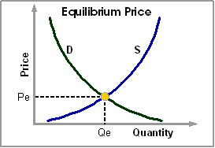
Section #2
Equilibrium
Equilibrium
  Equilibrium is where the
  price sellers are willing to
  sell at and the price buyers
  are willing to pay intersect.
  You can not sell something
  at a rate buyers are not
  willing to pay.
  Notice in the image to the
  right equilibrium is where
  the supply and demand curves intersect.

Slide 13
Investigate Principal Goals and Tools of Macroeconomic Analysis
        Section #3
        National Output: GDP
        Unemployment
        Inflation
        Dow Jones

Slide 14
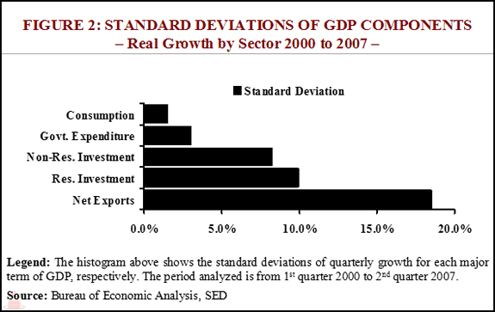
  Section #3
  National Output: GDP
C+I+G+(X-M) = GDP
Consumption
Investment
Government Spending
Net Exports
GDP can be REAL and NOMINAL
  Real GDP has inflation factored in so it can be compared with the GDP from other years.
  Nominal GDP is expressed with todays dollar value.
Real Growth Example

Slide 15
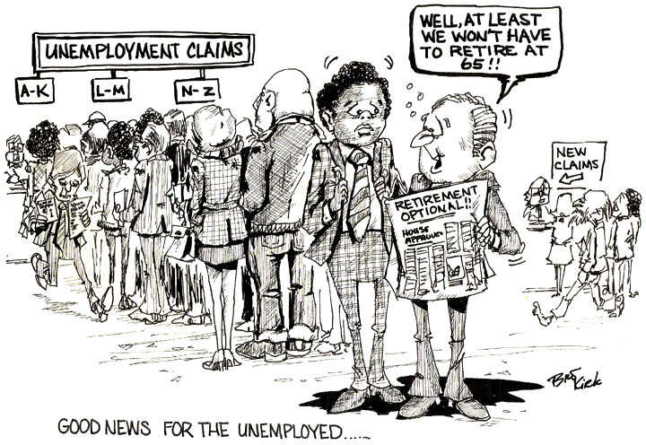
Section #3
Unemployment
  To attain Full
  Employment it must
  be a goal to eliminate
  unemployment.
  Statistics of
  unemployment
  are gathered from
  unemployment claims
  and used to help
  calculate the overall health of the macro economy.

Slide 16

Section #3
Inflation
Inflation Image
Inflation is the loss of currency
value. 3% inflation is considered
healthy.
Inflation rates are used to find
real GDP for comparison
If inflation gets out of hand
money you acquired today could
loose a lot of its value by tomorrow.
To keep inflation under control we exercise the adjustment of the federal interest rate.

Slide 17
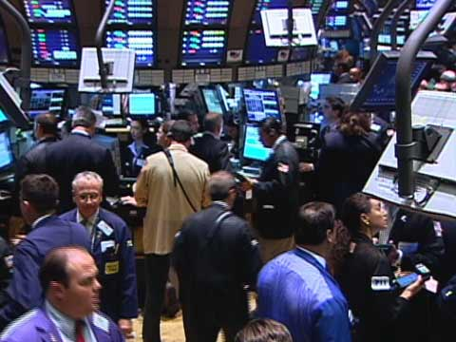
Section #3
Dow Jones
Every business day stock brokers Rally Floor Image
and investors get together to
buy and sell their interests.
The value of these interests
are tracked on stock indexes.
One of the main indexes that
is commonly used to asses the
health of the macro economy is
The Dow Jones index.
The Dow Jones has a large
number of corporations it tracks,
more than the others. That is why it is a main factor in guessing the health of the economy,

Slide 18
Aggregate Expenditure Model & the Aggregate Demand and Supply Model
        Section #4
        Government Spending
        Consumption & Savings
        Aggregate Demand
        Aggregate Supply

Slide 19
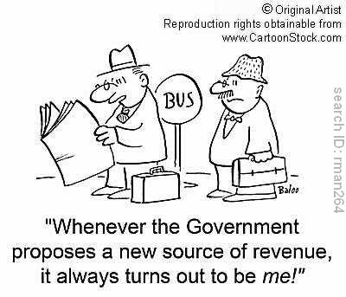
Section #4
Government Spending
The role government plays in the
aggregate expenditure model is by
spending money and returning
money to the tax payers.
This money has a multiplier effect
so any stimulus spent must be
calculated to include the multiplier.
When the government spends
money it increases aggregate
demand, we don't want to cause
excessive inflation so we must watch this technique closely.
Using aggregate expenditure model we can monitor spending to help assure it doesn't get out of hand. The goal is always equilibrium and we are the executors who spend the money.
Government Revenue Cartoon

Slide 20
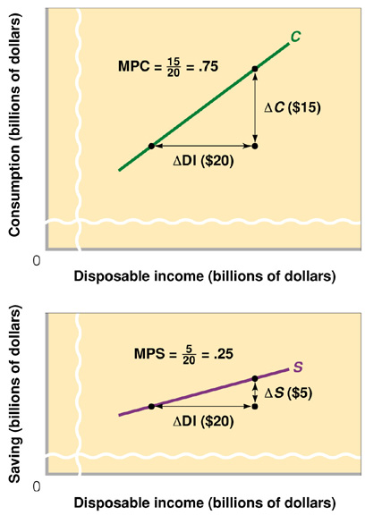
Section #4
Consumption & Savings
MPC: The fraction of our
money we are likely to
spend on consumption
MPS: The fraction of our
money we are likely to
save
These two variables are
used in the estimate of
aggregate expenditure,
helping us predict future
spending
MPC+MPS always = 1
MPC and MPS charts

Slide 21
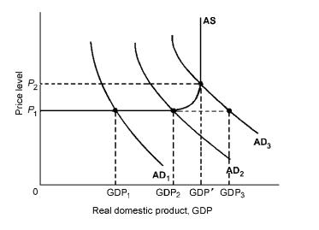
Section #4
Aggregate Demand
  Aggregate demand is
  The collective behavior
  of all buyers in the
  market place
  Aggregate demand
  curves like the one
  on the right are used
  to analyze demand.
Aggregate Demand Curve

Slide 22
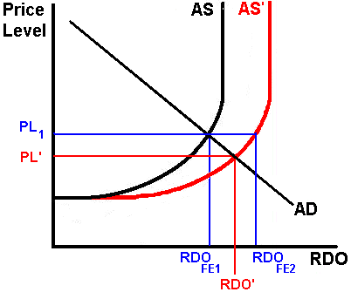
Section #4
Aggregate Supply
Aggregate Supply
Aggregate Supply like
demand changes along
the curve on when price
changes, except the QTY
goes down instead.
Notice the aggregate
supply curve to the right
starts in the bottom left
and flows upward

Slide 23
Structure Of Fiscal Policy
Section #5
        Multiplier Effect
        Fiscal Restraint
        Crowding Out
        Disposable income

Slide 24
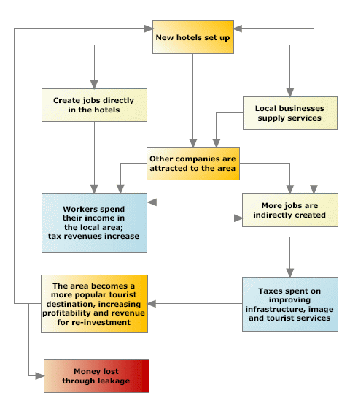
Section #5
Multiplier Effect
Multiplier Effect
The multiplier effect is
the number of times a
dollar of fiscal stimulus
gets re-spent. The image
to the right shows an
example of this

Slide 25

Section #5
Fiscal Restraint
Fiscal Restraint is the exercise
of tax increases to control
expansion
Uncle Sam and Taxes

Slide 26
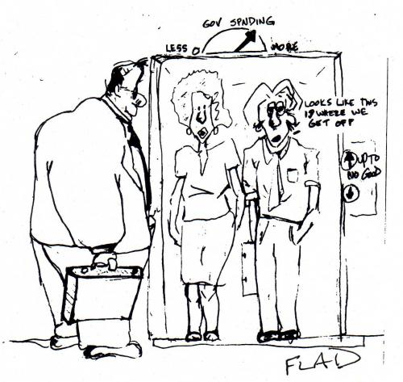
Section #5
Crowding Out
Crowding Out
Crowding out is
government expenditure
stepping on the toes
of other financiers and
suppliers that would
other wise have higher
employment if wasn't
for government stimulus

Slide 27
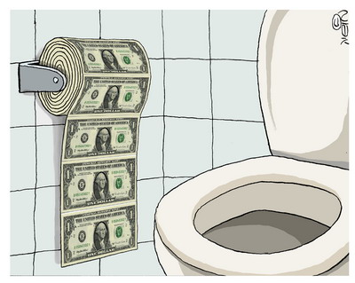
Section #5
Disposable Income
Disposable income is the
income after government
and personal taxes
Disposable Income

Slide 28
The System of Money and Banking Practiced in the US
Section #6
        Electronic Banking
        On line bill payment
        ATM cards and check cards
        Credit Cards

Slide 29

Section #6
Online Banking
Online Banking
Many of us now track
our deposits and debits
online. This is just one of
the tools that make our
lives easier

Slide 30

Section #6
Online Bill Payment
Americans these days
are paying their bills over
the phone and online,
you can even opt to have
automatic payments
directly from your account

Slide 31

Section #6
Debit Cards
Debit Cards
We use debit and check
cards everywhere now.

Slide 32
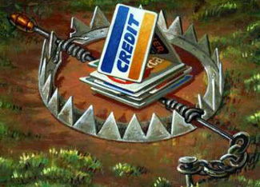
Section #6
Credit Cards
Credit card debt is
abundant in the US. I
guess we like to spend
money. Credit cards are
expensive but we still have
them.
Credit Trap

Slide 33
The Structure of Monetary Policy
Section #7
        Money Supply
        Money Multiplier
        Banks in Circular Flow
        Bank reserves

Slide 34
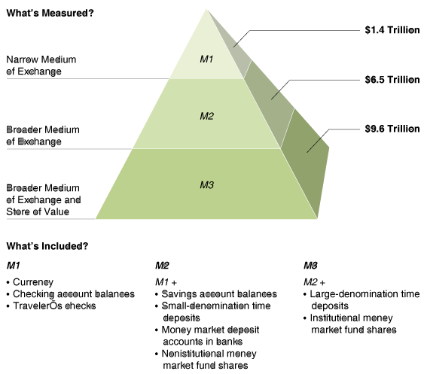
Section #7
Money Supply
Money Supply
Money supply falls
into 3 categories,
M1, M2, M3
A description of
these categories
can be seen in the
image to right.

Slide 35

Section #7
Money Multiplier
Money Tree
The multiplier is the amount
of money that can be created
from a deposit.
Money
multiplier =
___1___ required
reserve ratio

Slide 36
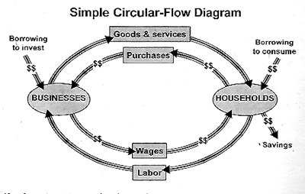
Section #7
Banks in Circular Flow
The circular flow of factor
and product markets also
include banks for borrowing
and saving money.
Circular Flow Including Banks Image

Slide 37
Section #7
Banks in Circular Flow
Banks provide loans that stimulate the market. They use the multiplier effect to create money and provide businesses and households with loans.

