Slide 1
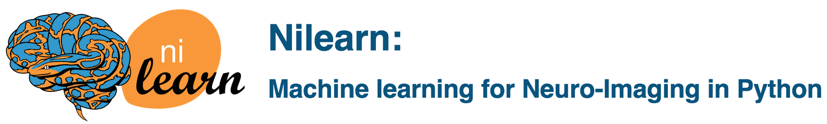
Hands-on-Workshop
Toronto
Danilo & Jo
21 June 2017

Slide 2
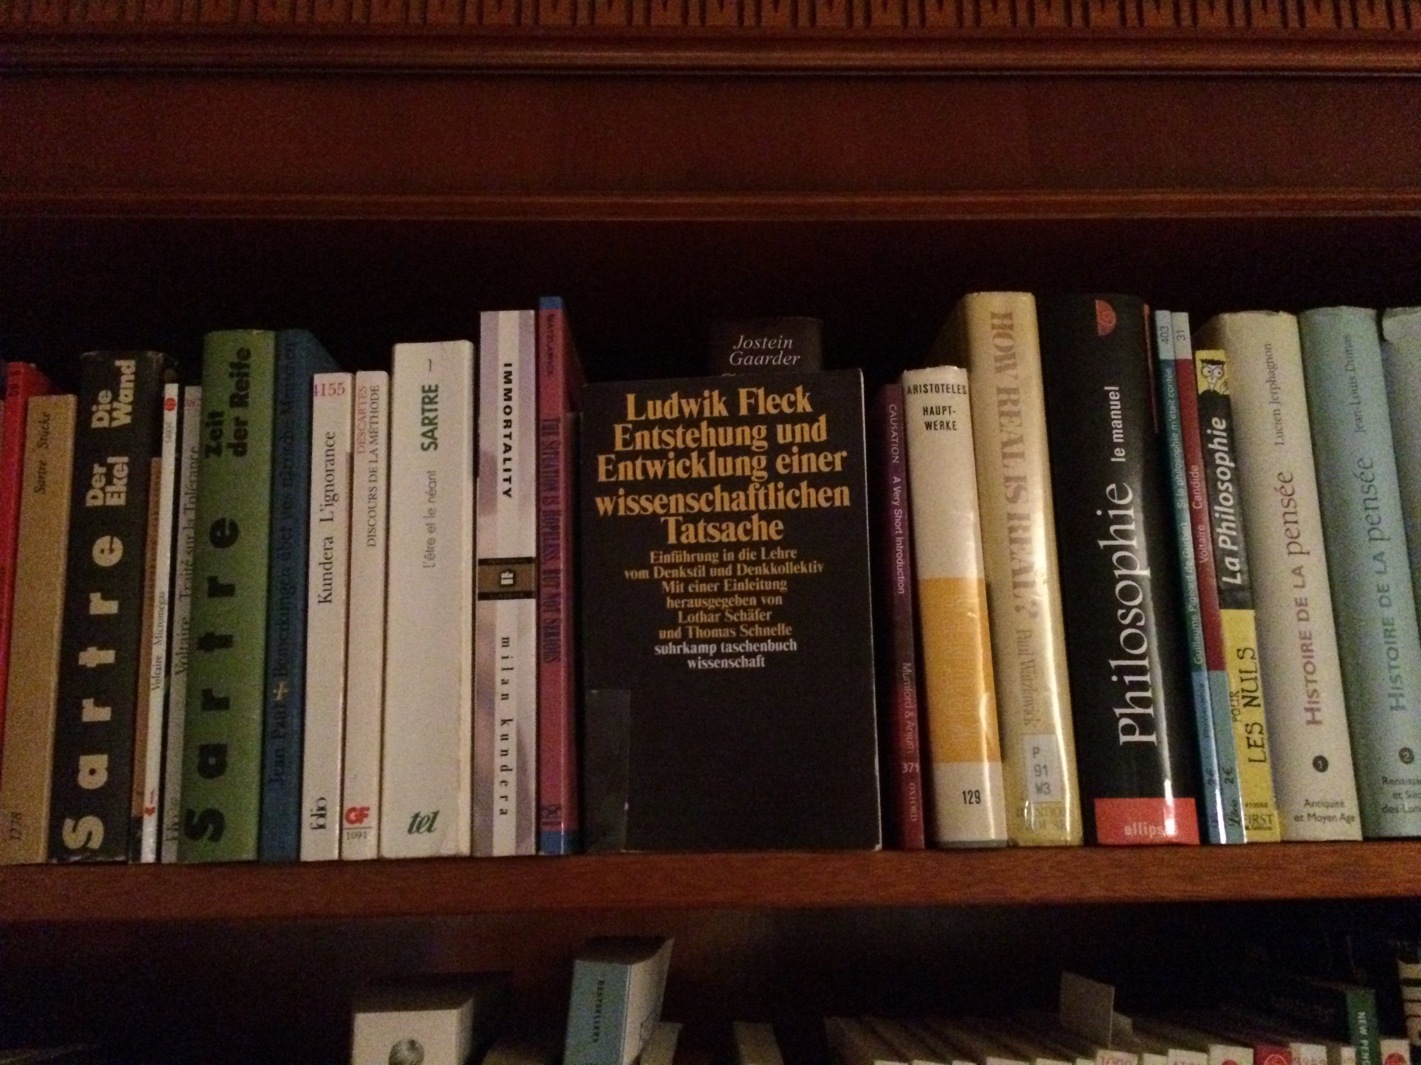
Notes:
Briefly taking an epistemological perspective, a new scientific fact is probably not established in vacuo (Fleck et al., 1935; italic terms taken from source). Rather, the object is recognized and accepted by the subject according to socially conditioned thought styles cultivated among members of thought collectives. A witnessed and measured neurobiological phenomenon tends to only become "true" if not at odds with the constructed thought history and closed opinion system shared by that subject. In the present paper, two such thought milieus will be revisited and reintegrated in the context of imaging neuroscience: classical statistics (CS) and statistical learning (SL).
Neuroimaging research has predominantly drawn conclusions based on classical statistics, which includes null-hypothesis testing, t-tests, and ANOVA. Throughout recent years, statistical learning algorithms enjoy increasing popularity, which includes cross-validation, classifiers, and sparsity-inducing regression.
In the last 15 years, neuroscientists have transitioned from qualitative reports of few patients with neurological brain lesions to quantitative lesion-symptom mapping on the voxel level in hundreds of patients (Bates et al., 2003). We have gone from manually staining and microscopically inspecting single brain slices to 3D models of neuroanatomy at micrometer scale (Amunts et al., 2013). We have also gone from experimentally motivated laboratory studies to automatized knowledge aggregation across thousands of isolated neuroimaging findings (Yarkoni et al., 2011). Rather than laboriously collecting and once publishing in-house data, investigators are now routinely reanalyzing multi-modal data repositories managed by national, continental, and inter-continental consortia (Kandel et al., 2013; Markram, 2012; Poldrack and Gorgolewski, 2014; Van Essen et al., 2012). The granularity of neuroimaging datasets is hence growning by resolution, sample size, and complexity of meta-information. As an important consequence, neuroimaging analyses have expanded from predominant null-hypothesis testing to statistical-learning methods that are more data-driven by flexible models, scalable to high dimensions, and heuristic by reliance on numerical optimization (Jordan and Mitchell, 2015; LeCun et al., 2015). "Statistical learning" (Hastie et al., 2001) henceforth comprises the umbrella of machine learning, data mining, pattern recognition, knowledge discovery, and high-dimensional statistics.

Slide 3
Classical regime
High-dimensional regime
n > p
n << p
p
p
n
n
„long data“
„wide data“
Hastie et al., 2001
Notes:
One of the hot topics in datascience appears to be: how to actually define „data science.“ There were tree different approaches that came to my mind.
Nowdays, increase in granularity (Jordan)

Slide 4

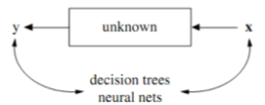
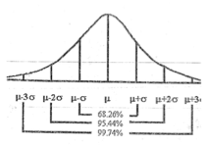
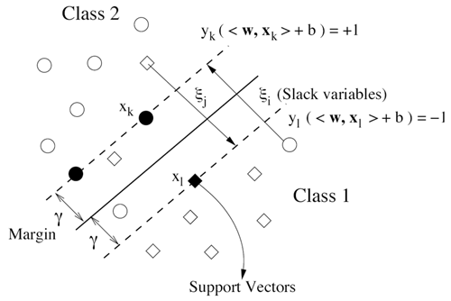
Data modelling
Algorithmic modelling
Breiman et al., 2001
Notes:
I have always been using data-driven methods, but a particular aspect caught my attention about roughly 3 years ago.
classical:
worked well for almost 100 years now
asymptotic results by letting n run against infinity
modern:
Say, n=50 and p=51 -> almost all classical statistical methods are guaranteed not to work anymore.
classical methods do not work anymore; it is not about adding fancy methods, there is actually no alternative.
SPM and other approaches in neuroimaging work mainly because of voxel-wise procedure repeated 300.000 times. Problem has only not been solved but only postponed -> comes back als multiple comparisons problem that has essentially never been solved. Cluster-level inference and more recently TFCE being perhaps best workarounds.
Much effort in the statistical community has been dedicated to solving problems related to wide data.

Slide 5
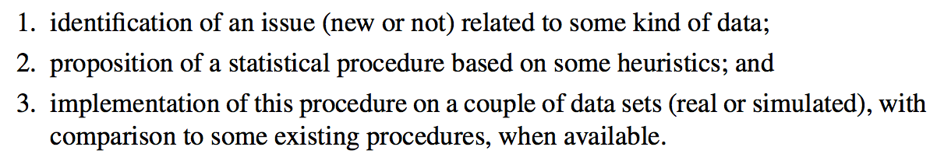
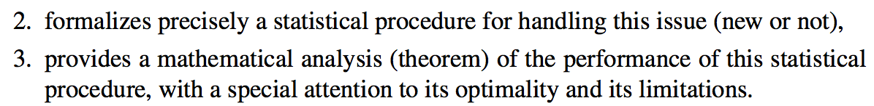
Mathematical Statistics
Data Science
Giraud, 2015
Notes:
One of the hot topics in datascience appears to be: how to actually define „data science.“ There were tree different approaches that came to my mind.
analytical <=> heuristic
kind of ad-hoc fashion
Conclusio: Math before application. Appliation before math.

Slide 6
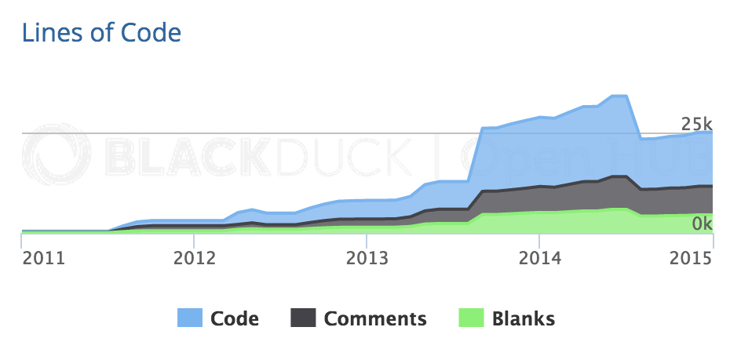





Slide 7




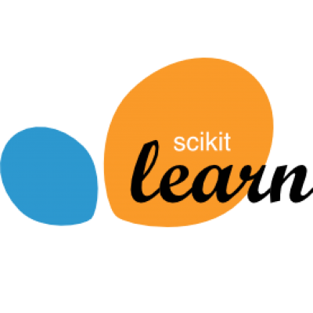



Notes:
Paris: scikitlearn was born here; an whole arsenal of self-learning algorithms
-> many nilearn developers are also scikit-learn developpers
lovely: At Lovely, we strive to deliver the best apartment marketplace, with respect to our users and our listings.
OkCupid: matchmaking system; Free Online Dating

Slide 8
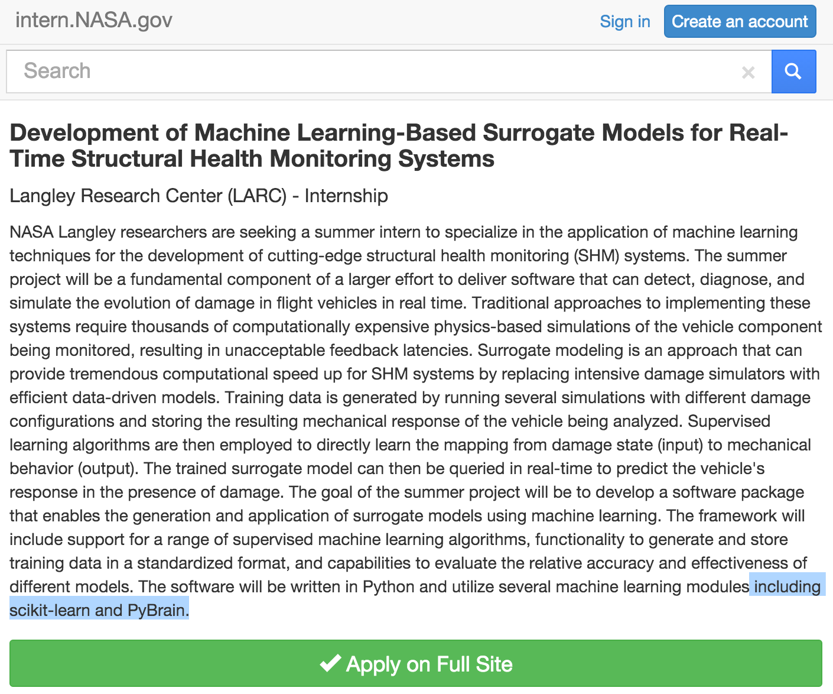

Slide 9
Notes:
Michael:
ENS / equipe data / Prof. Mallat

