Slide 1

Project 1:
Standardized Testing, Statistical Summaries and Inference
SAT and ACT Analysis
Ali Habibi
Winter 2021

Slide 2
Problem Statement
After several years of releasing new format of SAT, we are interested to track participation rate of test takers statewide. We collected SAT and ACT scores for three years (2017-2019). To have any suggestion for targeting any state, we analyse these datasets for ACT and SAT. Here are the steps required to analyse SAT and ACT results.
Workflow of the project
- Collecting/importing datasets.
- Cleaning datasets
- Exploratory data analysis
- Data visualization
- Analysing statistical parameters
- Conclusions

Slide 3
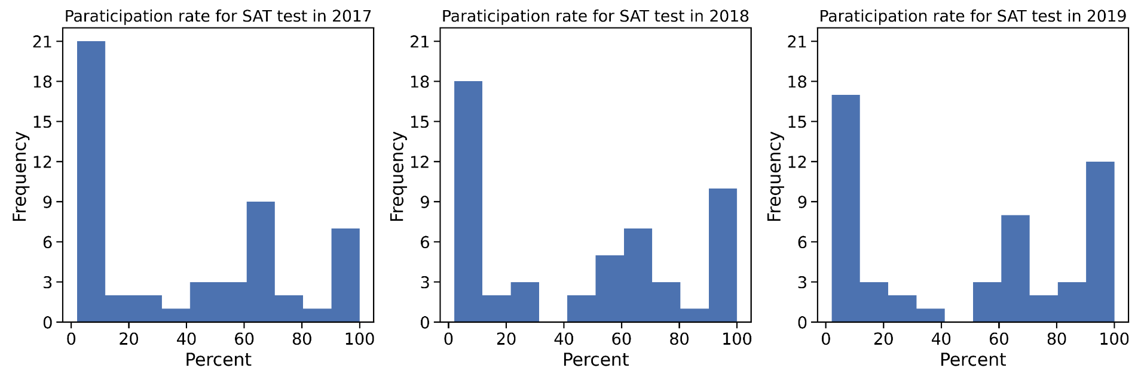
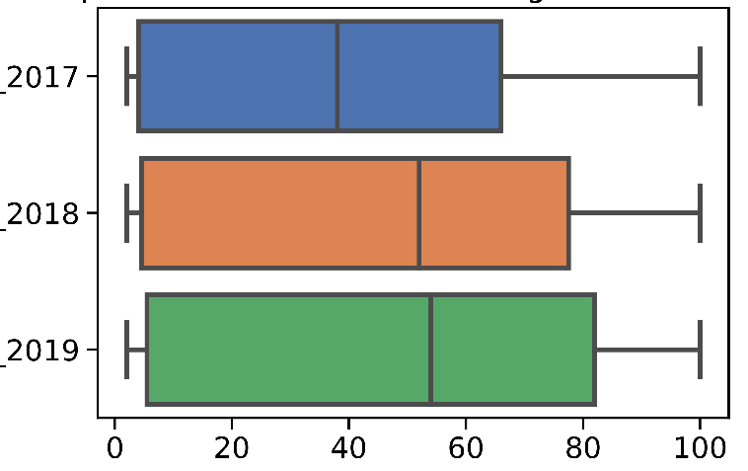
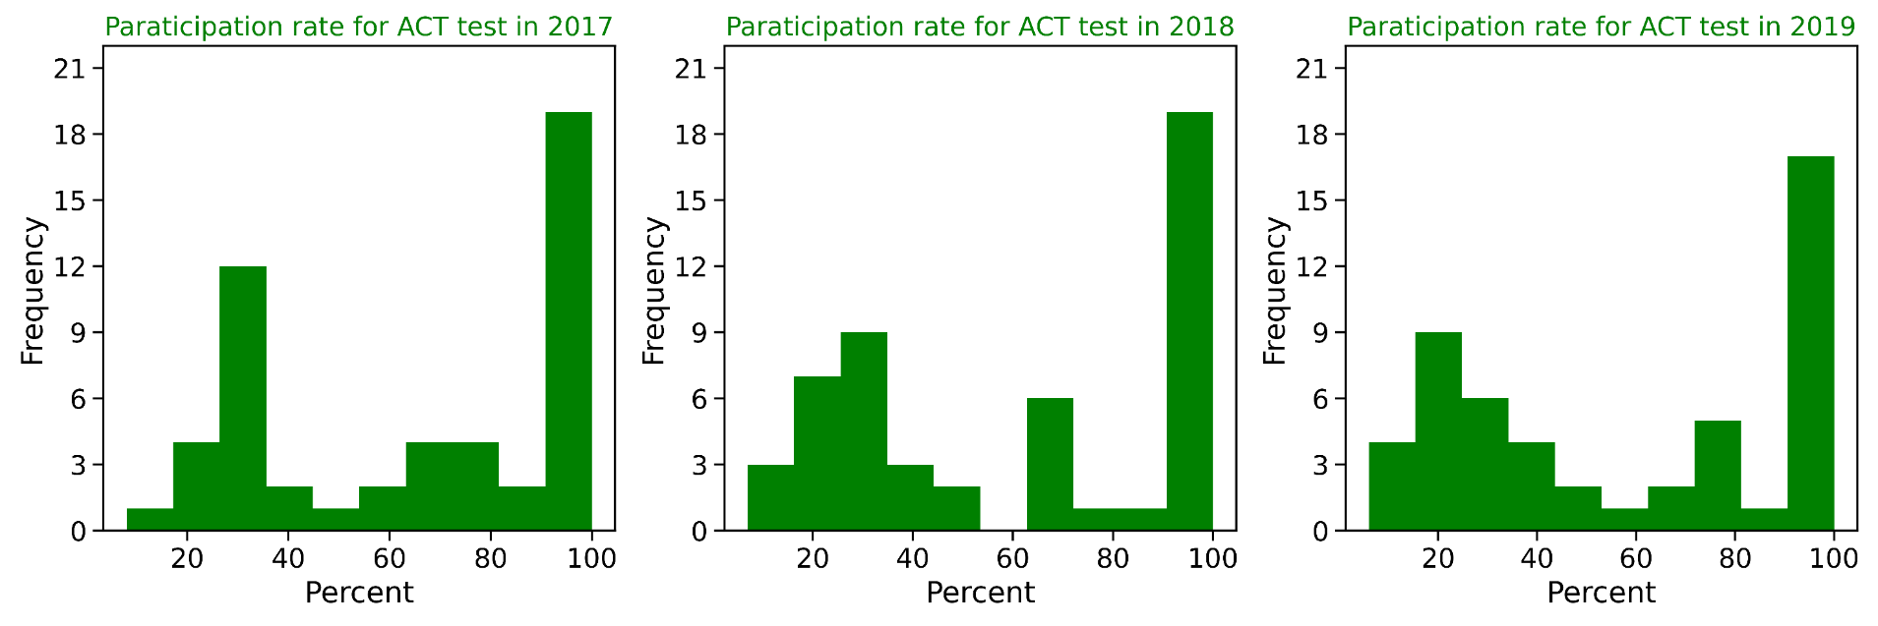
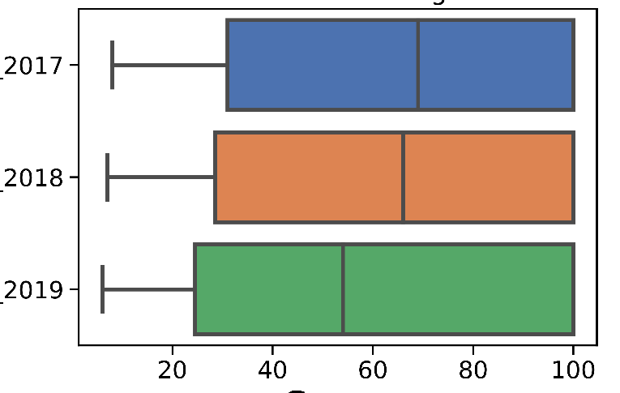
Participant rates for SAT and ACT tests (2017-2019)
Notes:
SAT: Frequency of states with low participant rate decreases while frequency of states with high participant rate increases.
ACT: Frequency of states with high participant rate does not significantly change .

Slide 4
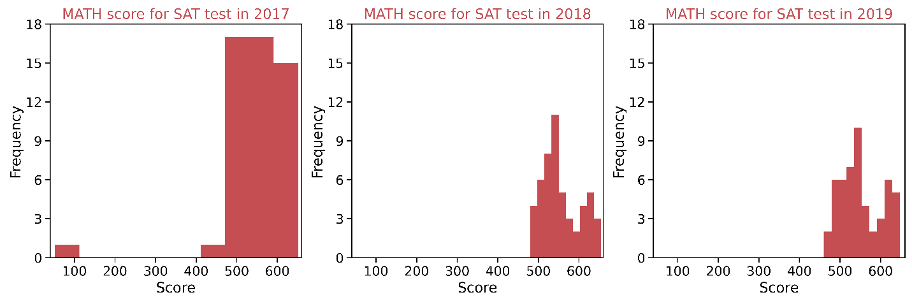
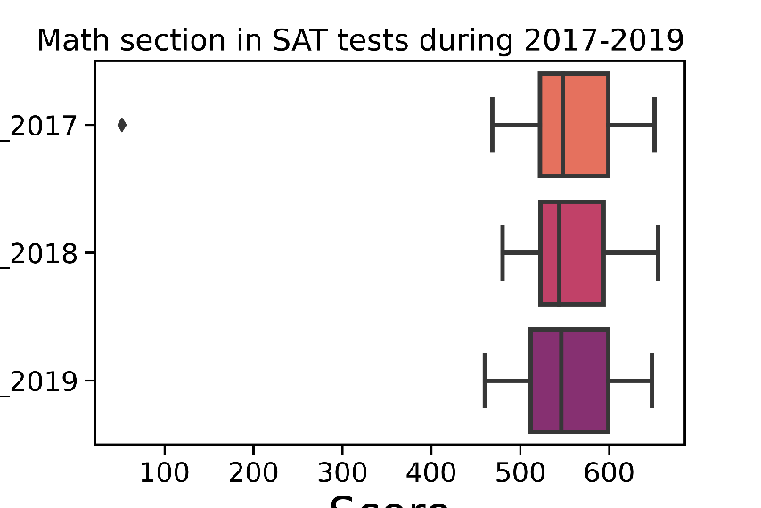
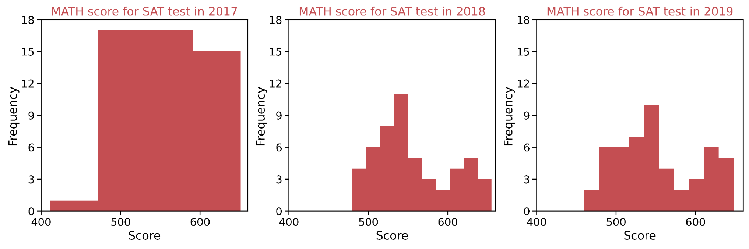
Math scores for SAT during (2017-2019)
Frequency of math in range of 480-650 in 2017 is higher than that in 2018 and 2019.
The presence of very low minimum value (52) in 2017 results in high standard deviation (84.9) compared with 2018 (47.7) and 2019 (51.2).

Slide 5
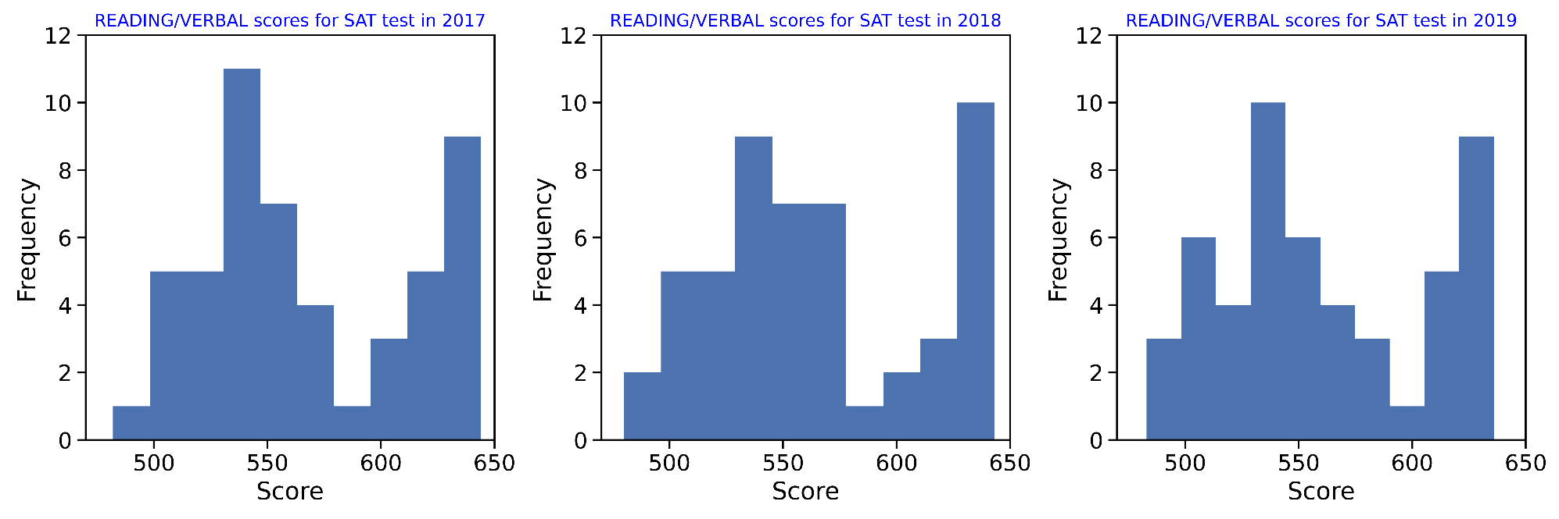
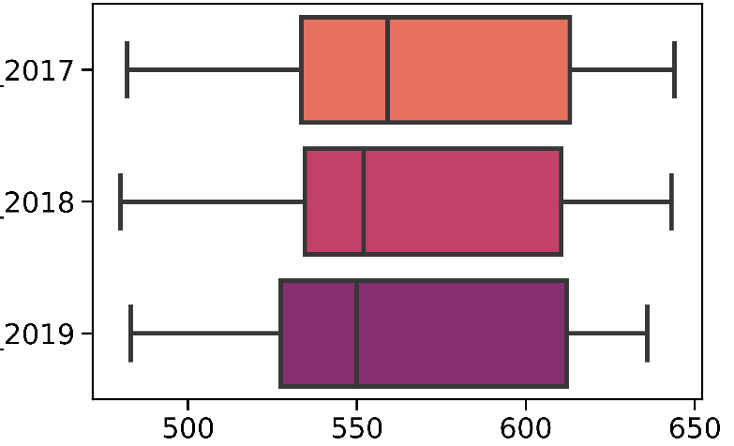
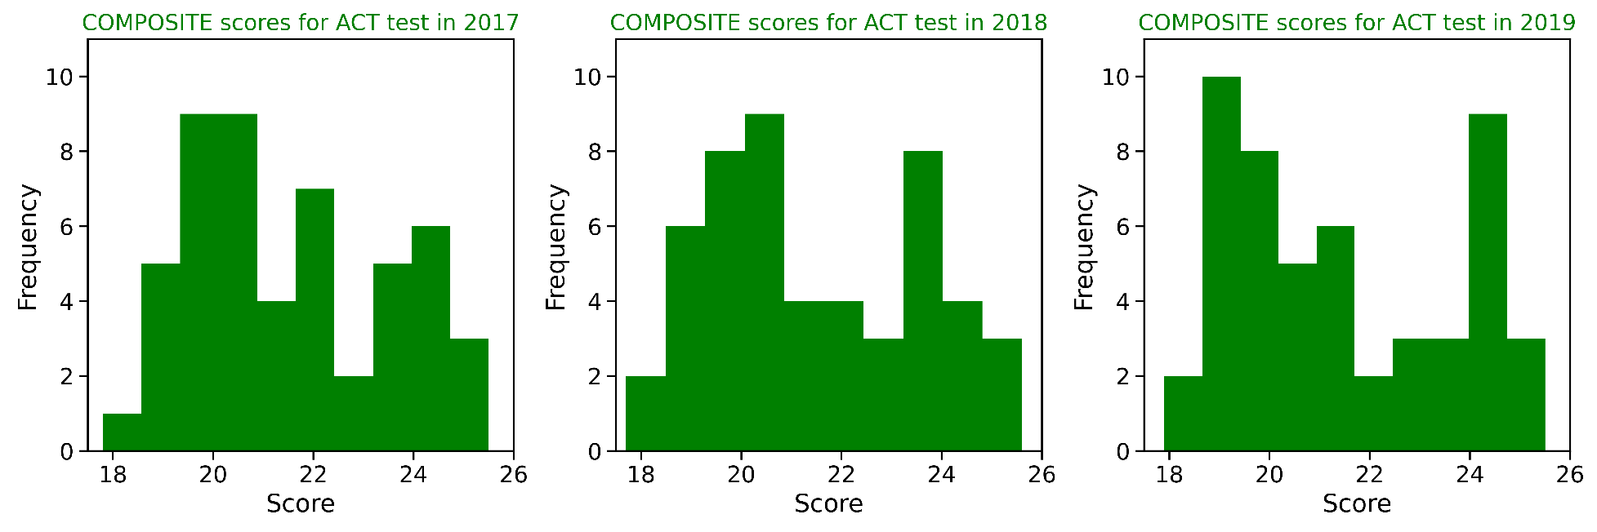
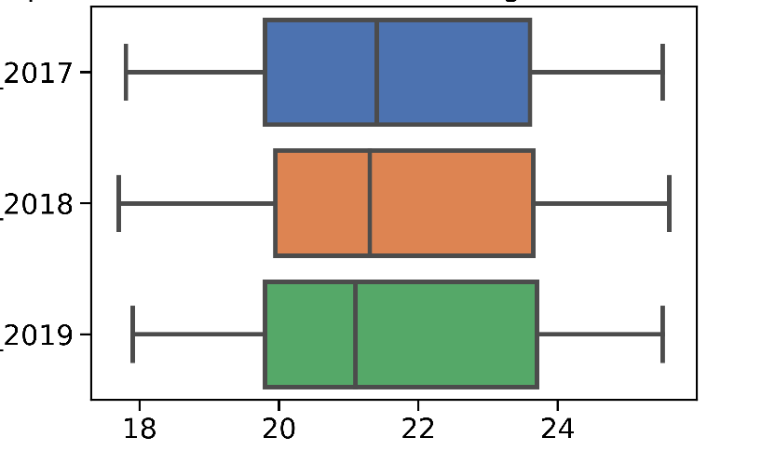
Reading/composite for SAT and ACT during (2017-2019)
Notes:
There is no specific trends in reading/ composite sections of SAT and ACT.

Slide 6
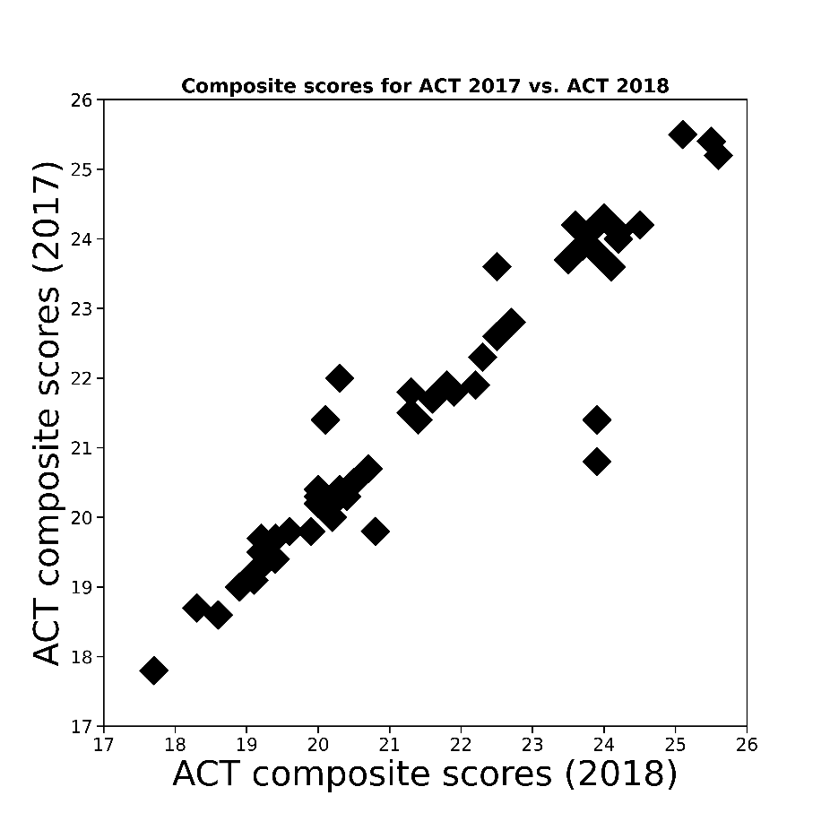
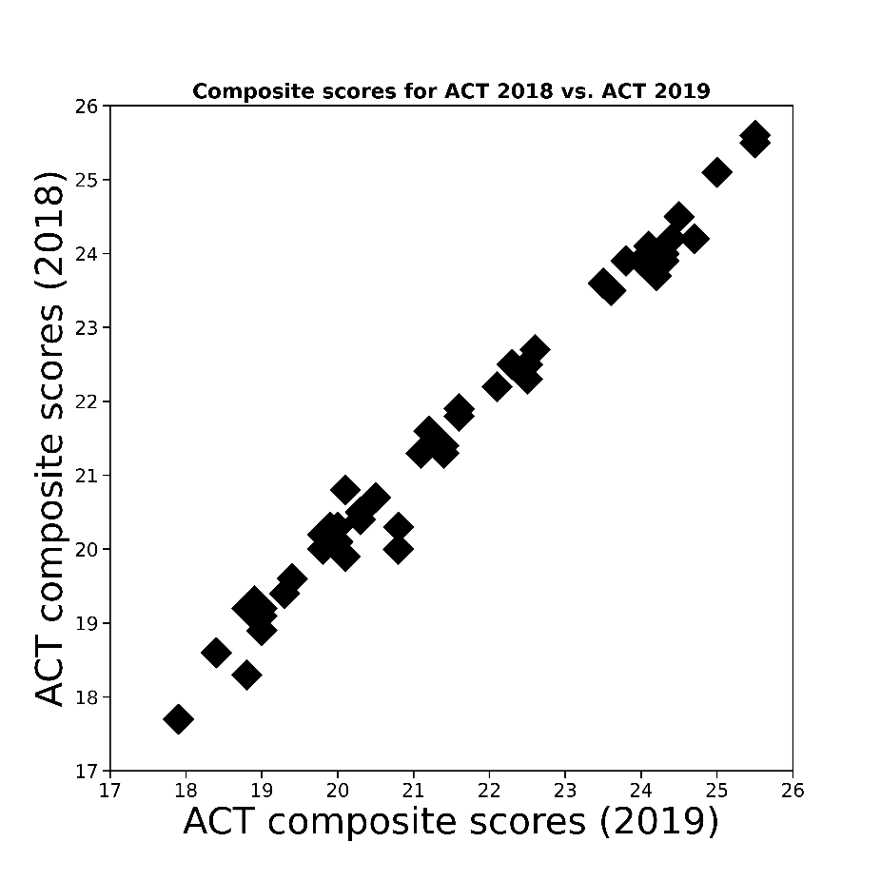
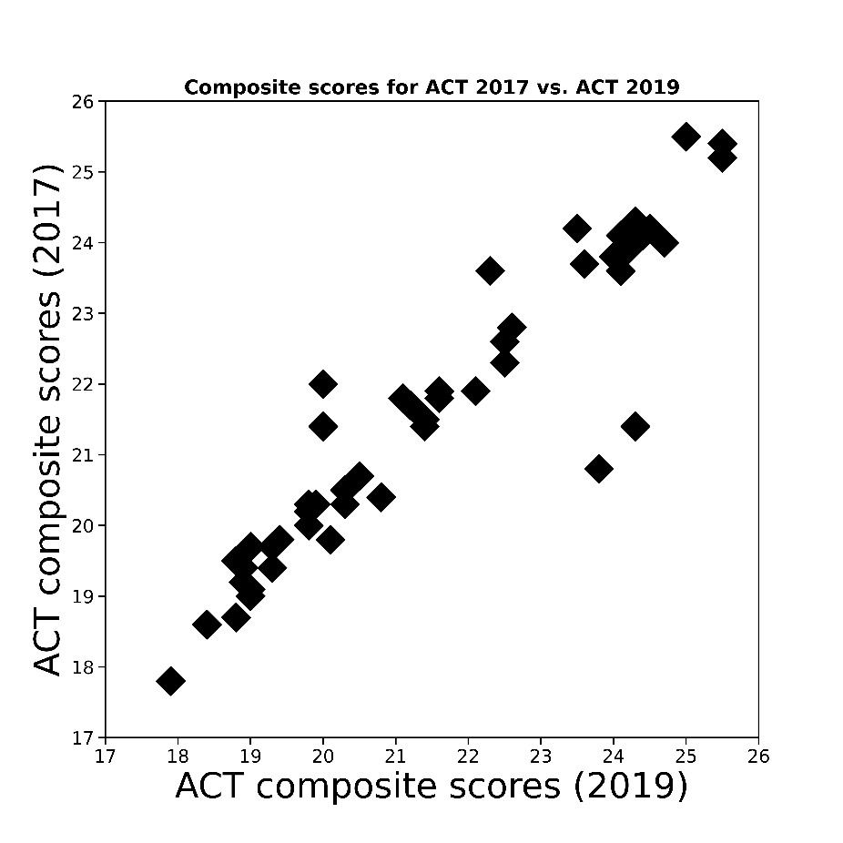
Scatterplot of composite scores for ACT during (2017-2019)
Pearson correlation=0.94
Pearson correlation=0.99
Pearson correlation=0.93
Composite scores in ACT are well correlated with each other during 2017-2019. This indicates that scores of this section does not change significantly in this period.

Slide 7
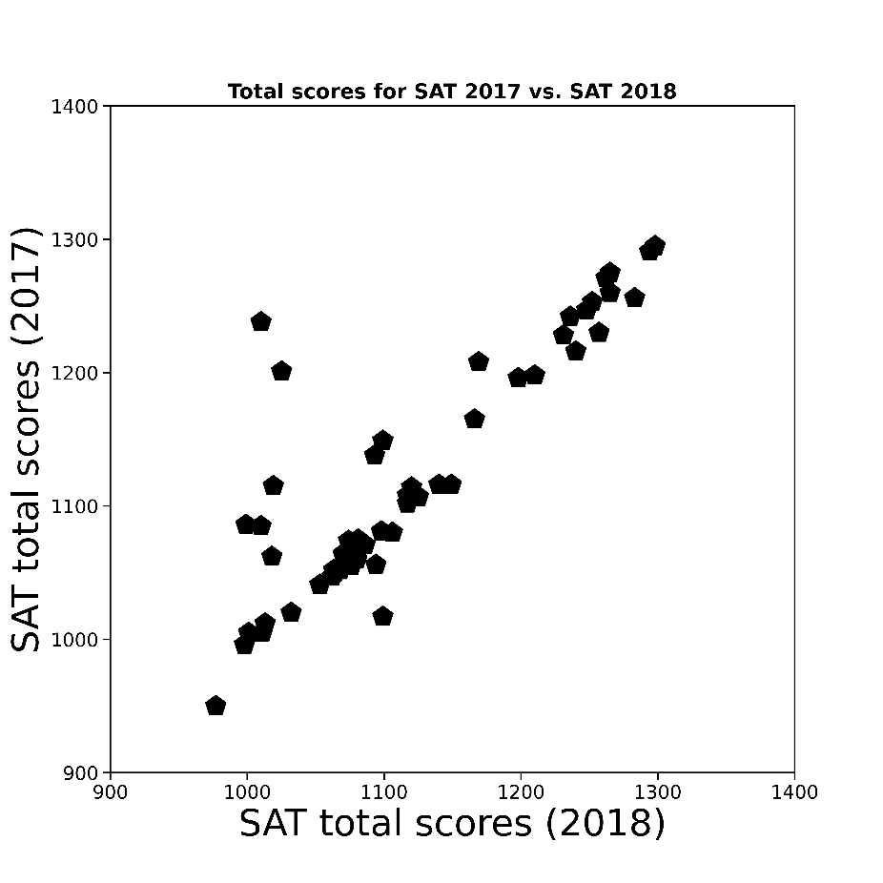
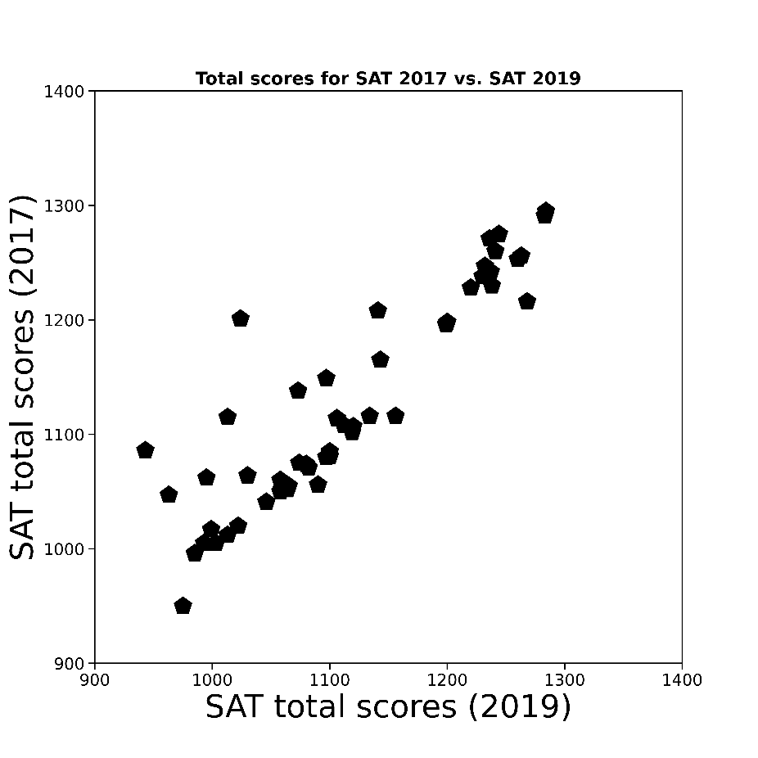
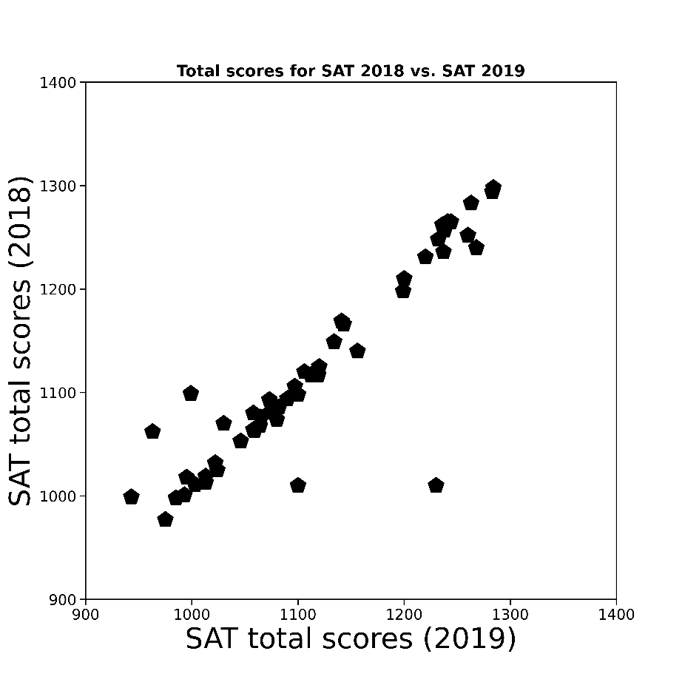
Scatterplot of total scores in SAT during (2017-2019)
Pearson correlation=0.85
Pearson correlation=0.90
Pearson correlation=0.91
Total scores of SAT are well correlated with each other during 2017-2019. This indicates that scores of this section does not change significantly in this period.

Slide 8
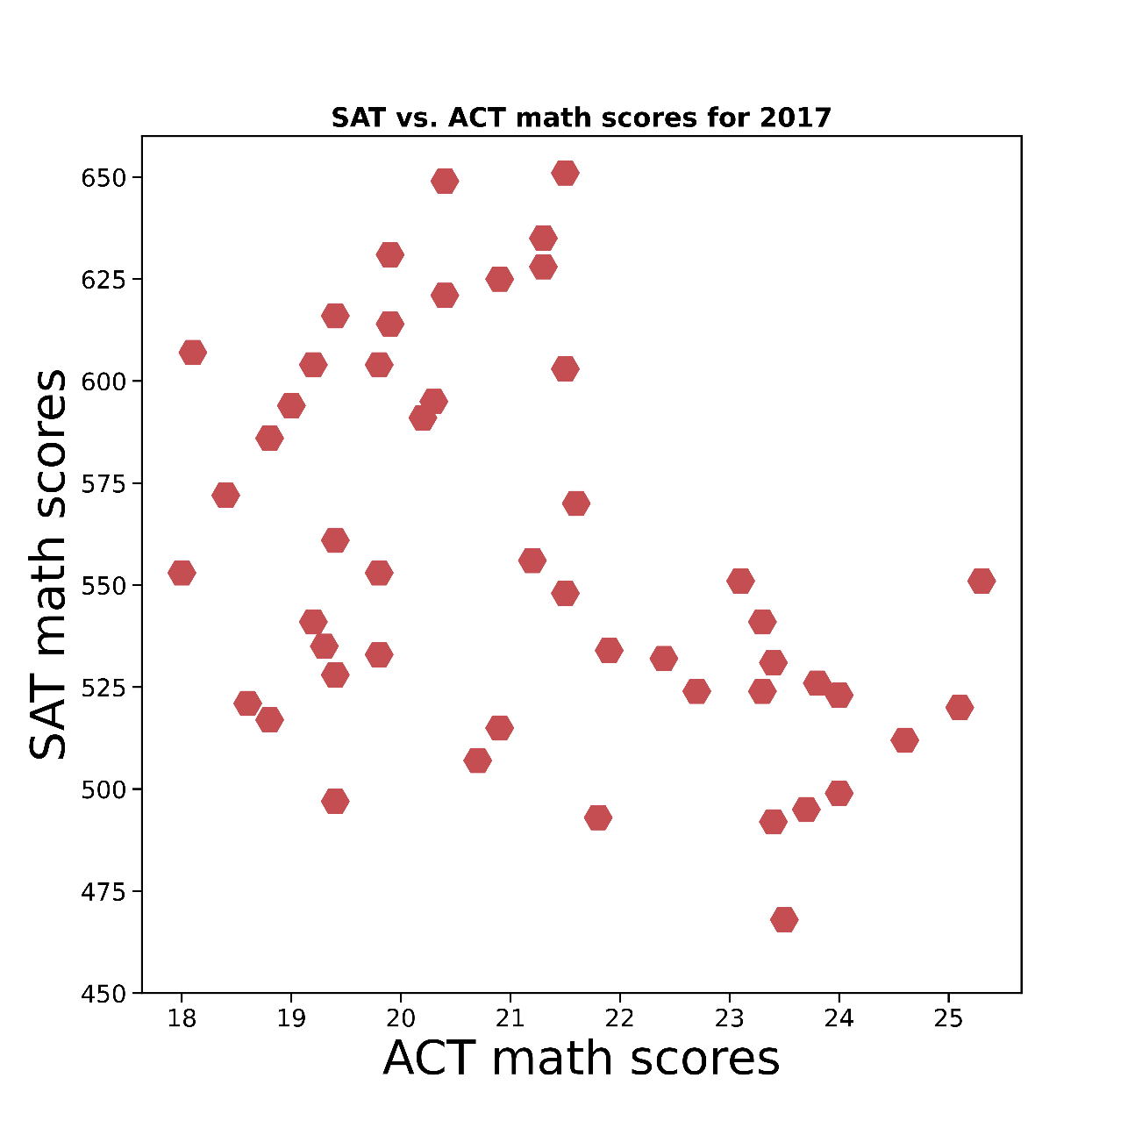
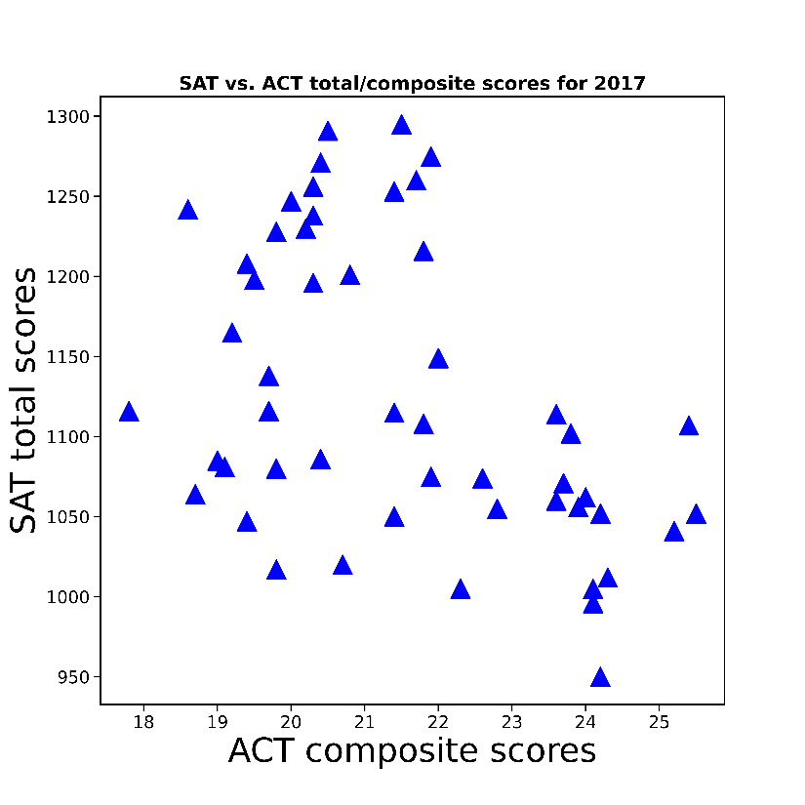
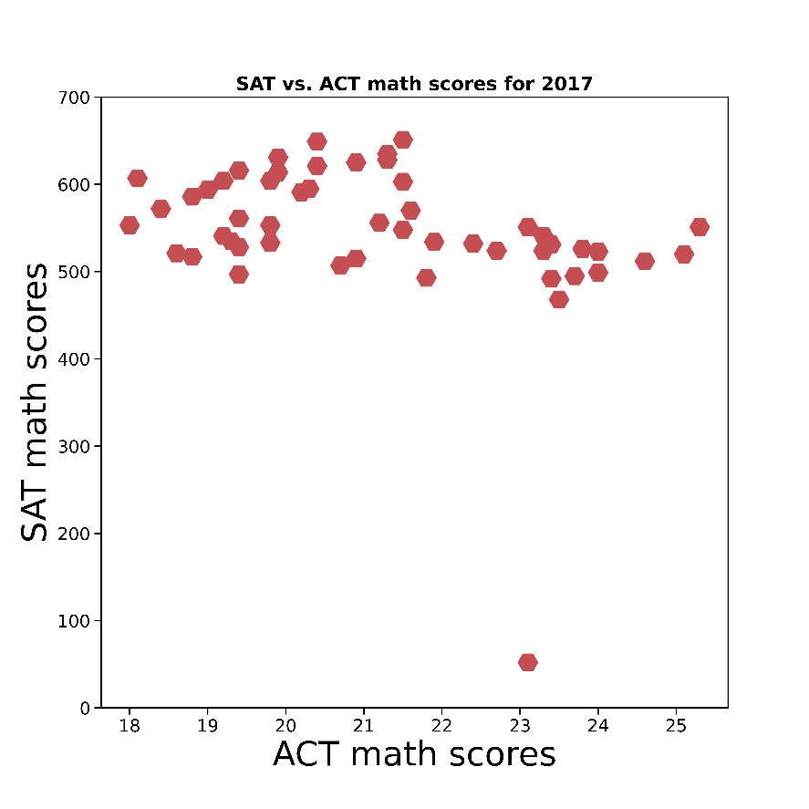
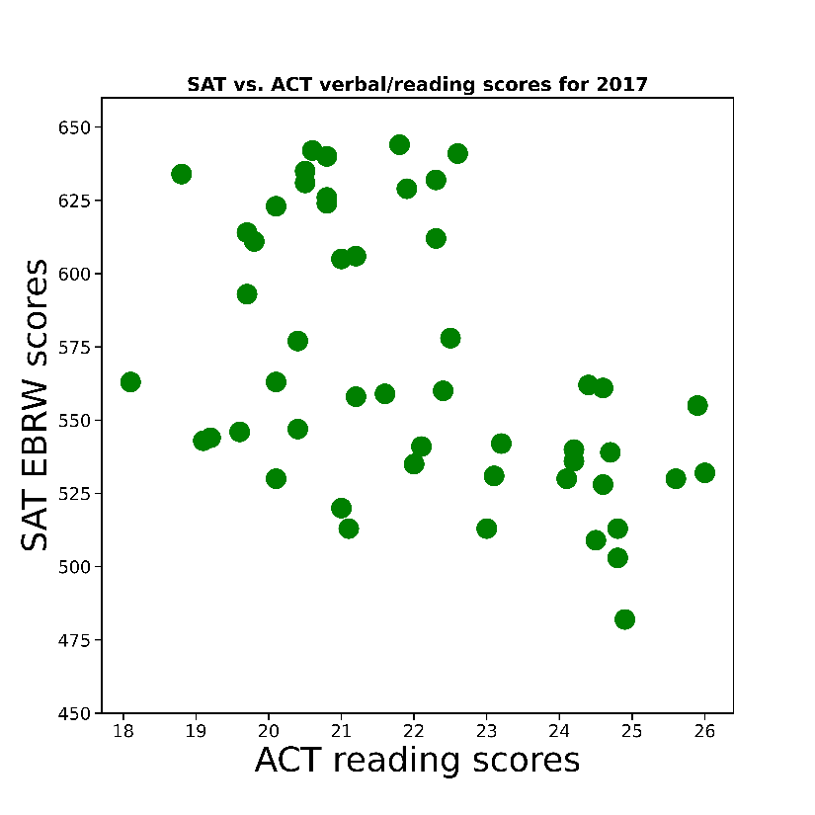
Scatterplot of ACT and SAT scores in 2017
Pearson correlation
-0.45
Pearson correlation=-0.34
Pearson correlation
-0.49
Scores of SAT have weak negative correlation with scores of ACT in 2017.

Slide 9
Which states have trends in SAT and ACT participant rates?
SAT:
Maximum participant rates (100%)
Connecticut, Delaware, and Michigan
SAT:
Minimum participant rates (2-3%)
North Dakota, Wyoming, South Dakota
SAT:
Decreasing participant rates
Nevada(26%-23%-20%)
SAT:
Most increasing participant rates
Illinois(9%-99%-100%)
Rhode Island(71%-97%-100%)
West Virginia(14%-28%-99%)
ACT:
Maximum participant rates (100%)
Alabama, Arkansas, Kentucky, Louisiana, Wyoming, Wisconsin,…
ACT:
Minimum participant rates (8%)
Maine
ACT:
Most Decreasing participant rates
Colorado(100%-30%-27%)
Illinois(93%-43%-35%)
West Virginia(69%-65%-49%)
ACT:
Increasing participant rates
Arizona(62%-66%73%)
Note: Maximum scores are based on the similar participant rates during 2017-2018

Slide 10
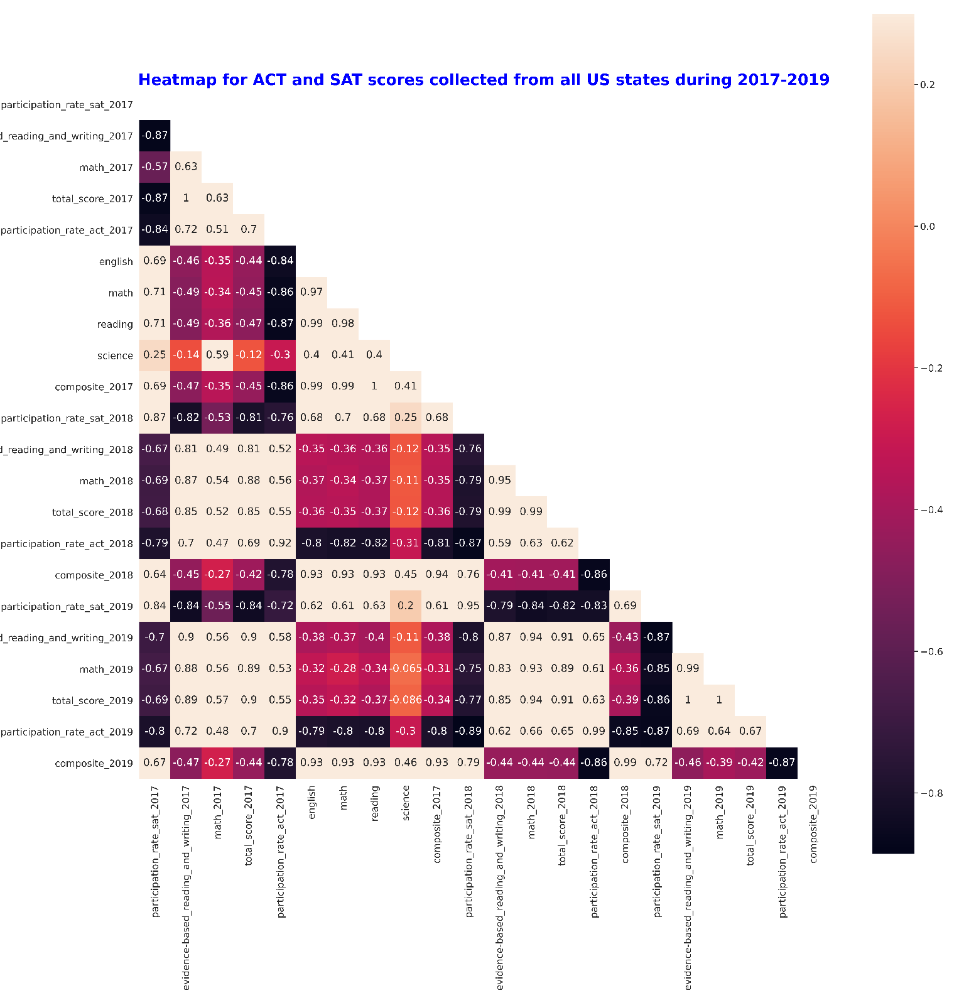

Slide 11
Conclusions and Recommendations
Participant rate is negatively correlated with SAT and ACT total scores (SAT: 2017:-0.87,2018:-0.79, 2019:-0.86, ACT: 2017:-0.86,2018:-0.86,2019:-0.87).
North Dakota shows the lowest participant rate (2%) among all states in SAT test while the total SAT score is in the range of 1256-1283.
ACT and SAT participation distribution are inversely correlated with each other (Pearson correlation= (-0.8)-(-0.9)).
It seems coastal states prefer to take SAT while Midwestern states prefer to take ACT.

