Slide 1

Project 2 Ames Housing Data and Kaggle Challenge
Ali Habibi
April 2021

Slide 2

Objective:
The Ames Housing dataset is a detailed dataset provided for data analysis. This dataset has 80 columns. Each column describes one feature of houses. In this project, the price of house at sale should be predicted using three regression models. These models work based on the linear least squares function.
Models used in this project:
Linear Regression
Ridge
Lasso
Source: https://bencho264.medium.com/predictions-of-ames-housing-prices-31319b4b51fe

Slide 3
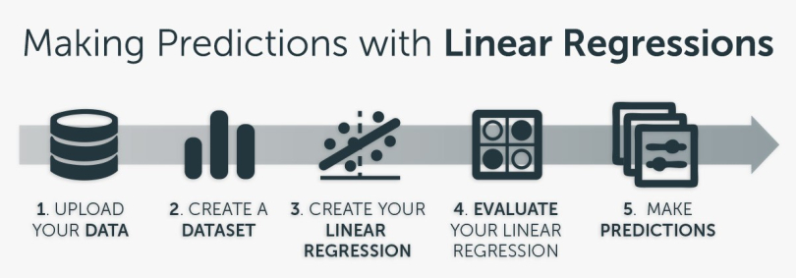
Workflow of the project
Importing dataset.
Cleaning dataset.
Feature engineering
Modelling with data.
Evaluating models.
Predicting the sale price
Conclusions
Source: https://blog.bigml.com/2019/03/22/programming-linear-regressions/

Slide 4
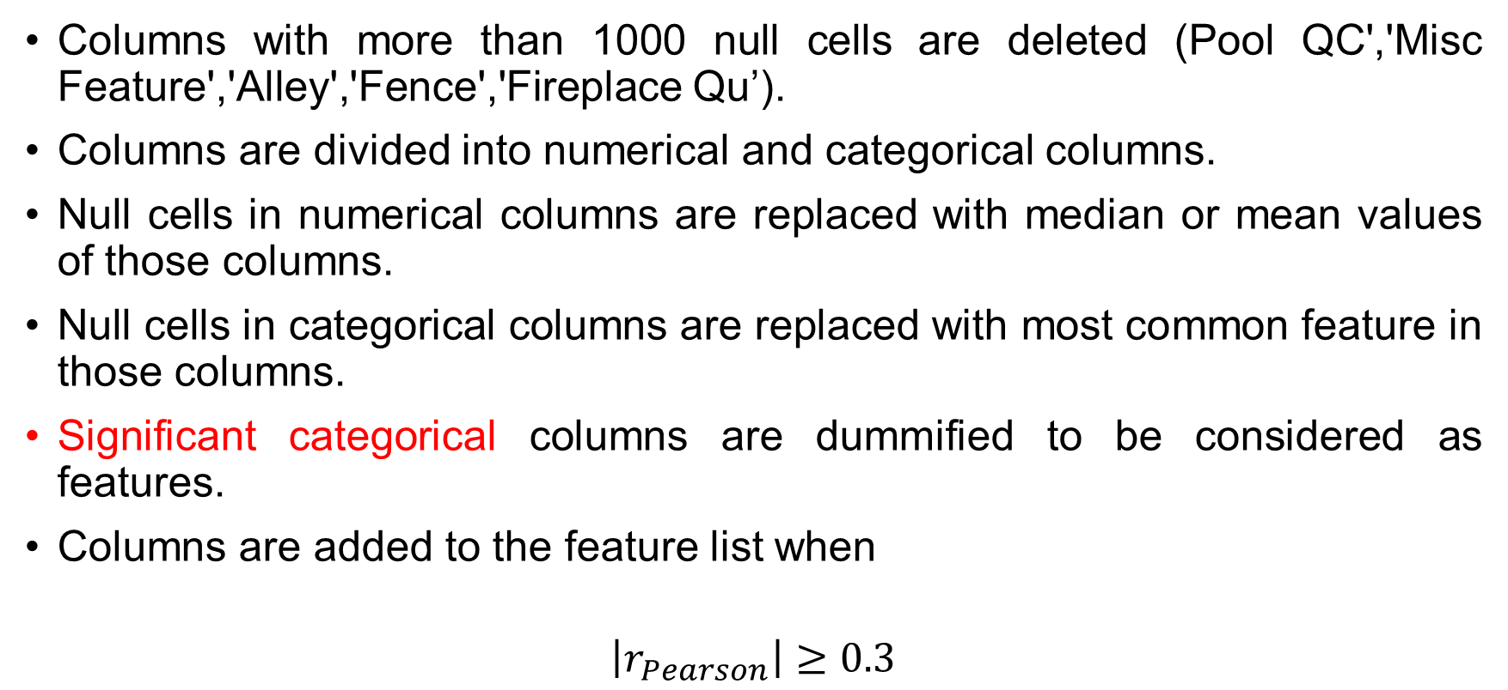
Highlights: Cleaning the training dataset
Columns with more than 1000 null cells are deleted (Pool QC','Misc Feature','Alley','Fence','Fireplace Qu’).
Columns are divided into numerical and categorical columns.
Null cells in numerical columns are replaced with median or mean values of those columns.
Null cells in categorical columns are replaced with most common feature in those columns.
Significant categorical columns are dummified to be considered as features.
Columns are added to the feature list when
$$\left|r_{Pearson}\right|≥0.3$$

Slide 5
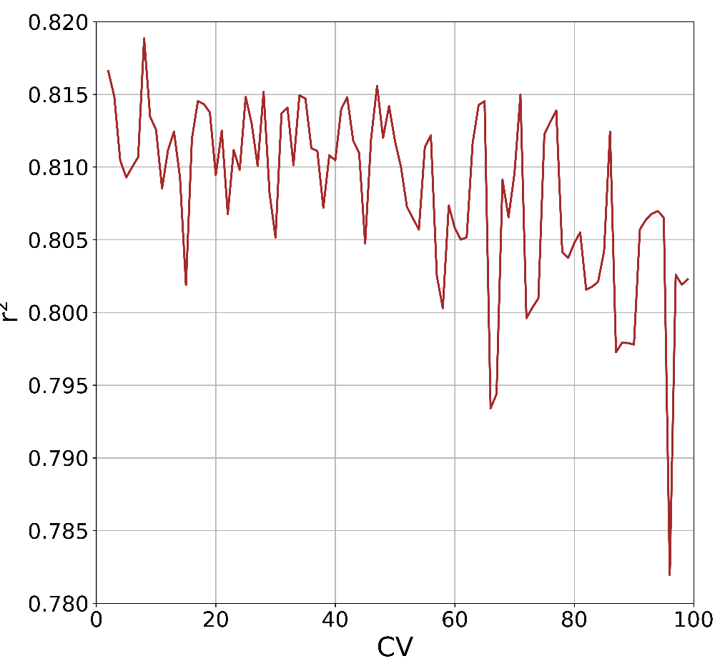






Highlights: Model preparation
Linear regression, ridge, and lasso are used.
$$−10<log{α_{lasso}<10}$$
$$r^{2}=0.805$$
$$1<log{α_{ridge}<10}$$
$$r^{2}=0.806$$
$${CV}_{lr}=8$$
$$r^{2}=0.818$$

Slide 6
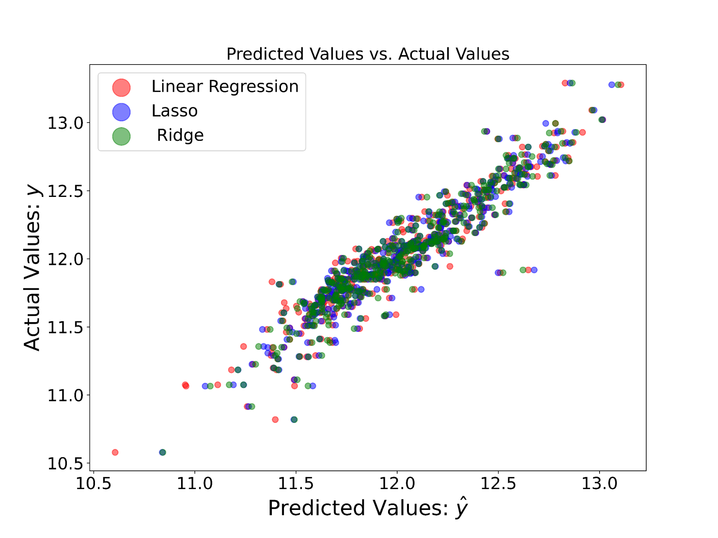
Highlights: Model fitting and evaluation

Slide 7
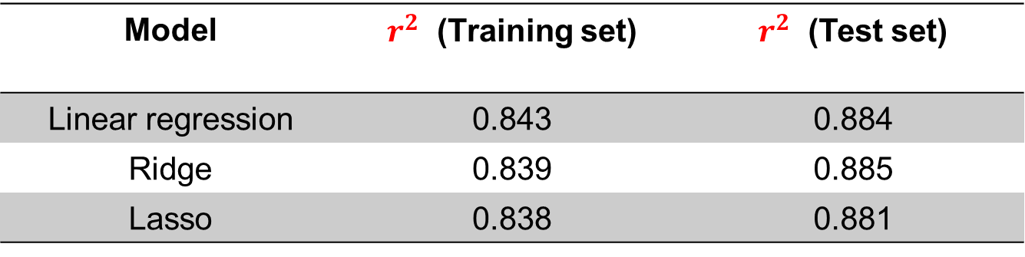
Highlights: Model fitting and evaluation
Linear regression, ridge, and lasso are used.
Model | $r^{2}$ (Training set) | $r^{2}$ (Test set)
Linear regression | 0.843 | 0.884
Ridge | 0.839 | 0.885
Lasso | 0.838 | 0.881

Slide 8
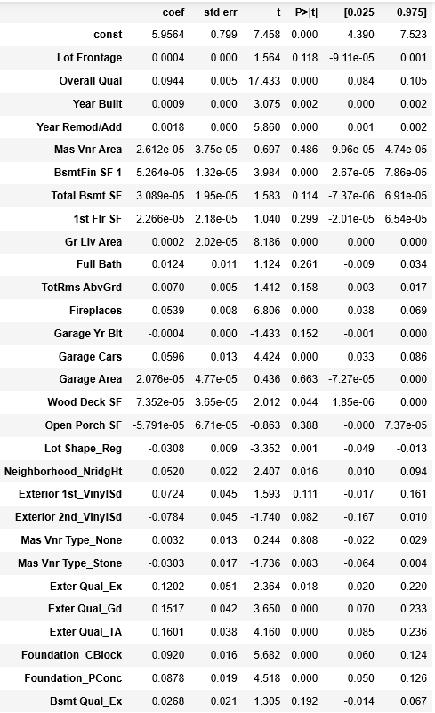
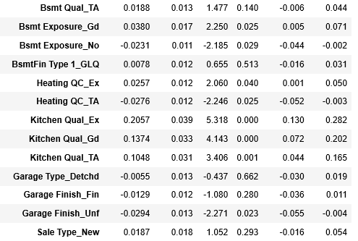
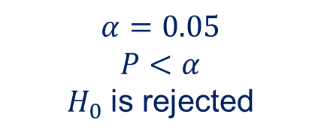


Highlights: Significant parameters
$$H_{0}: β_{parameter}=0$$
$$H_{A}: β_{parameter}≠0$$
$$α=0.05$$
$$P<α$$
$H_{0}$ is rejected

Slide 9
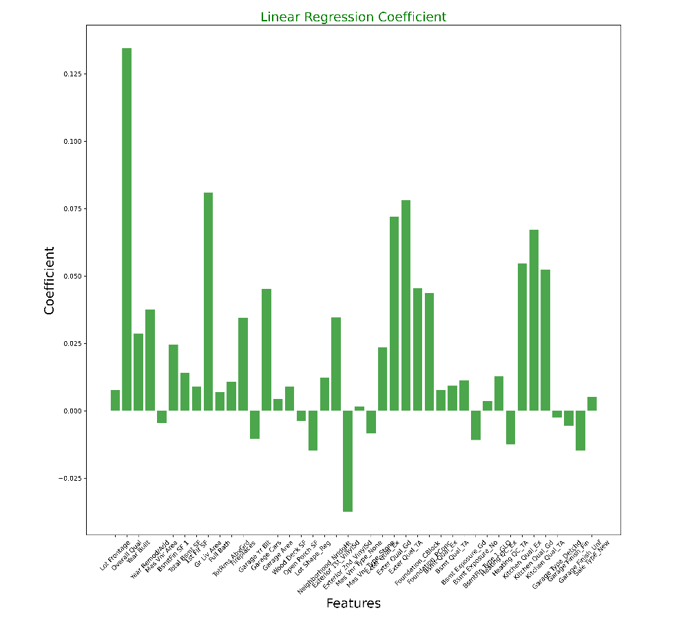
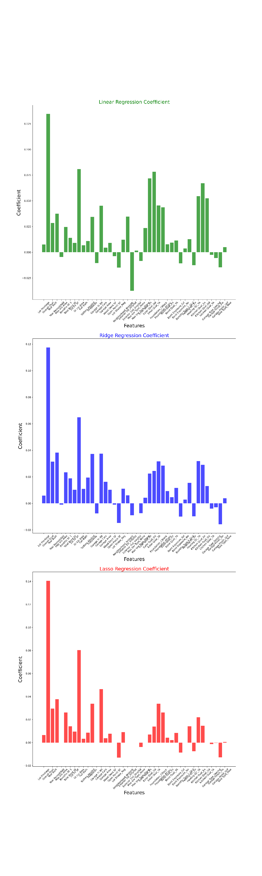
Highlights: Significant parameters
Lot Frontage has the highest $β$value among all coefficients.

Slide 10
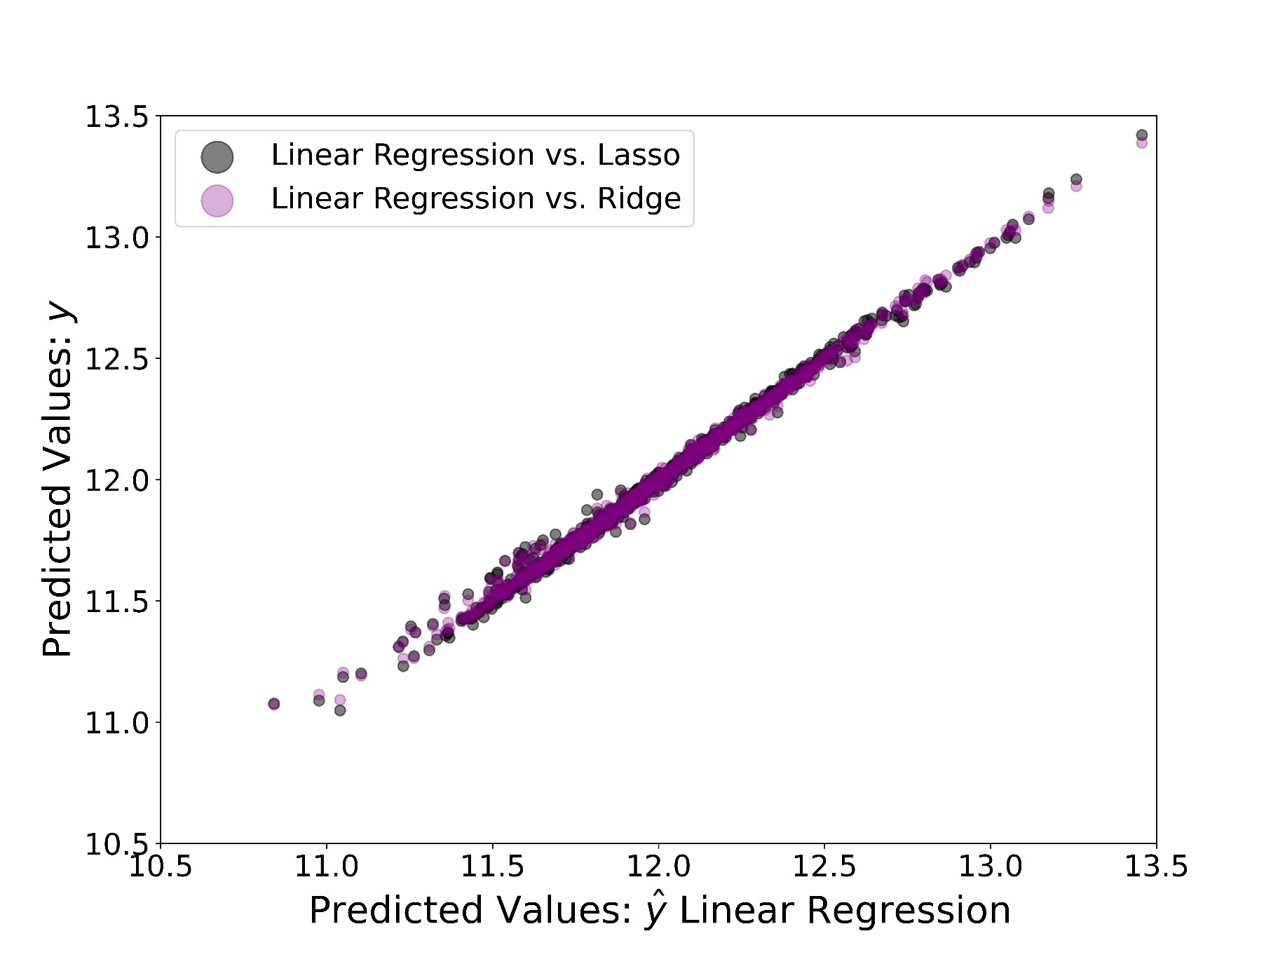
Highlights: Predicting sale price for a new dataset

Slide 11
Conclusions
All three models can successfully fit the sale price for Ames House datasets.
Linear regression has the highest R² Among models for train and test section.
Statmodel library is used to determine the significant parameters on the sale price.

