Slide 1

Project 3 Web APIs and NLP
Ali Habibi
April 2021
Notes:
Today, I wanna present the results of classifications for texts obtained from two categories of reddit website.

Slide 2


Objectives:
Collecting text data using Pushift's API
Performing binary classification on two subreddits.
Source: https://www.reddit.com/r/CryptoCurrency/
Source: https://www.reddit.com/r/stocks/

Slide 3
Classification workflow:
Importing libraries
Collecting data using the `request` library and Pushift's API
Performing EDA
Fitting and evaluating classification models (estimators)
Summary

Slide 4
Highlights: Collecting data
Posts from "Stocks" and "CryptoCurrency" subreddits are requested for a month starting from Sunday, 21 March 2021 10:00:00 to Tuesday, 20 April 2021 10:00:00 GMT.
A “message” function is defined to request posts using Pushift’s API
Three features are extracted from posts: subreddit (category), selftext, and title.
Two separate data frames are concatenated to form the final data frame.

Slide 5
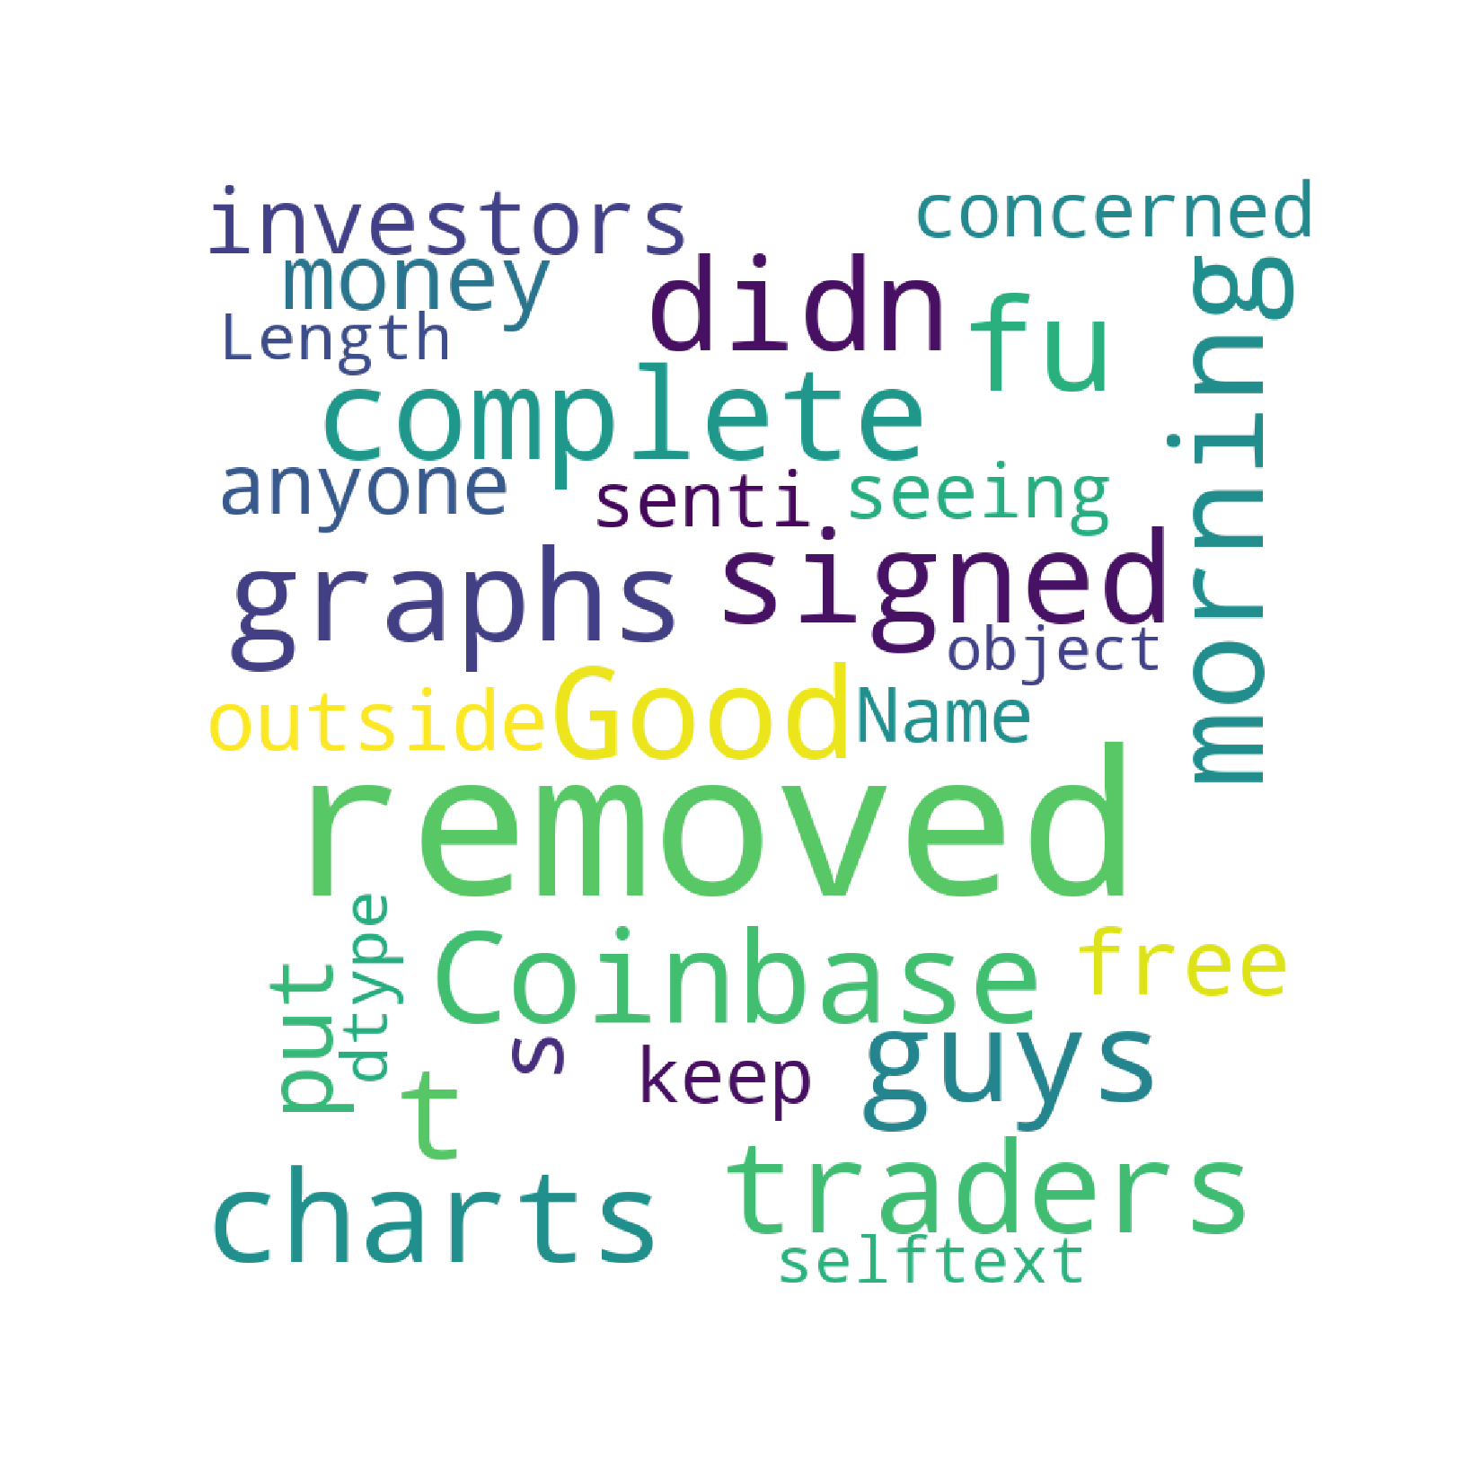

Highlights: Performing EDA
Mapped subreddit column as: "CryptoCurrency": 0 and "Stocks":1.
Word Cloud of “selftext”
Word Cloud of “title”
Notes:
The null cells in selftext column is dropped from the data frame. This is reasonable because there are only 27 null cells in selftext column.

Slide 6
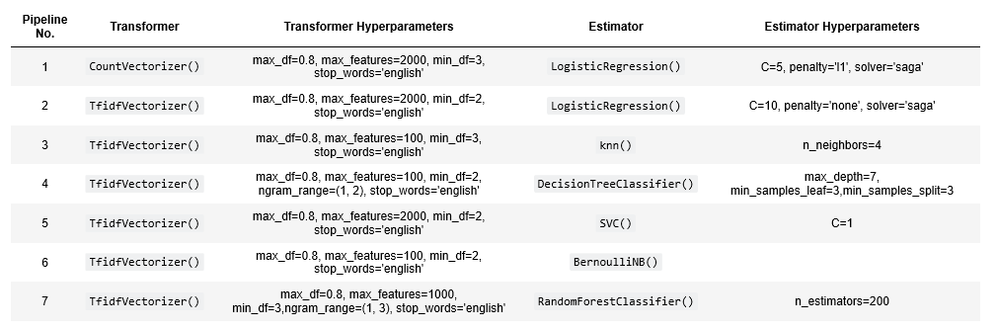
Highlights: Fitting using transformers and estimators
Best training score based on CV,
Training score,
Test score,
Confusion matrix,
Feature importance parameter (`eli5` library)

Slide 7
Highlights: Evaluating pipelines- scores
Pipeline No. | Transformers | Estimators | Best Score based on CV | Training Score | Test Score
1 | CountVectorizer | LogisticRegression | 0.811 | 0.817 | 0.803
2 | TfidfVectorizer | LogisticRegression | 0.811 | 0.826 | 0.800
3 | TfidfVectorizer | SVC | 0.813 | 0.825 | 0.803
4 | TfidfVectorizer | RandomForest | 0.811 | 0.826 | 0.802
5 | TfidfVectorizer | knn | 0.730 | 0.784 | 0.756
6 | TfidfVectorizer | DecisionTree | 0.779 | 0.786 | 0.773
7 | TfidfVectorizer | BernoulliNB | 0.793 | 0.798 | 0.789
LogisticRegression, SVM, and Random Forest classifiers show the best score values.

Slide 8
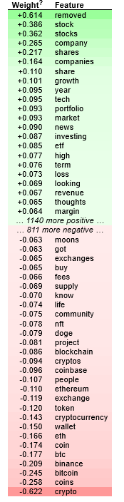
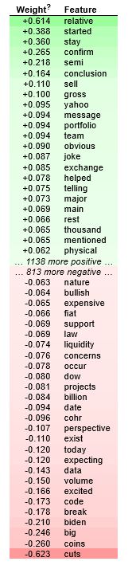
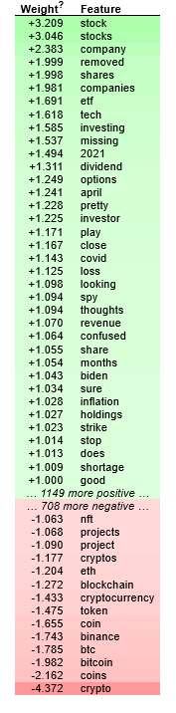
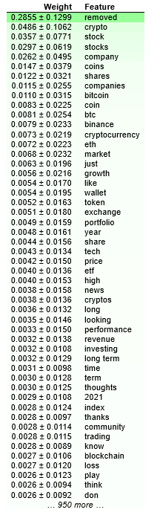
Highlights: Evaluating pipelines- feature importance
CountVectorizer
LogisticRegression
TfidfVectorizer
LogisticRegression
TfidfVectorizer
SVC
TfidfVectorizer
RandomForest
Notes:
Important features with positive and negative signs are related to Stocks and Cryptocurrency categories, respectively.

Slide 9
Highlights: Evaluating pipelines- confusion matrix
 | Predicted Cryptocurrency(-ve) | Predicted Stocks(+ve)
Actual Cryptocurrency(-ve) | 601-605 | 348-352 False positive
Actual Stocks(+ve) | 14-23 False negative | 884-893
Sensitivity | Specificity
0.98 | 0.63
Notes:
This means that, the number of false negative values (wrongly predicted Crypto subreddit) is low while the number of false positive values (wrongly predicted stocks subreddit) is relatively high. One reason can be related to application of stocks words in crypto subreddit. However, application of crypto words in stocks is limited, leading to low false negative and high sensitivity value.
High number of true positive and true negative values indicates that there are many unique words in these categories. Therefore, estimators can easily distinguish between these categories.

Slide 10
Summary
LogisticRegression, SVM, and Random Forest classifiers show the best score values.
All three estimators have the best score value of 0.81.
The score values obtained from these estimators for the test dataset are close to 0.8. This shows that the model is generalized properly.
The score values of the training dataset for these estimators are in the range 0.81-0.82, indicating that the over fitting issue does not exist.
Confusion matrices calculated for all estimators show that sensitivity values are in the range of 0.89-0.98 while specificity values are approximately 0.63.
The number of false negative values (wrongly predicted crypto category) is low while the number of false positive values (wrongly predicted stocks category) is relatively high.
One reason can be related to the use of stocks words in crypto category. However, application of crypto words in stocks is limited, leading to low false negative and high sensitivity value.
High number of true positive and true negative values indicates that there are many unique words in these categories. Therefore, estimators can easily distinguish between these categories.

