Slide 1

Greenhouse Gas Emission: Visualizing and Forecasting
Ali Habibi
June 2021

Slide 2
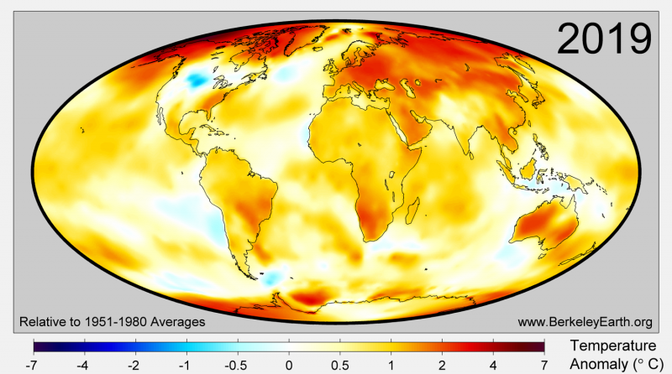
Problem statement
Does climate change matter?
Is greenhouse gas (GHG) emission contributing to the global warming?
The global average temperature has increased in the range of 1-1.2ºC since pre-industrial era.
Source: https://ourworldindata.org/co2-and-other-greenhouse-gas-emissions
Notes:
How much of the warming since 1850 can be attributed to human emissions? Almost all of it. The Intergovernmental Panel on Climate Change (IPCC) states clearly in its most recent assessment report (AR5)⁴:
“Anthropogenic greenhouse gas emissions have increased since the pre-industrial era, driven largely by economic and population growth, and are now higher than ever. This has led to atmospheric concentrations of carbon dioxide, methane and nitrous oxide that are unprecedented in at least the last 800,000 years. Their effects, together with those of other anthropogenic drivers, have been detected throughout the climate system and are extremely likely to have been the dominant cause of the observed warming since the mid-20th century.“

Slide 3
Objectives
Developing an application that interactively:
Visualizes emissions of greenhouse gases including carbon dioxide (CO₂​), methane (CH₄​), and nitrous oxide (N₂​O) for all countries.
Tabulates share of different sectors including coal, oil, gas, gas flaring or cement in CO₂ production for all countries.
Forecasts CO₂​ emission of 16 countries, leading the global economic output, for 2020-2025.

Slide 4
Project workflow
1
Creating a dataset
2
Performing EDA
3
Visualizing GHGs emissions for all countries
4
Modelling and forecasting CO₂ emission
https://github.com/owid/co2-data
GHGs: CO₂, CH₄, and N₂O
Providing insights and recommendations
Notes:
Which countries are key players in GHG emission?

Slide 5
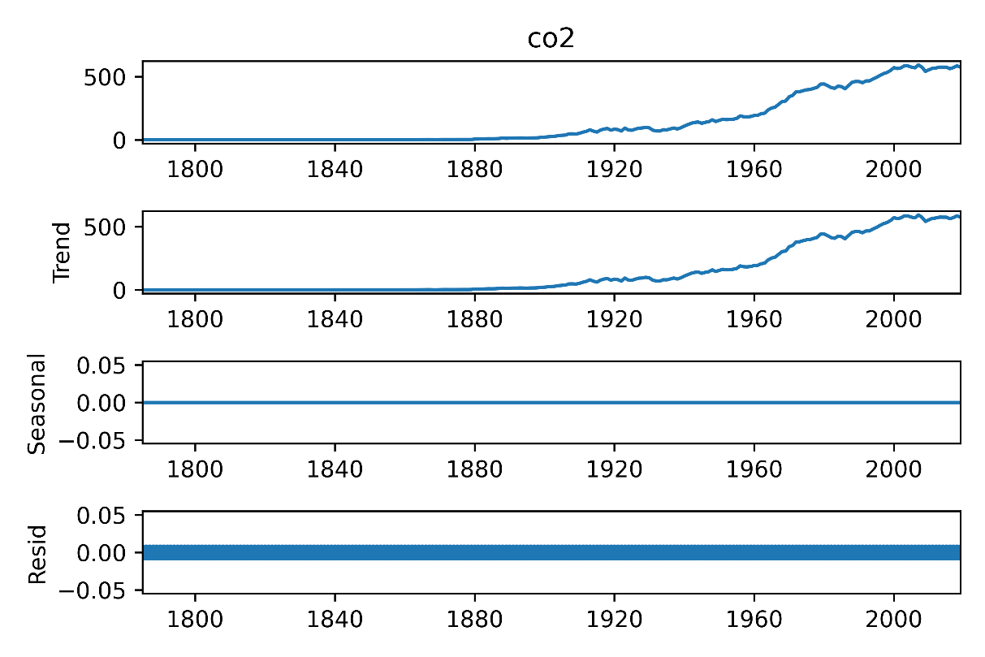
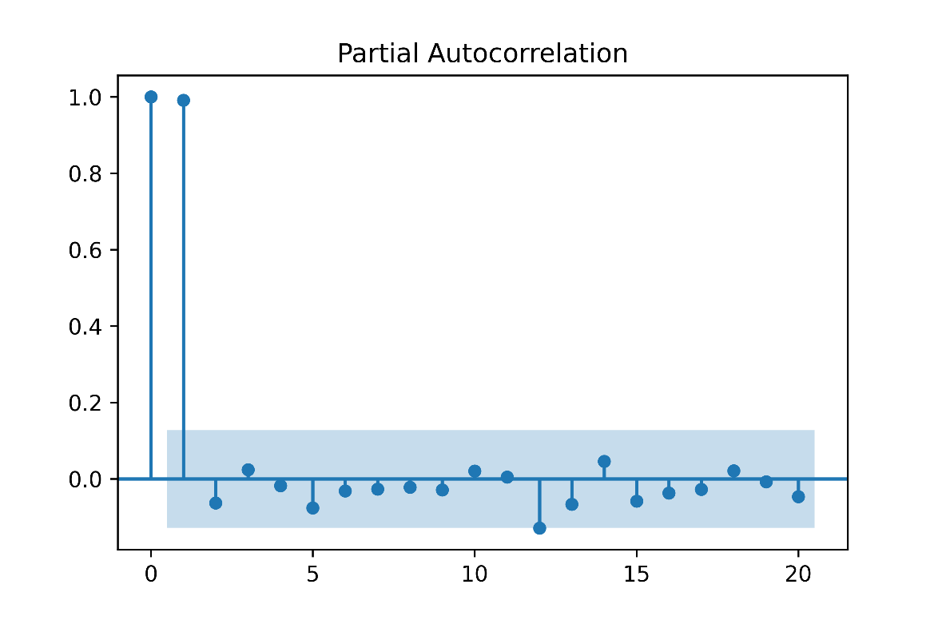
Modelling CO₂ emission
Linear time series and ARIMA approaches
ARIMA: poor performance
Linear time series modeling using Statsmodel package
CO₂ prediction is correlated to population and CO₂, time-step behind
Notes:
Which countries are key players in GHG emission?
Is there any chance to plan strategically for reducing GHG emission when we could forecast GHG emission for next couple of years?

Slide 6
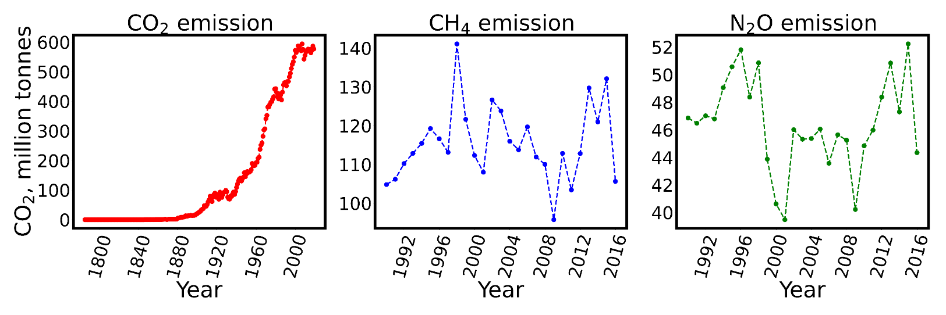
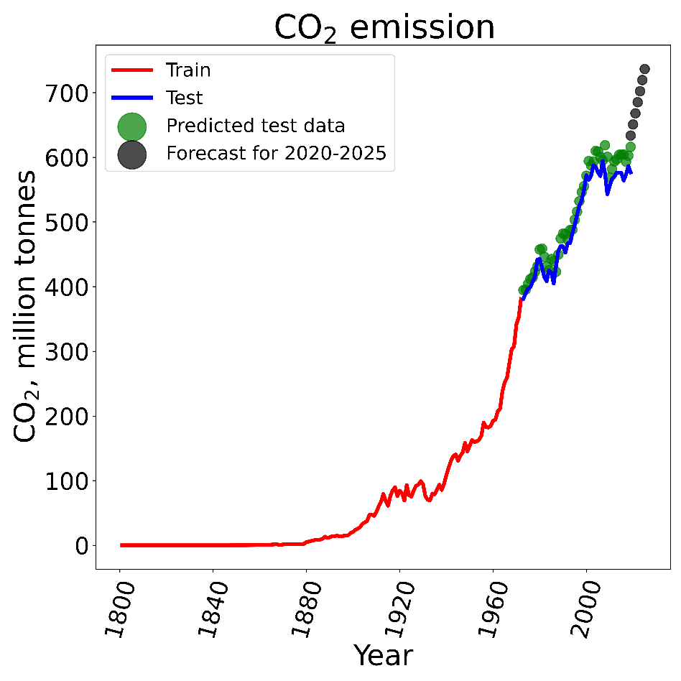
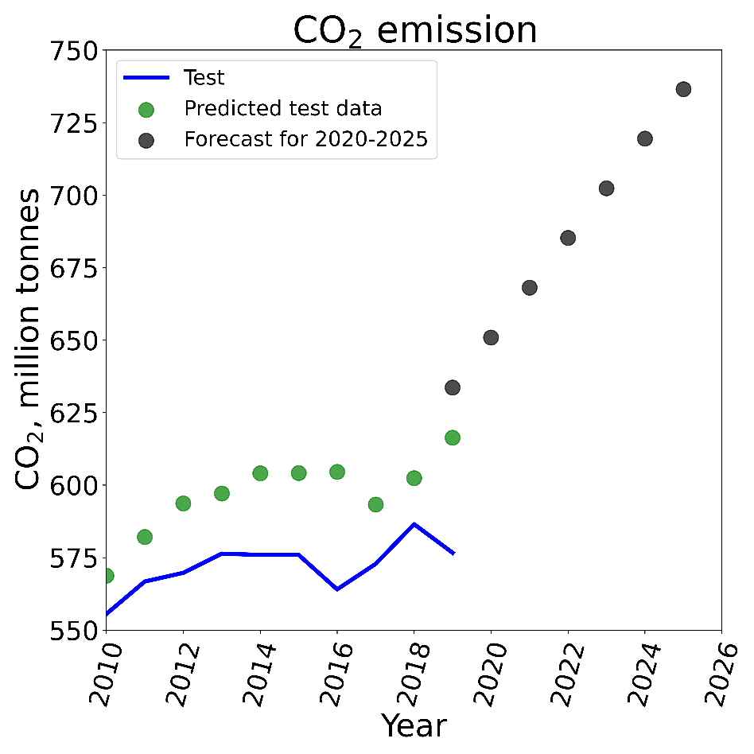
Results: Modelling for Canada
CO₂ emission is the highest among all GHGs.
R²=0.90
CO₂ emission forecasting suggests a linear increasing trend for next 5 years.

Slide 7
Recommendations for future
CO₂ emission has an increasing trend in next 5 years for the most countries.
Key players in CO₂ emission are: Canada, China, India, Indonesia, Japan, and US
The performance of this model can be improved by incorporating additional parameters.
A rigorous policy has be considered by key players to reduce the amount of CO₂ existing in the atmosphere. CCUS
Notes:
Which countries are key players in GHG emission?
Is there any chance to plan strategically for reducing GHG emission when we could forecast GHG emission for next couple of years?

Slide 8
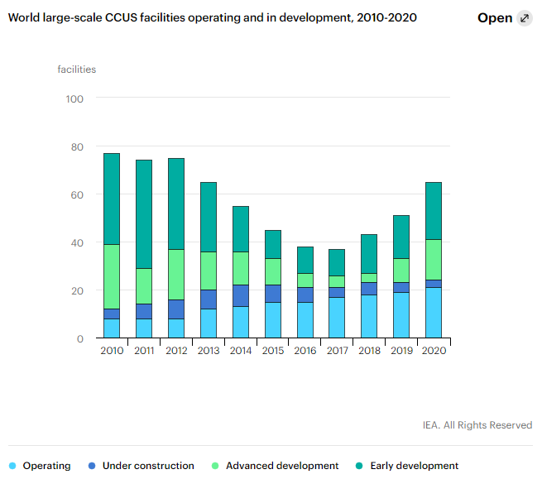
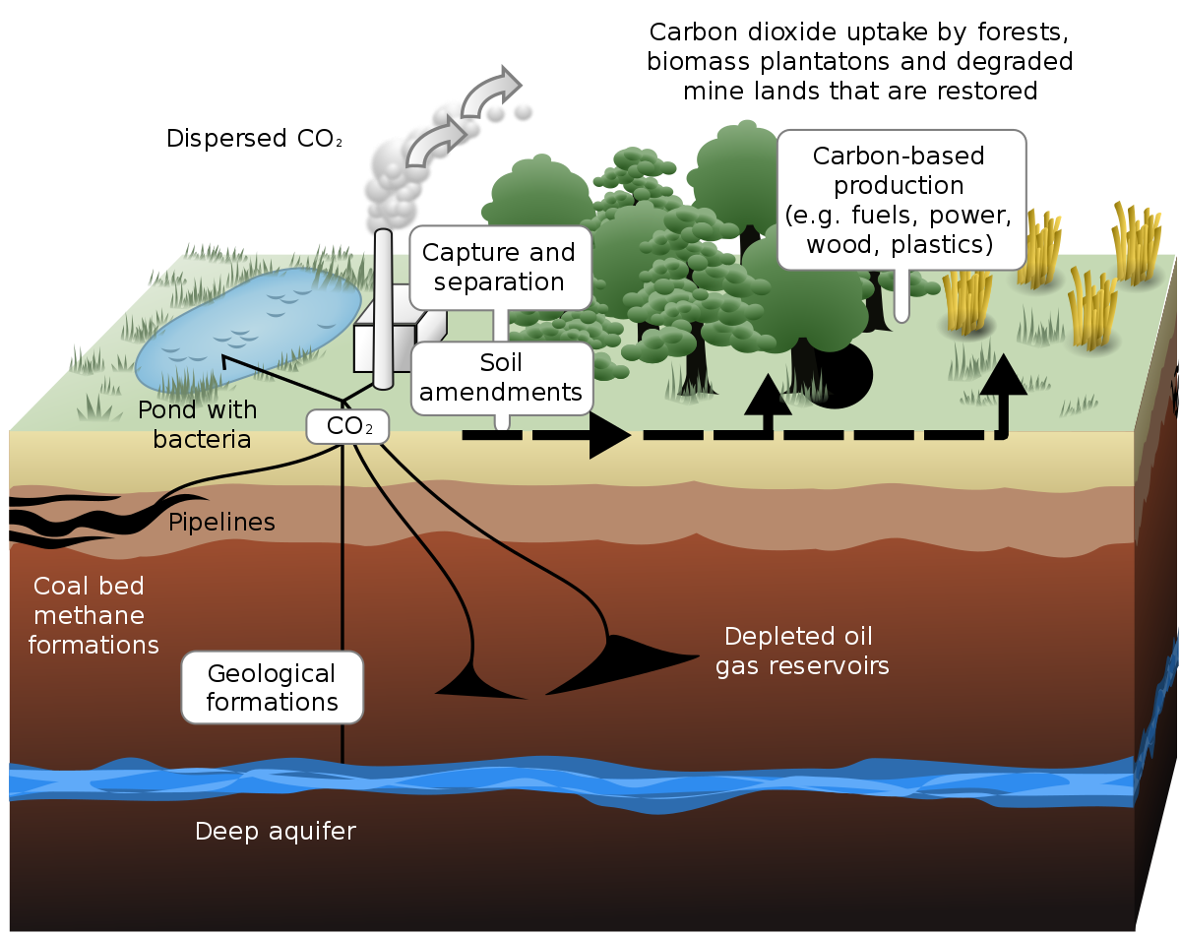
Carbon capture, utilization and storage
Source: https://ukccsrc.ac.uk/ccs-explained/
Source: https://www.iea.org/fuels-and-technologies/carbon-capture-utilisation-and-storage
Notes:
Is there any chance to plan strategically for reducing GHG emission when we could forecast GHG emission for next couple of years?

Slide 9
Thanks for your attention

Slide 10
Project workflow
Creating a dataset:
https://github.com/owid/co2-data
Performing exploratory data analysis
Visualizing trends of CO₂, CH₄, and N₂O emissions for all countries
Modelling CO₂ emission for 16 leading countries using linear time series approach
Forecasting CO₂ emission for next 5 years (2020-2025)
Providing insights and recommendations
Notes:
Which countries are key players in GHG emission?

