Slide 1

Artificial Neural Network (ANN) for Transient-Based Leak Detection in Water Distribution Networks
IAHR Committee on Transient Flows
Ali Haghighi
03.11.2026, Kaiserslautern
Notes:
Slide 1 (Cover and introduction)
Hello everyone and thank you for attending this session.
My name is Ali Haghighi. I am a professor of civil engineering. My research focuses on hydraulics, hydrodynamics, and hydroinformatics.
I worked at Shahid Chamran University of Ahvaz in Iran for about 14 years. Then, I have been working at RPTU University in Kaiserslautern, Germany, for the past three years, in the Department of Civil Engineering.
Today, I will address the problem of leak detection in water distribution networks and explain how it can be approached using transient flow analysis and artificial neural networks (ANNs).
We will cover the fundamental concepts and the main motivations behind these approaches.
As you know, this session is divided into two parts.
In the first part, which will take approximately 40 minutes, we will review the basic concepts and fundamentals of transient-based leak detection and then discuss how artificial neural networks can be used for this purpose.
We will then have a 5-minute break.
In the second part, we will work through a practical example.
Ok, let’s get started

Slide 2
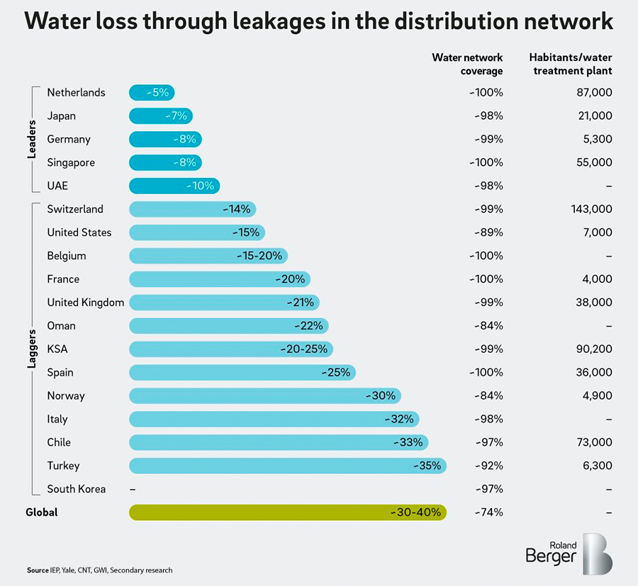
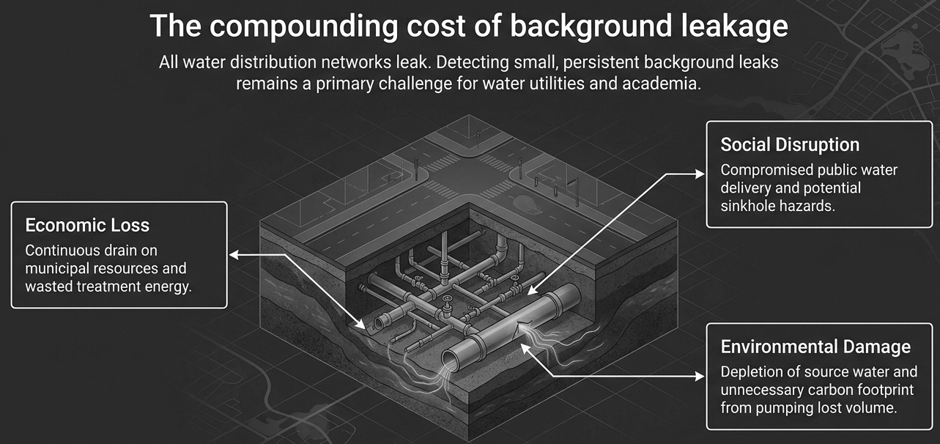
Leak and its costs in water distribution networks
Leak detection approaches:
Acoustic methods
Systematic field inspections
Satellite imagery
Hydraulic-model-based techniques
2
Notes:
Slide 2 (Leaks, Leak detection)
I want to start with this fact:
All water distribution networks are subject to leakage. According to the Roland Berger overview of water loss in distribution networks, global leakage is estimated at roughly 30 to 40 percent. That is a huge volume of water lost.
If leaks are not detected and repaired in a timely manner, they can cause significant economic losses, social problems, and environmental damage.
So, detecting leaks, particularly small leaks known as background leakage, has been a major challenge for water utilities, industry, and academia for decades.
Various techniques are available for leak detection, ranging from acoustic methods and field inspections to satellite imagery and hydraulic-model-based approaches.
Today, we will focus on hydraulic-model-based leak detection.

Slide 3
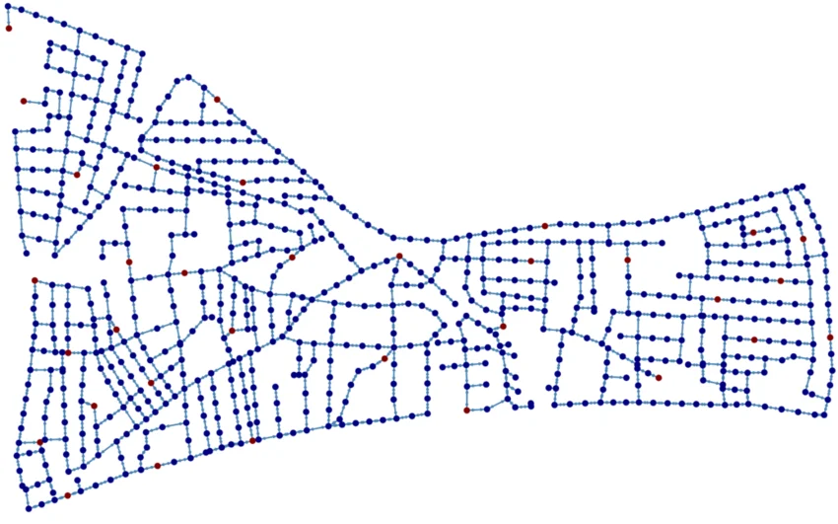
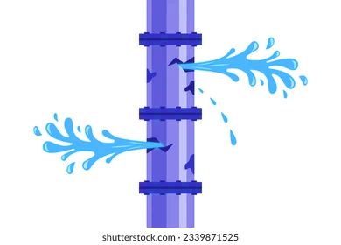
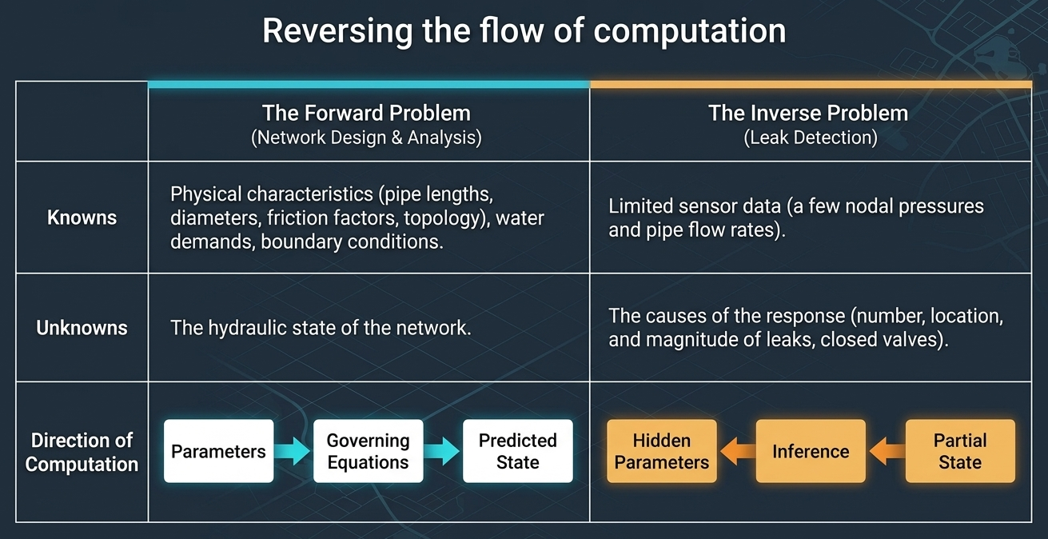

Hydraulic-model-based techniques
Forward problem
Pressure sensor
Hydraulic responses:
H at heads
Q and V in pipes
Simulation model
Simulation model
Inverse
problem
Optimization model
Data-driven (AI) model
Unknowns like leaks
3
Notes:
Slide 3 (Forward problem vs inverse problem)
To understand this approach, we first need to distinguish between a forward problem and an inverse problem.
In a forward problem, we know the physical characteristics and operating conditions of the network. These include pipe lengths and diameters, friction factors, network topology, water demands, and all boundary conditions.
Using this information, we solve the governing hydraulic equations to predict the hydraulic state of the network.
This is the conventional approach used in the hydraulic analysis, for design, and planning of a new system.
However, the situation is different when we deal with an existing network that is already in operation. We may want to assess its condition, calibrate pipe friction factors or detect unknown leaks. In these cases, some of the parameters or operating conditions are unknown, and we need to infer them from a few measurements.
This is where we encounter an inverse problem.
In leak detection, the main unknowns are the number, locations, and sizes of leaks in the network. While we have a limited number of pressure and flow measurements collected by sensors sparsely installed in the system.
In other words, we know some of the network’s pressure responses, but we want to determine leak parameters.
This is the fundamental idea behind formulating leak detection as an inverse problem.

Slide 4
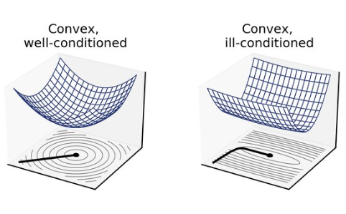
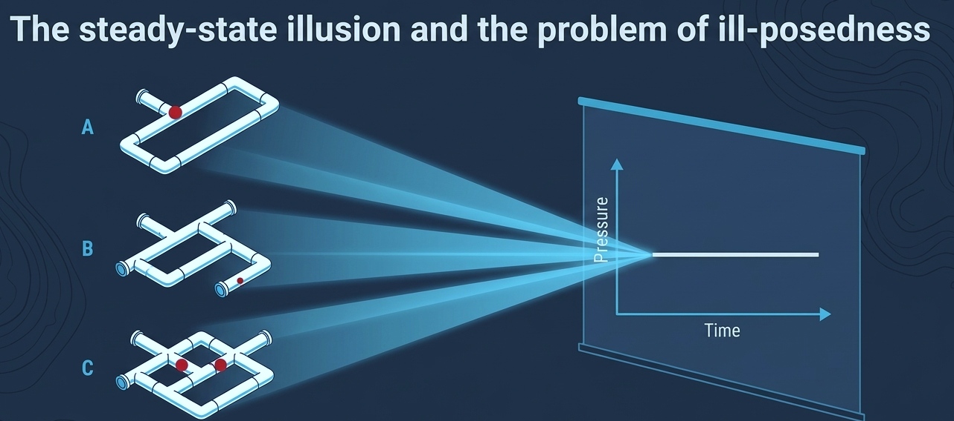

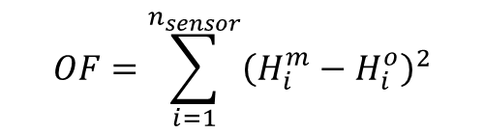
Solving the Inverse Problem: Steady-State vs. Transient Flow
NLP of leak detection:
Model-predicted
Observation
$$OF=\sum_{i=1}^{n_{sensor}}{{\left(H_{i}^{m}−H_{i}^{o}\right)}^{2}}$$
A nonlinear heuristic optimization like GA
Minimize:
Decision variables: Leak parameters (the number, location and size of leaks
Unique minimum
Ill-posed minimums
Transient Flow
Steady-State
4
Notes:
Slide 4 (Solving the Inverse Problem: Steady-State vs. Transient Flow)
In practice, it is not possible to measure hydraulic responses of a network at every location. Installing and maintaining many sensors is technically challenging and expensive. Therefore, we usually have only a limited number of pressure and flow measurements, while the number of unknowns is much larger.
This makes the inverse problem mathematically underdetermined.
For decades, researchers have addressed this problem using nonlinear mathematical programming and optimization techniques.
The general approach is to define a nonlinear objective function based on the least-squares criterion as you see in this slide.
This function quantifies the discrepancies between measured pressures and the corresponding values predicted by a hydraulic model.
The leak parameters are treated as decision variables. An optimization algorithm iteratively modifies these variables to minimize this objective function.
Initially, thus method was commonly based on steady-state hydraulic models.
However, researchers soon recognized a fundamental difficulty that the solution may not uniquely identify the actual leaks.
In fact, different leak scenarios can produce nearly identical pressures and flow rates at the available sensor locations.
This issue is called ill-pose conditions. That is a different concept from local and global optimization.
Global optimization methods like genetic algorithms and other metaheuristics, cannot resolve this fundamental lack of information by themselves.
Here on top right, you can see, for example, a well-conditioned and an ill-conditioned 2D convex search space side by side. In the ill-conditioned space, we may have several minimums with the same objective function value.
This led researchers to investigate whether additional hydraulic information could improve the identifiability of leaks.
One promising direction is transient flow analysis.
Unlike steady-state methods, transient’s time-dependent responses can provide additional information about the location and characteristics of a leak.
This provides the motivation for using transient flow analysis to improve leak detection by inverse problem approach.

Slide 5
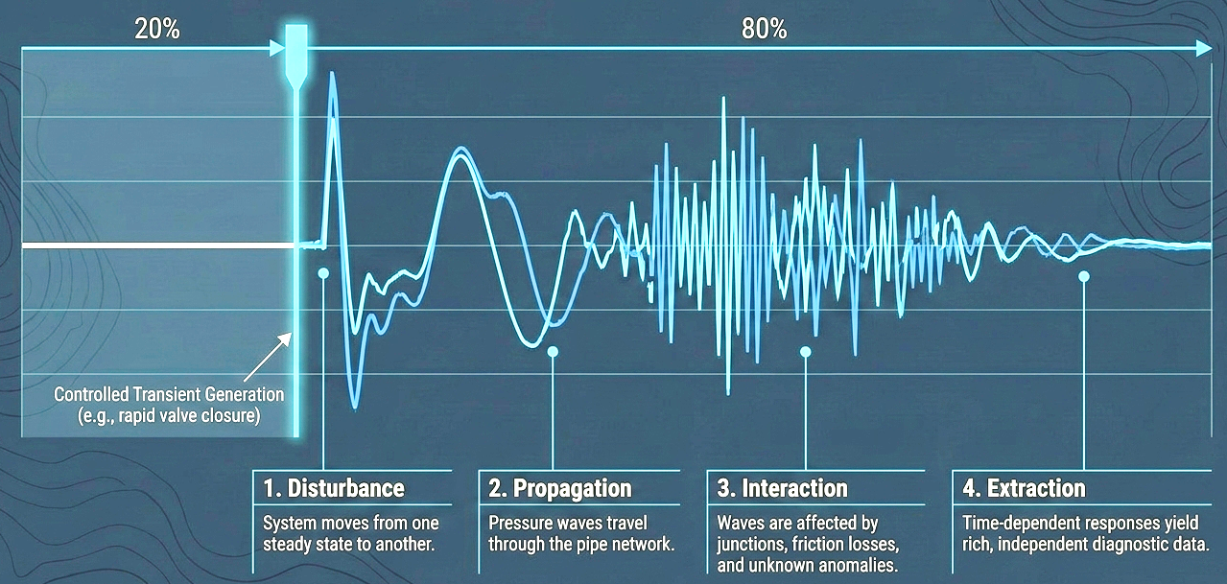
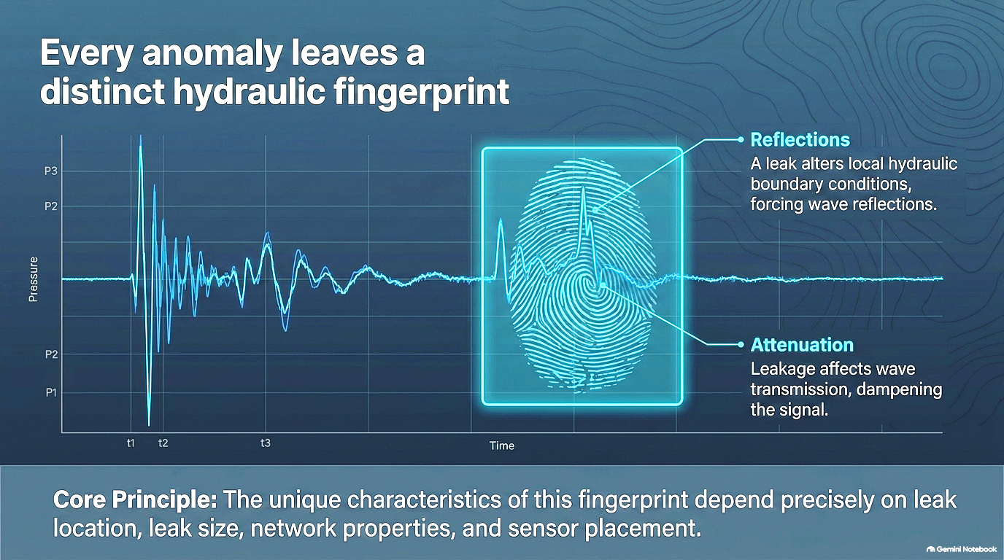
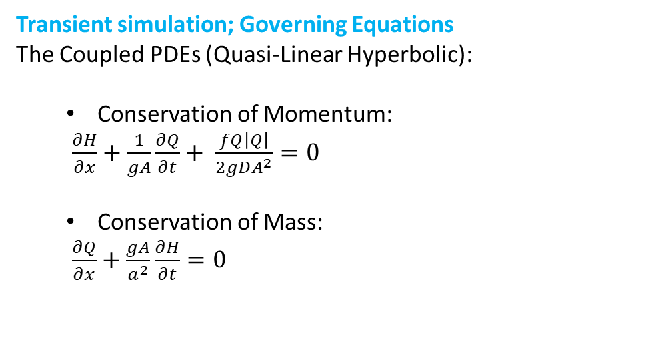
Inverse Transient Analysis (ITA) for System Identification and Anomaly Detection
Transient state
Transient simulation; Governing Equations
The Coupled PDEs (Quasi-Linear Hyperbolic):
  Conservation of Momentum:
  $\frac{∂H}{∂x}+\frac{1}{gA}\frac{∂Q}{∂t}+ \frac{fQ\left|Q\right|}{2gDA^{2}}=0$
  Conservation of Mass:
  $\frac{∂Q}{∂x}+\frac{gA}{a^{2}}\frac{∂H}{∂t}=0$
The MoC
This is the fundamental idea behind the Inverse Transient Analysis (ITA):
By exploiting these transient signatures, we can obtain additional information about the network's condition and potentially reduce the non-uniqueness and identifiability problems associated with steady-state leak detection.
5
Notes:
Slide 5 (Inverse Transient Analysis for System Identification and Anomaly Detection)
Transient flow refers to the time-dependent hydraulic conditions that occur when a system moves from one steady state to another, or when its hydraulic conditions change over time.
The transient state can be analyzed by solving its governing PDEs. Two governing equations of momentum and continuity as seen in this slide govern the transient flow in pipe systems. These equations are numerically solved using the MOC.
Transient events are generally considered undesirable in water distribution systems because they can generate severe pressure surges, known as water hammer, or even cause cavitation.
However, when a transient is generated under controlled conditions, the resulting pressure signals can provide valuable information for detecting leaks and other anomalies.
When a transient is initiated, pressure waves propagate through the pipe network. Their propagation and reflection are affected by network components.
For example, a leak changes the local hydraulic boundary conditions and can generate pressure-wave reflections. It can also affect wave transmission and signal attenuation. These effects influence the pressure signal recorded over time at different locations in the network.
In other words, a leak leaves a characteristic signature in the transient pressure response. We can refer to this signature as a leak fingerprint. Its characteristics depend on the leak location and size.
By exploiting these transient signatures, we can potentially overcome the ill-pose conditions we face in steady flow approaches.
This is the fundamental idea behind Inverse Transient Analysis (ITA).

Slide 6
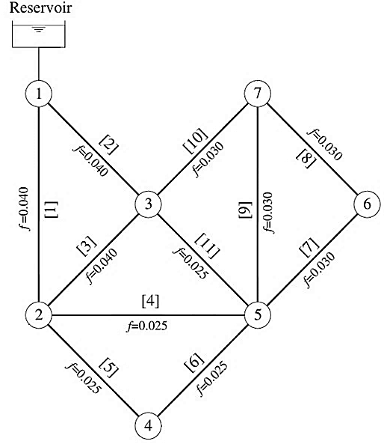
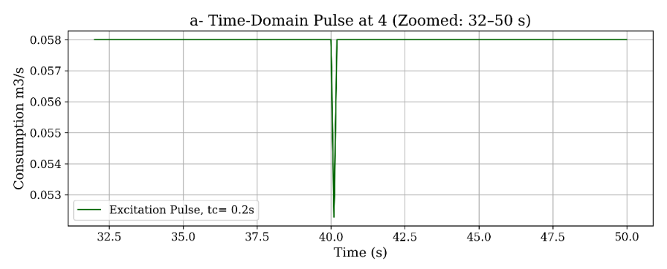
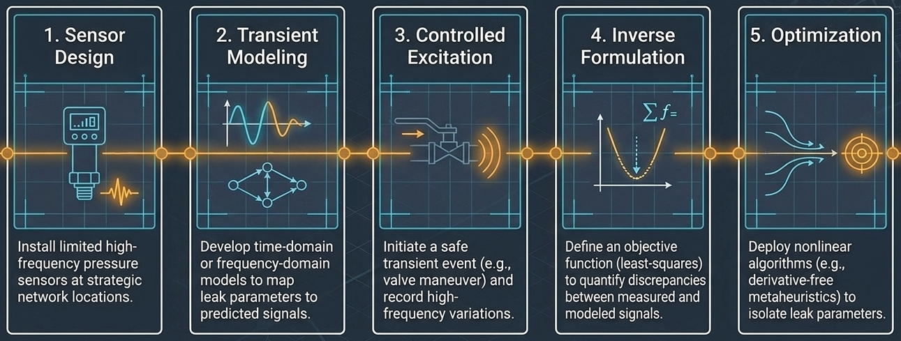
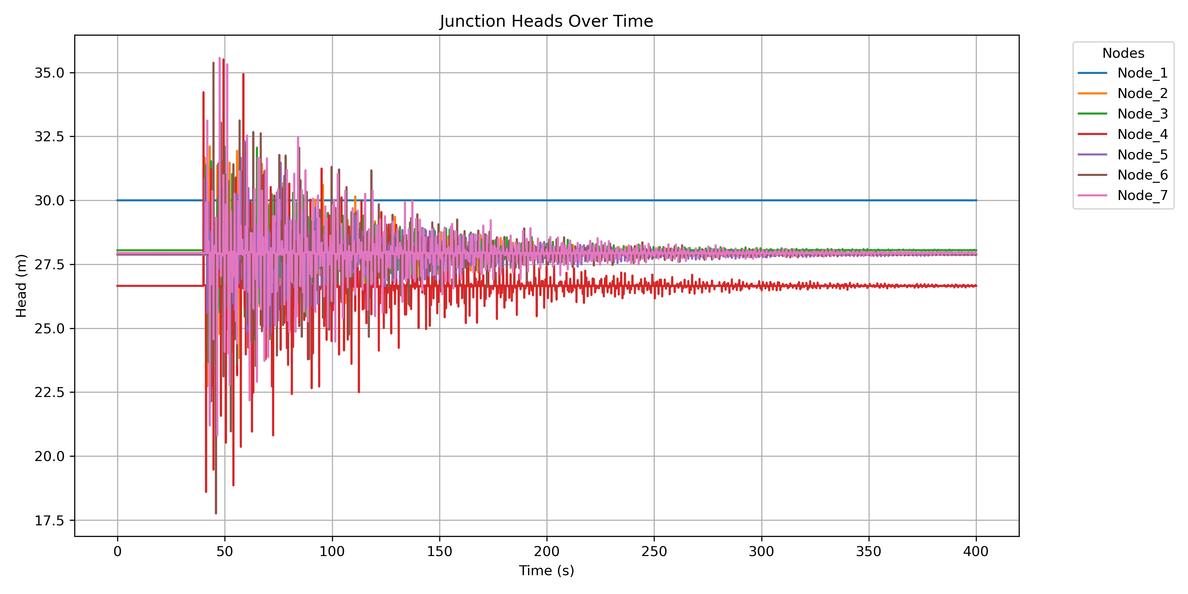
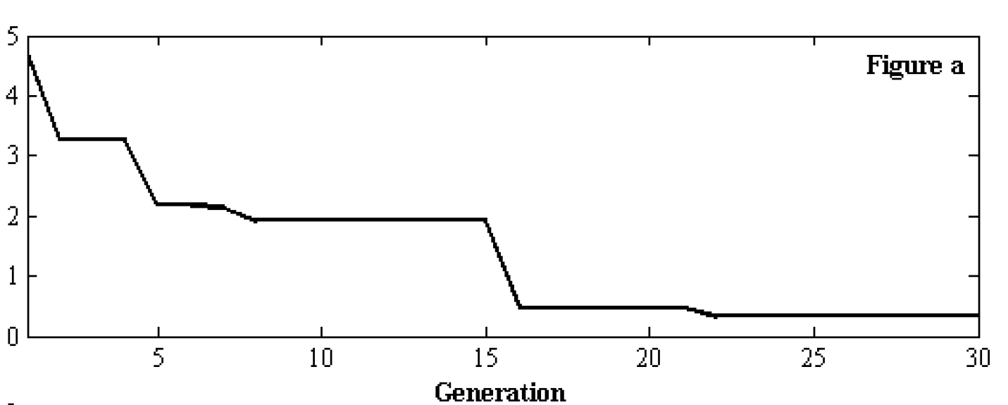
The ITA implementation for a water distribution network
Leak
Step 1. Measurement Site Design
Step 2. Development of a Transient Hydraulic Model
Step 3. Controlled Transient Generation and Measurement
Step 4. Formulation of the Inverse Problem
Step 5. Optimization and Leak Identification
Sensor place
Pulse
Excitation point
Optimization
6
Notes:
Slide 6 (The ITA implementation)
The ITA is conventionally implemented through five steps.
Step 1. Measurement Site Design
A limited number of pressure sensors are installed at strategically selected locations in the network.
The sensor locations should be selected to capture informative transient responses and maximize the ability to distinguish between different leak scenarios.
Step 2. Development of a Transient Hydraulic Model
A transient hydraulic model of the network is developed by solving the governing equations in the time domain or, where appropriate, in the frequency domain.
The model predicts the transient pressure responses at the sensor locations for specified network conditions and assumed leak parameters.
Step 3. Controlled Transient Generation and Measurement
A transient is generated at a suitable location in the network, for example, through a controlled valve maneuver.
The resulting pressure variations are then recorded by the sensors at a sufficiently high sampling frequency to capture the relevant wave dynamics.
The operation must be designed to ensure that the generated transient remains within the safe pressure limits.
Step 4. Formulation of the Inverse Problem
As we earlier discussed, an objective function is defined to quantify the discrepancy between the measured pressure signals and those predicted by the transient hydraulic model.
The unknown leak parameters are treated as decision variables, and a least-squares criterion can be used to formulate the optimization problem.
The objective is to identify the leak parameters that produce the closest agreement between the simulated and measured transient responses.
Step 5. Optimization and Leak Identification
A nonlinear optimization algorithm like GA is used to estimate the unknown leak parameters by minimizing the objective function.
By incorporating time-dependent pressure information, inverse transient analysis can provide substantially more diagnostic information than steady-state measurements alone. This can improve leak identifiability.
However, successful identification still depends on the quality of the transient excitation, sensor placement, model accuracy, measurement noise, and the sensitivity of the recorded signals to the unknown leak parameters.
There are several studies in the literature that investigate these aspects in detail and propose different approaches to improve the overall ITA.

Slide 7
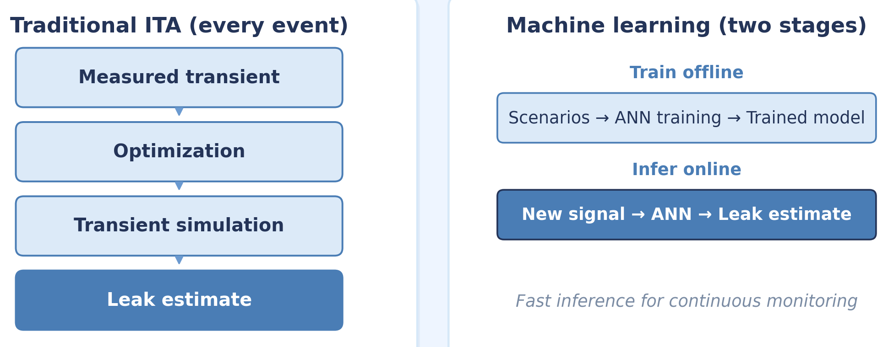
Machine Learning as an Alternative for Solving ITA Problems
Challenges of Traditional ITA:
Dependence on an Accurate and Deterministic Models
Measurement Noise and Uncertainty
High Real-Time Computational Cost
Changing Network Conditions
Dependence on the Transient Excitation
Highly Nonlinear Relationship Between Leaks and Transient
High-Dimensional Transient Signals
From ITA to Machine Learning
The solutions are in stochastic data-derive, probabilistic and machine learning approaches!
7
Notes:
Slide 7 (Machine Learning as an Alternative for Solving ITA Problems)
Okay, now we are going to discuss why we need to shift toward machine learning for ITA.
The traditional Inverse Transient Analysis, which combines a detailed transient simulation model with an optimization algorithm, still faces several challenges in real applications.
Let’s review some of them here:
1. Dependence on an Accurate and Deterministic Model
Traditional ITA is essentially a deterministic approach. We need an accurate and well-calibrated transient simulation model to represent the real network so that differences between the measured and model-predicted pressure signals can be attributed mainly to the unknown leak.
However, a perfectly calibrated deterministic model that accurately represents all these effects is rarely available for a real network if not impossible.
2. Measurement Noise and Uncertainty
Pressure sensors are not perfect. Measurements contain significant noise, drift, missing data, limited sampling resolution, and other sources of uncertainty.
Therefore, the measured signal is not exactly the true hydraulic response of the system.
In a traditional ITA, these discrepancies may directly enter the objective function and lead to false leak detection.
3. High Computational Cost
In traditional ITA, every evaluation of the objective function requires a transient simulation of the entire network. For numerical methods such as the Method of Characteristics (MOC), this can be computationally expensive, particularly for large and complex networks.
The optimization phase like a Genetic Algorithm requires thousands of objective-function evaluations.
Therefore, we have a nested computational problem that makes real-time or near-real-time leak detection highly expensive and time consuming.
4. Changing Network Conditions
A water distribution network is not a static system.
Water demands change throughout the day. Pumps and valves change their operating conditions. Pipes deteriorate, new connections are added, and the hydraulic characteristics of the system can change over time.
A deterministic model calibrated for one particular operating condition is no longer representative of the system as it evolves.
Traditional ITA does not automatically learn from new observations.
5. Dependence on the Transient Excitation
Another important challenge is the dependence of traditional ITA on how the transient is generated.
The location, type, magnitude, and timing of the transient excitation strongly influence the resulting pressure signals.
Ideally, we would like to extract characteristics and leak fingerprints that remain informative under different transient excitations and operating conditions.
6. Highly Nonlinear Relationship Between Leaks and Transient Signals
The observed signal depends not only on the leak location and size, but also on the network topology, pipe characteristics, operating conditions, sensor locations, and transient excitation.
This is precisely the type of complex nonlinear relationship that machine-learning methods, and particularly neural networks, can learn efficiently from data.
7. High-Dimensional Transient Signals
If we have several pressure sensors recording at a high sampling frequency, a single transient event can produce a very large multidimensional dataset.
The information related to a leak may be distributed across the signal in terms of wave arrival times, reflections, attenuation, amplitudes, and interactions between signals recorded at different sensors.
Processing these data with a deterministic simulation model could be highly challenging in practice.
All these limitations motivate the use of stochastic data-driven or machine learning as an alternative or at least complementary approach to conventional ITA.
In machine learning, we generate or collect a large number of leak scenarios, train a model to learn the relationship between transient signatures and leak conditions, and then use the trained model for rapid inference.
The computational cost is therefore shifted from repeatedly solving the inverse problem real-time to an offline training phase.
This makes machine learning particularly attractive for continuous monitoring and real-time or near-real-time condition assessment of pipe systems.

Slide 8
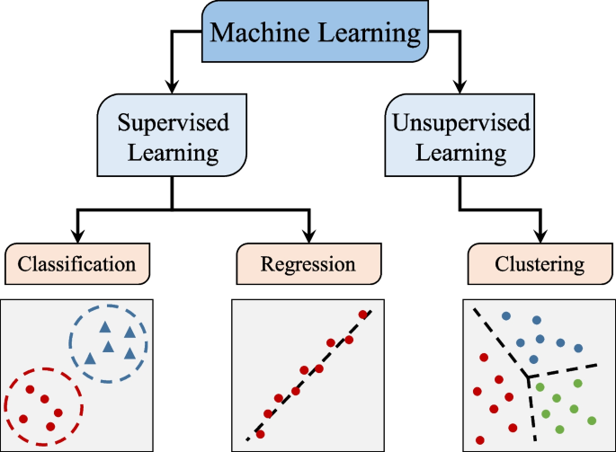
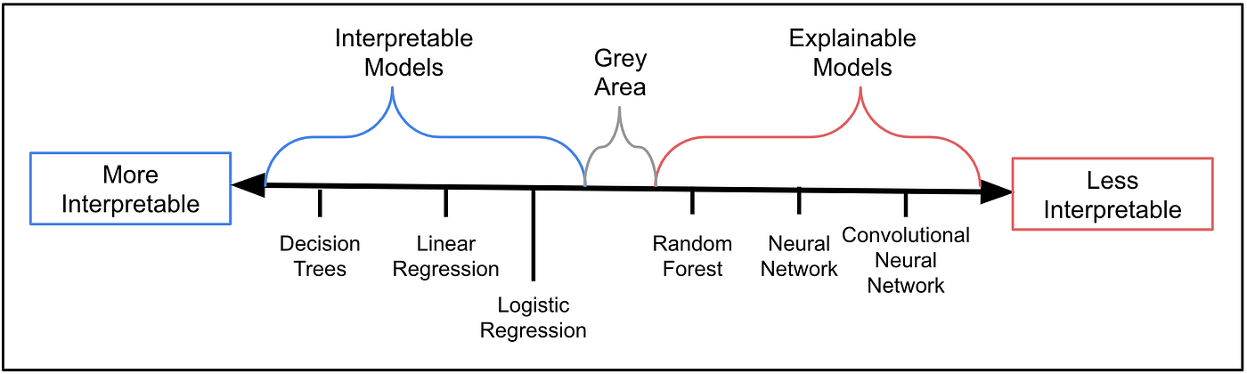
An Introduction to Machine Learning to Leak Detection
In our case, a machine-learning model could learn to:
Classify whether a leak is present.
Identify the leak location.
Estimate the leak magnitude.
Distinguish different hydraulic or operational conditions.
8
Notes:
Slide 8 (An Introduction to Machine Learning to Leak Detection)
Now, let’s have a quick review on ML approaches first.
Depending on the objective, an ML problem can be formulated as a classification, regression, or clustering problem.
For example, in our case, a machine-learning model could learn to:
1- Classify whether a leak is present.
2- Identify the leak location.
3- Estimate the leak magnitude or size.
4- Distinguish different hydraulic or operational conditions.
There are several machine-learning techniques to be used for leak detection, ranging from relatively interpretable methods such as decision trees and random forests to ensemble methods such as XGBoost and, of course, different architectures of artificial neural networks that are less interpretable.
Today, we are going to focus on the basic concept of an Artificial Neural Network (ANN) and see how it can be used to approach the inverse transient leak-detection problem.
The purpose of this session is not to cover the entire field of machine learning for leak detection. Rather, I want to introduce the basic idea of this approach and demonstrate how an ANN can learn the relationship between transient hydraulic responses and leak parameters.
It is worth noting that there are already more advanced machine-learning techniques being investigated in this field, and this will likely remain an important research direction for the future of transient-based leak detection.

Slide 9
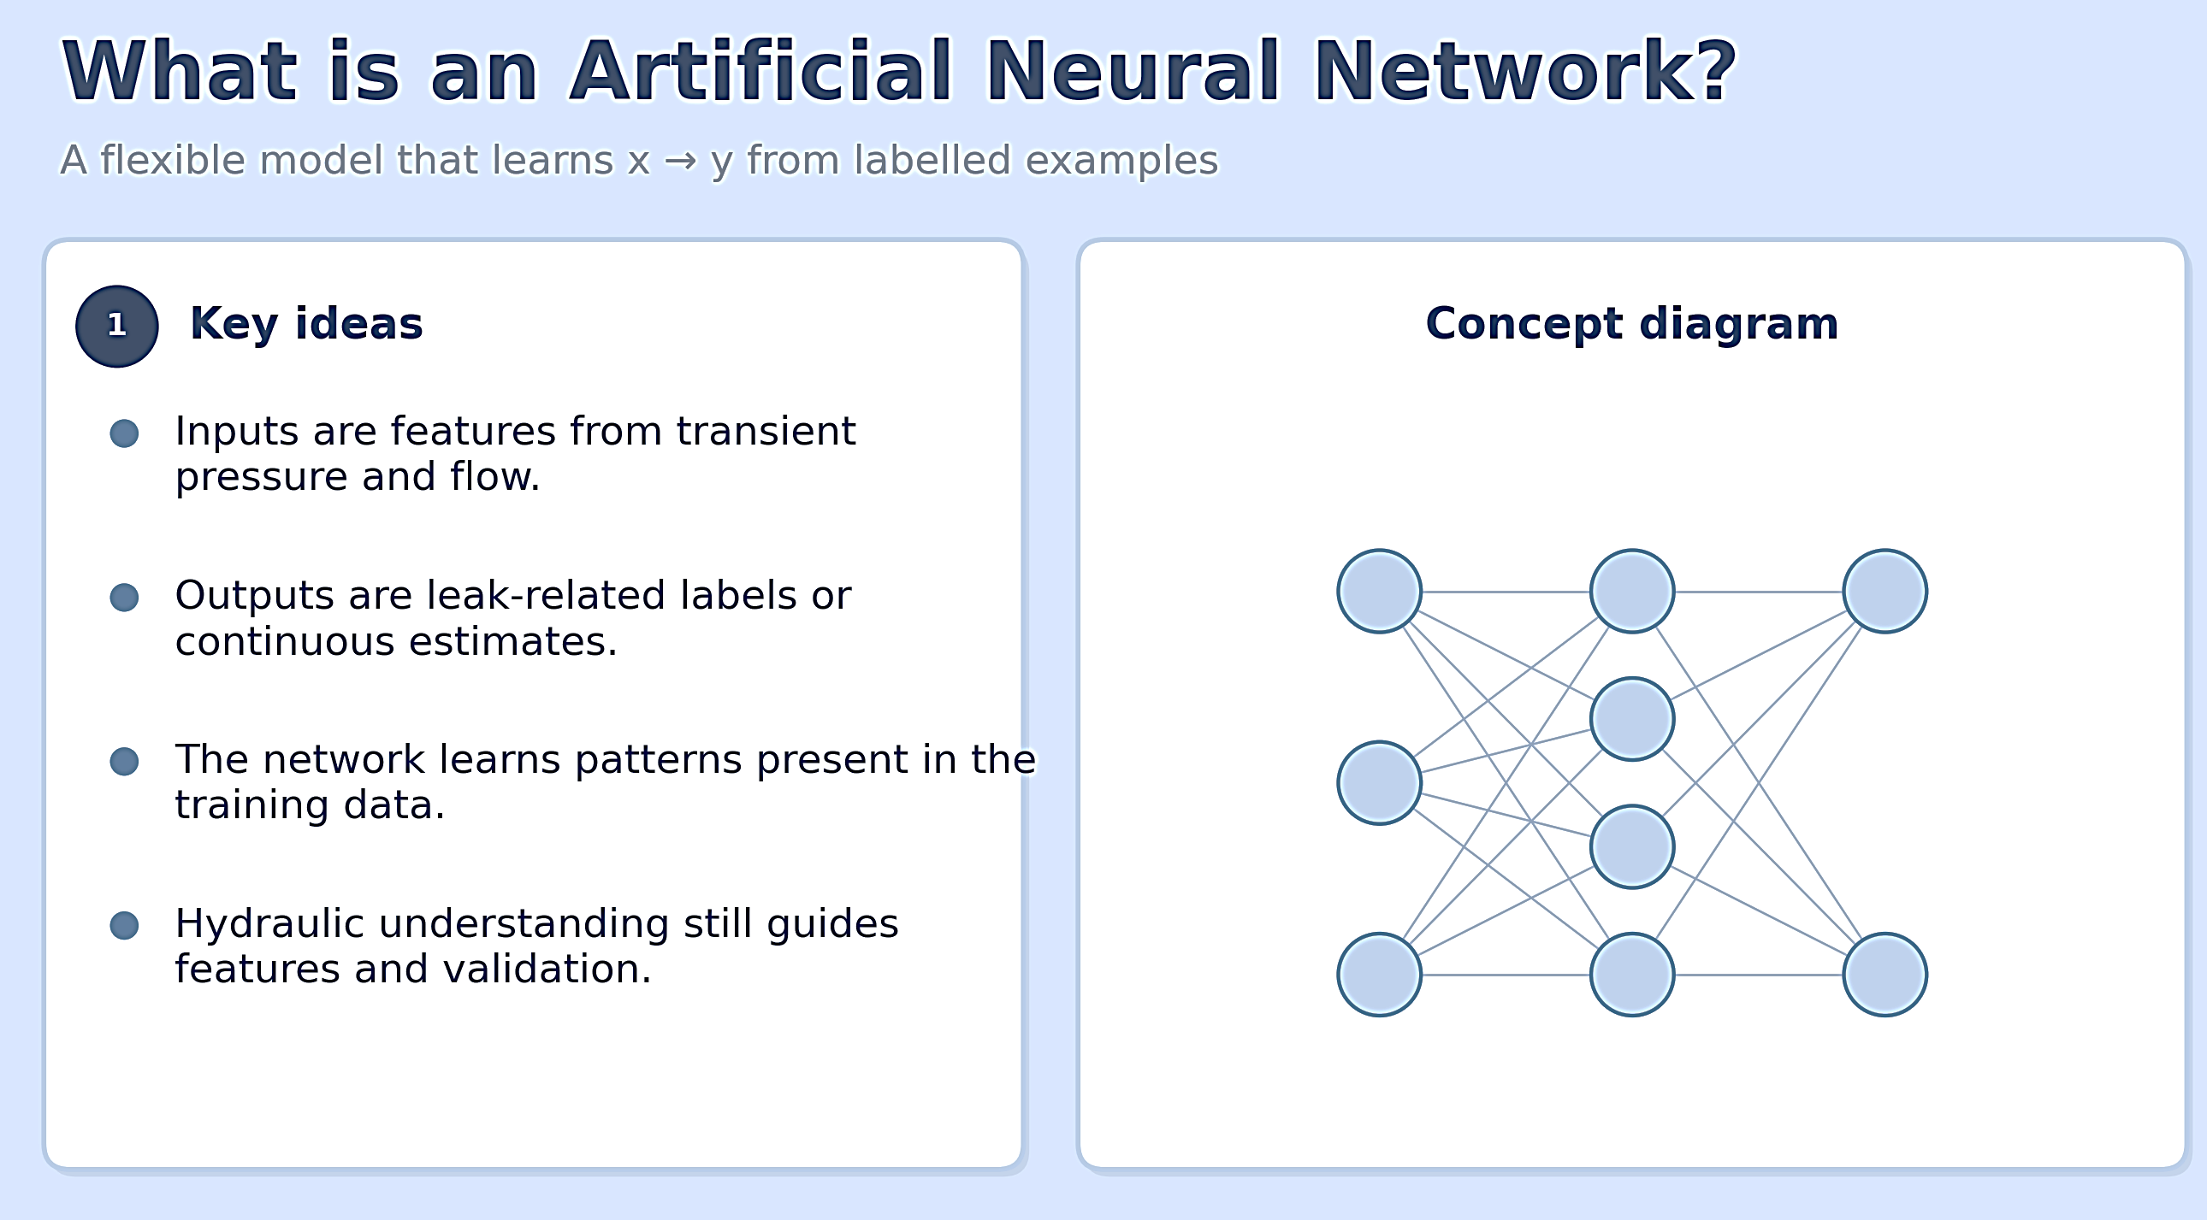
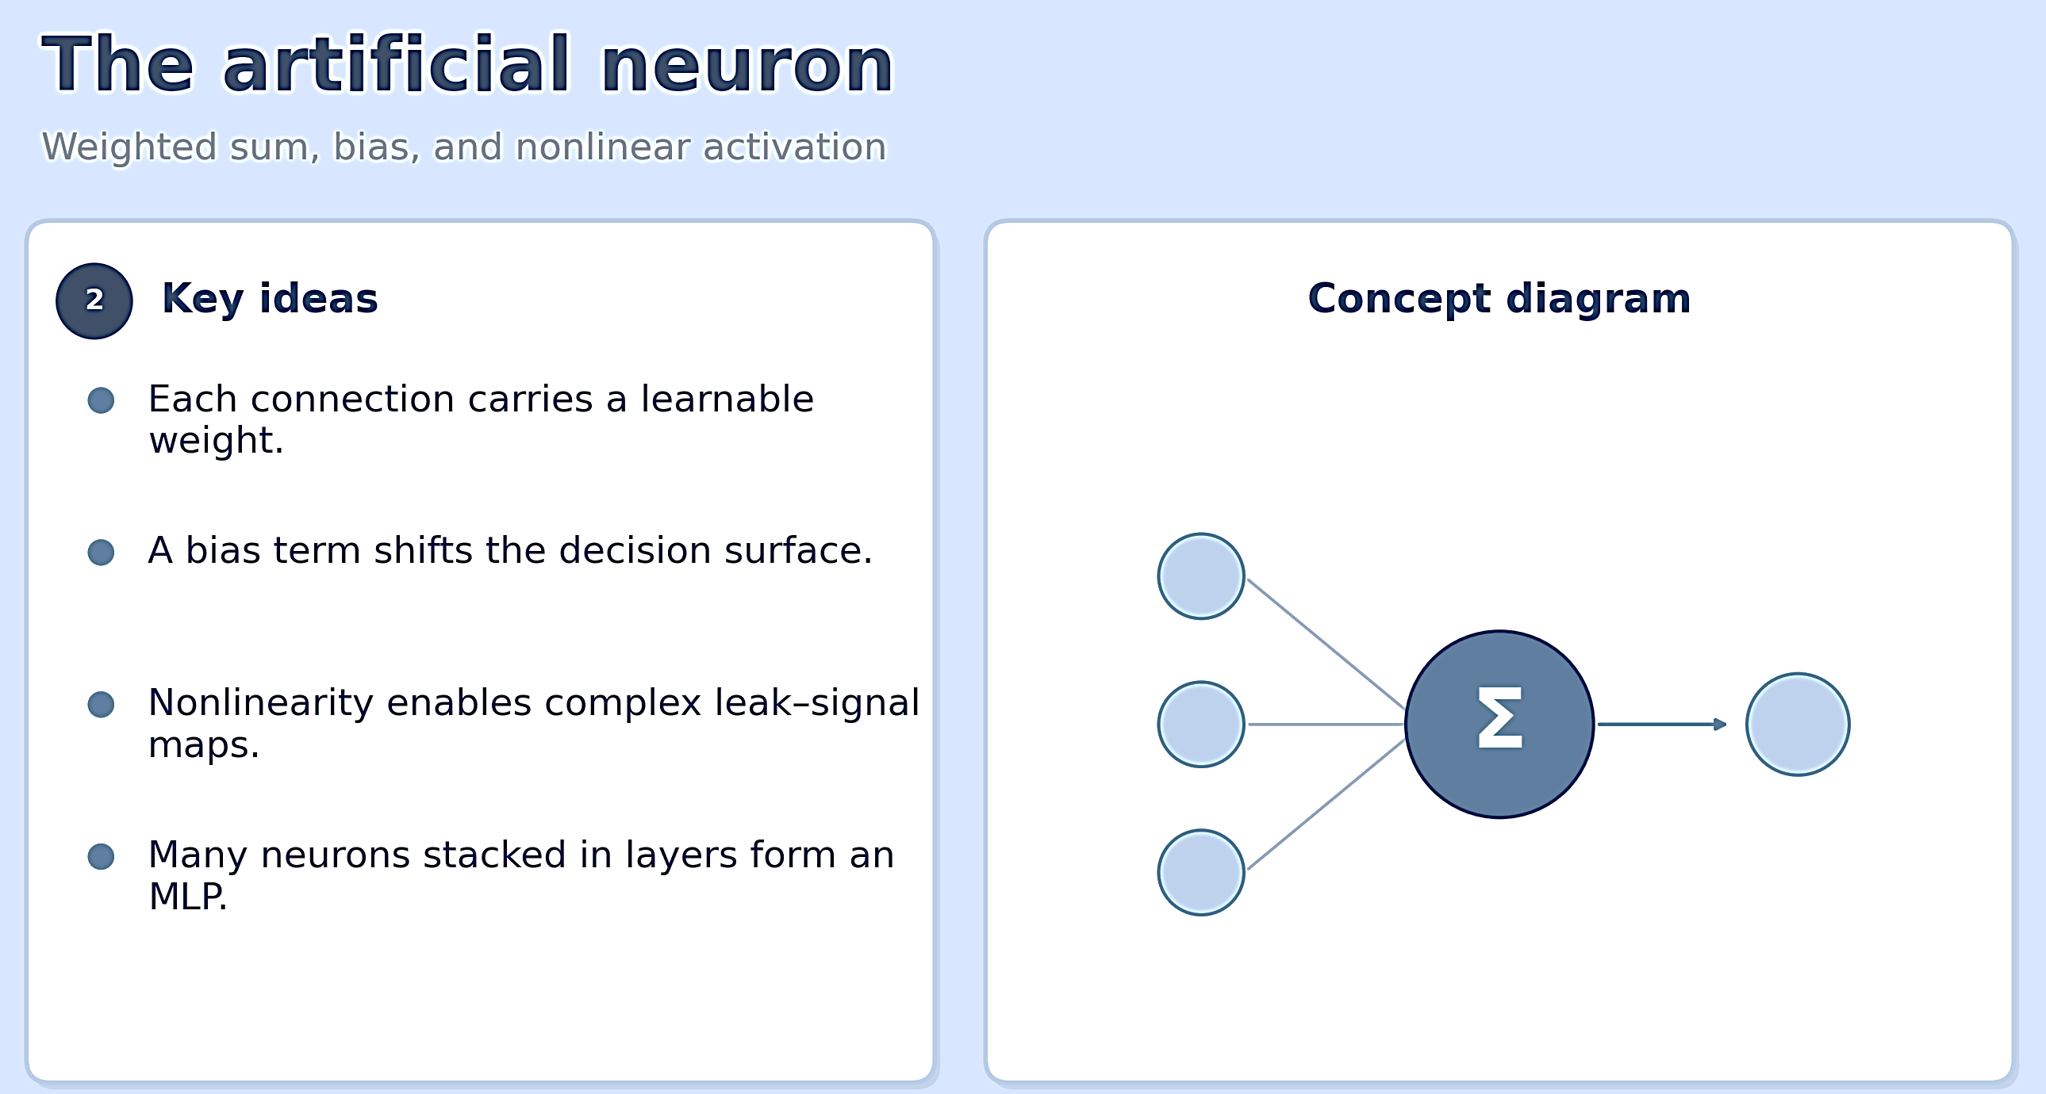
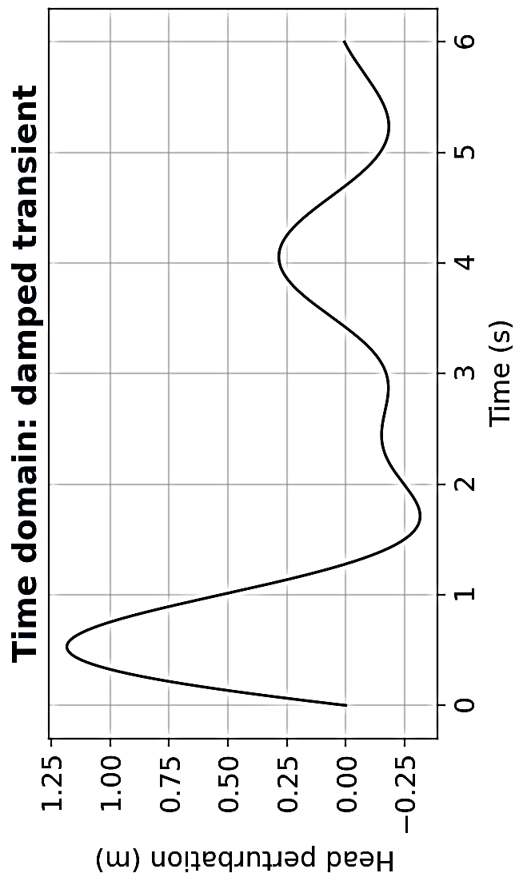
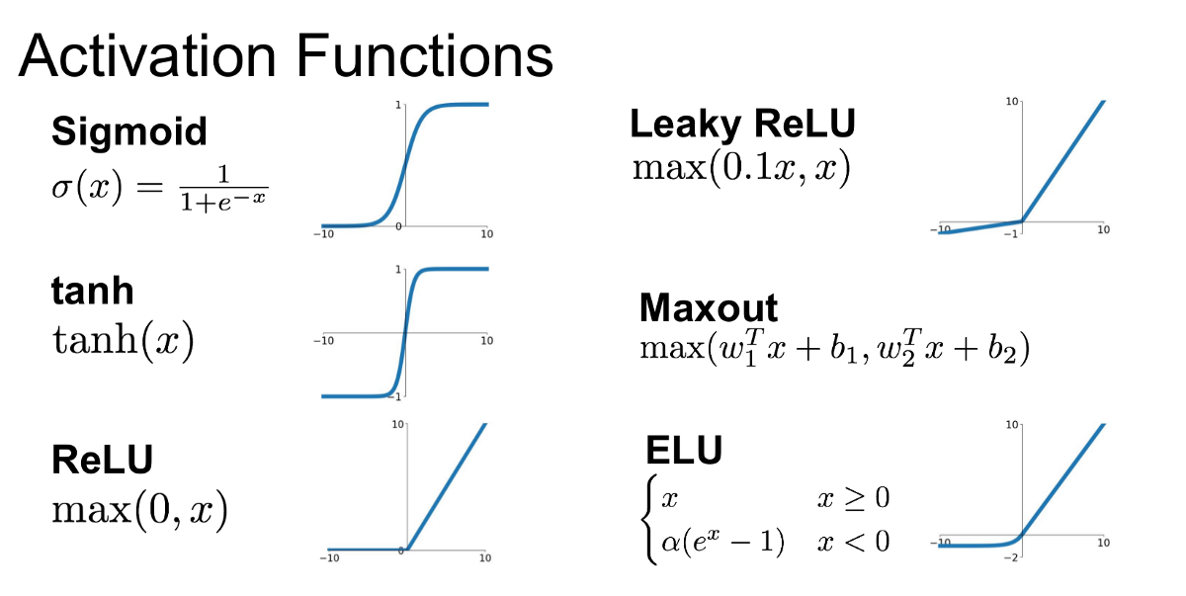

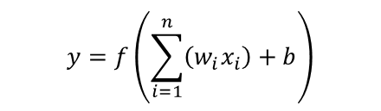



x → ANN → y
Leak location
$$y=f\left(\sum_{i=1}^{n}{\left(w_{i}x_{i}\right)+b}\right)$$
Leak size
$$x_{1}$$
$$x_{2}$$
$$y$$
$$x_{3}$$
Commonly used activation functions f
9
Notes:
Slide 9 (Introduction to Artificial Neural Networks)
We have motivated why machine learning is attractive for inverse transient analysis. We now introduce the basic concept of an Artificial Neural Network (ANN) and the practical pipeline needed to apply it to leak detection.
My aim is not obviously to cover ANN and deep learning in detail. The aim is to give you a mental model: what an ANN is, what data it needs, and how we turn our ITA into a supervised learning problem.
What Is an Artificial Neural Network?
An ANN is a flexible mathematical model that learns a mapping from inputs to outputs using examples.
In our context, the inputs x are features derived from transient pressure measurements. The outputs y are the leak-related quantities we want to infer, such as leak presence, location, or size.
x is also known as the feature vector and y is the target label.
The basic building block of an ANN is called the artificial neuron. It receives weighted inputs, adds a bias, applies a nonlinear activation function, and produces an output. The function (f), called the activation function, introduces nonlinearity into the neuron inputs.
There are several types of activation functions that depending on case and data one may use in developing an ANN. You see commonly used functions in this slide.
Among them, ReLU and Sigmoid are the most popular activation functions.
Why do activation functions and nonlinearity matter? because if the network used only linear operations, it could not represent the complex relationship between leaks and transient signatures.
Activation functions help the network learn and build this relationship brick by brick, step by step.

Slide 10
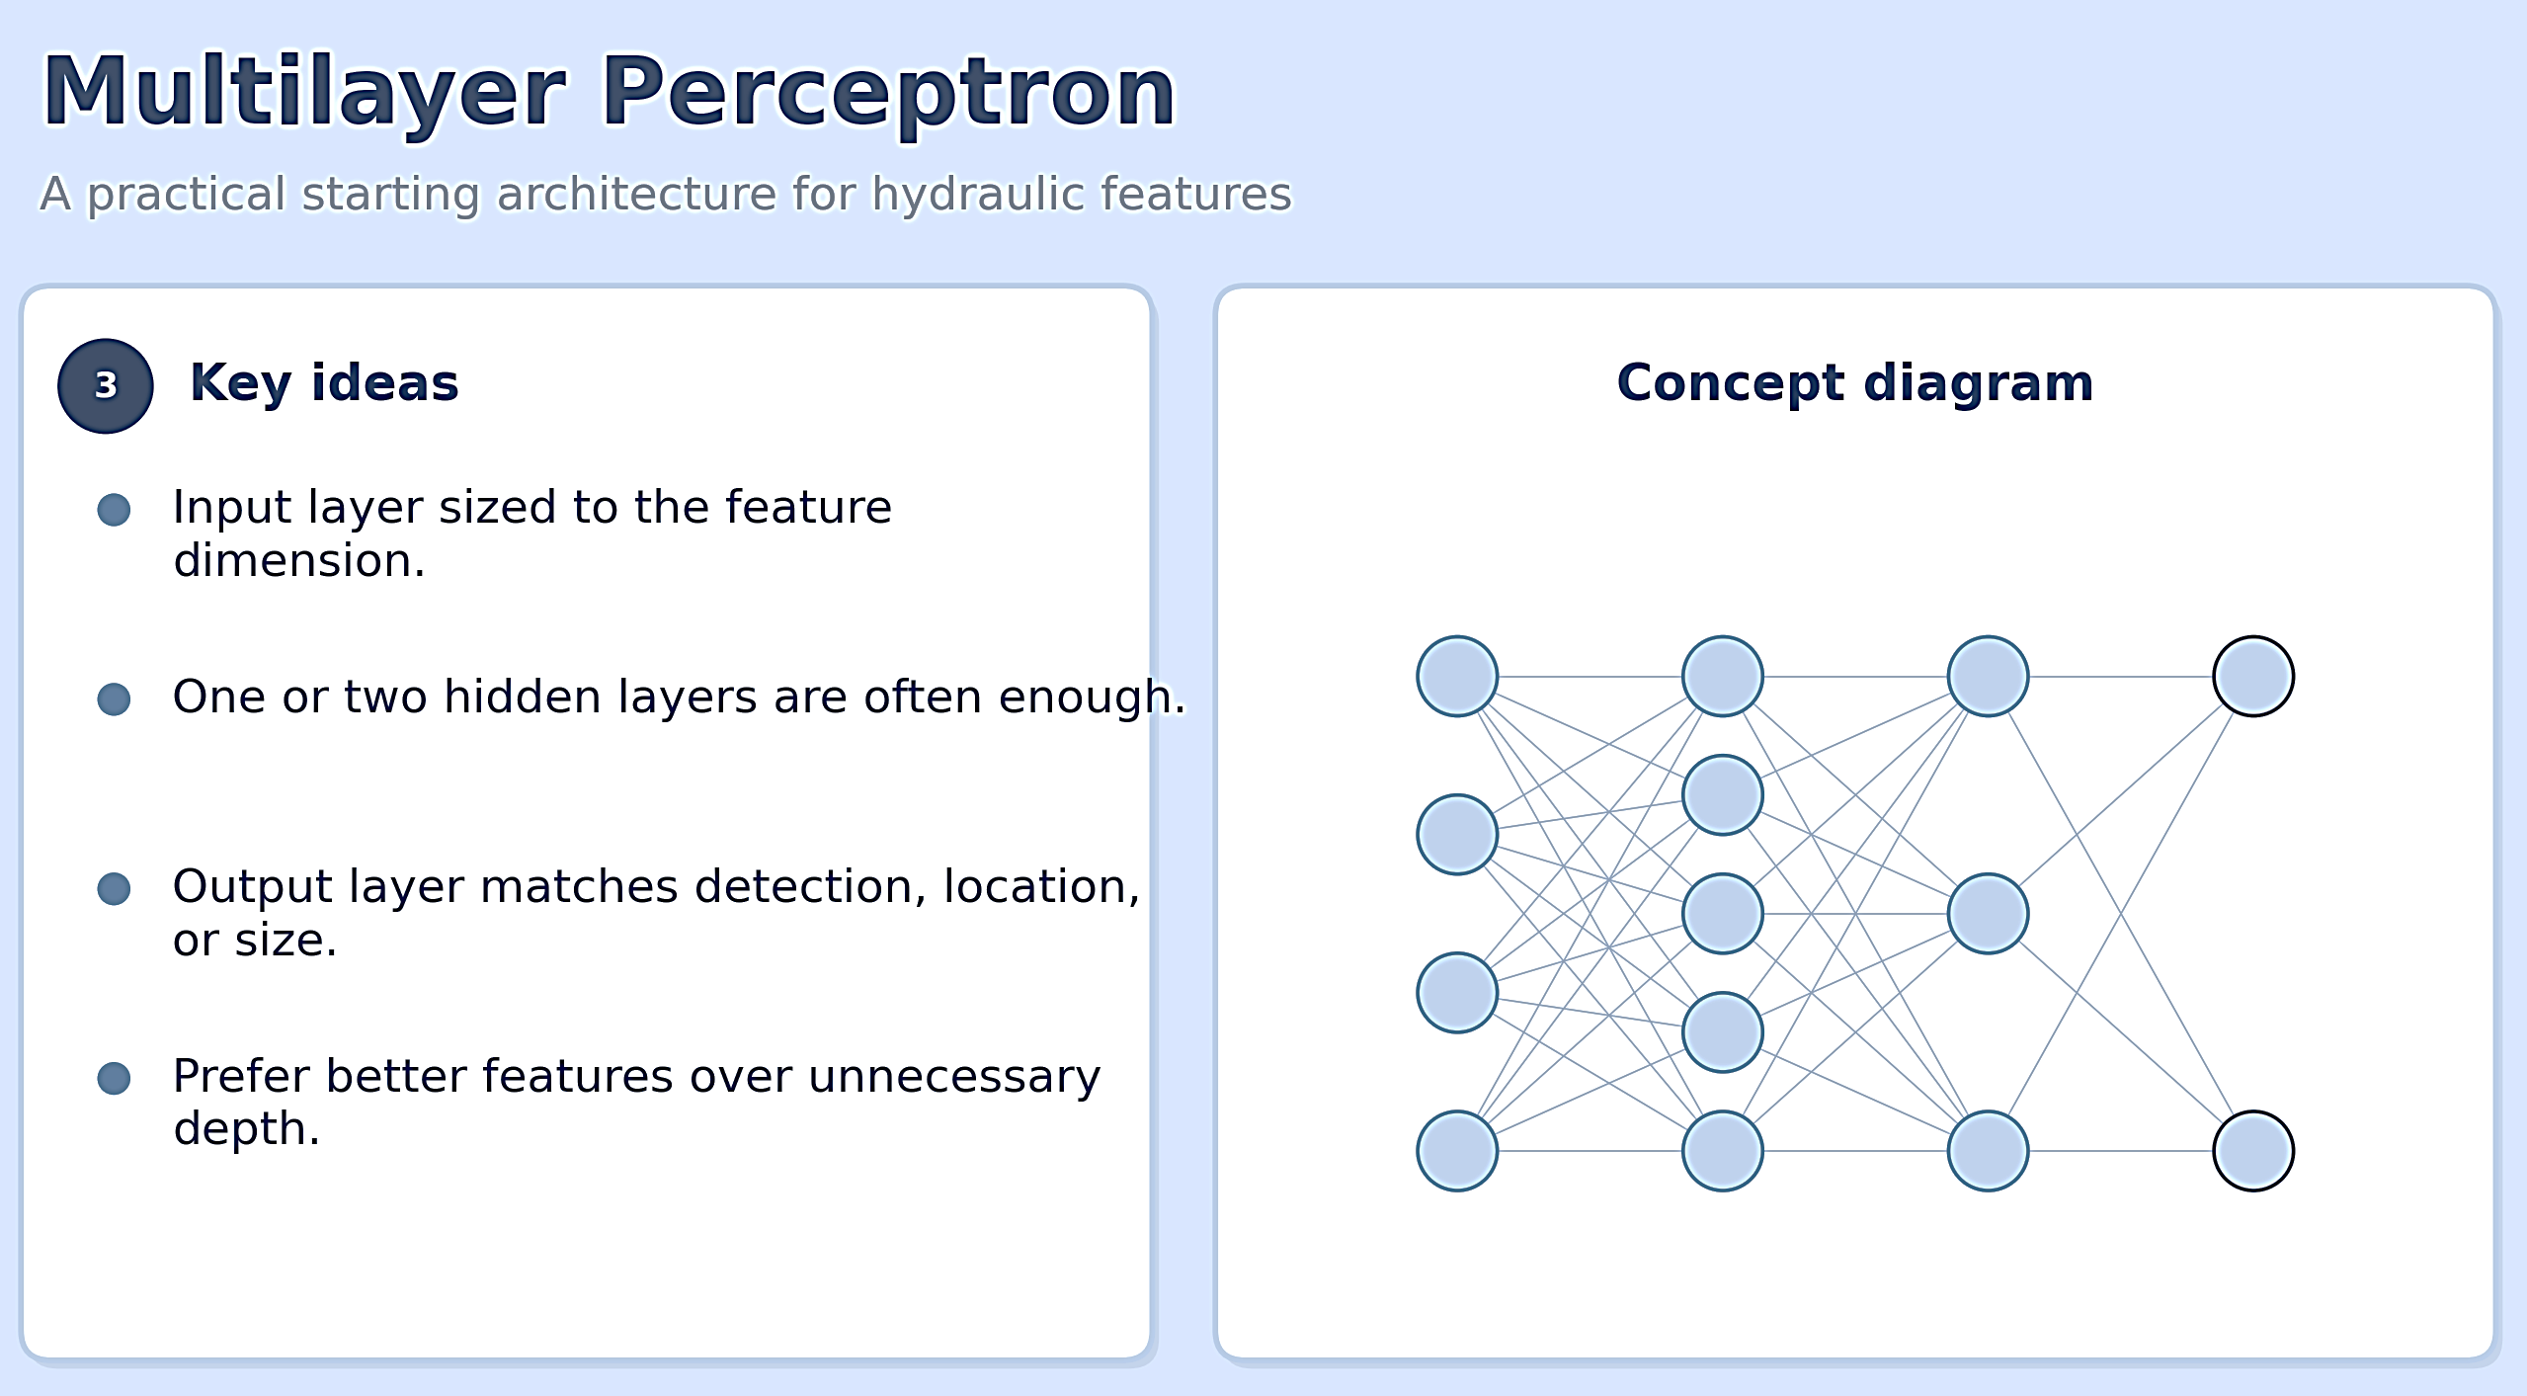
A Multilayer Perceptron (MLP), fully connected ANN
Back propagation to adjust w and b
Input features
Labels
(leak parameters)
Loss function
It learns the nonlinear relationship between the input hydraulic features and leaks!
The leak detection goals with ML:
Detection: is a leak present? (classification)
Localization: where is the leak? (multiclass classification or zone identification)
Sizing: how large is the leak? (regression)
10
Notes:
Slide 10 (Multilayer Perceptron (MLP) architecture)
Stacking many such neurons in layers creates a Multi-Layer Perceptron (MLP), the simplest ANN architecture that is often sufficient for structured datasets in hydraulics.
At the end of the network, we have a loss function that compares the labels predicted by the network with the actual labels in the training dataset.
Using a gradient-based optimization, namely backpropagation, the weights and biases are updated to minimize the loss function. When the loss function converges to a sufficiently low value, we say that the model is trained.
For more information, the Backpropagation process Calculates how much the loss function changes with respect to each weight and bias by applying the chain rule of differentiation.
Most ANN applications for leak detection are formulated as supervised learning.
That means we need pairs of examples:
Input features (from a transient event) + Known leak scenarios (the labels)
In general, an ANN may be designed for three goals for leak detection:
1- The first goal is “Detection”: is a leak present? (that is a binary classification)
2- The second is “Localization”: where is the leak? (that is a multiclass classification or zone identification)
3- And the third is “Sizing”: how large is the leak? (it is a regression problem)
During training, the network adjusts its internal parameters of weights and biases to reduce the error between its predictions and the true labels.
After training, we feed the corresponding features into the trained network and obtain a rapid estimate of the leak condition.
Here is an Important clarification: an ANN does not replace hydraulic understanding by itself. It learns patterns that exist in the training data. If the data are incomplete, biased, or poorly labelled, the network will learn the wrong relationship and is therefor useless.

Slide 11
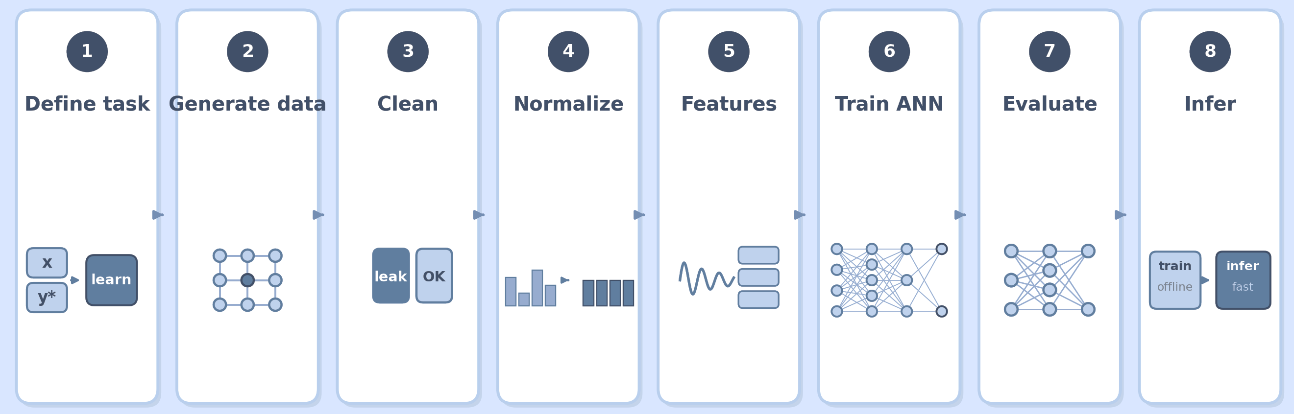
The Supervised Learning Idea for Leak Detection: End-to-End ANN Pipeline
Labels
Hydraulics
Site design
Simulation
Transient test
Leak scenarios
Noise
Uncertainties
Dataset
Real data
Failed simulations
Missing data
Outliers
Denoising
Sensors alignment
Preprocessing
Normalization
Standardization
Data leakage
Feature extraction
Dimensionality reduction
Transformations
ANN architecture
Dataset split
Loss function
Backpropagation
Overfitting
Accuracy
Error
Precision/recall
Confusion matrices
Sensitivity to noise
Deploying and Retraining
11
Notes:
Slide 11 (The Supervised Learning Idea for Leak Detection)
A practical ANN workflow for transient-based leak detection can be organized in 8 steps as you see in this slide.
Step 1. Define the Learning Task
We decide what the network should output: detection, localization, sizing, or a carefully designed combination of these.
Also, we define the operating envelope: which network, which demand patterns, which transient excitations, and which sensor layouts will be considered. Ambiguous task definition is a common source of weak models.
Step 2. Generate or Collect Training Data
For water networks, labelled field data with known leak locations and sizes are often scarce. Better to say unavailable. Therefore, training data are commonly synthetic and generated with a transient hydraulic simulator by systematically varying leak location and size, and operating conditions. We can add noise and uncertainties to data to make them more realistic.
Real data, when available, are valuable for data augmentation and model validation.
Step 3. Data Cleaning and Quality Control
Before training, the dataset must be checked and cleaned.
Typical checks include removing failed simulations, handling missing samples, identifying outliers, verifying sensor alignment in time, and confirming that labels match the intended scenarios.
For measured signals, we may also need to remove gross sensor faults and periods with incomplete excitation.
A clean dataset does not mean a noise-free dataset. Controlled noise can be useful to increase the model robustness and generality.
Step 4. Preprocessing and Normalization
Transient signals often have different magnitudes across sensors and operating conditions. Preprocessing typically includes time alignment, windowing around the transient event, and scaling of the input features.
Common practice is to normalize features so that each input dimension has a comparable range, for example using min–max scaling or standardization based on the training set only.
Here is a critical rule: statistics used for normalization must be computed from the training data and then applied to validation and test data. Using the full dataset for scaling creates information leakage and unrealistically optimistic results.
Step 5. Feature Engineering
We can feed the network either raw sampled pressure values or engineered features that compress hydraulic information.
Raw signals preserve detail but are high-dimensional and sensitive.
Good features should be informative for leaks, robust to noise, and consistent with the hydraulics.
Feature choice is more important than using very deep learning models.
There are several feature engineering approaches ranging from statistics data science to hydraulic perspectives. In the next session we discuss how a hydraulic approach and transformation of the pressure signals from time to frequency domain are efficient and helpful for this purpose.
Step 6. Choose the ANN Architecture and Training Setup
For structured feature vectors, a compact MLP is a natural starting point: the input layer is sized to the feature dimension. Then, two or three hidden layers are added, and finally we have an output layer that results in the targets.
We start with a simple scheme and if needed we add more complexity and nonlinearity.
Classification outputs use class scores (for example, for yes/no leak questions about leak presence) while regression outputs use continuous values for leak size.
As we discussed in the previous slide, training requires a loss function aligned with the task, an optimizer, and a stopping rule based on validation performance.
We also randomly split the data into training, validation, and test sets (generally 70% for training, 15% for validation to control overfitting and 15% for test).
Controlling overfitting is one of the most important tasks at this stage. Simply speaking, we want our model to generalize well to unseen data. We do not want a model that fits the training dataset very well but performs poorly on new data.
Therefore, during optimization, we monitor the loss function on both training and validation datasets. We generally use early-stop or dropout techniques to monitor overfitting.
Finally, Step 7 and 8 include Evaluate, Interpret Limitations, and Deploy for Inference
Performance should be reported with task-appropriate metrics: errors, accuracy, precision/recall, and confusion matrix.
We should also test sensitivity to measurement noise, missing sensors, and other network components.
After deployment, retraining or updating may be needed when the network configuration, sensor layout, or operating regime changes substantially.
Okay, that’s it for the first session.
We’ll take a five-minute break and then come back for Session 2 and demonstrate and solve an example pipe network using the methods we discussed. Thank you.

Slide 12
Thank you!

Slide 13
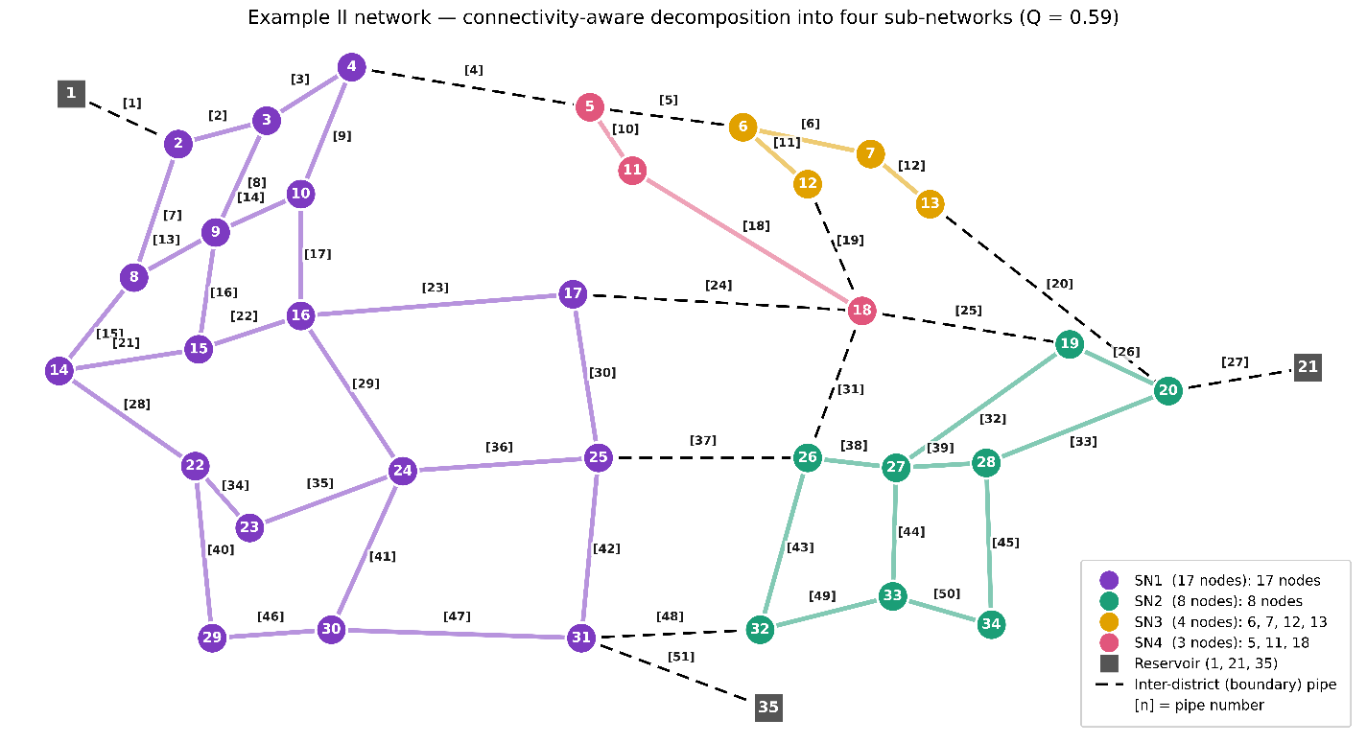
Water Distribution Network Tutorial
Prerequisite Tasks for Transient-Based Leak Detection
1. Transient Simulation Model
Method of Characteristics (MoC), time domain
Transfer Matrix Method (TMM), frequency domain
FFT and IFFT for conversion between time and frequency domains
2. Optimal Transient Excitation
Identify the most suitable excitation location
Select the excitation type and operating conditions
Maximize the information content of the generated transient
3. Optimal Sensor Placement
Identify the most informative measurement locations
Evaluate leak detectability and sensor sensitivity
Optimize sensor number and distribution
4. Network Decomposition
Analyze transient propagation, attenuation, and damping
Identify poorly observable or weakly excited network sections
Decompose large networks into smaller, manageable sub-networks
Hr = 30m
L= 762 m
a = 1316 m/s
Liggett, J. A., & Chen, L. C. (1994). Inverse transient analysis in pipe networks. Journal of Hydraulic Engineering, 120(8), 934–955.
13
Notes:
Slide 13 (Water Distribution Network Tutorial)
Okay, welcome back.
In this session, we are going to demonstrate the ITA method combined with an ANN using a simple but very well-known pipe network from the literature.
This network was originally introduced by Liggett and Chen in 1994 and since then has been used as a benchmark in many transient-based leak detection studies.
The system consists of 11 pipes and 7 nodes, with a reservoir at Node 1, at an elevation of 30 meters, supplying the network by gravity. As shown in the figure, all pipes have the same diameter of 254 millimeters, a length of 762 meters, and a wave speed of 1,316 meters per second.
Because of its simplicity and its widespread use in transient-based leak detection research, this benchmark provides an ideal case for introducing and demonstrating the key steps of our framework in this workshop.
So, the main objective here is to develop a leak detection setup for this network using inverse transient analysis, or ITA, together with a trained artificial neural network.
As we discussed in the first session, before implementing a transient-based leak detection method, we need to address several important tasks.
First, we need to develop a transient simulation model. This can be done using the Method of Characteristics, or MoC, in the time domain, or the Transfer Matrix Method in the frequency domain. If we use either approach, we can transform the results between the time and frequency domains using the Fast Fourier Transform, or FFT, and the Inverse Fast Fourier Transform, or IFFT.
Second, we need to identify the most suitable location for transient excitation
Third, we need to determine the optimal measurement locations or measurement site design.
Fourth, for a large network, if our analysis shows that the generated transient has poor dynamics and is rapidly attenuated or damped, we may need to systematically decompose the network into smaller sub-networks. As you see a sample decomposed network in this slide, below left.
I am not going to cover all these topics in this workshop. I just want you to keep in mind that developing a leak detection approach involves many investigations beyond the transient analysis and ANN itself, and there are several established ideas and methodologies in the literature. I will briefly point to some in the next slides.

Slide 14



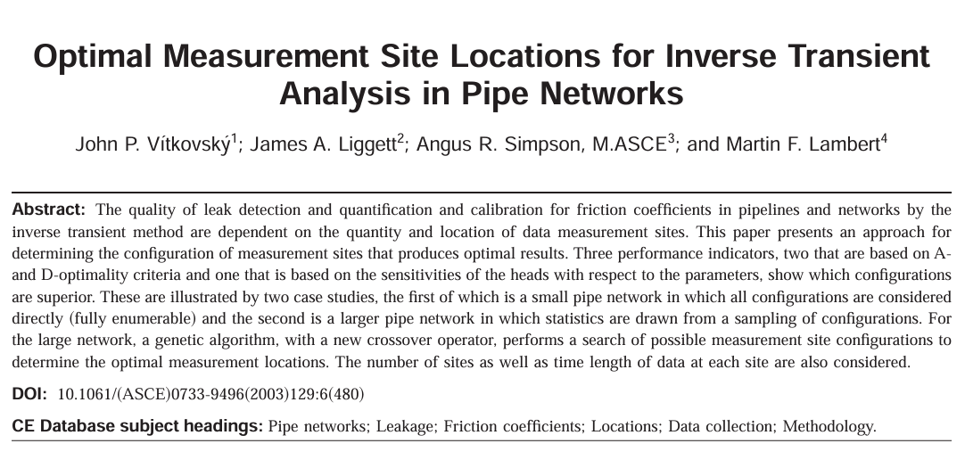
Designing the ITA problem
1. Transient Simulation Model
2. Optimal Transient Excitation
3. Optimal Sensor Placement
14
Notes:
Slide 14 (Designing the ITA problem )
As we discussed, to formulate an ITA problem, we first need a simulation model that acts as the forward analysis engine. It takes the leak characteristics as input and returns the pressure heads at the network nodes as outputs. As mentioned earlier, this model can be developed either in the time domain or in the frequency domain. In our case, we have already developed both models.
In addition, in particular, transient excitation optimization and measurement-site design are themselves active research areas. There are several approaches proposed in the literature to address these problems. Here, you can see some examples of papers that specifically focus on these topics. In particular, this paper by us focuses specifically on measurement-site design for machine-learning-based leak detection.

Slide 15
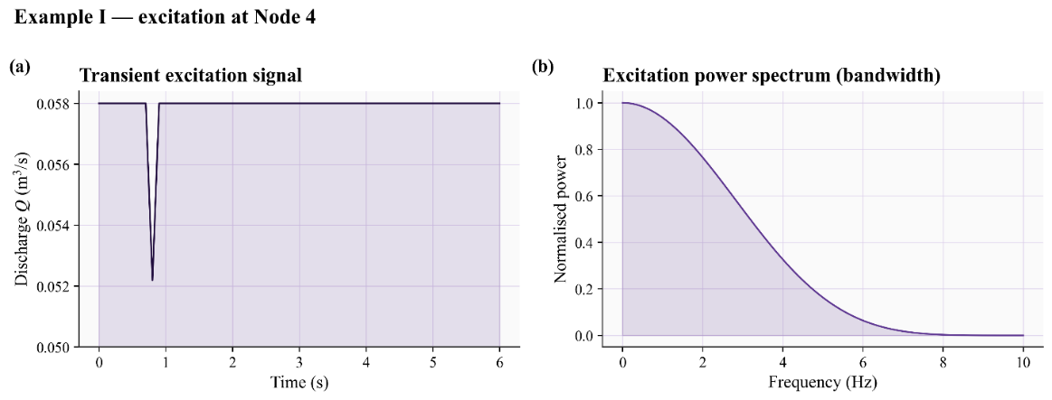
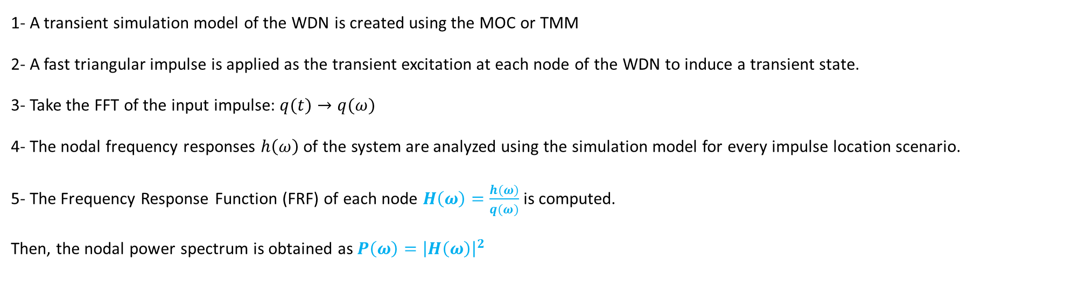
Hydraulic Impedance Spectroscopy
1- A transient simulation model of the WDN is created using the MOC or TMM
2- A fast triangular impulse is applied as the transient excitation at each node of the WDN to induce a transient state.
3- Take the FFT of the input impulse: $q(t)→q(ω)$
4- The nodal frequency responses $h\left(ω\right)$ of the system are analyzed using the simulation model for every impulse location scenario.
5- The Frequency Response Function (FRF) of each node $H\left(ω\right)=\frac{h(ω)}{q(ω)}$ is computed.
Then, the nodal power spectrum is obtained as $P\left(ω\right)={\left|H\left(ω\right)\right|}^{2}$
Impulse bandwidth
15
Notes:
Slide 15 (Hydraulic Impedance Spectroscopy)
Anyway, today I would like to introduce our recent study, Hydraulic Impedance Spectroscopy, that helps us fast and explicitly determine near optimum excitation point and measurement sites.
Here is the simplest version of implementing this method.
1- A transient simulation model of the WDN is created using the MOC or TMM
2- A fast triangular impulse is applied as the transient excitation at each node of the WDN to induce a transient state.
3- Take the FFT of the input impulse: $q(t)→q(ω)$ as seen here that is the transformation of the impulse in time domain in Fig. a to its frequency content in Fig. b.
4- The nodal frequency responses $h\left(ω\right)$ for the entire the system are analyzed using the simulation model for every impulse location scenario.
5- The Frequency Response Function (FRF) of each node, defined as the ratio of the output spectrum to the input spectrum, $H\left(ω\right)=\frac{h(ω)}{q(ω)}$, is computed. This helps us remove the effects of the input excitation from the analysis.
Then, the nodal power spectrum is obtained as $P\left(ω\right)={\left|H\left(ω\right)\right|}^{2}$

Slide 16
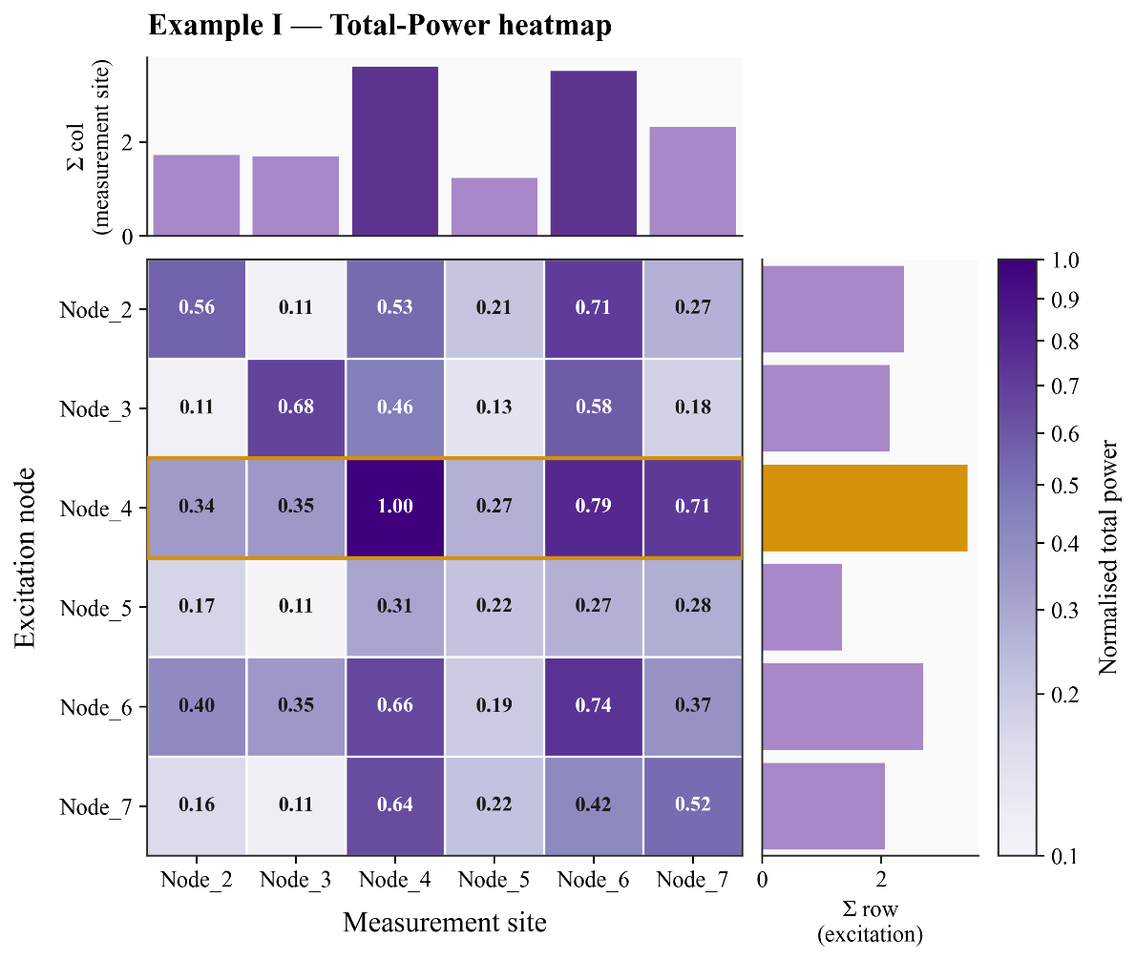
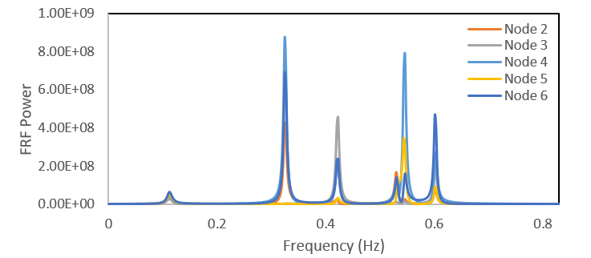
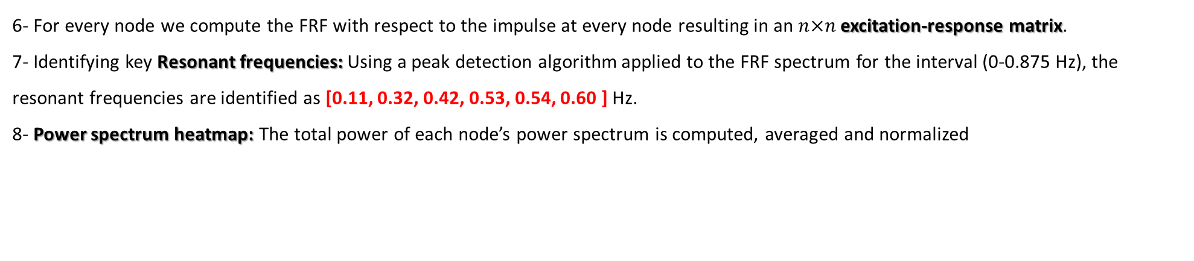
Hydraulic Impedance Spectroscopy
6- For every node we compute the FRF with respect to the impulse at every node resulting in an $n×n$ excitation-response matrix.
7- Identifying key Resonant frequencies: Using a peak detection algorithm applied to the FRF spectrum for the interval (0-0.875 Hz), the resonant frequencies are identified as [0.11, 0.32, 0.42, 0.53, 0.54, 0.60 ] Hz.
8- Power spectrum heatmap: The total power of each node’s power spectrum is computed, averaged and normalized
16
Notes:
Slide 16 (Hydraulic Impedance Spectroscopy)
6- For every node we compute the FRF with respect to the impulse at every node resulting in an $n×n$ excitation-response matrix. (n is the number of junctions)
7- Identifying key Resonant frequencies: Using a peak detection algorithm applied to the FRF spectrum, the resonant frequencies are identified as [0.11, 0.32, 0.42, 0.53, 0.54, 0.60] Hz. As you can see in this slide, in total, we identified six resonant frequencies in this example, which correspond to the number of junction nodes in the network, excluding the reservoir node.
8- When we vary the location of the impulse throughout the network and simulate the frequency responses at the different nodes, we can calculate the area under the power-spectrum curve, which represents the transient energy or power at each node.
This gives us an excitation-response heatmap, as shown in this slide. The heatmap provides valuable information about the system dynamics and how the transient propagates through the network.
For our purpose, it clearly shows which excitation node generates the most informative and powerful transient response across the network, as well as which nodes are most strongly affected by that excitation.
According to this heatmap, Node 4 is the best location for initiating the transient in the system. It also indicates that Nodes 4 and 6, and then Node 7, are the most informative locations for placing sensors.
So, by deriving this heatmap have solved the problem of excitation site and sensors placement simultaneously and explicitly.

Slide 17
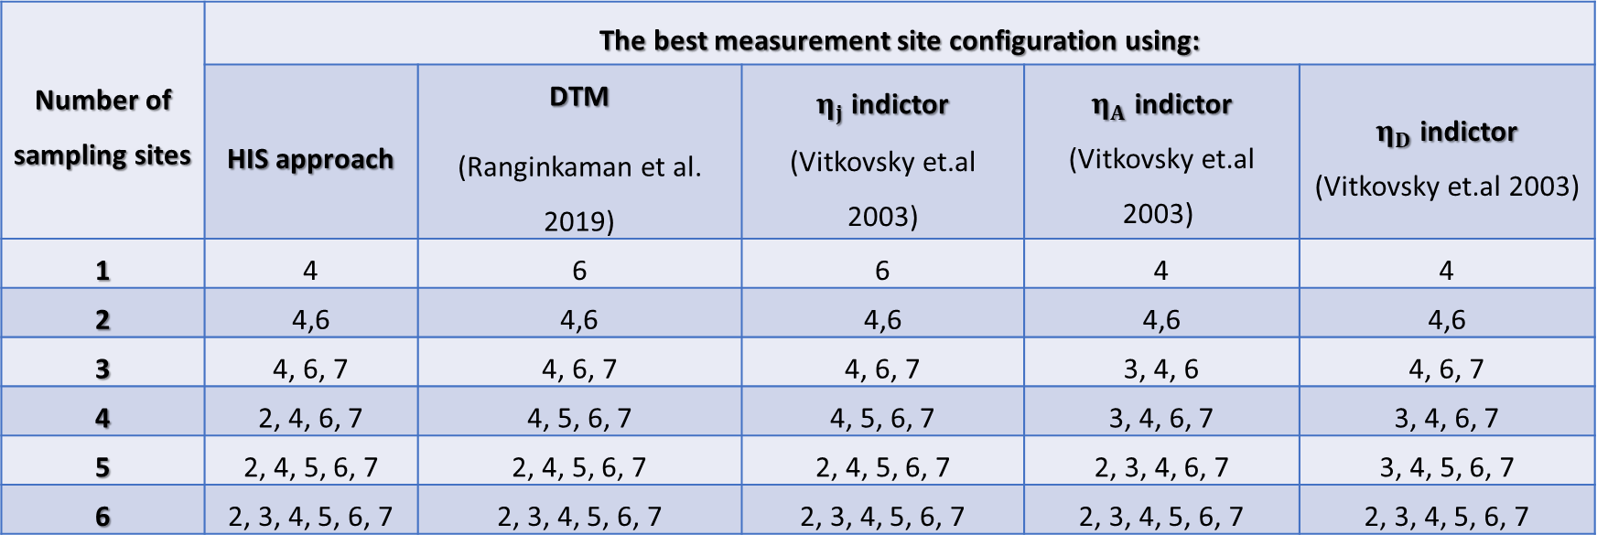
Hydraulic Impedance Spectroscopy
Supposing the transient is initiated from Node 4, focusing on the row of Node 4 in the heatmap, the optimum locations for sensor placements are explicitly determined.
Measurement site
Excitation node
Node 2
Node 3
Node 4
Node 5
Node 6
Node 7
Number of sampling sites | The best measurement site configuration using:
 | HIS approach | DTM (Ranginkaman et al. 2019) | $η_{j}$ indictor (Vitkovsky et.al 2003) | $η_{A}$ indictor (Vitkovsky et.al 2003) | $η_{D}$ indictor (Vitkovsky et.al 2003)
1 | 4 | 6 | 6 | 4 | 4
2 | 4,6 | 4,6 | 4,6 | 4,6 | 4,6
3 | 4, 6, 7 | 4, 6, 7 | 4, 6, 7 | 3, 4, 6 | 4, 6, 7
4 | 2, 4, 6, 7 | 4, 5, 6, 7 | 4, 5, 6, 7 | 3, 4, 6, 7 | 3, 4, 6, 7
5 | 2, 4, 5, 6, 7 | 2, 4, 5, 6, 7 | 2, 4, 5, 6, 7 | 2, 3, 4, 6, 7 | 3, 4, 5, 6, 7
6 | 2, 3, 4, 5, 6, 7 | 2, 3, 4, 5, 6, 7 | 2, 3, 4, 5, 6, 7 | 2, 3, 4, 5, 6, 7 | 2, 3, 4, 5, 6, 7
17
Notes:
Slide 17 (Hydraulic Impedance Spectroscopy)
So, for this example, we select Node 4 as the optimal location for generating the transient.
Then, by examining the row corresponding to Node 4 in the heatmap, as shown here, we can identify the optimal sensor locations.
This table also summarizes the results obtained from our heatmap approach and compares them with those reported in previous studies using different optimization approaches.
Now that we have selected Node 4 as the transient excitation point, we need to choose a measurement location. I am going to select Node 6, which is the second-best measurement location according to our analysis. Just for having two different sites for transient excitation and measurement!
Based on this configuration, we generate the transient at Node 4 and use only one measurement site, at Node 6. With these choices, we can now formulate our ITA problem.

Slide 18

Feature engineering for ANN
Time domain signal
Sensor
Reference (no leak) state
Frequency domain spectrum
Features: Powers at resonant frequencies [0.11, 0.32, 0.42, 0.53, 0.54, 0.60 ]
18
Notes:
Slide 18 (Feature engineering for ANN)
Our goal is to identify leaks based on the transient responses measured at our selected sensor location, Node 6. So, the transient pressure signal is the input data for our machine learning model.
In theory, we could directly feed the measured transient timeseries into the ANN after denoising and preprocessing. However, this signal contain thousands of data points. This would require thousands of input neurons that is impossible to make such complex model in practice.
Instead, we extract a limited number of informative features from the signal and use these features as the inputs to our ANN.
The process of identifying and constructing informative features that are sensitive to leaks and help the model distinguish between different leak scenarios is called feature engineering or feature extraction.
I believe that feature engineering is the most important and critical steps in developing any data-driven model.
There are several ways to do this. We can use statistical or machine learning techniques, such as principal component analysis, or PCA, or moving averages. We can also extract features directly from the time-domain signal, such as wave arrival and reflection times or damping rates. Alternatively, we can leverage our hydraulic knowledge to identify physically meaningful features.
For our example, we know that transforming the transient signal into the frequency domain can reveal distinctive leak signatures in the frequency response.
Please look at the power spectrum measured at Node 6 in this slide in below right. The blue curve represents the reference condition, no leak scenario.
Now, consider a leak at Node 2 in the network. You can see how clearly the power spectrum changes as the leak size increases. These changes provide a distinctive fingerprint of the leak.
Therefore, for our feature engineering, we transform the measured transient signal into the frequency domain and calculate the frequency response function, or FRF. We then extract the power-spectrum amplitudes at the identified resonant frequencies and use them as the input features for our ANN.
Since we identified six resonant frequencies in this network, we obtained six features for each transient response. These six features will serve as the inputs to our neural network.

Slide 19
Leakage fingerprints on the FRF of the measurement site, Node 6
19
Notes:
Slide 19 (Leakage fingerprints on the FRF)
Alo, for further clarification, you can see the fingerprint of the leak location in the FRF spectrum. As you can see here, the leak location affects the FRF amplitudes at the resonant frequencies significantly resulting in a distinguishable pattern.
Based on this, we can say we have identified a set of six independent and informative features to use as inputs to make our ANN.

Slide 20
Dataset generation
Leak parameters: The number, Location and Size of Leaks
Dataset Settings
Excitation node: 4 | Leak areas (cm²): 0.1-4
Sensor node(s): 6 | Relative noise= 5% Augmentation replicates=10
Leak / output junctions: 2,3,4,5,6,7 | Seed: 100
Final Structured Dataset
Number of rows (samples): 310 | ANN output: 6 leak parameters (existence or size)
Number of features: 6 | Reference rows (no leak samples): 10
Types of features: Resonant frequencies | Leak rows (leak scenarios): 300
Labels
Features
Node | leak_present | leak_size_mm | P_s6_0.1113Hz | P_s6_0.3247Hz | P_s6_0.4207Hz | P_s6_0.5300Hz | P_s6_0.5460Hz | P_s6_0.6021Hz
none | 0 | 0.00 | 3.01E+07 | 7.62E+08 | 2.14E+08 | 1.37E+08 | 2.21E+08 | 4.62E+08
2 | 1 | 3.57 | 2.97E+07 | 7.05E+08 | 2.12E+08 | 1.22E+08 | 2.20E+08 | 4.49E+08
2 | 1 | 7.98 | 2.80E+07 | 5.30E+08 | 2.07E+08 | 8.09E+07 | 2.15E+08 | 4.05E+08
2 | 1 | 11.28 | 2.61E+07 | 3.90E+08 | 2.01E+08 | 5.36E+07 | 2.09E+08 | 3.58E+08
2 | 1 | 15.96 | 2.29E+07 | 2.37E+08 | 1.89E+08 | 2.86E+07 | 1.94E+08 | 2.86E+08
2 | 1 | 22.57 | 1.80E+07 | 1.14E+08 | 1.69E+08 | 1.24E+07 | 1.67E+08 | 1.95E+08
3 | 1 | 3.57 | 2.97E+07 | 7.62E+08 | 1.87E+08 | 1.35E+08 | 2.21E+08 | 4.31E+08
3 | 1 | 7.98 | 2.79E+07 | 7.61E+08 | 1.17E+08 | 1.31E+08 | 2.20E+08 | 3.36E+08
3 | 1 | 11.28 | 2.60E+07 | 7.61E+08 | 7.32E+07 | 1.26E+08 | 2.18E+08 | 2.55E+08
3 | 1 | 15.96 | 2.26E+07 | 7.59E+08 | 3.64E+07 | 1.17E+08 | 2.15E+08 | 1.61E+08
20
Notes:
Slide 20 (Dataset generation)
Now we need a dataset on which the ANN can be trained and validated offline.
For this purpose, we use the transient simulation model.
We assume that every node in the network is a potential leak location, with an unknown leak size. A leak size of zero simply means that there is no leak at that node.
With this assumption, we reduce the leak unknowns to the leak size at each candidate node.
This allows us to formulate the supervised leak detection problem in two ways. First, as a binary classification problem, where each node is classified as either having a leak or not having a leak. Second, as a regression problem, where the model predicts the leak size at each node. We will try both approaches next.
To generate our dataset, these two tables summerize our settings and assumptions.
The transient excitation point is Node 4.
The measurement point is Node 6.
All nodes except the reservoir are considered potential leak locations.
Leak sizes range from a very small value of 0.1 cm² to a relatively large value of 4 cm².
We consider 100 different leak scenarios.
For simplicity, each scenario contains only one leak.
We assume 5% relative noise in the measured transient signals.
We use 10 augmentation replicates to generate noisy versions of each scenario.
In other words, each leak scenario, as well as the no-leak scenario, is replicated 10 times with different random noise in them.
Using a simple code coupled with our simulation model, I generated a dataset containing 310 samples. Ten samples correspond to the intact system, no-leak condition, with different noise scenarios, while the remaining 300 samples represent leak scenarios.
Each sample contains six input features, corresponding to the power amplitudes at the six identified resonant frequencies, and six outputs, corresponding to the six potential leak locations.
We also have two types of labels: leak presence (0-1), which is used for binary classification, and leak size, which is used for regression.
Here, you can see ten rows from our dataset, including the six features and the corresponding labels.
I will share the complete dataset with you at the end of the talk, so you can use it to develop and test your own machine learning models.

Slide 21
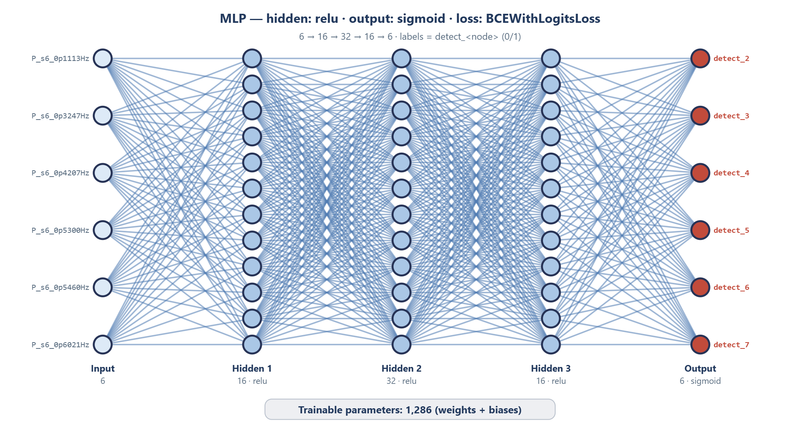
Model 1: Binary classification
(Binary Cross-Entropy on logits)
Binary classes:
0: no leak
1: leak
21
Notes:
Slide 21 (Model 1: Binary classification)
Now, using the dataset generated in the previous slide, we can start building and training our first ANN model. This is a binary, or yes/no, classification problem.
We start with a relatively simple Multi-Layer Perceptron (MLP) architecture.
The input layer has six neurons, corresponding to our six extracted features. We then have three hidden layers, with 16, 32, and 16 neurons, respectively. Finally, the output layer has six neurons, corresponding to the six network junctions considered as potential leak locations.
For the activation functions, we use ReLU in the hidden layers and Sigmoid in the output layer. The Sigmoid returns the probability of leak presence.
This is a supervised learning model. We use binary labels: 1 indicates the presence of a leak at a particular junction, while 0 indicates no leak.
For training, we normally use the Binary Cross-Entropy loss function for binary classification problems.
In total, this network has 1,286 trainable parameters that need to be optimized during training. So, we can consider this a relatively lightweight ANN model.
It is important to note that the architecture and all these configurations are not fixed. They can be modified and fine-tuned. For example, we can perform a sensitivity analysis, test different network architectures and hyperparameter configurations, and identify the most suitable setup for each case study.

Slide 22
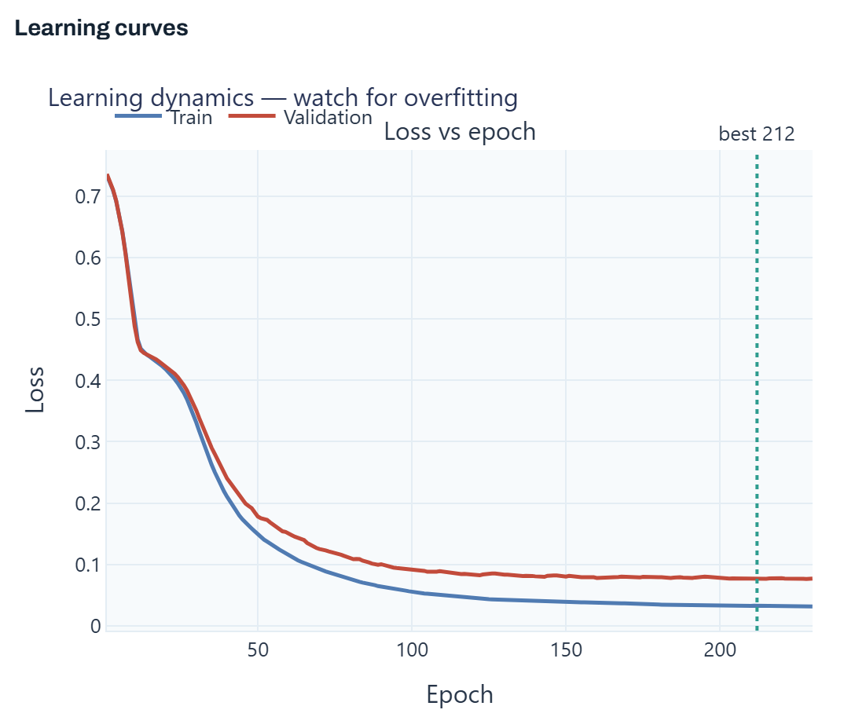
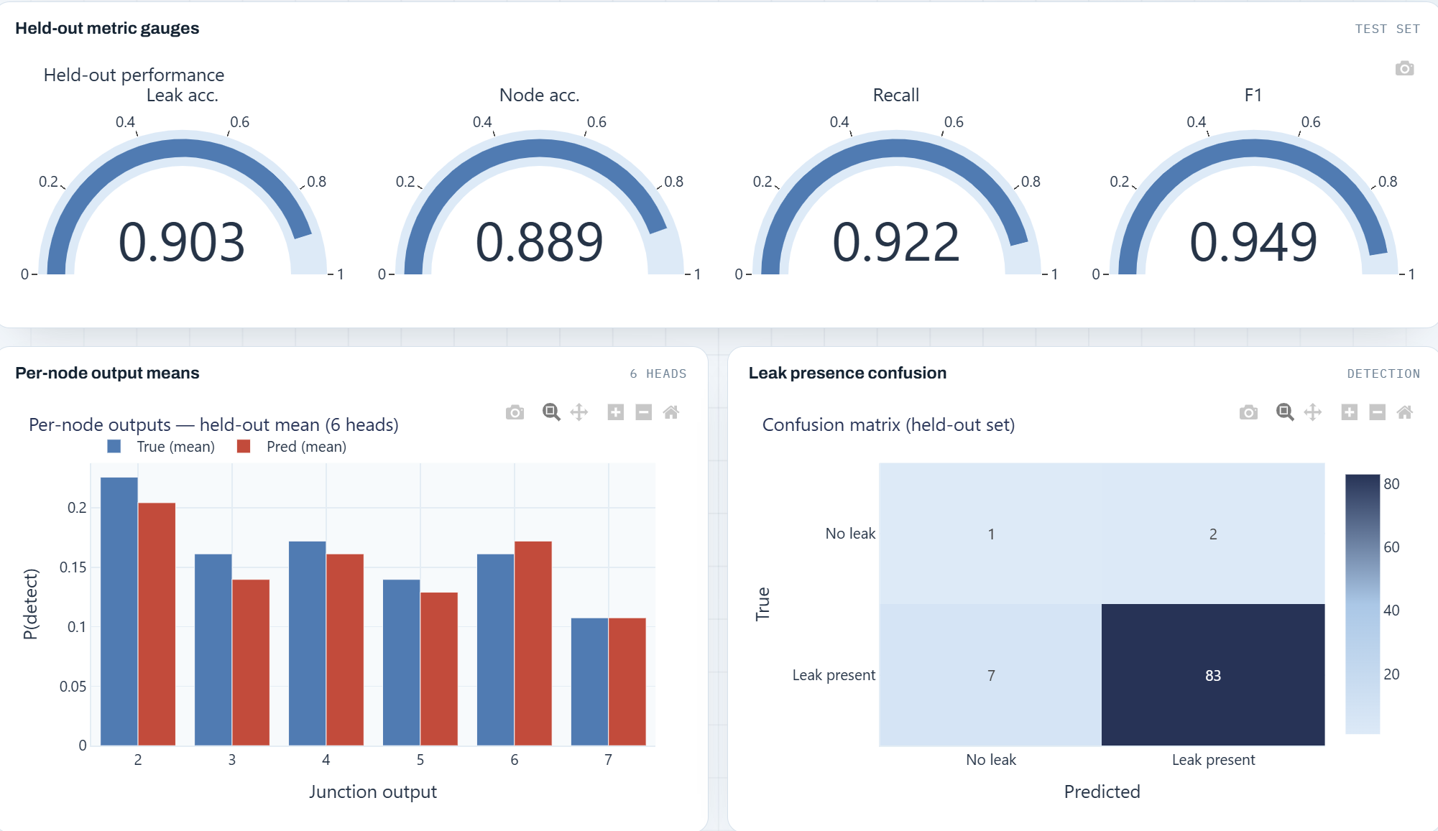
Model 1: Binary classification (yes/no classification)
Learning Settings
Learning rate: 0.001 | Dropout: 15%
Test and Validation fraction: 30% | Batch size: 32
Early stopping= yes - patience 20 | Framework: Torch
22
Notes:
Slide 22 (Model 1: Binary classification)
Now, let's look at the training results and see how well our first ANN model performs.
First, let me briefly explain the learning settings used for this model. We set the learning rate to 0.001, the batch size to 32, and the dropout rate to 15%. The dropout is a technique that helps prevent overfitting. We also used early stopping with a patience of 20 epochs. This means that if the validation loss does not improve for 20 consecutive epochs, the training process stops.
We used PyTorch as the deep learning framework. You may use other platforms like TensorFlow or other tools and libraries to cerate your ANN.
Let's first look at the learning curves on the left.
You can see here on top right how the training and validation losses decrease as the number of epochs increases. Both curves follow a similar trend, which is a good indication that the model is learning and generalizing well. We do not see a significant divergence between the two curves, which would be a typical indication of overfitting.
The best model was obtained at epoch 212, based on the validation performance.
Now, let's look at the performance metrics on the right. We evaluated the model using a held-out test dataset (I mean test and validation dataset), which was not used during training.
We have four main indicators here:
Leak accuracy: approximately 90.3%. This measures how accurately the model identifies the presence or absence of a leak.
Node accuracy: approximately 90%. This measures how accurately the model identifies the leak location.
Recall: approximately 92.2%. This means that the model successfully detects most of the actual leak cases.
F1-score: approximately 94.9%, which provides a combined measure of precision and recall.
At the bottom, we can look more closely at the model's predictions.
The chart on the left compares the average predicted output probabilities with the actual mean values for each junction. We have six output neurons, one for each potential leak location. The two sets of bars are relatively close, indicating that the model captures the overall distribution of leak predictions across the different junctions.
Finally, let's look at the confusion matrix on the bottom right.
This matrix compares the actual leak conditions with the model's predictions. The model correctly classified 83 cases as leak scenarios and 1 case as a no-leak scenario. It also produced 7 false negatives, meaning that actual leaks were missed, and 2 false positives, meaning that leaks were predicted when there was actually no leak.
Overall, these results are quite promising for our first ANN model. We achieved good leak detection performance and reasonably accurate leak localization.
However, this is only our first model. We can further improve its performance by refining the input features, experimenting with different network architectures, and tuning the hyperparameters.

Slide 23
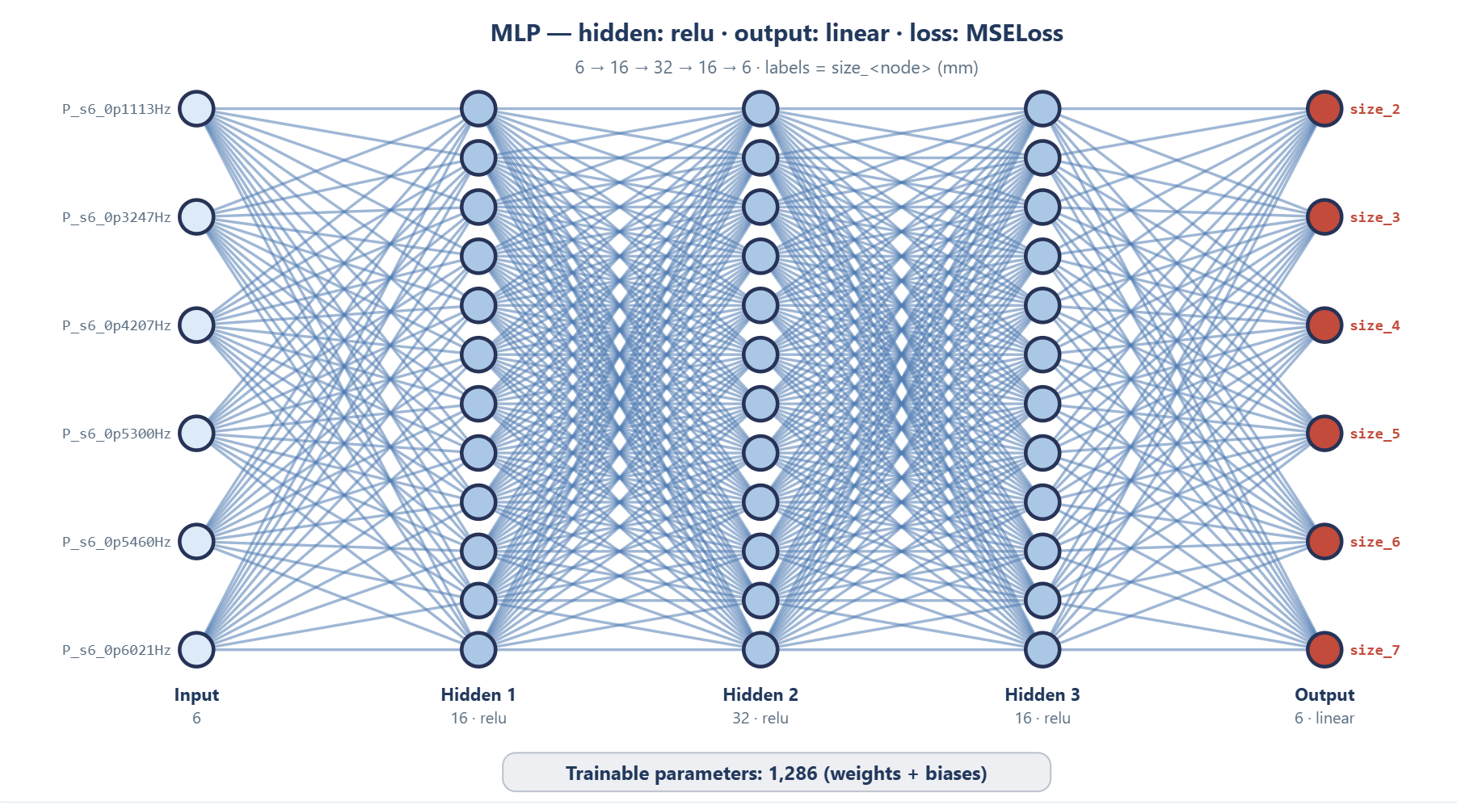
Model 2: Regression (leak sizing)
Real values:
leak sizes
23
Notes:
Slide 23 (Model 2: Regression (leak sizing))
Now, let's move on to the second model. This time, instead of simply detecting whether a leak exists and identifying its location, we want to estimate the actual leak sizes.
In other words, we want to use regression to determine the leak parameters and obtain a more complete characterization of the leakage scenario.
For this purpose, we use almost exactly the same ANN architecture as before, with the same six input features, the same three hidden layers, and the same number of neurons and trainable parameters in the hidden layers.
The main difference is in the output layer and the loss function.
For the classification model, we used the Sigmoid activation function to produce probabilities between zero and one. Here, we replace it with a linear activation function, which directly predicts the leak size at each network junction.
Therefore, each output neuron provides an estimated leak size for its corresponding junction. A value of zero indicates no leak, while a positive value represents the estimated leak size.
Regarding the loss function, we now use Mean Squared Error, or MSE, which measures the squared difference between the predicted and actual leak sizes.
So, with this regression model, we move beyond leak detection and localization towards estimating the complete set of leak parameters.

Slide 24
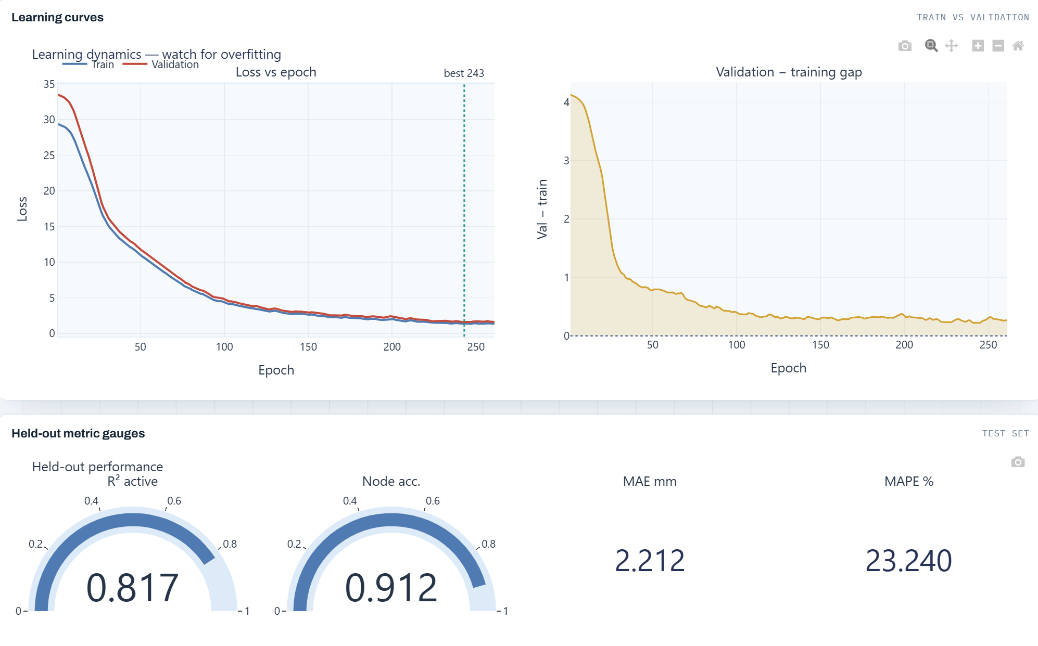
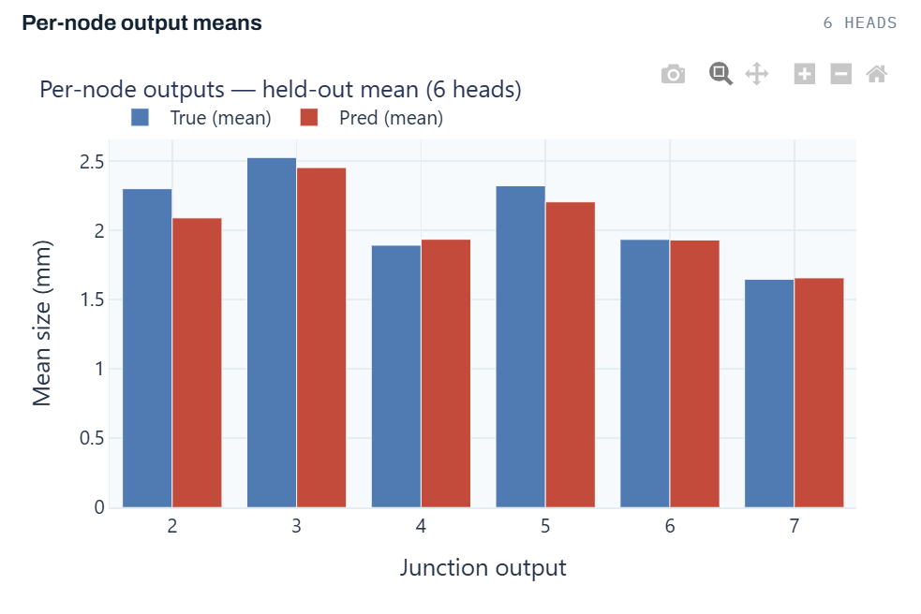
Model 2: Regression (leak sizing)
Learning Settings
Learning rate: 0.001 | Dropout: 15%
Test and Validation fraction: 30% | Batch size: 32
Early stopping= yes - patience 20 | Framework: Torch
24
Notes:
Slide 24 (Model 2: Regression (leak sizing))
Now, let's look at the training results of our second model.
As you can see, we have used exactly the same learning settings as in the previous classification model. So, the main difference here is the regression task itself, rather than the training configuration.
Let's first look at the learning curves on the left.
Both training and validation losses decrease steadily, and they follow very similar trends. This is a good indication that we do not have a significant overfitting problem.
The best model was selected at epoch 243, based on the validation performance.
The middle plot gives us another perspective. It shows the gap between validation and training loss throughout the training process. We can see that this gap decreases considerably during the first epochs and then remains relatively small. This suggests that the model is generalizing reasonably well to unseen data.
Now, let's look at the performance metrics at the bottom.
The first indicator is the coefficient of determination, or R-squared, which is approximately 0.817. This means that the model explains around 81.7% of the variance in the target leak-size values.
The second indicator is node accuracy, which is approximately 91.2%. This evaluates how accurately the model identifies the leak location.
We also have the Mean Absolute Error, or MAE, which is approximately 2.21 millimeters. This represents the average absolute difference between the predicted and actual leak sizes.
Finally, the chart on the right compares the actual mean leak sizes with the mean values predicted by the model for each junction. As you can see, the predicted values are generally quite close to the actual values across the six junctions.
Overall, these results show that the regression model can estimate leak sizes with reasonable accuracy while also providing good leak localization performance.
Combining this model with our previous classification model gives us a more reliable approach: the first model detects the presence of a leak, while the second estimates its location and size.

Slide 25
Practical Principles to Remember
Physics before learning: Let hydraulic knowledge guide the machine learning framework.
Features matter: Invest time in feature engineering and physical interpretation.
Labels define the problem: Detection, localization, and sizing require clearly defined outputs.
Generalization over memorization: Good validation performance matters more than low training error.
Data before complexity: Representative and informative data are more valuable than unnecessarily complex architectures.
Trust but verify: Check physical consistency, quantify uncertainty, and validate against real measurements.
The objective is not to develop the most complicated neural network. It is to develop the simplest reliable model that extracts the maximum useful information from the physics of the system.
25
Notes:
Slide 25 (Practical Principles to Remember)
Before we finish, I would like to leave you with some practical principles that I believe are important when developing machine learning models for engineering applications.
First, physics before learning. Always use your hydraulic knowledge to guide the machine learning framework. We should understand the physical problem first and then decide how machine learning can help us solve it.
Second, features matter. I cannot emphasize enough the importance of feature engineering. Invest time in extracting informative features and understanding their physical meaning. Sometimes, this is much more important than choosing a sophisticated algorithm.
Third, labels define the problem. Be clear about what you want your model to predict. Leak detection, localization, and sizing are different tasks, and each requires a properly defined output.
Fourth, focus on generalization, not memorization. A model that performs very well on training data but fails on unseen scenarios is not a successful model. Always pay attention to validation performance.
Fifth, data before complexity. Having representative and informative training data is generally more valuable than developing an unnecessarily complicated neural network.
And finally, trust but verify. Always check whether your predictions are physically consistent, quantify the uncertainty, and, whenever possible, validate your model against real measurements.
And if you remember only one thing from this workshop, let it be this:
Our objective is not to develop the most complicated neural network or deep learning model. It is to develop the simplest reliable model that extracts the maximum useful information from the physics of the system.
I hope you have found this tutorial useful, and I encourage you to experiment with the dataset and try your own machine learning approaches.
Finally, I have uploaded these slides and the dataset and the relevant materials from this tutorial to my GitHub repository. I now share the link here in the Zoom chatbot so you can access the files to make and train your models and other schemes like CNNs, GNNs or XGBoost and so on.

Slide 26
Thank you!
Ali.haghighi@rptu.de
Notes:
You can also see my email address on this slide.
If you have any questions or need further clarification, please feel free to contact me. I will be more than happy to help.
That’s it and thank you again for your participation!

