Slide 1
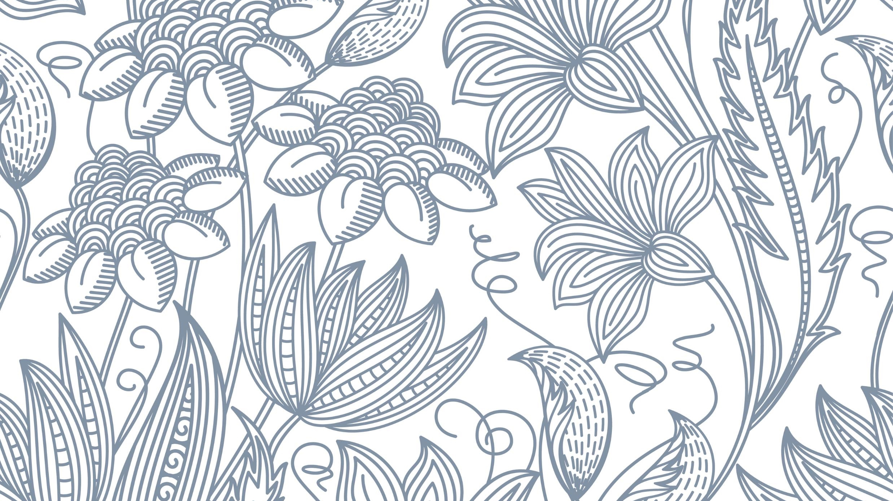
insights
Sit Dolor Amet

Slide 2
Conversions
Retail weeks to retail Years
'rgb_r_main_col', 'rgb_g_main_col', 'rgb_b_main_col’ TO primary_color
'rgb_r_sec_col', 'rgb_g_sec_col', 'rgb_b_sec_col’ TO secondary_color

Slide 3
insights
Country
Retail Years
Products group
Category
Style
Gender
Primary color
Secondary color

Slide 4
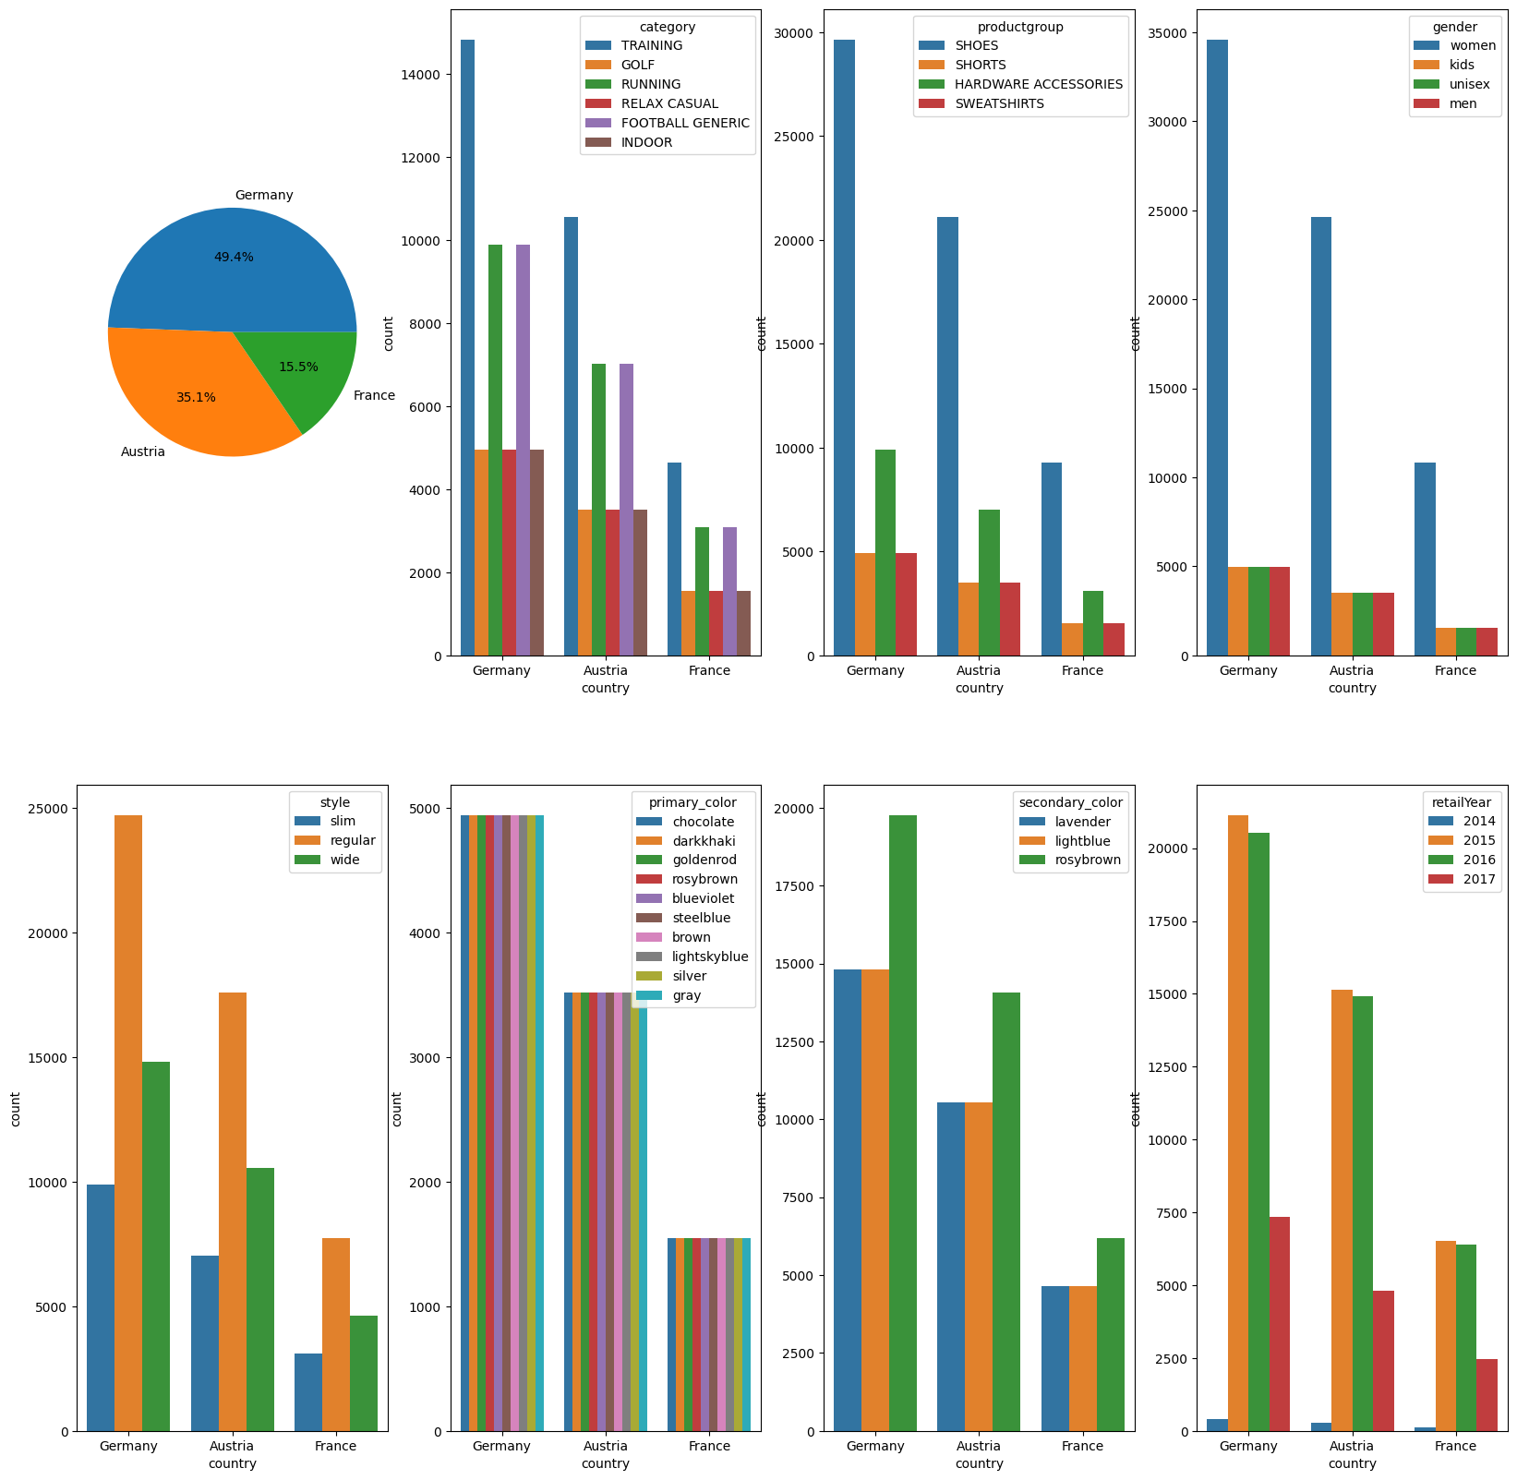
Country insights
Germany is the most country
Shoes are the most common product group
Training is the most common category
Women is the most gender
Regular is the most common style
Primary color almost identical
Rosy brown is the most common secondary color
The most Retail years are between 2015 and 2016

Slide 5
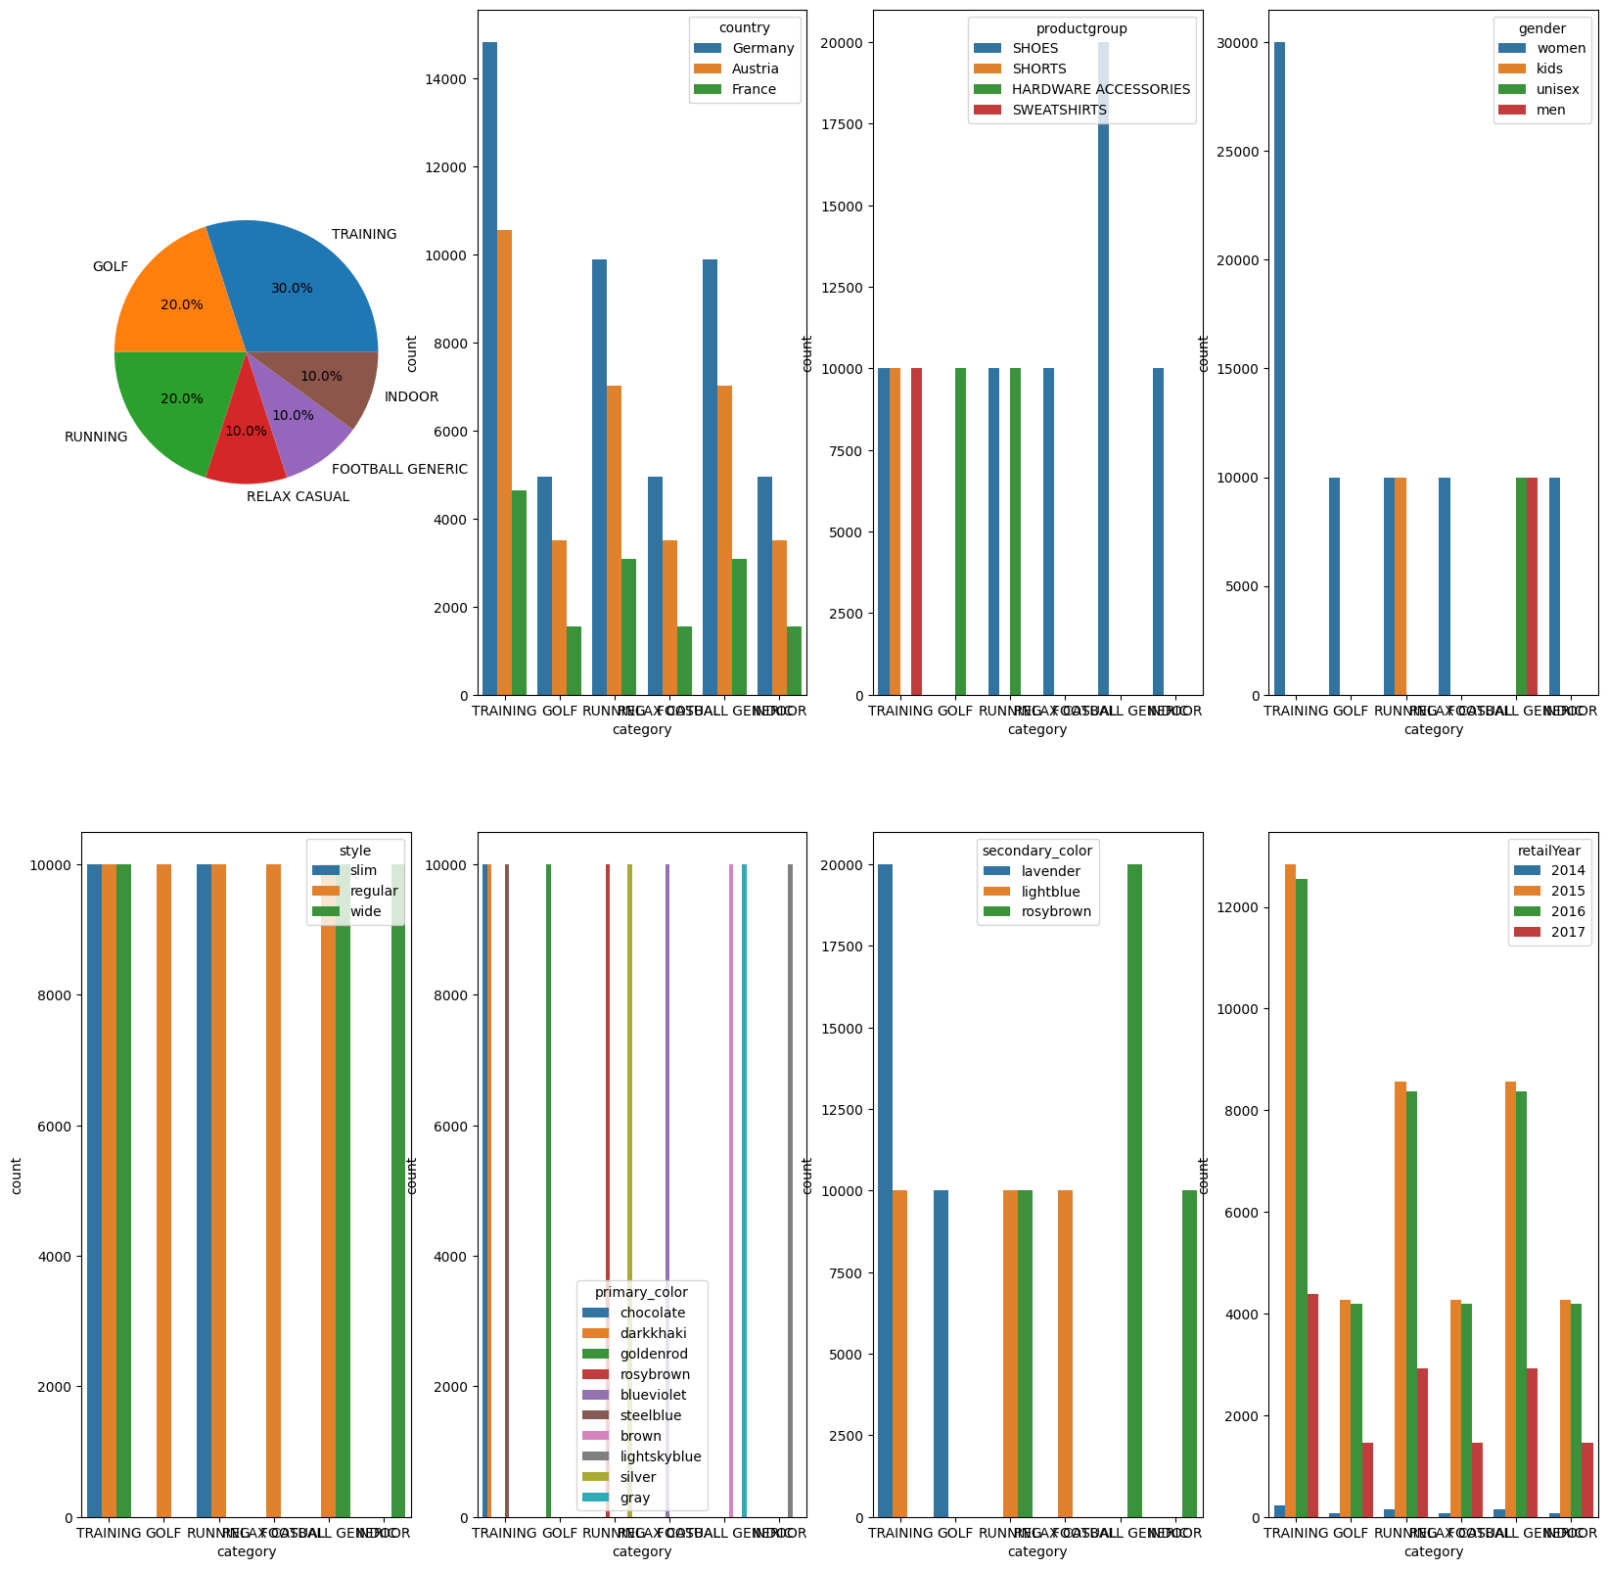
Category insights
Golf has no shoes and shorts only exist in training Sweatshirts exist only in training
Women not interested in Football generic, Kids interested in running
Unisex and men are interested in Football generic
Slim fits in running ,Slim and wide fits in Training ,Regular doesn’t fit in Indoor
Wide fits in football generic and indoor
chocolate and darkkhaki and steelblue in Training
Goldenrod in golf and Lightskyblue in indoor
Rosybrown and silver in running And blue violet in relax casual
Brown and gray in football generic
Lavender and light blue in Training ,Lavender in Golf
Light-blue and rosybrown in running
Light blue in relax casual, Rosybrown in football generic and in door

Slide 6
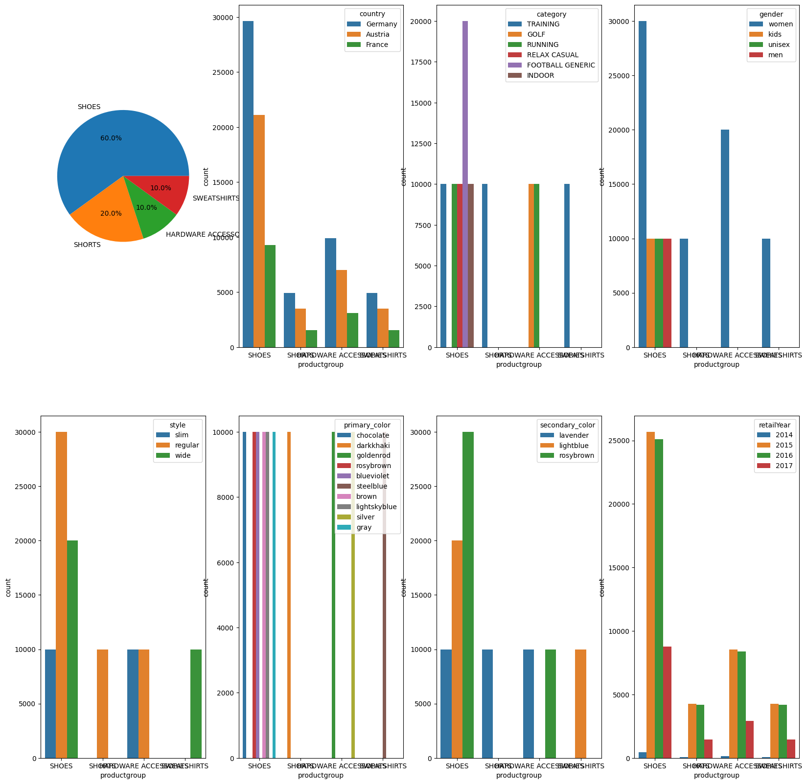
product group insights
Kids and men and unisex are interests in shoes
Shoes exists in all style hardware accessories in slim and regular
Regular with shorts and sweatshirts with wide
Shorts with darkkhaki sweatshirts with steelblue
Hardware accessories with goldenrod and silver
Shoes is without darkhhari goldenrod steelblue silver
All secondary color exists in shoes Shorts and hardware accessories exist in lavender
Hardware accessories in rosybrown and sweatshirts in light-blue

Slide 7
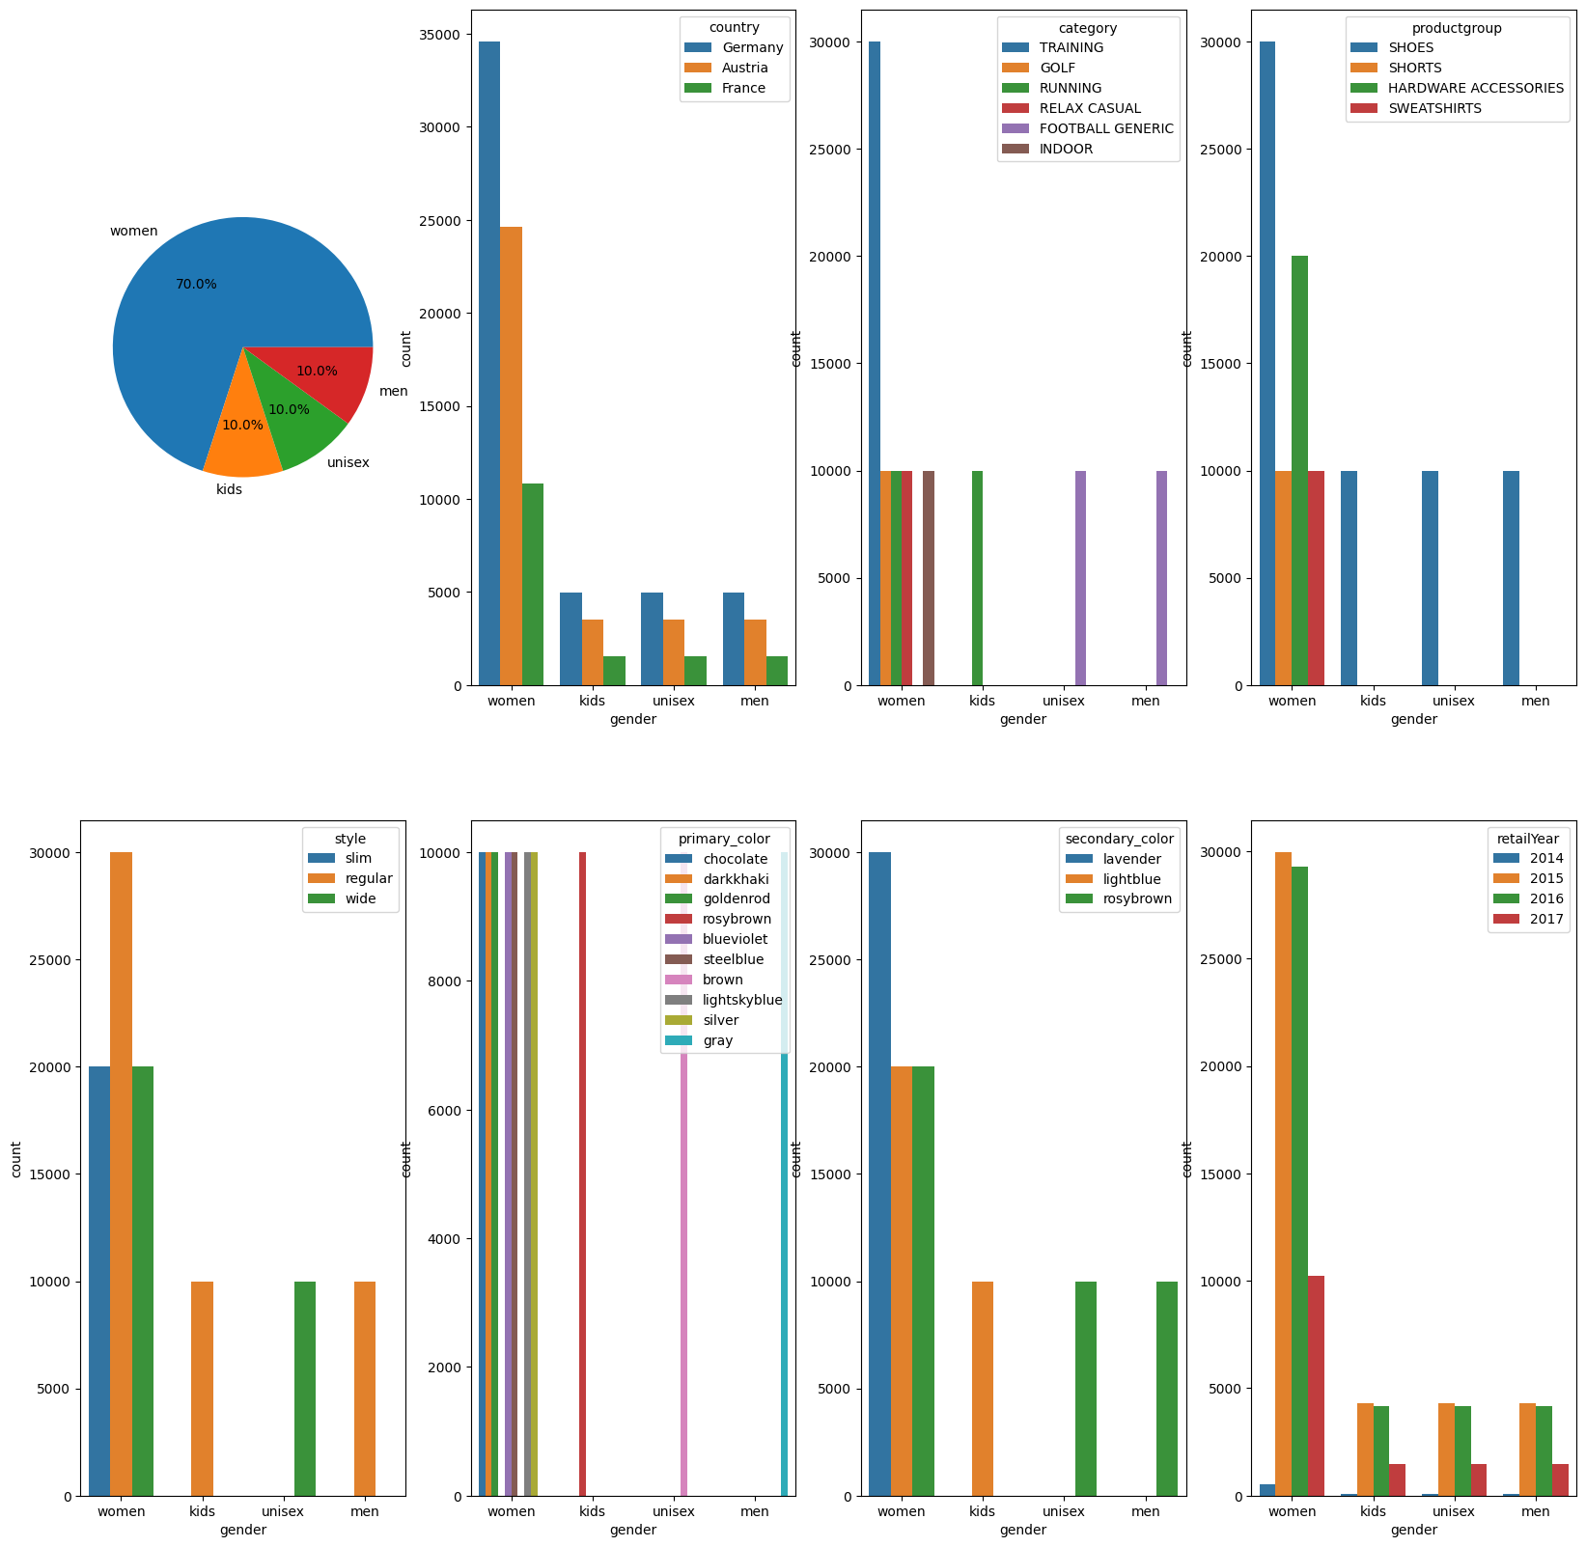
Gender insights
Kids and men prefer regular style and unisex prefer wide
Women don’t prefer rosybrown and brown
Kids prefer rosybrown and unisex prefer brown
Men prefer gray ,Kids prefer light-blue , Men and unisex prefer rosybrown

Slide 8
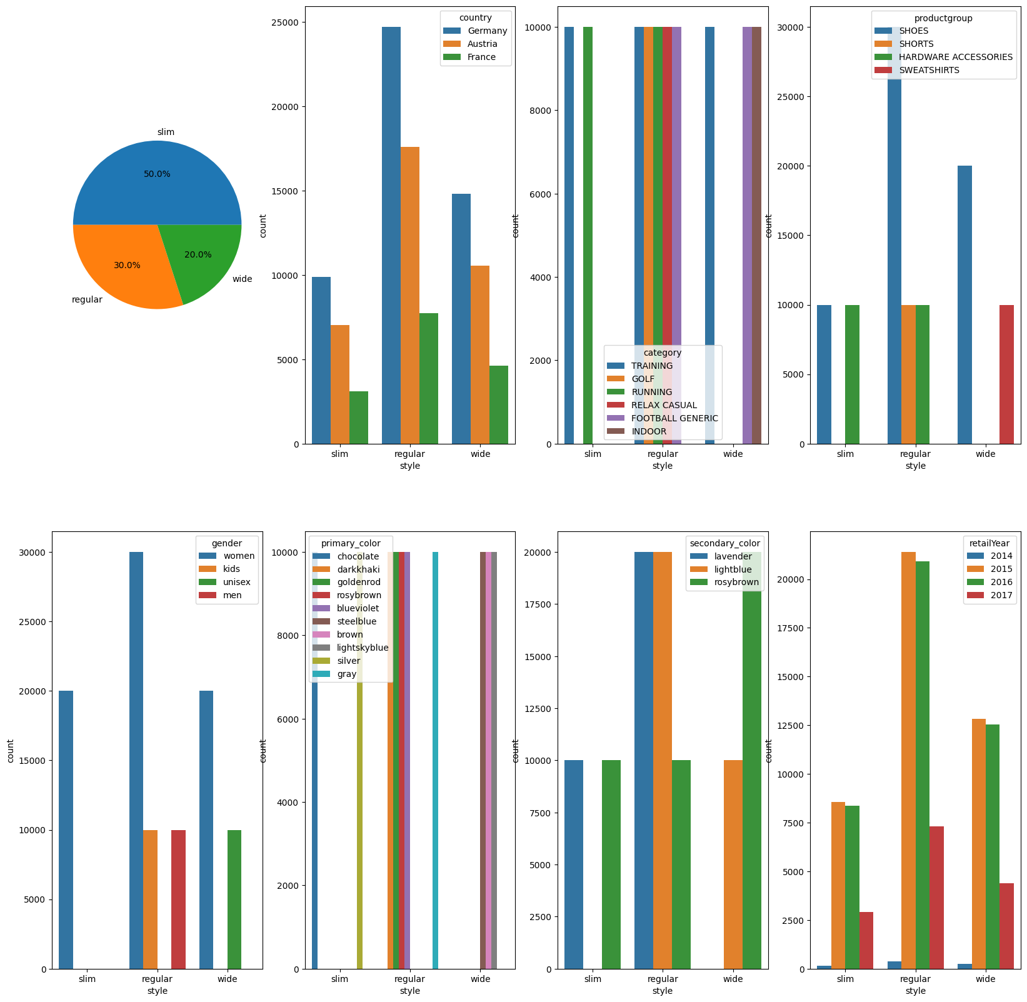
Style insights
Slim with chocolate and silver
regular is preferred with darkkahri goldenrod rosybrown blue violet
Wide is preferred with steelblue brown lightskyblue
Regular with all styles wide with light-blue and rosybrown
Slim with lavender and rosybrown

Slide 9
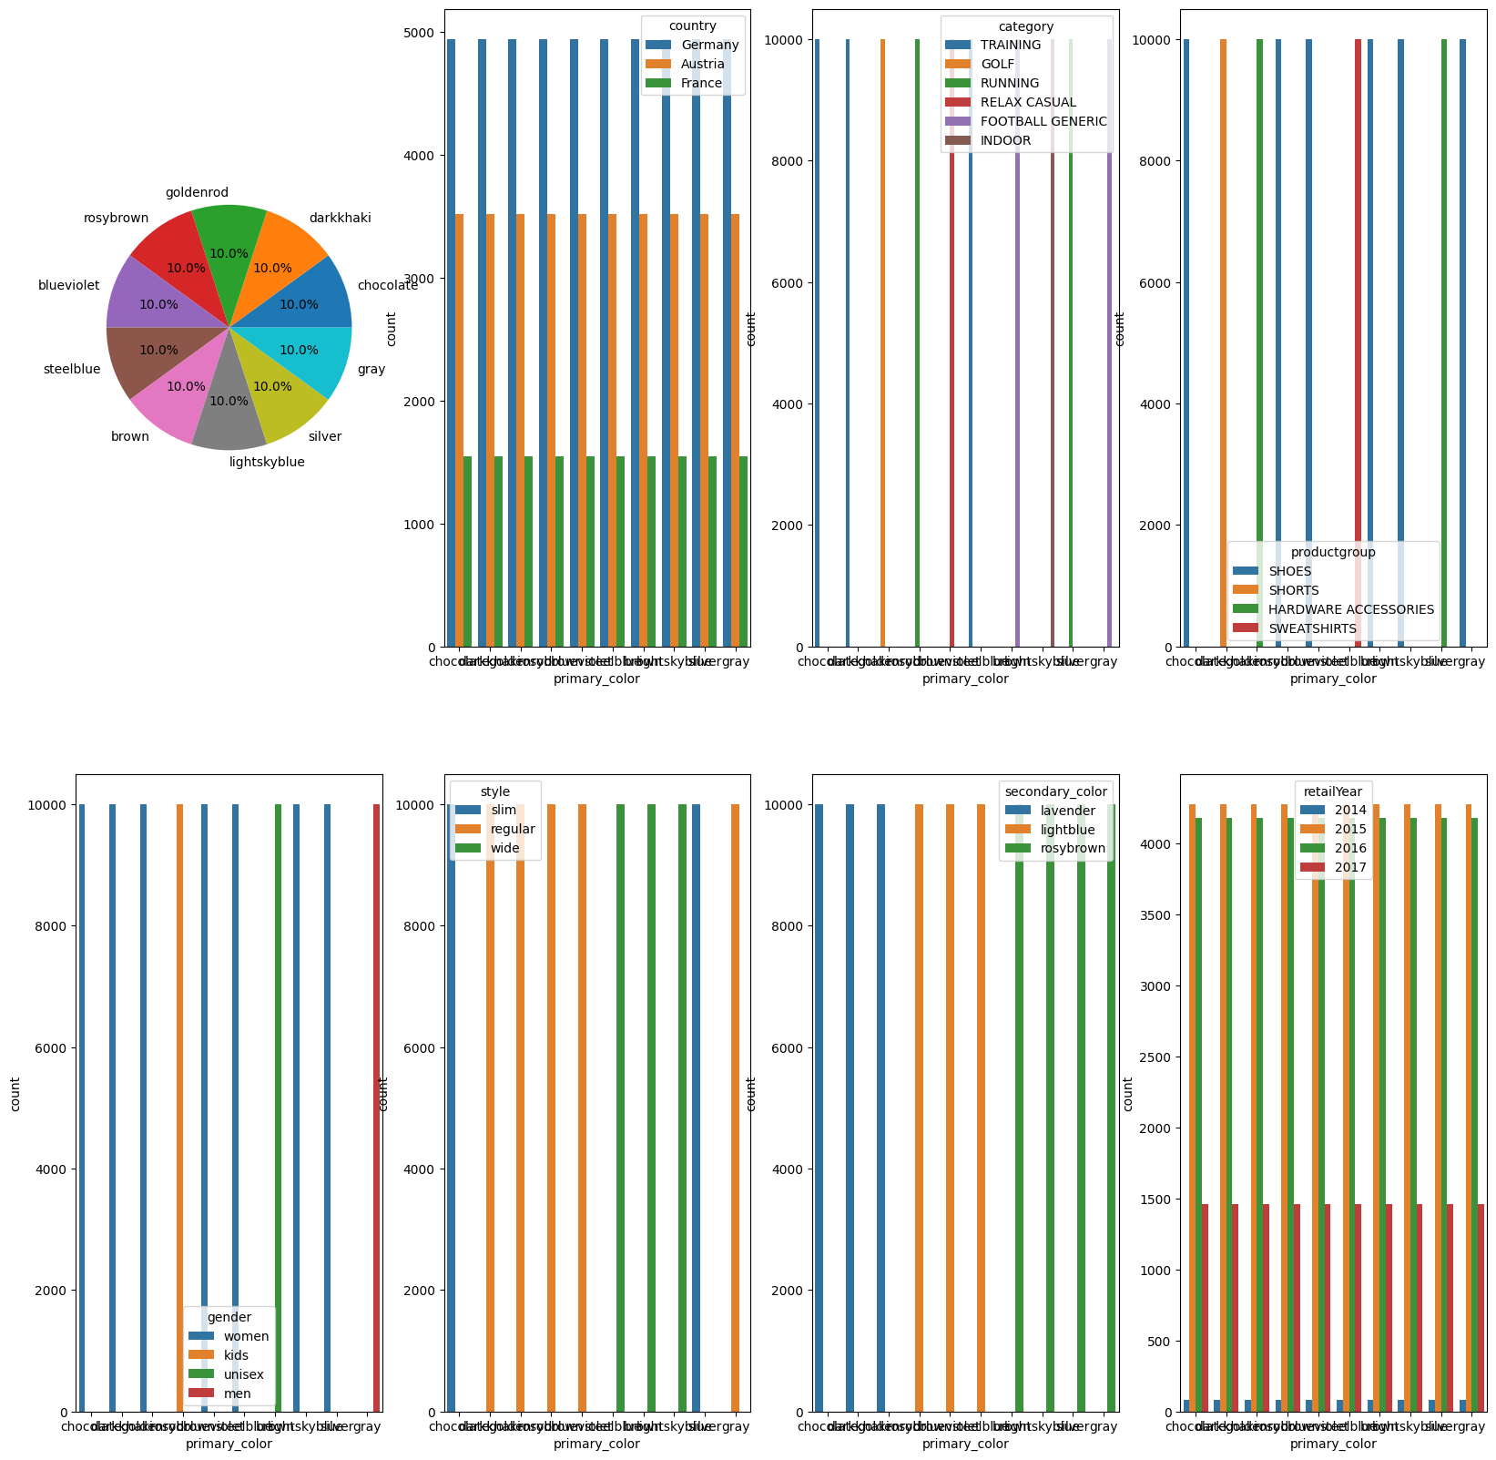
Primary color insights
Lavender goes with chocolate and dark Khari and goldenrod
Light-blue goes with rosybrown blue violet steel blue
Rosybrown goes with brown ,ightskyblue,sliver.gray

Slide 10
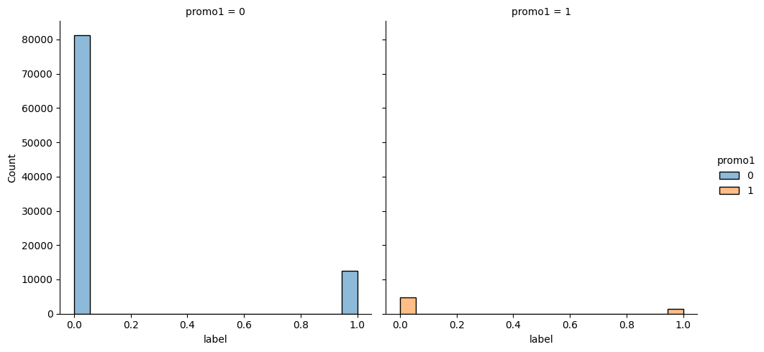
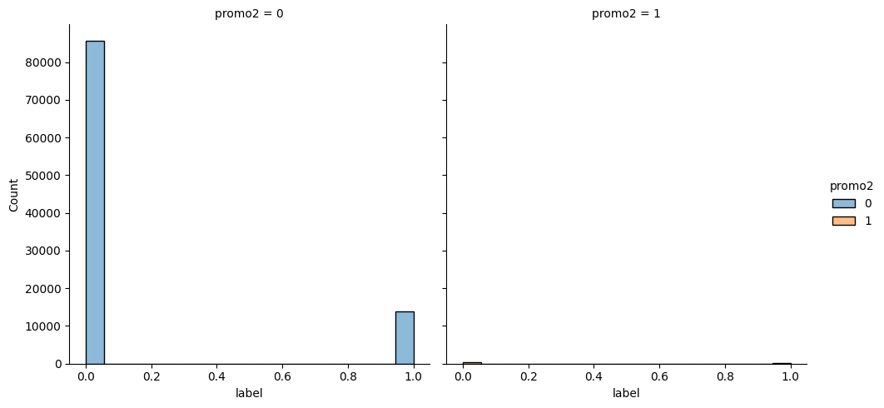
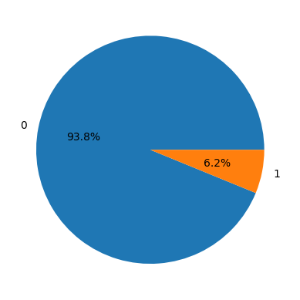
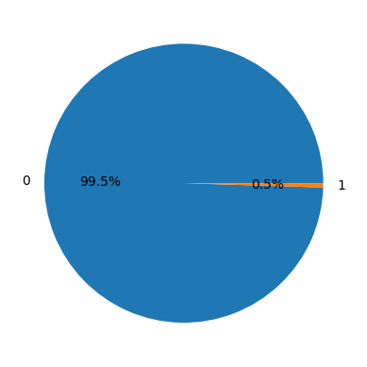
Promo1 and promo2 is not important (relation with label)

Slide 11
Extra notes
Each primary has it’s own secondary color
Primary color is the same as article.1

Slide 12
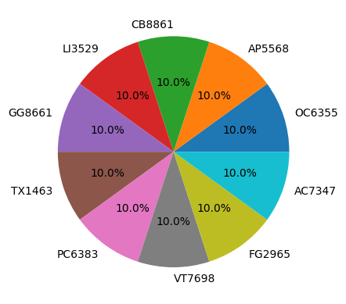
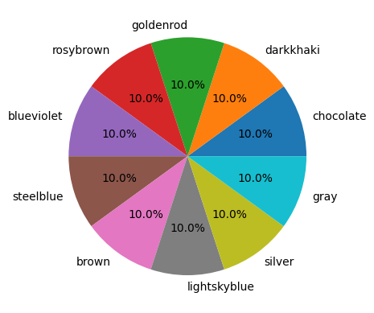
Primary color is Article.1

