Slide 1

Ali haider
Social Platform for burns.pk

Slide 2
Overview
Frontend➔ html, JS, CSS
Backend➔ python Django
Ready made LinkedIn platform available
Main Tasks:
1. Moulding
2. Chat
3. Discussions

Slide 3
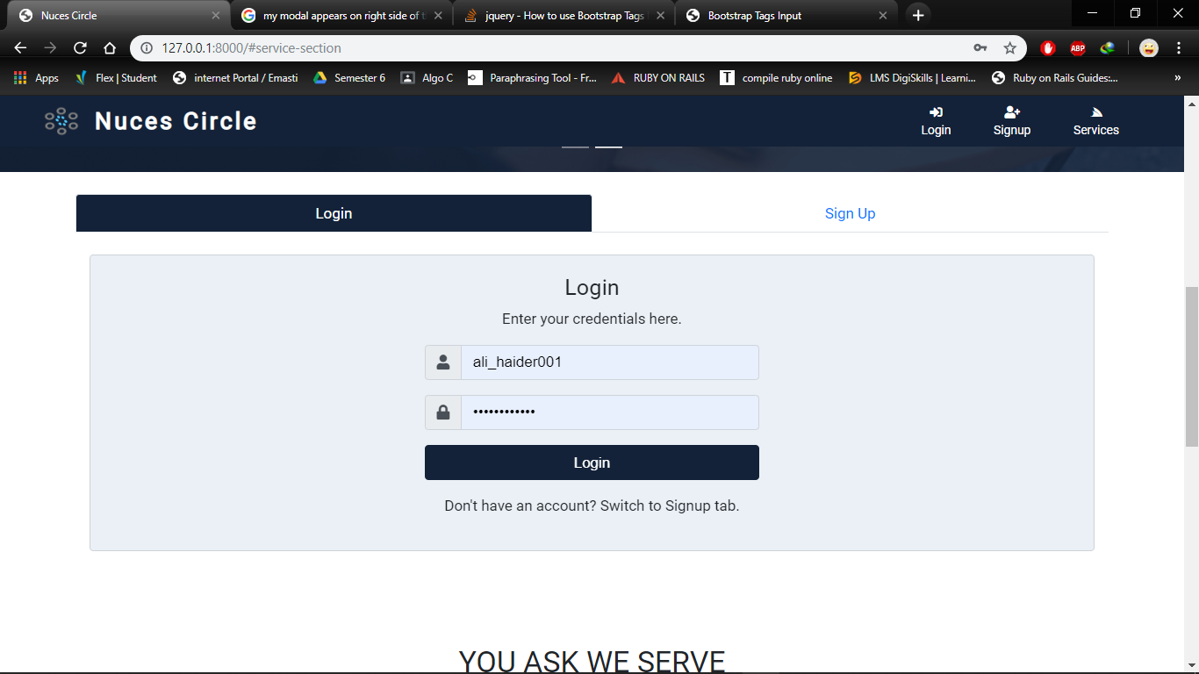

Slide 4
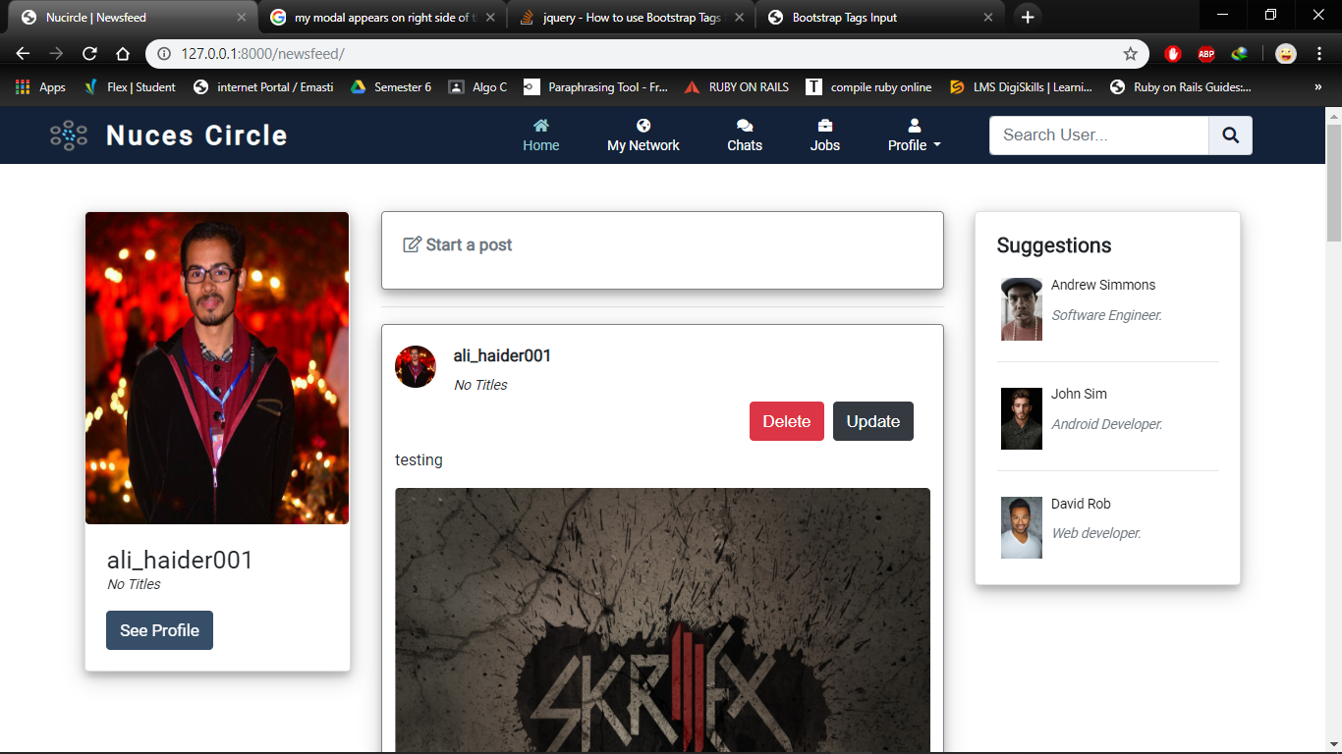

Slide 5
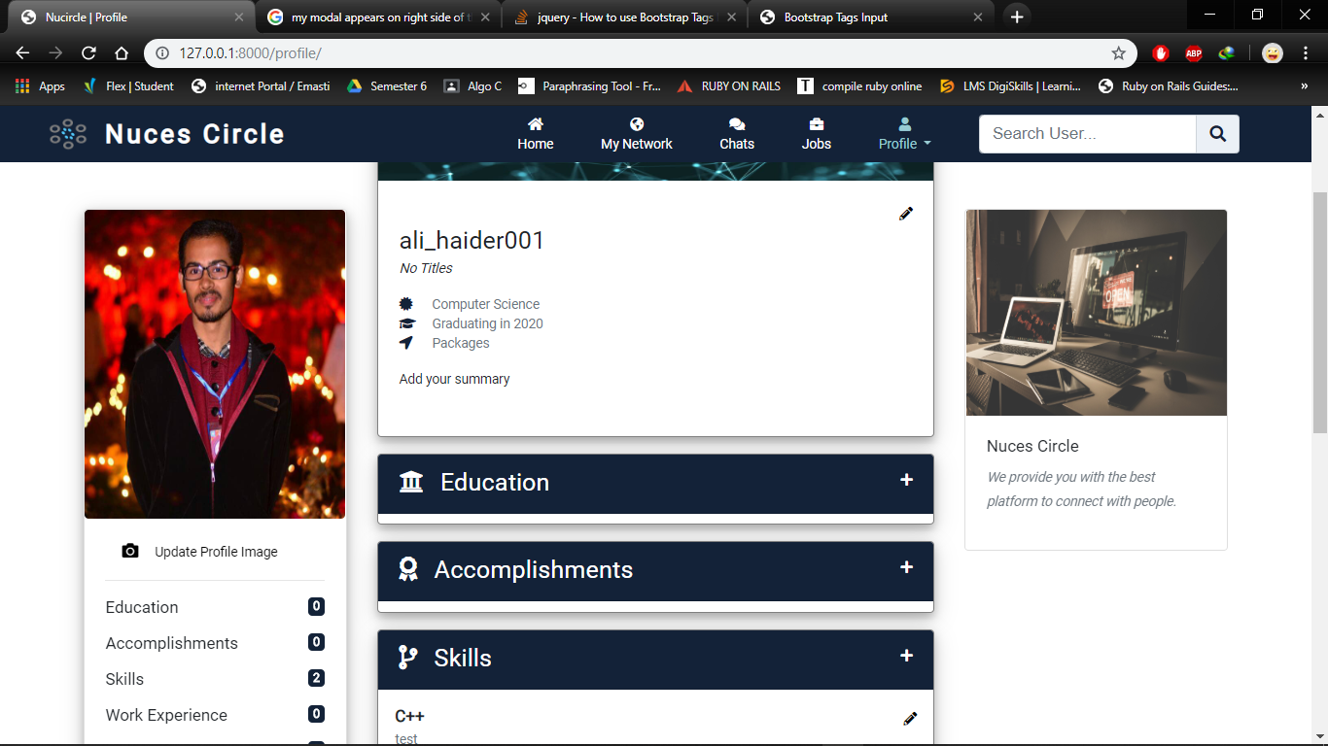

Slide 6
Current Status
Working on Chat currently

Slide 7
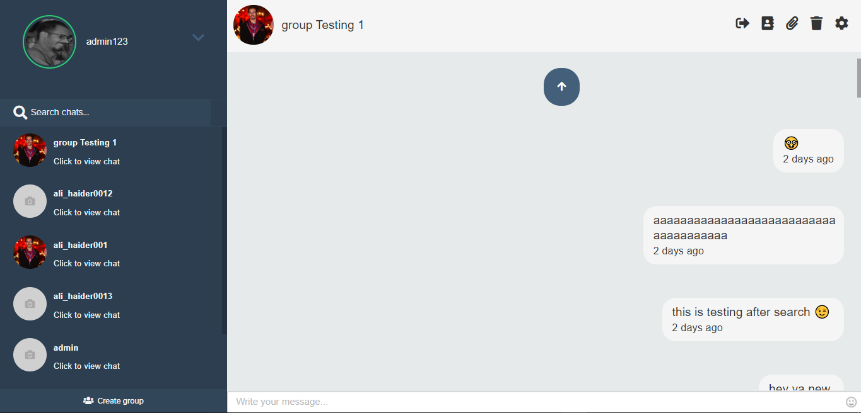
Main page

Slide 8
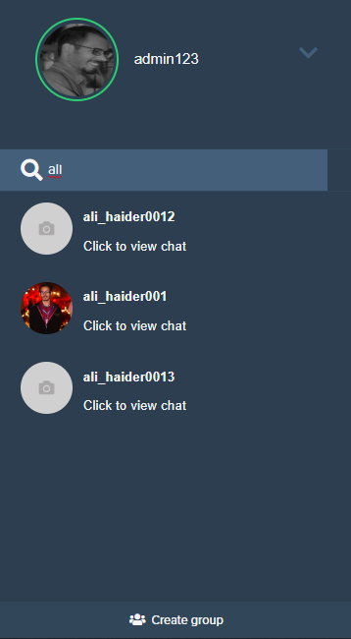
Search Facility

Slide 9
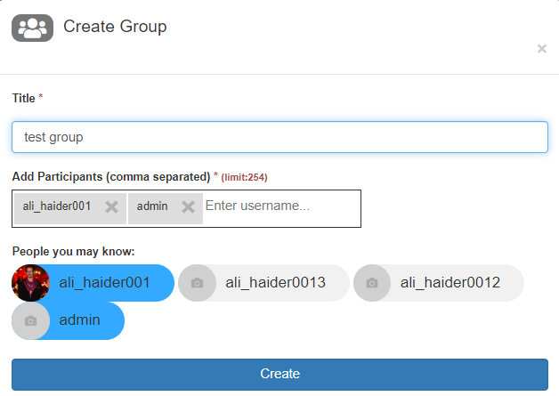
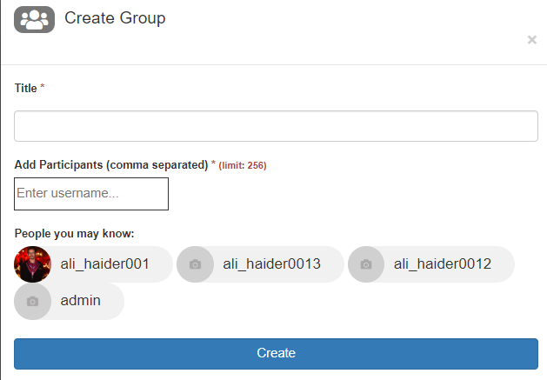
Create/Leave Group

Slide 10
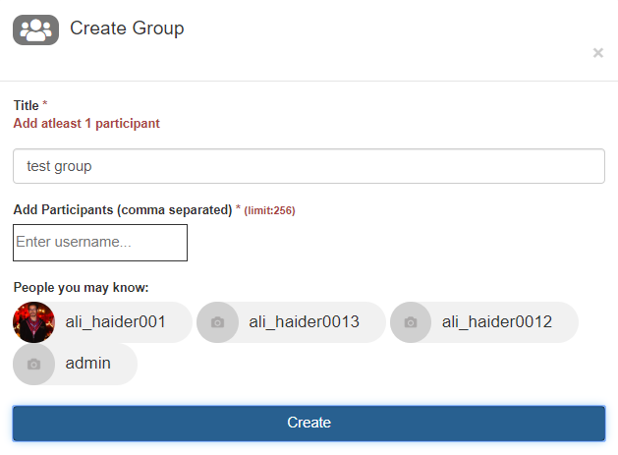
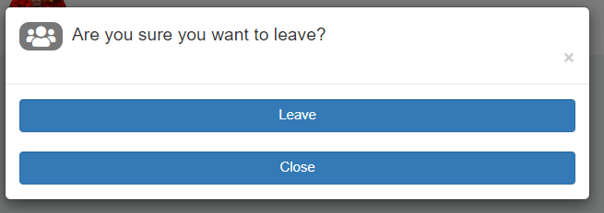
Cont.
Abc

Slide 11
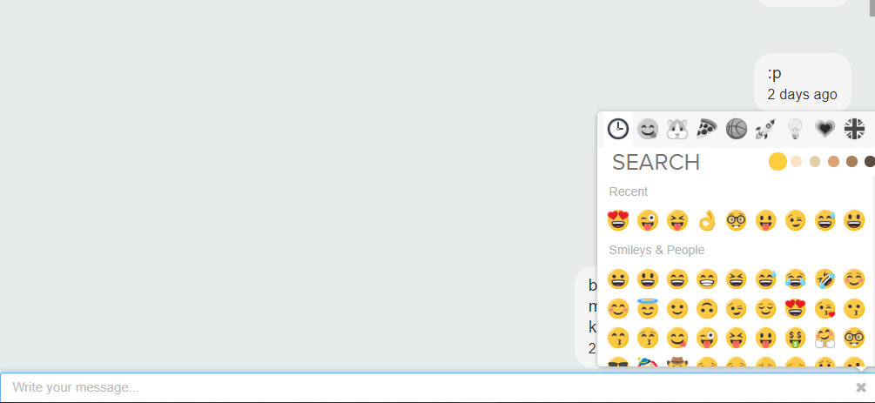
Emojis (tab key shortcut)
Abc

Slide 12
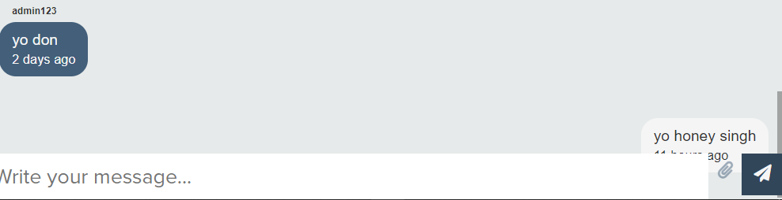
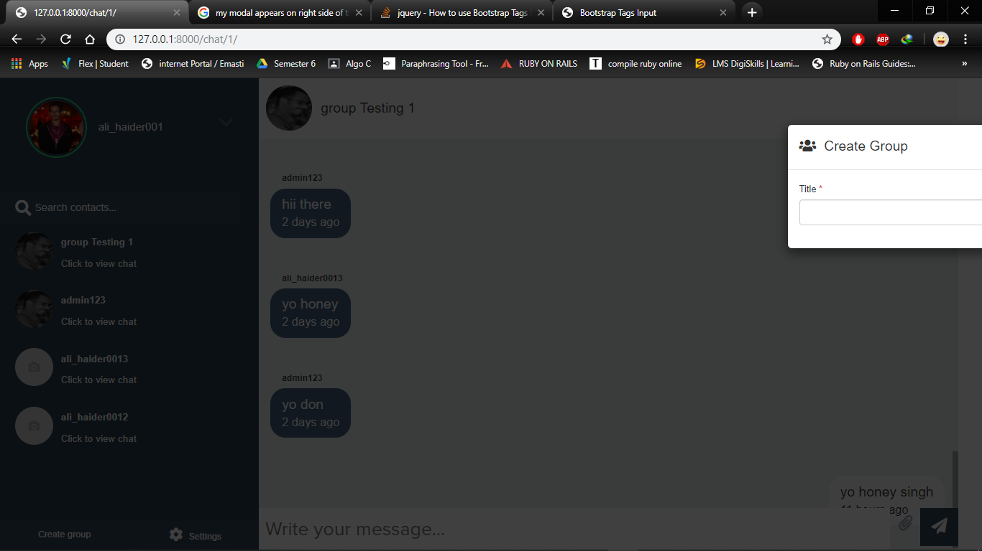
Problems and desired solution
CSS, JS, jQuery issues ➔ need a frontend expert

