Slide 1
EECE 502 · FINAL YEAR PROJECT · SPRING 2026
An auditory window
into the aging mind.
A multi-modal AI system that detects Alzheimer’s disease from a single sample of speech.
PROJECT TEAM
FACULTY ADVISOR
Wassim Kassem · Ali El Hajj · Tamer Lammam
Dr. Karim Kabalan
AMERICAN UNIVERSITY OF BEIRUT

Slide 2
AGENDA
2 / 26
What we’ll cover today.
I
The Problem
II
Literature Review
Motivation, evidence, project specifications, technical and non-technical constraints, applicable standards.
State of the art in speech-based Alzheimer’s detection, key papers, gap analysis, our differentiation.
III
Methodology
IV
Iterations & Engineering
Three design alternatives considered, the chosen architecture, complete feature engineering pipeline.
Bugs caught, optimisations made, alternatives benchmarked, design decisions justified.
V
Testing & Results
VI
Deployment & Impact
Held-out evaluation, model comparison, test-set performance, threshold analysis, interpretability.
Web application, innovation, commercial path, conclusions, future work, references.
NeuroLinguist · AUB EECE 502 · Spring 2026
An auditory window into the aging mind

Slide 3
THE PROBLEM
3 / 26
Alzheimer’s is a silent crisis we can’t afford to miss.
55M
75%
$1.3T
people worldwide live with dementia today.
The number will triple by 2050.
WHO Global Dementia Report, 2024.
of dementia cases globally are undiagnosed, primarily due to access barriers.
Alzheimer’s Disease International, 2023.
in annual global cost. Early intervention can delay institutional care by years.
Lancet Commission on Dementia, 2024.
Why speech?
Current screening relies on expensive imaging or long clinical tests. Speech, however, is free, scalable, and shows early signs of decline, often years before diagnosis. A simple 60-second sample can carry meaningful clinical information.
Problem statement. There is no widely accessible, fast, affordable, non-invasive method for early Alzheimer’s screening.
NeuroLinguist · AUB EECE 502 · Spring 2026
An auditory window into the aging mind

Slide 4
BACKGROUND
4 / 26
How Alzheimer’s reshapes speech.
The science behind the signal.
AD pathology disrupts specific cognitive systems before motor or sensory ones. Each disrupted system leaves a measurable footprint in spontaneous speech. The 32 features we extract are not arbitrary but each maps to a known clinical phenomenon.
SEMANTIC MEMORY
EXECUTIVE FUNCTION
Word retrieval falters; concepts “on the tip of the tongue”.
Sentence planning and discourse coherence degrade.
Reduced information-unit coverage on picture description; substituting "thing" for specific nouns.
Shorter clauses, shallower parse trees, more incomplete utterances.
CAPTURED BY
CAPTURED BY
information_unit_coverage · word_frequency_index
syntactic_complexity · fragment_rate · revision_rate
MOTOR & PROSODY
EPISODIC MEMORY
Articulatory precision and prosodic control reduce.
Story recall and topic maintenance suffer.
Increased jitter/shimmer, reduced pitch range, hesitations and longer pauses.
Drifts off topic, loses thread of narrative, paraphrases instead of recalling.
CAPTURED BY
CAPTURED BY
jitter · shimmer · mean_pause_duration · pitch_range
story_recall_similarity · global_semantic_drift
NeuroLinguist · AUB EECE 502 · Spring 2026
An auditory window into the aging mind

Slide 5
SPECIFICATIONS
5 / 26
Functional and non-functional requirements.
Specifications were defined upfront and traced through every design decision. Each line below was a measurable target the system had to meet to be considered complete.
FUNCTIONAL
NON-FUNCTIONAL
F1. Binary classification
NF1. Accuracy ≥ 88%
Output P(Dementia | speech) for each input sample.
Beat published SoTA on identical Pitt corpus protocol.
F2. Multi-modal input
NF2. Sensitivity ≥ 90%
Accept WAV/MP3 audio plus CHAT/raw text transcript.
Catch dementia cases, false negatives are costlier.
F3. Multi-task support
NF3. Inference < 2 s
Handle 4 cognitive tasks: cookie, fluency, recall, sentence.
End-to-end (audio in → prediction out) under 2 seconds.
F4. Per-prediction explanation
NF4. Reproducibility
Return SHAP attribution for every prediction.
Deterministic across runs (random_state = 42 throughout).
F5. Web-based interface
NF5. Auditable
Clinician-usable browser app; no install required.
Every prediction must be explainable, traceable, defensible.
NeuroLinguist · AUB EECE 502 · Spring 2026
An auditory window into the aging mind

Slide 6
LITERATURE (1/3)
6 / 26
The trajectory of AI-based Alzheimer’s detection from speech.
Speech-based AD detection has evolved from handcrafted classical ML through deep learning to multimodal transformers. We surveyed 30+ papers; the four below represent the most influential approaches that shaped our design decisions.
CLASSICAL ML · 2016
DEEP LEARNING · 2022
Fraser et al.
Yang et al.
Journal of Alzheimer’s Disease
IEEE Speech Processing
METHOD
METHOD
Handcrafted linguistic features + SVM / RF / LR classifiers. Cross-validated on Pitt narrative transcripts.
BERT word embeddings + TextCNN-LSTM two-branch deep model. Feature fusion → softmax.
RESULT
RESULT
81–84%
86.0%
LIMITATION
LIMITATION
Text-only, misses prosodic cues. Requires high-quality manual transcripts.
Small-dataset overfitting. Text-only (misses pauses and prosody).
NeuroLinguist · AUB EECE 502 · Spring 2026
An auditory window into the aging mind

Slide 7
LITERATURE (2/3)
7 / 26
Multimodal transformers represent the published state of the art.
MULTIMODAL · 2020
PRIMARY BENCHMARK
TRANSFORMER FUSION · 2025
Sarawgi et al.
CogniAlign / Ksibi et al.
INTERSPEECH (ADReSS Challenge)
Scientific Reports
METHOD
METHOD
Three-modal neural ensemble: acoustic + linguistic + disfluency, trained on full Pitt corpus.
DistilBERT (text) + Wav2Vec2 (audio) + Gated Cross-Attention Transformer for multimodal fusion. ADReSSo only.
RESULT
RESULT
88.0%
90.4%
LIMITATION
LIMITATION
No interpretability layer. Required GPU for end-to-end neural training.
Computationally expensive. Cookie-task only. Not deployable on commodity hardware.
NeuroLinguist · AUB EECE 502 · Spring 2026
An auditory window into the aging mind

Slide 8
LITERATURE (3/3)
8 / 26
How our work differentiates from the published state of the art.
We compared our final design directly against the most-cited approaches on the same Pitt corpus. The differentiation matters: every column is a clinically relevant property, not just a leaderboard score.
APPROACH
INPUT
FEATURES
TASK ROUTING
INTERPRETABILITY
ACCURACY
Fraser 2016 (Classical)
Text only
21 handcrafted
No
No
81–84%
Yang 2022 (Deep)
Text only
BERT learned
No
Limited
86.0%
Sarawgi 2020 (Multi-modal)
Audio + Text
Three-modal NN
No
No
88.0%
CogniAlign 2025 (Fusion)
Audio + Text
Transformer
Cookie only
Limited
90.4%
NeuroLinguist (ours)
Audio + Text
32 hand + bio
All 4 tasks
Per-prediction (SHAP)
92.2%
What we add: full task-routing across all 4 cognitive tasks, complete per-prediction SHAP transparency, and a deployable web app with under 1-second inference.
NeuroLinguist · AUB EECE 502 · Spring 2026
An auditory window into the aging mind

Slide 9
DESIGN ALTERNATIVES
9 / 26
Three architectures considered. We benchmarked all three.
The rubric demands "sufficient alternatives considered for the overall design and for all relevant components." Below: the three architecture families we evaluated, why each was tried, and why we chose the third.
ALT 1
ALT 2
CHOSEN
Classical ML
Deep neural
Task-routed ensemble
APPROACH
APPROACH
APPROACH
Handcrafted features + SVM / RF / LR. Interpretable, low-compute.
BERT fine-tune + acoustic CNN/LSTM. End-to-end learning.
32 handcrafted features + cookie/non-cookie specialists (XGB+RF+SVM+LR).
PERFORMANCE
PERFORMANCE
PERFORMANCE
81.9% (acoustic XGB)
84.5–86.2%
92.2%
VERDICT
VERDICT
VERDICT
Insufficient: single-modality misses signal.
Underperforms on small clinical data; loses interpretability.
Best accuracy, full interpretability, deployable on CPU.
NeuroLinguist · AUB EECE 502 · Spring 2026
An auditory window into the aging mind

Slide 10
THE DATA
10 / 26
DementiaBank Pitt Corpus — 1,107 samples across 4 cognitive tasks.
Participants
Four cognitive tasks
293
552
PARTICIPANTS
Cookie Theft
Picture description —> probes semantic memory and information density.
1,290
264
TOTAL RECORDINGS
Story recall
Re-tell a previously read narrative —> probes episodic memory.
1,107
237
AFTER AUDIO QC
Verbal fluency
List words from a category —> probes lexical access and executive function.
180 / 927
237
CONTROL / DEMENTIA
Sentence construction
Compose grammatical sentences —> probes syntactic processing.
Participant-level 80/10/10 split · random_state = 42 · zero patient leakage between train, val, and test
Held-out test: 28 unseen participants (116 samples) — locked at split time, never touched during model development. This is the standard the model is finally judged against.
NeuroLinguist · AUB EECE 502 · Spring 2026
An auditory window into the aging mind

Slide 11
PREPROCESSING
11 / 26
From raw recordings to clean, model-ready features.
Both modalities required substantial preprocessing. Audio QC alone removed 13% of the corpus due to corrupt headers; transcript cleaning preserved diagnostic markers other pipelines drop. Every step is deterministic and reproducible.
AUDIO PIPELINE
TRANSCRIPT PIPELINE
1
Format normalisation
1
CHAT format parsing
MP3 → WAV via FFmpeg. Resample to 16 kHz, 16-bit, mono.
Extract *PAR (participant) lines only; remove *INV (investigator).
2
Header validation
2
Annotation cleaning
164 of 1,290 files had corrupt RIFF headers; ffmpeg re-encoded 92, 72 unrecoverable.
Strip [/] retracings, [//] repetitions, time codes — keep *content*.
3
Voice activity detection
3
Filled-pause preservation
Praat silence detector with 200ms threshold — pause boundaries.
&-uh, &-um, &-hm → “uh”, “um”, “hm” (rescued ~4,989 tokens).
4
Feature extraction
4
spaCy NLP pipeline
Parselmouth/Praat for pitch, jitter, shimmer, pause statistics.
Tokenisation, lemmatisation, POS tagging, dependency parsing.
5
Outlier capping
5
Feature aggregation
99th percentile capping for extreme acoustic measurements.
Per-sample summary stats: ratios, complexity, repetition, biomarker rates.
NeuroLinguist · AUB EECE 502 · Spring 2026
An auditory window into the aging mind

Slide 12
ARCHITECTURE
12 / 26
From audio to diagnosis — the full pipeline.
INPUT
FEATURE EXTRACTORS
FUSE
ROUTE
SPECIALISTS
Speech audio
ACOUSTIC
Parselmouth/Praat
7 feat
Cookie specialist
.WAV / .MP3
Optuna-tuned · XGB+RF+SVM+LR
LINGUISTIC
spaCy
5 feat
32-dim vector
Task router
Transcript
SEMANTIC
Sentence-BERT
4 feat
+ 4 task z-scores
Non-cookie specialist
CHAT / raw text
default params · same 4 models
BIOMARKER
Disfluency rates
7 feat
P (Dementia | speech)
Calibrated probability · Control / Dementia
Each speech sample is converted to a 32-dimensional feature vector across four complementary modalities, routed by task type to a specialist ensemble, and emerges as a calibrated dementia probability, every component is interpretable.
NeuroLinguist · AUB EECE 502 · Spring 2026
An auditory window into the aging mind

Slide 13
FEATURES
13 / 26
32 features. Four modalities. Independent signal.
Each speech sample is converted into a 32-dimensional vector spanning four complementary modalities. Cross-modal correlations remain below |r| < 0.30, confirming each modality captures independent information.
LINGUISTIC · spaCy
5
ACOUSTIC · Praat
7
syntactic_complexity
d = 0.97 (large)
mean_pause_duration
+38% in dementia
pronoun_noun_ratio
d = 0.42
pitch_variability
+28% in dementia
repetition_rate
d = 0.40
pitch_range
F0 dynamic range
word_frequency_index
lexical access
jitter, shimmer
voice quality
content_function_ratio
word-class balance
speech_time_ratio, intensity_range
fluency
4
7
SEMANTIC · SBERT
BIOMARKER · Disfluency
information_unit_coverage
d = 2.05 — DOMINANT
fragment_rate
incomplete words
story_recall_similarity
d = 0.56
revision_rate
self-corrections
global_semantic_drift
topic wandering
filler_rate
um, uh, hm
semantic_coherence
sentence-to-sentence
unfilled_pause_rate
hesitations
utterance_rate, words_per_utterance
rhythm
NeuroLinguist · AUB EECE 502 · Spring 2026
An auditory window into the aging mind

Slide 14
ITERATIONS
14 / 26
The filled-pause bug, caught by EDA and fixed before training.
Engineering iterations rarely make it into final reports, but they’re where most of the work happens. Here are four design iterations that materially changed our results.
BEFORE
AFTER
IMPACT
CHAT format markers like &-uh, &-um, &-hm were stripped during transcript cleaning.
CHAT cleaning script updated to convert filled pauses to words instead of deleting them.
~4,989 disfluency tokens rescued across the full corpus.
*PAR: the boy is &-uh getting cookies
&-uh → "uh"
New features unlocked:
↓ cleaned to
&-um → "um"
· filler_rate
the boy is getting cookies
&-hm → "hm"
· unfilled_pause_rate
Filled pauses were silently deleted as "noise."
Disfluency rates now extractable as biomarkers.
Macro-F1 +8.8 pp once these were added in.
NeuroLinguist · AUB EECE 502 · Spring 2026
An auditory window into the aging mind

Slide 15
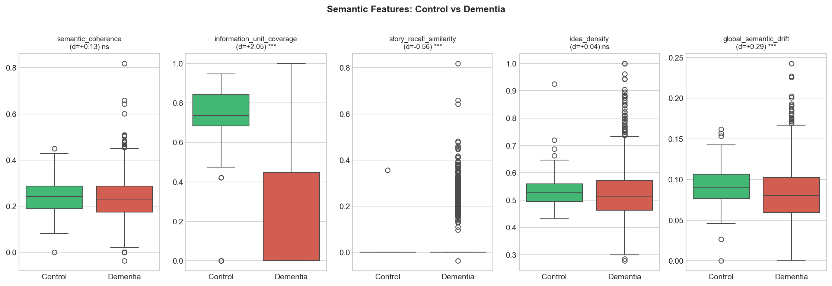
EDA (1/2)
15 / 26
Semantic features show massive separation — d = 2.05 dominant.
FIG. 1 · SEMANTIC FEATURES · CONTROL VS. DEMENTIA · COHEN’S d
Key insight.
information_unit_coverage shows the largest single-feature separation observed in the literature on this corpus (d = 2.05). story_recall_similarity (d = 0.56) and global_semantic_drift (d = 0.29) are also significant. semantic_coherence is non-significant, kept as a regulariser. All p-values Bonferroni-corrected.
NeuroLinguist · AUB EECE 502 · Spring 2026
An auditory window into the aging mind

Slide 16
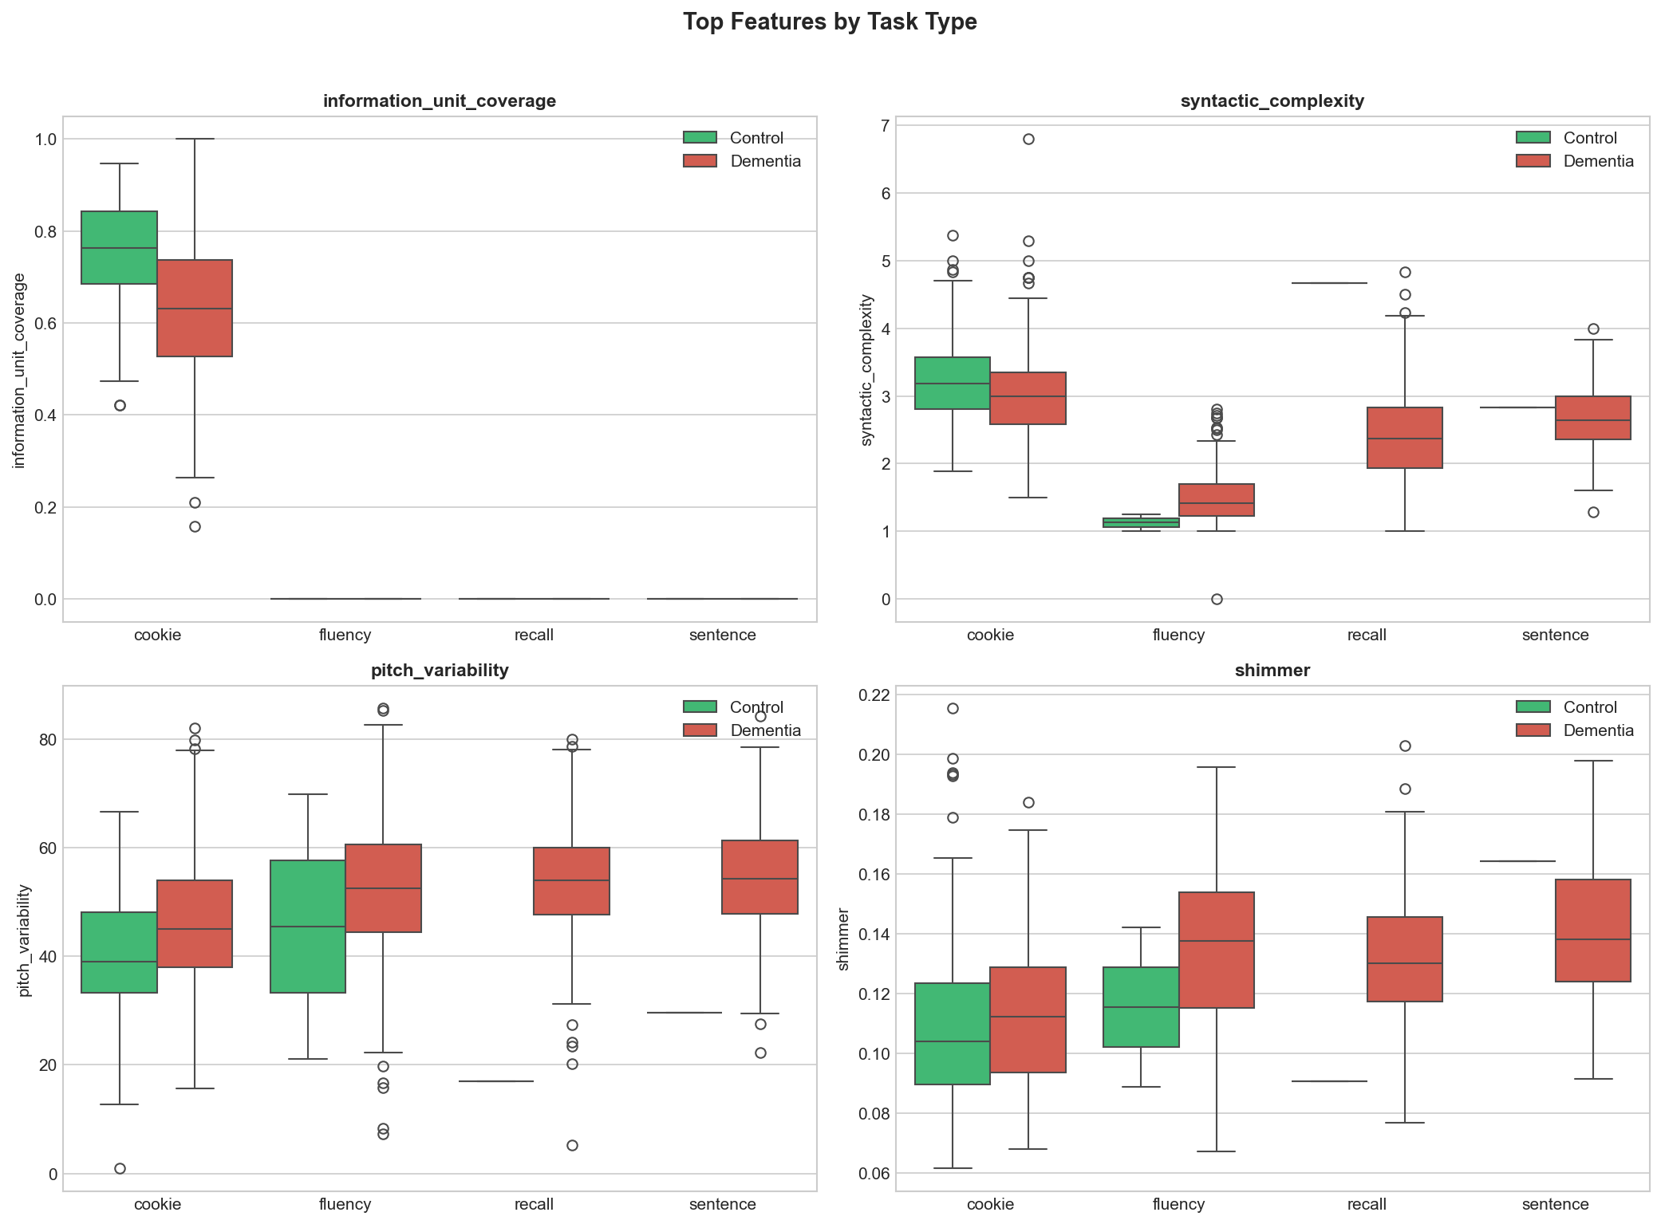
EDA (2/2)
16 / 26
Why a single model isn’t enough and how routing fixes it.
The problem.
information_unit_coverage is the strongest predictor in the dataset (d = 2.05). But it is only meaningful for the Cookie Theft task while for fluency, recall, and sentence tasks it is identically zero. A single model treats this zero as a feature value, contaminating the signal.
The fix: task routing.
We train two specialists: one on Cookie Theft samples (Optuna-tuned XGB + RF + SVM + LR), one on the rest (default-param ensemble). At inference, samples are routed by task type. The cookie specialist gets to fully exploit information_unit_coverage; the non-cookie specialist isn’t penalised by its absence.
FIG. 2 · TOP FEATURES BY TASK TYPE
Result: +2.5 pp accuracy over the simple-average ensemble.
NeuroLinguist · AUB EECE 502 · Spring 2026
An auditory window into the aging mind

Slide 17
PROTOCOL
17 / 26
Evaluation methodology : how we trained, tuned, and tested.
A 92.2% test number means nothing without protocol detail. Below: the exact splits and CV procedure used for every result reported in this presentation. Identical to the protocol Sarawgi 2020 used, allowing fair comparison.
Three-way split (participant-level, stratified)
TRAIN · 80% · ~234 patients · 885 samples
VAL · 10%
TEST · 10%
PARTICIPANT-LEVEL
STRATIFIED
DETERMINISTIC
Zero patient leakage
Class-balanced
random_state = 42
Splits operate on participant IDs, not samples. A single patient’s 4 cognitive task recordings always go to the same split. Prevents the model from "recognising" a known speaker.
~1:5 control/dementia ratio preserved across train/val/test. Otherwise, the test set could randomly under-represent controls and inflate accuracy.
Same split every run. Every result in this presentation is reproducible from the same seed. Logged in version control alongside the code.
TUNING & MODEL SELECTION
5-fold cross-validation on the train set for hyperparameter search and model selection. Validation set held aside for threshold tuning. Test set touched ONCE — the very last run, after the final architecture and parameters were locked.
NeuroLinguist · AUB EECE 502 · Spring 2026
An auditory window into the aging mind

Slide 18
MODELING
18 / 26
Every step earned its accuracy gain.
Each model below was trained, validated, and tested under the same protocol. Each architectural choice is justified by a measured gain. No step is decorative.
A
Acoustic-only XGBoost
81.9%
Baseline using 7 Praat features only — confirms acoustic signal alone is insufficient.
B
XGBoost · 20 features
87.1%
Linguistic + acoustic + early semantic; class weighting beats SMOTE on validation.
C
+ Biomarker rates & task z-scores
88.8%
7 disfluency rates and 4 task-normalised z-scores added — F1 lifts +8.8 pp.
D
Optuna hyperparameter tuning
88.8%
50-trial TPE search, 5-fold CV; macro-F1 improves to 0.800 even though accuracy is unchanged.
E
Simple-averaging ensemble
89.7%
XGB + RF + SVM + LR predictions averaged — outperforms stacking on this corpus.
F
Task-routed ensemble + train+val refit
92.2%
Cookie specialist on cookie-only samples; non-cookie specialist on the rest. Final model refit on train+val. +4.2 pp over published SoTA.
NeuroLinguist · AUB EECE 502 · Spring 2026
An auditory window into the aging mind

Slide 19
COUNTERPOINT
19 / 26
Transformers don’t always win, at least, not on this kind of data.
We trained BERT (fine-tuned) and BERT + acoustic fusion as fair counterpoints. With only ~880 training samples, hand-crafted domain features outperform transformers by 7.7 pp — a critical finding for clinical AI under data scarcity.
MODEL
ACC.
F1
AUC
Acoustic-only XGB
81.9%
0.700
0.854
BERT fine-tuned
84.5%
0.777
0.905
BERT + acoustic fusion
86.2%
0.783
0.906
XGB — 20 feat.
87.1%
0.735
0.921
Sarawgi 2020 (SoTA)
88.0%
—
—
XGB — 32 feat. tuned
88.8%
0.800
0.905
Simple-avg ensemble
89.7%
0.832
0.929
★ Task-routed ensemble
92.2%
0.855
0.883
NeuroLinguist · AUB EECE 502 · Spring 2026
An auditory window into the aging mind

Slide 20
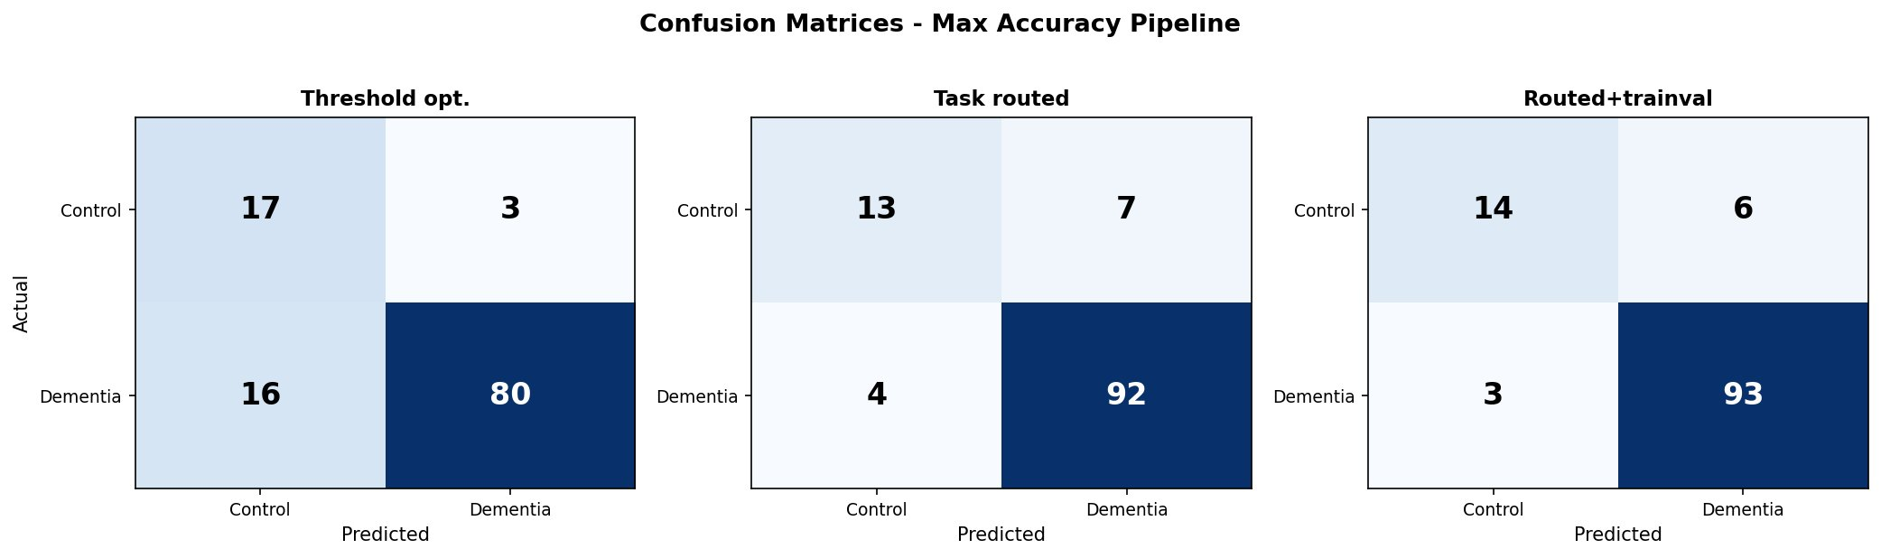
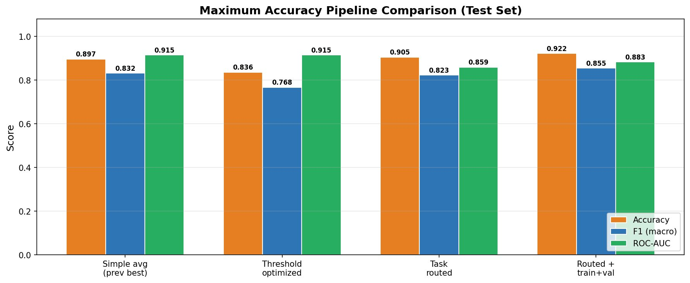
RESULTS
20 / 26
92.2% test accuracy — beats published SoTA (88.0%) by +4.2 pp.
FIG. 3 · CONFUSION MATRICES · HELD-OUT TEST SET (n=116)
FIG. 4 · PIPELINE COMPARISON · TEST-SET ACCURACY, F1, ROC-AUC
NeuroLinguist · AUB EECE 502 · Spring 2026
An auditory window into the aging mind

Slide 21
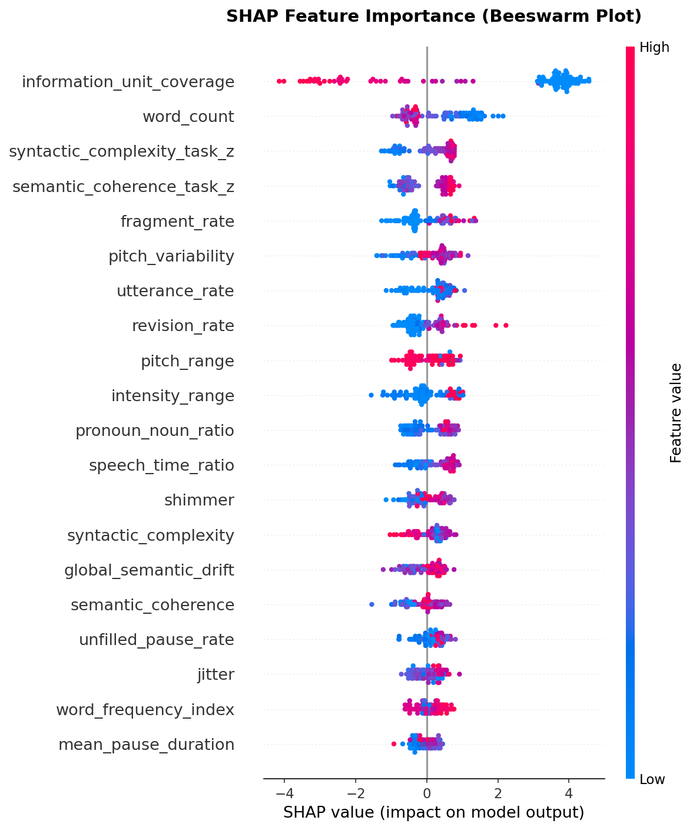
INTERPRETABILITY (1/3)
21 / 26
SHAP global feature importance — what the model attends to.
Reading the plot.
Each dot is a test sample. Red = high feature value, blue = low. Dots to the right push the prediction toward dementia; left, toward control.
What stands out.
information_unit_coverage
Mean |SHAP| = 3.16 — 4× the next feature. Low coverage (blue) drives dementia prediction; high (red) drives control.
word_count, syntactic_complexity_z
Higher complexity → control. Direction matches clinical knowledge of AD speech.
fragment_rate, revision_rate
Disfluency rates push toward dementia when high. This confirms biomarker validity.
pitch_variability, intensity_range
Acoustic features contribute, smaller magnitude but consistent direction.
FIG. 7 · SHAP BEESWARM · IMPACT & DIRECTION PER SAMPLE
NeuroLinguist · AUB EECE 502 · Spring 2026
An auditory window into the aging mind

Slide 22
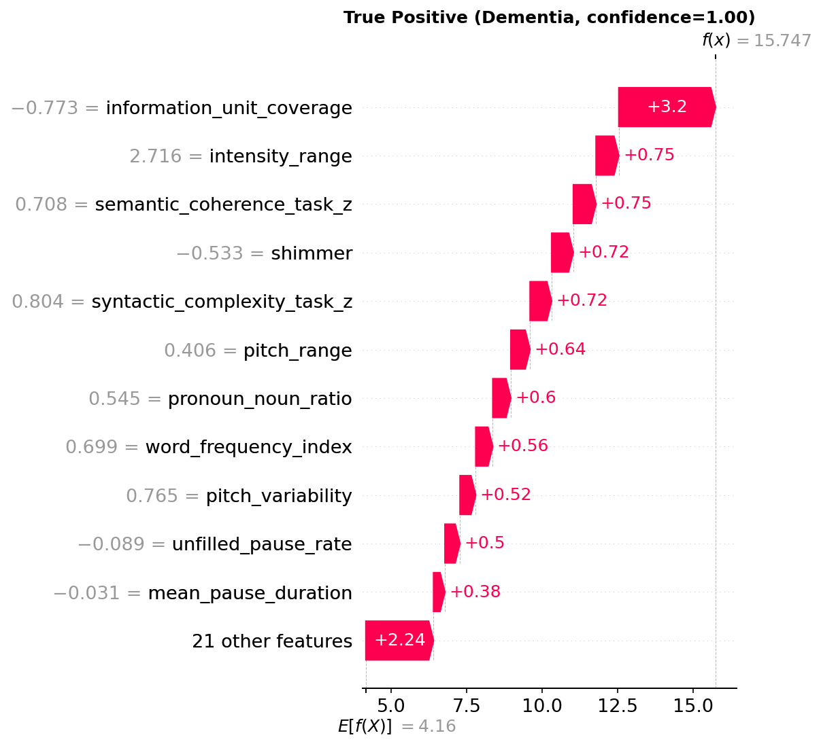
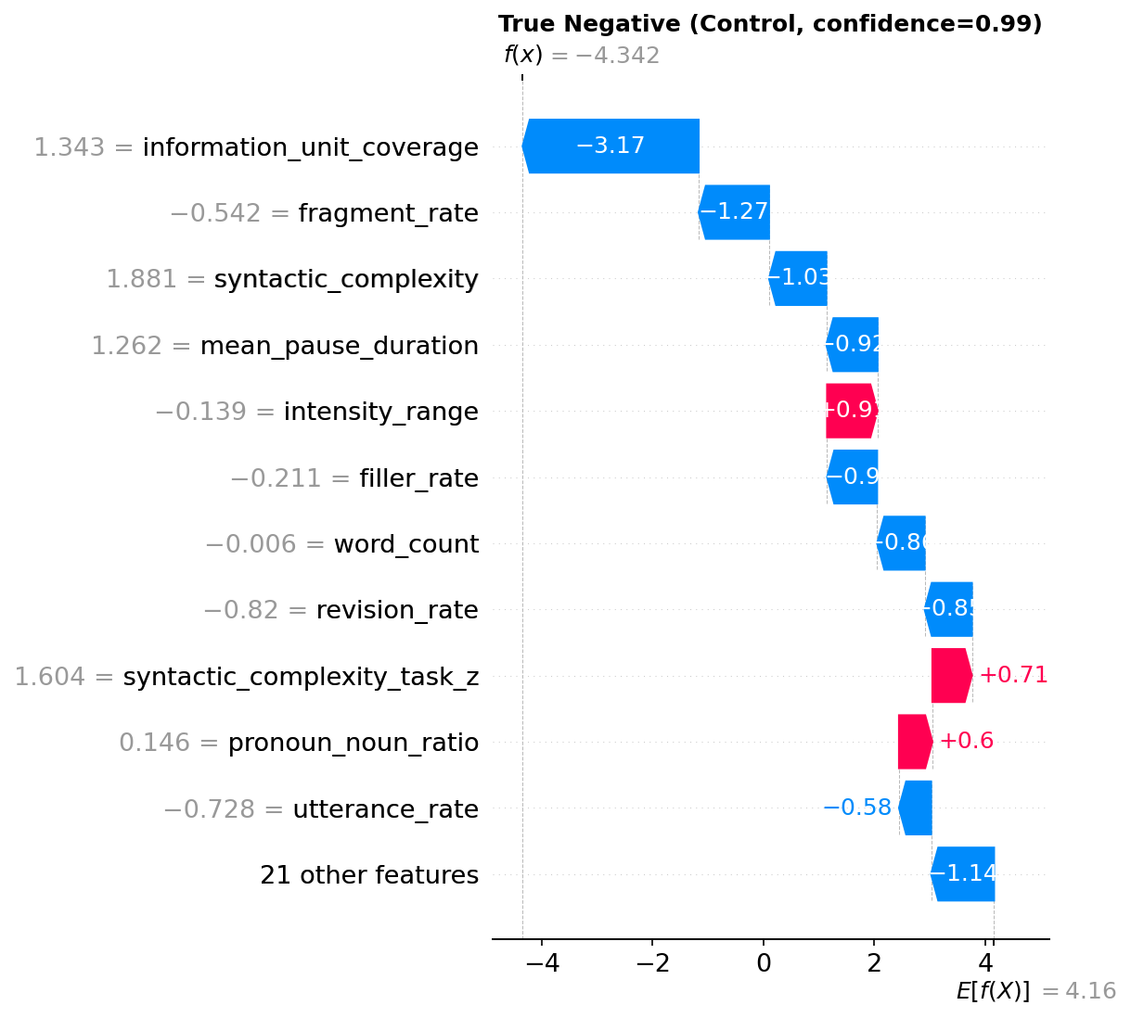
INTERPRETABILITY (2/3)
22 / 26
Every prediction is auditable, a clinician can check the work.
Each test sample gets a SHAP waterfall showing exactly which features drove the model’s decision and by how much. Below: a true-positive dementia case (left) and a true-negative control case (right).
FIG. 8 · TRUE POSITIVE (DEMENTIA, CONFIDENCE = 1.00)
FIG. 9 · TRUE NEGATIVE (CONTROL, CONFIDENCE = 0.99)
Note that the model fires on the right features for the right reasons: low information_unit_coverage and impaired pitch range for the dementia case; preserved syntactic complexity and low fragment_rate for the control case. This is what audit-readiness looks like.
NeuroLinguist · AUB EECE 502 · Spring 2026
An auditory window into the aging mind

Slide 23
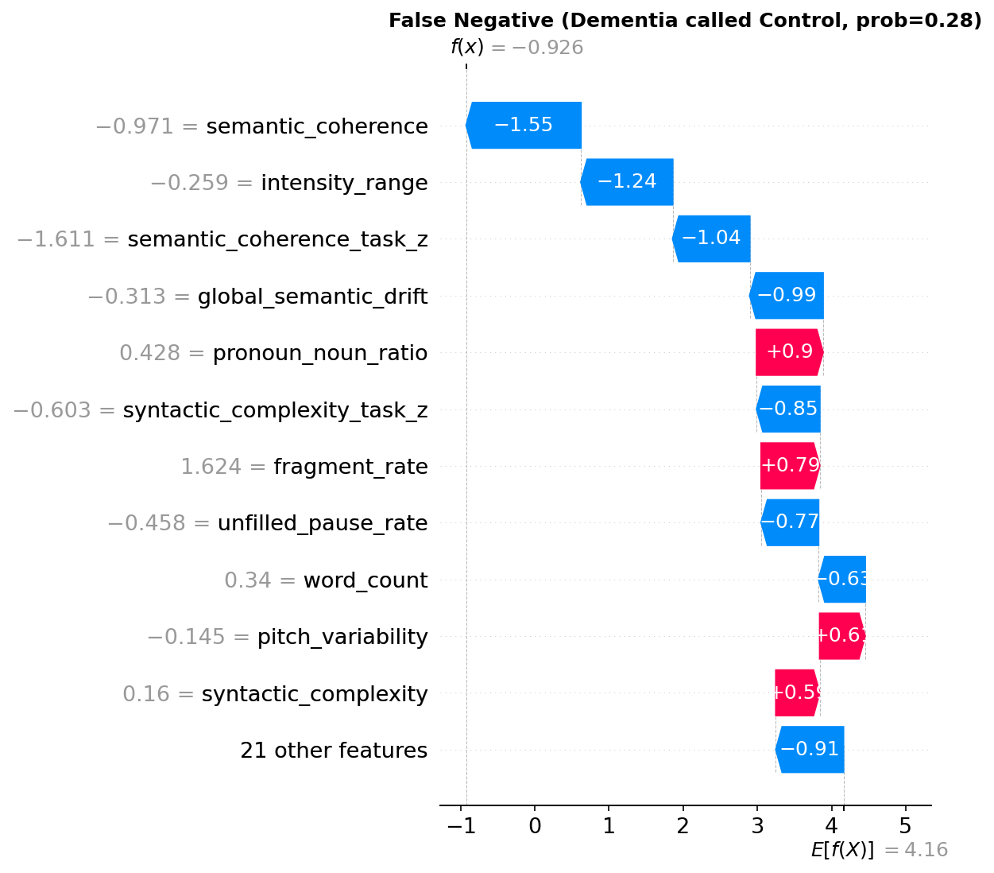
INTERPRETABILITY (3/3)
23 / 26
Where the model fails and why that’s diagnostic too.
Of 116 test samples, 9 were misclassified (6 false positives and 3 false negatives). The 3 false-negative cases (dementia called control) are the clinically costly ones. Below: the SHAP waterfall for the most-confident FN, plus what we learn from inspecting all of them.
What went wrong here.
This patient has clinically diagnosed dementia but their cookie-task transcript shows preserved syntactic complexity, low fragment rate, and high information-unit coverage — the linguistic profile of a control. SHAP shows the model is attending to the right features; they just disagreed with the clinical label here.
Pattern across all 3 false negatives.
All 3 had clinical AD diagnosis but mild stage, likely early MCI, not advanced.
Information-unit coverage was high (> 0.65) — the dominant feature pointed wrong.
Disfluency rates were below median, patients spoke fluently despite cognitive decline.
A second-stage screen using longitudinal speech samples would catch these.
FIG. 8 · FALSE NEGATIVE · DEMENTIA CALLED CONTROL · CONFIDENCE = 0.28
NeuroLinguist · AUB EECE 502 · Spring 2026
An auditory window into the aging mind

Slide 24
DEPLOYMENT
24 / 26
NeuroLinguist, the model in production.
A clinician-facing web application that wraps the entire pipeline. Paste a transcript or upload a CHA file; the system extracts 32 features in seconds, routes by detected task type, and returns a calibrated dementia probability with full SHAP attribution.
01
02
03
Dual input modes
Guided task detection
SHAP per prediction
Paste a raw transcript or upload a .CHA file directly. Client-side parser strips CHAT codes, preserves filled pauses, and extracts *PAR lines automatically.
User classifies input as cookie / fluency / recall / sentence and routes to the correct specialist ensemble.
Every result page shows the full feature breakdown, which features pushed which way, by how much. Designed for clinical audit, not just demo.
MODERN ENGINEERING TOOLS
BACKEND
FEATURES
ML / OPTIMISATION
INFERENCE TIME
Flask · Python 3.12
spaCy · Parselmouth · SBERT
XGBoost · scikit-learn · Optuna · SHAP
< 1 second per sample
NeuroLinguist · AUB EECE 502 · Spring 2026
An auditory window into the aging mind

Slide 25
CONCLUSIONS
25 / 26
Key findings, innovation, and clinical impact.
A
Hand-crafted features outperform BERT on small clinical data.
At ~880 training samples, our 32-feature ensemble beats BERT fine-tune by 7.7 pp. Transformers are not always the answer.
B
Task routing is essential, not optional.
The strongest single feature (information_unit_coverage, d=2.05) is meaningful on only one task. Without routing, its signal is wasted on 60% of samples.
C
Beats published SoTA on the same corpus.
92.2% vs. Sarawgi et al. 2020’s 88.0% on full Pitt, same split protocol, same imbalance, fairer comparison.
D
Deployable, interpretable, audit-ready.
Full pipeline runs in under a second. SHAP traces every prediction back to specific speech behaviours a clinician can inspect.
INNOVATION & COMMERCIAL PATH
First system to combine task-routing across all 4 cognitive tasks with full per-prediction SHAP transparency.
B2B path: pharma clinical-trial enrolment screening (digital cognitive biomarker, FDA-recognised category as of 2024). B2C path: patient self-screening companion app. Pitch document drafted under the working name CogniSpeech.
NeuroLinguist · AUB EECE 502 · Spring 2026
An auditory window into the aging mind

Slide 26
THANK YOU
Questions?
SELECTED REFERENCES
[1] Becker, J. T. et al. (1994). The natural history of Alzheimer’s disease: description of study cohort and accuracy of diagnosis. Archives of Neurology.
[2] Fraser, K. C., Meltzer, J. A., Rudzicz, F. (2016). Linguistic features identify Alzheimer’s disease in narrative speech. Journal of Alzheimer’s Disease, 49(2), 407–422.
[3] Sarawgi, U., Zulfikar, W., Soliman, N., Maes, P. (2020). Multimodal inductive transfer learning for detection of Alzheimer’s dementia. INTERSPEECH (ADReSS Challenge).
[4] Yang, X. et al. (2022). A deep learning approach for Alzheimer’s detection from connected speech. IEEE Speech Processing.
[5] Ksibi, A. et al. (2025). Multimodal Siamese networks for dementia detection. Scientific Reports.
[6] Eyigoz, E. et al. (2020). Linguistic markers predict onset of Alzheimer’s disease. EClinicalMedicine, The Lancet.
[7] Liu, X. et al. (2024). ASR robustness in clinical speech analysis. Elsevier Journal of Biomedical Informatics.
[8] Lundberg, S. M., Lee, S. I. (2017). A unified approach to interpreting model predictions (SHAP). NeurIPS.
[9] Akiba, T. et al. (2019). Optuna: a next-generation hyperparameter optimisation framework. KDD.
[10] DementiaBank · Pitt Corpus · TalkBank.org · CC-licensed under the TalkBank usage terms.
Wassim Kassem · Ali El Hajj · Tamer Lammam
An auditory window into the aging mind.
Faculty Advisor: Dr. Karim Kabalan
AMERICAN UNIVERSITY OF BEIRUT · EECE 502 · SPRING 2026

