Slide 1
BB22:The Most Advanced QKD

Slide 2
Motivation
Creating a new algorithm for key distribution protocol

Slide 3
Benefits
Sender only sends |+⟩.
Presence of eavesdropping can be detected apparently

Slide 4
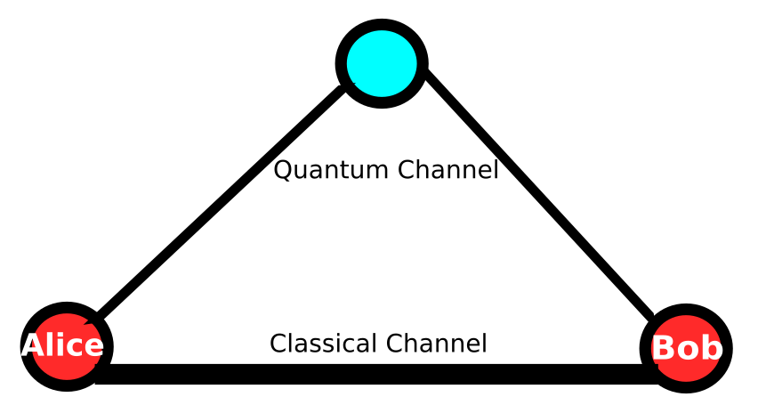
How does it work?

Slide 5


Alice prepares state of |+⟩ by applying Hadamard Gate, then sends it to Bob.
Bob picks a random number, 0 or 1.

Slide 6
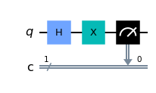
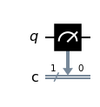
Bob measures the incoming state with computational or hadamard basis, depending on which random number is picked up.
If the number is 0, state is measured with hadamard basis.
If the number is 1, state is measured with computational basis.

Slide 7
Bob sends what he measured through classical channel.
Alice correlates the Bob’s measurement to determine if eavesdropper disturbing channel.
If the channel is safe, Alice sends the key.

Slide 8

The Correlation Function
Correlation function can detect eavesdropper

Slide 9
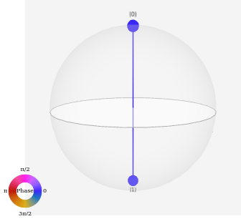
What if there is no eavesdropper?
The state is the same just like Alice sent
Alice always send |+⟩

Slide 10
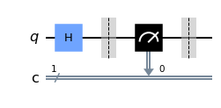
What if the channel eavesdropped?
Presence of eavesdropper will make |+⟩ collapsed.
By this way, Bob receives the state of |0⟩ or |1⟩

Slide 11
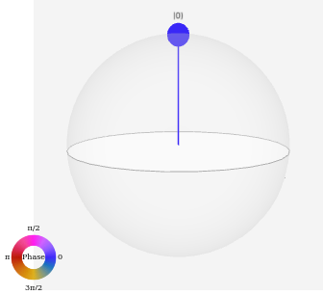
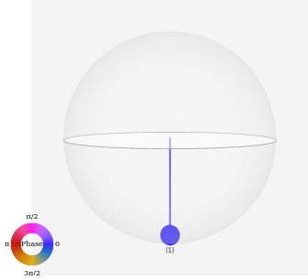
Without eavesdropping, Bob receives |+⟩
With eavesdropping, Bob receives |0⟩ or |1⟩

Slide 12
Bob measures the state in X or Z basis again and again. Then he analyzes the number of zeros and ones.

Slide 13
If Bob Measures with Z Basis:
If he measures “1”s vast majority of the time, he is receiving the state of |1⟩
If he measures “0”s vast majority of the time, he is receiving the state of |0⟩
If he measures “0”s and “1”s 50:50 distributed, he is receiving the state of |+⟩

Slide 14
If Bob Measures with X-Basis
If he measures “0”s vast majority of the time, he is receiving |+⟩
If he measures “1”s vast majority of the time, he is receiving |-⟩
If he measures “0”s and “1”s 50:50 distributed, he is receiving the state of |0⟩ or |1⟩, depending on phase which cannot be measured directly

Slide 15
After bob deduced which state he is receiving, he send “0” through classical channel if he detects |+⟩ or he send “1” through classical channel if he detects |1⟩.
Alice receives the value. Receiving “1”s she accumulates them on a variable.
Lastly, she divides accumulates the value by number of incoming bits. It’s the correlation value. If it’s 0, there is eavesdropper. If it’s different from 0 ,the quantum channel is safe.

Slide 16
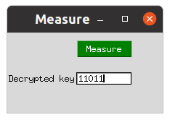
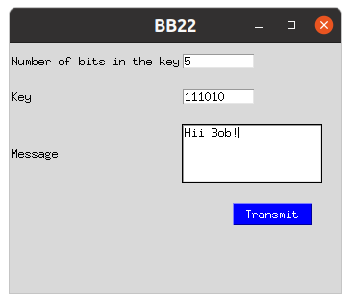
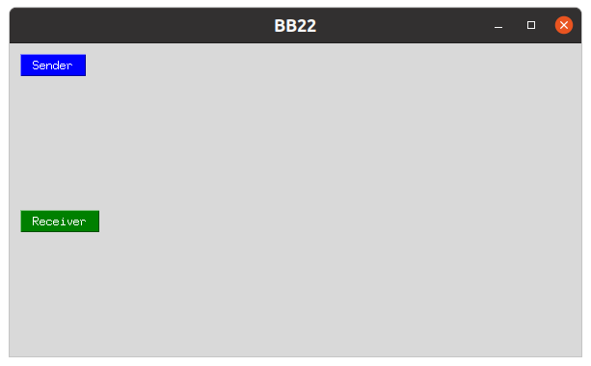
GUI

Slide 17
UI
Interface gets the data from the user and sends it securely.
It uses cloud storage platforms
It connects with Quantum Inspire Starmon-5

Slide 18
Thank you for your time

