Slide 1
CHAT WITH AIHAN
Alihan Sağöz

Slide 2
AGENDA
Problem statement
Dataset
DialoGPT: Fine-Tune
Results
Evaluation
Discussion of results
Future Direction

Slide 3
PROBLEM STATEMENT
The main purpose of the project is to examine whether we can give personality to an artificial intelligence, to a chatbot. Observing how accurate and correct answers he gives in cases where I am not present.

Slide 4
PROBLEM STATEMENT
The main purpose of the project is to examine whether we can give personality to an artificial intelligence, to a chatbot. Observing how accurate and correct answers he gives in cases where I am not present.
Applications
Virtual Personal Assistant: Assisting users with tasks such as scheduling appointments, setting reminders, and accessing relevant information.

Slide 5
PROBLEM STATEMENT
The main purpose of the project is to examine whether we can give personality to an artificial intelligence, to a chatbot. Observing how accurate and correct answers he gives in cases where I am not present.
Applications
Virtual Personal Assistant: Assisting users with tasks such as scheduling appointments, setting reminders, and accessing relevant information.
HR and Employee Support: Streamlining internal HR processes, answering employee queries, and providing guidance on company policies and benefits.

Slide 6
PROBLEM STATEMENT
The main purpose of the project is to examine whether we can give personality to an artificial intelligence, to a chatbot. Observing how accurate and correct answers he gives in cases where I am not present.
Applications
Virtual Personal Assistant: Assisting users with tasks such as scheduling appointments, setting reminders, and accessing relevant information.
HR and Employee Support: Streamlining internal HR processes, answering employee queries, and providing guidance on company policies and benefits.
Social Media Engagement: Enabling users to interact with social media platforms, schedule posts, and receive personalized content recommendations.

Slide 7
PROBLEM STATEMENT
The main purpose of the project is to examine whether we can give personality to an artificial intelligence, to a chatbot. Observing how accurate and correct answers he gives in cases where I am not present.
Applications
Virtual Personal Assistant: Assisting users with tasks such as scheduling appointments, setting reminders, and accessing relevant information.
HR and Employee Support: Streamlining internal HR processes, answering employee queries, and providing guidance on company policies and benefits.
Social Media Engagement: Enabling users to interact with social media platforms, schedule posts, and receive personalized content recommendations.
In Grieve: Talk with your friends or family members when they are not there. Even after they died. To lessen the pain just a little bit.

Slide 8
DATASET
Two types of data sets were used. The first of these is the data set prepared to get to know me, consisting of short questions and answers. The second is the data set prepared to understand how I speak from my past conversations and to make connections between past conversations.
Type 1 dataset with 100 questions and answers. With data augmentation (Increased to 300)
The second type of dataset is a 2444-line dataset with 8 features (1 of which is output, 7 of which is the last 7 conversations) consisting of conversations with 10 different people in total.
For type1 data set:
Test %10 - Validation %10 – Training %80
For type2 dataset:
Validation %10 - Training %90

Slide 9
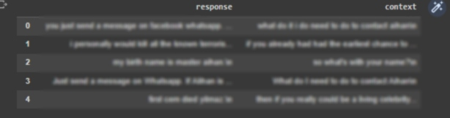
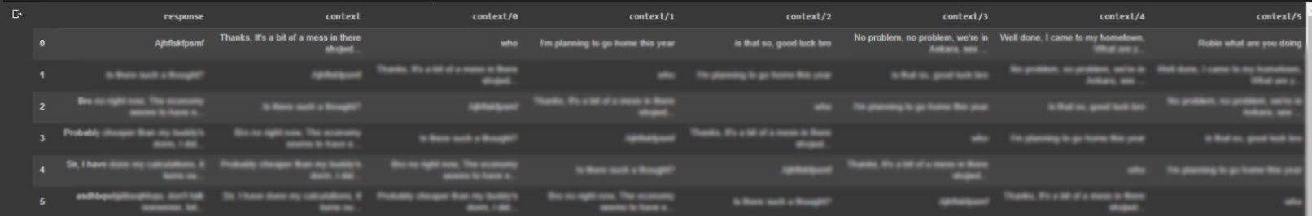
Example Data Format
Type 1
Type 2

Slide 10
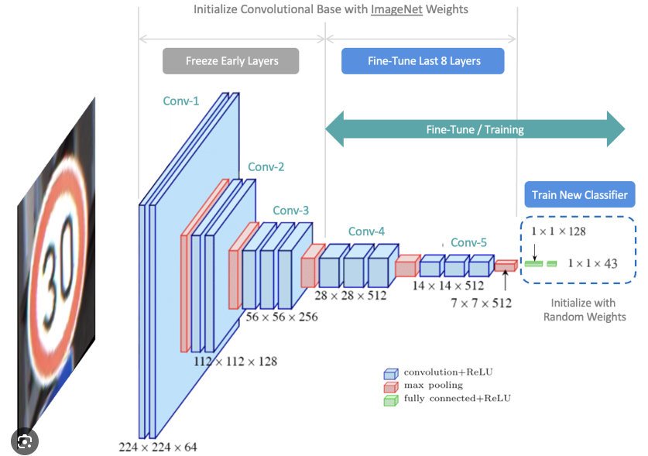
FINE - TUNE
Fine-tuning is the process of adapting a pre-trained model to a new task by updating the weights of the model using a limited amount of data. This is often preferred over training a model from scratch because it can be more computationally efficient and can lead to better performance.

Slide 11
WHY FINE – TUNE
Retains Pre-trained Knowledge: Fine-tuning allows the model to retain the valuable knowledge acquired during pre-training.

Slide 12
WHY FINE – TUNE
Retains Pre-trained Knowledge: Fine-tuning allows the model to retain the valuable knowledge acquired during pre-training.
Optimizes for Specific Task: Fine-tuning facilitates task-specific optimization by allowing the model to learn from a smaller, domain-specific dataset.

Slide 13
WHY FINE – TUNE
Retains Pre-trained Knowledge: Fine-tuning allows the model to retain the valuable knowledge acquired during pre-training.
Optimizes for Specific Task: Fine-tuning facilitates task-specific optimization by allowing the model to learn from a smaller, domain-specific dataset.
Balances Generalization and Specialization: Fine-tuning strikes a balance between generalization and specialization. While pre-training provides a general understanding of language, fine-tuning tailors the model to specific tasks.

Slide 14
FINE-TUNING DialoGPT IMPLEMENTATION DETAILS
source_ids: Tokenized input text + previous 7 conversation
source_mask: Attention mask corresponding to the input token IDs.
target_ids: Tokenized Target(completion).
target_mask: Attention mask corresponding to the target token IDs

Slide 15
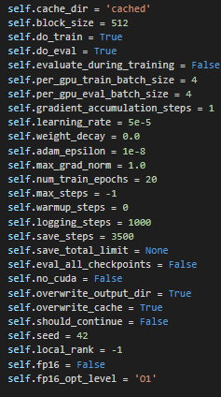
FINE-TUNING DialoGPT IMPLEMENTATION DETAILS
source_ids: Tokenized input text + previous 7 conversation
source_mask: Attention mask corresponding to the input token IDs.
target_ids: Tokenized Target(completion).
target_mask: Attention mask corresponding to the target token IDs

Slide 16
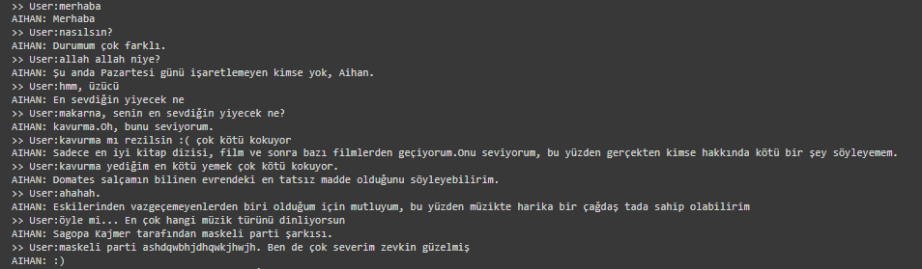
EXAMPLE RESULTS OBTAINED

Slide 17
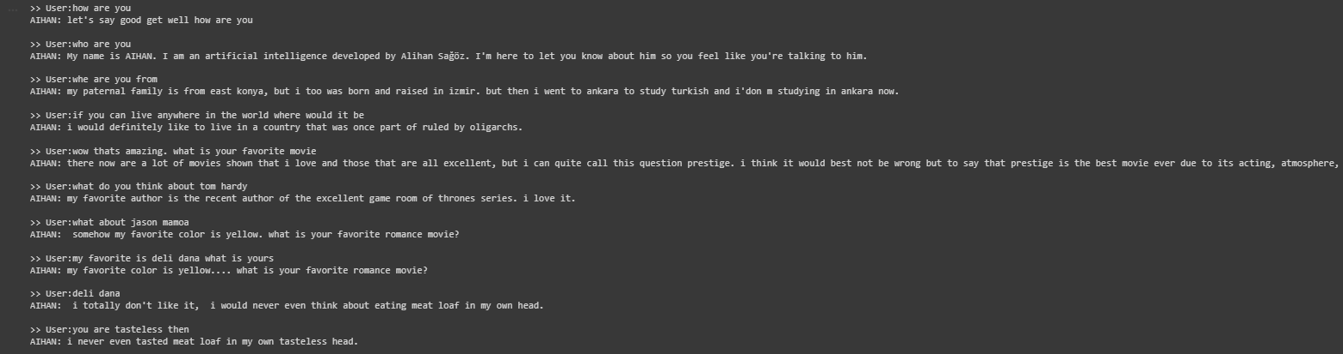
EXAMPLE RESULTS OBTAINED

Slide 18
EVALUATION
Two type metric used for evaluation:
Bleu Score:
bleu_2 = 0.63
bleu_4 = 0.55
Nist Score:
nist_2 = 3.84
nist_4 = 4.09

Slide 19
DISCUSSION OF RESULTS
Strengths:
In general, he understands questions and gives correct answers.

Slide 20
DISCUSSION OF RESULTS
Strengths:
In general, he understands questions and gives correct answers.
He can understand the joke and use a smiley face.

Slide 21
DISCUSSION OF RESULTS
Strengths:
In general, he understands questions and gives correct answers.
He can understand the joke and use a smiley face.
He can construct sentence structures similar to mine.

Slide 22
DISCUSSION OF RESULTS
Strengths:
In general, he understands questions and gives correct answers.
He can understand the joke and use a smiley face.
He can construct sentence structures similar to mine.
Weaknesses:
Sometimes he can give very irrelevant answers.

Slide 23
DISCUSSION OF RESULTS
Strengths:
In general, he understands questions and gives correct answers.
He can understand the joke and use a smiley face.
He can construct sentence structures similar to mine.
Weaknesses:
Sometimes he can give very irrelevant answers.
Sometimes he has a hard time connecting back with past conversations.

Slide 24
FUTURE DIRECTION
With more background speech data and personal information, it can be trained and approached more closely to a true copy of the person.
Whatsapp conversations can be complex and meaningless. Sentence integrity is like not speaking in order, jumping from topic to topic. Therefore, the data can be prepared more carefully. And in this way, more accurate results can be obtained.

Slide 25
REFERENCES
https://nathancooper.io/i-am-a-nerd/chatbot/deep-learning/gpt2/2020/05/12/chatbot-part-1.html
https://huggingface.co/docs/transformers/model_doc/dialogpt

Slide 26
THANK YOU
Alihan Sağöz

