Slide 1
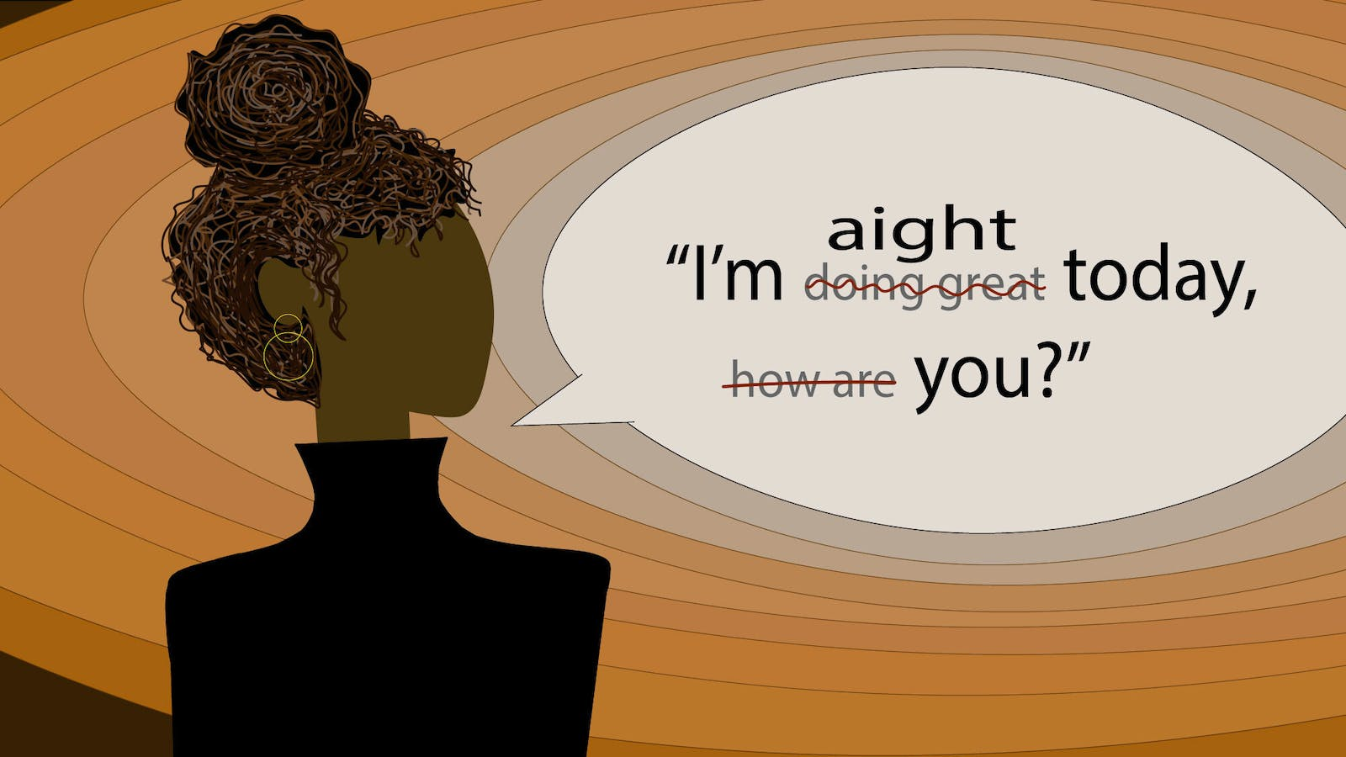
Impact of Code-Switching on Large Language Models
Seyed Ali Hejazi
seyed.ali.hejazi.35@gmail.com

Slide 2
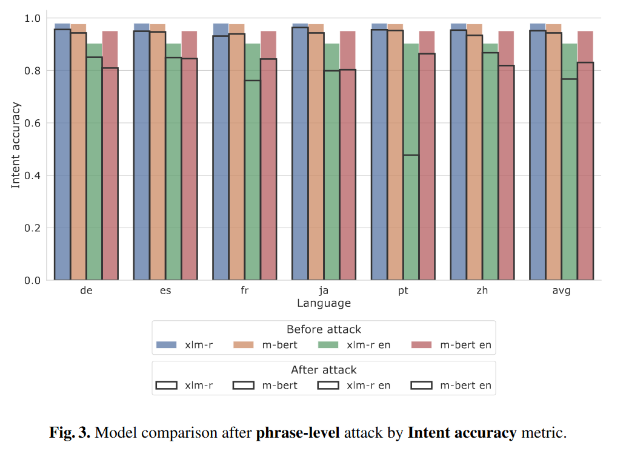
Related Work
Call Larisa Ivanovna: Code-Switching Fools Multilingual NLU Models (Birshert and Artemova, 2022)

Slide 3
XQuAD
Derived from SQuAD 1.1
Translated to 11 languages with professional human translators
Languages
1. Hindi: hi 2.Arabic: ar 3.german: de 4.English: en 5. espanish: es 6.Romanian: ro 7.Russian:ru 8.thai: th 9.Turkish: tr 10.Vietnamese: vi 11.Chinese: zh 12.Greek : el
On the Cross-lingual Transferability of Monolingual Representations(Artetxe et al., 2020)

Slide 4
English
German
Context = The Panthers defense gave up just 308 points, ranking sixth in the league, while also leading the NFL in interceptions with 24 and boasting four Pro Bowl selections. Pro Bowl defensive tackle Kawann Short led the team in sacks with 11, while also forcing three fumbles and recovering two. Fellow lineman Mario Addison added 6½ sacks. The Panthers line also featured veteran defensive end Jared Allen, a 5-time pro bowler who was the NFL's active career sack leader with 136, along with defensive end Kony Ealy, who had 5 sacks in just 9 starts. Behind them, two of the Panthers three starting linebackers were also selected to play in the Pro Bowl: Thomas Davis and Luke Kuechly. Davis compiled 5½ sacks, four forced fumbles, and four interceptions, while Kuechly led the team in tackles (118) forced two fumbles, and intercepted four passes of his own. Carolina's secondary featured Pro Bowl safety Kurt Coleman, who led the team with a career high seven interceptions, while also racking up 88 tackles and Pro Bowl cornerback Josh Norman, who developed into a shutdown corner during the season and had four interceptions, two of which were returned for touchdowns.
Question = How many points did the Panthers defense surrender?
Answer = 308
Question = How many career sacks did Jared Allen have?
Answer = 136
Question = Who registered the most sacks on the team this season?
Answer = Kawann Short
Context = Die Verteidigung der Panthers gab nur 308 Punkte ab und belegte den sechsten Platz in der Liga, während sie die NFL mit 24 Interceptions in dieser Kategorie anführte und sich mit vier Pro Bowl-Selektionen rühmen konnte. Pro Bowl Defensive Tackle Kawann Short führte das Team mit 11 Sacks an, erzwang zudem drei Fumbles und erzielte zwei Fumble Recoverys. Mario Addison, ebenfalls Lineman, addierte 6½ Sacks hinzu. Die Panthers-Line präsentierte auch den erfahrenen Defensive End Jared Allen, einen 5-fachen Pro-Bowler, der mit 136 Sacks der aktive Anführer in der NFL-Kategorie Karriere-Sacks war, sowie den Defensive End Kony Ealy, der 5 Sacks in nur 9 Starts erzielte. Nach ihnen wurden zwei der drei Linebacker der Panthers ausgewählt, um im Pro Bowl zu spielen: Thomas Davis und Luke Kuechly. Davis erzielte 5½ Sacks, vier erzwungene Fumbles und vier Interceptions, während Kuechly das Team bei den Tackles anführte (118), zwei Fumbles erzwang und vier Pässe abfing. Carolinas Secondarys bestanden aus dem Pro Bowl-Safety Kurt Coleman, der das Team mit einem Karrierehoch von sieben Interceptions anführte und gleichzeitig 88 Tackles erzielen konnte, und Pro Bowl-Cornerback Josh Norman, der sich während der Saison zur Shutdown Corner entwickelte und vier Interceptions erzielte, von denen zwei zu Touchdowns für sein Team wurden.
Question = Wie viele Punkte gab die Verteidigung der Panthers ab?
Answer = 308
Question = Wie viele Sacks erzielte Jared Allen in seiner Karriere?
Answer = 136
Question = Who registered the most sacks on the team this season?
Answer = Kawann Short

Slide 5
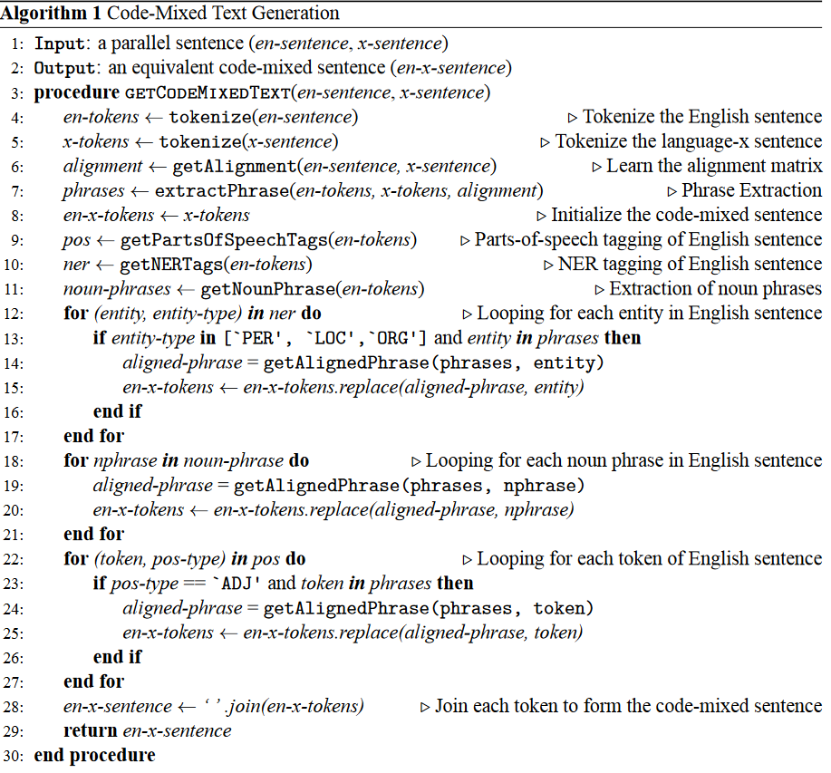
Code-Switched Text Synthesis in Unseen Language Pairs (Gupta et al., 2020)
Related Work

Slide 6
Examples
Target :
Matt Damon is a versatile, charismatic, and accomplished actor, renowned for his compelling performances across a diverse range of roles in the film industry.
Src :
مت دیمون بازیگری همه کاره، کاریزماتیک و کارکشته است که به خاطر بازی های جذابش در طیف متنوعی از نقش ها در صنعت فیلم شهرت دارد.
Result:
Matt Damon versatile، charismatic و کارکشته است که به خاطر بازی های compelling در طیف diverse از نقش ها در صنعت فیلم شهرت دارد.

Slide 7
Examples
Target:
The devastating 9/11 terrorist attacks on the World Trade Center in 2001 were an unprecedented and tragic event that shook the world.
Source:
حملات تروریستی ویرانگر 11 سپتامبر به مرکز تجارت جهانی در سال 2001 رویدادی بی سابقه و غم انگیز بود که جهان را تکان داد.
Result:
حملات تروریستی ویرانگر 9/11terrorist ویرانگر 11 سپتامبر به the World Trade Center در سال 2001 رویدادی بی سابقه و tragic بود که جهان را تکان داد.

Slide 8
Code-switching vs normal dataset
 | DE | el | es | ro | ru | tr | zh
chRF | 88.3 | 82.70 | 89.27 | 89.69 | 80.12 | 89.75 | 73.52
BLEU | 77.9 | 76.66 | 76.66 | 80.07 | 72.43 | 72.96 | 19.99
Table 1. chRF and BLEU score between code-switching and monolingual paragraphs in XQuAD dataset

Slide 9
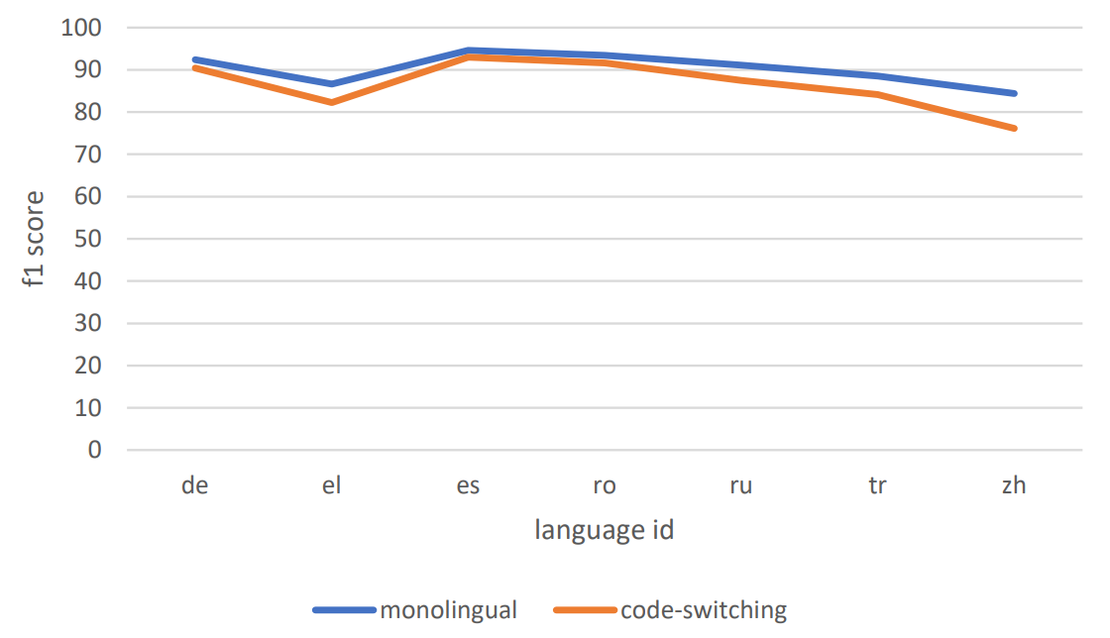
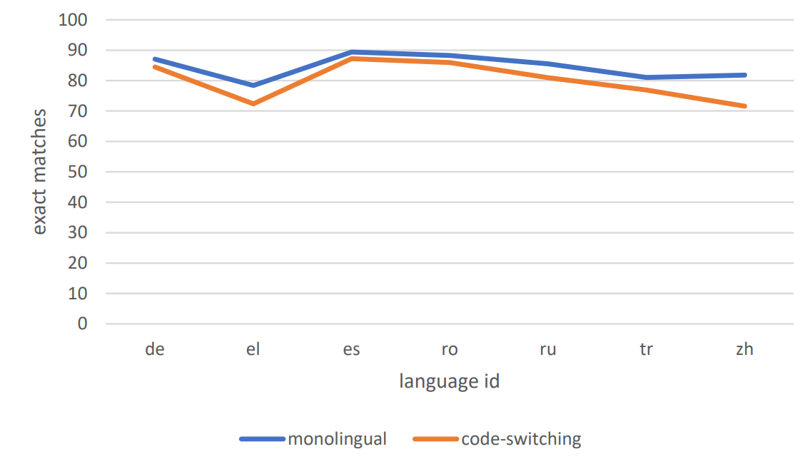
Figure 1. BERT-base model fine-tuned on SQuAD 2.0 evaluated on XQuAD dataset

Slide 10
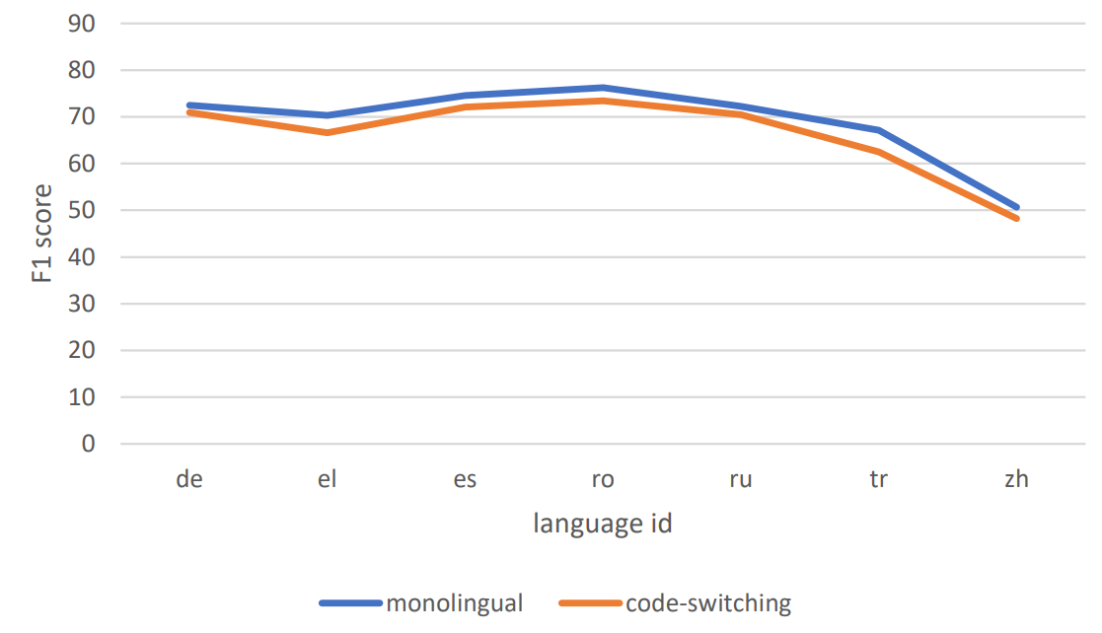
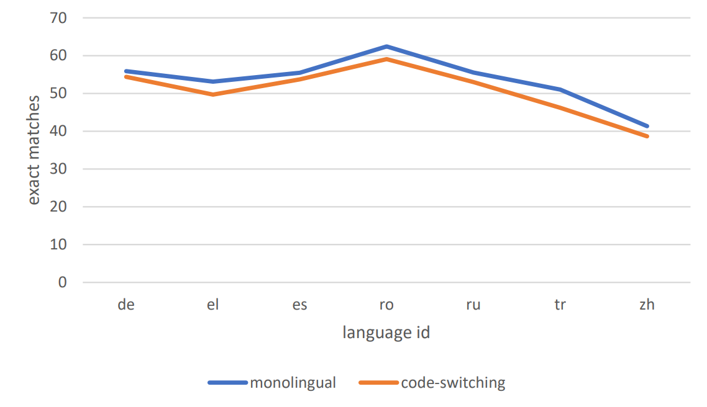
Figure 2. XLM Roberta model fine-tuned on SQuAD 2.0 dataset evaluated on XQuAD dataset

Slide 11
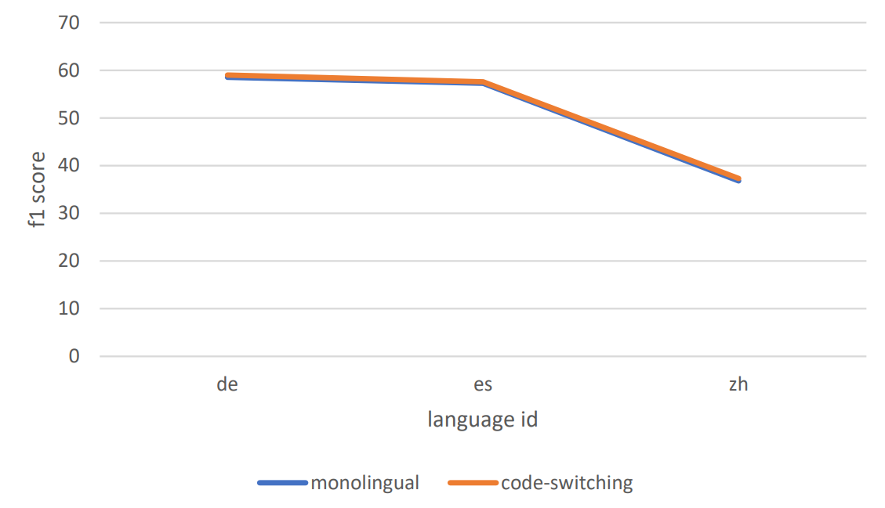
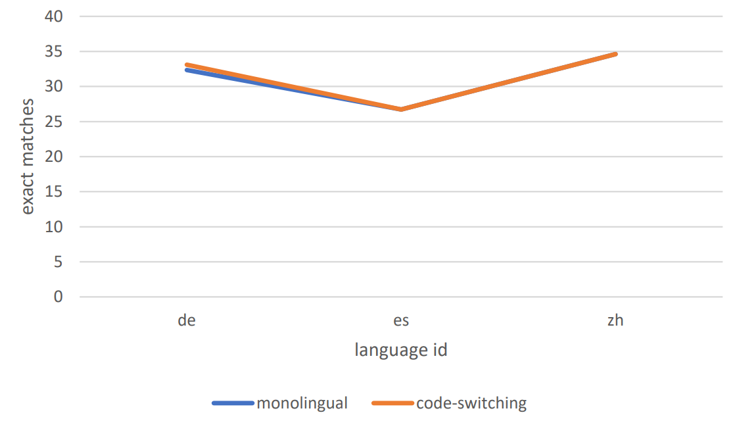
Figure 3. GPT 3.5 Turbo 1-shot evaluated on XQuAD dataset

Slide 12
References
[1] Alexey Birshert and Ekaterina Artemova. 2022. Call Larisa Ivanovna: Code-Switching Fools Multilingual NLU Models. In Evgeny Burnaev, Dmitry I. Ignatov, Sergei Ivanov, Michael Khachay, Olessia Koltsova, Andrei Kutuzov, Sergei O. Kuznetsov, Natalia Loukachevitch, Amedeo Napoli, Alexander Panchenko, Panos M. Pardalos, Jari Saramäki, Andrey V. Savchenko, Evgenii Tsymbalov, and Elena Tutubalina, editors, Recent Trends in Analysis of Images, Social Networks and Texts, pages 3–16, Cham. Springer International Publishing.
[2] Mikel Artetxe, Sebastian Ruder, and Dani Yogatama. 2020. On the Cross-lingual Transferability of Monolingual Representations. In Dan Jurafsky, Joyce Chai, Natalie Schluter, and Joel Tetreault, editors, Proceedings of the 58th Annual Meeting of the Association for Computational Linguistics, pages 4623–4637, Online. Association for Computational Linguistics.
[3] Deepak Gupta, Asif Ekbal, and Pushpak Bhattacharyya. 2020. A Semi-supervised Approach to Generate the Code-Mixed Text using Pre-trained Encoder and Transfer Learning. In Trevor Cohn, Yulan He, and Yang Liu, editors, Findings of the Association for Computational Linguistics: EMNLP 2020, pages 2267–2280, Online. Association for Computational Linguistics.

