Slide 1

improving win rate with data analysis
Ali Emre Hayırlıoğlu #29422

Slide 2
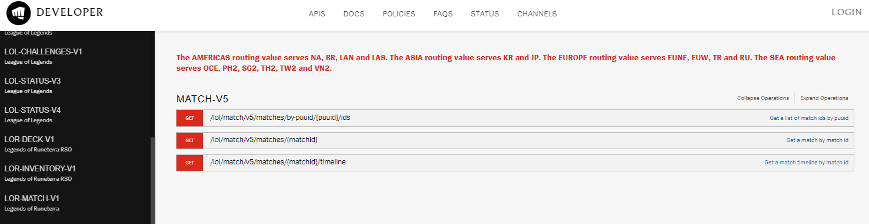
How do I get the data?

Slide 3

DATASET
OBJECTIVES CHAMPS INDIVIUDUAL PERFORMANCE

Slide 4
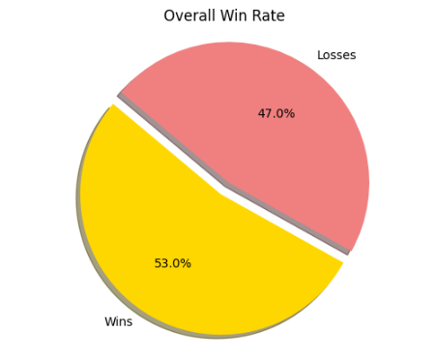
Focusing on INCREASING WIN RATE
What are the things that really effects my win rate?

Slide 5
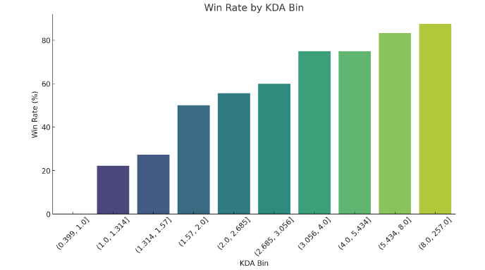
Individual performance KDA: (KILLS + assists) / deaths Pearson correlation value: 0.144

Slide 6
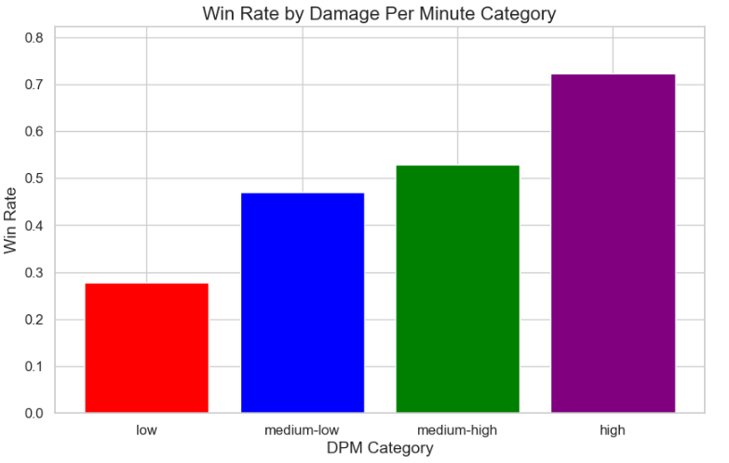
Damage per minute 0.18

Slide 7
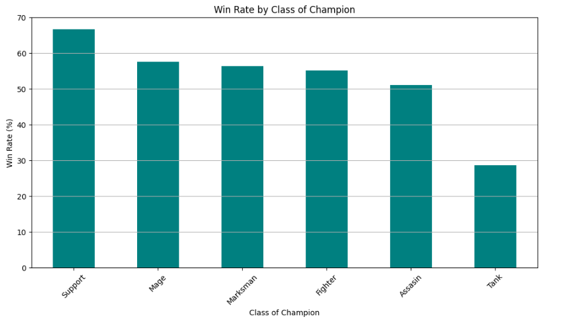
CHAMPION STATICS

Slide 8
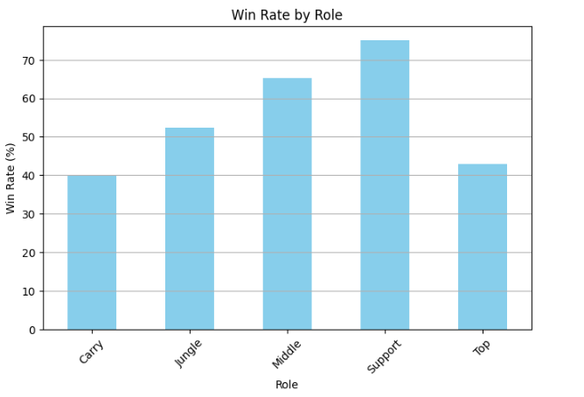

Slide 9
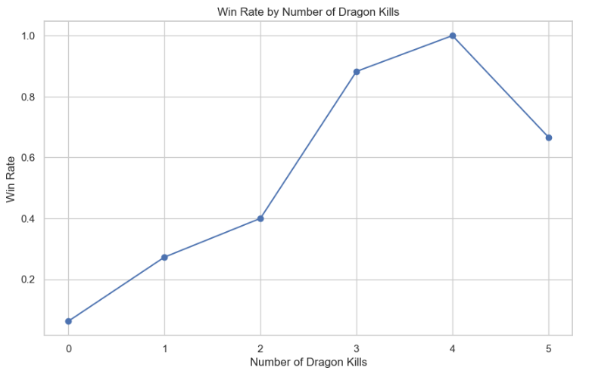
HOW ABOUT OBJECTİVES IN THE GAME

Slide 10
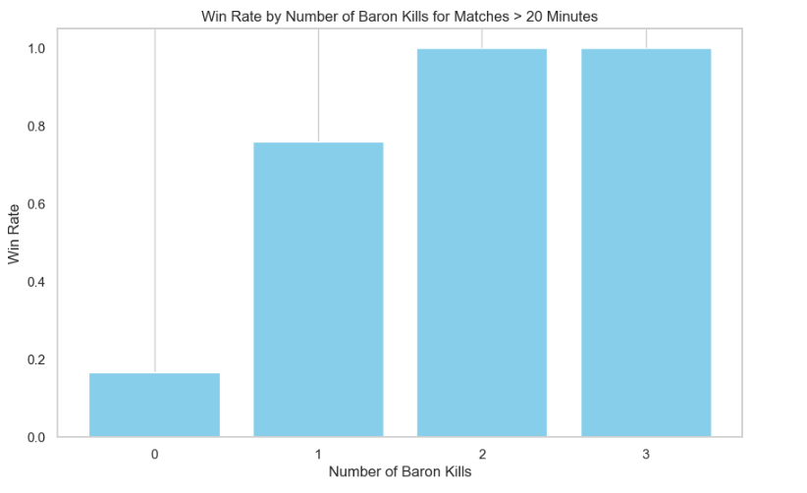

Slide 11
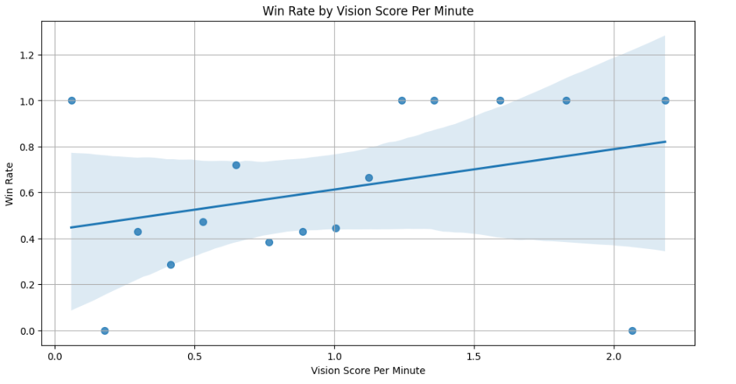
Vision provides you to play the game more awarded of what your enemies are doing

Slide 12
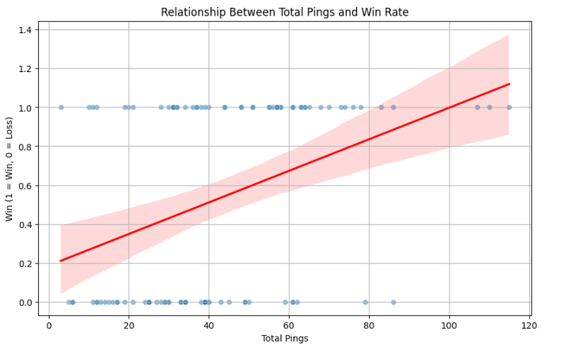
COMMUNICATION IS THE KEY

Slide 13
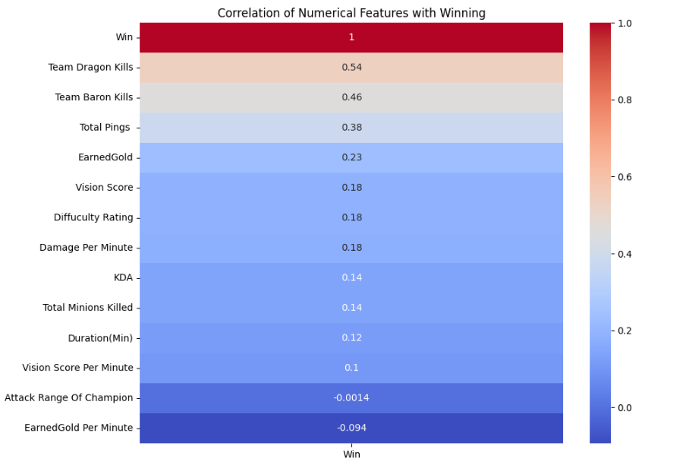
CONCLUSION: Objectives teamwork communication provides win

