Slide 1
Design and Implementation of a Reinforcement Learning-Based Controller for a Single-Degree-of-Freedom Flexible Robot Arm
Author: Seyed ali Hendi
Supervisor: Prof.Seyed Majid Esmailzade
Iran University of Science and Technology– EE Department
July 2025

Slide 2
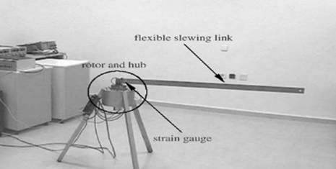
introduction
In this project, we use a data- driven approach to identify the flexible robotic arm dynamics and control it with RL-based controller .
Active Vibration Damping
Reaching target position
1

Slide 3
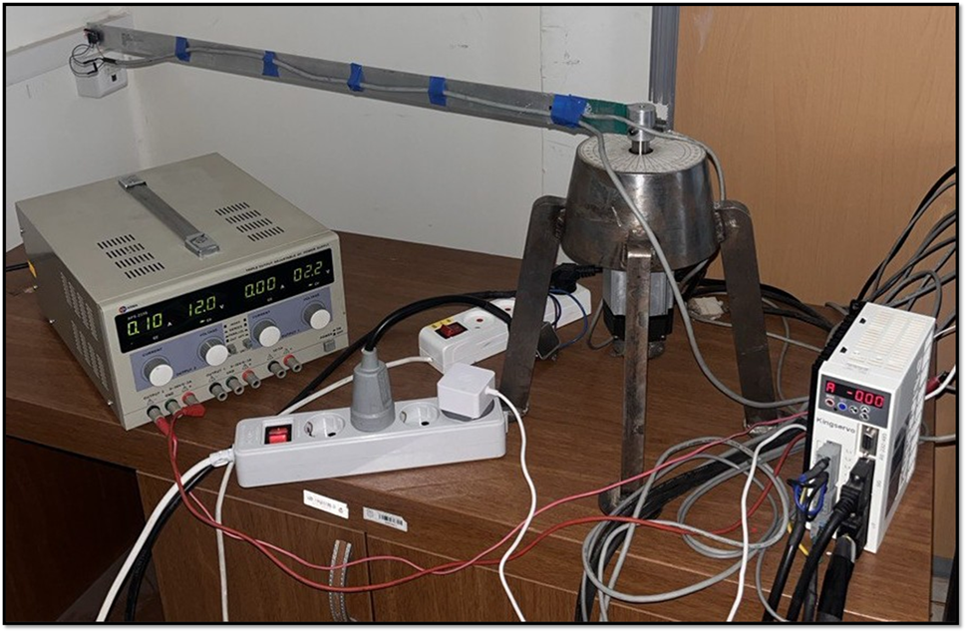
Hardware Architecture
Plant: 1-DOF Flexible Link Manipulator
Actuator: AC Servo Motor (Torque control)
Sensors: Incremental Encoder , Strain gauge
Microcontroller: Raspberry Pi 4B
2

Slide 4
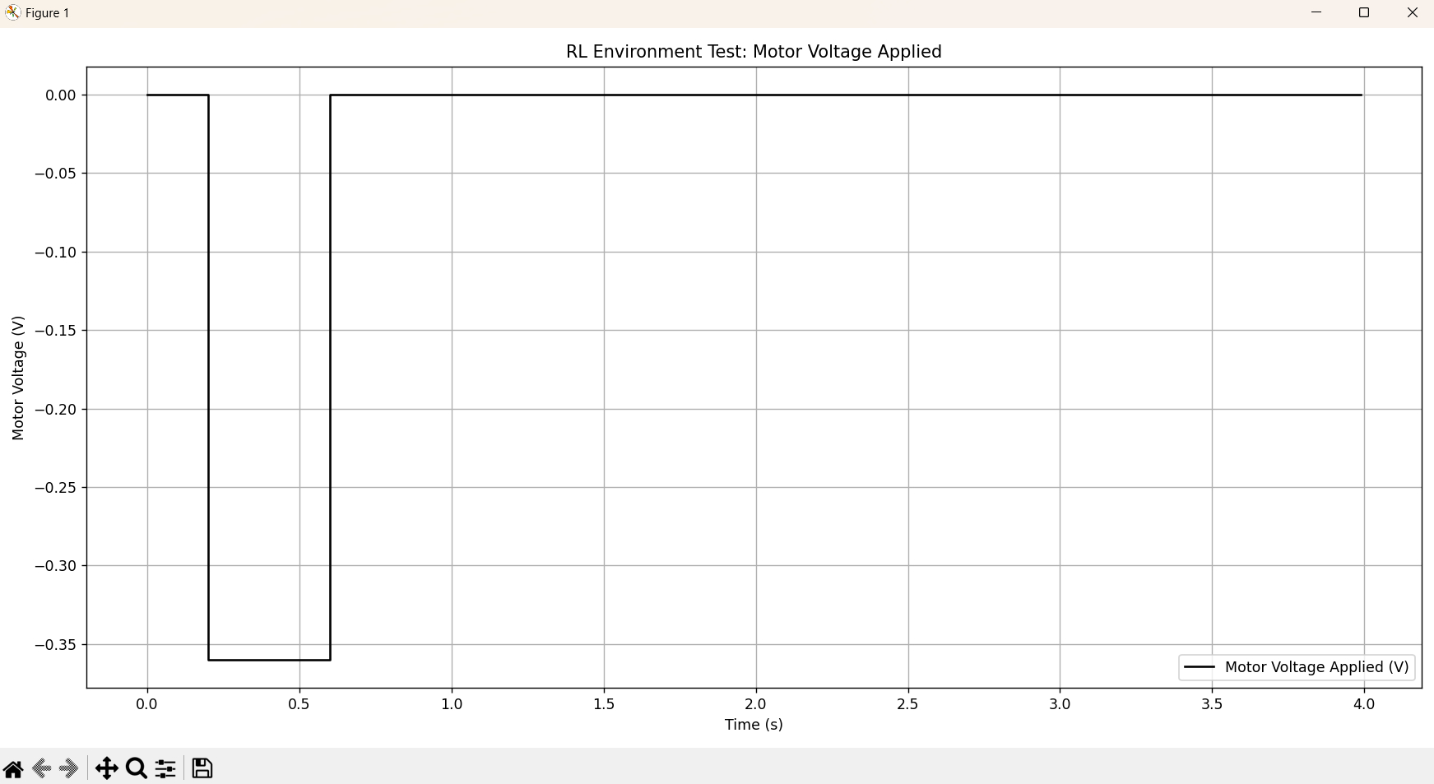
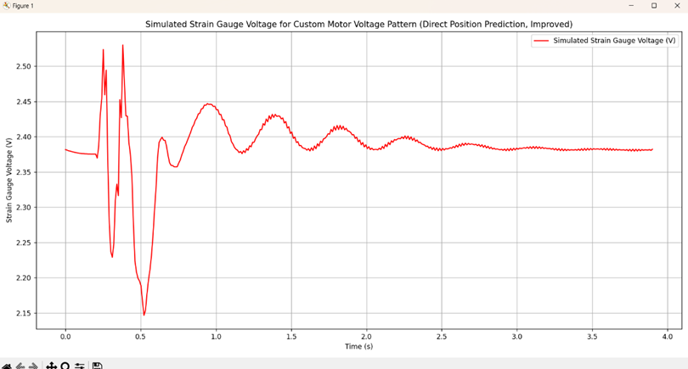
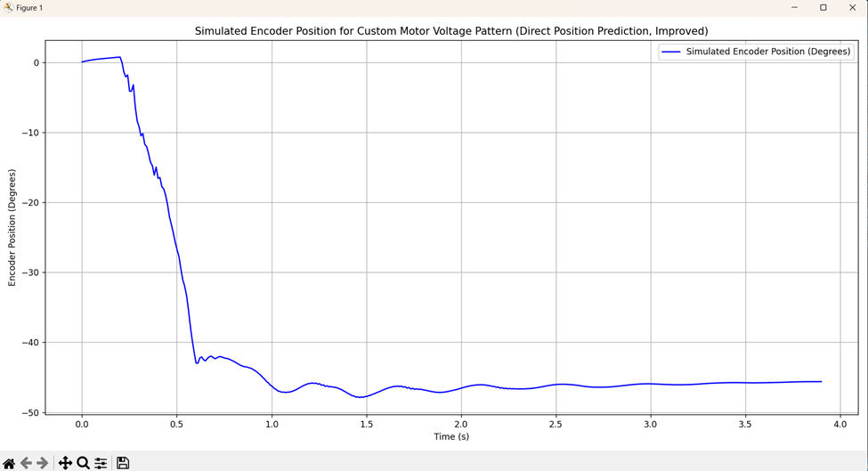
System Identification via LSTM Neural Network
Dataset:
Data Volume: 520 experimental CSV logs
Input Diversity: Step, Pulse, and Sine waves.
Data format: 1.time 2. motor voltage 3.encoder position(degree) 4.strain gauge voltage
LSTM Neural Network
Network Structure: 2 LSTM layers with 256 hidden units
Look-back Window: 50 time-steps (0.5s context at 100Hz) to capture full vibration periods.
Sample results:
3
Pulse input
Strain gauge voltage
Encoder position

Slide 5
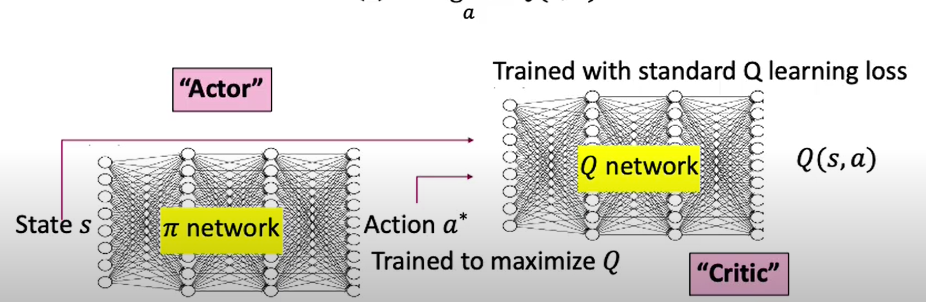
Reinforcement Learning: Soft Actor-Critic (SAC)
Target position = -30
Strain gauge voltage offset = 2.4
Max episode steps = 400
Sampling rate = 100 Hz
5

Slide 6
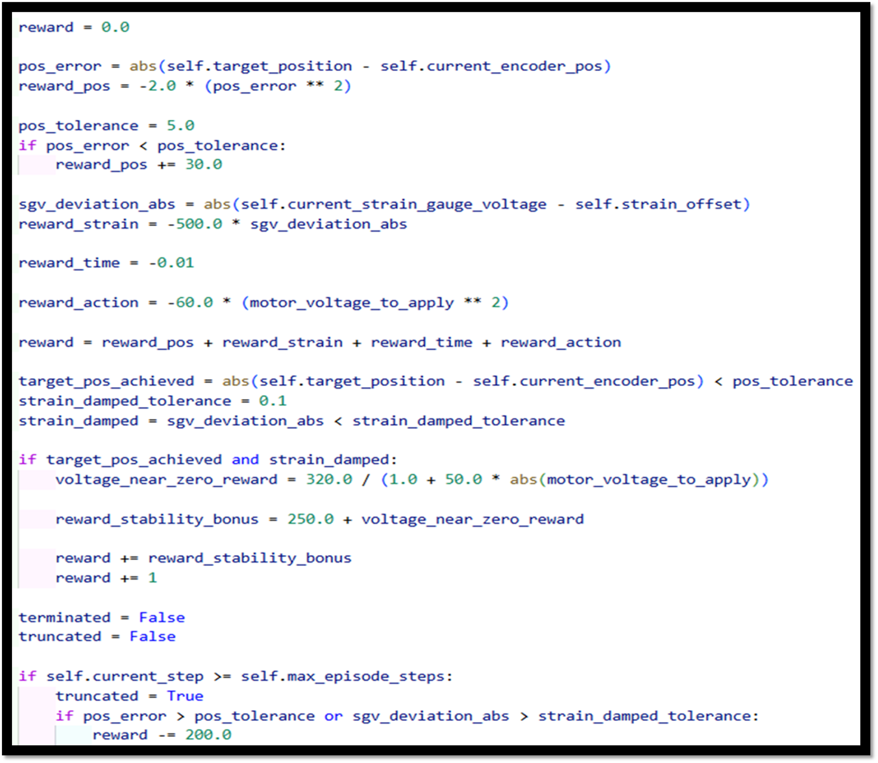
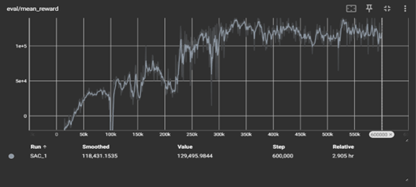
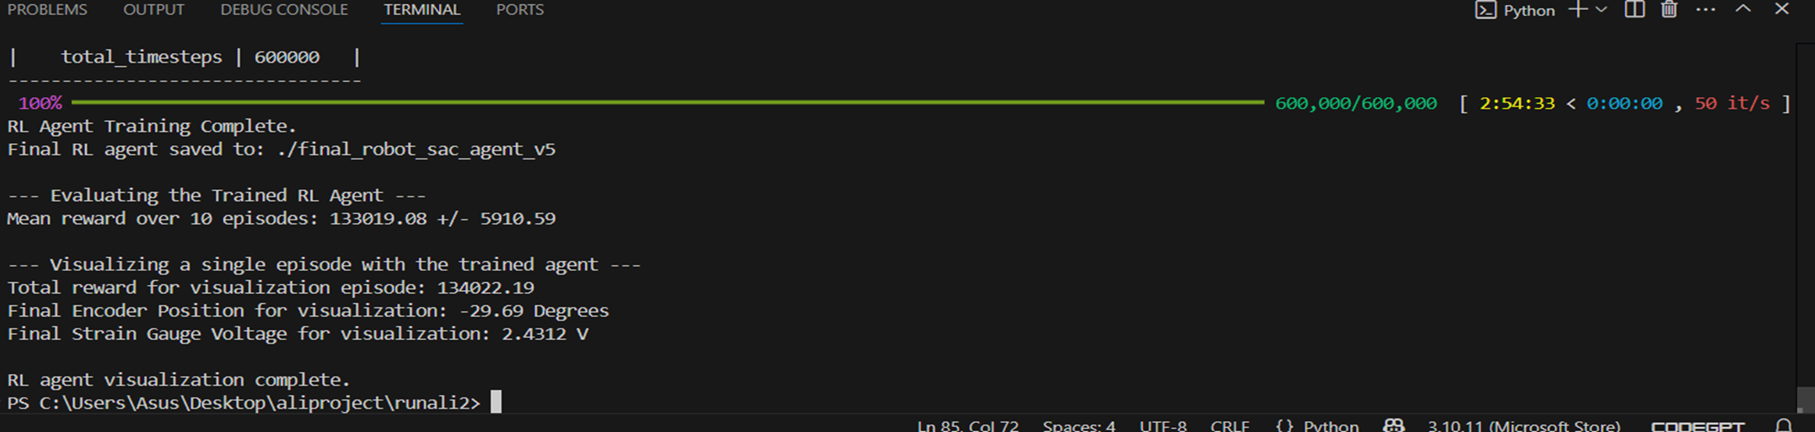
Rl agent training
Mean reward
6
Reward function

Slide 7
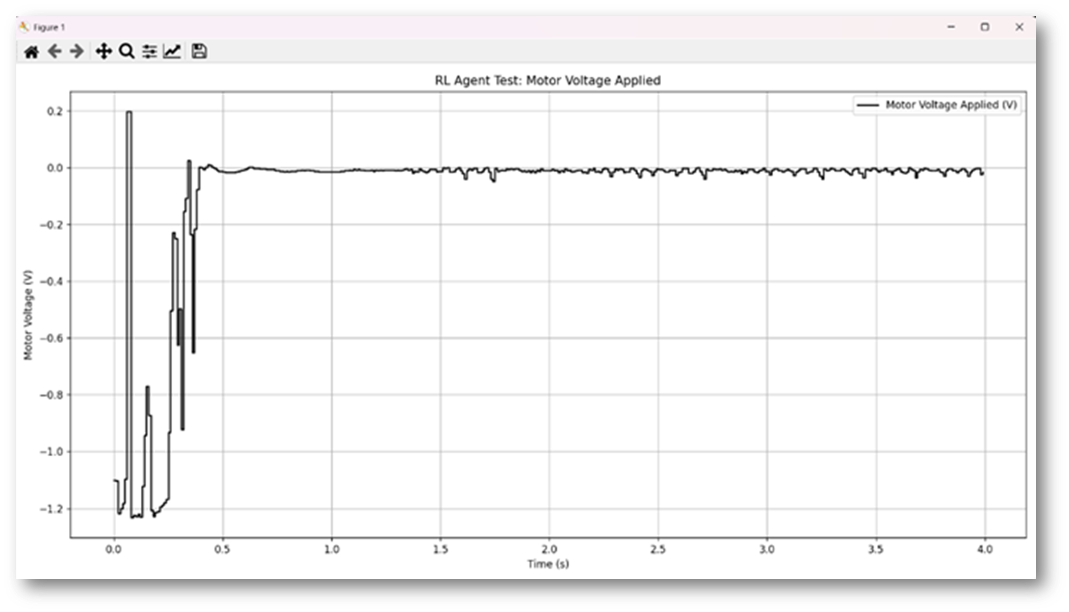
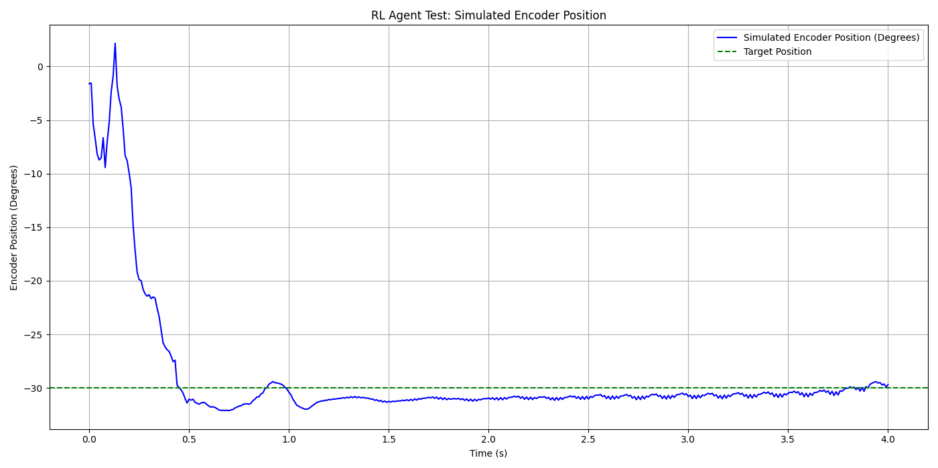
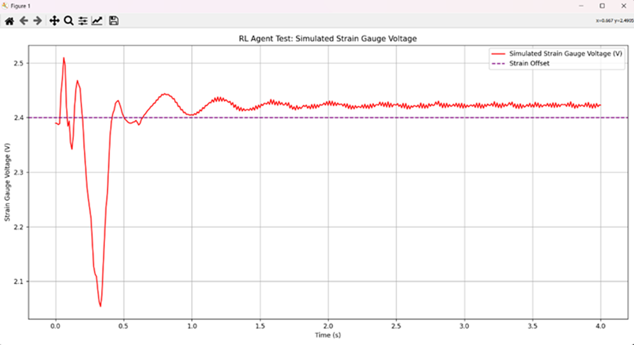
Reinforcement learning final voltage sequence and sensors outputs
Motor voltage
Encoder position
Strain gauge voltage
7

Slide 8
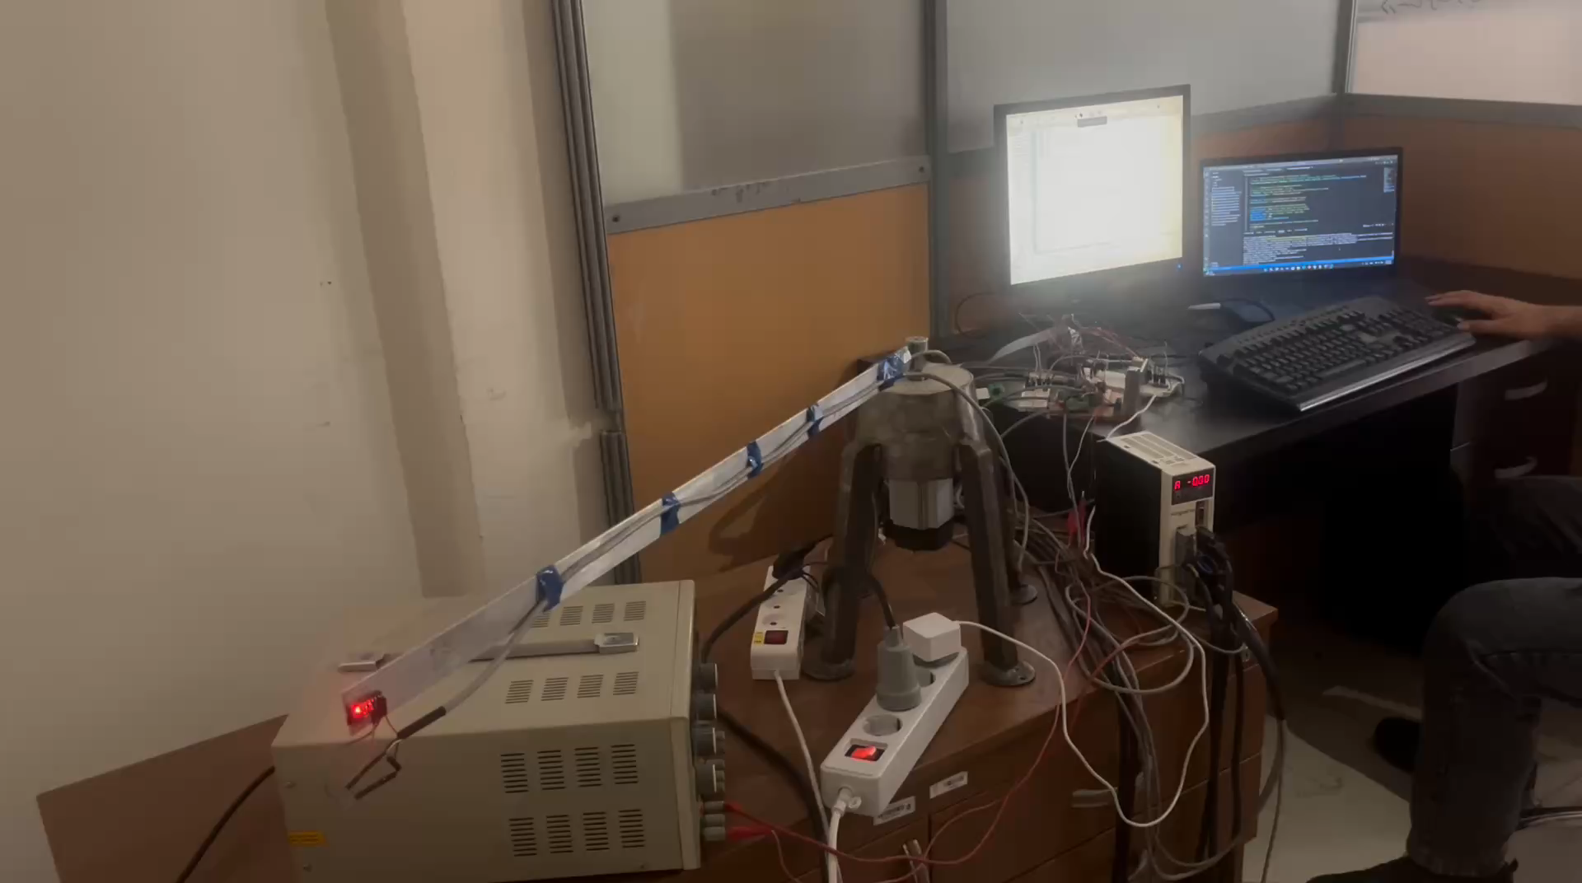
8

Slide 9
Thank you for your attention

