Slide 1
Advanced Medicinal
Chemistry
Lecture 4:
Drug Metabolism and Pharmokinetics - 1
Barrie Martin
AstraZeneca R&D Charnwood

Slide 2
DMPK – What is it and Why study it?
Drug Metabolism
The chemical alteration of a drug by a biological system with the principal
purpose of eliminating it from the system.
Pharmacokinetics
The study of the movement of drugs within the body (What the body does to the drug).
Pharmacodynamics
The study of the pharmacological response to a drug (What the drug does to the body).
Why?
Compare drug candidates –need to understand how they behave in the body in order to have confidence that they will be safe and efficaceous.
Understand how to improve the in vivo properties of candidates during the Lead
Optimisation process.
Notes:
Drug Metabolism - “the chemical alteration of a drug by a biological system with the principal purpose of eliminating it from the system”. This generally involves alteration by the living system to enhance water solubility and hence excretability.
Pharmacokinetics - “the study of the movement of drugs within the body (encompassing absorption distribution and elimination)” i.e. what the body does with the drug.
This differs from pharmacodynamics which is defined as “the study of the pharmacological response to a drug” i.e. what the drug does to the body.
Why study drug metabolism and pharmacokinetics?
Compare rival drug candidates – understand how they behave in the body to have confidence that they will be safe and efficacious.
By understanding the DMPK properties of a drug, we can relate pharmacodynamic effects to the fate of the compound in the body.
Use interspecies comparisons to support pharmacology and toxicity.
Understand how to improve on the in vivo properties of drug candidates during the lead optimisation process.

Slide 3
Typical Plasma Concentration/Time Profiles
Plasma
conc
Toxic
Plasma
conc
Toxic
MTC
MTC
Therapeutic
Therapeutic
Css_{max}
Duration
Css_{min}
MEC
MEC
Ineffective
Ineffective
Time
Time
Understanding the DMPK of compounds allows effective prediction of appropriate doses to give safe, therapeutic concentrations
MTC - Maximum tolerated concentration
MEC - Minimum effective concentration
Css - Steady state concentration
Notes:
LHS diagram - typical plasma concentration profile over time following an oral dose of a compound.
As the compound is absorbed and enters the bloodstream the concentration rises initially, as the compound distributes into tissues and absorption rates start to slow, the concentration levels off, and as the drug is metabolised and excreted from the systemic circulation the concentration then decreases over time.
Target concentrations in the blood sufficient to give activity at the desired target and to give coverage of that receptor for a sufficient period of time (duration). i.e. achieving the MEC (minimum effective concentration).
Ensure that drug concentration does not reach levels which might cause side effects/toxicity, i.e. exceeding the MTC (maximum tolerated concentration).
RHS diagram - most oral drugs are given once or twice daily so need to consider the effects of multiple dosing.
Not all of the compound may have been eliminated from the body by the time of a subsequent dose - the concentration will build up over time until it reaches ‘steady state’, where the amount eliminated is equal to the amount dosed.

Slide 4
DMPK Processes & Terminology
Absorption Distribution Metabolism Excretion (ADME)
For a drug which is administered orally, a number of factors affect delivery to
the site of action:
Absorption: the process by which a drug moves from its site of administration
to the systemic circulation
Distribution: the reversible transfer of a drug to and from the systemic circulation
Metabolism: any chemical alteration of a drug by the living system to enhance
water solubility and hence excretion
Excretion (Elimination): the irreversible transfer of a drug from the systemic
circulation
Absorption
Distribution
BLOOD
TISSUES
Elimination
Notes:
The amount of drug administered and the inherent potency are not the only factors that influence their behaviour. For a drug which is administered orally, there are a number of variables which affect delivery to the site of action. These can be summarised by the following processes:
Absorption – the process by which a drug moves from its site of administration to the systemic circulation – (for example from the gastrointestinal tract across the intestinal epithelia). Sites of absorption can include the GI tract, skin, lungs etc.
Distribution – the reversible transfer of a drug to and from the systemic circulation (i.e. the drug can distribute into tissues from the blood).
Metabolism – any chemical alteration of a drug by the living system to enhance water solubility and hence excretability. Occurs in most organs and tissues of the body, notably the liver, also the GI wall, kidneys and blood.
Excretion (Elimination) – the irreversible transfer of a drug from the systemic circulation. Includes metabolic loss, renal excretion, biliary excretion, sweat etc.

Slide 5

Absorption
Factors affecting absorption:
Solubility
Acid stability
Permeability
Metabolism – gut wall / first pass metabolism
MOUTH
Portal vein
pH ~1
Relative SA ~1
STOMACH
Liver
BLOOD
pH ~ 7
Relative SA ~ 600
INTESTINE
Metabolism
Gut wall
Notes:
Absorption
When we take a tablet, before it gets into the systemic circulation, it has to pass through the stomach (pH ~ 1). The drug needs to be stable to these acidic conditions at body temperature.
The pH of the small intestine is ~ 7 and the majority of absorption often takes place here, due to the comparatively large surface area.
The drug requires sufficient aqueous solubility for dissolution, as only dissolved compound can be absorbed.
Poor permeability, gut wall metabolism and/or efflux can all lead to poor absorption across the intestinal wall.
Drugs which are absorbed passively through the gut wall also need to be sufficiently lipophilic to cross cell membranes
It is the neutral form of compounds that is absorbed.
All blood from the stomach, small and large intestine passes to the liver via the hepatic portal vein. Some of the compound may be metabolised (first pass metabolism) before the compound reaches the systemic circulation.

Slide 6
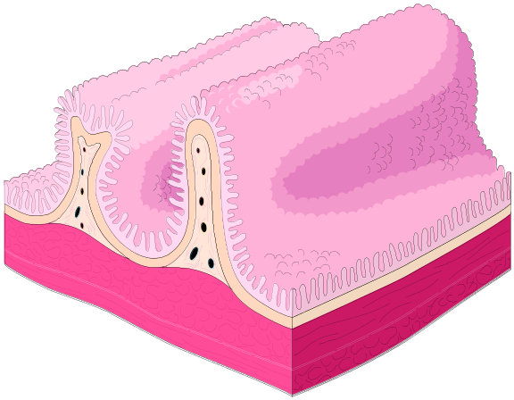
Intestinal Wall Structure
Epithelium
Central capillary network
Microvilli
Apical surface
Basolateral surface
Brush Border
Membrane
Epithelial
Cell (enterocyte)
Intestinal wall epithelial cells have many finger-like projections on their luminal surface called microvilli which form the brush border membrane
Notes:
Intestinal wall structure
Small intestine has large surface area, maximised by the presence of villi, fingerlike structures which protrude from the intestinal wall.
Microvilli – additional extensions which protrude from epithelial cells.
Apical surface – the part of the membrane which forms the lumenal surface, distinct from the basolateral surface
Compounds which pass across the gut wall are then taken by a network of capillaries via the hepatic portal vein to the liver.

Slide 7
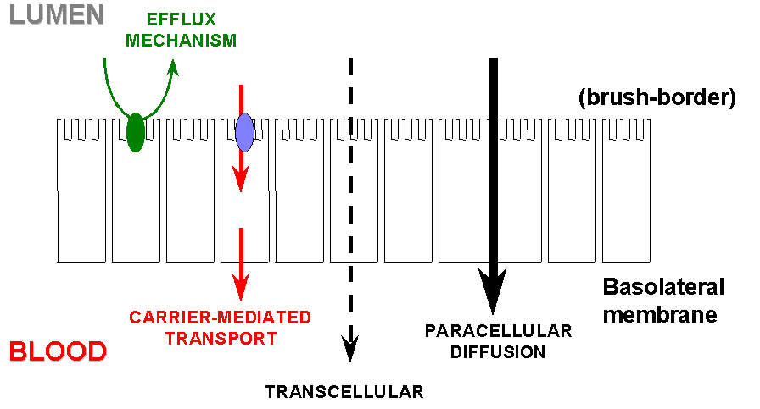
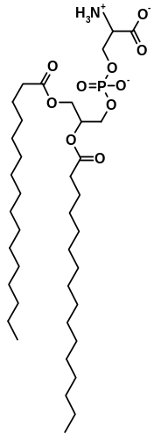
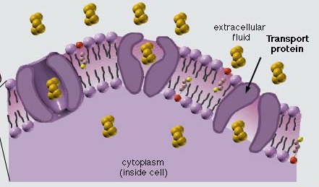
Absorption Mechanisms
Transcellular absorption
  Main route for most oral drugs
  Drug must be in solution at cell surface
  pKa important - drug must be unionised
  Lipophilicity important - ideal log D 1-4
  H-bonds - solvation shell needs dispersing
  Lipinski’s ‘Rule of 5’
Paracellular absorption
  Drug passes through gaps between cells
  Inefficient – pores have << surface area than cellular surface
  Restricted to low MW hydrophilic molecules
Active Transport
  Drugs carried through membrane by a transporter – requires energy
  Many transporters exist for nutrient molecules, eg glucose, amino acids
  SAR specific – few drugs absorbed by this route
Phosphatidylserine
Notes:
Absorption Mechanisms
Transcellular absorption - main route of absorption for most oral drugs. Passive process - drug moves from an area of high concentration to an area of low concentration via diffusion, non-specific and has no energy requirements
Drug must be in solution at the cell surface in an unionised state. Lipophilicity critical - compound must be polar enough to be sufficiently water soluble, but must also be lipophilic enough to cross the cell membrane. i.e. logP 1 - 4.
Paracellular absorption - compounds pass between the small gaps/pores between cells.
Active transport - can be important for a few drugs. Compounds are recognised and carried through the membrane by a transporter in an ATP driven process.

Slide 8
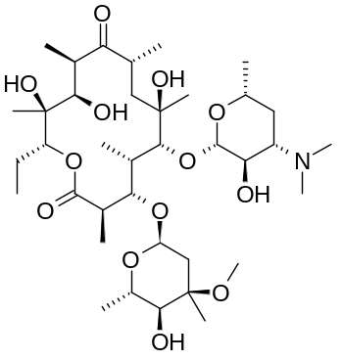
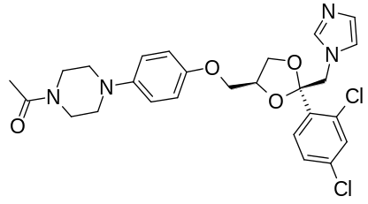
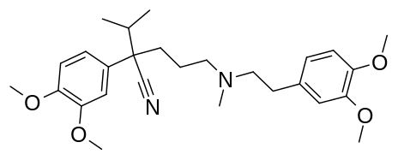
Efflux Transporters - P-glycoprotein
A number of efflux transporters act as a barrier to prevent entry of toxic compounds into the body
P-gp (P-glycoprotein) is the most well characterised transporter
ATP dependent efflux pump with broad substrate specificity.
170 kDa protein, dimeric structure connected by a linker peptide. Each half contains 6 transmembrane domains and an ATP binding site.
P-gp found in high levels at apical surface of enterocytes. CYP3A4 (metabolising enzyme) also expressed - can reduce absorption through efflux/metabolism.
Co-administration of compounds which inhibit P-gp can lead to increased bioavailability of drugs
ATP
Ketoconazole
Antifungal
P-gp Inhibitor
Verapamil
Ca channel blocker
P-gp substrate
Erythromycin
Macrolide antibiotic
P-gp substrate/inhibitor
Notes:
A number of efflux transporters are found at the apical surface of enterocytes/epithelial cells whose function is to act as a barrier to toxic compounds entering the body.
Poor oral absorption of drugs can be due to transporters effluxing (pumping) the compounds back out into the gut.
P-glycoprotein or P-gp is the most well characterised - 170 kilodalton protein with a dimeric structure connected by a linker peptide. Each half contains 6 transmembrane domains and an ATP binding site.
P-gp also has broad SAR for its substrates, i.e. a wide variety of structures are recognised and transported.

Slide 9
Distribution
Distribution: the reversible transfer of a drug to and from the systemic circulation
Absorption
Distribution
BLOOD
TISSUES
Compounds can distribute out of plasma into tissues:
Main factors influencing distribution are pKa, lipophilicity, plasma protein binding
(only unbound tissue is free to distribute).
Tissue pH is slightly lower than plasma pH
∴ Basic compounds tend to distribute out of plasma into tissue more than acids.
Notes:
Distribution – defined as the reversible transfer of a drug to and from the systemic circulation (i.e. the bloodstream).
Compounds can distribute into various tissues within the body. Principal factors are the pKa of the compound, its lipophilicity (logP), and the degree of plasma protein binding.
pH of tissues is generally lower than that of plasma. Basic compounds tend to transfer into tissues, become ionised and then reside in the tissues.

Slide 10
Plasma Protein Binding (PPB)
Rapid
Drug
Drug
Protein
Free
Equilibrium
Bound
Drugs can bind to macromolecules in the blood – known as plasma protein binding (PPB)
Only unbound compound is available for distribution into tissues
Acids bind to basic binding sites on albumin, bases bind to alpha-1 acid glycoprotein
0-50% bound = negligible
50-90% = moderate
90-99% = high
>99% = very high
For bases and neutrals, PPB is proportional to logD.
Acidic drugs tend to have higher PPB than neutral/basic drugs.
Notes:
Drugs/Compounds bind to a number of macromolecules which are found in plasma, known as plasma protein binding or PPB.
Compounds with high PPB are retained in the plasma and cannot therefore distribute into the tissues i.e. only unbound protein is available for distribution.
Acidic drugs tend to bind to albumin. Basic drugs bind to alpha-1 acid glycoprotein.
PPB:
0-50% is described as low, 50-90% as moderate, 90-99% is high, and <99% is very high.
Generally, acids tend to be more highly protein bound and bases/neutrals tend to have lower or moderate PPB.
Lipophilicity can also be important in affecting PPB. For bases and neutrals, PPB is often proportional to logD/logP, i.e. the more lipophilic a compound, the higher the degree of PPB.

Slide 11
Metabolism
Definition: Any chemical alteration of a drug by the living system
Purpose: To enhance water solubility and hence excretability
Types of metabolism
  Phase I: production of a new chemical group on the molecule
  Phase II: addition of an endogenous ligand to the molecule
Sites of metabolism
  Main site of metabolism is the liver.
  Other sites include the gastrointestinal wall (CYP-450), kidneys, blood etc.
Factors affecting metabolism
  The structure of a drug influences its physicochemical properties.
  (blocking/altering sites of metabolism can improve DMPK properties)
  MW, LogP/LogD, pKa
  The more complex the structure, the more the potential sites for metabolism.
Notes:
Metabolism – defined as any chemical alteration of a drug by the living system.
Why does metabolism takes place?
Exogenous compounds such as proteins, fat, carbohydrates are required by mammals for the maintenance of life.
However, require a way to get rid of unwanted or noxious compounds – eliminated either by excretion and/or by metabolism.
Metabolism generally results in a product with greater aqueous solubility – thereby easier to excrete.
Types of metabolism categorised as phase I and phase II. Phase I involves the production of a new chemical group on a molecule and phase II involves the incorporation of an endogenous ligand into the molecule.
The liver is the largest site of metabolism, other sites include the GI tract (where CYP3A4 is expressed and carries out phase I oxidative transformations), but metabolism can also occur in the kidneys and in the blood stream.

Slide 12
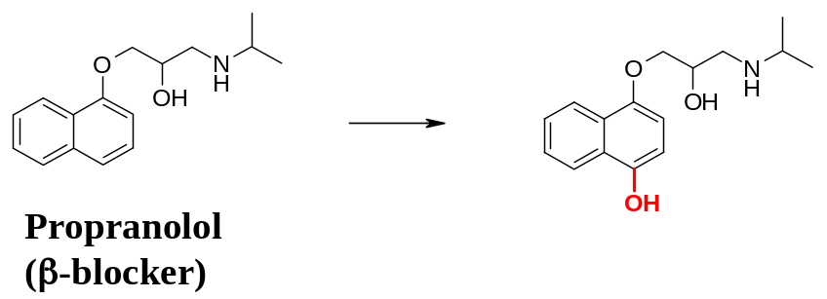
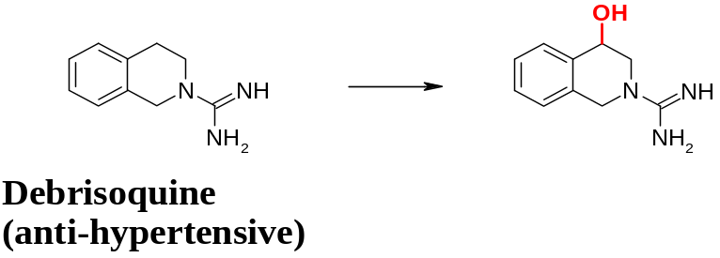
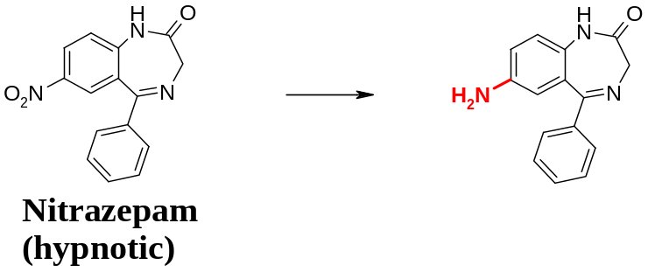
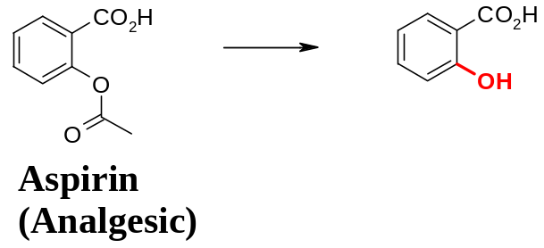
Phase I Metabolism
(i) Oxidation
Aliphatic or aromatic hydroxylation
N-, or S-oxidation
N-, O-, S-dealkylation
(ii) Reduction
Nitro reduction to hydroxylamine/ amine
Carbonyl reduction to alcohol
(iii) Hydrolysis
Ester or amide to acid and alcohol or amine
Hydrazides to acid and substituted hydrazine

Slide 13
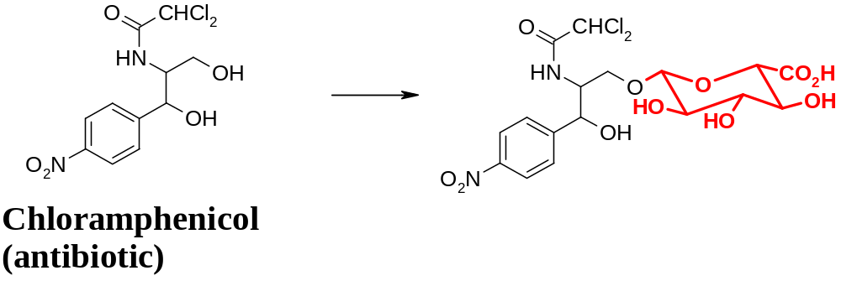
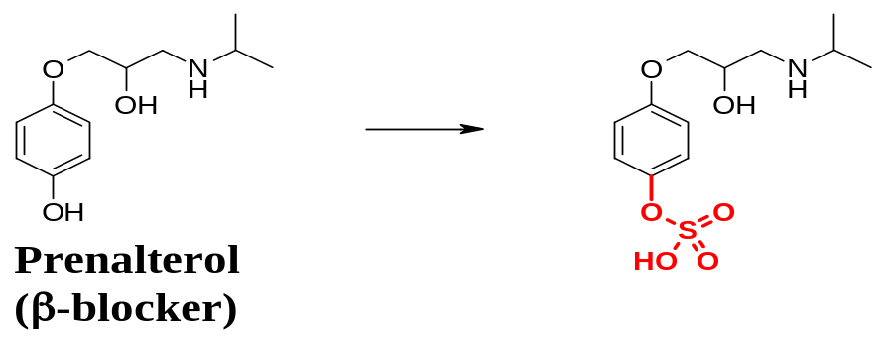
Phase II Metabolism
(i) Glucuronidation
Carboxylic acid, alcohol, phenol, amine
(ii) Amino acids
Carboxylic acids
(iii) Acetylation
Amines
(iv) Sulfation
Alcohol, phenol, amine
(v) Glutathione conjugation (gly-cys-glu)
Halo-cpds, epoxides, arene oxides, quinone-imine

Slide 14
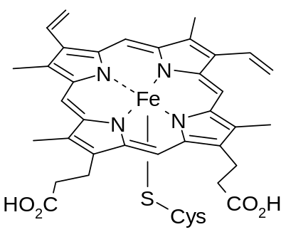
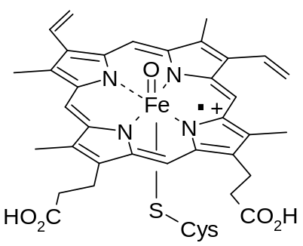
Cytochrome P450 Enzymes (CYP-450)
RH + O₂
2e⁻, 2H⁺
ROH + H₂O
CYP-450
Many Phase I oxidations are mediated by cytochrome P450 enzymes.
Membrane bound proteins - found on the endoplasmic reticulum.
Heme-containing proteins – porphyrin ring co-ordinating iron at the active site.
Many iso-forms with different substrate specificities:
Major human CYP’s: 1A2, 2C9, 2C19, 2D6, 3A4
CYP inhibition/induction: issues in exposure + drug-drug interactions.
Iron(III) porphyrin
Active oxygen Fe (IV) species
Notes:
Many Phase I oxidative transformations are carried out by a group of enzymes known as cytochrome P450s (or CYPs).
CYPs are membrane bound proteins which are found on the endoplasmic reticulum of cells (hepatocytes), enterocytes also. Endoplasmic reticulum is a cellular transport system composed of a honeycomb of membrane which pervades the entire cytoplasm.
They are heme-containing proteins - i.e. their active site contains a porphyrin ring co-ordinated to iron. The active species comprises an oxoiron (IV) prophyrin cation radical species.
CYPs are a large superfamily of enzymes. Of this number (36) of CYP-450 enzymes, about 5 or 6 are quantitatively relevant for the metabolism of drugs – 1A2, 2C9, 2C19, 2D6, 3A4.
CYP inhibition - where a compound binds to a particular CYP and inhibits it, thereby preventing it from metabolising other substrates - important when multiple drugs are dosed together.
CYP induction - where a compound leads to the expression of greater levels of a particular CYP, again this can have effects on the PK of co-administered compounds.

Slide 15
Excretion (Elimination)
Absorption
Distribution
BLOOD
TISSUES
Elimination
Elimination: the irreversible transfer of a drug from the systemic circulation
Major routes of elimination:
  Metabolism
  Renal excretion (for free drug, ie low logD)
  Biliary excretion
  Also lungs, sweat etc.
Notes:
Excretion – (also known as elimination). It is defined as the irreversible transfer of a drug from the systemic circulation.
The difference between elimination and excretion that elimination includes metabolism (parent compound is eliminated from the systemic circulation) & excretion.
Principle routes of excretion are biliary (from the liver via the bile duct) or renal (from the kidneys as urine).
Substances can also be excreted through sweat, exhalation etc.

Slide 16
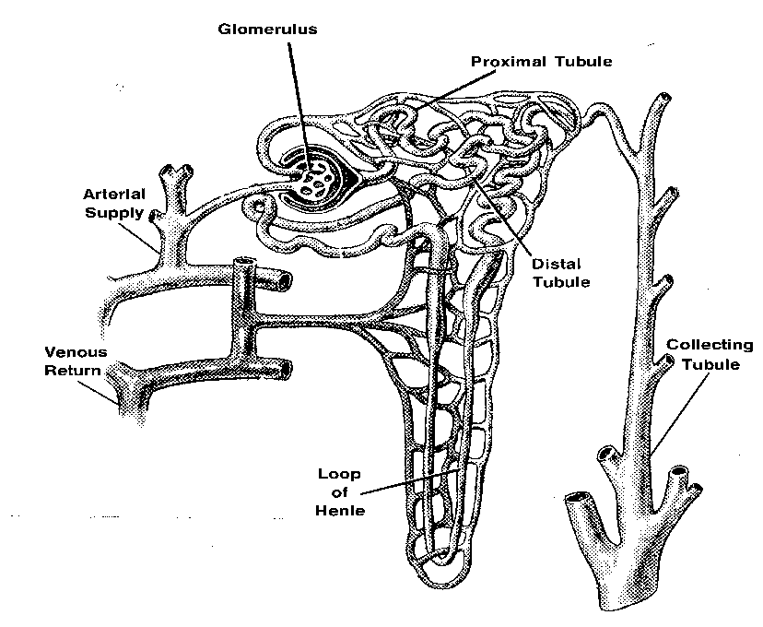
Renal Excretion
Blood
Nephron
Urine
1. All unbound drug in plasma is filtered
in the glomerulus. Only significant
for very polar compounds, log D < 0.
2. Some compounds are actively secreted
into urine along the proximal tubule.
3. Unionised drug can undergo passive reabsorption from
urine into blood along the length of the nephron (net excretion may be zero).
4. Drug that is bound to plasma proteins is not filtered.
Notes:
Renal excretion
Blood passes through the kidneys, which filters waste (e.g. urea) from the blood stream and excretes it as urine.
Renal excretion is generally only important for polar drugs, i.e. log D < 0 and that lipophilic compounds tend to be eliminated through a metabolic route (and metabolites then excreted).
All unbound drug is filtered in the glomerulus, i.e. plasma protein bound drug is not filtered out.
Some molecules are secreted from the blood stream into urine (in the proximal tubule), also some required molecules are reabsorbed into the bloodstream, including some of the drug that has been filtered which may be reabsorbed into the bloodstream.
Significant proportions of polar drugs can end up being removed from the body via these mechanisms.

Slide 17
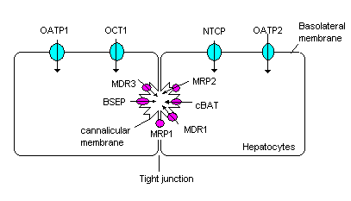
Biliary Excretion
In the liver drugs can be secreted into the bile
Transporters in the basolateral and canalicular
membranes of hepatocytes mediate uptake into
the hepatocyte and efflux into bile
Biliary clearance is commonly higher in Rats/Mice
than in Dog/Man
Bile collects in gall bladder, then released into
intestine upon food intake. Drug may then be
reabsorbed - known as enterohepatic
recirculation (EHC).
Liver
Gall bladder
EHC
Intestine
Hepatic portal vein
Notes:
Bilary excretion
A process where drug compound can be excreted from the liver, via the bile duct.
Hepatocytes (liver cells, which carry out many of the metabolic processes we’ve discussed) can transport compounds via transporters first into the cells (e.g PGP).
Compounds are then effluxed into the bile, which is collected in the gall bladder and released upon eating.
The drug is now also released back into the small intestine, and may be reabsorbed. Sometimes, therefore, you get a second peak in the concentration/time graph. This re-circulation of drug compound is known as EHC (enterohepatic circulation).

