Slide 1
Advanced Medicinal
Chemistry
Lectures 8 and 9:
Safety Assessment
Rhona Cox
AstraZeneca R&D Charnwood

Slide 2
Preclinical toxicology
Before human studies, it is necessary to demonstrate safety in vitro and in vivo.
We assume that
in vitro assays predict in vivo effects
the effects of chemicals in laboratory animals apply to humans
the use of high doses in animals is valid for predicting possible toxicity in humans.
These assumptions are broadly true, but despite this, we cannot be certain that a chemical will show no toxic effects in humans.
Notes:
Safety studies in vitro (‘in glass’ i.e. non-living systems) start to take place early in the lead optimisation phase of a project, with in vivo (‘in life’ i.e. animals) studies taking place just before the compound is given to healthy volunteers in Phase 1 clinical trials. Before human studies can take place, safety data, including pharmacological and toxicological data from animal studies, are submitted to the Food and Drug Administration (FDA). If these data demonstrate that the drug is sufficiently safe and effective, then human clinical studies can then be conducted. Without these studies, no human studies are allowed (or indeed, advisable).
Three assumptions have to be made in the pre-clinical studies; firstly that in vitro assays predict in vivo effects, that the effects of chemicals in laboratory animals apply to humans and finally that the use of high doses in these animals is a valid method for predicting possible toxicity in humans. High doses are required because of the small number of animals used in the studies along with the need to detect low-incidence toxic responses. These assumptions are broadly true but there is still much to learn about prediction of toxic effects in humans.

Slide 3
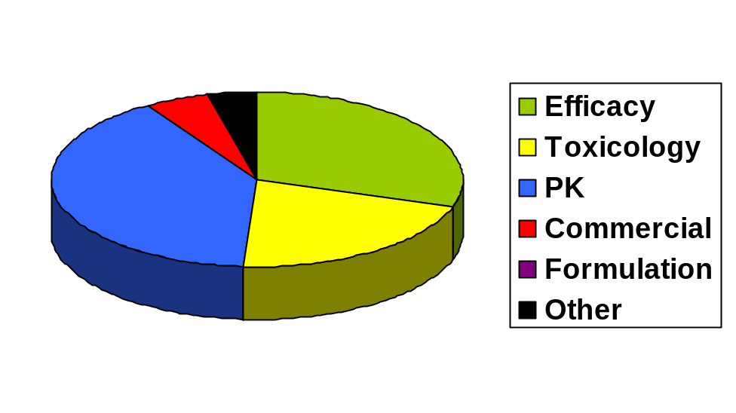
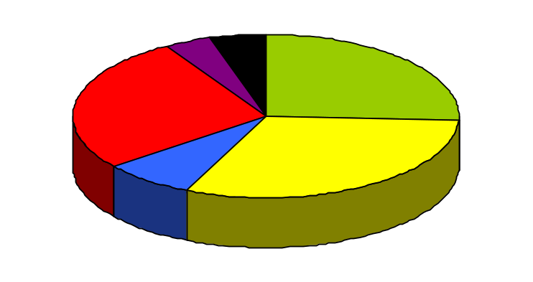
Why do compounds still fail once they reach clinical trials?
Only about 1 in 9 compounds going into Phase 1 clinical trials will become marketed medicines.
1991 2000
Reasons for failure of medicines in clinical trials
We have improved our ability to predict pharmacokinetics in man since 1991. Now we need to improve our toxicology predictions.
Notes:
Despite pre-clinical safety studies, only about 11%, or one in nine, chemical compounds going into Phase 1 clinical trials will become marketed medicines, although it’s interesting to note that this varies between therapeutic areas. For examples, 20% of cardiovascular drugs make it through, but only 5% of drugs to treat cancer.
These two pie charts show the reasons for drugs failing in clinical trials for 1991 and 2000. You can see that in recent years over 30% have failed for safety reasons, up from 20% in 1991. This doesn’t mean we’re getting worse at predicting safety! It does, however, illustrate the fact that we have become a lot better at predicting pharmacokinetics in man since 1991, and now we need to work at reducing the number of compounds that fail for safety reasons.
Learning about possible toxic effects early in the project will help prevent attrition in clinical trials, by which time the research has become much more expensive. This is especially true since failures in pharmacokinetics are usually picked up in Phase I, but failures in safety are often not apparent until Phases II and III.

Slide 4
What do we already know about toxicity?
Toxic effects can include:
Mechanism based pharmacology
Formation of reactive metabolites
Activation of other receptors, including hERG
Interactions with other substances
Idiosyncratic toxicity
N.B. Problems with toxicity (apart from those related to the target itself) can often be avoided by making a very potent compound.
e.g. pIC₅₀ (target) = 7.0, pIC₅₀ (hERG) = 6.0, margin = 10-fold
pIC₅₀ (target) = 9.0, pIC₅₀ (hERG) = 6.0, margin = 1000-fold
Notes:
Fortunately it is becoming increasingly possible to be able to predict many of these toxicities before clinical trials and each of these topics will be covered in more detail.
One important point to note is that problems of toxicity (apart from those related to the target itself) can often be avoided by making a very potent compound. This means that a larger margin of safety can be achieved.

Slide 5
Mechanism-based pharmacology
Caused when activation of the target causes unwanted effects as well as the desired therapeutic effect.
Balance of good/bad effects.
Usually not predictable from in vitro tests, but can sometimes be predicted from animal models.
A big potential problem with drugs designed for completely novel targets, rather than new drugs for a known mechanism.
Notes:
Recent topical examples include TeGenero’s TGN1412 (this was not actually a small molecule but a biological drug) and the COX-2 inhibitors.

Slide 6
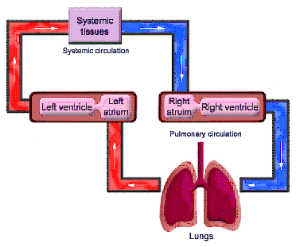
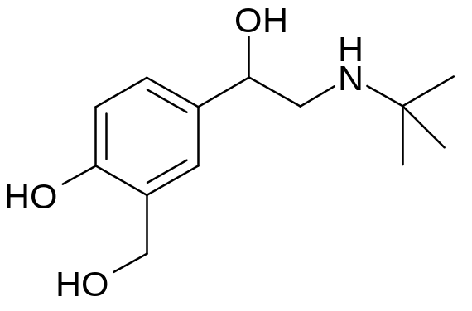
Case study: beta agonists
ß-agonists (e.g. salbutamol) are used to control asthma by causing activation of the ß₂ receptors in the lung. This causes the airways to dilate.
These compounds are taken by inhalation, so most of the drug stays in the lung.
If the patient takes too much medicine, the levels in the systemic circulation rise and can now affect the ß₂ receptors in the heart causing palpitations.
salbutamol

Slide 7
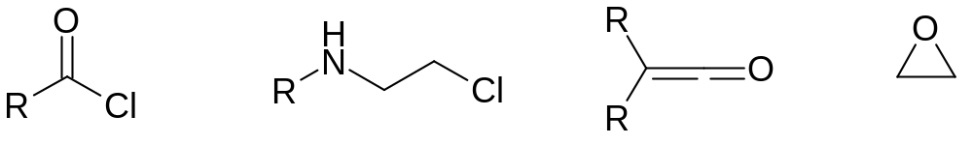
Formation of reactive metabolites
We don’t want chemically reactive medicines!
What functional groups might we want to avoid?
e.g.
These are all electrophiles, which means that they can covalently bind to nucleophiles in the body, e.g. in proteins and DNA which lead to toxic effects.
Most common effects are hepatotoxicity (liver) & genotoxicity (DNA).
But don’t forget that in the body, chemicals are metabolised so we need to consider the fate of our new medicine – will any of the metabolites be chemically reactive?

Slide 8
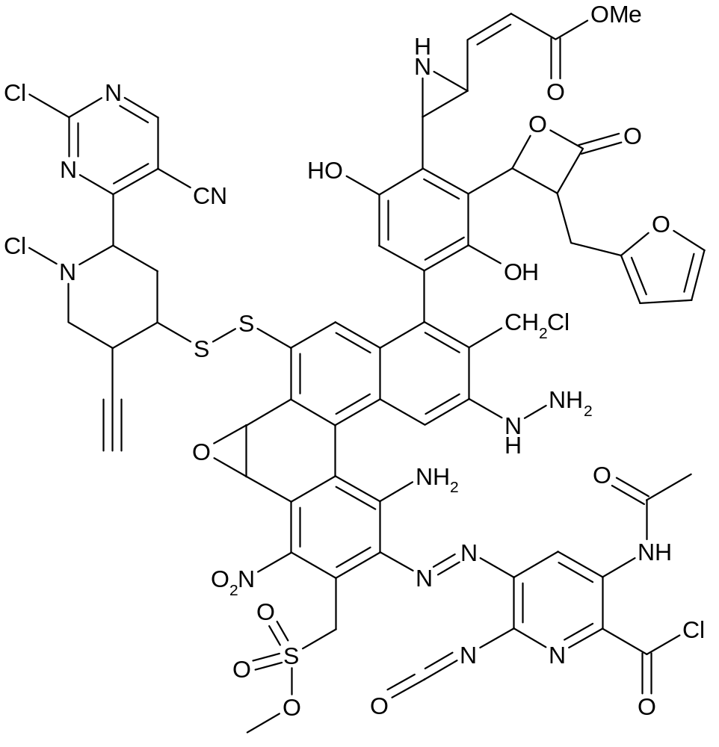
Some unwanted groups!

Slide 9
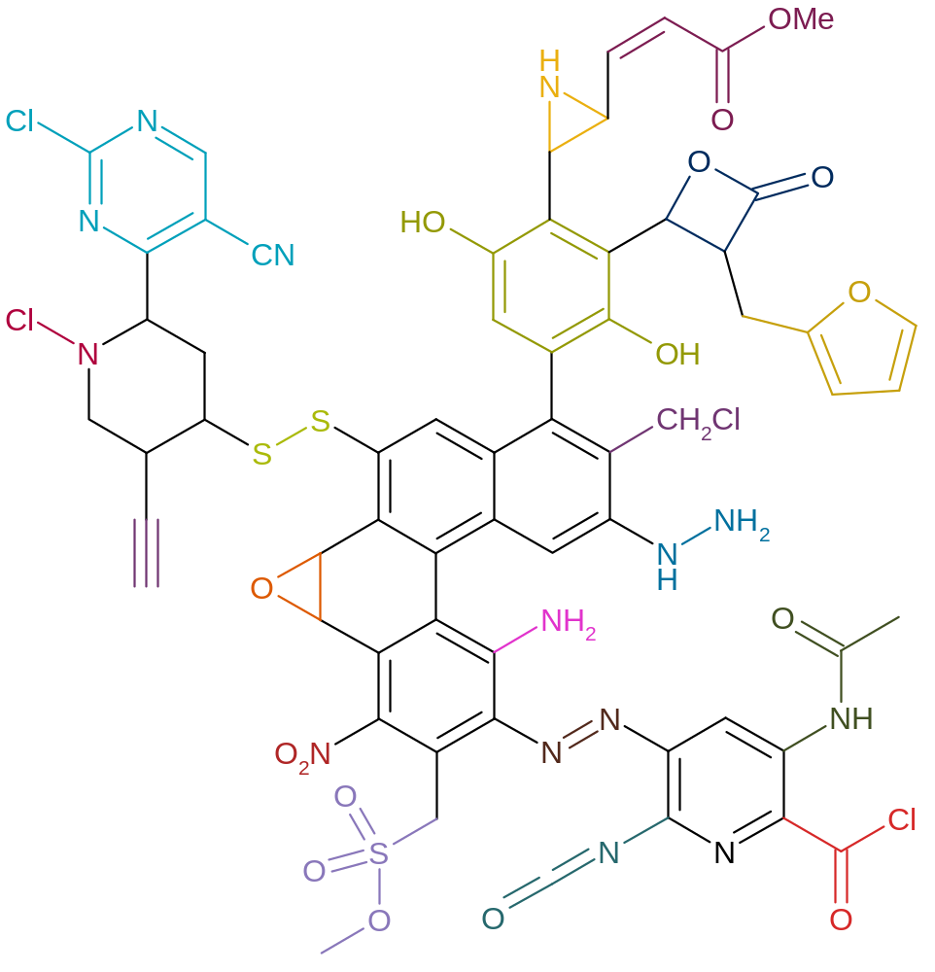
Some unwanted groups!
Aziridines
Michael acceptors
Certain
phenols
Electrophilic esters
Electophilic
aromatics
Mono-substituted
furans and
thiophenes
Disulphides
Chloroamines
Alkylhalides
Terminal
acetylenes
Hydrazines
Epoxides
Anilines
Masked anilines
Nitro
Azo
Acylating agents
Alkylsuphohonate
esters
Isocyanates
Notes:
Here’s a completely preposterous molecule which contains lots of functional groups which could cause reactive metabolites!
These groups are all chemically reactive, or can be metabolised to something chemically reactive.

Slide 10
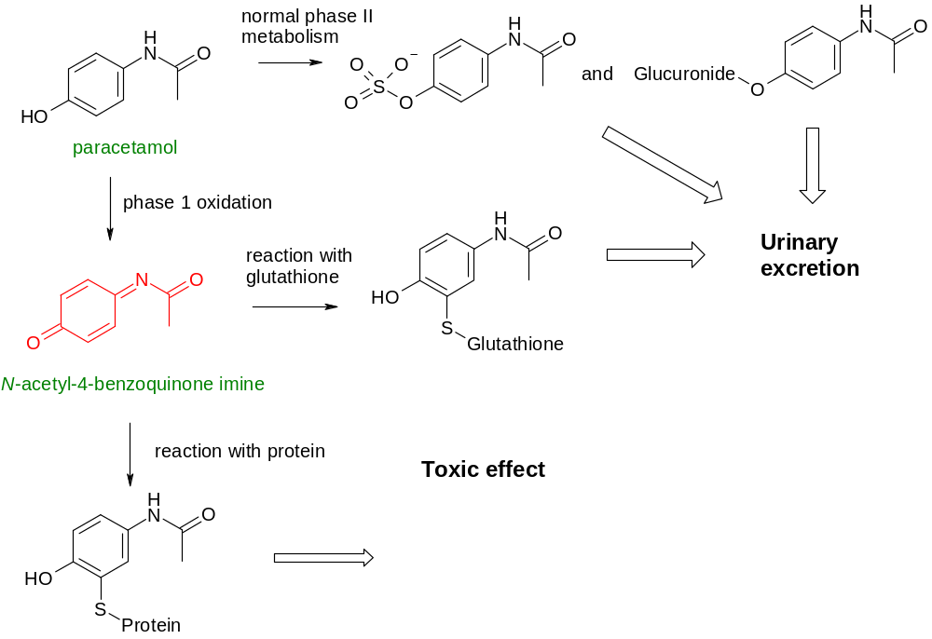


Case study: paracetamol
Notes:
Hepatic failure from paracetamol overdoses accounts for over 100 deaths per year in the UK. The hepatotoxicity is dose-dependent, and results from a saturation of the normal phase II metabolism via the enzymes UDP glucuronyl transferase and sulfotransferase causing a metabolic switch to a phase I-type oxidative pathway which generates the toxicophore, generally accepted as the N-acetyl-4-benzoquinone imine. The observed toxic effects are believed to arise from reaction of this intermediate with nucleophilic functional groups in proteins.
Paracetamol would never be acceptable to today’s drug regulatory bodies as the margin of safety is too low.

Slide 11
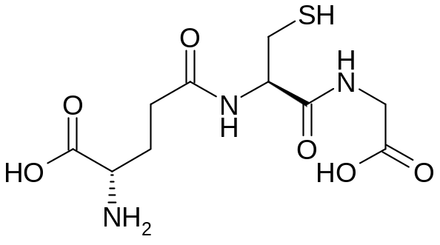
Avoiding the problem
Most obviously, avoid functional groups known to show reactive metabolites (not an absolute – some are worse than others).
Test for the presence of reactive groups
  Look for binding to proteins or glutathione - detect by mass spectroscopy
‘Ames’ test to detect mutagenicity
  Use a genetically modified bacterium which cannot grow in the absence of histidine.
  Expose bacteria to chemical.
  If the chemical can cause mutations, the genetic modification can be reversed and the bacteria will grow.
  Can also be carried out in the presence of liver enzymes to look for mutagenic metabolites.
glutathione
Notes:
The best way of avoiding reactive metabolites is avoid functional groups which have been shown to cause a problem in the past. This is why you will see very few drugs containing, for example, a nitro group. However, some functional groups are worse than others. Anilines (aminobenzenes) can cause problems as they are oxidised to nitrosoaryls (Ar-N=O) which are chemically reactive. However, the ease of metabolic oxidation depends on other substituents on the benzene ring and not all anilines form reactive metabolites. This is why we need a method of detecting the formation of reactive groups.

Slide 12
Activation of other receptors/enzymes
Sometimes known as ‘off-target toxicity’.
Screen against other systems – similar targets will be done early on in the project. Before nomination to preclinical studies, the compound will be tested in many other assays to look for activity.
Potency (and therefore dose) is important as we are looking for a safety margin, i.e. the absolute potency at another receptor is less important than how much less than the potency at the primary receptor it is.
Remember! If pIC₅₀ (A) = 7.0 and pIC₅₀ (B) = 6.0, the margin is 10x. But if pIC₅₀ (A) = 9.0, the margin is 1000x.

Slide 13
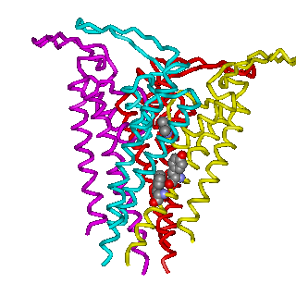
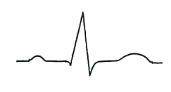
hERG
hERG = ‘human ether-a-go-go related gene’
Potassium channel
Activation causes prolongation of electrical impulses regulating heart beat
Can lead to fatal arrhythmias
R
R
‘T’ wave is delayed
P
T
P
T
Q
S
Q
S
Normal heart beat Activation of hERG
Notes:
hERG, or the ‘human ether-a-go-go gene’ was identified in the late 1980s in a mutant fruit fly. The presence of the gene was indicated by leg-shaking in the flies when anaesthetised with ether. The receptor is a potassium ion channel located in cell membranes in the heart, which opens and closes to allow potassium ions to flow out of the cells.
Arrhythmia is a lack of rhythm in the heart beat. A delay of the T wave by 5-10 milliseconds can cause lack of control of the heartbeat, which may lead to a fatal arrhythmia.
This is obviously something to be avoided.

Slide 14
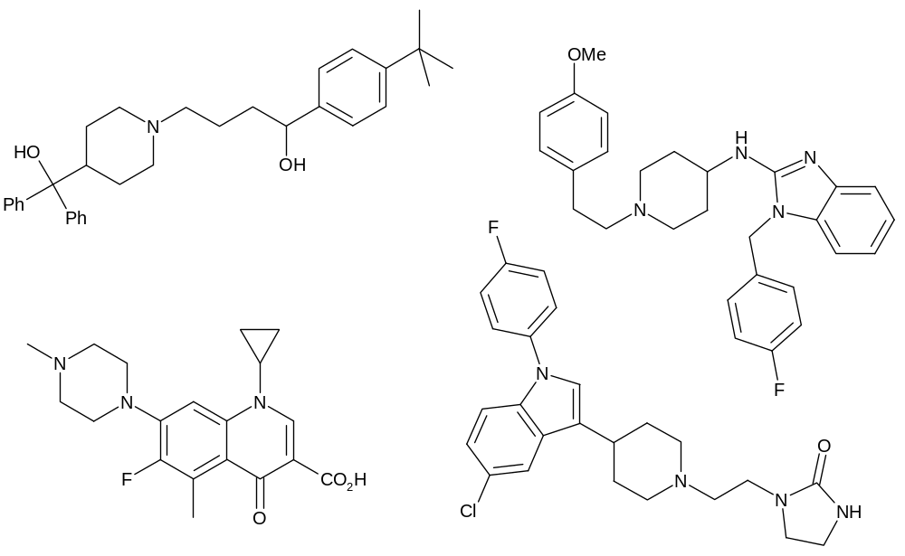
Why is hERG important?
Lots of marketed drugs bind to it, with apparently diverse structures.
e.g.
astemizole
(antihistamine)
terfenadine (antihistamine)
grepafloxacin (antibiotic)
sertindole (neuroleptic)
Notes:
Note that none of these drugs is prescribed for heart conditions.
However, there is a common pharmacophore; can you see it?

Slide 15
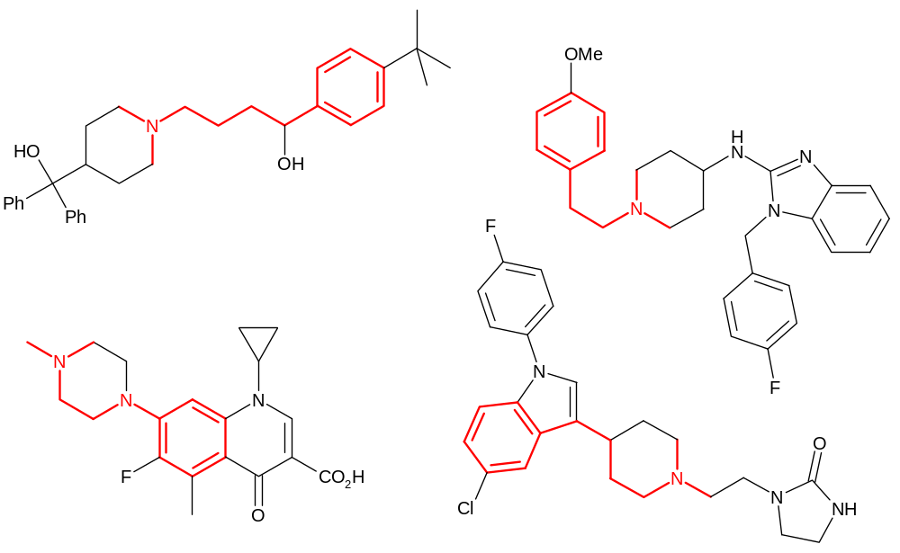
Why is hERG important?
Lots of marketed drugs bind to it, with apparently diverse structures.
e.g.
astemizole
(antihistamine)
terfenadine (antihistamine)
grepafloxacin (antibiotic)
sertindole (neuroleptic)
Notes:
Note that none of these drugs is prescribed for heart conditions.
However, there is a common pharmacophore. These four drugs were withdrawn from the market or had their use restricted, although other drugs with less severe hERG activity are still used and patients are monitored for hERG effects.

Slide 16
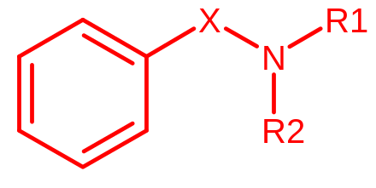
A hERG pharmacophore
Lipophilic base, usually a tertiary amine
X = 2-5 atom chain, may include rings, heteroatoms or polar groups
Now we know about it, we can try and design hERG activity out and can test for activity in vitro.
Notes:
The hERG pharmacophore is quite crude, but we can test for hERG activity in a cloned cell line.

Slide 17
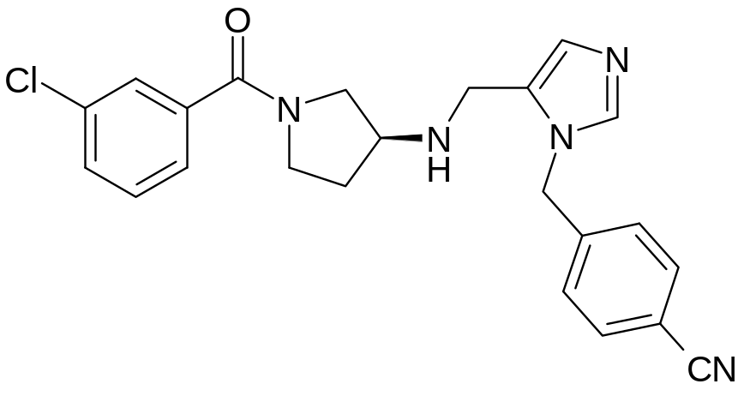
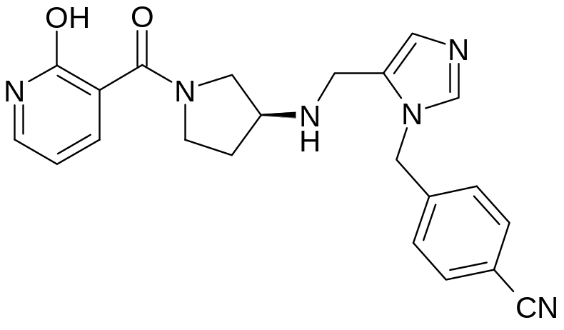
Case study: farnesyltransferase inhibitors
hERG IC₅₀= 5800nM
calculated pK_{a} = 8.6
calculated logD = 0.3
hERG IC₅₀= >50,000nM
calculated pKa = 8.5
calculated logD = -3.3
Changing the lipophilic aromatic ring to a polar one reduces hERG activity by >10x.
Notes:
Original reference: J. Med. Chem. 2001, 44, 2933.

Slide 18
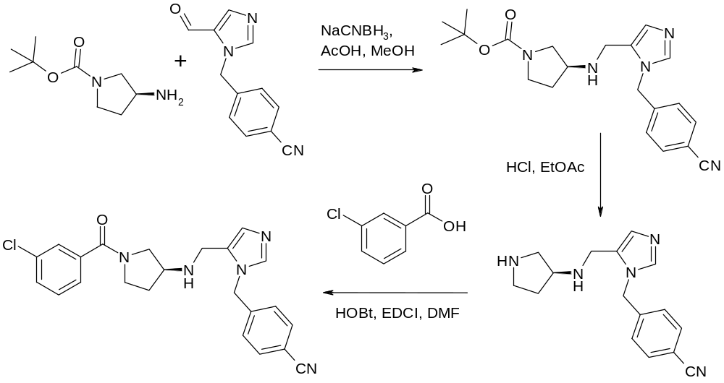
Case study: farnesyltransferase inhibitors
Synthesis of the first compound:
Notes:
This synthesis illustrates three very important reactions in medicinal chemistry; reductive amination, removal of a Boc protecting group and amide coupling.
Some abbreviations:
NaCNBH₃ = sodium cyanoborohydride
HOBt = 1-hydroxybenzotriazole
EDCI = N-ethyl-N’-(3-dimethylaminopropyl)carbodiimide
DMF = N,N-dimethylformamide (solvent)

Slide 19
Drug-drug interactions (DDIs)
It’s complicated enough to look at the pharmacokinetics, toxicology etc of one medicine at a time, but many patients take several medicines, which can interact……
What might cause this?
One substance can affect the metabolism of another. This is why many medicines have a warning on them to say that the patient shouldn’t drink alcohol whilst taking the medication, because alcohol metabolism can affect drug metabolism.
Notes:
It’s not just drugs interacting with each other that can cause a problem – they may also interact with foodstuffs (like alcohol) or herbal medicines.

Slide 20
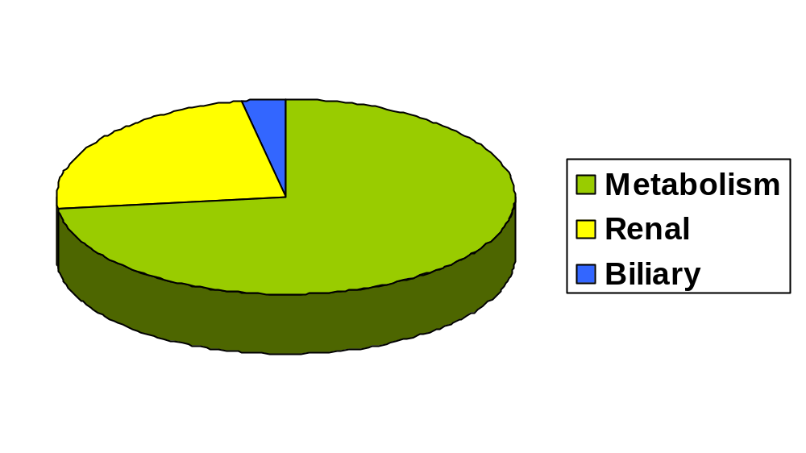
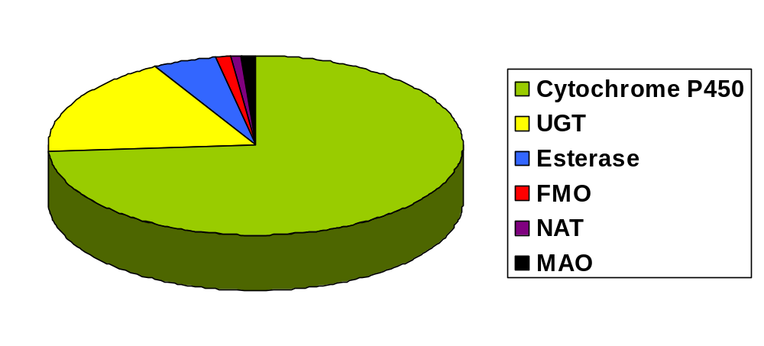
Cytochrome P₄₅₀ (CYP)
Top 200 drugs in the USA in 2002
Primary route of clearance
Primary metabolic
enzymes
So compounds which inhibit and induce CYPs have the potential to interact with many other drugs.
Notes:
These pie charts show some data for the clearance of the top 200 best selling drugs in the USA in 2002. As you can see from the top chart, nearly three quarters of them are mainly cleared by liver metabolism. If we classify this liver clearance by the enzyme that carries out the transformation, you can see that three quarters are mainly cleared by a group of hepatic enzymes called cytochrome P₄₅₀s or CYPs. CYPs can be further sub-divided into smaller classes of enzymes, all of which have their own structure-activity relationships. The most common CYPs to cause problems are known as 3A4, 2C9, 1A2, 2D6 and 2C19. Compounds with low oral bioavailability and high first pass metabolism are most susceptible to interaction with other medicines which affect CYPs.

Slide 21
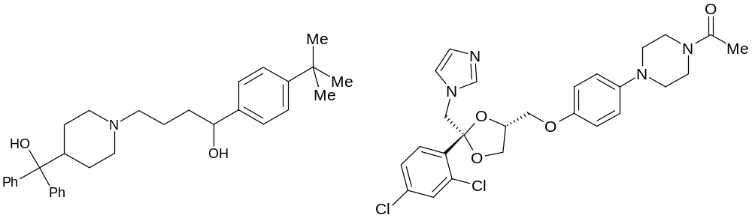
Case study 1: terfenadine & ketoconazole
terfenadine
ketoconazole
Terfenadine – antihistamine drug on market for many years as an ‘over the counter’ remedy for hayfever.
Found to cause life threatening cardiac arrhythmias when co-administered with medicines such as erythromycin (antibiotic) or ketoconazole (antifungal).
Caused by inhibition of hepatic P₄₅₀ enzymes.
Notes:
P₄₅₀ enzymes can be inhibited by many compounds, including erythromycin and ketoconazole. The effect of inhibiting these enzymes is that the they are then unavailable to metabolise other compounds, such as terfenadine. As a result, the levels of terfenadine in the body become higher as multiple doses are taken. In this example, this means that the toxic effect of terfenadine – the activation of hERG – becomes apparent. Terfenadine is now no longer available over-the-counter and can only be prescribed by a GP.
Grapefruit juice also contains substances which inhibit CYP 3A4 P₄₅₀ enzymes in the small intestine, which is why it’s inadvisable to drink it while taking some medicines. This was discovered by accident during a clinical trial in which grapefruit juice was used to mask the taste of a drug.

Slide 22
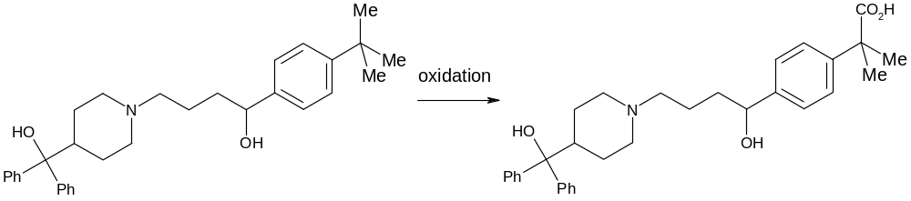
Case study 1: terfenadine & ketoconazole
terfenadine (hERG pIC₅₀ ~ 7.6)
fexofenadine hERG pIC₅₀ ~ 4.8
Found that the major metabolite of terfenadine, caused by oxidation of the tert-butyl group, is the active species.
This compound, fexofenadine, has little hERG activity as it is a zwitterion, and is now a medicine in its own right.
Notes:
Zwitterion = molecule which contains both a positive and a negative charge.

Slide 23
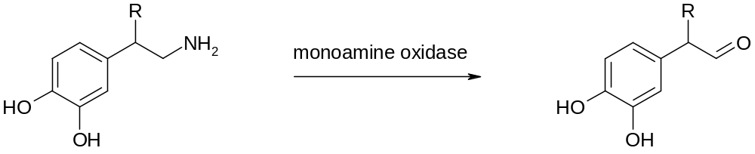
Case study 2: MAOIs and the ‘cheese effect’
noradrenaline (R = OH)
dopamine ( R = H)
Monoamine oxidase inhibitors (MAOIs) have antidepressant activity.
Depressed individuals often have decreased levels of amines such as noradrenaline, serotonin and dopamine in the brain.
MAOIs increases these levels by reducing oxidation of the amines.
However, they are not the drug of choice as they are sometimes associated with cardiovascular side effects.

Slide 24
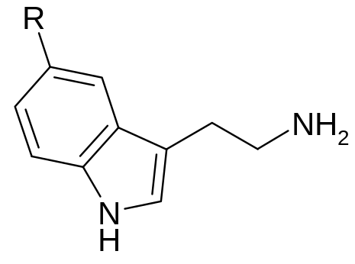
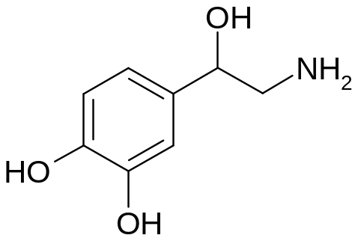
Case study 2: MAOIs and the ‘cheese effect’
tyramine (R = H)
serotonin (R = OH)
noradrenaline
Side effects caused when patient has eaten food which contains high levels of tyramine, e.g. cheese, wine, beer.
Ingested tyramine causes the release of noradrenaline (NA), which would normally be metabolised by MAOs.
But because these enzymes have been inhibited, the NA levels rise. As NA is a vasoconstrictor, the blood pressure rises uncontrollably, which can trigger a cardiovascular event.
Notes:
Drugs can not only interact with each other, but also with anything that the patient is ingesting, in this example, cheese.

Slide 25
Idiosyncratic toxicity
‘Idiosyncratic toxicity’ is something of a catch-all term to include other toxic effects that we don’t currently understand.
Note that increased potency reduces the possibility of this.
It is desirable to have two or more compounds in development which are structurally different – this reduces the possibility of both being hit by idiosyncratic toxicity problems.
It’s a continuous challenge to understand the causes of idiosyncratic toxicity therefore to be able to avoid them at an early stage.

