Slide 1
Advanced Medicinal
Chemistry
Lecture 10:
Case History –
Inducible Nitric Oxide Synthase (iNOS) inhibitors
AstraZeneca R&D Charnwood

Slide 2
The Drug Discovery Process
Target
Identification
3 months to
2 years!
HTS
3-4 months
Active-to-Hit
(AtH)
3 months
Hit-to-Lead
(HtL)
6-9 months
New Lead
Optimisation
Projects (LO)
2 years
Candidate
Drug (CD)
Notes:
So Far you have been told about the different aspects of medicinal chemistry that are of key importance in the discovery of a new drug in the pharmaceutical industry. These have included targets of interest, how to find leads against these targets, and how to turn a lead into a drug (physical chemistry, ADME and toxicology considerations).
Today we will look at these principles in practise. We will look at the transformation of a lead into a drug candidate using a real example from the medicinal chemistry programmes at AZ Charnwood.

Slide 3
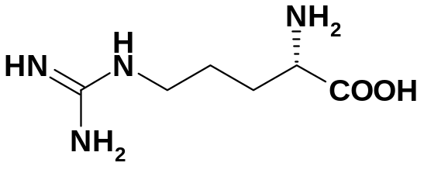
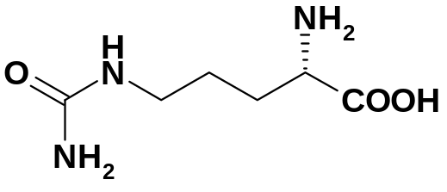
Nitric Oxide Synthase – Biological Mechanism
2O₂ , NADPH,
NADP
+
NO
FMN/FAD/H₄B
L-Arginine
L-Citrulline
iNOS - induced NOS
    induced, constitutively active, Ca²⁺ independent
    over expression causes inflammation & pain
nNOS - neuronal NOS
    constitutively expressed, Ca²⁺ dependent
    long term memory, GI motility, stroke
eNOS - endothelial NOS
    constitutively expressed, Ca²⁺ dependent
    vasodilatation - inhibition causes increased blood pressure!
Notes:
Our Case History will focus on the inhibition of the inducible isoform of the enzyme nitric oxide synthase (iNOS). NOS enzymes convert the amino acid arginine into citrulline and nitric oxide. Nitric oxide is a key inflammatory mediator and inhibition of its production can alleviate the symptoms of inflammation in a joint for example (osteoarthritis).
There are 3 isoforms of this enzyme, and the inducible isoform is the only one of interest when treating inflamed joints. Inhibiting the neuronal and endothelial isoforms would likely cause side effects and so selectivity is absolutely essential.

Slide 4
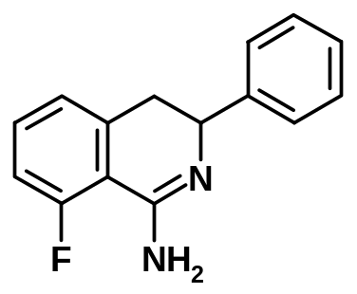
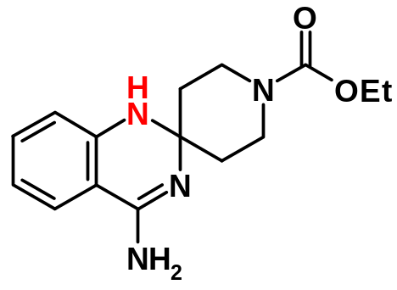
Early Compounds based on arginine
Simple 1-isoquinolinamines were potent iNOS inhibitors, although prone to aromatisation.
BMCL, 2001, 11(11) 1023.
iNOS 0.6 μM
sel. vs eNOS x 160
Stability was markedly improved by making the spirocyclic quinazolines
JMC, 2003, 46(6), 913-916
iNOS 0.7 μM
sel. vs eNOS x 60
Notes:
In the early stages of the project the natural ligand, arginine, was taken as the lead (HTS was not run). This led to a series of arginine-mimic compounds, containing an amidine functional group (as an isostere for the guanidine functional group of arginine).
Initial compounds suffered from aromatisation (this gave inactive compounds) and this was alleviated by converting to a spirocyclic series which was unable to aromatise. The introduction of a nitrogen atom allowed for ease of chemical synthesis (combinatorial chemistry allowed the synthesis of numerous analogues).

Slide 5
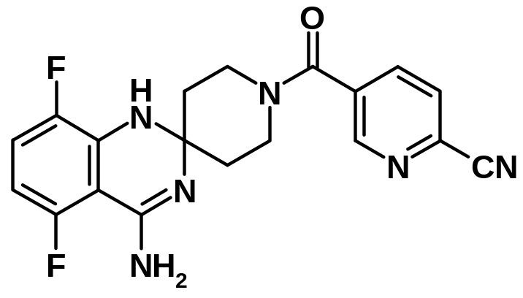
Best Compound in the series
AZ10896372 - a potent and selective inhibitor
iNOS 0.035 μM (isolated enzyme)
cell 1.1 μM (DLD-1 cell)
sel. vs eNOS > 1000
sel. vs. nNOS x 22
Rat PK
Cl = 57 ml/min/kg
t_{1/2} 2.4 hours
Bioavailability 75%
Notes:
AZ10896372 was the best compound of the spirocyclic series. Unfortunately it suffered from high clearance, and showed poor PK in rat (rapid metabolism). This series was abandoned as it was very unlikely that a compound with good PK AND potency could be found. Selectivity against nNOS was also poor for all compounds in this series, providing a likelihood of serious side effects.

Slide 6
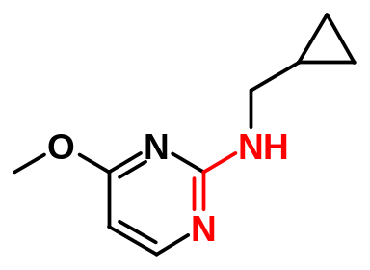
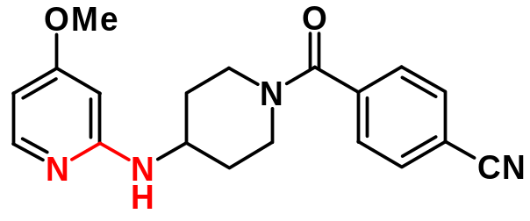
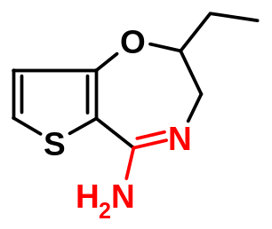
Other ‘Amidine-like’ Series
We pursued many other series, for example
Cell 4 uM
Cell 1.6 uM
Cell 1.5 uM
    all had low cell potency and/or sub-optimal pharmacokinetics
Move away from the amidine isosteres!
Notes:
A number of other ‘arginine-like’ series were also developed, but all suffered with poor cell permeability and/or poor PK profile.
The decision was made to move away from amidine-type compounds as they were highly unlikely to deliver a drug candidate.

Slide 7
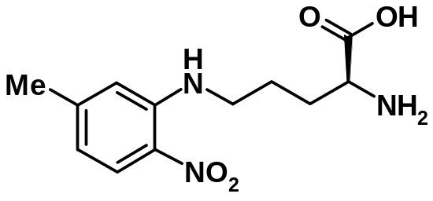
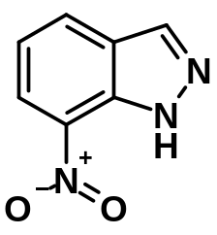
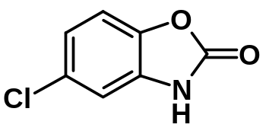
Non-amidine inhibitors – Literature Leads
Some weak non-amidine inhibitors were known
iNOS 11 μM
JMC, 1998, 41(14), 2636
iNOS 9 μM
iNOS 5 μM
But how do they bind to iNOS?
Notes:
A search of the patent literature identified a number of non-amidine series from our competitors. Some of these compounds were synthesised in house, and shown to be weakly active against iNOS.
AstraZeneca chose to take a “me-too” approach using these competitor compounds as leads. The key was to use use Xray crystal data to determine how these compounds bound, and to use this data to influence the design of AZ proprietary compounds.

Slide 8
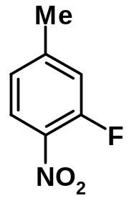
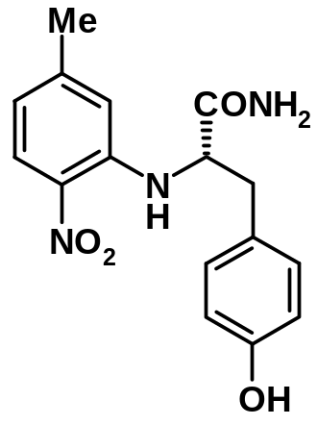
Finding a New Lead
Decided to explore ‘Abbott’ compound further
iNOS 11 μM
JMC, 1998, 41(14), 2636
R₁₋₈₀NH₂
iNOS ~50% at 1 μM
only 1 well active
‘tyrosine amide’
Notes:
An Amino acid series from Abbott was chosen as the lead for our own research at AZ as it showed the most promise of potency against the enzyme, and could be easily adapted to parallel chemical synthesis.
Rapid combinatorial synthesis using a range of amines identified only one potent hit. This contained tyrosine amide as the amine nucleophile.

Slide 9
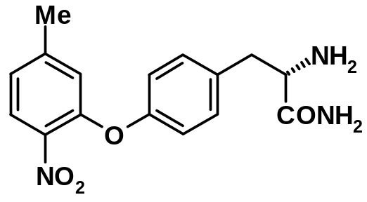
Finding a New Lead
Decided to explore ‘Abbott’ compound further
iNOS 11 μM
JMC, 1998, 41(14), 2636
R₁₋₈₀NH₂
iNOS 1.2 μM
sel. vs eNOS x 3
‘tyrosine amide’
Check Structure!
Notes:
When the structure was checked, it was (suprisingly) found that the active compound was the isomer of the expected product. The oxygen linking atom now provided AZ with its own IP, successful me-too chemistry!
This shows the importance of always checking the structure of an active from parallel synthesis.
But how does the compound bind to the enzyme? We now turn to crystallographic analysis, and how it was used to influence further compound design.

Slide 10
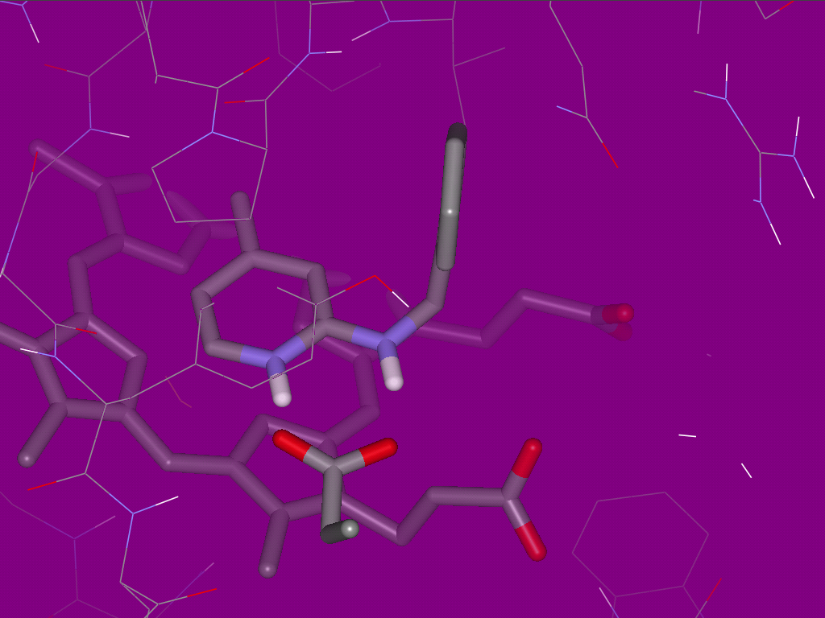
Using Crystal Structure data
Salt bridge
Glu³⁷¹
Notes:
All Xray data in the iNOS project was generated by co-crystallising a compound of interest with mouse iNOS enzyme.
This Xray shows how a salt bridge is formed between the aminopyridine (amidine mimic) and a key amino acid residue in the active site. This same interaction is made between the guanidine functional group of arginine and glutamic acid residue 371 (Glu371).
We can also see the iron haem group which has a pi-stacking interaction with the aromatic ring of the ligand.

Slide 11
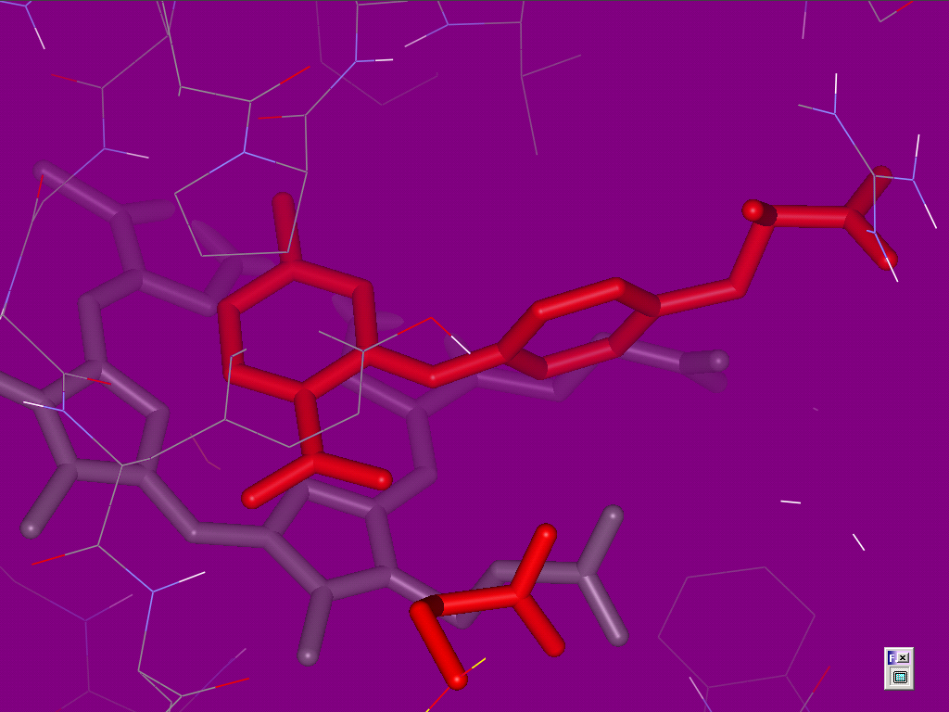
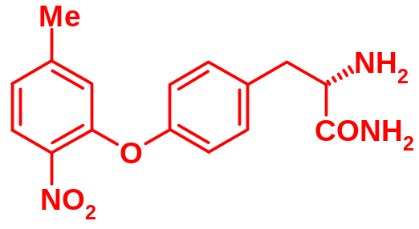
Using Crystal Structure data
Residue moved
Glu³⁷¹
Notes:
Our new lead compound binds very differently to our previous series. In this case the nitro group moves the Glu371 residue to one side, binding with the protein backbone instead.
This is the principle of ‘induced fit’. One should think of a protein like a jelly which can be moulded (within reason!) to fit the ligand into its active site.
The aromatic ring still forms a pi-stacking interaction with the haem porphorin system.

Slide 12
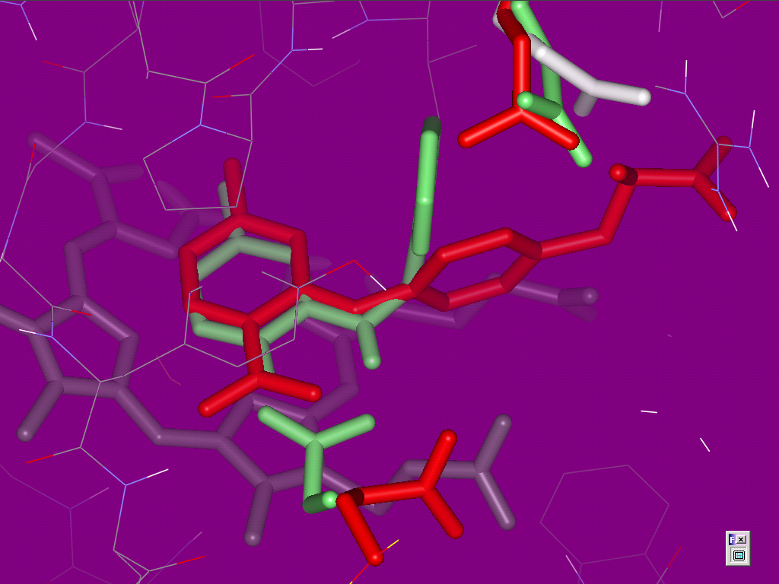
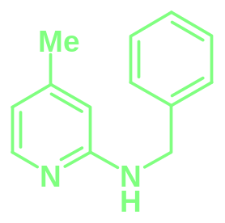
Combining data
Gln²⁵⁷
Glu³⁷¹
Notes:
When the two series are overlapped using molecular modelling we can see a possible new design.
The original compound causes a shift in the Glutamine residue 257 (Gln257), the so-called “Gln pocket”. This shift is key to selectivity against eNOS and nNOS.
The new compound causes a shift in the Glu371.

Slide 13
Gln²⁵⁷
Haem acids
Glu³⁷¹
Notes:
Combining these two shifts provides a new series, with increased potency over the two compounds which make up the design.
There is also the possibility of forming an interaction with the two carboxylic acids which make up part of the haem group.

Slide 14
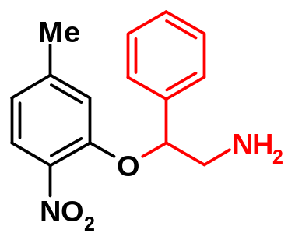
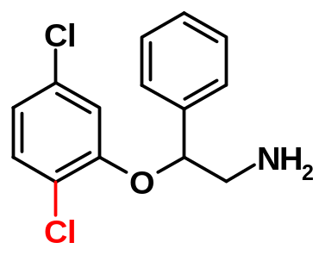
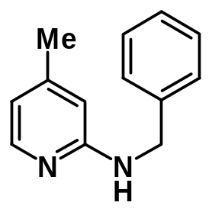
Using Crystal Structure to Design a New Series
Move Gln²⁵⁷ and add amine to bind haem acids
+
iNOS 0.9 μM
sel. vs eNOS x100
(racemic)
iNOS 2 μM
sel. vs eNOS >50
sel. vs nNOS >50
(racemic)
Notes:
The new series is shown here, and as anticipated has good potency and excellent selectivity against the other NOS isoforms (Gln pocket).
An amine is added to bind to the haem acids and the Nitro group is replaced by Chlorine substituents as nitro arenes have potential toxicity issues.

Slide 15
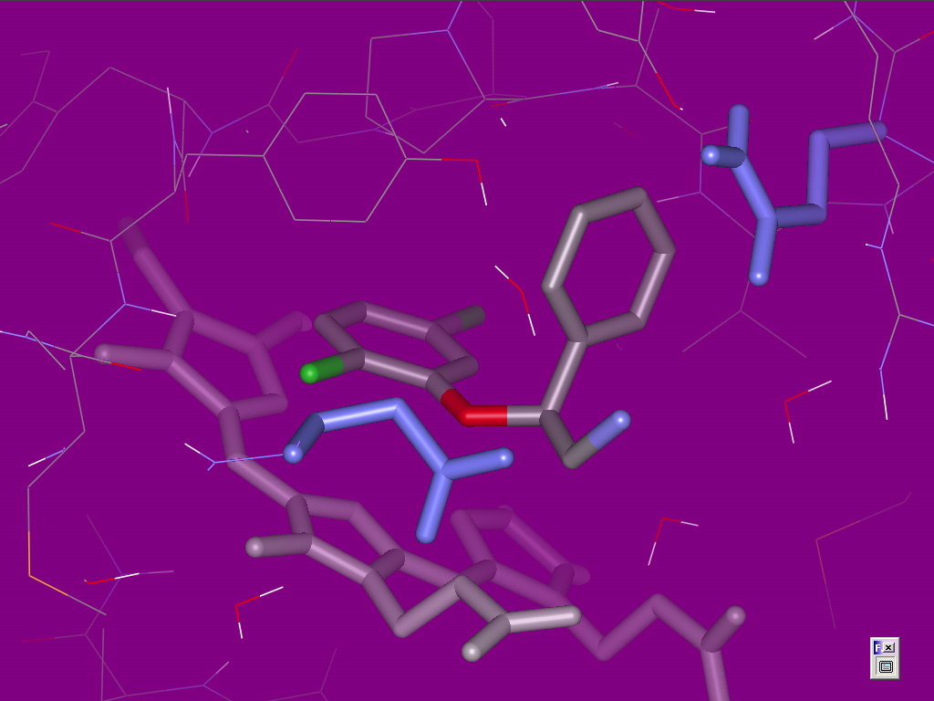
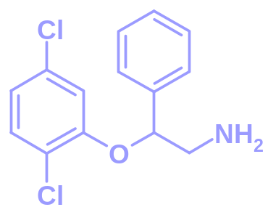
Gln²⁵⁷
iNOS 2 μM
sel. vs eNOS >50
sel. vs nNOS >50
(racemic)
Glu³⁷¹
Notes:
The Xray indeed showed that the Glu371 is moved, and the Phenyl ring fits nicely into the Gln pocket.

Slide 16

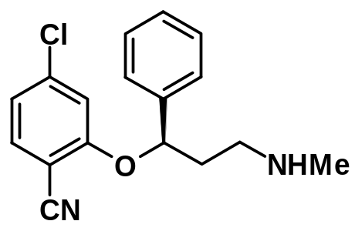
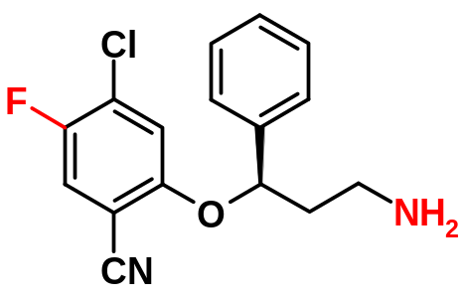
Improving Potency
R = Cl
iNOS 2 μM
sel. vs eNOS > x 50
(racemic)
R = CN
iNOS 0.9 μM
sel. vs eNOS x 110
(racemic)
iNOS 0.009 μM
cell 0.7 μM
sel. vs eNOS >10000
sel. vs. nNOS x150
not active in vivo
Cl = 94 ml/min/kg
t_{1/2} 1.3 hours
iNOS 0.006 μM
cell 0.7 μM
sel. vs eNOS >13,000
sel. vs. nNOS x35
active in vivo
Cl = 35 ml/min/kg
t_{1/2} 7 hours
Notes:
A number of analogues were made in an attempt to improve potency to nanomolar levels.
It was found that replacing Cl with CN was beneficial for potency. More important was moving the amine one more atom across. Chirality was also very important. The isomer drawn being >1000 times more active than its enantiomer.
When metabolic profiling was performed, it was discovered that oxidation of the aromatic ring (para-oxidation) and N-demethylation were the two key routes of metabolism.
These were easily blocked by adding a para Fluorine, and converting to a primary amine.
These changes provided a new lead compound with excellent potency, reasonable selectivity and good PK.

Slide 17
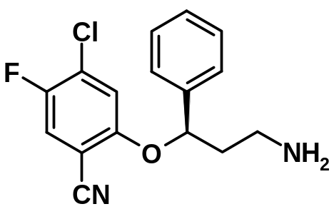
A New Series of iNOS Inhibitors
  pKa = 9.6, logD = 0.8
  stable in in vitro in rat, dog & human microsomes and hepatocytes.
  dog t_{1/2} = 11 hours, F = 70%
  radiolabelled study shows no glutathione displacement of F
  not nNOS selective enough < 50 fold
  unacceptable CYP 2D6 (0.3 μM)
  Other activities (5-HT, NA uptake)
iNOS 0.006 μM
cell 0.7 μM
sel. vs eNOS >10,000
sel. vs. nNOS x35
active in vivo
Cl = 35 ml/min/kg
t_{1/2} 7 hours
Notes:
After further profiling, more improvements were required. Selectivity was the main issue, not just against nNOS, but also against other biological effectors which would more than likely give side effects.

Slide 18
Series Optimisation - Requirements
Selectivity versus eNOS
  All compounds, selectivity of >1000 fold!
Cellular potency need < 1 μM
  Dose to Man, off-target selectivity
Selectivity versus nNOS > 50 fold
Metabolic stability

Slide 19
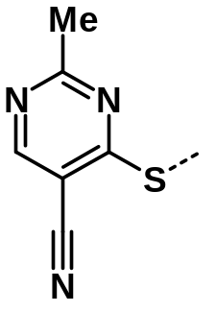
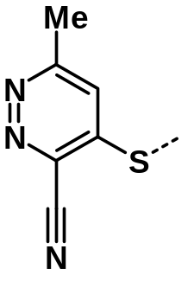
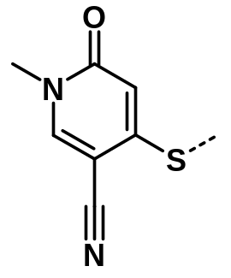
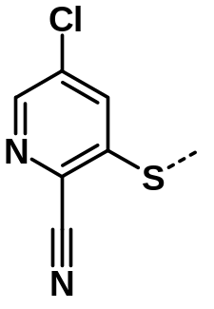
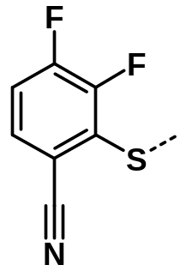
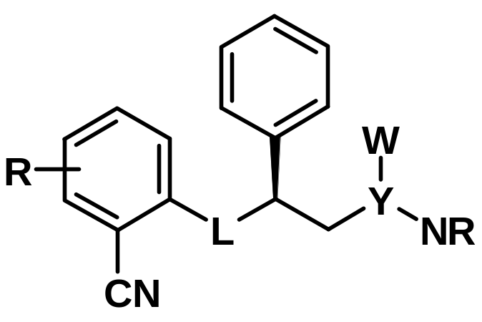
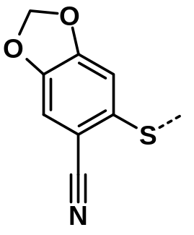
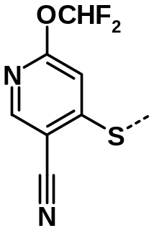
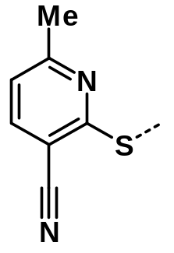
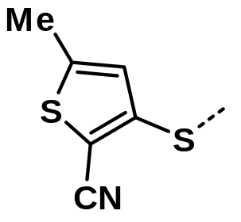
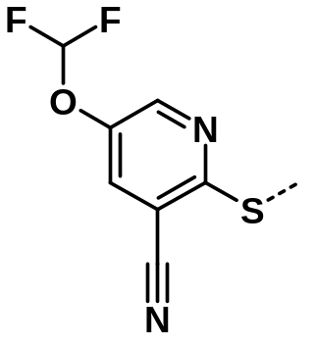
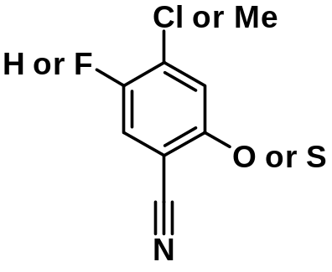
iNOS Potency – Overview of SAR
Notes:
The next few slides detail a significant amount of work which was done to optimise the series against the criteria set.

Slide 20
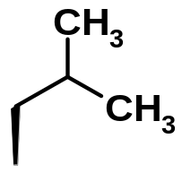
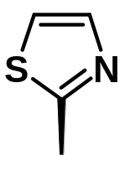
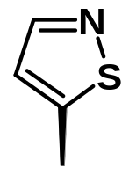
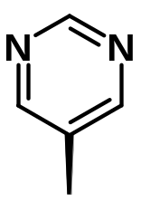
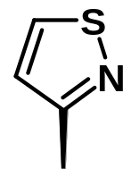
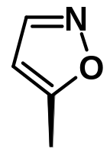
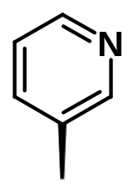
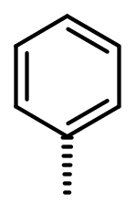
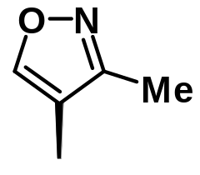
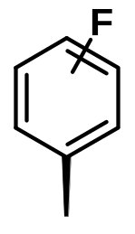
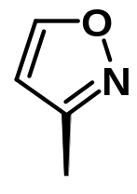


iNOS Potency – Overview of SAR
Notes:
Numerous “Gln pocket” groups were tried, but phenyl was always optimal.

Slide 21
iNOS Potency – Overview of SAR
Linker L
    O,S iNOS ↑
    N,C iNOS ↓
Y = CH_{2,} W = CH₂OH
    iNOS ↑
Y = bond or -CH₂CH₂-
    iNOS ↓
any R, except R = Me
    iNOS ↓

Slide 22

nNOS Selectivity
Selectivity vs. nNOS improves;
  R1 = NH₂, NHMe, NMe₂
  R1 = H & R2 = F, Cl, OMe
    but iNOS potency falls away!
  L = ‘S’ vs. ‘O’
  Y = -C(CH₂OH)-
    and iNOS potency increases!
Selectivity vs. nNOS decreases;
  R1 = Br, CF₃, CH₂F, CHF₂ or R2 = F
    but iNOS potency increases!

Slide 23

Best Compound of the Series
logD = 1.2, pKa = 8.2
iNOS 0.002 μM, cell 0.1 μM
sel. vs. eNOS > 10,000
sel. vs. nNOS x 50
Cyp2D6 = 0.6 μM, 5HT = 4 μM
& NA > 10 μM, hERG = 16μM
Rat PK - poor
Notes:
Despite the significant work summarised, the project were still unable to identify a compound which met all of the criteria.
This compound was found to have the best balance of properties, but still did not display good enough PK to be nominated as a candidate drug.

Slide 24

Crystal Structure
Trp³⁶⁶
Gln²⁵⁷
Met³⁶⁸
Glu³⁷¹

Slide 25





Synthesis
NaBH₄, THF-H₂0, O°C
(85g, 100%)
(MeO)₂C(Me)₂
CSA toluene (90g, 100%)
H₂ Pd/C EtOH
(86g, 83%)
MeNHOMe.HCl EDCI
25°C DCM (60g, 97%)
PhMgBr, THF O°C
(64g, 95%)
Borane, THF, -10 °C
(R)-Me-CBS catalyst
d.r. = 4:1
37g (58%)

Slide 26



Completion of Synthesis
1) PPh₃, DIAD, 0°C, THF
2) PhCOSH
+
1) NH₃, MeOH
2) Cs₂CO₃, DMF (89%)
3) MeOH, HCl (87%)
29.4g 99.6% pure

