Slide 1
Advanced Medicinal
Chemistry
Lectures 6 and 7:
Physical Properties and Drug Design
Rhona Cox
AstraZeneca R&D Charnwood

Slide 2
Overview
Introduction
Ionisation
Lipophilicity
Hydrogen bonding
Molecular size
Rotatable bonds
Bulk physical properties
Lipinski Rule of Five
The Drug Design Conundrum
Two lectures

Slide 3
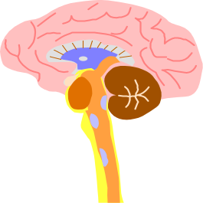
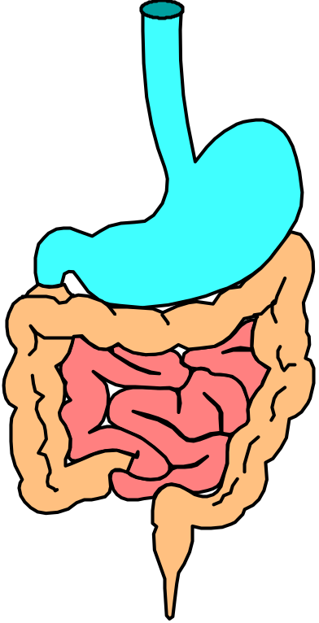
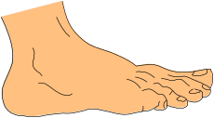
What must a drug do other than bind?
An oral drug must be able to:
dissolve
survive a range of pHs (1.5 to 8.0)
survive intestinal bacteria
cross membranes
survive liver metabolism
avoid active transport to bile
avoid excretion by kidneys
partition into target organ
avoid partition into undesired places (e.g. brain, foetus)
bladder
kidneys
BBB
bile
duct
liver
Notes:
A drug needs to be able to do many things other than bind to the active site of the receptor! This diagram illustrates a model for an oral drug to treat a problem with the foot. It is a very complicated model of a human, and it’s hard, if not impossible, to measure all these processes directly. In addition, it is much better to have an in vitro model than have to carry out these tests in living animals or whole organs.
BBB = blood brain barrier

Slide 4
Why are physical properties
important in medicinal chemistry?
So, before the drug reaches its active site, there are many hurdles to overcome.
However, many complicated biological processes can be modelled using simple physical chemistry models or properties – and understanding these often drives both the lead optimisation and lead identification phases of a drug discovery program forward.
This lecture will focus on oral therapy, but remember that there are lots of other methods of administration e.g. intravenous, inhalation, topical. These will have some of the same, and some different, hurdles.

Slide 5
Reducing the complexity
Biological process in drug action
Underlying physical chemistry
Physical chemistry model
Dissolution of drug in gastrointestinal fluids
Energy of dissolution; lipophilicity & crystal packing
Solubility in buffer,
acid or base
Absorption from small intestine
Diffusion rate, membrane partition coefficient
logP, logD, polar surface area, hydrogen bond counts, MWt
Blood protein
binding
Binding affinity to blood proteins e.g. albumin
Plasma protein binding, logP and logD
Distribution of compound in tissues
Binding affinity to cellular membranes
logP, acid or base
Notes:
These are some examples of biological processes, the underlying physical chemistry that governs them and the physical chemistry models we can look at to understand the biology.

Slide 6
Ionisation
Ionisation = protonation or deprotonation resulting in charged molecules
About 85% of marketed drugs contain functional groups that are ionised to some extent at physiological pH (pH 1.5 – 8).
The acidity or basicity of a compound plays a major role in controlling:
Absorption and transport to site of action
  Solubility, bioavailability, absorption and cell penetration, plasma binding, volume of distribution
Binding of a compound at its site of action
  un-ionised form involved in hydrogen bonding
  ionised form influences strength of salt bridges or H-bonds
Elimination of compound
  Biliary and renal excretion
  CYP P₄₅₀ metabolism

Slide 7
How does pH vary in the body?
Fluid | pH
Aqueous humour | 7.2
Blood | 7.4
Colon | 5-8
Duodenum (fasting) | 4.4-6.6
Duodenum (fed) | 5.2-6.2
Saliva | 6.4
Small intestine | 6.5
Stomach (fasting) | 1.4-2.1
Stomach (fed) | 3-7
Sweat | 5.4
Urine | 5.5-7.0
So the same compound will be ionised to different extents in different parts of the body.
This means that, for example, basic compounds will not be so well absorbed in the stomach than acidic compounds since it is generally the unionised form of the drug which diffuses into the blood stream.
Notes:
Drugs are only absorbed passively when they are unionised. This is because the compound has to pass through a lipophilic (‘fat loving’) membrane and this process will be unfavourable for charged molecules. In a more acidic medium, such as the stomach, the percentage ionised for an acidic compound will be less than at pH 7.4 and so more compound will have the capacity to be passively absorbed. In comparison, a basic compound in an acidic medium will be more ionised and so less of the compound will be in the neutral form and have the capacity to undergo passive absorption. This may well be the reason for the observation that acidic compounds generally have better fraction absorbed (hence bioavailability) than bases with neutral compounds lying between them.

Slide 8
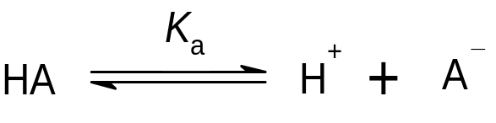
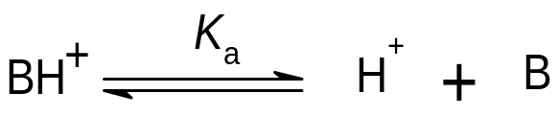
Ionisation constants
The equilibrium between un-ionised and ionised forms is defined by the acidity constant K_{a} or pK_{a} = -log₁₀ K_{a}
For an acid:
[H⁺][A⁻]
100
K_{a} =
% ionised =
[AH]
1 + 10^{(pKa - pH)}
For a base:
[H⁺][B]
100
K_{a} =
% ionised =
[BH⁺]
1 + 10^{(pH - pKa)}
When an acid or base is 50% ionised:
pH = pK_{a}
Notes:
The extent of ionisation of a compound can have a large effect on many biological properties, such as receptor/enzyme binding, binding to plasma proteins, CNS penetration, solubility and absorption. Once the pKa value of a molecule is known, then it is possible to calculate the proportion of ionised and neutral species at any pH.

Slide 9
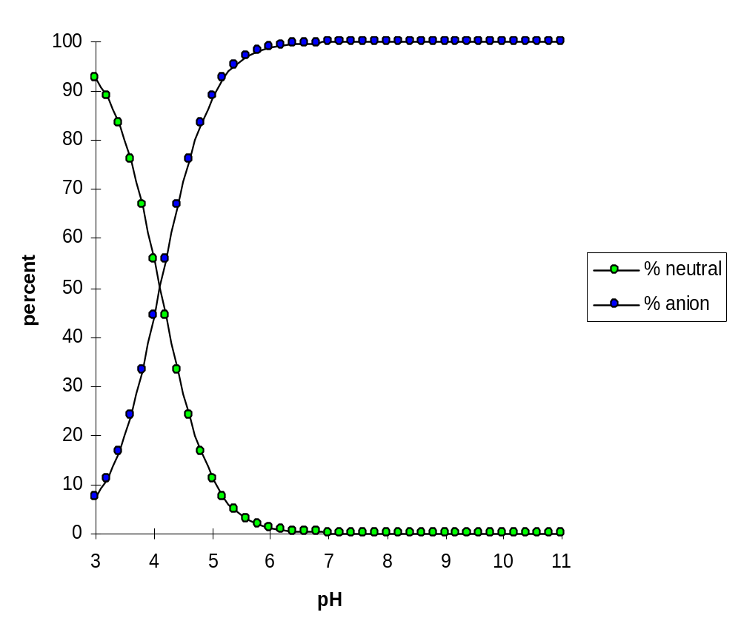
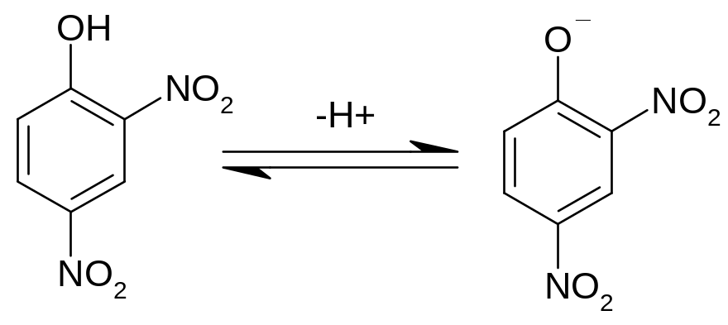
Ionisation of an acid – 2,4-dinitrophenol
pK_{a} = 4.1
Notes:
This diagram shows the proportions of phenol and phenolate anion at pHs between 3 and 11. Above about pH 6 the phenol is completely deprotonated. When the pH is the same as the pK_{a} (i.e. 4.1 in this case), half the molecules are ionised and half are not. Note that phenols are significantly more acidic than aliphatic alcohols, and that 2- and 4-nitrophenols are more acidic than phenol itself. Do you know the pKa of, for example, ethanol?

Slide 10
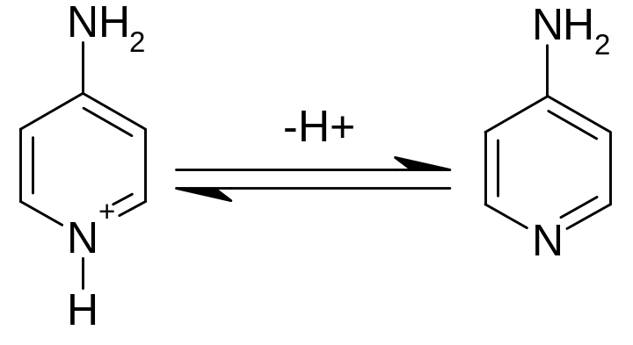
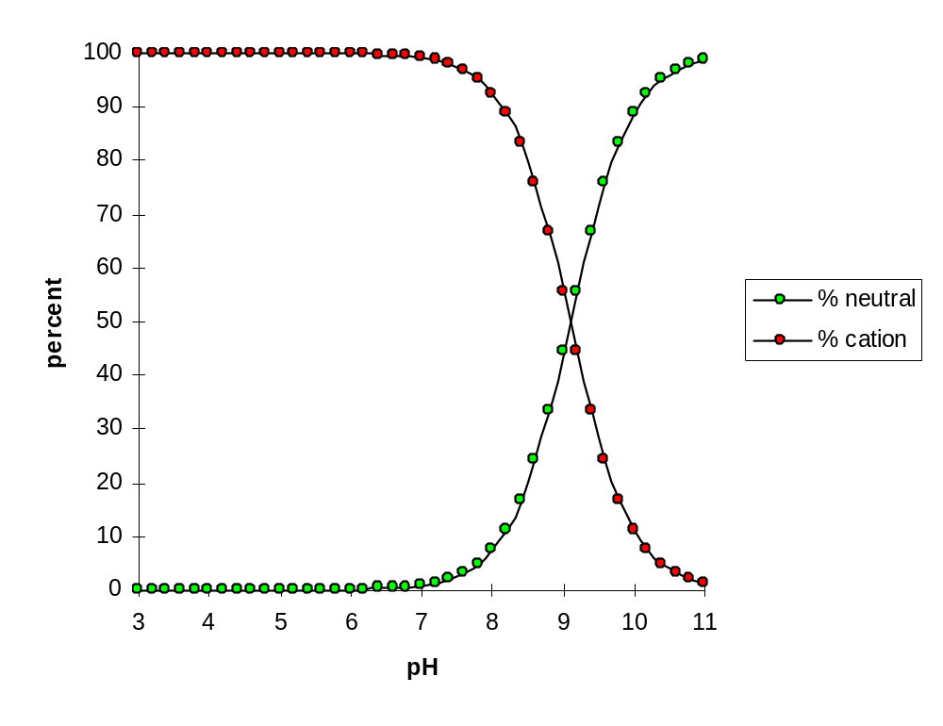
Ionisation of an base – 4-aminopyridine
pK_{a} = 9.1
Notes:
And here is the corresponding diagram for a basic compound. Below about pH 7, the molecule will be completely protonated. Do you know why the ring nitrogen protonates rather than the NH₂?

Slide 11
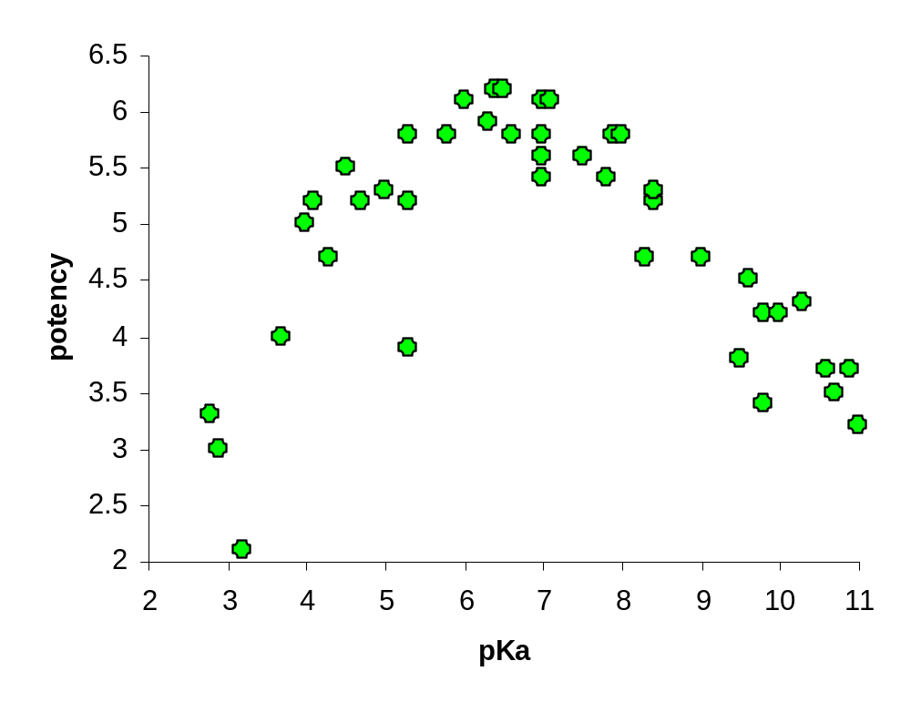
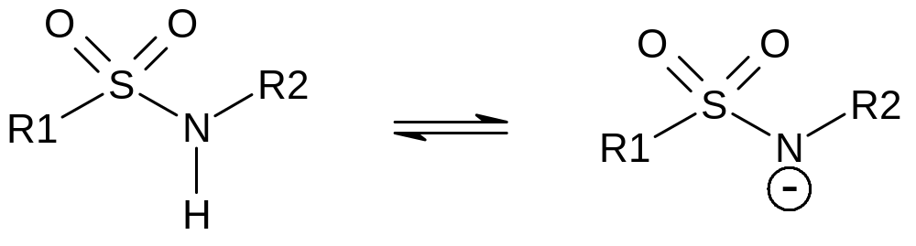
Effect of ionisation on antibacterial potency of sulphonamides
From pH 11 to 7 potency increases since active species is the anion.
From pH 7 to 3 potency decreases since only the neutral form of the compound can transport into the cell.
Notes:
This plot shows how the antibacterial activity (potency) of a series of compounds varies according to the pK_{a}. As R1 and R2 change, the ease with which the proton can be removed will change.

Slide 12
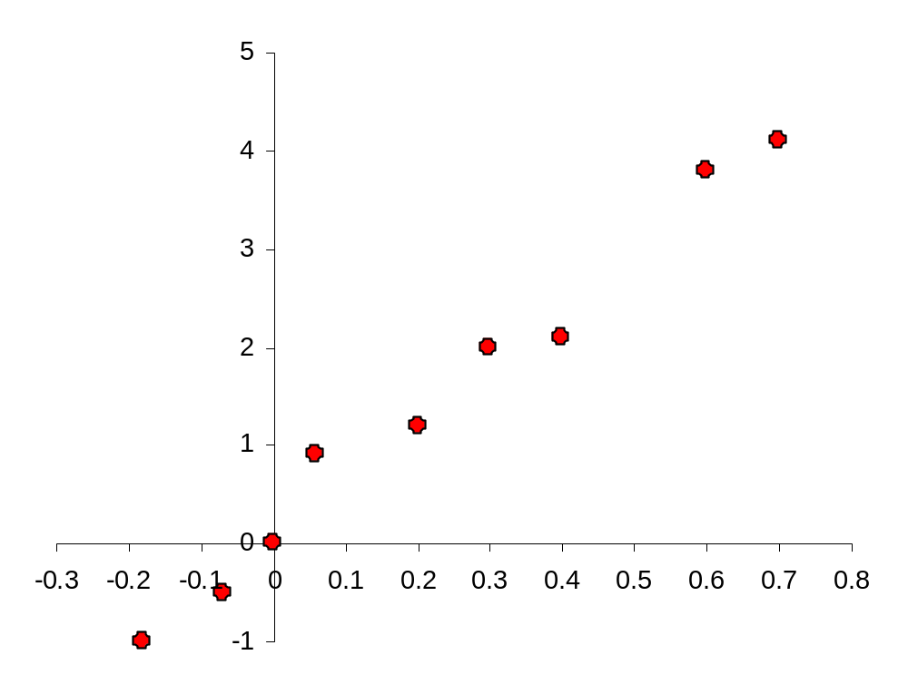
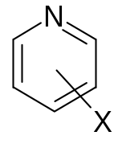
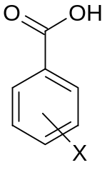
Effects of substituents on ionisation
Substituents have similar effects on the ionisation of different series of compounds.
This is an example of a linear free energy relationship.
3-CN
3-NO₂
Trends such as this are found for a very wide range of aromatic ionising functionalities. This allows prediction of the pK_{a} of molecules before they are even made!
log(K_{X}/K_{H}) pyridines
3-F
3-Cl
4-F
4-Cl
H
3-Me
log(K_{X}/K_{H}) benzoic acids
4-Me
Notes:
This plot shows the acidity of a range of benzoic acids plotted against the basicity of a pyridine with the same substitution pattern. The term K_{X}/K_{H} is a measure of the acidity or basicity compared to the compound with no substituents. The correlation is very good!

Slide 13
Lipophilicity
Lipophilicity (‘fat-liking’) is the most important physical property of a drug in relation to its absorption, distribution, potency, and elimination.
Lipophilicity is often an important factor in all of the following, which include both biological and physicochemical properties:
Solubility
Absorption
Plasma protein binding
Metabolic clearance
Volume of distribution
Enzyme / receptor binding
Biliary and renal clearance
CNS penetration
Storage in tissues
Bioavailability
Toxicity

Slide 14
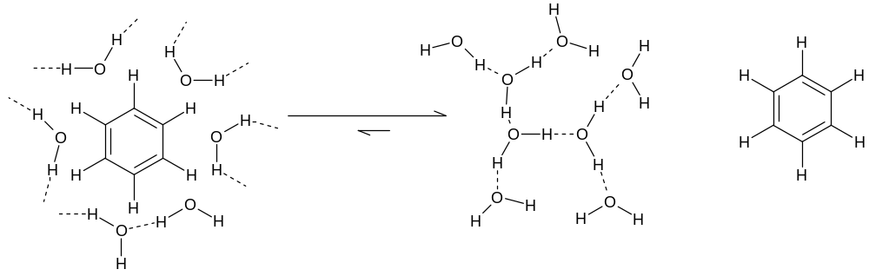
The hydrophobic effect
Molecular interactions – why don’t oil and water mix?
This is entropy driven (remember δG = δH – TδS). Hydrophobic molecules are encouraged to associate with each other in water.
Placing a non-polar surface into water disturbs network of water-water hydrogen bonds. This causes a reorientation of the network of hydrogen bonds to give fewer, but stronger, water-water H-bonds close to the non-polar surface.
Water molecules close to a non-polar surface consequently exhibit much greater orientational ordering and hence lower entropy than bulk water.
Notes:
Recap from the lecture on Molecular Interactions…… Hydrophobic means ‘water hating’.

Slide 15
The hydrophobic effect
This principle also applies to the physical properties of drug molecules.
If a compound is too lipophilic, it may
be insoluble in aqueous media (e.g. gastrointestinal fluid or blood)
bind too strongly to plasma proteins and therefore the free blood concentration will be too low to produce the desired effect
distribute into lipid bilayers and be unable to reach the inside of the cell
Conversely, if the compound is too polar, it may not be absorbed through the gut wall due to lack of membrane solubility.
So it is important that the lipophilicity of a potential drug molecule is correct.
How can we measure this?

Slide 16
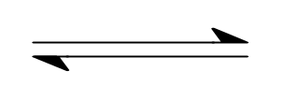
Partition coefficients
P
X_{aqueous}
X_{octanol}
Partition coefficient P (usually expressed as log₁₀P or logP) is defined as:
[X]_{octanol}
P =
[X]_{aqueous}
P is a measure of the relative affinity of a molecule for the lipid and aqueous phases in the absence of ionisation.
1-Octanol is the most frequently used lipid phase in pharmaceutical research. This is because:
It has a polar and non polar region (like a membrane phospholipid)
P_{o/w} is fairly easy to measure
P_{o/w} often correlates well with many biological properties
It can be predicted fairly accurately using computational models
Notes:
Lipophilicity may be modelled using simple physical chemical models. The partition coefficient P is a measure of lipophilicity and is usually experimentally determined by equilibrating a sample of the compound in an octanol/aqueous buffer mixture. The resulting emulsion is then separated. Once separated, the concentration of the drug in each layer is measured and the partition coefficient is then calculated.

Slide 17
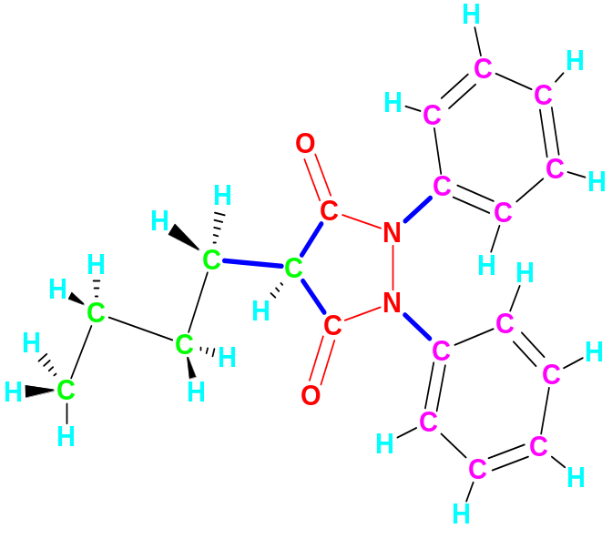
Calculation of logP
LogP for a molecule can be calculated from a sum of fragmental or atom-based terms plus various corrections.
logP = Σ fragments + Σ corrections
Branch
clogP for windows output
C: 3.16 M: 3.16 PHENYLBUTAZONE
Class | Type | Log(P) Contribution Description Value
FRAGMENT | # 1 | 3,5-pyrazolidinedione -3.240
ISOLATING |CARBON| 5 Aliphatic isolating carbon(s) 0.975
ISOLATING |CARBON| 12 Aromatic isolating carbon(s) 1.560
EXFRAGMENT|BRANCH| 1 chain and 0 cluster branch(es) -0.130
EXFRAGMENT|HYDROG| 20 H(s) on isolating carbons 4.540
EXFRAGMENT|BONDS | 3 chain and 2 alicyclic (net) -0.540
RESULT | 2.11 |All fragments measured clogP 3.165
Phenylbutazone
Notes:
Don’t worry about exactly how this works. Calculations are almost always carried out using a computer program, and sometimes extra corrections are calculated and added to make the prediction specially good for a specific series of compounds.

Slide 18
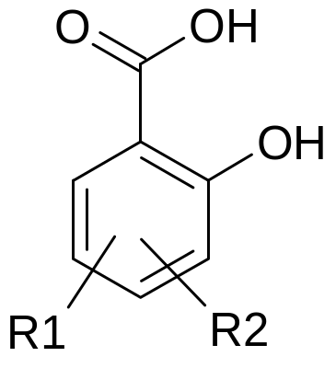
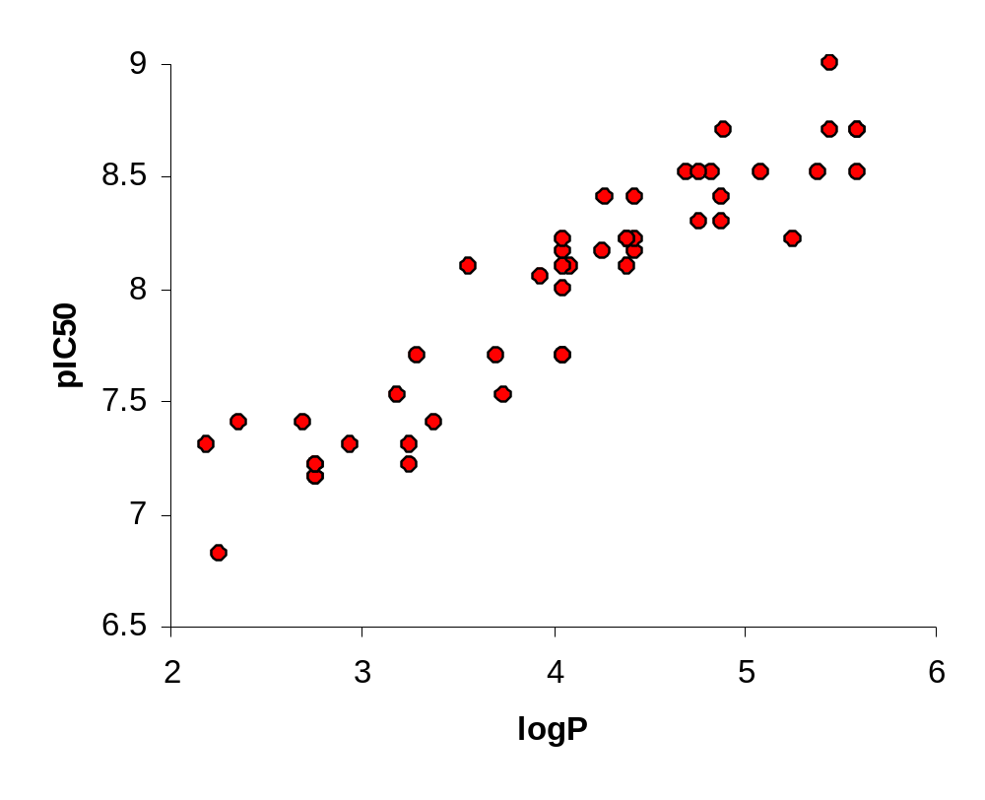
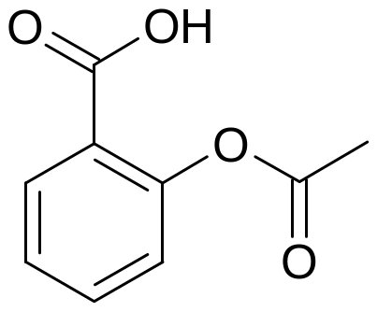
Blood clot preventing activity
of salicylic acids
Aspirin
Notes:
As the lipophilicity (logP) of the molecule increases, it binds more tightly to the receptor. Note that aspirin is a structurally similar compound; it, too, shows blood clot preventing activity.

Slide 19
What else does logP affect?
logP
Binding to enzyme / receptor
Aqueous solubility
Binding to P₄₅₀ metabolising enzymes
Absorption through membrane
Binding to blood / tissue proteins – less drug free to act
Binding to hERG heart ion channel -cardiotoxicity risk
So log P needs to be optimised
Notes:
As lipophilicity changes, so do many properties in addition to the strength of binding to the receptor. Some of these changes are desirable, others are not.

Slide 20



Distribution coefficients
If a compound can ionise then the observed partitioning between water and octanol will be pH dependent.
[un-ionised]_{octanol}
insignificant
octanol phase
P
Distribution coefficient D (usually expressed as logD) is the effective lipophilicity of a compound at a given pH, and is a function of both the lipophilicity of the
un-ionised compound and the degree of ionisation.
aqueous phase
K_{a}
[un-ionised]_{aq}
[ionised]_{aq}
For an acidic compound:
HA_{aq}
H⁺_{aq}
+
A⁻_{aq}
[HA]_{octanol}
D =
[HA]_{aq}
+
[A⁻]_{aq}
For a basic compound:
BH⁺_{aq}
H⁺_{aq}
+
B_{aq}
[B]_{octanol}
D =
[BH⁺]_{aq}
+
[B]_{aq}
Notes:
Ionisation of a compound (either an acid or a base) will favour the distribution of the drug into the aqueous phase since the concentration of the neutral form of the compound, which is the only form of the compound capable of partitioning into the octanol phase, is reduced.

Slide 21
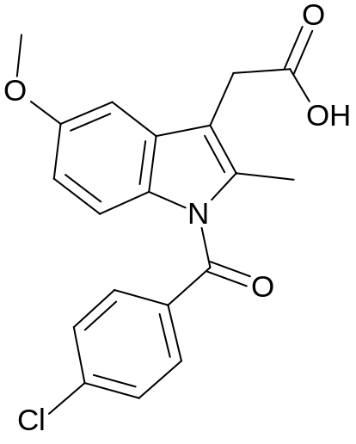
Relationship between logD, logP and pH for an acidic drug
logP=4.25
5
4
50% neutral
10%
3
1%
2
logD
0.1%
1
Indomethacin
0.01%
0
0.001% neutral
-1
-2
2
3
4
5
6
7
8
9
10
pH
For singly ionising acids in general:
pK_{a}=4.50
logD = logP - log[1 + 10^{(pH-pKa)}]
Notes:
If we can calculate a theoretical pK_{a} and logP, these equations allow the calculation of a theoretical logD.

Slide 22
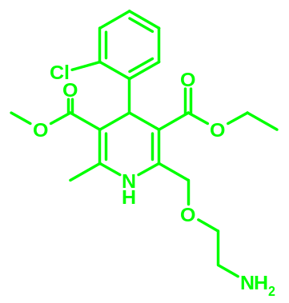
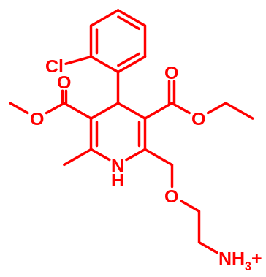
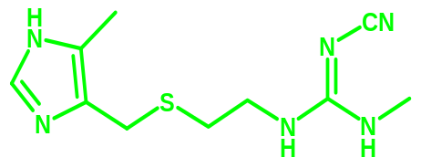
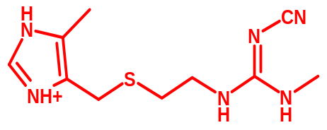
pH - Distribution behaviour of bases
4
3
Amlodipine
pK_{a}=9.3
2
1
logD
0
-1
-2
Cimetidine
pK_{a}=6.8
-3
-4
3
4
5
6
7
8
9
10
11
pH
For singly ionising bases in general:
logD = logP - log[1 + 10^{(pKa-pH)}]

Slide 23
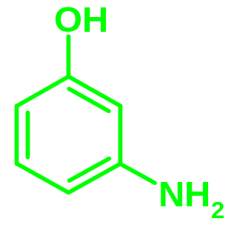
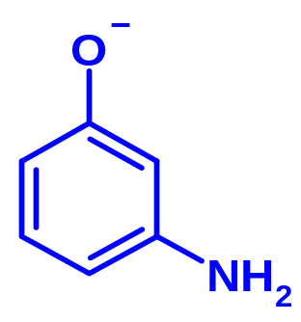
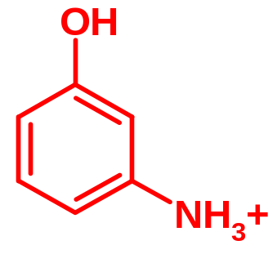
pH - Distribution behaviour of amphoteric compounds
pK_{a1} = 4.4
pK_{a2} = 9.8
0.5
0
-0.5
logD
-1
-1.5
-2
-2.5
2
3
4
5
6
7
8
9
10
11
12
pH
Notes:
An amphoteric compound can act as either an acid or a base.

Slide 24
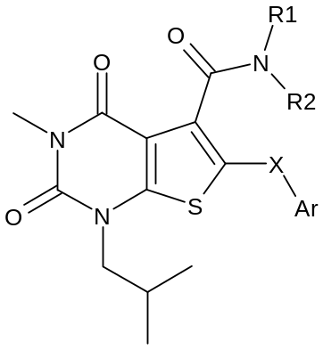
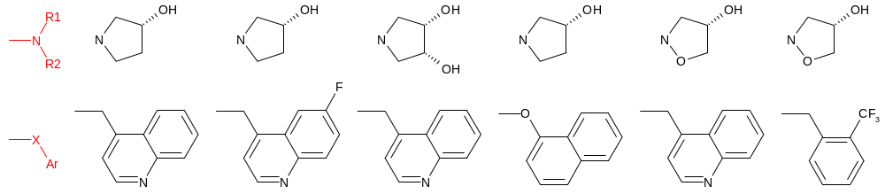
How can lipophilicity be altered?
e.g. Monocarboxylate transporter 1 blockers
logD 1.7 2.0 1.2 2.9 2.2 3.2
Notes:
Here is a small series of compounds illustrating some techniques that are used to change the logD of a compound.
1. Replacing hydrogen with a halogen increases the lipophilicity. This is a small effect with fluorine but would be much larger for chlorine.
2. Addition of a hydroxyl group decreases the lipophilicity.
3. Removal of the quinoline nitrogen to give a carbocyclic ring greatly increases the lipophilicity. This will be slightly offset by the incorporation of an ether, but this is a much smaller effect.
4. Addition of an oxygen into the ring adjacent to the nitrogen makes a more lipophilic compound.
5. Replacement of the quinoline with a benzene ring will make the compound more lipophilic, and this effect is enhanced by the addition of a trifluoromethyl group.
Original reference: J. Med. Chem., 2007, 50, 254.

Slide 25
How can lipophilicity be altered?
e.g. Monocarboxylate transporter 1 blockers
logD 1.7 2.0 1.2 2.9 2.2 3.2

Slide 26
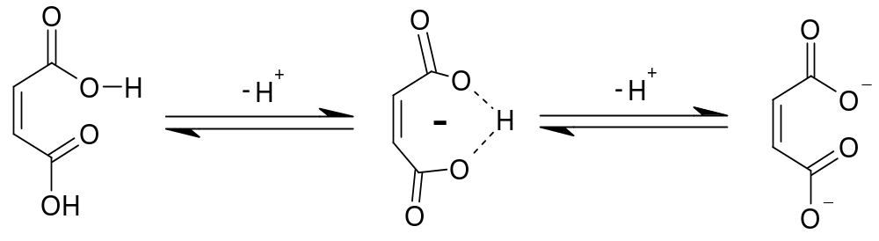
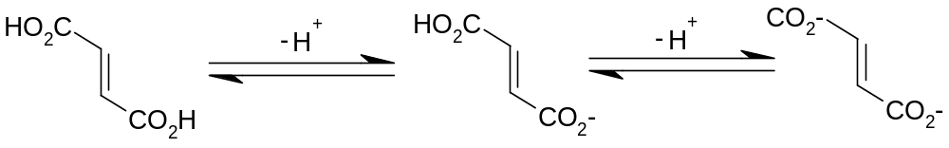
Hydrogen bonding
Intermolecular hydrogen bonds are virtually non-existent between small molecules in water. To form a hydrogen bond between a donor and acceptor group, both the donor and the acceptor must first break their hydrogen bonds to surrounding water molecules
The position of this equilibrium depends on the relative energies of the species on either side, and not just the energy of the donor-acceptor complex
Intramolecular hydrogen bonds are more readily formed in water - they are entropically more favourable.
pK_{a1}=1.91
pK_{a2}=6.33
pK_{a1}=3.03
pK_{a2}=4.54
Notes:
Hydrogen bonding is the attractive force between a hydrogen atom covalently bound to an electronegative atom (the donor) and a second electronegative atom (the acceptor).
Compare maleic (cis) and fumaric (trans) acids. In maleic acid the first deprotonation is extremely facile as the resulting anion is stabilised by formation of a seven membered ring. The second deprotonation breaks this ring and forces the two negatively charged carboxylate anions into close proximity. In fumaric acid, however, the two carboxylic acids are further apart and therefore more independent.

Slide 27
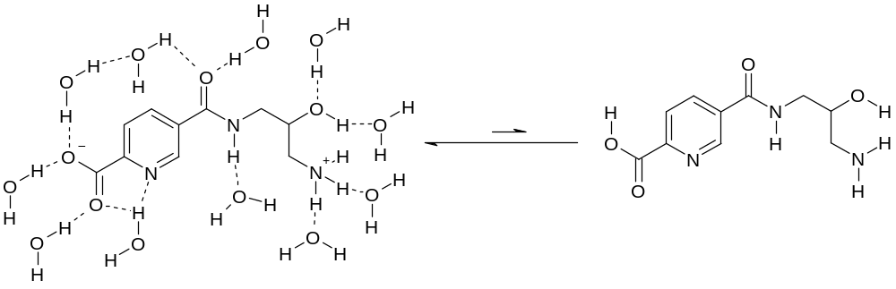
Hydrogen bonding and bioavailability
Remember! Most oral drugs are absorbed through the gut wall by transcellular absorption.
De-solvation and formation of a neutral molecule is unfavourable if the compound forms many hydrogen or ionic bonds with water.
So, as a good rule of thumb, you don’t want too many hydrogen bond donors or acceptors, otherwise the drug won’t get from the gut into the blood.
There are some exceptions to this – sugars, for example, but these have special transport mechanisms.

Slide 28
Molecular size
Molecular size is one of the most important factors affecting biological activity, but it’s also one of the most difficult to measure.
There are various ways of investigating the molecular size, including measurement of:
Molecular weight (most important)
Electron density
Polar surface area
Van der Waals surface
Molar refractivity
Notes:
Molecular weight is probably the most useful measure of molecular size as it is very easy to calculate, but you may also come across other measures. Polar surface area, for example, is a measure of what proportion of the surface of the molecule is comprised of polar groups, compared to the proportion of hydrophobic groups. Molar refractivity is a measure of both the size and the polarisability of a molecule, and can be calculated by measuring the density and how much a liquid refracts light.

Slide 29
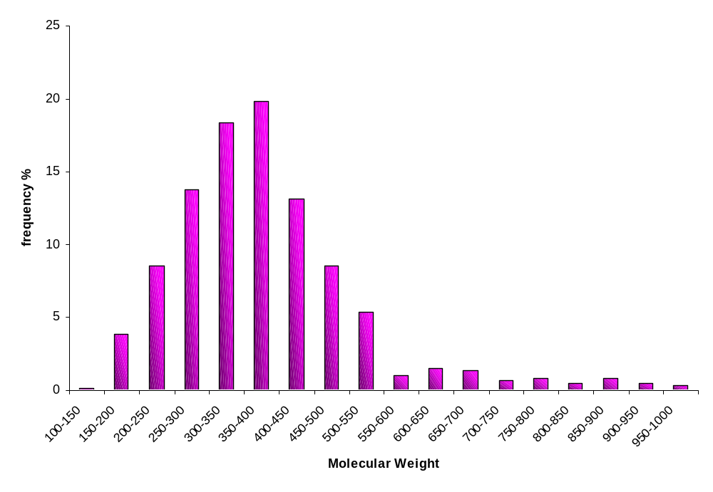
Molecular weight
Plot of frequency of occurrence against molecular weight for 594 marketed oral drugs
Most oral drugs have molecular weight < 500
Notes:
Note that there are virtually no oral drugs on the market which have molecular weights above 550. This is because they tend to suffer from problems like poor bioavailability – so when designing a new drug it’s best to stick to molecular weights of under 500, and preferably nearer to to 350-400.

Slide 30
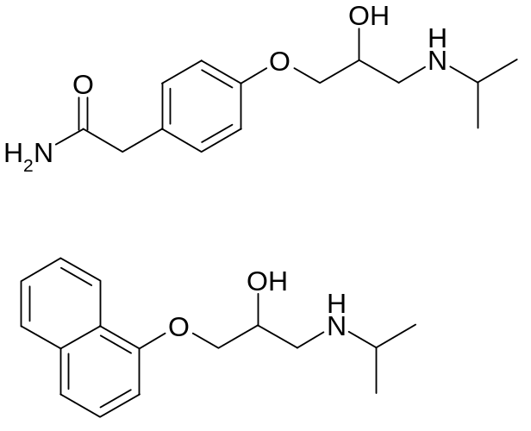
Number of rotatable bonds
A rotatable bond is defined as any single non-ring bond, attached to a non-terminal, non-hydrogen atom. Amide C-N bonds are not counted because of their high barrier to rotation.
No. of rotatable
bonds
Atenolol
Propranolol

Slide 31
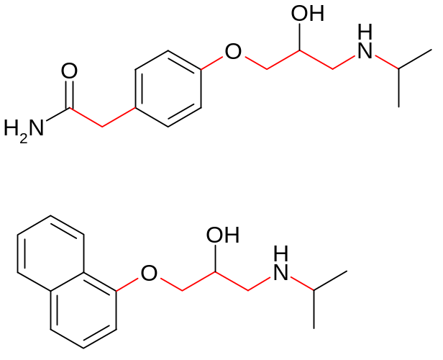
Number of rotatable bonds
A rotatable bond is defined as any single non-ring bond, attached to a non-terminal, non-hydrogen atom. Amide C-N bonds are not counted because of their high barrier to rotation.
No. of rotatable
bonds
Bioavailability
Atenolol
8
50%
Propranolol
6
90%
The number of rotatable bonds influences, in particular, bioavailability and binding potency. Why should this be so?
Notes:
In the case of flexible drug molecules, there is a loss of entropy on binding due to conformational restriction (remember dG = dH –TdS), so if a molecule is more rigid to start off with, less entropy is lost on binding. Of course, the problem with removing rotatable bonds from a molecule to make it more rigid is that potentially you will lose all potency as you may have restricted the molecule into the wrong conformation.
About 65% of fairly rigid compounds in the collection (those with seven or fewer rotatable bonds) exhibited good-to-excellent oral bioavailability, independent of molecular weight. In contrast, more than 75% of floppy compounds (those with more than 10 rotatable bonds) had poor oral bioavailability. Compounds of intermediate rigidity fell somewhere in between. NB This is in rats.

Slide 32
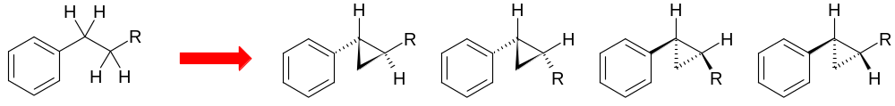
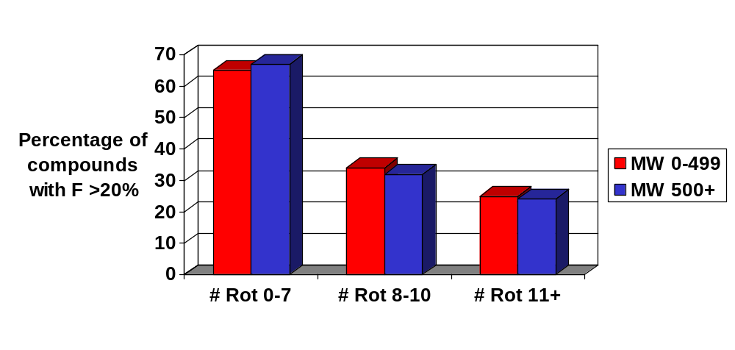
Number of rotatable bonds
Remember δG = δH – TδS ! A molecule will have to adopt a fixed conformation to bind, and to pass through a membrane. This involves a loss in entropy, so if the molecule is more rigid to start with, less entropy is lost. But beware!
Any, or none, of these could be the active conformation!
Notes:
In the case of flexible drug molecules, there is a loss of entropy on binding due to conformational restriction, so if a molecule is more rigid to start off with, less entropy is lost on binding. Of course, the problem with removing rotatable bonds from a molecule to make it more rigid is that potentially you will lose all potency as you may have restricted the molecule into the wrong conformation.
The bar chart shows how the number of rotatable bonds (# Rot) affects the bioavailability (F) for some compounds made by GlaxoSmithKline. A bioavailability of 20% is chosen as the cut off for an acceptable compound as this is about the minimum necessary for a good oral drug. As you can see, the bioavailability decreases as the flexibility of the molecule increases, and this is independent of molecular weight.
A key reference is Veber et al, J. Med. Chem. 2002, 45, 2615.

Slide 33
Bulk physical properties
When a compound is nearing nomination for entry to clinical trials, we need to look at:
Solubility, including in human intestinal fluid
Hygroscopicity, i.e. how readily a compound absorbs water from the atmosphere
Crystalline forms – may have different properties
Chemical stability (not a physical property! Look at stability to pH, temperature, water, air, etc)
How can these be altered?
Different counter ion or salt
Different method of crystallisation
Notes:
Finally, there are a few important physical properties which relate to the bulk compound rather than just one molecule. Other than solubility, which is easy to measure and usually looked at early in a project, these need to be taken into consideration when a compound is nearing clinical trials. At the same time as looking at solubility in lots of solvents (including human intestinal fluid) it’s also necessary to carefully look at the chemical stability of the compound, to make sure that it will stand up to varying temperature, solvents, pH etc.

Slide 34
This seems like a lot to remember!
There are various guidelines to help, the most well-known of which is the Lipinski Rule of Five
molecular weight < 500
logP < 5
< 5 H-bond donors (sum of NH and OH)
< 10 H-bond acceptors (sum of N and O)
An additional rule was proposed by Veber
< 10 rotatable bonds
Otherwise absorption and bioavailability are likely to be poor. NB This is for oral drugs only.
Notes:
Lipinski’s key reference is Advanced Drug Delivery Reviews, 1997, 23, 3-25.

Slide 35
The Drug Design Conundrum
The conundrum is that while pharmacokinetic properties improve by modulating bulk properties, potency also depends on these – particularly lipophilicity. There are then three approaches that could be adopted.
Potency
New receptor interaction
to increase potency and modulate
bulk properties
Find a substitution position not affecting
potency where bulk properties can be
modulated for good DMPK
Trade potency for
DMPK improvements
dose to man focus
logD/Clearance/CYP inhibition
Notes:
Herein lies the challenge!

