Slide 1
Advanced Medicinal
Chemistry
Lecture 1:
Target Classes
Dr Jeff Stonehouse
AstraZeneca R&D Charnwood

Slide 2
The Drug Discovery Process
Target
Identification
3 months to
2 years!
HTS
3-4 months
Active-to-Hit
(AtH)
3 months
Hit-to-Lead
(HtL)
6-9 months
New Lead
Optimisation
Projects (LO)
2 years
Candidate
Drug (CD)
Notes:
Finding a drug candidate can take many years. The drug discovery process above shows the timelines that are usually required from initial target identification to discovery of a candidate drug. The candidate drug is then taken forwards through clinical trials and if successful will eventually reach the market place many years afterwards.
This first lecture details the biological targets that are of interest to the pharmaceutical industry.

Slide 3
Taxonomy of Biological Mechanisms
Receptors -
  agonists
  antagonists
  partial agonists
  inverse agonists
Enzymes -
  inhibitors
Ion Channels -
  openers
  blockers
Protein-Protein -
  inhibitors
In vivo
Effectors
Notes:
There are 4 key effectors of biological pathways in the body. These are receptors, enzymes, ion channels and protein-protein complexes.
The pharmaceutical industry has been largely involved in the discovery of drugs that interact with 3 of the 4 aforementioned biological effectors. Namely enzymes, receptors and ion channels.

Slide 4
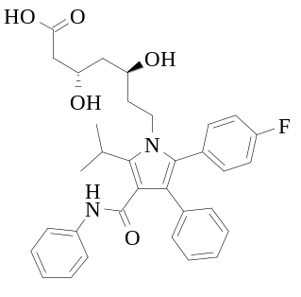
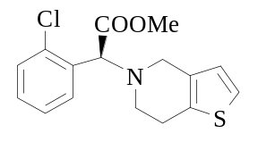
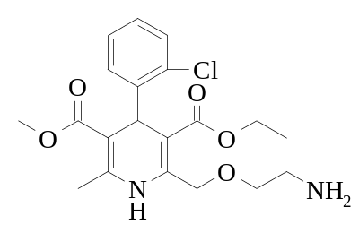
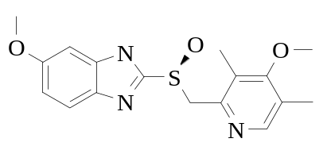
Blockbuster Drugs
Lipitor HMG CoA inhibitor
Plavix Anti-platelet
Enzyme
Receptor
Thrombosis
BMS/Sanofi-Aventis
$5.0billion
Cholesterol
Pfizer
$12.0 billion
Norvasc Calcium channel blocker
Nexium Proton pump inhibitor
Enzyme
Ion-channel
Anti-ulcer
AstraZeneca
$4.8billion
Hyper-tension
Pfizer
$4.8billion
Notes:
Here are examples of 4 of the top 10 best selling drugs of 2005. We can clearly see that they span the 3 key biological effectors mentioned earlier.

Slide 5
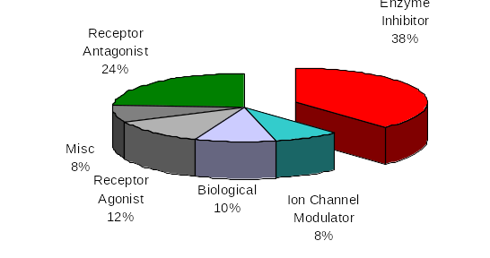
Biological Mechanisms
2005 Top 50 drugs by Worldwide sales
Notes:
Enzyme inhibitor drugs made up 38% of sales of all drugs in 2005.
The next few slides will explain types of enzymes that are of interest to pharmaceutical research.

Slide 6
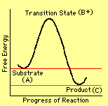
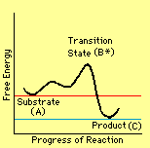
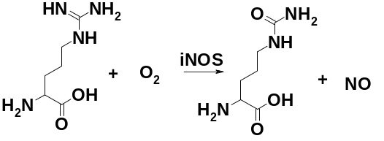
Enzyme function
TS
Free Energy
Free Energy
TS
E
S
S
P
P
Progress of Reaction
Progress of Reaction
#
E + S
ES
E + P
Active Site is tailored to bind the transition state for S P
Usually, the substrate & inhibitors bind at the active site
Allosteric (non-competitive) binding occurs remotely to the active site
Notes:
An enzyme is a biological catalyst. Just like a synthetic catalyst the enzyme reduces the activation energy required to bring about the transformation of substrate to product. The enzyme active site will be tailored to bind the transition state for substrate-product and thus will reduce the energy if this transition state, making the overall transformation much easier than without the enzyme.
For example, Nitric Oxide Synthase (NOS) is an enzyme that converts the amino acid arginine and oxygen into citrulline and the inflammatory mediator Nitric oxide. The enzyme active site binds both arginine and oxygen, bringing both reactive groups into close proximity, and reducing the energy required to effect this transformation.

Slide 7
Enzyme Inhibition - Four mechanistic categories
1. Competitive inhibition. Inhibitor competes reversibly with substrate for the active site.
2. Uncompetitive inhibition. Inhibitor binds only to the ES complex, leading to EIS intermediates. This is very rare.
3. Non-competitive inhibition. Inhibitor binds non-covalently to sites other than the active site (Allosteric inhibition). Kinetics are complex and partially inhibited enzymes can still turn over substrate.
Notes:
There are 4 mechanistic categories of enzyme inhibition.
Competitive inhibitors compete for the active site of the enzyme with the enzyme’s natural substrate. This is a completely reversible process (cf irreversible inhibitors).
Uncompetitive inhibitors bid to the enzyme-substrate complex and prevent transformation of the substrate. This is not a usual inhibition mechanism.
Non-competitive inhibitors bind to the enzyme, but not at the active site. The enzyme conformation is changed and substrate binding is affected, although not always completely. These are also known as allosteric inhibitors.

Slide 8
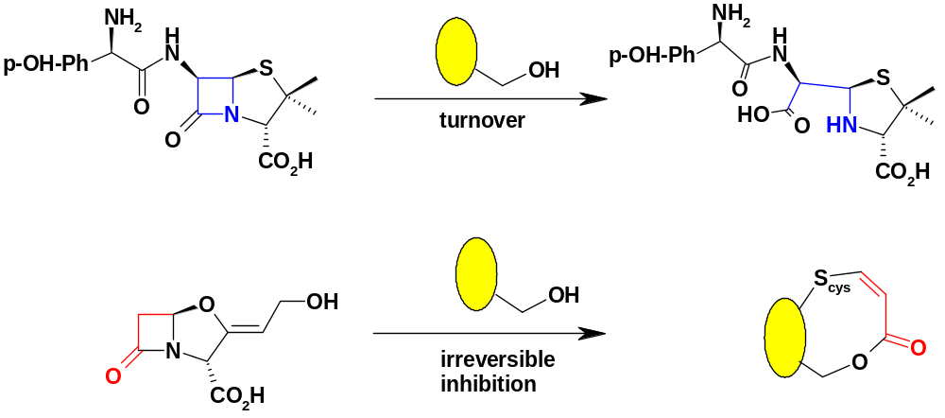
Enzyme Inhibition
- Four mechanistic categories
4. Irreversible inhibition. Inhibitor binds covalently, usually to the active site machinery. Also known as Suicide inhibitors. Examples include MAO inhibitors and β-lactamase inhibitors:
β
Amoxycillin
β
Clavulanic
acid
β
Notes:
There are 4 mechanistic categories of enzyme inhibition.
4. Irreversible or suicide inhibitors form a covalent bond with the active site of the enzyme, thereby preventing binding and transformation of the natural substrate.
Amoxycillin is a typical beta-lactam antibiotic drug which can be broken down by beta lactamases secreted by bacteria, thus confering anti-bacterial resistance.
Clavulanic acid is not itself an antibiotic, but when administered alongside amoxycillin can reverse the antibiotic resistance by irreversibly binding to beta-lactamases that break down the antibiotic.

Slide 9
Proteases (proteinases, peptidases)
Hydrolytically cleave peptidic amide bonds
Endopeptidases cleavage site may be anywhere in the substrate
Exopeptidases terminal residue (carboxypeptidase, aminopeptidase)
Four Mechanistic Classes
Nucleophile pH preference Endo/Exo
Serine
Cysteine (thiol)
Aspartic
Zinc (metallo)
Ser-CH₂OH
~7
endo
Cys-CH₂SH
~7
endo
H₂O
3-6
endo
H₂O
~7
endo/exo
Notes:
Proteases are enzymes that cleave amide bonds within proteins, thereby effectively truncating a protein.
Peptide cleavage may lead to activation of the protein and a subsequent biological response. This is why protease inhibition is attractive from a drug discovery point of view.

Slide 10

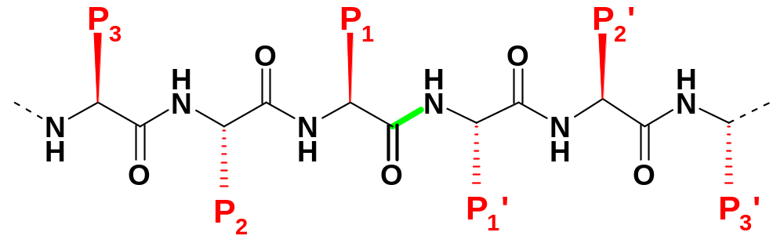

Protease Specificity
Determined by the binding of substrate amino acid side-chains near the cleavage site
Specificity-Pocket nomenclature
(Schechter & Berger, Biochem Biophys Res Com, 1967, 27, 157-162)
S₃
S₁
S₂’
substrate
N-terminus
Substrate
C-terminus
..
S₂
E-XH
S₁’
S₃’
non-prime side
prime side
Notes:
There are 4 protease classes, each cleaving at specific amino acid residues along the protein sequence.
This clearly shows the power of enzymes. Chemical cleavage of an amide is a difficult process in itself, but selectivity for amino acid residues is impossible chemically!

Slide 11
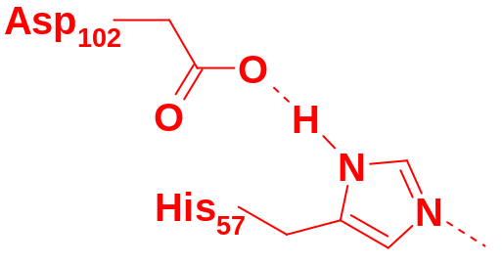
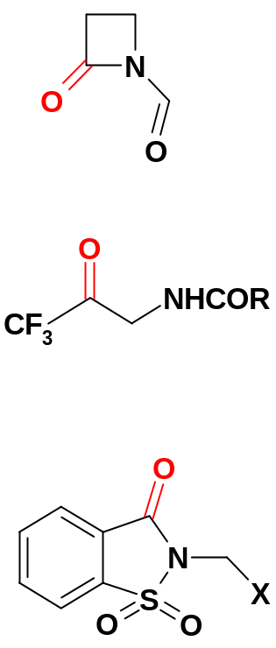
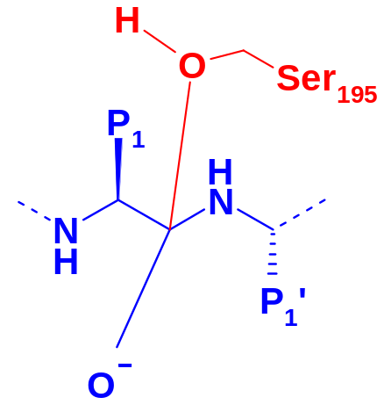
Serine Proteases
Thrombin, Tryptase , β-Lactamase, Elastase, Chymotrypsin, HCV-NS3
Catalytic triad
boosts serine nucleophilicity
Inhibitors create or mimic
stable tetrahedral intermediates
enzyme
β-lactams
substrate
trifluoromethyl
ketones
P₁ is the primary
specificity site
oxy-anion hole
Arg/Lys rich
saccharins
Notes:
The catalytic triad involves 3 amino acid residues within the active site. An hydrogen bonding network is created between these three residues to effectively deprotonate the serine residue which now attacks the amide carbonyl centre.
Serine protease inhibitors include those that are tetrahedral transition state mimics, or have carbonyl centres that can form a tetrahedral transition state mimic once within the enzyme active site.

Slide 12
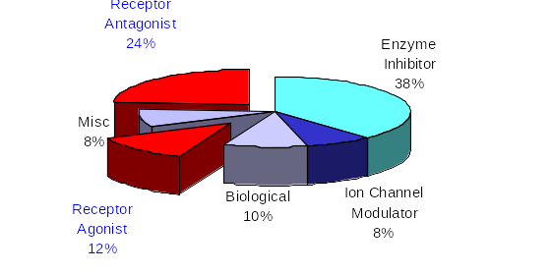
Biological Mechanisms
2005 Top 50 drugs by Worldwide sales
Notes:
Molecules that interact with receptors fall into two categories:
Receptor agonists
Receptor antagonists
These made up a combined 36% of all drug sales in 2005.
The next few slides will explain the difference between agonists and antagonists and how we measure how compounds affect receptor signalling.

Slide 13
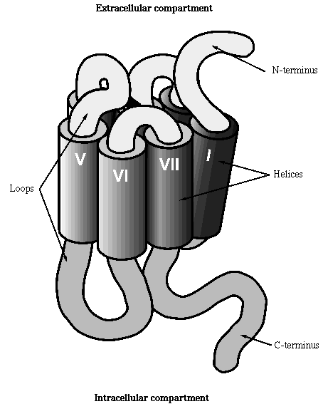
Receptors
Receptors are membrane-bound proteins that bind endogenous ligands (usually extracellular) to induce a phsiological effect (usually intracellular)
A receptor is often the first step in a long intracellular signalling cascade leading to physiological effects
G-Protein Coupled, Seven-Transmembrane Spanning Receptors comprise the majority of known examples
extracellular
7TM GPCR
intracellular
Notes:
G-protein coupled receptors form the majority of all known receptors found in the body. The G-protein is a ‘go-between’ which transfers signals, via a secondary messenger, from the receptor to downstream intracellular enzymes. Ultimately this will lead to a biological response.
When an agonist binds to a receptor the G-protein will usually free up bound Ca²⁺ or release Cyclic Adenosine MonoPhosphate (cAMP). These secondary messengers then propagate the biological signal to down stream intracellular enzymes, eventually providing a biological response.

Slide 14
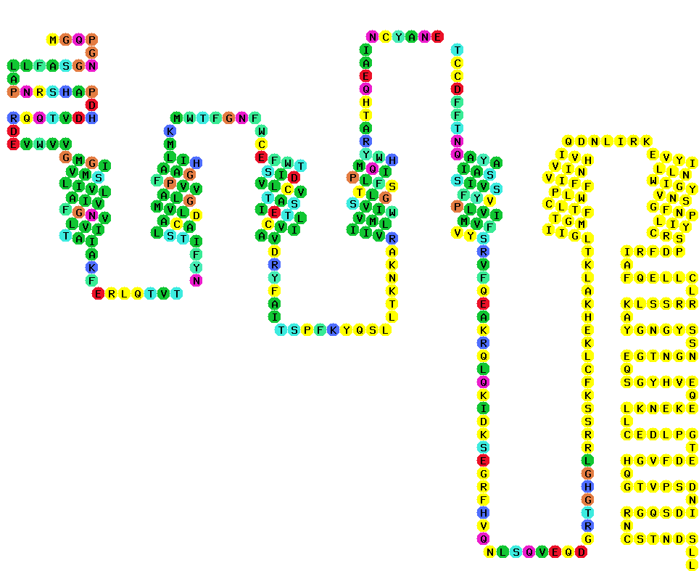
α-adrenoceptor
extracellular loops
ligand recognition & binding
N-terminus
I
membrane
intracellular loops
signalling
G-protein coupling
C-terminus
Notes:
The majority of receptors have this type of structure shown here, and are known as 7TM or 7 trans-membrane. This relates to the 7 alpha helices that span the membrane. Amino acid residues which point into the centre of this 7TM array usually form part of the binding region of the receptor, along with residues along the extracellular loops.
The G-protein, which is found in GPCR’s, is located attached to the intracellular loops of the receptor.
Because receptors are membrane bound, only one crystal structure exists of a GPCR, that of Retinal bound to the bovine rhodopsin receptor. This is very different to the multitude of enzyme crystal structures available.

Slide 15
Binding to Receptors
R
R*
ground-state
receptor
no signal
Excited-state
receptor
signal
Agonist a ligand that binds to, and provokes a signal from a receptor via conformational changes in the excited state
Antagonist a ligand that binds to a receptor and induces no signal. Blocks agonist binding. Little conformational change overall
ligands can be proteins, peptides or small molecules

Slide 16
Binding to Receptors
Agonists & Antagonists bind competitively - beware misunderstandings
from binding data without further functional analysis
Endogenous agonists often bind weakly (enthalpy driven)
Successful antagonists often bind tightly (entropy driven)
Inverse
Partial
Agonist
Partial
Agonist
Inverse
Agonist
Partial
Agonist
Agonist
Agonist
Antagonist
Antagonist
Notes:
An agonist binds and induces a signal.
An antagonist binds and produces no signal.
An inverse agonist binds to a receptor which signals when in the the ground state, and stops this signalling.
All three bind to the receptor, and a simple binding assay will not distinguish between them. A ‘functional’ assay is required to determine the effect of compound binding on receptor signalling. For example, a compound that bound and increased receptor signalling would be an agonist.

Slide 17
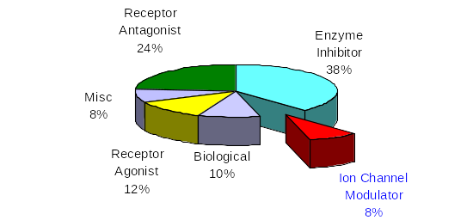
Biological Mechanisms
2005 Top 50 drugs by Worldwide sales
Notes:
Ion channel modulators only represent 8% of drug sales in 2005.
The next few slides will provide a little information on ion channel as potential targets for drug molecules.

Slide 18
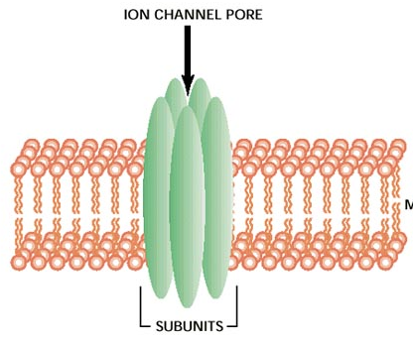
Ion Channels
All of life exists within an electric potential
window of less than one volt
The membrane potential of most cells is 60-70mV
Ion channels regulate passive ion flow through
membranes in an electric or concentration gradient
Channels are ion selective and comprise groups of
glycoprotein subunits in homo- or heteropolymer
arrays. Almost no channels have an open rest state
Channels are involved in cardiac, neuronal, psychiatric and (?) R&I disorders
Which ions?
Na⁺ K⁺ Ca⁺⁺ ( Cl⁻ )
hERG (iKr) channel: blockade causes prolongation of cardiac Q-T interval
“Long QT syndrome” can lead to sudden death
Notes:
Ion channels are closely associated with the nervous system and underlie the nerve impulse. When activated they open to allow passage of a specific ion which then causes a change in electric potential across the cell membrane, thus relaying the nerve impulse.
The ion channel is formed by an array of, usually, 5 helical subunits (similar to the array in a 7TM receptor) which surround a ‘pore’. In the resting state this ‘pore’ is closed.
hERG = human Ether-a-go-go gene which encodes a potassium ion channel which is responsible for repolarising the I_{KR} current in the cardiac action potential. Indiscriminate binding of drug candidates to this ion channel has lead to sudden death by cardiac failure in some clinical trials.

Slide 19
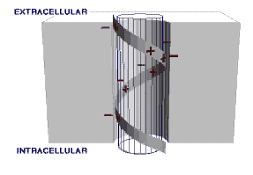
Ion Channels
Channel families are complex, but all channels are either
Voltage-gated
or
Ligand-gated
Ligands can be other ions, small molecules or toxins & venoms such as tetrodotoxin, pumiliotoxin, margatoxin & charybdotoxin
Blockbuster antihypertensive drugs have emerged from calcium-channel antagonist programmes
– Nifedipine, Nimodipine, Isradipine, Amlodipine (NorVasc™)
Notes:
Pore opening is controlled by:
Ligand binding-opens the pore. These are usually found at nerve synapses where the ligands are released by depolarisation at a nerve ending, travel across the synapse and propagate the electrical signal. These ligands are also known as ‘nuero-transmitters’.
Voltage change-Change in cell polarity will open an ion channel and propagate the electrical signal from one nerve cell to another.
Toxins and venoms which block ion channels shut down the organism’s nervous system, which is why a snake or spider bite is so deadly and fast-acting.

