Slide 1
Computer Networks
Module 1
Networking Foundations
Layering & Protocols • Topology • Encapsulation • Multiplexing • OSI • TCP/IP • Physical Layer • Internet Architecture • API
Performance Metrics • High Speed Networks
Reference: Larry L. Peterson, Bruce S. Davie, "Computer Networks : A Systems Approach", The Morgan Kaufmann Series in Networking, 6th Edition, 2021
1

Slide 2
Module 1 - Topics
S.No | Topic
1 | Introduction , Layering & Protocols
2 | Network Topology
3 | Encapsulation
4 | Multiplexing & Demultiplexing
5 | OSI Reference Model
6 | TCP/IP Model
7 | Basics of the Physical Layer
8 | Internet Architecture
9 | Application Programming Interface (Sockets)
10 | Performance Metrics & High-Speed Networks.
4h 00m
2

Slide 3
Learning Objectives
Explain why abstraction and layering are essential to managing the complexity of network design.
Distinguish between a protocol's service interface and its peer interface, and trace a message through a protocol graph.
Classify network topologies and evaluate their cost, reliability, and scalability trade-offs.
Describe encapsulation and de-encapsulation, and identify headers, trailers, and payloads at each layer.
Explain multiplexing/demultiplexing and the role of a demux key in delivering data to the correct process.
Compare the OSI 7-layer reference model with the 4-layer TCP/IP (Internet) architecture.
Identify core physical layer concepts: transmission media, signals, bandwidth, and bit rate.
Describe the Internet's hourglass architecture and explain why IP occupies the narrow waist.
COURSE ORIENTATION
3

Slide 4
TOPIC 1 · LAYERING & PROTOCOLS
Why We Need a Network Architecture
A network must provide connectivity that is general, cost-effective, fair, and robust among a large number of computers.
Networks do not stay fixed — they must evolve as underlying technologies change and as new applications place new demands on them.
Networks must be manageable by humans with varying levels of skill.
Designing a network that satisfies all these requirements at once is not a small task.
Network designers respond with general blueprints called network architectures that guide design and implementation.
Blueprint Analogy
Just as a building architect provides a blueprint that guides electricians, plumbers, and carpenters independently, a network architecture provides a blueprint so hardware and software from many vendors can interoperate.
TOPIC 1 · LAYERING & PROTOCOLS
4

Slide 5
TOPIC 1 · LAYERING & PROTOCOLS
Abstraction — The Core Design Tool
Abstraction: hiding implementation details behind a well-defined interface.
System designers use abstraction as the fundamental tool to manage complexity.
Steps in creating a useful abstraction:
Define a model that captures an important aspect of the system.
Encapsulate the model in an object with a manipulable interface.
Hide implementation details from the object's users.
Example: a communication channel is an abstraction that hides network complexity from application writers.
Key Takeaway
Abstraction in computer networks means providing a simple interface for communication while hiding the complex details of data transmission, routing, error handling, and protocol operations. This allows applications to communicate easily without needing to understand how the underlying network works.
TOPIC 1 · LAYERING & PROTOCOLS
5

Slide 6
TOPIC 1 · LAYERING & PROTOCOLS
What Is Layering?
Start with services offered by the underlying hardware.
Add a sequence of layers, each providing a higher, more abstract level of service.
A high layer is implemented in terms of the services of the layer below it.
Layering gives two big benefits:
Decomposition — break one hard problem into several manageable ones.
Modularity — change one layer's implementation without touching the rest.
Application Program
Process-to-Process Channel
Host-to-Host Connectivity
Underlying Hardware
Each layer builds on the service below it and hides that layer's complexity from the one above.
TOPIC 1 · LAYERING & PROTOCOLS
6

Slide 7
TOPIC 1 · LAYERING & PROTOCOLS
Multiple Abstractions at One Layer
Layering is not always a strictly linear stack.
A given level can offer several alternative abstractions, each built on the same lower-level service.
Example: a request/reply channel and a message-stream channel can both sit at the same level, offering different services to the layer above.
The application picks whichever channel type best fits what it needs to do.
Application Program
Request/Reply
Channel
Message Stream
Channel
Host-to-Host Connectivity
TOPIC 1 · LAYERING & PROTOCOLS
7

Slide 8
TOPIC 1 · LAYERING & PROTOCOLS
Protocols: Two Interfaces
Protocol: An object that provides a communication service used by higher-level objects to exchange messages.
Every protocol defines two distinct interfaces:
Service interface — operations local objects use to invoke the protocol's service (e.g. send / receive).
Peer interface — the form and meaning of messages exchanged with its counterpart on another machine.
Example: HTTP's service interface lets a browser 'fetch a page'; its peer interface defines exactly how a GET request is formatted.
Host A
Protocol
Host B
Protocol
Service interfaces and peer interfaces
To summarize, a protocol defines a communication service that it
exports locally (the service interface), along with a set of rules governing
the messages that the protocol exchanges with its peer(s) to implement
this service (the peer interface).
TOPIC 1 · LAYERING & PROTOCOLS
8

Slide 9
TOPIC 1 · LAYERING & PROTOCOLS
Protocol Graph: RRP, MSP, and HHP
A protocol graph represents the suite of protocols in a system: nodes are protocols, edges show a 'depends on' relation.
RRP (Request/Reply Protocol) and MSP (Message Stream Protocol) both depend on HHP (Host-to-Host Protocol).
To send a message, the file application asks RRP; RRP invokes HHP; HHP delivers it to its peer on Host 2, which passes it back up to RRP, then to the application.
This path — RRP over HHP — is called a protocol stack.
File App
File App
RRP
MS
RRP
MSP
HHP
HHP
TOPIC 1 · LAYERING & PROTOCOLS
9

Slide 10
TOPIC 1 · LAYERING & PROTOCOLS
Specification vs. Implementation
Protocol specification:
A protocol specification is a document that defines how a protocol should work.
Expressed using prose, pseudocode, state diagrams, and packet-format pictures.
Protocol implementation:
A module (software) that actually realises the specification.
Different programmers can implement the same specification differently.
Interoperability:
Two or more implementations that correctly follow a specification and can successfully exchange messages are said to interoperate.
TOPIC 1 · LAYERING & PROTOCOLS
10
Notes:
The HTTP specification is followed by many web servers.
Different implementations include:
Apache HTTP Server
Nginx
Microsoft IIS

Slide 11
TOPIC 1 · LAYERING & PROTOCOLS
Standardization Bodies
IETF
ISO
Internet Engineering Task Force — defines the Internet architecture and specifies protocols such as TCP, UDP, IP, DNS, and BGP.
International Standards Organization — defined the OSI reference architecture and 7-layer model.
These standards specify how protocols should work and how they should be organized into layers. When companies implement these standards correctly, their devices can communicate seamlessly, regardless of who manufactured them.
TOPIC 1 · LAYERING & PROTOCOLS
11

Slide 12

BRAINSTORMING SESSION
Map the Postal System to a Protocol Stack
In pairs, list the 'layers' involved when you post a letter: you writing a letter, an envelope with an address, the local post office, a transport truck/plane, and the receiving post office.
For each layer, identify: (a) what service it offers the layer above, and (b) what 'peer' it communicates with on the receiving side.
Identify one header (control information) that gets added at each stage — e.g., the envelope address is the 'header' added by the postal layer.
Discuss: what does the letter writer NOT need to know about, thanks to abstraction, in order to send the letter successfully?
Be ready to share your mapping and name which part corresponds to a service interface and which to a peer interface.
TOPIC 1 · ACTIVITY
12

Slide 13
TOPIC 2
Network Topology
The physical and logical arrangement of nodes and links in a network.
TOPIC 2
13

Slide 14
TOPIC 2 · NETWORK TOPOLOGY
What Is Network Topology?
Network topology: the arrangement of nodes (computers, switches) and links (cables, wireless paths) that make up a network.
Physical topology — the actual physical layout of cabling and devices.
Logical topology — the path data actually takes as it flows through the network, which may differ from the physical layout.
Topology choice affects: cost, cabling complexity, fault tolerance, ease of adding new nodes, and performance under load.
Common topologies: Bus, Star, Ring, Mesh, Tree, and Hybrid.
TOPIC 2 · NETWORK TOPOLOGY
14

Slide 15
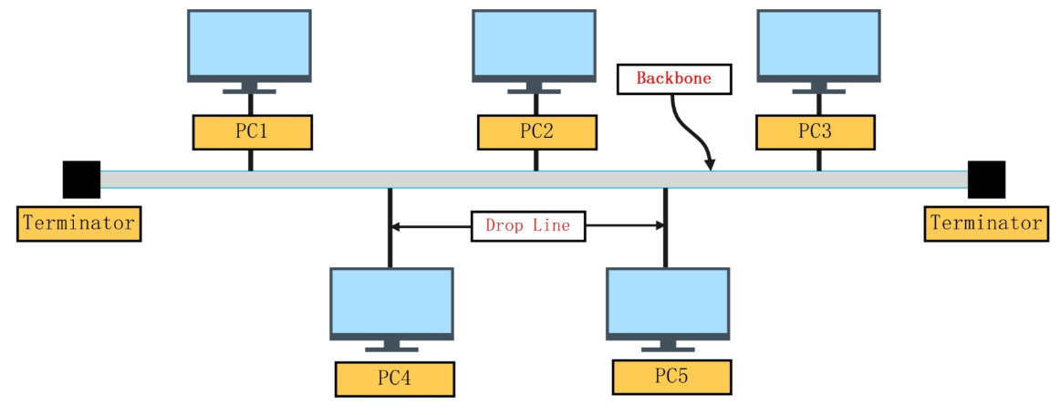
TOPIC 2 · NETWORK TOPOLOGY
Bus Topology
All nodes connect to a single shared communication line (the 'bus'), typically via a tap or connector.
A signal sent by any node travels along the bus and is received by all other nodes.
Advantages:
Low cabling cost; simple to install for small networks.
Disadvantages:
A single break in the bus can disable the entire network.
Performance degrades as more nodes are added (shared medium contention).
TOPIC 2 · NETWORK TOPOLOGY
15

Slide 16
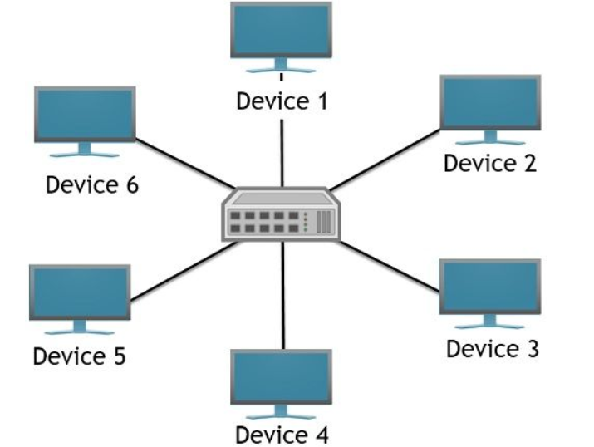
TOPIC 2 · NETWORK TOPOLOGY
Star Topology
Every node connects individually to a central device (a hub or switch).
All traffic passes through the central device, even traffic between two ordinary nodes.
Advantages:
Easy to add/remove nodes; a single cable failure only affects one node.
Centralized management and troubleshooting.
Disadvantages:
The central device is a single point of failure for the whole network.
TOPIC 2 · NETWORK TOPOLOGY
16

Slide 17
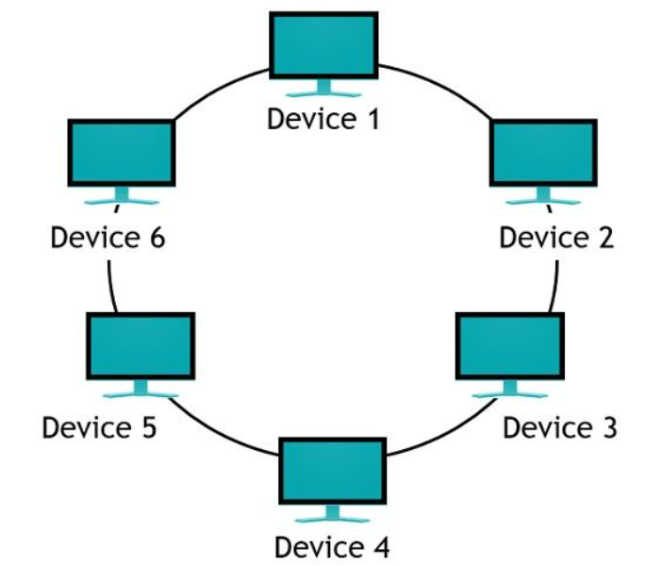
TOPIC 1 · NETWORK TOPOLOGY
Ring Topology
Each node connects to exactly two neighbors, forming a closed loop.
Data travels around the ring, typically in one direction, passing through intermediate nodes to reach its destination.
Advantages:
Predictable performance; no collisions if using token passing.
Disadvantages:
A single broken link can disrupt the entire ring (unless a dual-ring design is used).
Adding or removing a node can disrupt network operation.
TOPIC 2 · NETWORK TOPOLOGY
17

Slide 18
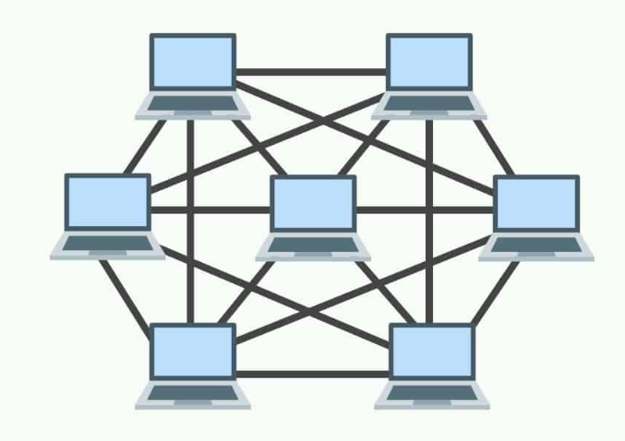
TOPIC 2 · NETWORK TOPOLOGY
Mesh Topology
Full mesh: every node connects directly to every other node.
Partial mesh: only some nodes have direct links to multiple others.
Advantages:
Very high fault tolerance — multiple paths exist between any two nodes.
No single point of failure or traffic bottleneck.
Disadvantages:
Expensive and complex — a full mesh of n nodes needs n(n-1)/2 links.
18

Slide 19
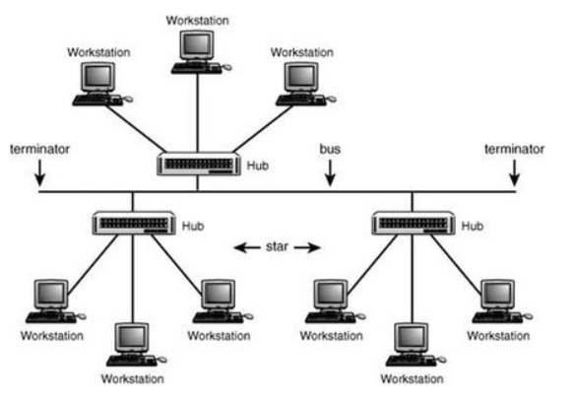
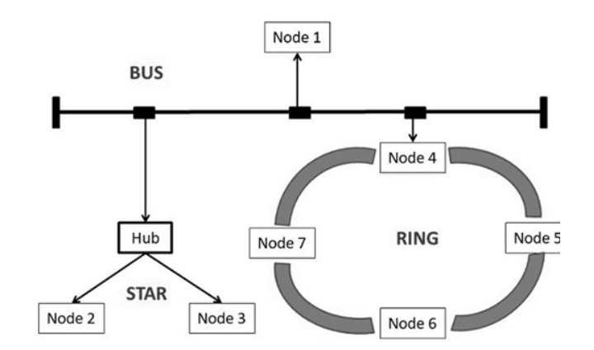
Tree & Hybrid Topology
Tree topology:
A hierarchical structure — groups of star networks connected to a central backbone, like branches of a tree.
Scales well for large organizations (e.g. campus networks with per-building stars).
Hybrid topology:
Combines two or more basic topologies (e.g. a star-of-rings, or star combined with mesh for critical links).
Used in practice to balance cost, performance, and reliability for real-world networks.
19

Slide 20
TOPIC 2 · NETWORK TOPOLOGY
Topology Comparison
Topology | Cost | Scalability | Fault Tolerance | Typical Use
Bus | Low | Low | Poor (single break disables all) | Small, temporary LANs
Star | Medium | Easy | Good (central point fails whole net) | Most modern LANs/offices
Ring | Medium | Moderate | Moderate (dual-ring improves this) | Legacy token-ring, MANs
Mesh | High | Complex | Excellent (multiple paths) | Backbone/critical infrastructure
Tree | Medium-High | Moderate | Good (isolated branch failures) | Campus / enterprise networks
TOPIC 2 · NETWORK TOPOLOGY
20

Slide 21

HANDS-ON ACTIVITY
Design a Campus Network Topology
Scenario: A college campus has 4 buildings (Admin, Library, Hostel, Labs) that must all be interconnected, and each building has 20–40 devices to connect internally.
In groups of 3–4, sketch a topology for:
(a) connecting devices within each building, and
(b) connecting the 4 buildings to each other.
Justify your choice using the comparison table. Consider:
Cabling cost
Fault tolerance if one building's link fails
Ease of adding a 5th building later
Calculate: If you chose a full mesh between the 4 buildings, how many backbone links would you need? (Hint: n(n − 1)/2)
Present your design to the class and defend it against one weakness a classmate identifies.
TOPIC 3 · ACTIVITY
21

Slide 22
TOPIC 3
Encapsulation
How each protocol layer wraps data with its own control information.
TOPIC 3
22

Slide 23
TOPIC 3 · ENCAPSULATION
What Is Encapsulation?
When an application hands a message to a protocol (e.g. RRP), that message is just an uninterpreted string of bytes to the protocol.
The protocol does not care whether the bytes represent an integer array, an email, or an image — it only needs to deliver them.
But the protocol must still communicate control information to its peer, so it attaches a header to the message.
Header:
A small data structure (a few bytes to a few dozen bytes) carrying peer-to-peer control information.
Usually placed at the front of the message; if placed at the end, it is called a trailer.
The original data becomes the body or payload of the new, larger message — this is called encapsulation.
TOPIC 3 · ENCAPSULATION
23

Slide 24
TOPIC 3 · ENCAPSULATION
Anatomy of an Encapsulated Message
A message built by a layer typically has three parts:
Header — control info added at the front by this layer's protocol.
Payload / body — the data handed down from the layer above (may itself contain a header from that layer).
Trailer (optional) — control info some protocols add at the end, e.g. for error checking.
This repeats at every layer as the message travels down the protocol graph before transmission.
HHP
Header
Application Data (Payload)
Trailer
(optional)
RRP
Header
Frame built by HHP, ready for transmission on the wire
TOPIC 3 · ENCAPSULATION
24

Slide 25
TOPIC 3 · ENCAPSULATION
Encapsulation Across the Protocol Graph
Encapsulation repeats at each level of the protocol graph: RRP attaches its header, then HHP encapsulates RRP's entire message by attaching its own header.
A low-level protocol usually does not interpret the data it is given — it just wraps it. (Some protocols do transform the whole body, e.g. to compress or encrypt it.)
High-level messages become nested inside low-level messages, like Russian nesting dolls.
Application Data
RRP Hdr + Data
HHP Hdr + RRP Hdr + Data
Growing outward: each layer adds its own header around what it received from above.
25

Slide 26
TOPIC 3 · ENCAPSULATION
De-encapsulation at the Receiver
At the destination, the message is processed in exactly the reverse order it was built.
HHP interprets its header (acts on the control info), then passes the body — without the HHP header — up to RRP.
RRP interprets its header, then passes the body — without the RRP header — up to the application.
Key result:
The message the application receives is identical to the message the sending application handed down — no headers are ever visible to the application layer.
Intermediate network devices (switches, routers) may inspect lower-layer headers (like the HHP header) without touching the payload above it.
26

Slide 27
HANDS-ON ACTIVITY
Build and Unwrap an Encapsulated Packet
Work in pairs. One partner is the 'Sender stack', the other is the 'Receiver stack'.
On paper, write a short message (the 'Application Data'). The Sender wraps it step by step: add an RRP header (write a fake sequence number), then an HHP header (write fake source/destination addresses) around the outside.
Pass the fully wrapped 'packet' (the paper) to your partner, the Receiver.
The Receiver must de-encapsulate it correctly: read and remove the HHP header first, then the RRP header, and finally recover the original Application Data — in the correct reverse order.
Discuss: what would go wrong if the Receiver tried to read the RRP header before removing the HHP header?
TOPIC 3 · ACTIVITY
27

Slide 28
TOPIC 4
Multiplexing & Demultiplexing
Sharing one channel among many flows, and routing each message back to the right one.
TOPIC 4
28

Slide 29
TOPIC 4 · MULTIPLEXING & DEMULTIPLEXING
What Is Multiplexing?
Packet switching's fundamental idea is to multiplex multiple flows of data over a single physical link.
The same idea applies up and down the protocol graph, not just at switching nodes.
Example: RRP can implement one logical channel, with messages from two different applications multiplexed over it at the source host.
At the destination host, those combined messages must then be demultiplexed back to the correct application.
App A
App B
RRP (multiplexed channel)
Shared Link (HHP)
TOPIC 4 · MULTIPLEXING & DEMULTIPLEXING
29

Slide 30
TOPIC 4 · MULTIPLEXING & DEMULTIPLEXING
Demultiplexing and the Demux Key
Demultiplexing key (demux key):
An identifier included in a protocol's header that records which application (or higher protocol) a message belongs to.
At the source host, the protocol includes the correct demux key in its header when sending.
At the destination host, the protocol strips its header, examines the demux key, and delivers the message to the correct application.
Nearly every protocol supports multiplexing this way — e.g. HHP has its own demux key to decide whether to pass a message up to RRP or to MSP.
Important nuance:
There is no universal demux key format — field size (8, 16, or 32 bits) and count (one key vs. a pair of keys) vary between protocols, even within one architecture.
30

Slide 31
TOPIC 4 · MULTIPLEXING & DEMULTIPLEXING
Worked Example: Two Protocols Over HHP
HHP carries traffic for two higher-level protocols: RRP and MSP.
Every message HHP delivers includes a demux key identifying whether it belongs to RRP or MSP.
On arrival, HHP strips its own header, reads the demux key, and hands the message to the correct protocol module (RRP or MSP).
That protocol then repeats the process one level up, using its own demux key to choose the correct destination application.
This is exactly how a modern host uses a single network card to serve many simultaneous applications at once.
TOPIC 4 · MULTIPLEXING & DEMULTIPLEXING
31

Slide 32
BRAINSTORMING ACTIVITY
Demux Key Detective
In small groups, imagine HHP uses an 8-bit demux key field (supporting 256 possible higher-level protocols).
Discuss: what problem would arise if two different protocol designers, working independently, each picked the same demux key value for their own protocol?
Propose a real-world analogy for a demux key from daily life (e.g., an apartment number on a shared building address, a TV channel number, a radio frequency).
Discuss why a protocol might need a PAIR of demux keys (one for each direction) rather than a single shared key — think about how a source and destination might each track many independent connections.
Share your best analogy with the class.
TOPIC 4 · ACTIVITY
32

Slide 33
TOPIC 5
OSI Reference Model
The OSI Reference Model is a seven-layer framework that describes how an application on one computer communicates with an application on another computer by dividing the communication process into seven functional layers, each performing a specific task..
TOPIC 5
33

Slide 34
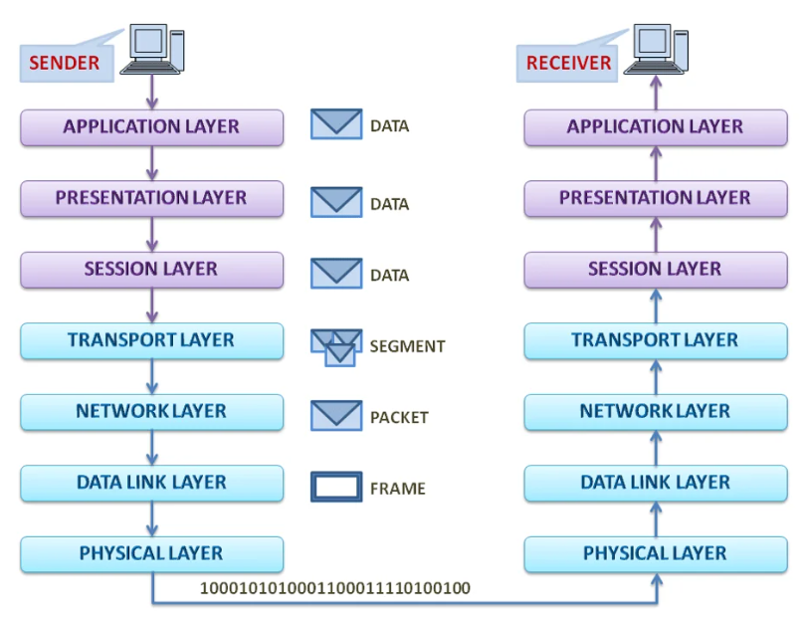
TOPIC 5 · OSI MODEL
The OSI 7-Layer Model — Overview
ISO's Open Systems Interconnection (OSI) architecture partitions network functionality into 7 layers.
One or more protocols implement the functionality assigned to each layer.
It is a reference model for a protocol graph, not a protocol graph itself — no OSI-based network runs today, but its terminology is still widely used.
The lower 3 layers run on every node (hosts AND switches/routers); the top 4 layers run only on end hosts.
TOPIC 5 · OSI MODEL
34

Slide 35
TOPIC 5 · OSI MODEL
Layers 1-3: Physical, Data Link, Network
Layer 1 — Physical:
Handles transmission of raw bits over a communication link.
Layer 2 — Data Link:
Collects a stream of bits into a larger aggregate called a frame; implemented by network adaptors and device drivers.
Layer 3 — Network:
Handles routing among nodes within a packet-switched network; the unit of data here is a packet.
All three of these layers are implemented on every network node — including switches and routers, not just end hosts.
TOPIC 5 · OSI MODEL
35

Slide 36
TOPIC 5 · OSI MODEL
Layer 4: Transport
The transport layer implements what we've been calling a process-to-process channel.
The unit of data exchanged here is commonly called a message, rather than a packet or frame.
The transport layer — and every layer above it — typically runs only on end hosts, not on intermediate switches or routers.
This is the layer where reliability, ordering, and flow control between two communicating processes are usually handled.
TOPIC 5 · OSI MODEL
36

Slide 37
TOPIC 5 · OSI MODEL
Layers 5-7: Session, Presentation, Application
Layer 5 — Session:
Provides a name space tying together potentially different transport streams belonging to one application — e.g. managing an audio stream and a video stream together in a teleconferencing app.
Layer 6 — Presentation:
Concerned with the format of exchanged data — e.g. integer size (16/32/64-bit), byte order, or video stream format.
Layer 7 — Application:
Where application protocols like HTTP live — the basis of the Web, enabling browsers to request pages from servers.
TOPIC 5 · OSI MODEL
37

Slide 38
TOPIC 5 · OSI MODEL
How Data Flows Through the OSI Stack
On the sending host, data flows DOWN through the 7 layers — each layer encapsulates the data with its own header (Application → ... → Physical).
The Physical layer transmits raw bits across the link to the next node.
On the receiving host, data flows UP through the layers — each layer strips its own header and passes the rest upward (Physical → ... → Application).
Intermediate devices (like routers) only process up through Layer 3 before forwarding the packet back down and out.
App
Pres
Sess
Trans
Net
Link
Phy
Sender: data travels down, gaining a header at each layer → Physical link → Receiver: data travels up, losing a header at each layer
TOPIC 5 · OSI MODEL
38

Slide 39
TOPIC 5 · OSI MODEL
Why OSI Still Matters Today
No production network actually runs the full 7-layer OSI stack — the Internet uses the simpler TCP/IP model instead.
But OSI terminology is universally used by networking professionals: 'Layer 2 switch', 'Layer 3 routing', 'Layer 7 firewall' are everyday industry terms.
It gives students and engineers a common vocabulary and a clean conceptual reference for discussing where a given protocol or device operates.
Understanding OSI makes it much easier to understand the more compact, real-world TCP/IP architecture, covered next.
TOPIC 5 · OSI MODEL
39

Slide 40
BRAINSTORMING ACTIVITY
OSI Layer Matching Game
The instructor calls out a real-world networking term or scenario one at a time (e.g., 'Wi-Fi radio signal', 'MAC address', 'IP routing table', 'HTTPS encryption format', 'a Zoom call syncing audio and video', 'a web browser requesting a page').
In teams, quickly decide which OSI layer (1-7) each term belongs to and write your answer on a whiteboard/paper.
Teams reveal answers simultaneously after each term; discuss any disagreements as a class.
Bonus round: for one scenario, trace it through ALL 7 layers from Application down to Physical.
Wrap-up discussion: which layer was hardest to agree on, and why?
TOPIC 5 · ACTIVITY
40

Slide 41
TOPIC 6
TCP/IP Model
The Internet's own 4-layer architecture, built from real-world experience.
TOPIC 6
41

Slide 42
TOPIC 6 · TCP/IP MODEL
TCP/IP (Internet) Architecture — Overview
Also called the Internet architecture, named after its two main protocols: TCP and IP.
Evolved from experience with the ARPANET, an earlier packet-switched network funded by the U.S. Department of Defense's ARPA.
The Internet and ARPANET predate the OSI model — the experience gained building them directly influenced OSI's design.
A simpler 4-layer stack is normally used instead of the full 7-layer OSI model.
Application (HTTP, FTP, SMTP...)
Transport (TCP / UDP)
Internet (IP)
Network Interface (NET1, NET2...)
TOPIC 6 · TCP/IP MODEL
42

Slide 43
TOPIC 6 · TCP/IP MODEL
OSI vs. TCP/IP: Layer Mapping
Layer # | OSI Layer | TCP/IP Layer | Example / Notes
7 | Application | Application | HTTP, FTP, SMTP, DNS, Telnet
6 | Presentation | (folded into Application) | Data formatting, encryption
5 | Session | (folded into Application) | Session/stream management
4 | Transport | Transport | TCP (reliable), UDP (unreliable)
3 | Network | Internet | IP — the architecture's 'narrow waist'
2 | Data Link | Network Interface | Ethernet, Wi-Fi (802.11)
1 | Physical | Network Interface | Cabling, radio signals
TOPIC 6 · TCP/IP MODEL
43

Slide 44
TOPIC 6 · TCP/IP MODEL
TCP vs. UDP
Aspect | TCP | UDP
Channel type | Reliable byte-stream | Unreliable datagram delivery
Delivery guarantee | Guaranteed, in-order delivery | Best-effort, no guarantee
Overhead | Higher (acknowledgements, retransmission) | Lower (minimal header)
Typical use | Web (HTTP), email, file transfer | Streaming, DNS queries, gaming, VoIP
Both TCP and UDP are called end-to-end protocols (or transport protocols) — they provide alternative logical channels directly to application programs, both running on top of IP.
TOPIC 6 · TCP/IP MODEL
44

Slide 45
TOPIC 6 · TCP/IP MODEL
Application Layer Protocols
A range of application protocols run above the transport layer, enabling interoperation of popular applications:
HTTP — Hypertext Transfer Protocol, the basis of the World Wide Web.
FTP — File Transfer Protocol.
Telnet — remote login.
SMTP — Simple Mail Transfer Protocol, for email.
Different browsers (Chrome, Firefox, Safari) all interoperate with any web server because they conform to the same HTTP specification.
Note the terminology overlap:
The same term (e.g. 'FTP') often names both the application program AND the protocol it implements.
TOPIC 6 · TCP/IP MODEL
45

Slide 46
HANDS-ON ACTIVITY
Trace a Protocol Stack
Scenario: A student opens a web browser and requests a page from a college website using HTTP.
In groups, write out the full protocol stack this request travels through, from Application down to Network Interface, labeling each TCP/IP layer.
Decide: should this request use TCP or UDP at the transport layer? Justify your choice using the TCP vs UDP comparison table.
Now repeat the exercise for a live video call (e.g. a VoIP or video-conferencing app) — does your transport-layer choice change? Why?
Map both scenarios onto the OSI 7-layer model as well, and note which OSI layers TCP/IP compresses together.
TOPIC 6 · ACTIVITY
46

Slide 47
TOPIC 7
Basics of the Physical Layer
How raw bits actually travel across cables, fibers, and the air.
TOPIC 7
47

Slide 48
TOPIC 7 · PHYSICAL LAYER
Role of the Physical Layer
The physical layer is Layer 1 — it handles the transmission of raw bits (0s and 1s) over a communication link.
It defines the electrical, mechanical, and timing details of turning bits into signals: voltage levels, light pulses, or radio waves.
It does not understand frames, addresses, or messages — it simply moves a stream of bits from one point to another.
Everything above it (data link and up) depends on the physical layer successfully delivering bits, even if imperfectly — higher layers handle error detection and correction.
TOPIC 7 · PHYSICAL LAYER
48

Slide 49
TOPIC 7 · PHYSICAL LAYER
Transmission Media: Guided (Wired)
Twisted Pair Cable:
Copper wires twisted together to reduce interference; inexpensive; used in Ethernet LANs (Cat5e/Cat6).
Coaxial Cable:
A central conductor shielded by a metal mesh; more resistant to interference than twisted pair; used in cable TV/broadband.
Fiber Optic Cable:
Transmits data as pulses of light through glass/plastic fiber; extremely high bandwidth, very low signal loss, immune to electromagnetic interference; used for backbones and long-haul links.
TOPIC 7 · PHYSICAL LAYER
49

Slide 50
TOPIC 7 · PHYSICAL LAYER
Transmission Media: Unguided (Wireless)
Radio Waves:
Used by Wi-Fi (802.11 standards) and cellular networks; can penetrate walls; range varies with frequency and power.
Microwaves:
Line-of-sight transmission; used for point-to-point links and satellite communication.
Infrared:
Short-range line-of-sight; used in remote controls and some short-range device links.
Wireless media are shared, so multiple devices must coordinate access to avoid interference — a key challenge unique to unguided transmission.
TOPIC 7 · PHYSICAL LAYER
50

Slide 51
TOPIC 7 · PHYSICAL LAYER
Key Concepts: Bandwidth, Signals, Bit Rate
Bandwidth
Bit Rate
The range of frequencies a medium can carry, or loosely, the maximum data rate a link can support — measured in Hz (frequency) or bits per second (data capacity).
The number of bits transmitted per second (bps) — determines how fast data actually moves across the link.
Analog vs Digital Signal
Attenuation & Noise
Analog signals vary continuously (e.g. traditional telephone voice); digital signals take discrete values (0s and 1s) — most modern networks are digital.
Attenuation is signal weakening over distance; noise is unwanted interference — both physical layer engineers must design around.
TOPIC 7 · PHYSICAL LAYER
51

Slide 52
BRAINSTORMING ACTIVITY
Media Selection Challenge
In groups, you are network consultants. For each scenario below, choose the best transmission medium and justify it in one sentence:
(a) Connecting two office buildings 2 km apart, needing very high bandwidth and immunity to lightning/electrical interference.
(b) Providing internet access to student laptops moving freely around a hostel common room.
(c) Connecting a desktop PC to a switch 5 meters away in a low-interference office.
(d) Linking two ground stations to a satellite in orbit.
Discuss: which choice would change if cost was the ONLY factor instead of performance?
TOPIC 7 · ACTIVITY
52

Slide 53
TOPIC 8
Internet Architecture
The hourglass philosophy that let the Internet scale and evolve.
TOPIC 8
53

Slide 54
TOPIC 8 · INTERNET ARCHITECTURE
Origins: From ARPANET to the Internet
The Internet architecture evolved from experience with the ARPANET, an earlier packet-switched network.
Both the ARPANET and the Internet were funded by ARPA (Advanced Research Projects Agency), part of the U.S. Department of Defense.
The Internet and ARPANET existed before the OSI architecture — lessons learned building them heavily influenced the OSI reference model, not the other way around.
The Internet architecture is also called the TCP/IP architecture, named after its two most central protocols.
TOPIC 8 · INTERNET ARCHITECTURE
54

Slide 55

TOPIC 8 · INTERNET ARCHITECTURE
The Hourglass Model
The Internet protocol graph has an hourglass shape: wide at the top, narrow in the middle, wide at the bottom.
IP sits at the narrow waist — a single, common method for exchanging packets across many different networks.
Above IP: arbitrarily many transport protocols (TCP, UDP, ...), each offering a different channel abstraction to applications.
Below IP: arbitrarily many network technologies (Ethernet, Wi-Fi, fiber, ...) can be used interchangeably.
This separates 'delivering messages host-to-host' from 'providing a useful process-to-process service' — the central philosophy of the architecture.
HTTP FTP SMTP DNS ...
TCP UDP
IP
Data Link / Network Interface
Ethernet Wi-Fi Fiber ...
Narrow waist = one common protocol (IP) everything above and below can rely on.
TOPIC 8 · INTERNET ARCHITECTURE
55

Slide 56
TOPIC 8 · INTERNET ARCHITECTURE
Three Key Features of Internet Architecture
1. No strict layering enforced:
Applications are free to bypass defined transport layers and use IP (or even an underlying network) directly; programmers can define entirely new channel abstractions.
2. The hourglass philosophy:
IP is the focal point — a common way to exchange packets across many networks, cleanly separating host-to-host delivery from process-to-process service.
3. Specification + working implementation required:
For the IETF to adopt a new protocol, there must be both a written specification AND at least one (preferably two) working implementations.
TOPIC 8 · INTERNET ARCHITECTURE
56

Slide 57
TOPIC 8 · INTERNET ARCHITECTURE
IETF & 'Rough Consensus and Running Code'
The IETF (Internet Engineering Task Force) is the primary standardization body for the Internet architecture and many of its core protocols (TCP, UDP, IP, DNS, BGP).
The Internet architecture also embraces protocols from other bodies: IEEE (802.3 Ethernet, 802.11 Wi-Fi), W3C (HTTP/HTML), 3GPP (4G/5G), ITU-T (H.264 video).
IANA (Internet Assigned Numbers Authority), a department of ICANN, hands out the unique identifiers protocols need to interoperate.
“We reject kings, presidents, and voting.
We believe in rough consensus and running code.”
— David Clark, widely quoted at IETF meetings
TOPIC 8 · INTERNET ARCHITECTURE
57
Notes:
Rough consensus means:
Most technical experts agree that this is a good solution, even if everyone does not agree.

Slide 58
BRAINSTORMING ACTIVITY
Redesign the Hourglass
In groups, discuss: why is it important that the 'waist' of the hourglass (IP) stays narrow — i.e., why not add lots of features directly into IP itself?
Brainstorm: what would happen to Internet innovation if a new physical network technology required rewriting every application? Connect this to the hourglass's separation of concerns.
Discuss one modern technology that sits ABOVE the transport layer (e.g. a new streaming protocol) and one that sits BELOW IP (e.g. a new wireless standard) — explain why neither required changes to IP itself.
Debate: is a narrow, stable waist still the right design for the Internet today, given the huge diversity of modern devices (IoT, mobile, satellites)? Give one argument for and one against.
58

Slide 59
Self-Assessment: Practice Questions
1. Explain the difference between a protocol's service interface and its peer interface, using an example.
2. Why does the Internet architecture avoid enforcing strict layering, unlike the OSI model?
3. Draw the encapsulated message that results when application data passes through RRP and then HHP.
4. Compare a star topology and a mesh topology in terms of cost and fault tolerance.
5. What is a demux key, and why can't all protocols agree on one universal format for it?
6. Map each OSI layer to its corresponding TCP/IP layer, noting which OSI layers are combined.
7. Explain why IP is described as the 'narrow waist' of the Internet's hourglass architecture.
8. List two guided and two unguided transmission media, with one use case each.
59

Slide 60
TOPIC 9
Application Programming Interface (Sockets)
API (Application Programming Interface) acts as a bridge between an application and network services.
It enables applications to send requests and receive responses over a network using standard interfaces.
60

Slide 61
Software Makes the Internet Powerful
Why is the Internet so successful?
The Internet became successful not only because of cables and routers but because of software.
Software allows developers to create new applications without changing the Internet infrastructure.
Examples
WhatsApp
YouTube
Gmail
Zoom
Google Maps
Instagram
All these applications work because they use the same Internet.
Program
Process-to-Process Channel
61
Notes:
Key Point : Hardware carries the data. Software decides what data to send and how users interact with it.

Slide 62
What is a Network Application?
A Network Application is software that communicates with another software over a network.
Application Program
Real-life Example
When you send "Hello“ through WhatsApp
your phone application
↓
uses the Internet
↓
reaches the WhatsApp server
↓
server sends it to your friend's phone.
Examples
Application | Communicates With
WhatsApp | WhatsApp Server
Chrome | Web Server
Gmail | Mail Server
Zoom | Zoom Server
PUBG | Game Server
Host-to-Host Connectivity
62

Slide 63
How Applications Communicate?
Applications do NOT
touch Ethernet cables
control routers
manage switches
Instead, they ask the Operating System for networking services.
Application
│
Operating System
│
TCP/IP Protocol Stack
│
Internet
Host A
Protocol
Host B
Protocol
63

Slide 64
What is an API ?
API = Application Programming Interface
An API is a set of functions provided by the Operating System.
Applications use these functions to communicate over the network.
Example
Instead of building networking from scratch, the application simply asks the OS "Please send this message.“
The Operating System handles everything.
File App
File App
RRP
MS
RRP
MSP
HHP
HHP
The Network API Concept
Every OS provides an interface to its networking subsystem → Network API
Most protocols are implemented in software within the OS
64

Slide 65
What is Socket API?
A Socket API is a programming interface used by applications to communicate over a network.
It acts as the connection point between Application and Network.
Why are Sockets Important?
Without sockets, every programmer would need to build networking from scratch.
Sockets make networking easy.
They provide ready-made functions.
Benefits
Easy programming
Faster application development
Same interface on Windows, Linux and Mac
Used in Java, Python and C
Socket API: Originated in Berkeley Unix (BSD)
Now supported by virtually all major OSs
Foundation for language-specific libraries (Java, Python sockets, etc.)
65

Slide 66
Significance of the Socket API
Defines the boundary between:
Applications running on top of the Internet
The internal implementation of the Internet
A stable, well-defined interface → enabled Internet applications to become a multi-billion-dollar industry
Evolution: simple client/server apps (email, FTP, remote login) → today's cloud applications on smartphones
Concept | Description
Protocol | Defines the services offered (e.g., TCP's reliable byte stream)
API | Defines the syntax to invoke those services on a system
66
Notes:
Key Point : Hardware carries the data. Software decides what data to send and how users interact with it.

Slide 67
The Socket - Core Abstraction
Definition: The point where a local application process attaches to the network
Socket interface provides operations to:
Create a socket
Attach it to the network
Send/receive messages
Close the socket
Focus: Sockets used with TCP (connection-oriented)
67
Notes:
Key Point : Hardware carries the data. Software decides what data to send and how users interact with it.

Slide 68
Creating a Socket
int socket(int domain, int type, int protocol);
domain → protocol family
PF_INET – Internet family
PF_UNIX – Unix pipe facility
PF_PACKET – direct network interface access (bypasses TCP/IP)
type → communication semantics
SOCK_STREAM – byte stream (TCP)
SOCK_DGRAM – message-oriented (UDP)
protocol → specific protocol (often UNSPEC; PF_INET + SOCK_STREAM implies TCP)
Return value: socket handle (identifier for future operations)
Program
Process-to-Process Channel
68
Notes:
Key Point : Hardware carries the data. Software decides what data to send and how users interact with it.

Slide 69
Server Side - Passive Open
Server prepares to accept connections (doesn't establish one itself)
Three operations:
int bind(int socket, struct sockaddr *address, int addr_len);
int listen(int socket, int backlog);
int accept(int socket, struct sockaddr *address, int *addr_len);
bind → attaches socket to local address (IP + port number)
Ports act as demultiplexing keys
Well-known ports (e.g., HTTP = port 80)
listen → sets max number of pending connections
accept → blocking call; waits for a client to connect
Returns a new socket for the established connection
Original socket remains open for future accept() calls
69
Notes:
Key Point : Hardware carries the data. Software decides what data to send and how users interact with it.

Slide 70
Client Side - Active Open
int connect(int socket, struct sockaddr *address, int addr_len);
Client specifies the address of the remote server it wants to connect to
Blocks until TCP successfully establishes the connection
Client generally lets the OS choose its own local port (doesn't care which one)
Server, in contrast, listens on a well-known fixed port
70
Notes:
Key Point : Hardware carries the data. Software decides what data to send and how users interact with it.

Slide 71
Sending and Receiving Data
int send(int socket, char *message, int msg_len, int flags);
int recv(int socket, char *buffer, int buf_len, int flags);
send() → transmits a message over the connected socket
recv() → receives a message into a buffer
Both accept flags to control operation details
Used after connection is successfully established (client & server)
71
Notes:
Key Point : Hardware carries the data. Software decides what data to send and how users interact with it.

Slide 72
Socket API - Summary
Program
Operation | Used By | Purpose
socket() | Both | Create a socket
bind() | Server | Attach socket to local address/port
listen() | Server | Set pending connection queue size
accept() | Server | Accept incoming connection (blocking)
connect() | Client | Initiate connection to server
send() | Both | Send data
recv() | Both | Receive data
close() | Both | Terminate the connection
Process-to-Process Channel
72
Notes:
Hardware carries the data. Software decides what data to send and how users interact with it.

Slide 73
Summary
The Socket API is the demarcation point between applications and the underlying network implementation
Sockets = local endpoint of a network connection
TCP socket programming involves a clear sequence: socket → bind/listen/accept (server) and socket → connect (client)
Same API pattern underlies most modern client-server and networked applications, including cloud services
Program
73
Notes:
Key Point : Hardware carries the data. Software decides what data to send and how users interact with it.

Slide 74
TOPIC 10
Network Performance Metrics
Throughput • Bandwidth • Delay • Latency • High-Speed Networks
74

Slide 75
Why Network Performance Matters
"First get it right, then make it fast"
is a classic programming adage but in networking, performance must often be
designed in from the start.
TWO PILLARS OF
PERFORMANCE
Bandwidth
The effectiveness of distributed computations depends directly on how efficiently the network delivers data.
Volume of data delivered per unit time (bits/second).
Network performance is judged using two fundamental measures: bandwidth (throughput) and latency (delay).
Latency
Time taken for a message to travel end-to-end.
Understanding these metrics lets engineers predict, diagnose, and improve real-world application behaviour over a network.
Together, they define the complete performance profile of any link or channel.
75

Slide 76
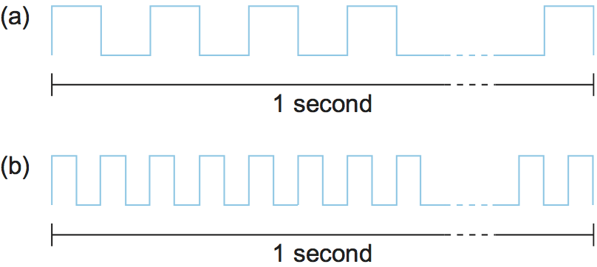
Bandwidth: The Data Highway
Definition
VISUALIZE
The number of bits that can be transmitted over a network in a given period of time.
Think of 1 second as a length of ruler. Bandwidth = how many bit-pulses fit in that length.
e.g. a 10 Mbps network delivers 10 million bits every second each bit takes 0.1 μs to transmit.
1 Mbps → each bit is 1 μs wide
Two Senses of the Word
Signal bandwidth (Hz):
width of a frequency band e.g. voice-grade phone line: 3300 Hz − 300 Hz = 3000 Hz.
Data-link bandwidth (bits/sec):
the commonly used networking sense e.g. "a 10 Mbps Ethernet link."
2 Mbps → each bit is 0.5 μs wide
76

Slide 77
Bandwidth vs Throughput vs Requirement
Term | What it Means | Example
Bandwidth (Data Rate) | Maximum data rate available on a link, a theoretical capacity. | "The link bandwidth is 10 Mbps."
Throughput | Actual measured performance achieved in practice, often lower than bandwidth due to inefficiencies. | A 10 Mbps link achieving only 2 Mbps throughput.
Bandwidth Requirement | Bits/second an application needs to perform acceptably may be fixed, variable, or "best-effort." | A video app needing a steady 5 Mbps.
Bandwidth is the capacity of the pipe; throughput is what actually flows through it. The gap between the two is caused by protocol overhead, congestion, and implementation inefficiencies.
77

Slide 78
What Influences Bandwidth?
1
2
3
Physical Link Bandwidth
Logical Channel Bandwidth
Bit Width
Constantly improving with better transmitting/receiving technology narrower bit-pulses fit more bits per second.
Process-to-process bandwidth is also shaped by how many times software must handle or transform each bit.
Each bit occupies a fixed 'width' in time e.g. 1 μs at 1 Mbps, 0.5 μs at 2 Mbps. Higher bandwidth = narrower bits.
Example
On a 10-Mbps link: Time to transmit 1 bit = 1 / (10 × 10⁶) = 0.1 μs.
On a 100-Mbps link: Time to transmit 1 bit = 1 / (100 × 10⁶) = 0.01 μs — bits are 10× narrower.
78

Slide 79
Hands-On Activity
Bandwidth vs Throughput — Real Life
Your ISP advertises "100 Mbps" broadband, but a speed test shows only 62 Mbps. List THREE possible real-world causes for this gap.
1
A file-sharing app needs "whatever bandwidth it can get," while a video call needs a fixed 3 Mbps. Classify 3 more everyday apps by their bandwidth requirement type.
2
Quick Poll: Would doubling your Wi-Fi router's advertised bandwidth double your real download speed? Justify your answer using today's concepts.
3
79

Slide 80
Latency: The Time Cost of a Journey
Definition
REMEMBER
Latency (delay) is how long it takes a message to travel from one end of a network to the other.
Latency ≠ Bandwidth
Example: A transcontinental network may have a one-way latency of 24 ms.
Latency is measured strictly in units of TIME (ms, μs) , never in bits/second.
Round-Trip Time (RTT)
One-way latency
The time to send a message from one end to the other AND back , often more important than one-way latency in practice (e.g. request–response protocols, TCP handshakes).
Source → Destination, single direction
Round-Trip Time
Source → Destination → back to Source
80

Slide 81
The Three Components of Latency
1
2
3
Propagation Delay
Transmit Delay
Queuing Delay
Time for a signal to physically travel through the medium — limited by the speed of light in that medium.
Time needed to push all bits of a packet onto the link — depends on packet size and bandwidth.
Time a packet waits inside switches/routers before being forwarded on an outbound link.
Latency = Propagation + Transmit + Queue
81

Slide 82
Latency Formulas
Propagation Delay
Transmit Delay
Propagation = Distance / SpeedOfLight
Transmit = Size / Bandwidth
Distance = length of the wire; SpeedOfLight = effective speed in that medium.
Size = packet size (bits); Bandwidth = link's transmission rate.
Total Latency = Propagation + Transmit + Queue
Special case: for a single link and a 1-bit message, Transmit and Queue vanish — latency = propagation delay only.
"Latency" and "delay" are used generically in networking; "propagation delay" refers specifically to signal travel time.
82

Slide 83
Speed of Light Varies by Medium
Medium | Effective Speed of Light | Relative to Vacuum
Vacuum / Free Space | 3.0 × 10⁸ m/s | 100% (baseline)
Copper Cable | 2.3 × 10⁸ m/s | ~77%
Optical Fiber | 2.0 × 10⁸ m/s | ~67%
Don’t plug in the vacuum speed of light (3×10⁸ m/s) for every problem. Always check the transmission medium stated in the question fiber and copper are noticeably slower than free space, and this changes your propagation-delay answer.
Formula reminder: Propagation Delay = Distance ÷ Speed-of-Light (in that medium)
83

Slide 84
Worked Example: Propagation Delay
Problem: An optical-fiber link runs 1,000 km between two cities. Find the propagation delay.
Step 1
Identify values: Distance = 1000 km = 1 × 10⁶ m; Speed in fiber = 2.0 × 10⁸ m/s
Step 2
Apply formula: Propagation = Distance / SpeedOfLight
Step 3
Compute: Propagation = (1 × 10⁶) / (2.0 × 10⁸) = 5 × 10⁻³ s = 5 ms
Answer: Propagation Delay = 5 milliseconds (one-way)
84

Slide 85
When Does Latency Dominate?
Case: Small Messages (Latency-Bound)
A client sends a 1-byte message and receives a 1-byte reply , think of a keystroke echoed back, or a single ping.
Across the Room
Transcontinental
RTT = 1 ms
RTT = 100 ms
Transmit time @ 1 Mbps for 1 byte = 8 μs
Transmit time @ 100 Mbps = 0.08 μs
Same negligible transmit times, but the round-trip time itself dominates completely.
→ Response time ≈ 1 ms either way
→ Link speed (1 Mbps vs 100 Mbps) barely matters here!
85

Slide 86
When Does Bandwidth Dominate?
Case: Large Transfers (Bandwidth-Bound) fetching a 25 MB digital-library image over a 10 Mbps channel.
Transmit Time = Size / Bandwidth = (25 × 10⁶ × 8 bits) / (10 × 10⁶ bps) = 20 seconds
1-ms RTT channel
100-ms RTT channel
Total ≈ 20.001 seconds
Total ≈ 20.1 seconds
RTT contributes a tiny 0.001 s
Negligible difference from the 1-ms case!
86

Slide 87
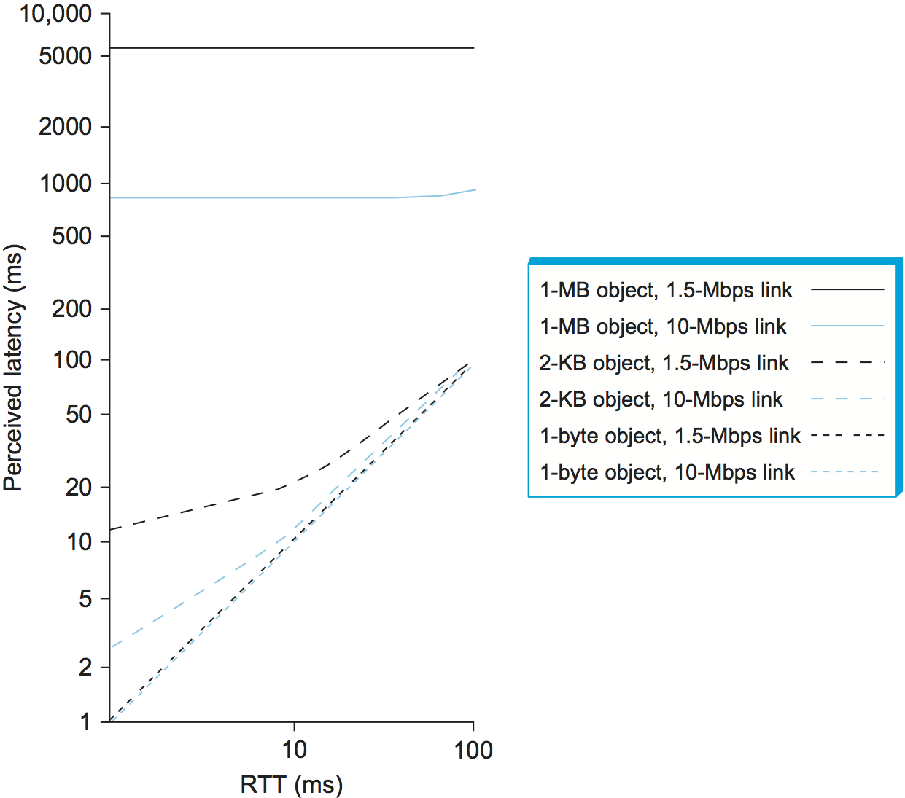
Visualizing Latency vs Bandwidth Dominance
1-byte object: response time ≈ RTT, 1.5 Mbps vs 10 Mbps link makes no visible difference.
2-KB object (an email): link speed matters a lot at low RTT, negligibly at high RTT.
1-MB object (an image): RTT barely matters, link (bandwidth) speed dominates across the board.
Perceived latency (response time) versus round-trip time for various object sizes and link speeds.
87

Slide 88
Hands-On Activity
Latency-Bound or Bandwidth-Bound?
An online multiplayer game sends tiny 20-byte position updates 30 times/second. Is this game latency-bound or bandwidth-bound? Explain.
1
A cloud backup service uploads a 4K video (2 GB) overnight. Would improving your RTT from 80 ms to 20 ms noticeably speed this up? Justify with reasoning from today's examples.
2
Brainstorm: Name ONE real application from your daily life for each category — (a) latency-bound, (b) bandwidth-bound, (c) roughly balanced.
3
88

Slide 89
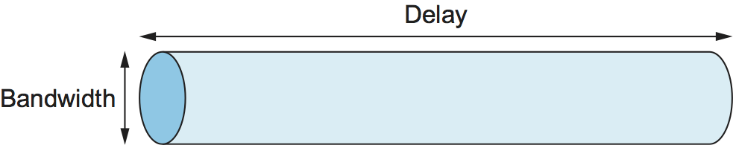
The Delay × Bandwidth Product
Definition
The product of latency and bandwidth, the maximum number of bits that can be "in flight" (in transit) through a channel at any instant.
The Pipe Analogy
Why it matters: tells us how many bits the sender can transmit before hearing back from the receiver.
Latency = length of the pipe Bandwidth = diameter of the pipe Delay × Bandwidth = volume of the pipe (bits it can hold)
89

Slide 90
Computing the Delay × Bandwidth Product
Delay × Bandwidth Product = Latency (RTT or one-way) × Bandwidth
Example
A transcontinental channel has one-way latency = 50 ms and bandwidth = 45 Mbps.
Volume = 50 × 10⁻³ s × 45 × 10⁶ bits/s = 2.25 × 10⁶ bits ≈ 280 KB
If we instead use RTT (2 × 50 ms = 100 ms): RTT × Bandwidth = 100×10⁻³ × 45×10⁶ = 5.5 × 10⁶ bits ≈ 671 KB , the amount that could arrive after a "stop" signal is sent, before the sender reacts.
90

Slide 91
Table 1: RTT × Bandwidth for Real Networks
Link Type | Bandwidth | One-Way Distance | RTT | RTT × Bandwidth
Wireless LAN | 54 Mbps | 50 m | 0.33 μs | 18 bits
Satellite | 1 Gbps | 35,000 km | 230 ms | 230 Mb
Cross-country Fiber | 10 Gbps | 4,000 km | 40 ms | 400 Mb
Interpreting the Table
• Wireless LAN:
Tiny RTT × Bandwidth , almost nothing is ever "in flight."
• Satellite:
Huge product hundreds of megabits can be in transit simultaneously due to the very long RTT.
• Cross-country Fiber:
High bandwidth combined with moderate delay also yields a very large product.
91

Slide 92
Hands-On Activity
Compute the Delay × Bandwidth Product
A satellite link has a one-way propagation delay of 270 ms and bandwidth of 2 Mbps. Compute the RTT × Bandwidth product in bits and in KB.
1
If the sender in Q1 wants to keep the pipe completely full (never idle waiting for an ACK), how many bits should it send before pausing?
2
Brainstorm: Why might a satellite link need a much larger 'window' of unacknowledged data in flight than a LAN link? Connect your answer to the pipe analogy.
3
92

Slide 93
High-Speed Networks: What Changes, What Doesn't
WHAT DOES NOT CHANGE
WHAT DOES CHANGE
The Speed of Light
Bandwidth Keeps Rising
A transcontinental RTT is the same ~100 ms whether the link is 1 Mbps or 1 Gbps propagation delay is fixed by distance and medium, not by bandwidth.
As bandwidth rises without bound, our thinking about network design must shift:
Going from 100 RTTs to 101 RTTs (1% more) feels trivial. But going from 1 RTT to 2 RTTs (100% more) is a huge relative jump so latency, not throughput, starts to dominate our thinking.
93

Slide 94
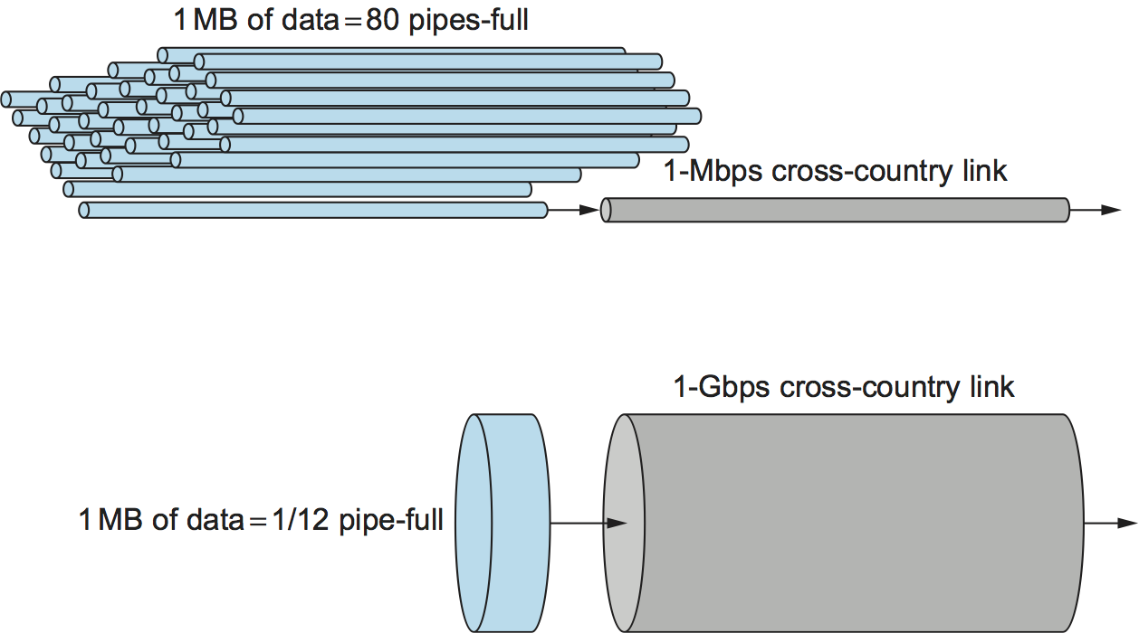
Example: A 1 MB File on Two Networks
Both networks below share the same 100 ms RTT.
1-Mbps Network
1-Gbps Network
80 round-trip times
Fits in 1/12th of an RTT
needed to transmit the file — each RTT carries only 1.25% of it.
Delay × bandwidth product = 12.5 MB — far bigger than our 1 MB file.
The file behaves like a continuous STREAM of data.
The file behaves like a SINGLE PACKET.
A 1-MB file would fill the 1-Mbps link 80 times but only 1/12th of a 1-Gbps link." Analogy: a 1-MB file is to a 1-Gbps network what a 1-KB packet is to a 1-Mbps network.
94

Slide 95
Effective Throughput & Transfer Time
Throughput = TransferSize / TransferTime
TransferTime = RTT + (1/Bandwidth) × TransferSize
Why Include RTT?
RTT accounts for the request message travelling to the server and the response data travelling back — the full round trip of a real request/response transfer, not just raw transmission.
As TransferSize → ∞, effective throughput approaches the network's raw bandwidth. Enduring extra RTTs (e.g. retransmissions) hurts effective throughput most for small transfers.
95

Slide 96
Example: Effective Throughput
Problem: Fetch a 1 MB file across a 1-Gbps link with RTT = 100 ms. Find the effective throughput.
Step 1 Transmit time
1/(1 Gbps) × 1 MB = 8 ms
Step 2 Total transfer time
TransferTime = RTT + Transmit = 100 ms + 8 ms = 108 ms
Step 3 Effective throughput
1 MB / 108 ms = 74.1 Mbps , NOT the full 1 Gbps!
The 1-Gbps "speed limit" is rarely reached for small transfers, RTT overhead dominates.
96

Slide 97
Hands-On Activity
High-Speed Networks in the Real World
You upgrade your home internet from 100 Mbps to 1 Gbps but your video calls still stutter. Using today's concepts, brainstorm 3 possible explanations that are NOT about bandwidth.
1
Calculate: fetching a 500 KB web page over a 500-Mbps link with RTT = 60 ms. Find TransferTime and effective throughput. Compare with the raw bandwidth.
2
Discuss: Why do engineers designing satellite or undersea-cable networks worry MORE about RTT than about adding more bandwidth? Link your answer to the delay × bandwidth product.
3
97

Slide 98
Summary
Bandwidth
Latency
Capacity of the link (bits/sec); throughput is what's actually achieved in practice.
Time for data to travel = Propagation + Transmit + Queue delay.
Latency vs Bandwidth
Delay × Bandwidth
Small transfers are latency-bound; large transfers are bandwidth-bound.
The 'volume' of the pipe bits that can be in flight at once.
High-Speed Networks
Effective Throughput
Bandwidth keeps rising, but the speed of light and hence RTT stays fixed.
= TransferSize / (RTT + Size/Bandwidth); approaches raw bandwidth only for large transfers.
98

