Slide 1
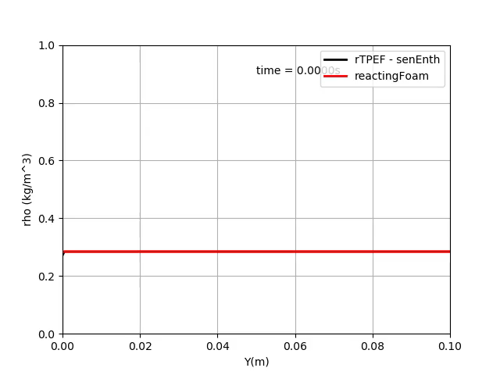
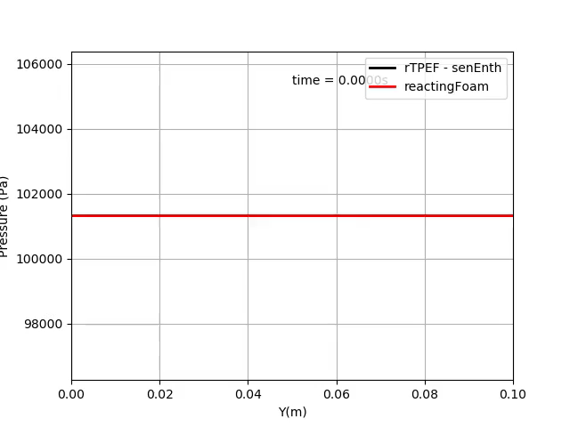
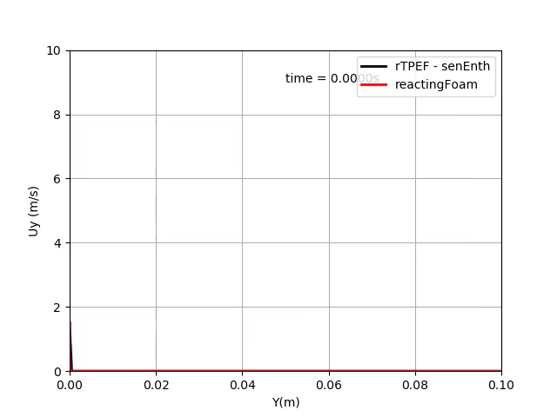
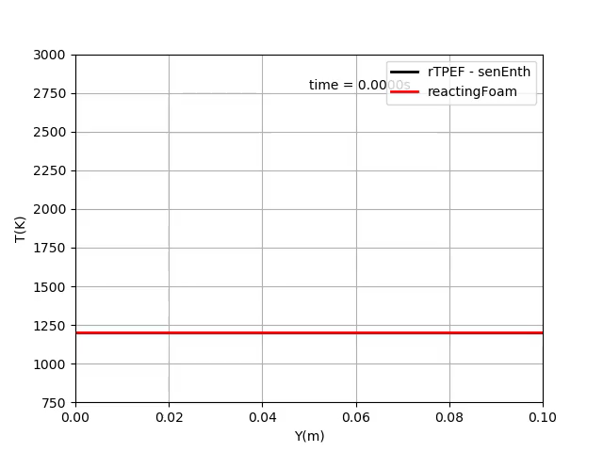
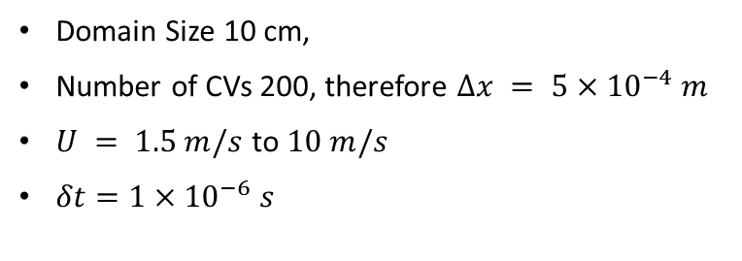
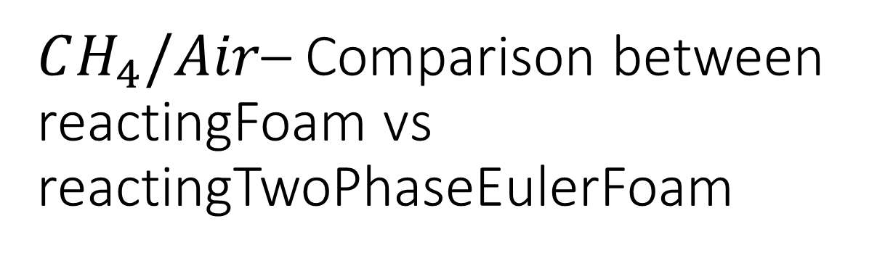
$CH_{4}/Air$– Comparison between reactingFoam vs reactingTwoPhaseEulerFoam
(pressure BC - waveTransmissive)
Domain Size 10 cm,
Number of CVs 200, therefore $Δx = 5×{10}^{−4} m$
$U = 1.5 m/s$ to $10 m/s$
$δt=1×{10}^{−6} s$
Simulation Time = 0.1 Sec
Inference : -
More close to adiabatic flame temperature

