Slide 1
Postal Code Conversion File: Not as scary as you think
Alexandra Cooper, Queen’s University Library
ACCOLEDS/Western DLI Training, November 2019

Slide 2
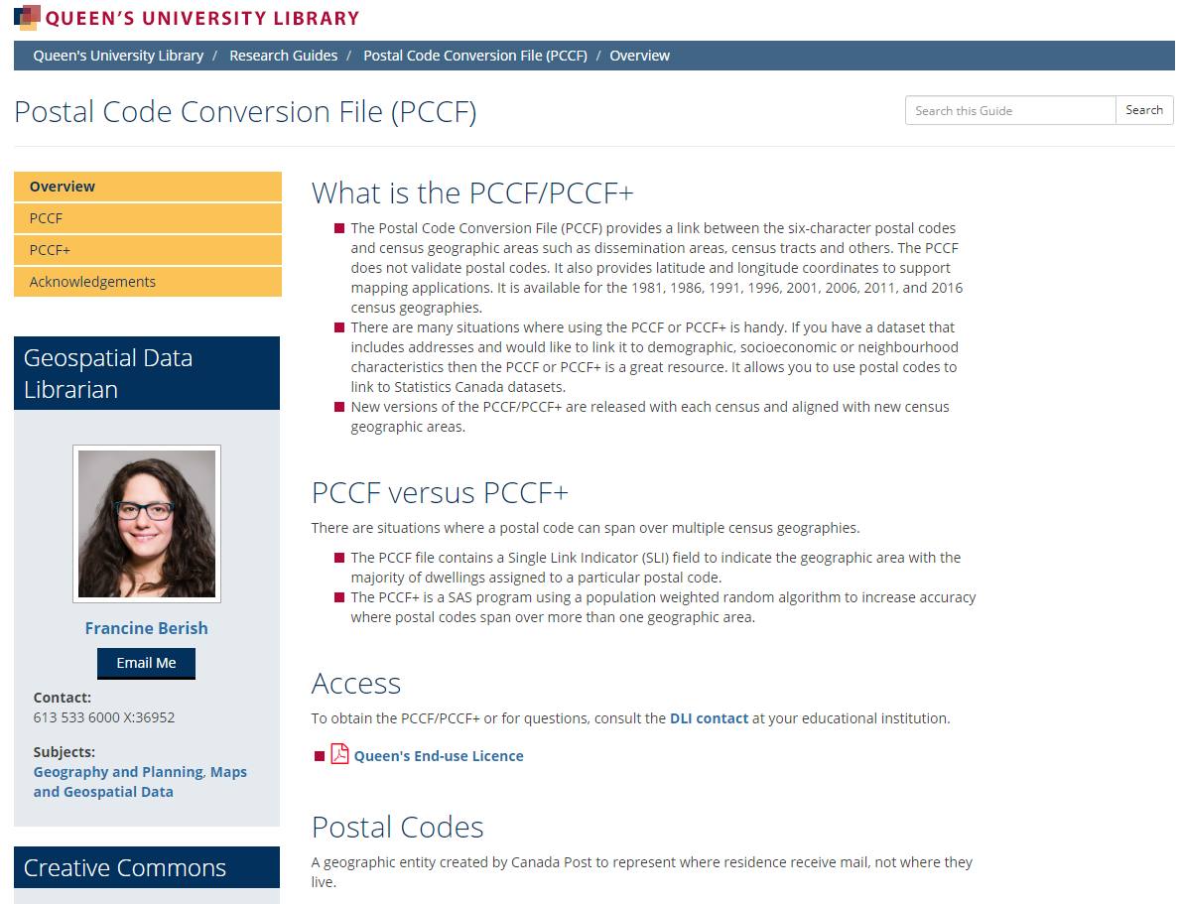
Resources
Postal Code Conversion File (PCCF) Guide
https://guides.library.queensu.ca/PCCF
Ask the DLI list
Notes:
PCCF guide – overview of PCCF; includes past presentations and guide to running the PCCF+; Has CC BY-NC licence

Slide 3
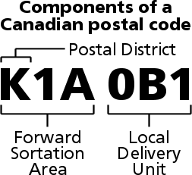

What are Postal Codes?
Geographic entity created by Canada Post
No direct ‘spatial existence’
Represent where residents receive mail, not where they live
Notes:
In FSA, if number is 0 then rural; if 1-9 then urban

Slide 4
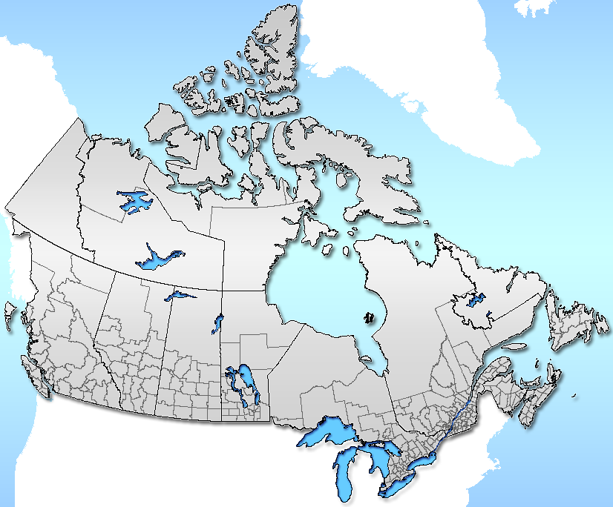
What is the PCCF?
a digital file which provides a correspondence between Canada Post’s 6-character postal code and Statistics Canada’s standard geographic areas (e.g., census tracts, dissemination areas) for which Census data and other attribute data is produced
Notes:
Provides a correspondence between postal codes and Statistics Canada’s standard geographic areas. Plain text file.

Slide 5
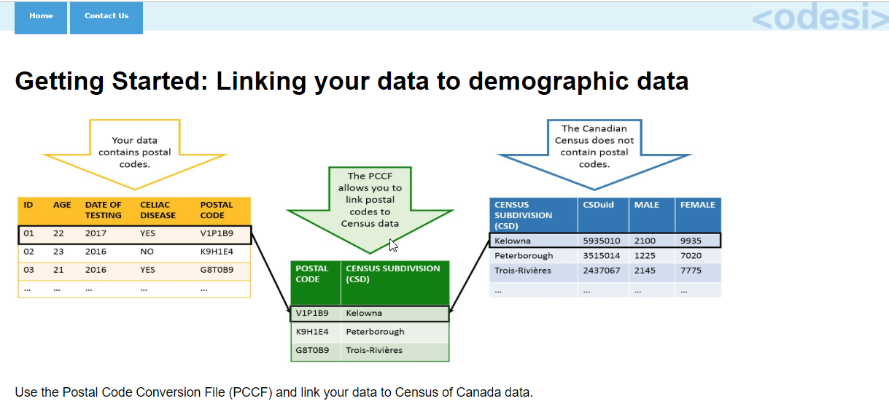
PCCF resources
<odesi> (http://odesi.ca)
PCCF guides back to 1996 Census
Syntax file (not from StatCan)
Getting Started Guide
Notes:
Susan Mowers at the University of Ottawa and her student have added documentation for the PCCF back to the 1996 census. This includes a syntax file to create an SPSS data file, and a getting started guide that provides an overview of how to link a user’s research data to demographic data. These files are open to all DLI members.

Slide 6
What is the PCCF+?
Consists of:
SAS control program
reference files primarily derived from the PCCF
postal code population-weight file derived from the Census of Population
Assigns geographic identifiers based on postal codes (3, 4, 5, or 6 characters)
Provides residential & institutional coding separately
Additional variables not in PCCF
Notes:
The PCCF+ is a SAS control program, derived from the PCCF, with a postal code population-weight file (from the Census of Population). It assigns geographic identifiers based on postal codes, can assign geographic coding using 3, 4, or 5 characters of the postal code as well as all 6; can provide output for potentially troublesome postal codes, and provides residential & institutional coding separately.

Slide 7
What do they do?
Both PCCF & PCCF+ are used to assign
Statistics Canada’s standard geographic areas to Postal Codes

Slide 8

Why do this?
Notes:
So you can match postal codes to Census geography to support linking data from different sources.
Example is PCCF+ use – immunization rates in Public Health Units. Researcher had data on immunization of children within a public health unit and the child’s home and school postal codes. With the PCCF+, the researcher was able to look at her data and Census data at the DA level.

Slide 9
Licence
Appendix of the DLI Licence
Academic, non-commercial use
Teaching and learning purposes
Research purposes
Planning purposes
Ask the list
Notes:
Looking at licensing and access.
PCCF Licence is appendix of the DLI Licence and is signed separately.
Uses of the PCCF:
Academic, non-commercial use
Teaching and learning - Students can download PCCF on their laptop to do their assignments. This includes projects, maps, analytical papers, etc. Faculty can download and use the PCCF in teaching exercises.
Research – to analysis data and publish articles, Masters or PHD thesis. Cannot share data but results can be published. (e.g. – DAs can be included in a report and shared as long as no postal codes are displayed in the report.)
Planning purposes – institutions can use the PCCF for student recruitment activities or finding where students are from; Alumni department is included under Planning purposes.
If not sure, email the DLI list

Slide 10
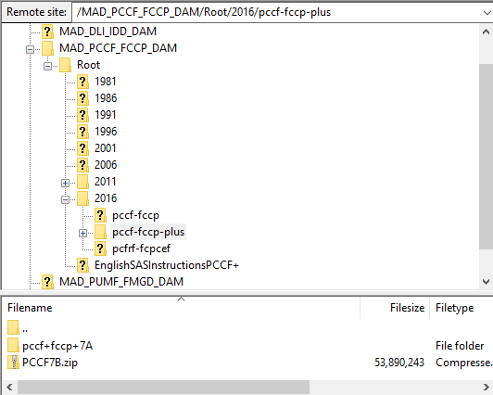
Access
DLI EFT:
/MAD_PCCF_FCCP_DAM/
organized by census year
PCCF – month, year (e.g. August 2019)
PCCF+ - number, letter (e.g. 7B)
new release with each census
Notes:
If your institution has signed the PCCF Appendix, then the PCCF folder will be in the EFT
There is a new release with each census; between each census, new editions are released.
Organized by census year; PCCF – month, year (current version August 2019); PCCF+ - number, letter (current version 7B)

Slide 11
PCCF vs. PCCF+
PCCF
single link indicator (SLI)
forces each postal code to be assigned to a single dissemination area (DA) and dissemination block (DB) regardless of size
identifies the geographic area with the majority of dwellings assigned to a particular postal code
PCCF+
population-weighted random allocation for postal codes to link to more than one geographic area
multiple matches are possible
distribution of responses more accurately reflects the underlying population
Notes:
What is the basic difference between the 2.
The PCCF is single link indicator so each postal code is assigned to a single DA. It identifies the geographic area with the majority of dwellings and assigns it to the postal code.
The PCCF+, however, uses a population-weighted random allocation, based on the census, for postal codes that links to more than one geographic area. The distribution will more accurately reflect where the population is.

Slide 12
A1A 1A1
DA 1
60%
DA 3
10%
DA 2
30%
PCCF (SLI)
PCCF+
A1A 1A1
A1A 1A1
DA 1
100%
DA 1
60%
DA3
0%
DA 3
10%
DA 2 0%
DA 2
30%
Notes:
Have a postal code that covers 3 DAs with 60% of the population on DA1, 30% in DA2, and 10% in DA3.
The PCCF, using the single link indicator, forces all the postal codes into DA1 since it has the highest population. The PCCF+, using the population-weighted random allocation for postal codes, assigns postal codes to each of the 3 DAs according to their size. So, in this example, 60% are assigned to DA1, 30% to DA2 and 10% to DA3.

Slide 13
Advantages of PCCF+
PCCF+ provides:
additional variables not in the PCCF
better handling of imperfect postal codes
feedback quality of postal codes
view to the past using earlier censuses
improved treatment of rural postal codes
proper coding of postal codes on Reserves
Notes:
Want to use variables present on the PCCF+ which are not present in regular PCCF
File is less than perfect with respect to postal codes
will work with the first 5 characters of a postal code if necessary
will work with FSA; coding will be cruder
Vintage of the postal code spans more than one census
Assigns DAs and EAs from 1981 census to current census
Evaluate the quality of the postal code
PCCF+ problem file uses Canada Post’s building name database to identify postal codes for
residences - hospitals, nursing homes, prisons, and university residences
non-residences – coroner’s offices, children’s aid societies, public trustees, and government offices
Residence flag identifies “business buildings” as populated or un-populated
Do better coding in rural areas
population weights derived from the census are used to probabilistically assign geographic codes in rural areas, across all DAs served by a given postal code
The PCCF, however, assigns everyone with the same rural postal code to the same DA; not necessarily the best, just the one with the highest population
If postal codes are used by residents of “incompletely enumerated Indian Reserves”
The PCCF tends to assign postal codes tend to non-reserve areas, while the PCCF+ uses the census population weights to account for estimates of the population living on incompletely enumerated reserves
PCCF – less granular; if don’t need lower levels of geography

Slide 14
Running the PCCF+
What you need:
Latest PCCF+ from DLI EFT (includes SAS program file)
Researcher’s list of postal codes as a text file
readPCCF1.sas (convert text file to SAS)
https://guides.library.queensu.ca/PCCF/PCCFplus
Notes:
What you need:
Latest PCCF+ from DLI EFT
List of postal codes as a text file
readPCCF1.sas file which is used to convert the text file with the postal codes to a SAS dataset

Slide 15
Running the PCCF+: data files downloaded from EFT
DATA – contains data used by PCCF+
Documentation – user guides in English and French
Sample – sample SAS datasets
SAS_InputFiles – PCCF and Geocoding files used by PCCF+
Supplementary – other files used by PCCF+
FCCPplus_7B.sas – French version of SAS program used to run PCCF+
PCCFplus_7B.sas – English version of SAS program used to run PCCF+
Notes:
When you unzip the files from the EFT, you get these folders and the SAS program for running the PCCF+. These contain the data files that SAS will use to run the program. Do not change any of the file paths.
PCCFplus_7B.sas - SAS program used to run the PCCF+

Slide 16
Running the PCCF+: 2 step process
Create a SAS dataset from text file with postal codes
Use the PCCF+ SAS program to read this dataset
Notes:
First, you create a SAS dataset of the researcher’s postal codes; then, the PCCF+SAS program reads this dataset to match the postal codes with Census geography and generate the output that matches the postal codes to the geography.

Slide 17
Running the PCCF+: What you end up with
PDF summary file
CSV and text file with postal codes matched to census geography
Problem file – CSV and text
Notes:
After running the PCCF+ what you end up with is a summary of the conversion, listing any errors or problems; an output file (in CSV and text) with the postal codes matched to census geography; and a problem file listing any errors or problems with the postal codes.

Slide 18
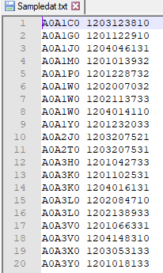
Running the PCCF+: Step 1a
Text file:
postal codes – 6 digit, upper case, no spaces
ID# - up to 15 characters; alphanumeric
1 space between postal code and ID
Notes:
Start with a text file containing only the postal codes and their IDs. Postal codes in the first column, need to be 6 digit, upper case, no spaces; the ID# can be up to 15 characters and can be alphanumeric. There should be one space between the postal codes and the ID#.

Slide 19
Running the PCCF+: Step 1b
readPCCF1.sas
reads the text file and creates SAS dataset
not created by Statistics Canada; not included in download from EFT
copy of file available in how-to guide (https://guides.library.queensu.ca/PCCF)
Notes:
This program reads the text file and creates that SAS dataset that the PCCF+ program will use. This program was not created by Statistics Canada and is not included in the download. A copy of it is available in Appendix 1 of the PCCF+ guide.

Slide 20
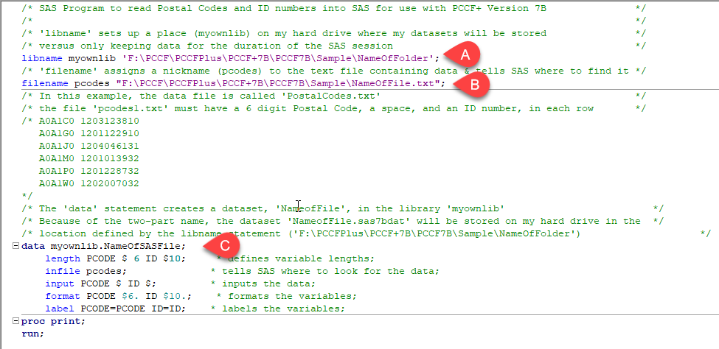
Running the PCCF+: Step 1b - program
Notes:
This is screen shot of the readPCCF1.sas program. You need to change the file paths to point to where the text file with the postal codes is.
A – file path to the folder that text file is in
B – if the name of the text file
C – Data statement – this is where you name the SAS dataset being created and will be used in the next step;
and tell the program what the length of the ID# number is (reminder – up to 15 characters).
Then Run the program. You will then find a SAS dataset in the folder you named. The file will have the extension - .sas7bat.

Slide 21
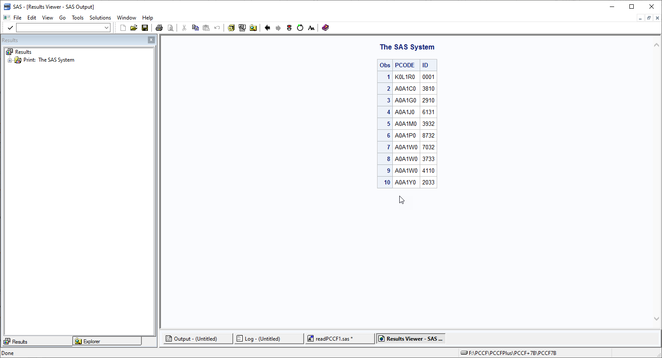
Running the PCCF+: Step 1b - output
Filename: pcodesdata.sas7bat
Notes:
Screenshot of SAS results; this is the SAS dataset

Slide 22
Running the PCCF+: Step 2
PCCFplus_7B.sas
SAS program that matches postal codes to census geography
Notes:
Now that you have the SAS dataset file, you can run the PCCF+ to read the dataset just created. Open the PCCFplus_7B.sas program and make changes.

Slide 23
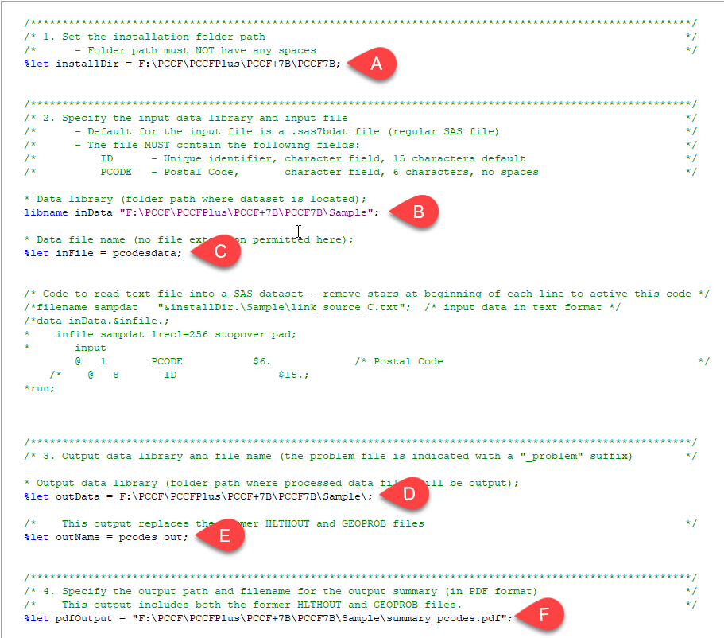
Notes:
This is a screen shot of the PCCFplus_7B.sas program. Like the first SAS program file, you need to change file paths and names to run the program.
A – this is the location where the PCCF+ data files sit; all the files and folders that you downloaded from the EFT and unzipped.
B – folder where the dataset you created in the previous step is sitting; the .sas7bat file.
C – the name of the SAS dataset (.sas7bat) with no extension
D – path to where the output files are going to go
E – provide the filename of the output files that will be created
F – file path and name of the summary file that will be created

Slide 24
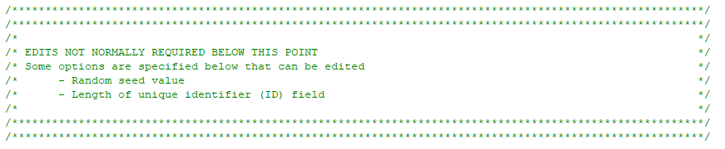
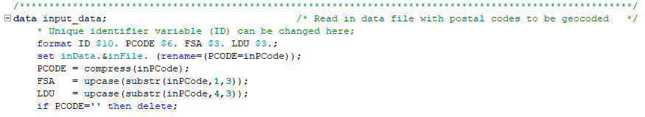
Notes:
There is one more change that needs to be made further down on the SAS screen.
You will come this warning – Edits nor normally required below this point. But there is one edit to make to the ID length. So scroll pass this to **here, and **change the ID length to match the length of the ID#.
Once you have made all these changes, Run the program

Slide 25
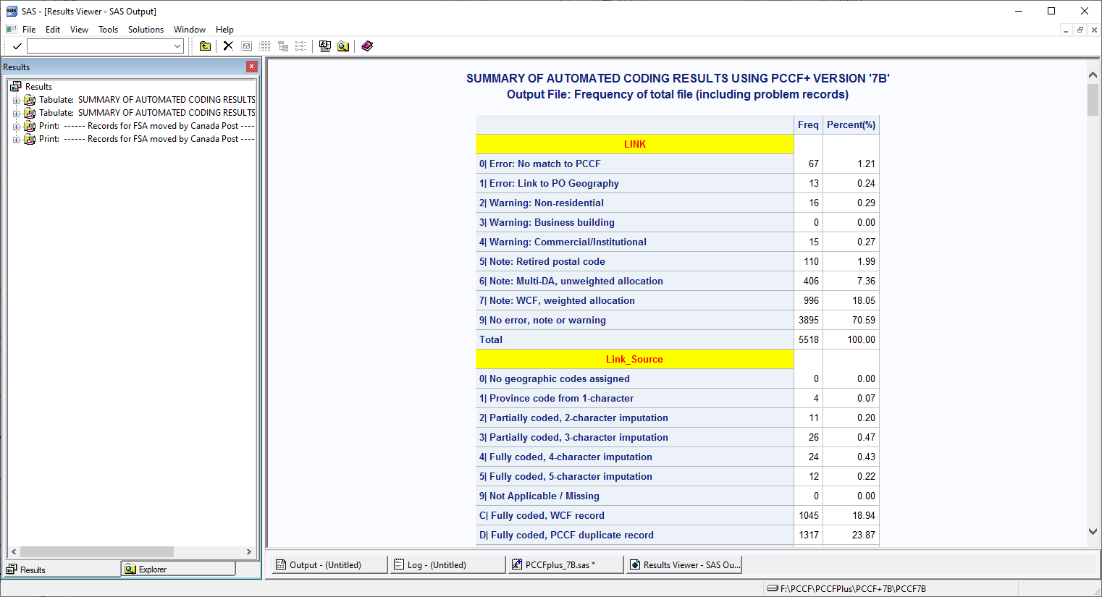
Notes:
Screenshot of the summary of results, including any problem records.
This information is also in the Summary PDF file created.

Slide 26
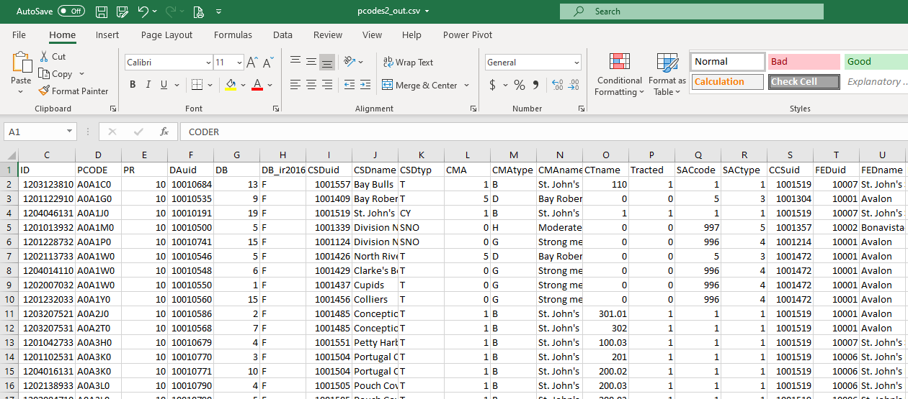
Running the PCCF+: Results – output file
Notes:
Screenshot of the output file. **We have the postal codes **matched to census geography. Not all the columns are seen here

Slide 27
Running the PCCF+: Results – census geography
PR
DAuid
DB
DB_ir2016
CSDuid
CSDname
CSDtyp
CMA
CMAtype
CMAname
CTname
Tracted
SACcode
SACtype
CCSuid
FEDuid
FEDname
DPLuid
DPLtyp
DPLname
ERuid
ERname
CARuid
CARname
PopCtrRAPuid
PopCtrRAname
PopCtrRAtype
PopCtrRAclass
CSize
CSizeMIZ
HRuid
HRename
HRfname
AHRuid
AHRename
AHRfname
SLI
Rep_Pt_type
RPF
PCtype
DMT
H_DMT
DMTDIFF
PO
QI
Source
Lat
Long
Link_Source
Link
Prec
nCD
nCSD
Comm_Name
AirLift
InstFlag
ResFlag
InuitLands
BTIPPE
ATIPPE
QABTIPPE
QNBTIPPE
DABTIPPE
DNBTIPPE
QAATIPPE
QNATIPPE
DAATIPPE
DNATIPPE
IMPFLG
DA11uid
DB11uid
DA06uid
DA01uid
EA96uid
EA91uid
EA86uid
EA81uid
Notes:
Here is a list of all the columns in the output file. Each are explained in the PCCF+ User Guide.
There are a number of census geographies, Lat/Long, and at the end, vintage EAs and DAs.

Slide 28
Running the PCCF+: Results - problem file
PCCF originally created for health data with emphasize on residential postal codes. Error file will pick up non-residential postal codes
Subset of output records for any cases that had warnings, errors, or notes
Building name and address for businesses or institution from the Canada Post building name database
Notes:
Created also with the output file is the Problem File.
PCCF originally created for health data with emphasize on residential postal codes. Error file will pick up non-residential postal codes so if the postal codes you have are from a lot of businesses or non-residential buildings like banks or schools, these are included here. Unless the postal code couldn’t be found (Error 0: No match to PCCF), then what’s listed may not necessarily be an ‘error’. This file can be useful when trying learn about a postal code.

Slide 29
Problem file: errors
Postal codes could not be matched on all 6 characters
Postal codes linked to post office and census location data not available
Delivery mode type indicates a non-residential address
Postal codes known to indicate non-residential address
Postal codes could have been assigned to more than one census subdivision
Records which could have been assigned to more than one census subdivision
Notes:
The problem file contains the following information:
Records with postal codes which could not be matched on all 6 characters (Link 0: error); these will have to be manually checked to determine why this error is there.
Records with postal codes for a delivery mode type (DMT) which is only linked to post office location on the PCCF (Link 1: error), and for which census location data were not available on the weighted conversion file;
Records for postal codes known to indicate a non-residential address (Link 2: warning);
Records where the DMT frequently indicates a non-residential address (Link 3 and 4: warning);
Records which could have been assigned more than one census subdivision based on the unweighted PCCF (Link 6: note);
Records which could have been assigned to more than one census subdivision based on the weighted conversion file (Link 7: note).

Slide 30
Running the PCCF+: Results - Problem file
Notes:
Here is a screenshot of a problem file.
The problem output file contains a subset of output records for any cases that had warnings, errors, or notes (these are also included in the output file). **It includes a Message column indicating the error, warning, or note, **the Link column which has the code for the error and is included in both files; and an **ADR column giving the building name and address for businesses or institution (from the Canada Post building name database).
2 other columns that may be of interest that are in both files are the InstFlag and ResFlag. The InstFlag helps identify records likely to be for institutional residents and the ResFlag indicates postal codes for possible or improbable residence address, or postal codes for which the residential or non-residential nature is undetermined.

Slide 31
Running the PCCF+: Results - Problem file
Notes:
In this example, we see that postal code for Lester Lockyear has an InstFlag of ‘N’ meaning “Nursing home or group home” and ResFlag of ‘+’ meaning ‘possible residence’. **The postal code above, ‘Medical Centre’ has a dash in ResFlag meaning “improbable residence” since there probably isn’t anyone living in a medical centre.
These columns can be helpful in determining why a record is listed in the problem file; it is also useful to evaluate the quality of the postal code

Slide 33
Resources
Postal Code Conversion File (PCCF) Guide
Getting Started: Linking your data to demographic data
How to run PCCF+ SAS Program Guide
Postal Code Conversion for Data Analysis: An overview of the PCCF and PCCF+
Seed Khan and Michael Tjepkema, Health Analysis Division, Statistics Canada
DLI Ontario Regional Training, December 1, 2015
https://cudo.carleton.ca/dli-training/3767
PCCF+ Postal Code Conversion File Plus – An Introduction
Jeff Moon, Data Librarian & Academic Director, Queen’s Research Data Centre, Queen’s University Library
DLI Ontario Regional Training, December, 2016
https://cudo.carleton.ca/dli-training/3861

Slide 34
Acknowledgements
Postal Code Conversion for Data Analysis: An overview of the PCCF and PCCF+
Seed Khan and Michael Tjepkema
Health Analysis Division, Statistics Canada
DLI Ontario Regional Training, December 1, 2015
https://cudo.carleton.ca/dli-training/3767
PCCF+ Postal Code Conversion File Plus – An Introduction
Jeff Moon, Data Librarian & Academic Director, Queen’s Research Data Centre
Queen’s University Library
DLI Ontario Regional Training, December, 2016
https://cudo.carleton.ca/dli-training/3861

