Slide 1
Online News Popularity
Problem Statement:
The main aim of this exercise is to predict the shares variable(popularity of articles) from other variable.
General Approach & Methodology
Exploratory Data Analysis (descriptive statistics, missing values, correlation, creating simple plot, outlier)
Feature Selection by (Highly correlated features from Correlation Matrix )
Scaling and Removing outlier (using Skewness and Kurtosis values )
Machine Learning Models( Linear Reg, Random Forest Reg, Xgboost, Lasso)
Performance Metrics (RMSE, R squared)
Hyperparameter Tuning ( reducing error rate and accuracy, selecting according to importance F score)

Slide 2
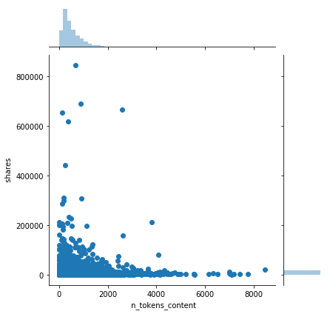
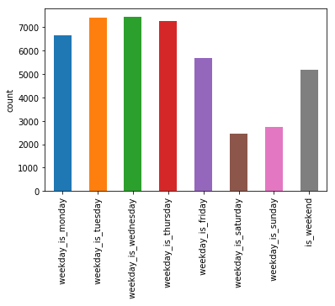
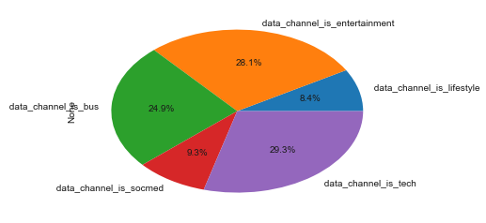
Exploratory Data Analysis
Joint plots indicates a negative correlation between the number of words in the content and the number of shares. That means people don't like to read longer Articles, so that they won't share.
From joint plot, we can also observe the outlier in our dataset.
Bar chart indicates that, the dataset contains more articles that are published during weekdays as compare to the weekends
This pie chart shows that Most of the articles were published on the topic of "Technology" and the least on "lifestyle" topic.

Slide 3
MACHINE LEARNING APPROACHES
MODEL NAME | RMSE For Test Set | RMSE for Train Set | R-squared for Test Set | R-square for Train Set
Linear Regression | 0.13961788404 | 0.14208249830 | 0.0727426247 | 0.0743414175
Lasso | 0.14414810328 | 0.14679453237 | 0.0115924430 | 0.0119261127
Random Forest Regressor | 0.13552904389 | 0.05109852882 | 0.1262585444 | 0.8802745562
Tuned Random Forest Reg | 0.13409701658 | 0.09183133974 | 0.1446252539 | 0.6133201841
Xgboost | 0.13451244219 | 0.13378657558 | 0.1393172314 | 0.1792805276
Tuned Xgboost | 0.13437512657 | 0.13157091960 | 0.1410735725 | 0.2062395010
Since I formulate this problem as a Regression problem, 4 Machine learning algorithms has been implemented including Linear Regression, Random Forest Regressor, Xgboost and Lasso.
Before Modelling, I checked the Skewness and Kurtosis Values to check the perfection of the normal distribution and fixed all of the skewed data so that our models will be more accurate.
At the for optimization, I have used hyperparameter tuning to choose a optimal hyperparameter
Performance Analysis:
REMARK: From this comparison we can see that both Tuned Random Forest Reg, Tuned xgboost have the best score on Test Set

Slide 4
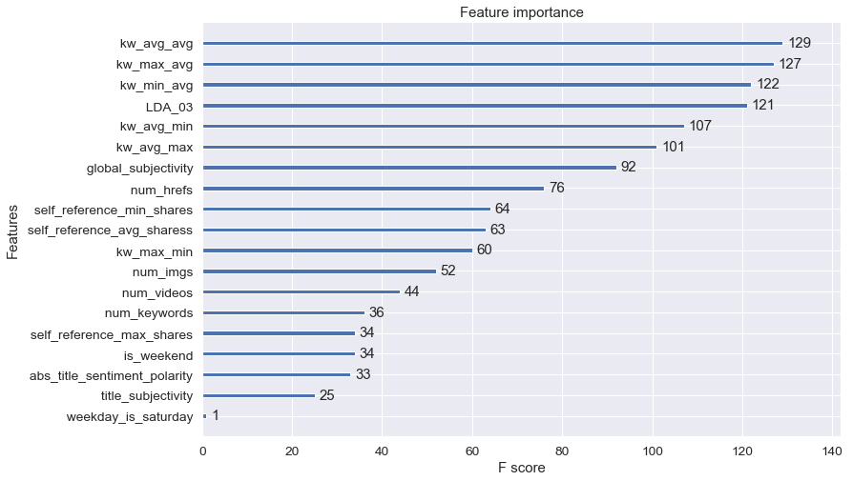
Conclusion:
From the 61 available attributes these are the important features for the target variable Shares, these are the key factors that contribute to predict the popularity of the articles by the numbers of shares.
Improvement
The are many other ways for feature selection and scaling, might be by using them we can achieve better result.
We can draw a learning curve to see if added data could be beneficial to model or not.

