Slide 1



Slide 2

Email Spam and Non-Spam Classification

Slide 3
Group Members Introduction
Group ID F2002F5DD9
Muhammad Ali MC190402102

Slide 4

INTRODUCTION OF PROJECT
The expanding volume of spam emails has created a need for solid spam filtering solutions. Therefore, the purposes of this project are:
• Use Python based Text Classification technique to classify email spam messages.
• To find Accuracy, Time, and Error Rate by applying suitable algorithms. Such as Naive Bayes or Naive Bayes Multinomial etc.
• To compare different algorithms to find the best suitable for text classification.

Slide 5
Process Model
Adopted Process Model is VU Process Model which is the combination of Waterfall and Spiral Methodologies. One feature of waterfall methodology is the sequence of steps that we take in our methodology and one feature of spiral methodology is to go previous steps which is also included in our methodology.

Slide 6
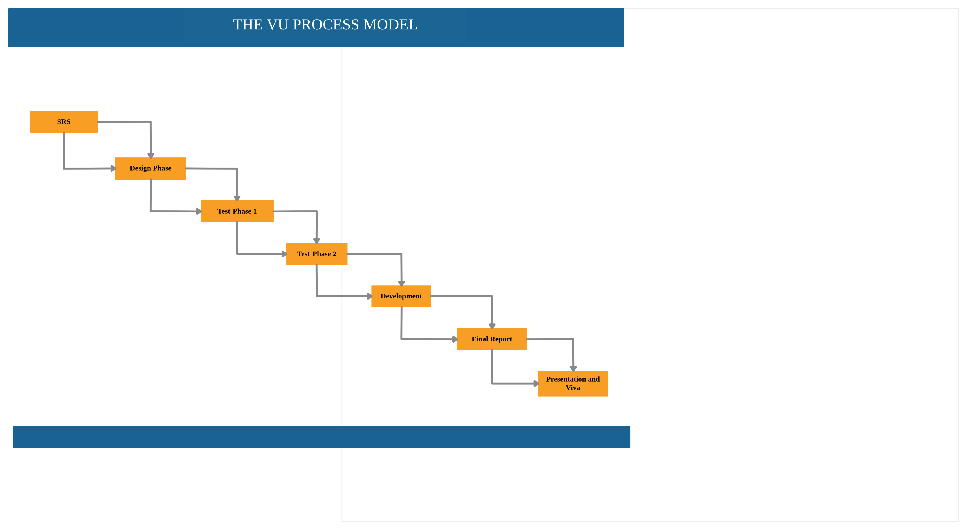
VU Process Model

Slide 7
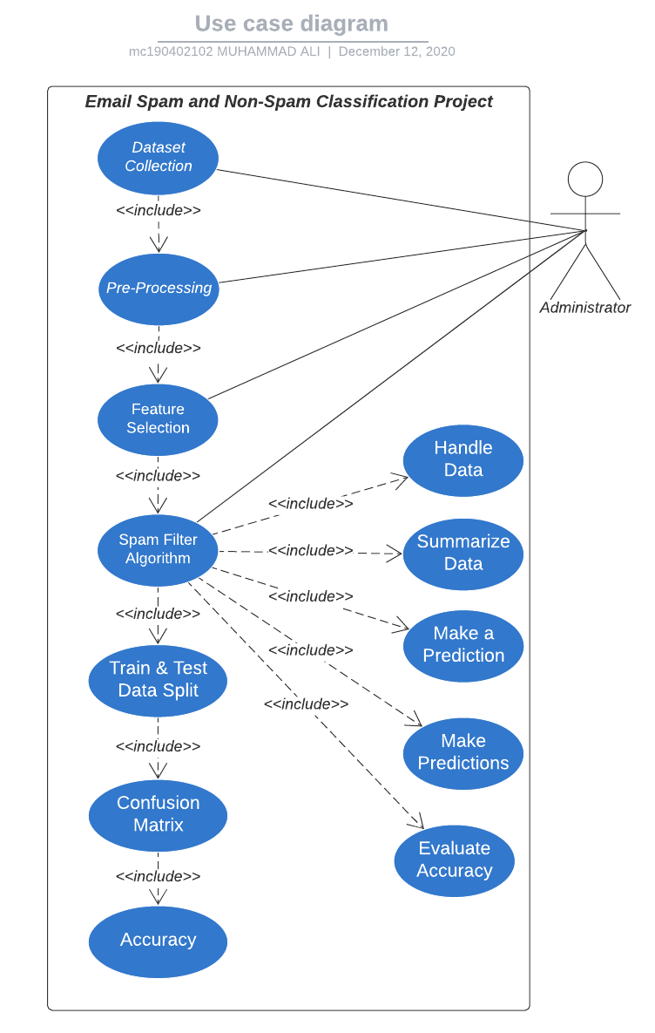
Use Case Diagram

Slide 8
Business Rules Catalog
Functional Requirements:
Administrator will perform all these tasks.
Collect Data Set
Pre-processing
Feature Selection
Apply Spam Filter Algorithms.
Train & Test Data
Confusion Matrix
Accuracy
.

Slide 9
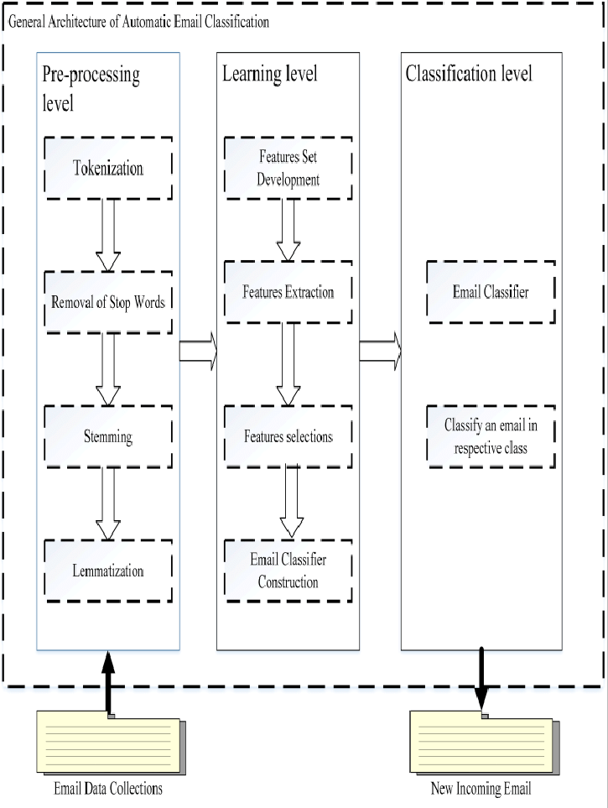
Architectural Design

Slide 10
Team Structure
The project Email Spam and Non-Spam Classification includes two members,
one Supervisor and one Developer.
Supervisor
Developer

Slide 11
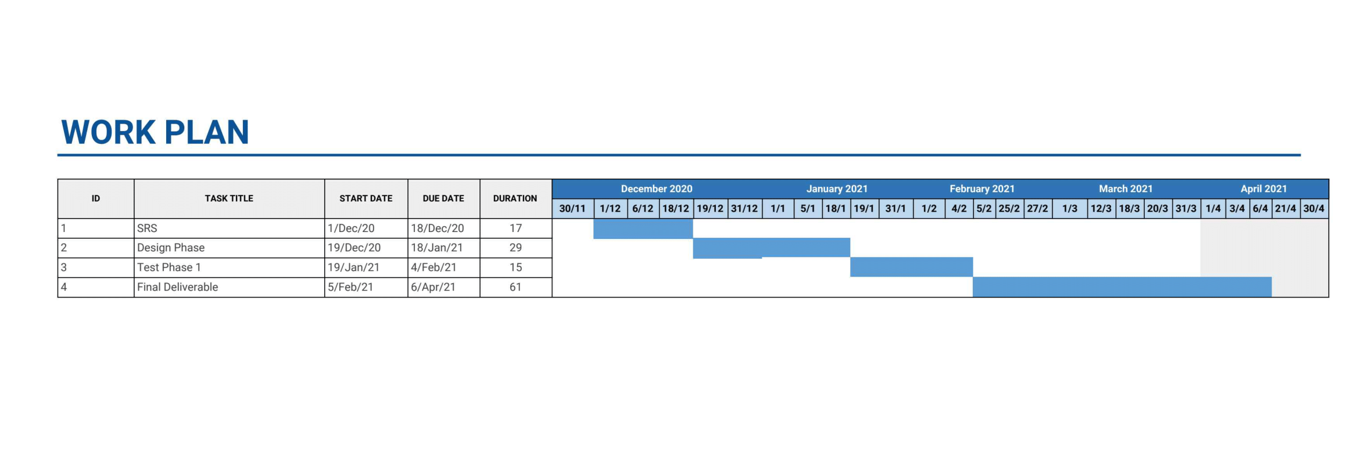
Project Schedule

Slide 12
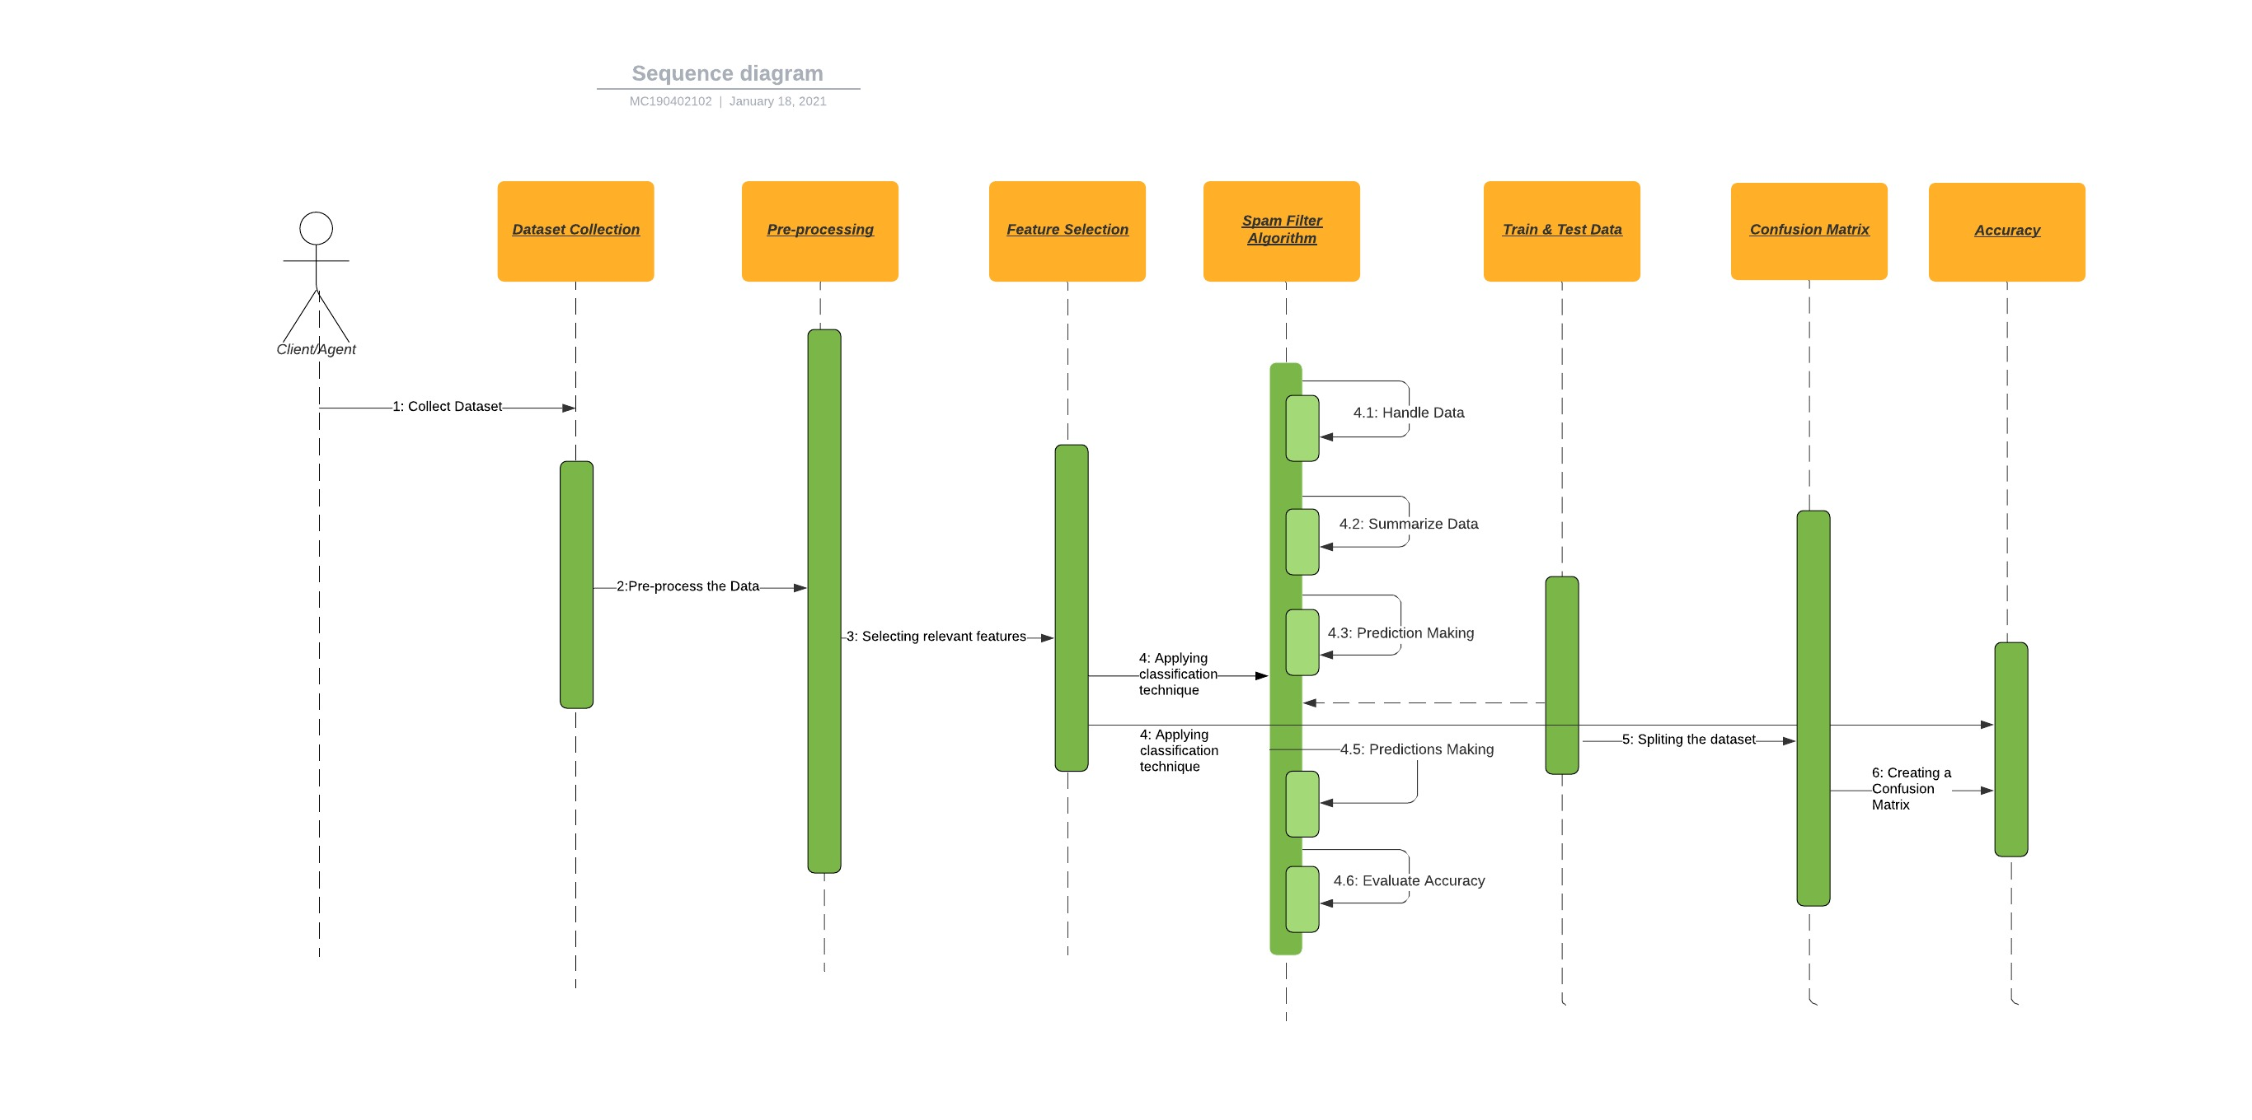
Sequence Diagrams

Slide 13
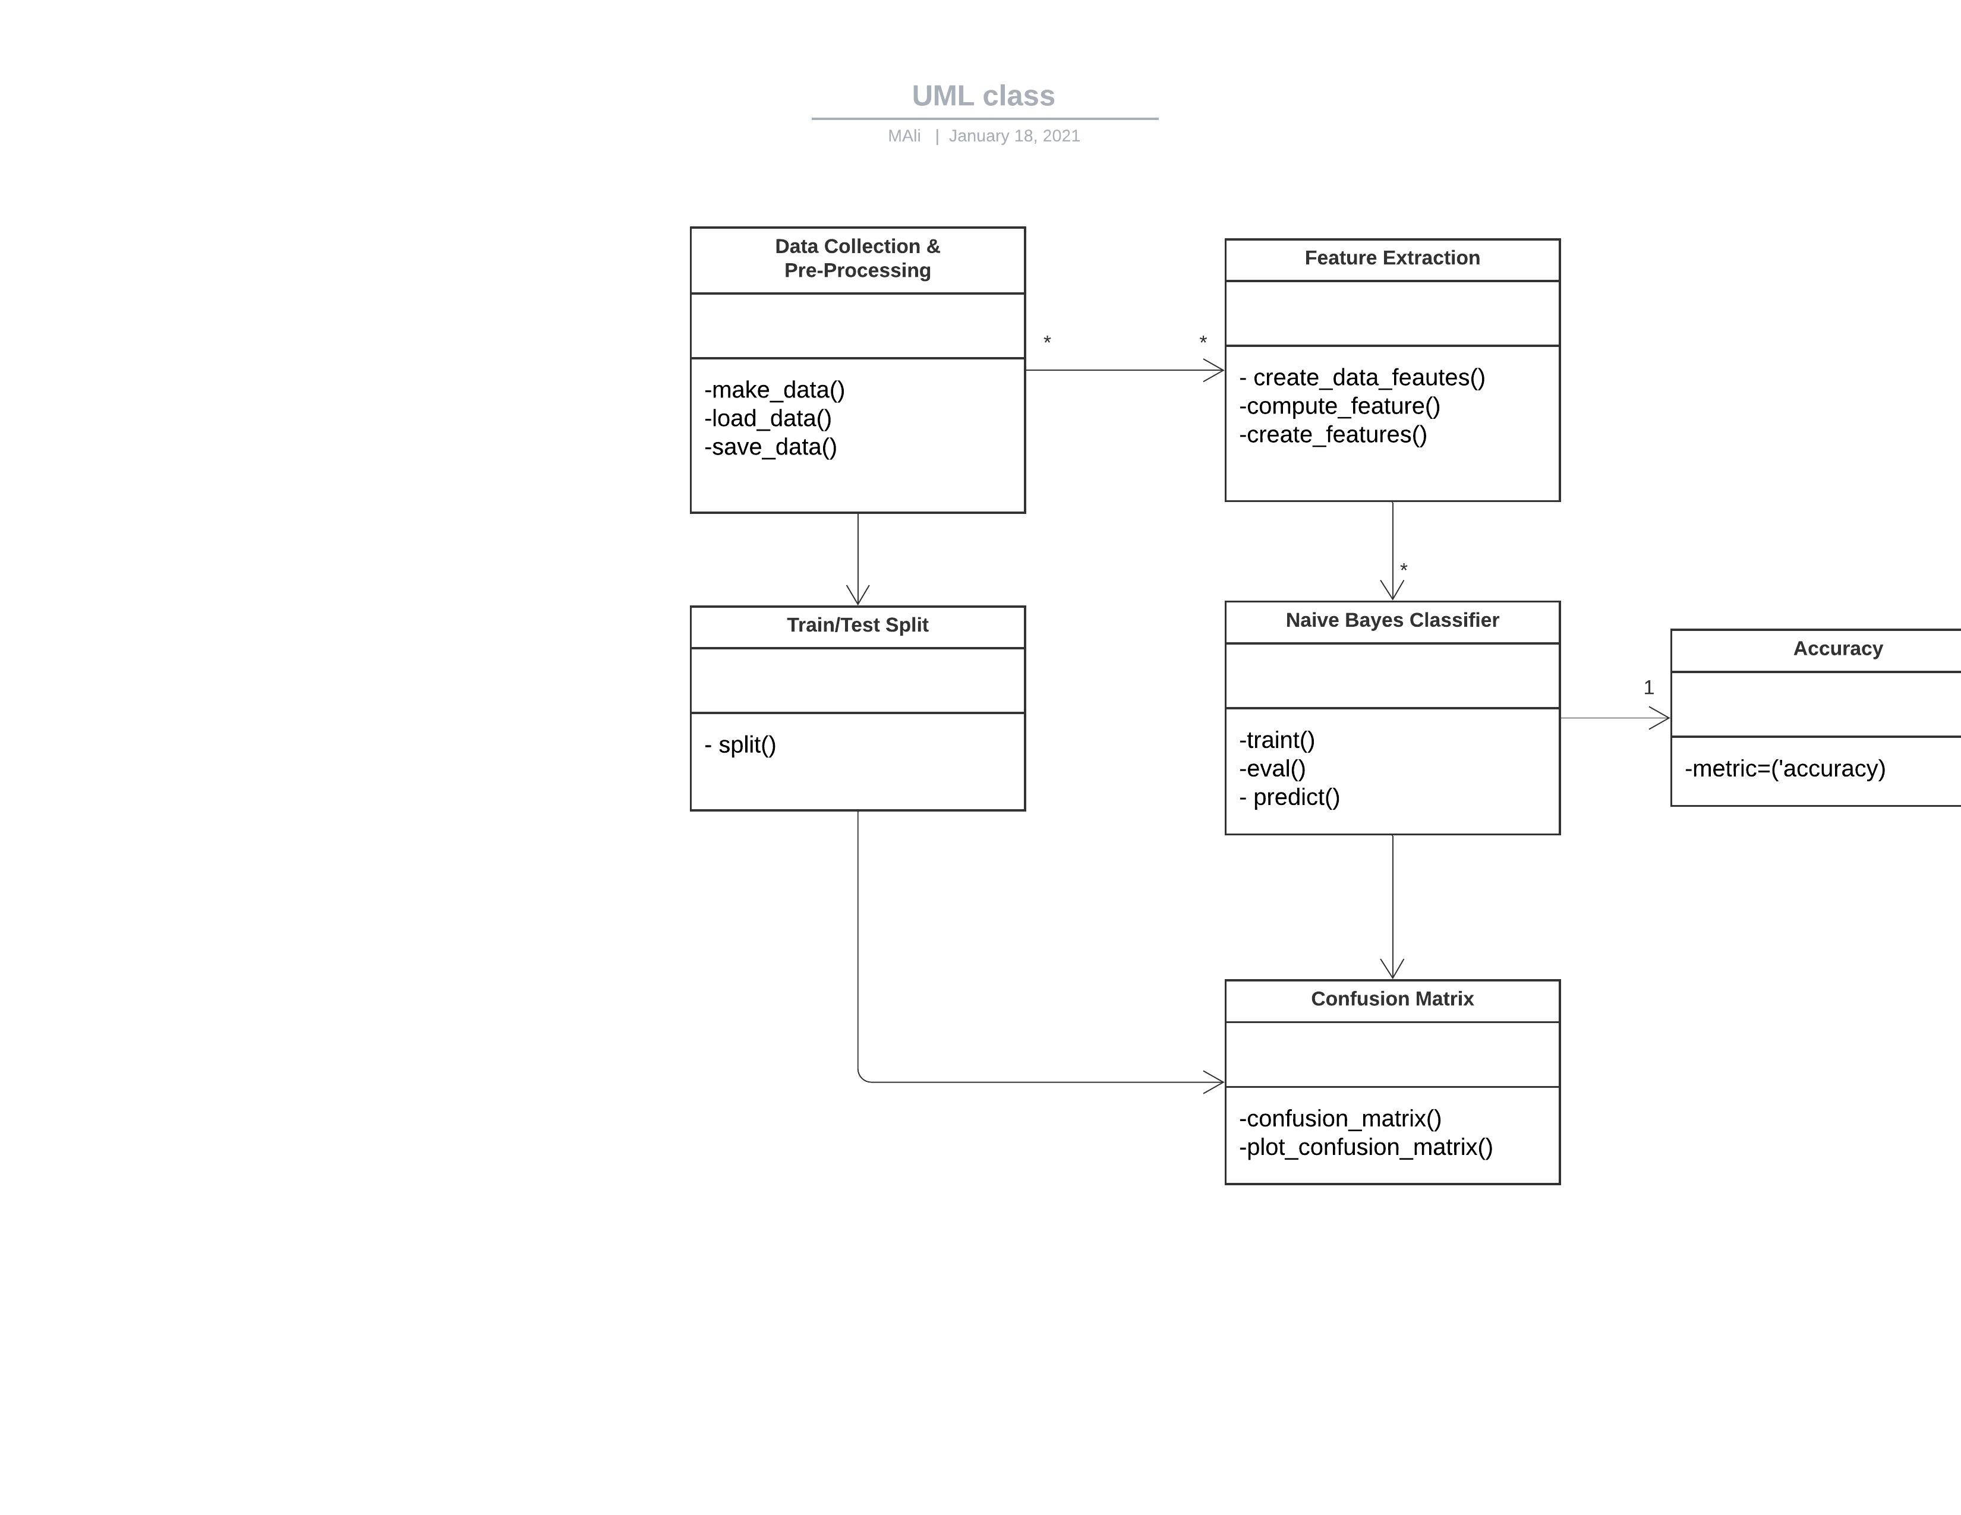
Logical Model/Class Diagram

Slide 14
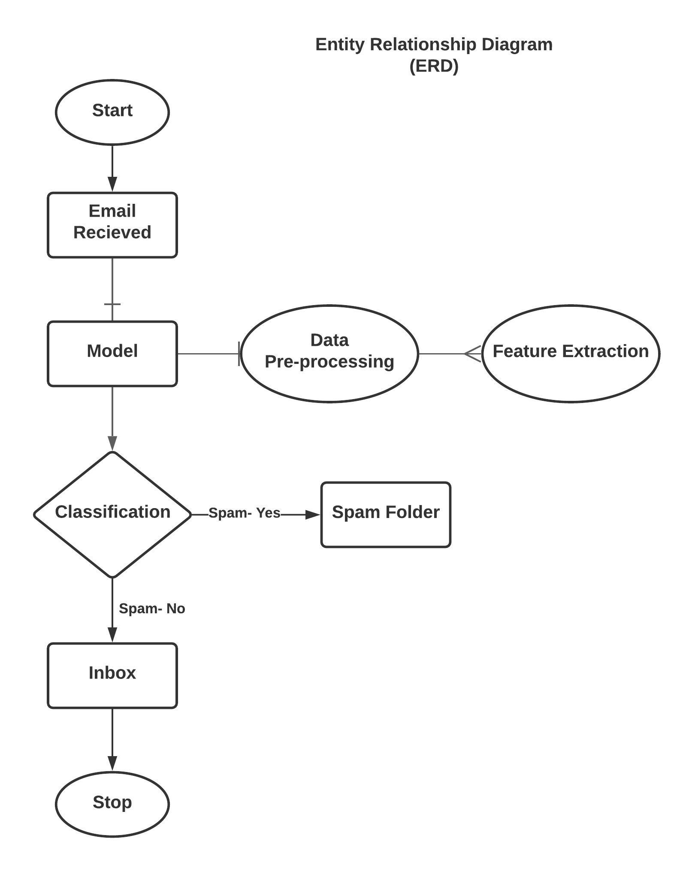
Entity-Relationship Diagram

Slide 15
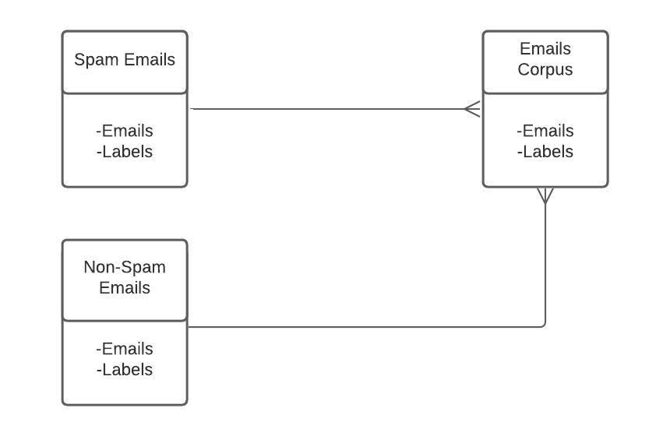
Database Diagram

Slide 16
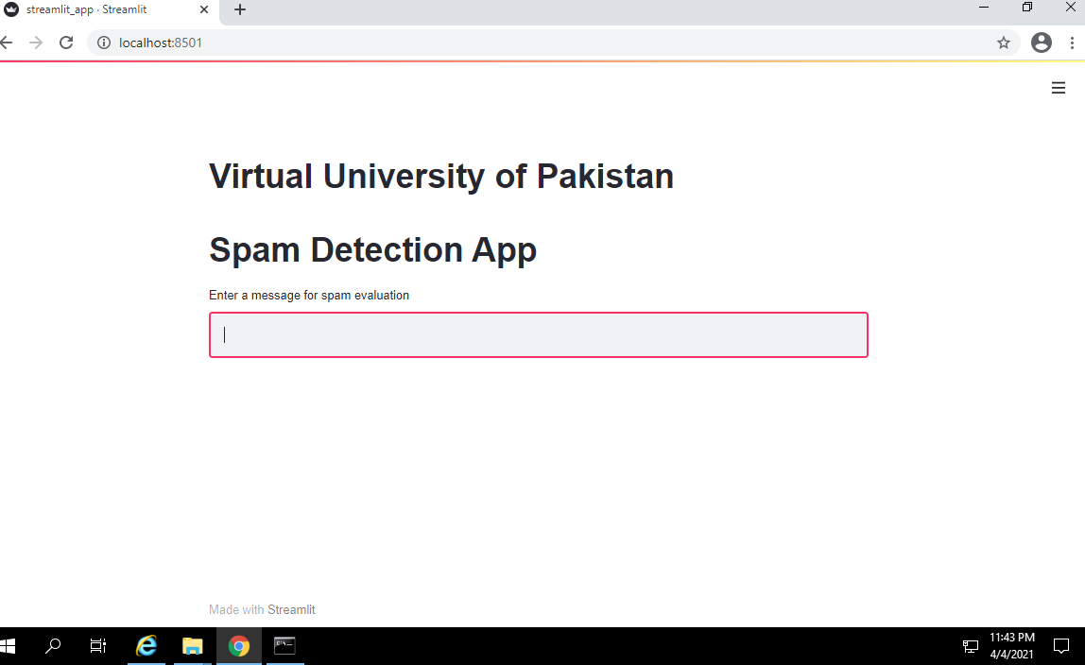
User Interfaces

Slide 17
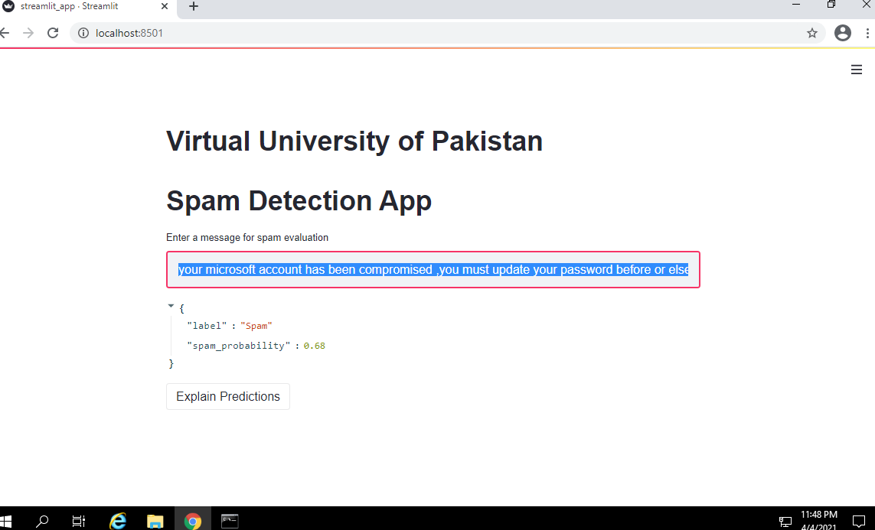
User Interfaces

Slide 18
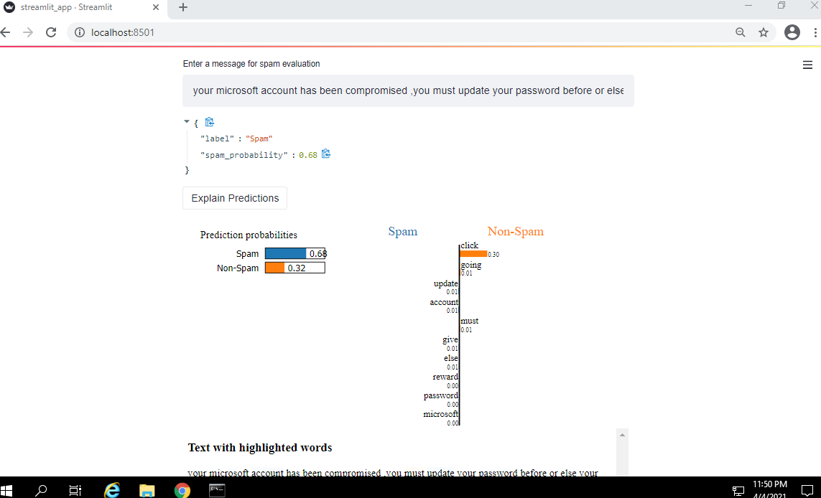
User Interfaces

Slide 19
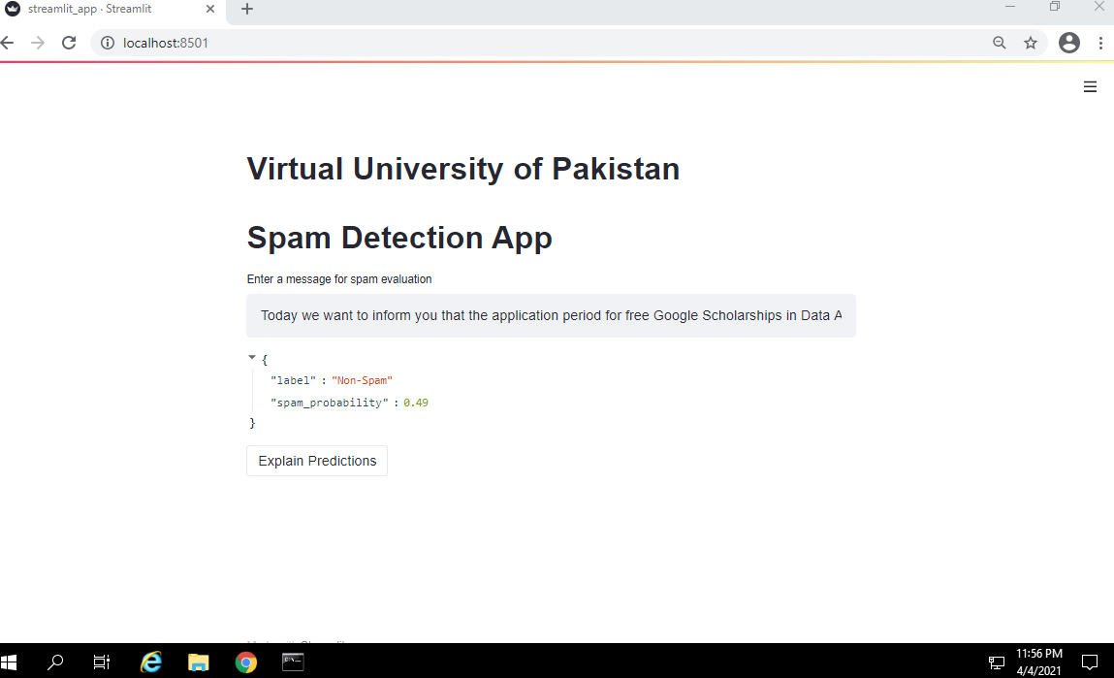
User Interfaces

Slide 20
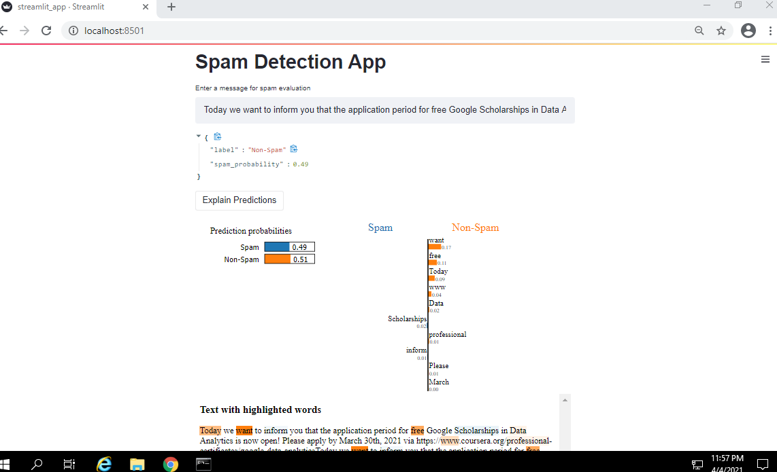
User Interfaces

Slide 21
Tools
Anaconda Package Manager
Jupyter Notebook IDE
Python Programming Language
Streamlit Web App Development Framework

