Slide 1
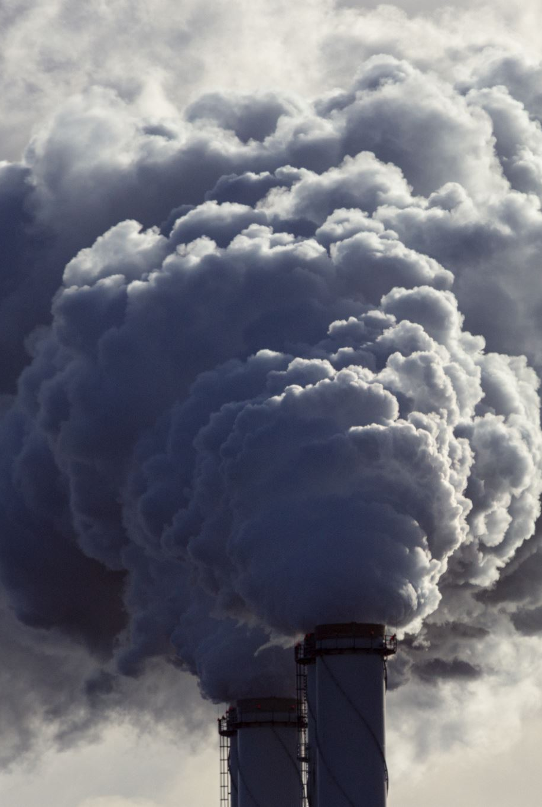
U.S. Carbon Dioxide Emissions Analysis
Ali Raza
2024-MSDS-19
Presented to: Dr Awais Hassan

Slide 2

Introduction
To identify high-risk states and the key factors contributing to carbon emissions by analyzing historical data.

Slide 3

Questions
What are the historical trends in carbon emissions across different states?
Which states, sectors, and fuel types contribute most significantly to carbon emissions?
How accurately can future carbon emissions be predicted using historical data?
What actionable insights can be derived to mitigate high emissions in identified high-risk states?

Slide 4
Dataset Overview
Source: Kaggle
Columns:
year: Year of emissions record
state-name: State name
sector-name: Emission sector
fuel-name: Fuel type
value: Emissions in million metric tons
Date spans 1970 to 2021.

Slide 5

Data Wrangling and Cleaning
Verified data consistency and addressed missing values.
Removed outliers using interquartile range (IQR).
Encoded categorical columns for modeling.
Converted “year" column to datetime format.

Slide 6
Exploratory Data Analysis
Identified states with the highest emissions.
Analyzed emission trends over decades.
Explored sector and fuel contributions to emissions.
Visualized patterns using line plots and bar charts.

Slide 7
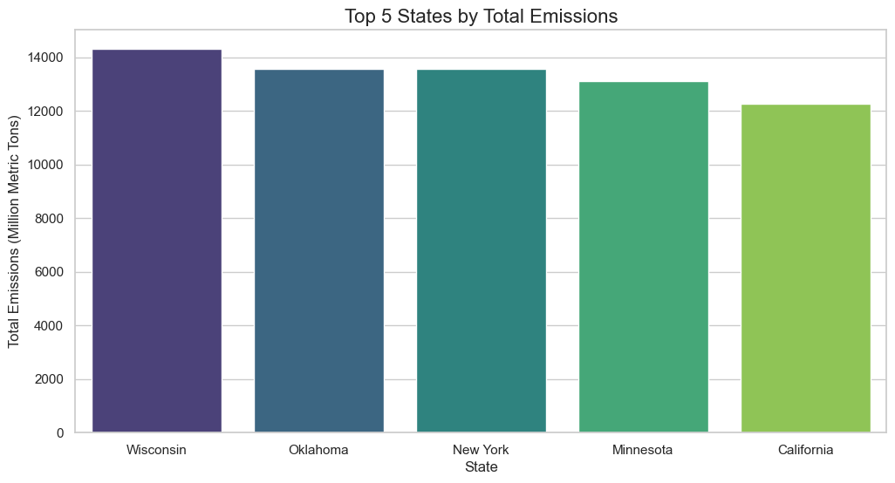
Results
High-emission states include industrial-heavy regions.

Slide 8
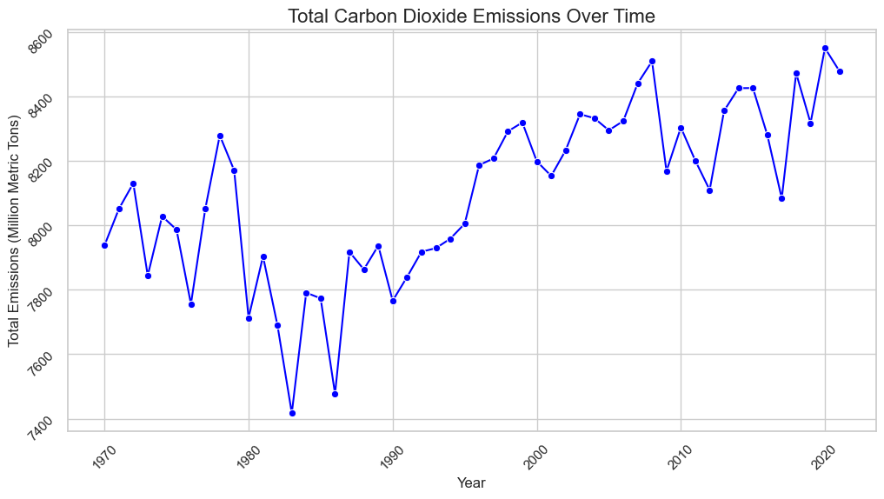
Results
Emissions increased in certain sectors over decades.

Slide 9
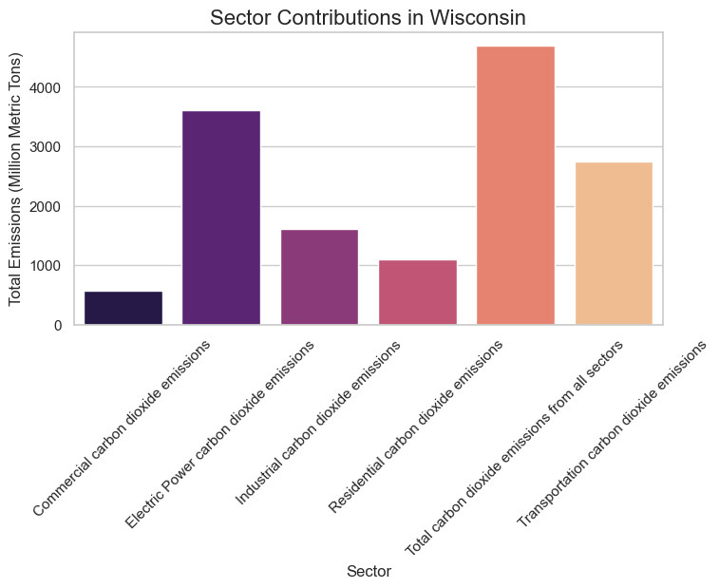
Results
Transportation and electric power are critical sectors.

Slide 10
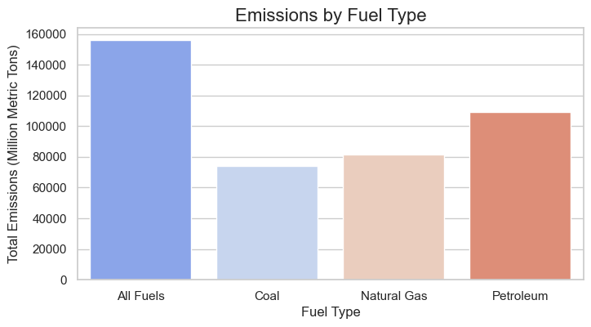
Results
Coal and petroleum dominate as emission sources

Slide 11
Predictive Modeling
Model: Random Forest Regressor.
Features: State, sector, fuel type, and year.
Target: Emissions value (million metric tons).
Evaluation Metrics:
•RMSE: Root Mean Squared Error
• MAE: Mean Absolute Error
• R²: Explained variance

Slide 12
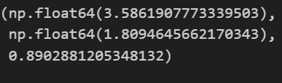
Model Performance
RMSE and MAE confirm low prediction error.
High R² indicates model captures variance well.
Reliable for forecasting future emissions trends.

Slide 13
Recommendations
Focus on high-emission states for targeted policies.
Transition to renewable energy sources to reduce dependency on coal.
Prioritize sectors like transportation for cleaner solutions.
Implement predictive insights for proactive decision-making.

Slide 14
Conclusion
Historical analysis revealed critical emission patterns.
Predictive modeling demonstrated actionable insights.
Findings guide policy and energy transition efforts.
Supports sustainable environmental strategies.

Slide 15

Thank You

