Slide 1
“Improving an Academic Information System through Cognitive Load Principles and User-Centered Information Architecture: A Case Study of LUIS”
Alīna Žogota-Kiliča
RTU Digital Humanities Masters Programme
Masters Thesis Presentation
Scientific adviser RTU FCSITE docent
Ilze Andersone
December 16, 2025

Slide 2
Digital Humanities Framework
Academic systems as digital infrastructures
Language
Structure
Institutional practice
Methods
User data
Computational analysis
Human interpretation

Slide 3
Problem & Motivation
DH context:
Latvia is planning to merge and replace current academic platforms (LUIS, VIIS, ORTUS) under a new national digital architecture.
Why this matters:
Today, users report navigation friction, unclear terminology, hidden actions, and slow feedback in LUIS.
Opportunity:
LUIS is still used daily, so it gives a real chance to collect user evidence now and use it to design the next system better (based on cognitive load + information architecture).

Slide 4
Research Aim & Question
Research aim:
To develop a replicable methodological framework for analyzing and redesigning academic information systems using cognitive-load principles and user-centered information architecture.
Research question:
How can user-centered information architecture, informed by cognitive load principles, improve the usability of academic information systems, and what does the case of LUIS show about reducing unnecessary mental effort in such platforms?

Slide 5
Integrated Methodological Framework
Cognitive Load Theory
Information Architecture
User Centered design
UX Prototyping & Testing
Quantitative Analysis
NLP supported user feedback

Slide 6
Thesis Contribution
Replicable analytical framework for analyzing + redesigning academic workflows (CLT + IA + UX)
Evidence base from 92 LUIS users (quant + open-text NLP)
Workflow prioritization method (frequency + difficulty + clarity + priority score)
Three redesigned workflows (student + admin) with step reduction
Prototype validation with 51 users showing higher clarity and lower perceived effort
Public GitHub repository: data structure, code notebooks, and design artefacts

Slide 7
Data & Methods
Mixed-methods research design (pragmatic approach)
Quantitative user survey (n = 92)
Open-text feedback analyzed with NLP
Prototype-based usability testing (n = 51)
Focus on cognitive load, navigation, terminology, and workflow clarity

Slide 8
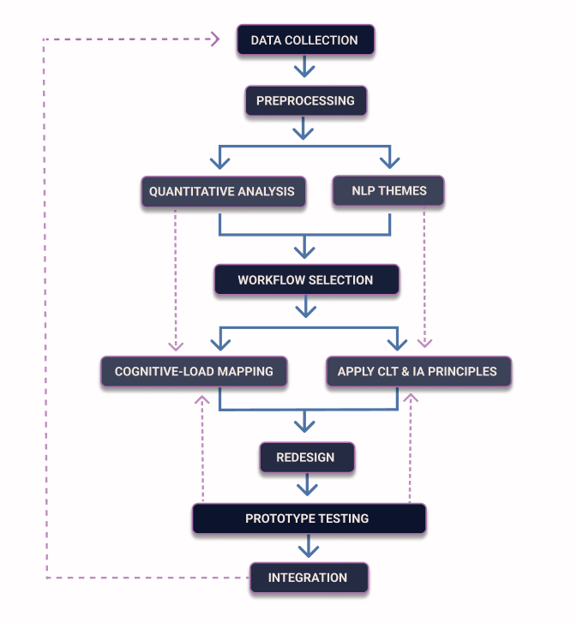
Analytical Pipeline

Slide 9
Key analytical findings
Low intrinsic difficulty across workflows; high extraneous difficulty + clarity importance
Main problem = interface structure, not academic task logic
Role differences:
Students: navigation + terminology friction (course registration, grades)
Admin: high load in multi-step workflows (grade entry, reports)
NLP confirms 4 themes: navigation, terminology, layout/visibility, system feedback
Device context matters: students' desktop + mobile, admin desktop

Slide 10
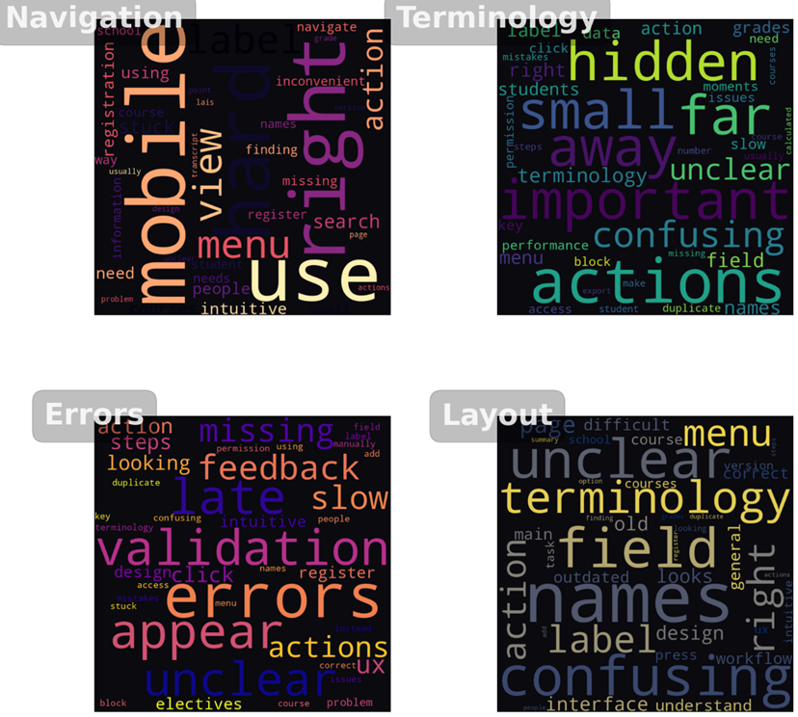
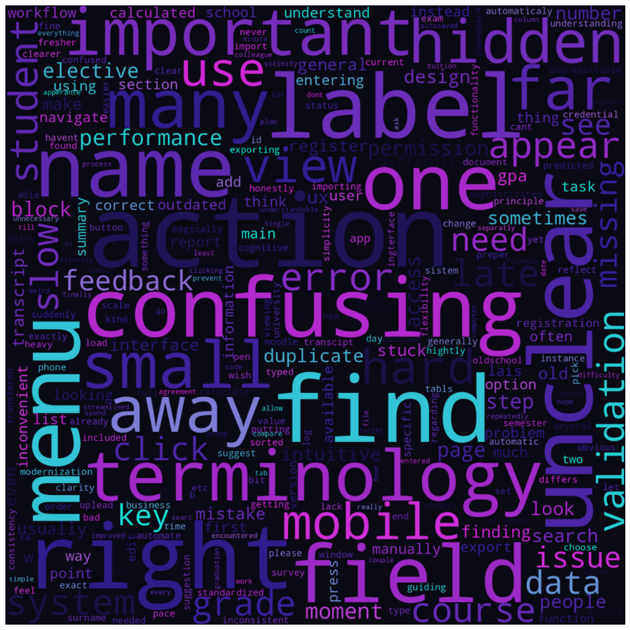
Word clouds of open-text responses

Slide 11
Workflow selection
Exam Grade Entry (desktop)
Highest priority score
High responsibility + fragmented path + late validation + unclear fields
Search & Register for Courses (desktop + mobile)
Highest frequency + most student comments
Navigation friction + unclear terminology + hidden actions
Mobile introduction of workflow

Slide 12
Redesign Strategy
Reduce extraneous load
Shorten workflow paths
Clear labels
Accessabilty
Stable layouts
Device specific logic

Slide 13
Existing LUIS Mobile Interface Visuals

Slide 14
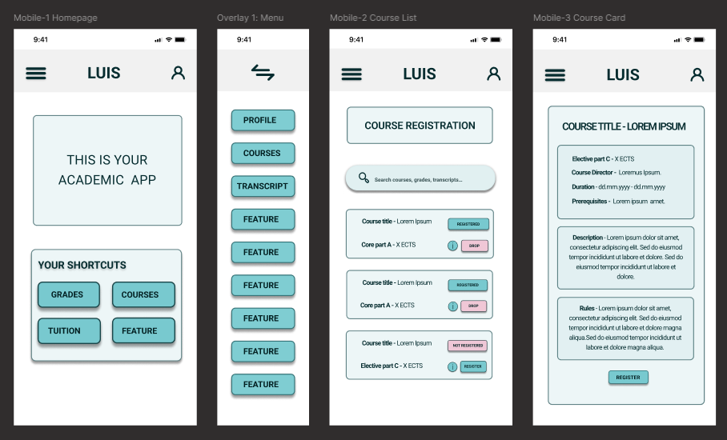
Student Mobile workflow Low-Fi Wireframes

Slide 15
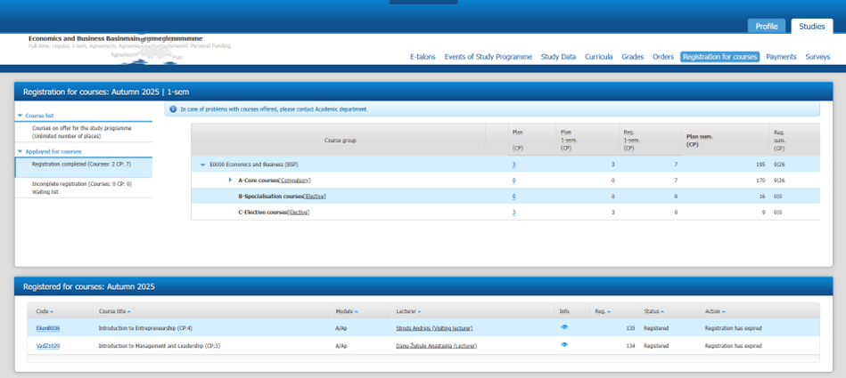
Existing LUIS Sudent Desktop Interface Visuals

Slide 16
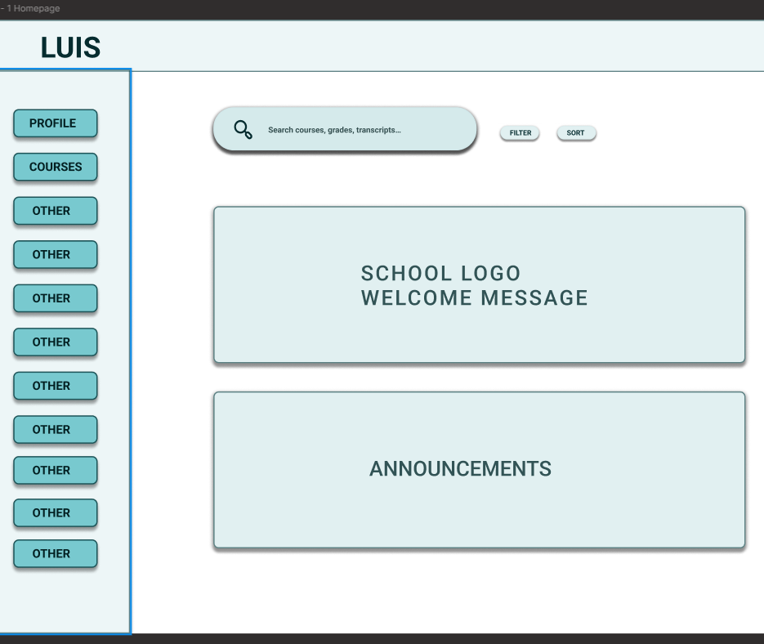
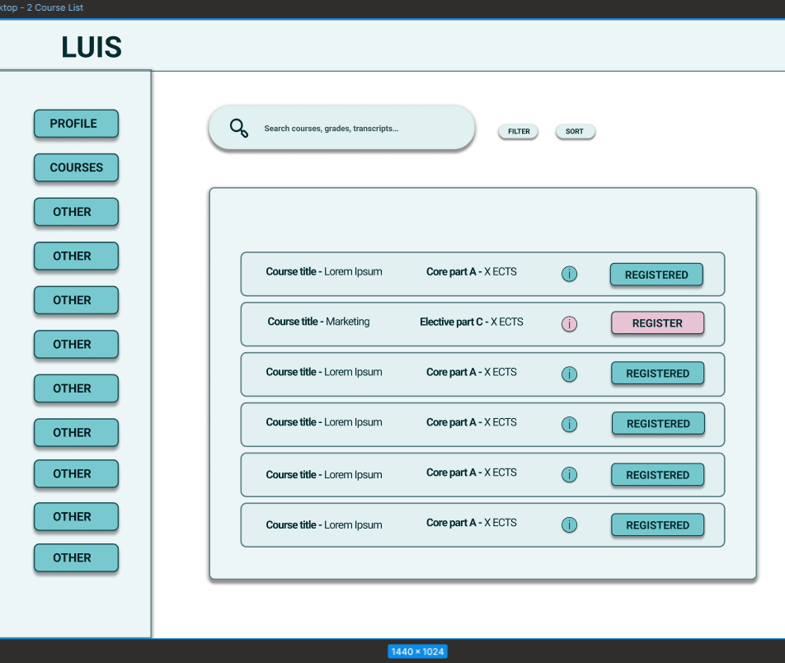
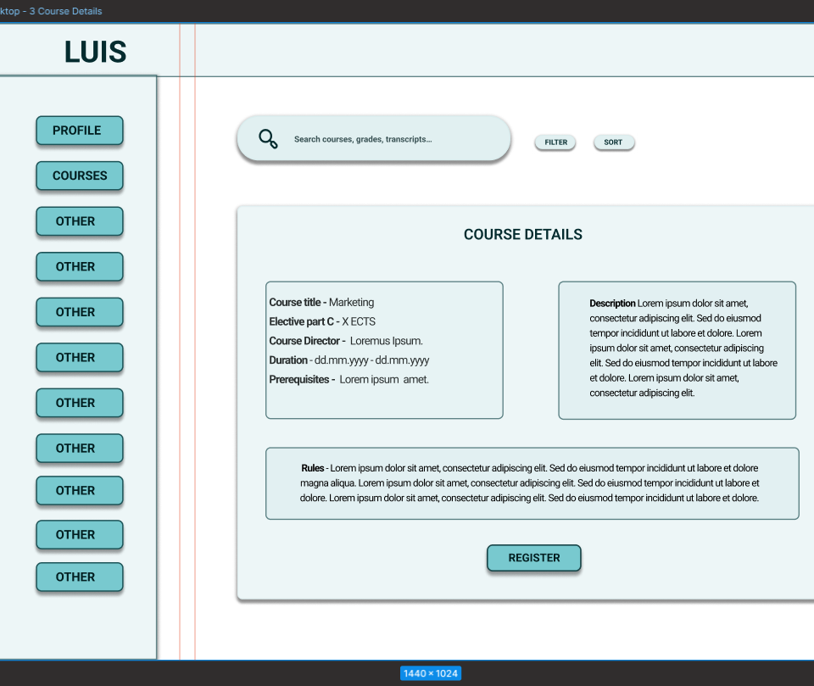
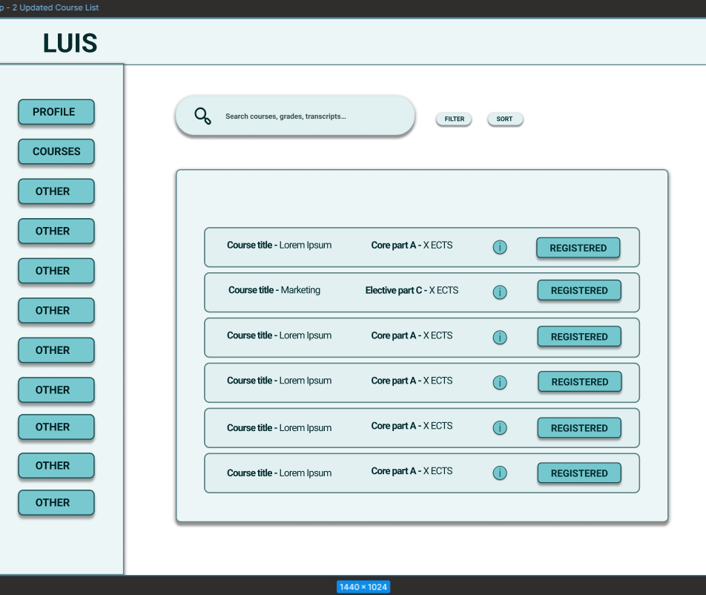
Student desktop wireframes

Slide 17
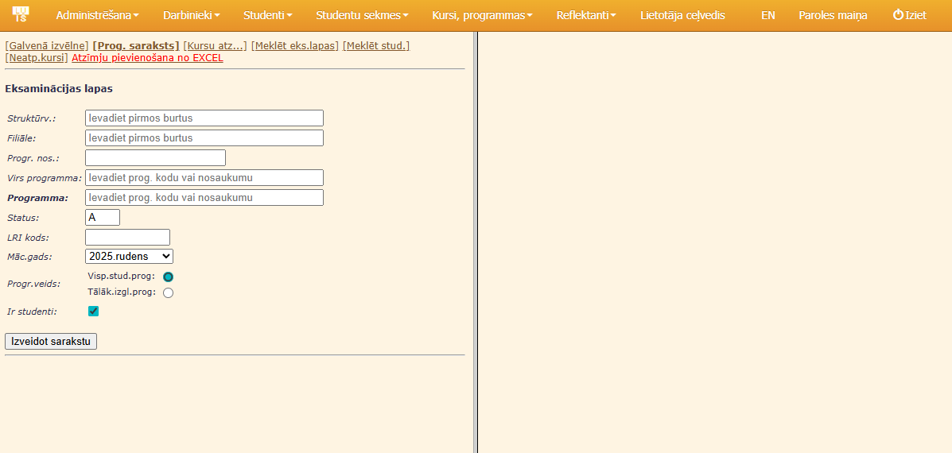
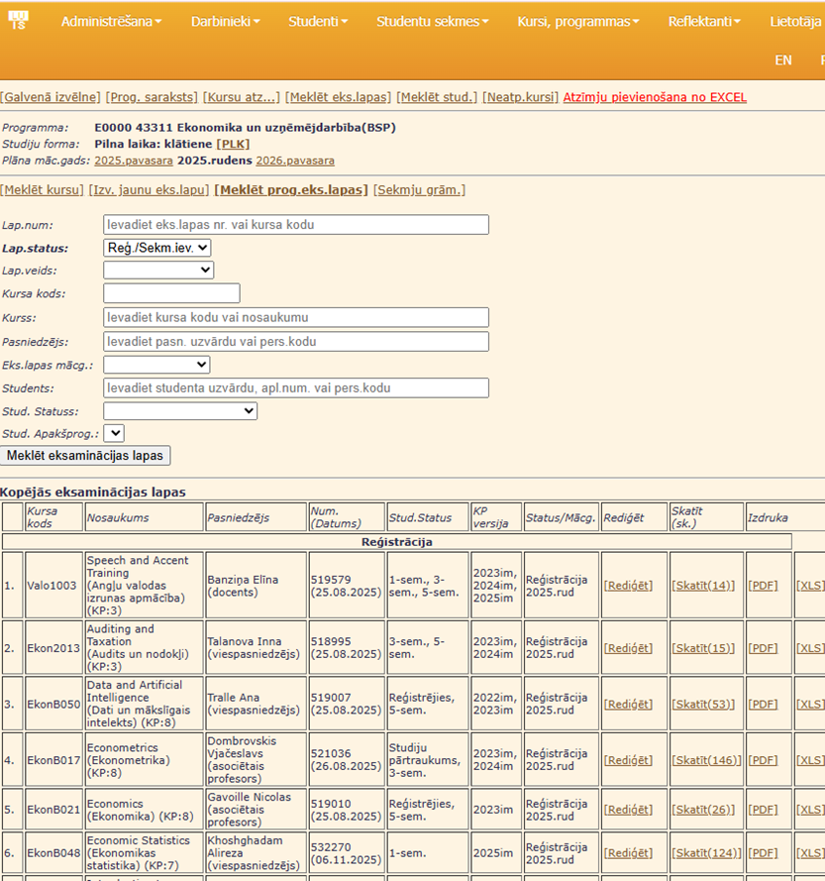
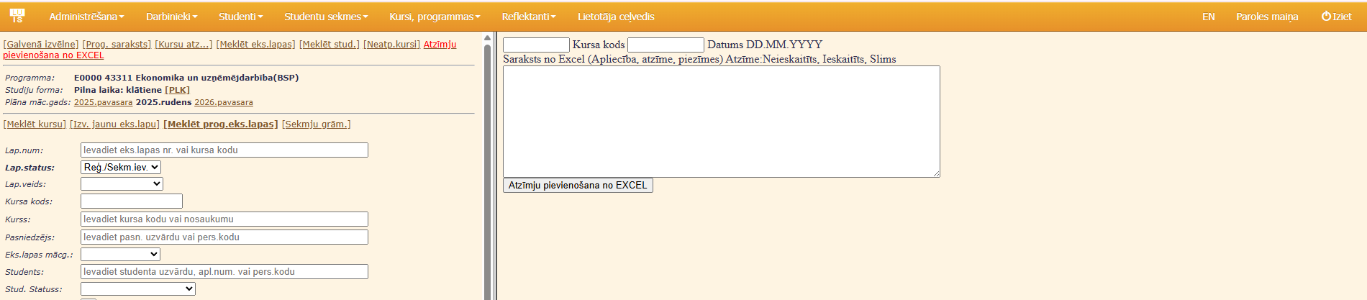
Existing LUIS Admin Desktop Interface Visuals

Slide 18
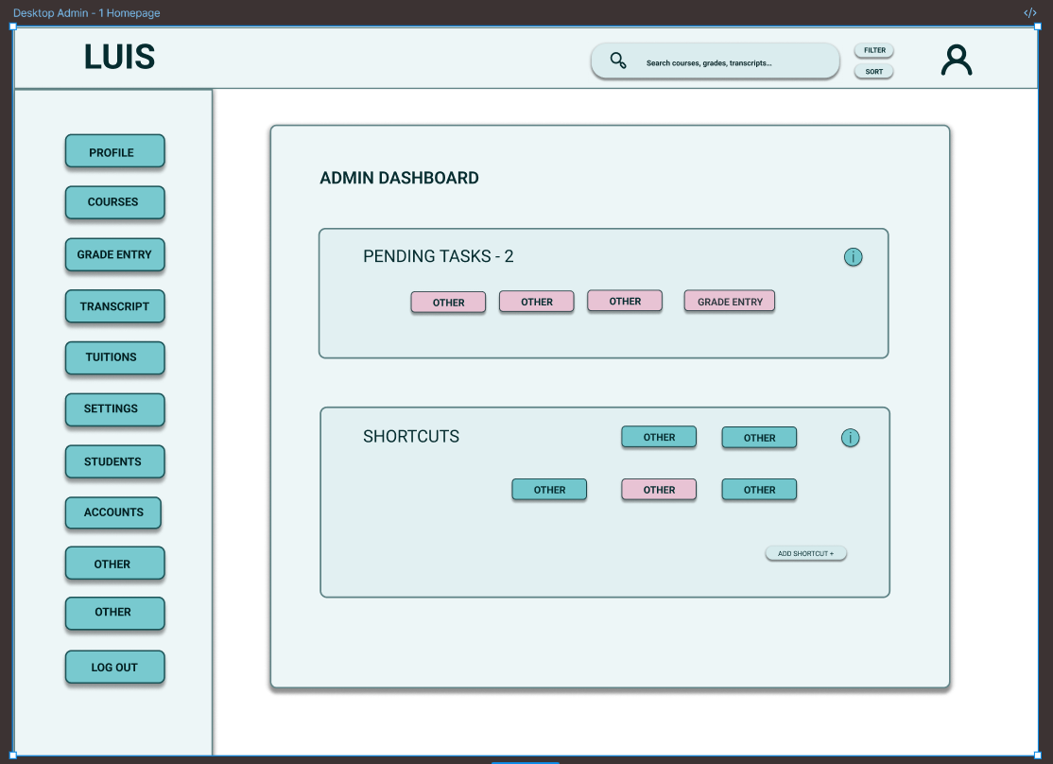
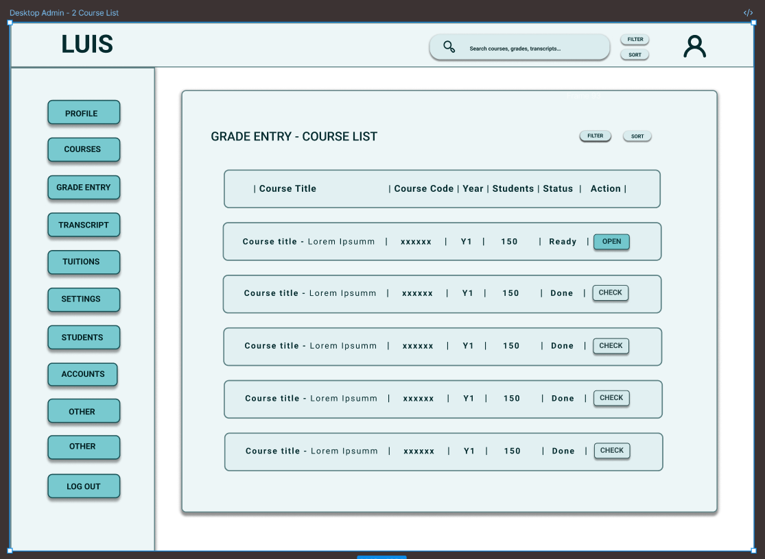
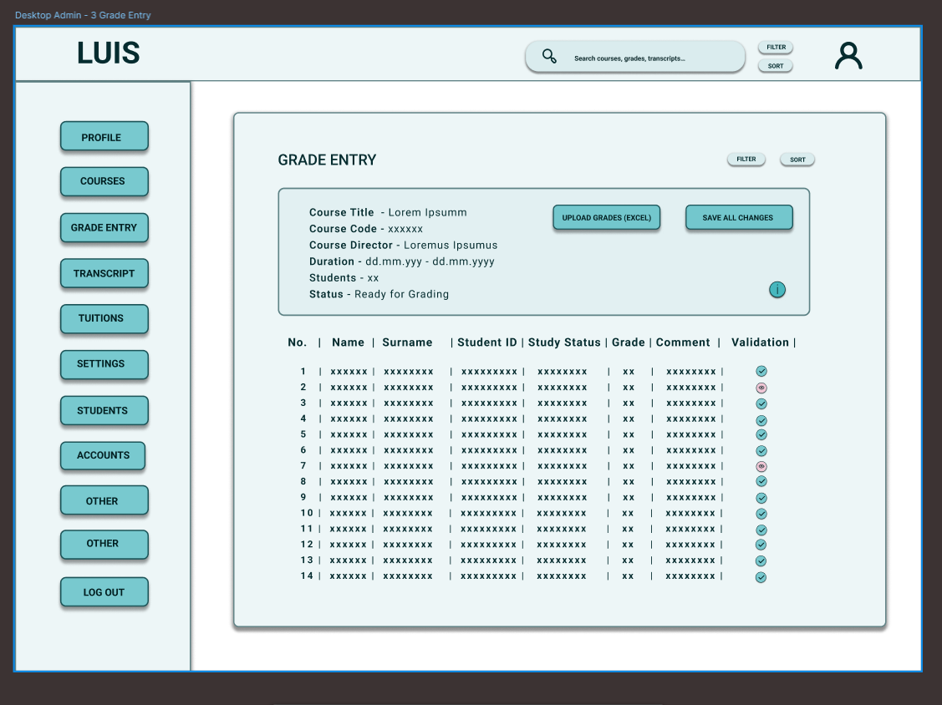
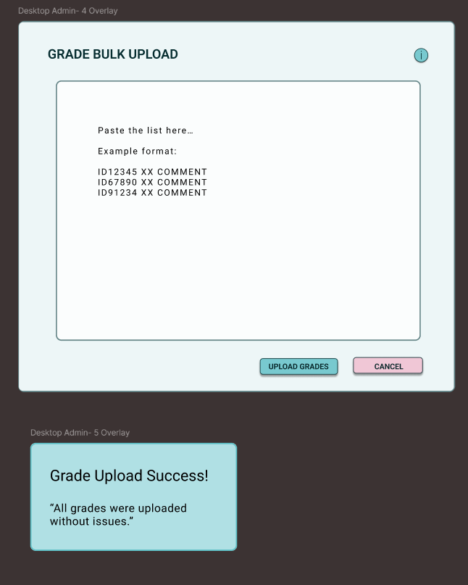
Admin desktop wireframes

Slide 19
Workflow Steps Comparison
Workflow | Before Redesign | After Redesign | Step Reduction
Exam Grade Entry (Desktop) | 11 | 5 | -6
Course Registration (Desktop) | 4 | 3 | -1
Course Registration (Mobile) | N/A | 3 | -

Slide 20
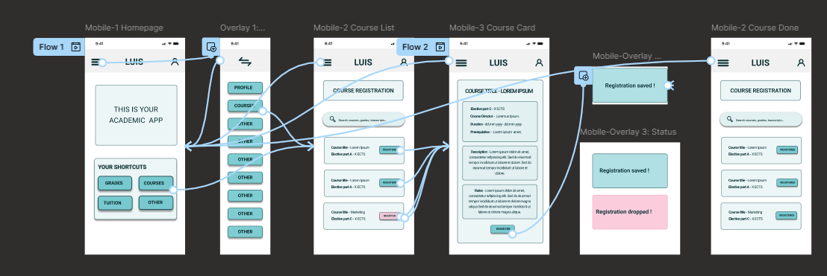
Prototype testing: student mobile workflow

Slide 21
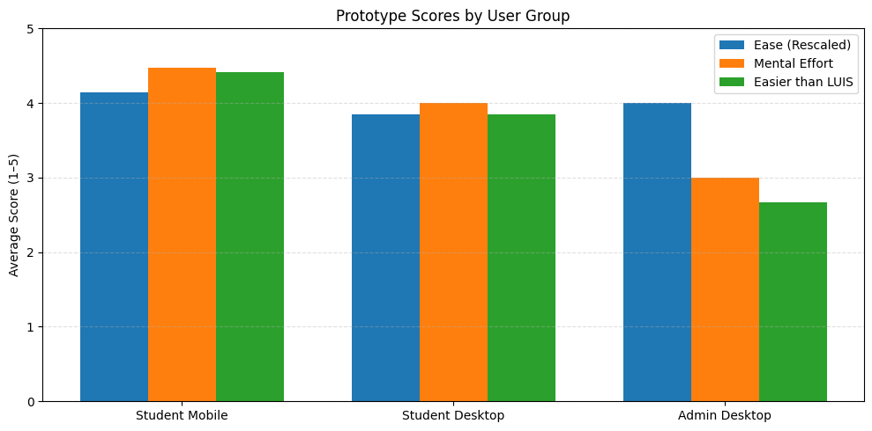
Prototype Testing Results

Slide 22
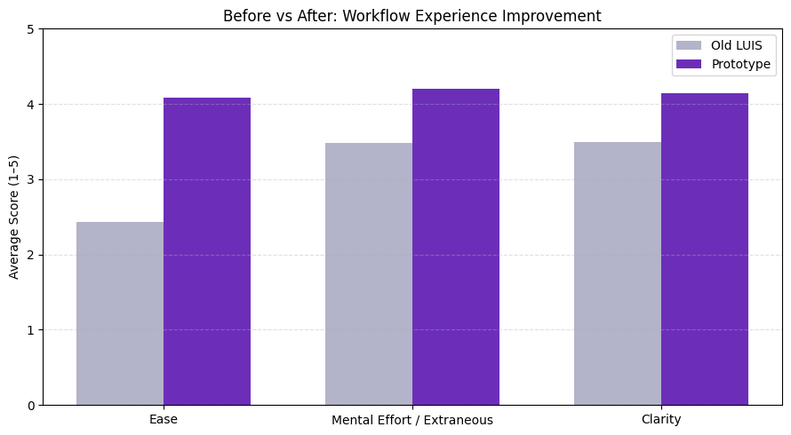
Quantitative Evaluation After Redesign

Slide 23
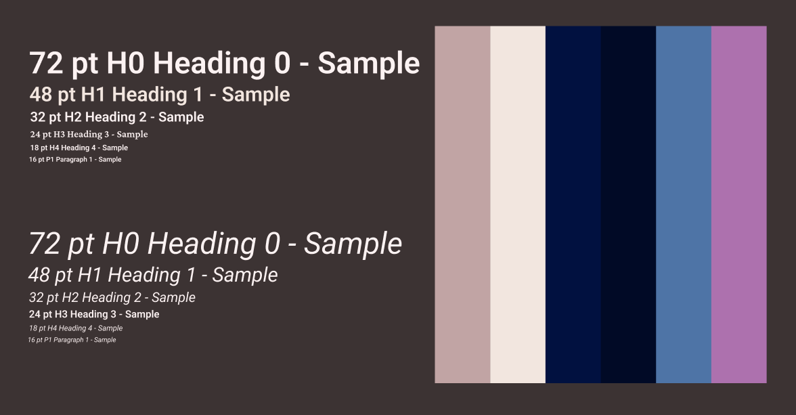
UI Design Style Guide

Slide 24
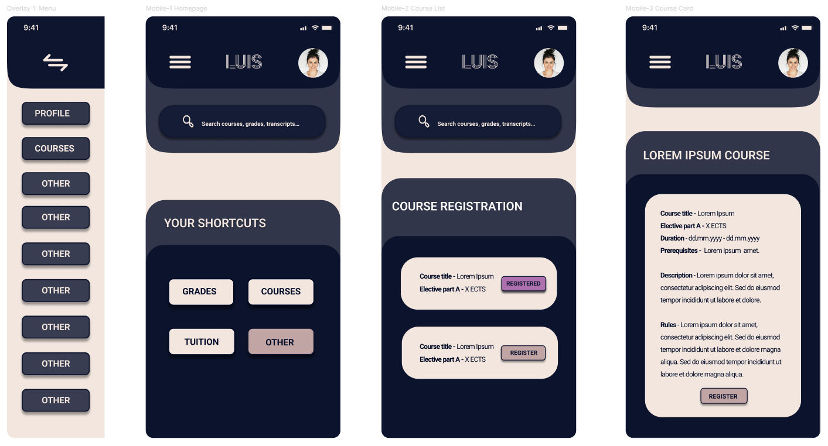
High-fidelity Mobile Screens

Slide 25
Implications
Usability problems in academic systems stem mainly from information structure, not task logic
Reducing extraneous cognitive load improves efficiency without system replacement
Information architecture should precede visual redesign in public digital systems
Early user testing and workflow modelling should be standard in national platforms

Slide 26
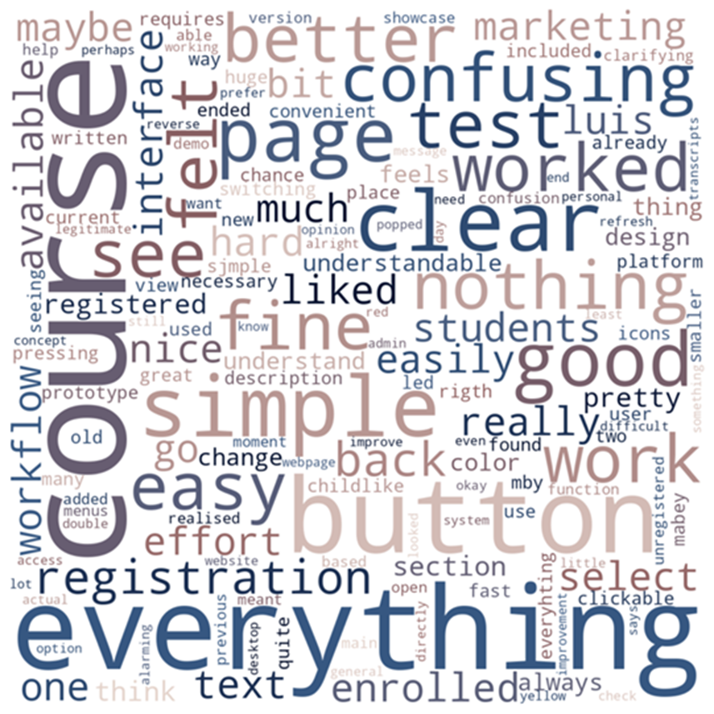
Conclusions
From a Digital Humanities perspective, this work shows how computational methods and human interpretation can be combined to study and redesign everyday digital infrastructures
Cognitive load theory and information architecture explain key usability failures in LUIS
Users struggle with presentation, not academic rules
Targeted workflow redesign reduced workflow steps, effort, and confusion
The proposed analytical framework is transferable to other academic systems

Slide 27
Future Work
Implement redesigned workflows in a live system
Validate results with larger, multi-institution samples
Develop a full design system for future academic platforms
Combine usability data with real system logs

Slide 28

Thank You! The full research repository, including datasets, analysis notebooks, and prototype materials, are available on GitHub.

