Slide 1

LRU Cache Implementation
Explore efficient cache management using doubly linked lists and hashing. This approach ensures fast data retrieval and optimal performance.
Əli Məmmədov – 6224 e

Slide 2
What is Caching?
Purpose
Benefits
Stores frequently accessed data for faster retrieval
Reduces latency
Improves performance
Examples
Key Metric
Web browsers
Cache hit ratio around 90% is ideal
Databases
Content Delivery Networks

Slide 3
LRU Cache: Least Recently Used
Eviction Policy
Temporal Locality
Comparison
Removes least recently used items first
Recent items are likely to be accessed again
FIFO
LFU
LRU adapts best to access patterns

Slide 4
Data Structures: Doubly Linked List
Node Components
Head & Tail
Key
Head is most recent; tail is least recent
Value
O(1) time to add or remove nodes
Next and previous pointers

Slide 5



Data Structures: Hash Map
Quick Access
Maps keys directly to linked list nodes
Collision Handling
Key-Node Pairs
Uses separate chaining or open addressing
Enables O(1) lookup of nodes
2
1
3

Slide 6



LRU Cache: Implementation
Get(key)
Check hash map, move node to head, return value or null
Put(key, value)
Update or add node at head, update hash map
Capacity Check
Evict tail node if cache is full

Slide 7
Algorithm: Step-by-Step
Initialization
1
Create doubly linked list, hash map, define capacity
2
Get Operation
Return value and move node to head if found
Put Operation
3
Add or update node at head, evict tail if needed

Slide 8
Performance Analysis
Time Complexity
Space Complexity
Benchmark
O(1) for both get and put
O(capacity) for linked list and hash map
LRU is 20% faster than FIFO in 1M operations

Slide 9
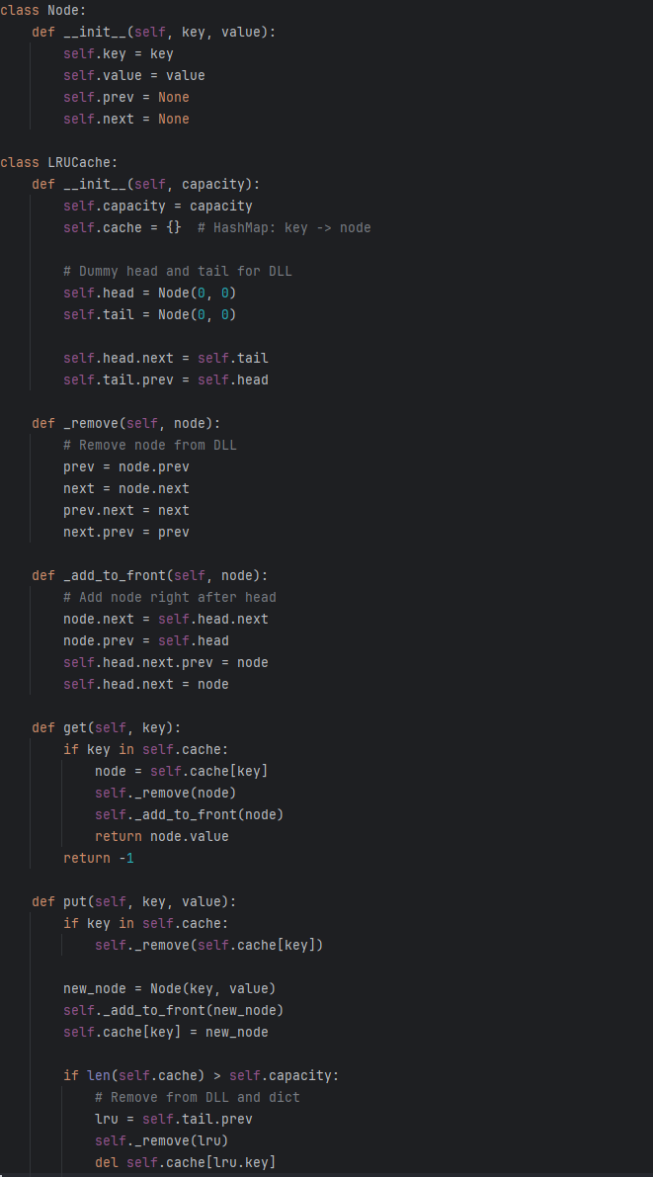
Use Cases & Examples

Slide 10
Conclusion
Efficient Management
O(1) time complexity for fast cache ops
Core Components
Doubly Linked List and Hashing enable rapid lookups
Applications
Ideal for high-performance, low-latency needs
Future Enhancements
Add concurrency control for multi-threaded access

