Slide 1
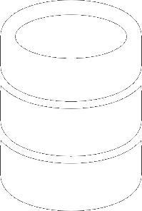
Crash Course on the History of Database Systems
Adapted from “What Goes Around Comes Around,”
by Hellerstein & Stonebraker

Slide 2
Why?
Notes:
You may be asking why should we read papers about old database technology when the focus on the course is going to be on newer Big Data systems that have come out in the last five years. Or why should we read a 20 year old paper that computers from companies that don’t exist anymore.

Slide 3
DATA MODELS
A data model is collection of concepts for describing the data in a database.
A schema is a description of a particular collection of data, using a given data model.

Slide 4
DATA MODELS
Relational
Key/Value
Graph
Document
Column-family
Array / Matrix
Hierarchical
Network

Slide 5
History Repeats Itself
Old database issues are still relevant today.
The “SQL vs. NoSQL” debate is reminiscent of “Relational vs. CODASYL” debate.
Many of the ideas in today’s database systems are not new.
5
Notes:
In the Stonebraker paper he talks about the “great debate” between the relational people and the CODASYL people during the 1970s. If you look back at those old annuals for those meetings, many of the things that they talk about are exactly the same thing people are saying today about NoSQL systems. That SQL is too slow. The database system can never optimize things as well as a human can. But if we look at the history, we see that the CODASYL people were wrong, and relational database systems are a billion dollar industry today. I also think we’re at the cusp of the two sides merging as well. You are starting to see certain things from the NoSQL and SQL worlds bleed into each other. For example, Cassandra has support for a variant of SQL and Postgres now has support for JSON data types.
Another thing that is important to consider as we read these papers in class is that in many cases the ideas that they are going to talk about are not new. For example, the big news last year was the announcement of Google’s Spanner system. This is one of the paper’s we’re going to read later on in the course. But when it came out, everyone was blown away because they were able to do distributed transactions over the wide-area network, which was assumed to be impossible. Sure they used custom atomic clocks and GPS devices to make this work, but the underlying concurrency control method that they’re using is not new. In fact, it’s going to be discussed in one of the papers that we’re reading for Monday that was written in 1981.

Slide 6

1960s – IBM IMS
First database system.
Hierarchical data model.
Programmer-defined physical storage format.
Tuple-at-a-time queries.
6
Notes:
Ok so now let’s start from the beginning. The first “real” general purpose database system was developed in the 1960s by IBM. IMS was created in 1966 as part of NASA’s Apollo project to keep track of large bill of materials.
Came on-line in 1968.
It’s still being used today and I think that it’s still IBM’s #1 best seller.
IMS uses what is known as a hierarchical data model where everything has to be laid out as a tree.
You have to tell the system when you load data how it should store it: sequential files, b-tree, or a hash table.

Slide 7
Hierarchical Data Model
Schema
Instance
SUPPLIER
(sno,sname,scity,sstate)
3, “Rick’s Supplies”, New York, NY
PART
(pno,pname,psize,qty,price)
1001, “Battery Pack”, Large, 500, $100
Can you have a part without a supplier?
7
Notes:
Problems:
Information is repeated.
Existence depends on parents. Impossible to have a part that is not currently supplied by anybody, impossible to have a supplier that does not have any parts.
No physical storage abstraction. The storage format that the programmer chooses for a database determines what operations could be performed on it. For example, if you chose the sequential data format, then the programmer was not allowed to insert new records into the database. You had to write a program that scanned the entire database, insert the changes in the right location, and then create a new database.

Slide 8
Hierarchical Data Model
Instance
Instance
3, “Rick’s Supplies”, New York, NY
4, “Dave’s Supplies”, New York, NY
1001, “Battery Pack”, Large, 500, $100
1002, “Battery Pack”, Large, 500, $100
Duplicate data if same part sold by different supplies
8
8
Notes:
Problems:
Information is repeated.
Existence depends on parents. Impossible to have a part that is not currently supplied by anybody, impossible to have a supplier that does not have any parts.
No physical storage abstraction. The storage format that the programmer chooses for a database determines what operations could be performed on it. For example, if you chose the sequential data format, then the programmer was not allowed to insert new records into the database. You had to write a program that scanned the entire database, insert the changes in the right location, and then create a new database.

Slide 9
Hierarchical Data Model
Instance
Instance
3, “Rick’s Supplies”, New York, NY
4, “Dave’s Supplies”, New York, NY
1001, “Battery Pack”, Large, 500, $100
1002, “Battery Pack”, Large, 500, $100
How do you update the price of a battery pack?
9
Notes:
Problems:
Information is repeated.
Existence depends on parents. Impossible to have a part that is not currently supplied by anybody, impossible to have a supplier that does not have any parts.
No physical storage abstraction. The storage format that the programmer chooses for a database determines what operations could be performed on it. For example, if you chose the sequential data format, then the programmer was not allowed to insert new records into the database. You had to write a program that scanned the entire database, insert the changes in the right location, and then create a new database.

Slide 10

Hierarchical Data Model
Schema
Instance
Duplicate Data
SUPPLIER
(sno,sname,scity,sstate)
3, “Dirty Rick’s Supplies”, New York, NY
No Independence
PART
(pno,pname,psize,qty,price)
1001, “Battery Pack”, Large, 500, $100
10
Notes:
Problems:
Information is repeated.
Existence depends on parents. Impossible to have a part that is not currently supplied by anybody, impossible to have a supplier that does not have any parts.
No physical storage abstraction. The storage format that the programmer chooses for a database determines what operations could be performed on it. For example, if you chose the sequential data format, then the programmer was not allowed to insert new records into the database. You had to write a program that scanned the entire database, insert the changes in the right location, and then create a new database.

Slide 11
Record-at-a-time
Write algorithm to access data
Iterate through hierarchy
Breaks if hierarchy changes
Performance is algorithm & data dependent

Slide 12
Schema impacts code
Schema
Schema
SUPPLIER
(sno,sname,scity,sstate)
PART
(pno,pname,psize,qty,price)
PART
(pno,pname,psize,qty,price)
SUPPLIER
(sno,sname,scity,sstate)
What happens when the schema changes?

Slide 13
Schema Impacts Code
For s in suppliers:
For p in parts[s]:
print s, p
For p in parts:
For s in suppliers[p]:
print s, p

Slide 14
Data Independence
Data organization can change without programming change
Important to work through logical abstractions

Slide 15
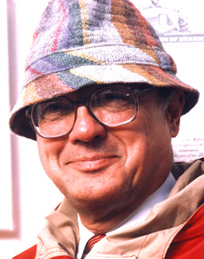
1970s – CODASYL
COBOL people got together and proposed a standard.
Network data model.
Record-at-a-time queries.
Bachman
15
Notes:
Major CODASYL Systems:
Culinaine Corporation’s IDMS (Integrated Database Management System)
Honeywell's Integrated Data Store (IDS/2)
Univac's DMS-1100
Digital Equipment Corporation's DBMS32

Slide 16
Network Data Model
Schema
SUPPLIER
(sno, sname, scity, sstate)
PART
(pno, pname,psize)
Supplies
SuppliedBy
Supply
(qty,price)
Notes:
Find Supplier (SNO=16)
Until no-more {
Find next Supply record in Supplies
Find owner Part record in Supplied_By
Get current record & check for psize=“large”
}
Problems:
Programs are tightly coupled to physical data layout. Schema cannot change without affecting programs.
Programs must navigate multi-dimensional space. Need to keep track of where you are at each vertex as you traverse the network.
Corrupting one set can cause the entire database to become corrupt.

Slide 17
Network Data Model
Find Supplier (SNO=16)
Until no-more {
Find next Supply record in Supplies
Find owner Part record in Supplied_By
Get current record & check for psize=“large”
}
Programming defines how to retrieve data
Notes:
Find Supplier (SNO=16)
Until no-more {
Find next Supply record in Supplies
Find owner Part record in Supplied_By
Get current record & check for psize=“large”
}
Problems:
Programs are tightly coupled to physical data layout. Schema cannot change without affecting programs.
Programs must navigate multi-dimensional space. Need to keep track of where you are at each vertex as you traverse the network.
Corrupting one set can cause the entire database to become corrupt.

Slide 18
Network Data Model
Schema
SUPPLIER
(sno,sname,scity,sstate)
PART
(pno,pname,psize)
Complex Queries
Supplies
SuppliedBy
Supply
(qty,price)
18
Notes:
Find Supplier (SNO=16)
Until no-more {
Find next Supply record in Supplies
Find owner Part record in Supplied_By
Get current record & check for psize=“large”
}
Problems:
Programs are tightly coupled to physical data layout. Schema cannot change without affecting programs.
Programs must navigate multi-dimensional space. Need to keep track of where you are at each vertex as you traverse the network.
Corrupting one set can cause the entire database to become corrupt.

Slide 19
Stonebraker Lessons
Physical and logical data independence are good.
Tree-based data models are too restrictive.
Record-at-a-time forces the programmer to do manual query optimization.
19

Slide 20
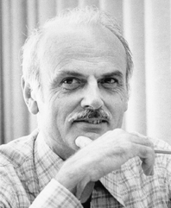
1970s – Relational Model
Codd saw the maintenance overhead for IMS/Codasyl.
Proposes database abstraction based on tables.
Codd
20

Slide 21
Relational Model
Structure: Store database in simple data structures (i.e., tables).
Manipulation: Access it through high-level language (i.e., SQL).
Integrity: Ensure content satisfies constraints
21

Slide 22
Schema
"A database schema specifies, based on the database administrator's knowledge of possible applications, the facts that can enter the database, or those of interest to the possible end-users.”
Tables / relations composed of attributes / fields, which are of specific types (integer, text).
Imielinski, T.; Lipski, W. "A systematic approach to relational database theory". Proceedings of the 1982 ACM SIGMOD

Slide 23
Relational Data Model
Schema
SUPPLIER
(sno,sname,scity,sstate)
PART
(pno,pname,psize)
Supply
(sno,pno,qty,price)
23
Notes:
Find Supplier (SNO=16)
Until no-more {
Find next Supply record in Supplies
Find owner Part record in Supplied_By
Get current record & check for psize=“large”
}
Problems:
Programs are tightly coupled to physical data layout. Schema cannot change without affecting programs.
Programs must navigate multi-dimensional space. Need to keep track of where you are at each vertex as you traverse the network.
Corrupting one set can cause the entire database to become corrupt.

Slide 24
RELATIONAL MODEL
A relation is unordered set that contain the relationship of attributes that represent entities.
A tuple is a set of attribute values (also known as its domain) in the relation.
Values are (normally) atomic/scalar.
The special value NULL is a member of every domain.
Artist(name, year, country)
name | year | country
Wu Tang Clan | 1992 | USA
Notorious B.I.G. | 1992 | USA
Ice Cube | 1989 | USA
n-ary Relation
=
Table with n columns

Slide 25
RELATIONAL MODEL: PRIMARY KEY
A relation’s primary key is a candidate key that is deemed more “important” than other candidate keys.
Some DBMSs automatically create an internal primary key for a table if you do not define one.
Artist(id, name, year, country)
id | name | year | country
101 | Wu Tang Clan | 1992 | USA
102 | Notorious B.I.G. | 1992 | USA
103 | Ice Cube | 1989 | USA
104 | Ice Cube | 2017 | India
105 | Ice Cube | 2017 | USA
106 | Ice Cube | 2017 | USA
name | year | country
Wu Tang Clan | 1992 | USA
Notorious B.I.G. | 1992 | USA
Ice Cube | 1989 | USA

Slide 26
RELATIONAL MODEL: FOREIGN KEYS
Artist(id, name, year, country)
A foreign key specifies that an attribute from one relation has to map to a tuple in another relation.
id | name | year | country
101 | Wu Tang Clan | 1992 | USA
102 | Notorious B.I.G. | 1992 | USA
103 | Ice Cube | 1989 | USA
ArtistAlbum(artist_id, album_id)
Album(id, name, artists, year)
artist_id | album_id
101 | 11
101 | 22
103 | 22
Album(id, name, year)
id | name | artists | year
11 | Enter the Wu Tang | 101 | 1993
22 | St.Ides Mix Tape | ??? | 1994

Slide 27
Schema
Primary key (PK) -- unique identifier
Foreign key (FK) – reference to PK
Normalization – reduce redundancy
Divide info across smaller tables
Define relationships between tables
Isolate data so operations can modify one table
Every table should have a PK

Slide 28
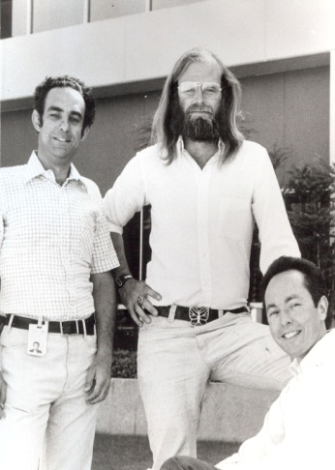
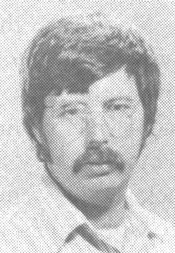
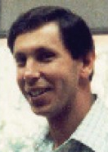
1970s – Relational Model
System R – IBM Research
INGRES – Berkeley
Oracle – Larry Ellison
Gray
Ellison
Stonebraker
28

Slide 29

1980s – Relational Model
IBM comes out with DB2.
SQL becomes the standard.
Oracle wins marketplace.
Stonebraker creates Postgres.
Stonebraker

Slide 30
Stonebraker Lessons
Set-at-a-time interface offers better physical data independence.
Database system optimizer is better than manual tuning.
30

Slide 31
Set-at-a-time interface
Operate on many rows at once
Common operation applied across sets of data
Mathematically easier to follow
31

Slide 32
Quick Detour
SQL

Slide 33
SQL
Logical language to express database operations
Data description language (DDL):
create, drop tables / views
Data manipulation language (DML):
select, insert, update, delete
View: Logical view of tables expressed with a select query
Index: Fast lookup to data (B-Tree, R-Tree, Hash Table)
SQL Review: https://github.com/swcarpentry/sql-novice-survey/

Slide 34
SQL
Create table tweet(attr1 int, attr2 int);
Create view v_tweet_a1 AS select attr1 from tweet;
Insert into tweet VALUES (1, 2);
Select attr1, attr2 from tweet;
Update tweet set attr2 = 3 where attr1 = 1;
Delete from tweet where attr1 = 1;
Drop table tweet;
SQL Review: https://github.com/swcarpentry/sql-novice-survey/

Slide 35
Semantics
Set-based
Order of rows not specified by default
Set-based operations
UNION, INTERSECT, DISTICT, …
Aggregation operations (group by):
Count, sum, average, …
Can explicitly order results

Slide 36
Optimizer
Provide DB your SQL query (logical)
It optimizes the query
Method of access (scans, indexes)
Determines access path (order data are accessed)
Determines how to combine / join multiple tables
Creates a physical query plan (to see, run EXPLAIN <query>)
Uses DB stats and machine resources to optimize
The optimizer is often smarter than you

Slide 37
Usage: Terminal
sqlite3 tempdb
>run sql commands from previous slide
[for help] >.help
[to quit] >.q
Create table tweet(attr1 int, attr2 int);
Create view v_tweet_a1 AS select attr1 from tweet;
Insert into tweet VALUES (1, 2);
Select attr1, attr2 from tweet;
Update tweet set attr2 = 3 where attr1 = 1;
Delete from tweet where attr1 = 1;
Drop table tweet;

Slide 38
Usage: Python
import sqlite3
con = sqlite3.connect('tempdb')
cur = con.cursor()
cur.execute('create table tweet(attr1 int, attr2 int)')
cur.execute('insert into tweet VALUES (1, 2)')
con.commit()
cur.execute('select * from tweet')
for row in cur.fetchall():
print row
Note: tempdb is a file created in the current directory

Slide 39



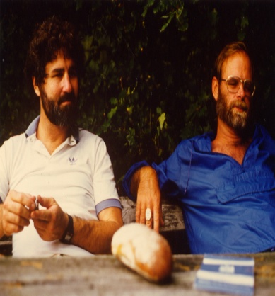
1980s – Distributed DBs
SDD-1 – CCA
System R* – IBM Research
Gamma – Univ. of Wisconsin
NonStop SQL – Tandem
Bernstein
Mohan
DeWitt
Gray

Slide 40
Distributed Databases
Data split across many machines
Execute queries that pull data from many machines
Ensure results are correct
Execute millions of operations / sec

Slide 41

Database Partitioning
Schema Tree
Partitions
P1
P2
P3
P4
P5
WAREHOUSE
P1
P2
P3
P4
P5
P1
P2
P3
P4
P5
P1
P2
DISTRICT
STOCK
ITEM
ITEM
P1
P2
P3
P4
P5
CUSTOMER
P3
P4
ITEM
ITEM
P1
P2
P3
P4
P5
ORDERS
ITEM
ITEM
ITEM
ITEM
ITEM
ITEM
Replicated
P1
P2
P3
P4
P5
P5
ORDER_ITEM
ITEM

Slide 42
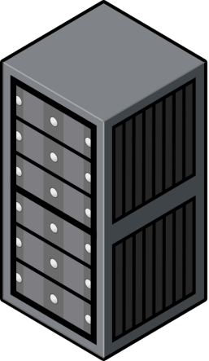
Distributed OLTP
Partitions
P1
P2
ITEM
ITEM
P3
P4
ITEM
ITEM
Application
Server
P5
ITEM

Slide 43
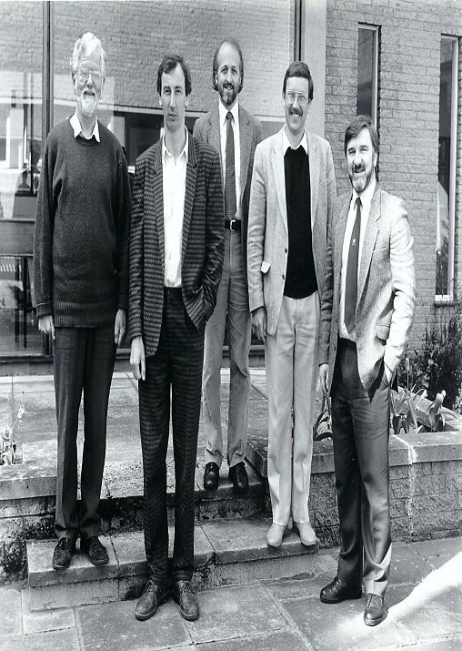
1980s – OO Databases
Avoid “relational-object impedance mismatch.”
Tight coupling between objects and database.
Zdonik
43

Slide 44
Object-Oriented Model
Application Code
class Student {
int id;
String name;
String email;
String phone[];
}
Schema
STUDENT
(id, name, email)
id
name
email
STUDENT_PHONE
(sid, phone)
1001
Tone Loc
funky@medina.com
sid
phone
1001
444-444-4444
1001
555-555-5555
44

Slide 45
https://sequelize.readthedocs.io/en/v3/: ORM
SELECT * FROM USERS WHERE zip_code=94107;
The equivalent Django ORM query would instead look like the following Python code:
# obtain everyone in the 94107 zip code and assign to users variable
users = Users.objects.filter(zip_code=94107)
Notes:
# obtain everyone in the 94107 zip code and assign to users variable users = Users.objects.filter(zip_code=94107)

Slide 46
Object-Oriented Model
Application Code
Schema
class Student {
int id;
String name;
String email;
String phone[];
}
STUDENT
(id, name, email)
Too Much Work
STUDENT_PHONE
(sid, phone)
id
name
email
1001
Tone Loc
funky@medina.com
sid
phone
1001
444-444-4444
1001
555-555-5555
46

Slide 47



1990s – Boring Days
Microsoft forks Sybase and creates SQL Server.
MySQL is written as a replacement for mSQL.
Postgres gets SQL support.
47

Slide 48
2000s – Internet Boom
All the big players were heavyweight and expensive.
Open-source databases were missing important features.
Custom scale-out middleware.
Examples: eBay, Facebook
48

Slide 49

Middleware Approach
Too Much Work
Middleware
Reinvent Wheel
Application
Server
Database
Cluster
49

Slide 50
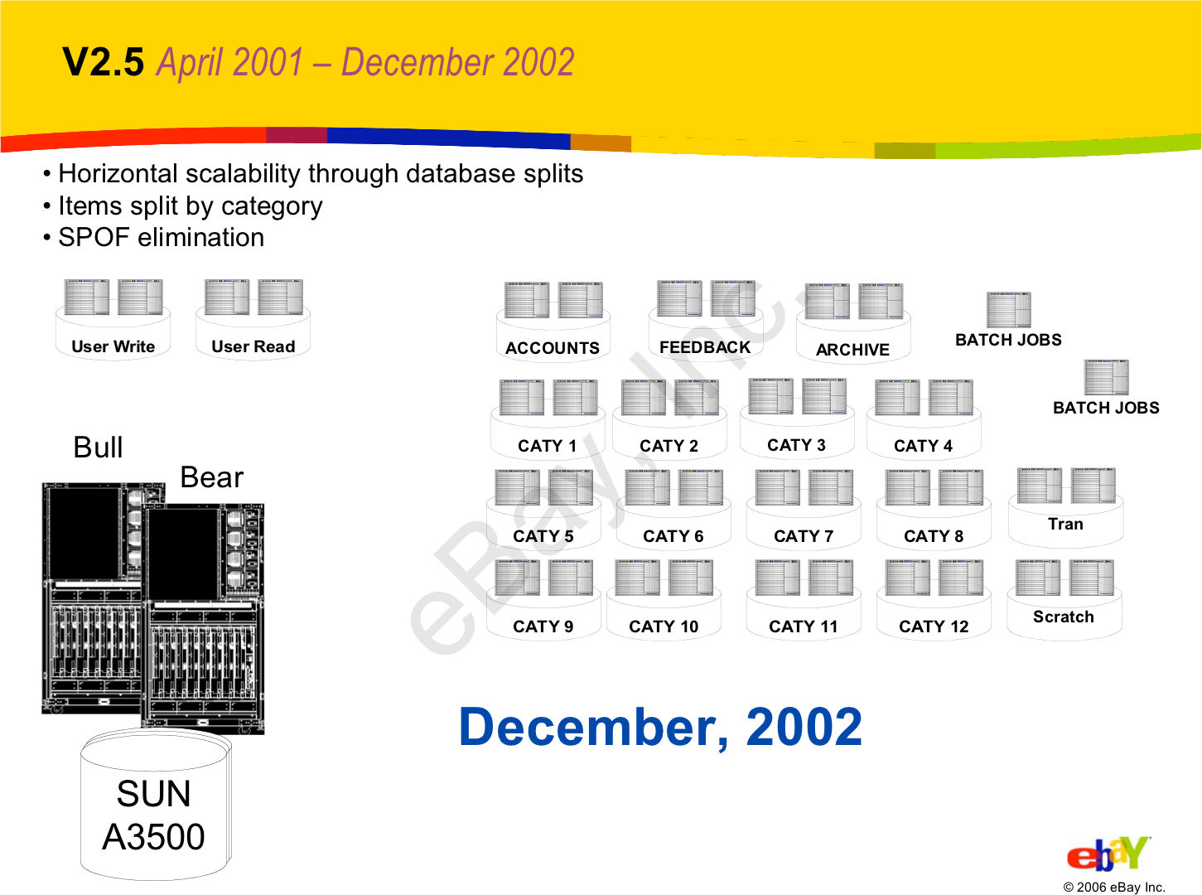
Randy Shoup - “The eBay Architecture” http://highscalability.com/ebay-architecture

Slide 51
Push functionality to application:
Joins
Referential integrity
Sorting
No distributed transactions.
Randy Shoup - “The eBay Architecture” http://highscalability.com/ebay-architecture

Slide 52
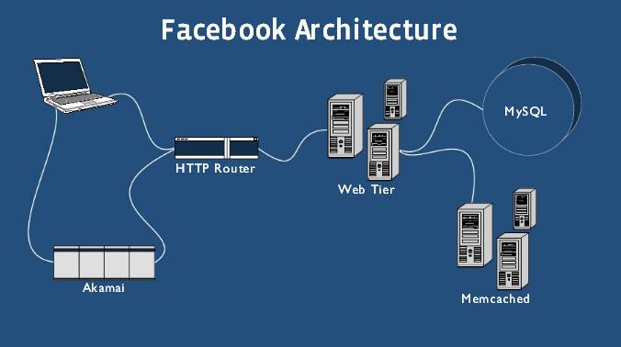

Jay Thadeshwar -“Technology Used by Facebook” http://www.techthebest.com/2011/11/29/technology-used-in-facebook/

Slide 53
Scale out using custom middleware.
Store ~75% of database in Memcache.
No distributed transactions.
Jay Thadeshwar -“Technology Used by Facebook” http://www.techthebest.com/2011/11/29/technology-used-in-facebook/

Slide 54





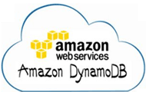



2000s – NoSQL
Focus on high-availability & high-scalability:
Schema-less (“Schema Last”)
Not ACID
Custom APIs instead of SQL.
54
Notes:
Everything that Stonebraker says about XML can be said about NoSQL.
XML never took off. NoSQL did.

Slide 55
2000s – NoSQL
Alternative data models:
Column-family (Cassandra, HBase)
Document (MongoDB, CouchDB)
Key-value (Riak, Dynamo)
Graph (Neo4j, FlockDB)
Usually open-source.
“A” + “P” in CAP Theorem
55

Slide 56
Detour: CAP Theorem

Slide 57
CAP Theorem
Consistency:
All nodes should see the same data at the same time
Availability:
Node failures do not prevent survivors from continuing to operate
Partition-tolerance:
The system continues to operate despite network partitions
A distributed system can satisfy any two of these guarantees at the same time but not all three

Slide 58
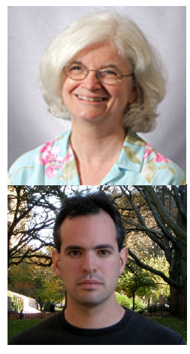
CAP Theorem: Proof
2002: Proven by research conducted by Nancy Lynch and Seth Gilbert at MIT
Gilbert, Seth, and Nancy Lynch. "Brewer's conjecture and the feasibility of consistent, available, partition-tolerant web services." ACM SIGACT News 33.2 (2002): 51-59.

Slide 59
Consistency
Availability
Partition Tolerant
V = 1
Middleware
Application
Server
V = 1
59

Slide 60
Consistency
Availability
Partition Tolerant
V = 2
V = 2
Middleware
Application
Server
V = 2
60

Slide 61

Consistency
Availability
Partition Tolerant
V = 1
V = 2
Middleware
Application
Server
V = 2
61

Slide 62
Consistency
Availability
Partition Tolerant
What is V?
V = 1
Middleware
Application
Server
V = 2
Do you respond with V = 1, V = 2 or not respond?
62

Slide 63
Why this is important?
All modern databases are distributed (Big Data Trend, etc.)
CAP theorem describes the trade-offs involved in distributed systems
A proper understanding of CAP theorem is essential to making decisions about the distributed database design
Misunderstanding can lead to erroneous or inappropriate design choices

Slide 64
Problem for Relational Database to Scale
The Relational Database is built on the principle of ACID (Atomicity, Consistency, Isolation, Durability)
It implies that a truly distributed relational database should have availability, consistency and partition tolerance.
Which unfortunately is impossible …

Slide 65
Revisit CAP Theorem
Of the following three guarantees potentially offered a by distributed systems:
Consistency
Availability
Partition tolerance
Pick two
This suggests there are three kinds of distributed systems:
CP
AP
CA
C
A
P
Any problems?

Slide 66
Consistency or Availability
Consistency and Availability is not “binary” decision
AP systems relax consistency in favor of availability – but are not inconsistent
CP systems sacrifice availability for consistency- but are not unavailable
This suggests both AP and CP systems can offer a degree of consistency, and availability, as well as partition tolerance
C
A
P

Slide 67
AP: Best Effort Consistency
Example:
Web Caching
DNS
Trait:
Optimistic
Expiration/Time-to-live
Conflict resolution

Slide 68
CP: Best Effort Availability
Example:
Majority protocols
Distributed Locking (Google Chubby Lock service)
Trait:
Pessimistic locking
Make minority partition unavailable

Slide 69
Types of Consistency
Strong Consistency
After the update completes, any subsequent access will return the same updated value.
Weak Consistency
It is not guaranteed that subsequent accesses will return the updated value.
Eventual Consistency
Specific form of weak consistency
It is guaranteed that if no new updates are made to object, eventually all accesses will return the last updated value (e.g., propagate updates to replicas in a lazy fashion)

Slide 70
Eventual Consistency Variations
Causal consistency
Processes that have causal relationship will see consistent data
Read-your-write consistency
A process always accesses the data item after it’s update operation and never sees an older value
Session consistency
As long as session exists, system guarantees read-your-write consistency
Guarantees do not overlap sessions

Slide 71



Eventual Consistency - A Facebook Example
Bob finds an interesting story and shares with Alice by posting on her Facebook wall
Bob asks Alice to check it out
Alice logs in her account, checks her Facebook wall but finds:
- Nothing is there!
?

Slide 72

Eventual Consistency - A Facebook Example
Bob tells Alice to wait a bit and check out later
Alice waits for a minute or so and checks back:
- She finds the story Bob shared with her!

Slide 73
Eventual Consistency - A Facebook Example
Reason: it is possible because Facebook uses an eventual consistent model
Why Facebook chooses eventual consistent model over the strong consistent one?
Facebook has more than 1 billion active users
It is non-trivial to efficiently and reliably store the huge amount of data generated at any given time
Eventual consistent model offers the option to reduce the load and improve availability

Slide 74






NON-RELATIONAL DATA MODELS: KEY-VALUE
Store records in an associative array that maps a key to a value.
Sometimes called a dictionary or hash table.
The contents of a record’s value is often opaque to DBMS.
It is up to the application to interpret its contents.
Some systems allow for compound values.
Artist: name→(year,country)
Key
Value
Wu Tang Clan
1992,"USA"
Notorious BIG
1992,"USA"
Ice Cube
1989,"USA"

Slide 75






NON-RELATIONAL DATA MODELS: DOCUMENT
{
"name": "Wu Tang Clan",
"year": 1992,
"country": "USA",
"albums": [
{ "name": "Enter the Wu Tang",
"year": 1993,
"tracks": [
"Bring da Ruckus",
"Shame on a *****",
"Clan in da Front",
⋮
] }
]
}
A document is a self-contained record that contains the description of its data attributes and their corresponding values.
Support nesting together all of the documents for a single entity.
This is called denormalization in the relational model.
{
"name": "Wu Tang Clan",
"year": 1992,
"country": "USA"
}
{
"name": "Ice Cube",
"year": 1989,
"country": "USA",
"city": "Los Angeles"
}

Slide 76
2000s – NoSQL
Alternative data models:
Column-family (Cassandra, HBase)
Document (MongoDB, CouchDB)
Key-value (Riak, Dynamo)
Graph (Neo4j, FlockDB)
Usually open-source.
“A” + “P” in CAP Theorem
76

Slide 77










2010s – NewSQL
Provide same performance of NoSQL without giving up ACID
Relational / SQL
Distributed (Mostly)
Usually closed-source.
77

Slide 78
2010s – NewSQL
Different solutions:
Specialized OLTP (H-Store, VoltDB)
Distributed MVCC (NuoDB)
Custom Hardware (Clustrix, Spanner)
Relaxed Consistency (MemSQL, SQLFire)
Middleware (ScaleBase, dbShards)
78

Slide 79
Observations
Innovations come from both industry and academia.
IBM was the vanguard during 1970-1980s.
Google is current trendsetter.
79

Slide 80
RELATIONAL ALGEBRA: PRODUCT
Generate a relation that contains all possible combinations of tuples from the input relations.
Syntax: (R × S)
R(a_id,b_id)
S(a_id,b_id)
a_id | b_id
a1 | 101
a2 | 102
a3 | 103
a_id | b_id
a3 | 103
a4 | 104
a5 | 105
(R × S)
R.a_id | R.b_id | S.a_id | S.b_id
a1 | 101 | a3 | 103
a1 | 101 | a4 | 104
a1 | 101 | a5 | 105
a2 | 102 | a3 | 103
a2 | 102 | a4 | 104
a2 | 102 | a5 | 105
a3 | 103 | a3 | 103
a3 | 103 | a4 | 104
a3 | 103 | a5 | 105
SELECT * FROM R CROSS JOIN S;
SELECT * FROM R, S;

Slide 81
RELATIONAL ALGEBRA: JOIN
Generate a relation that contains all tuples that are a combination of two tuples (one from each input relation) with a common value(s) for one or more attributes.
Syntax: (R ⋈ S)
R(a_id,b_id)
S(a_id,b_id)
a_id | b_id
a1 | 101
a2 | 102
a3 | 103
a_id | b_id
a3 | 103
a4 | 104
a5 | 105
(R ⋈ S)
a_id | b_id
a3 | 103
SELECT * FROM R NATURAL JOIN S;

Slide 82
RELATIONAL ALGEBRA: JOIN TYPES
Cross Join
Same thing as Cartesian product
Inner Join
Each tuple in the first relation must have a corresponding match in the second relation.
Outer Join
Each tuple in one relation does not need to have a corresponding match in the other relation.

Slide 83
RELATIONAL ALGEBRA: INNER JOINS (1)
Natural Join (R⋈S)
Match tuples in R and S where the shared attributes are equivalent.
Theta / Equi Join (R⋈_{θ}S)
Match tuples using some arbitrary join predicate defined by θ.
If θ is just an equality predicate, then it is called an "Equi Join".
(R ⋈ S)
a_id | b_id
a3 | 103
(R ⋈(R.a_id=S.a_id ∧ R.b_id=S.b_id) S)
R.a_id | R.b_id | S.a_id | S.b_id
a3 | 103 | a3 | 103
SELECT * FROM R INNER JOIN S ON R.a_id = S.a_id AND R.b_id = S.b_id;
SELECT * FROM R JOIN S ON R.a_id = S.a_id AND R.b_id = S.b_id;
SELECT * FROM R, S WHERE R.a_id = S.a_id AND R.b_id = S.b_id;

Slide 84
RELATIONAL ALGEBRA: INNER JOINS (2)
(R ⋉ S)
R.a_id | R.b_id
a3 | 103
Semi Join (R⋉S)
Generate relation that contains tuples of R that match with tuples in S.
Same as natural join except that output relation only contains tuples from the first relation.
Anti Join (R▷S)
Generate relation that contains tuples of R that do not match with any tuple in S.
SELECT R.* FROM R
WHERE EXISTS(
SELECT * FROM S
WHERE R.a_id = S.a_id AND R.b_id = S.b_id);
(R ▷ S)
R.a_id | R.b_id
a1 | 101
a2 | 102
SELECT R.* FROM R
WHERE NOT EXISTS(
SELECT * FROM S
WHERE R.a_id = S.a_id AND R.b_id = S.b_id);

Slide 85
RELATIONAL ALGEBRA: OUTER JOINS
Left Outer Join (R⟕S)
Generate all combinations of tuples in R and S that are equal on their shared attributes, in addition to tuples in R that have no matching tuples in S.
Right Outer Join (R⟖S)
Same as LEFT OUTER but with the input relations reversed.
Full Outer Join (R⟗S)
Union of LEFT OUTER and RIGHT OUTER.
(R ⟕ S)
R.a_id | R.b_id | S.a_id | S.b_id
a1 | 101 | NULL | NULL
a2 | 102 | NULL | NULL
a3 | 103 | a3 | 103
SELECT * FROM R LEFT OUTER JOIN S ON R.a_id = S.a_id AND R.b_id = S.b_id;

Slide 86
Summary
Data independence
Keep it simple
Cycle between:
Structured and non-structured DB
Functionality in-DB vs out-of-DB
Programming language tight vs loose integration
86

