Slide 1
Project Title: Expression Classification from Facial Images
The facial emotion detection project utilizes the MobileNetV2 model to recognize emotions in human faces from images

Slide 2
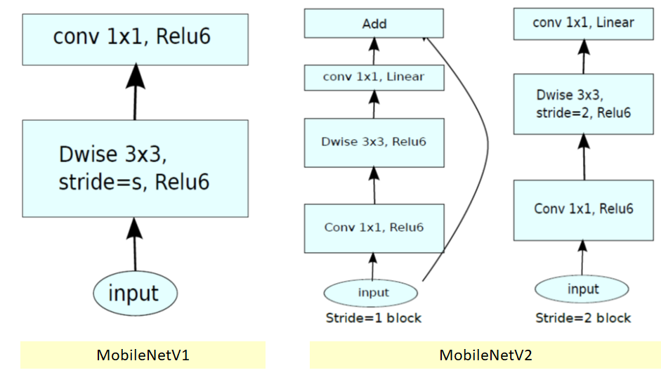
How does MobileNetV2 work?
MobileNet-v2 is a convolutional neural network that is 53 layers deep. You can load a pre-trained version of the network trained on more than a million images from the ImageNet database [1]. The pre-trained network can classify images into 1000 object categories, such as keyboard, mouse, pencil, and many animals.

Slide 3
Dataset and Preprocessing
Data Extraction: Initially, you obtained a dataset containing facial expression images.
Data extraction involves accessing the dataset and organizing it in a structured format
for further processing.
Subdirectory Organization: You organized the dataset into subdirectories based on the
different emotion classes. Each subdirectory represents a specific emotion label
(e.g., "happy," "sad," "angry," etc.). This organization is essential for supervised learning,
where the model requires labeled data for training.
Removing Unsupported Format Images: During the data extraction process, you might
have encountered images in unsupported formats that could not be processed by the facial
emotion detection model. To ensure data uniformity and compatibility, you removed such
images from the dataset.

Slide 4
Performance of Model
I trained the model on 8346 images dataset where I splitted into training and validation data 80% : 20% and applying pre trained Model MobileNetV2 so finally I get following results
Loss: 0.506
Accuracy: 0.8645
Val_Loss: 0.607
Val_Acc: 0.8646

