Slide 1
EEM5524 - Advanced Communication Electonics
Subject : Software Defined Radio
Lecturer : Asso. Prof.Bahadır Süleyman YILDIRIM
Prepared by : Ali Kaan TÜRKMEN
1642180002

Slide 2
What's Software Defined Radio?
As it has described by FCC(Federal Communication Commission) It is a radio that includes a transmitter in which the operating parameters of the transmitter, including the frequency range, modulation type or maximum radiated or conducted output power can be altered by making a change in software without making any hardware changes.
Basically it let us to make a design with one hardware, we just do changes in software.

Slide 3
What's Software Defined Radio?
As it has described by FCC(Federal Communication Commission) It is a radio that includes a transmitter in which the operating parameters of the transmitter, including the frequency range, modulation type or maximum radiated or conducted output power can be altered by making a change in software without making any hardware changes.
Basically it let us to make a design with one hardware, we just do changes in software.

Slide 4
What's Software Defined Radio?
Traditional hardware based radio devices limit cross-functionality and can only be modified through physical intervention. In higher production it costs much and we can't be a flexable while developing our radio device.Also SDR supports us multiple waveform standards.
By contrast, software defined radio technology provides an efficient and comparatively inexpensive solution to solve this problem, by allowing multi-mode, multi-band or multi-functional wireless devices , we can develop just by using software upgrades.

Slide 5
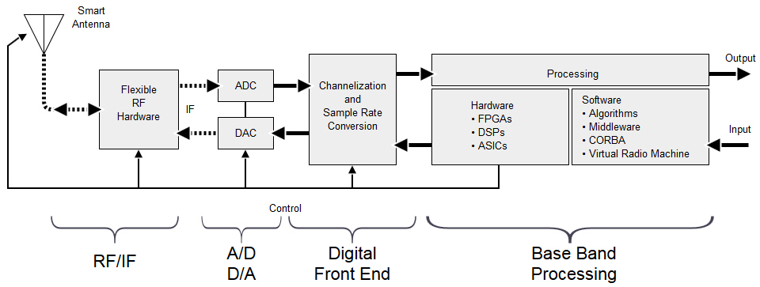
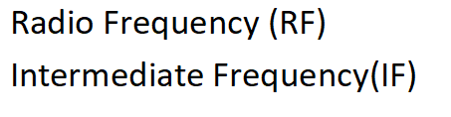
What's Software Defined Radio?

Slide 6
FPGA (Field Programmable Gate Arrays)
FPGAs contain an array of programmable logic blocks, and a hierarchy of reconfigurable interconnects that allow the blocks to be "wired together", like many logic gates that can be inter-wired in different configurations.
Logic blocks can be configured to perform complex combinational functions, or merely simple logic gates like AND and XOR.
In most FPGAs, logic blocks also include memory elements, which may be simple flip-flops or more complete blocks of memory.
One of the most important features of FPGA is the ability to perform parallel operations. Like video, voice processing.

Slide 7
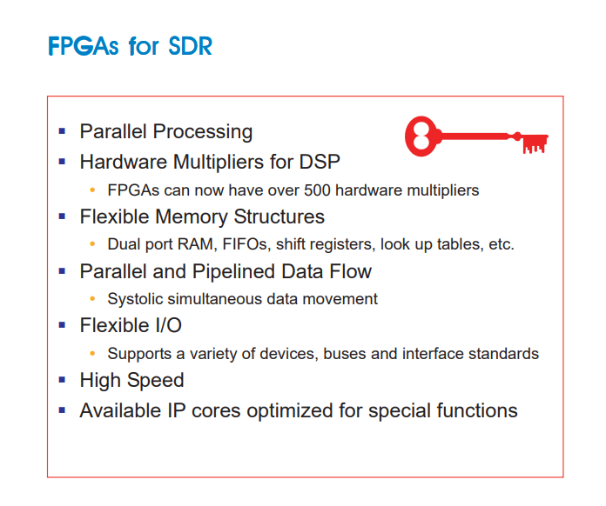
FPGA (Field Programmable Gate Arrays)
If we talk about FPGA's advantages
Do anything and flexible
Super fast than microcontroller
Field programmable
Ability of parallel processing
High I/O
An IP (intellectual property) core in FPGA is a block of logic or data that is used in making a field programmable gate array ( FPGA ) or application-specific integrated circuit ( ASIC ) for a product.

Slide 8


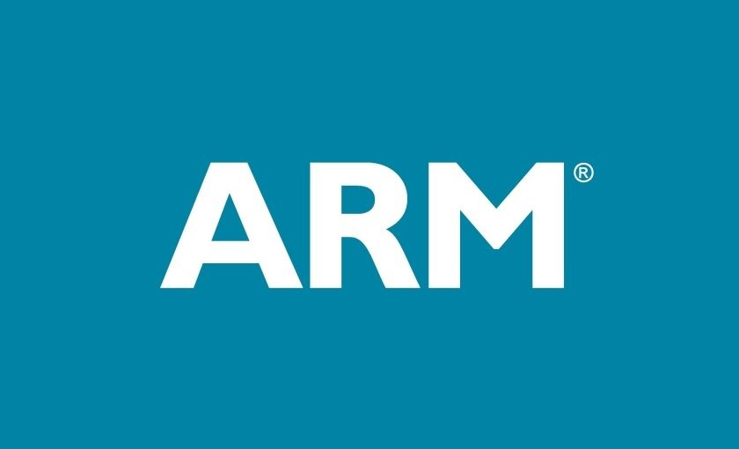
FPGA (Field Programmable Gate Arrays)
FPGA Solutions

Slide 9
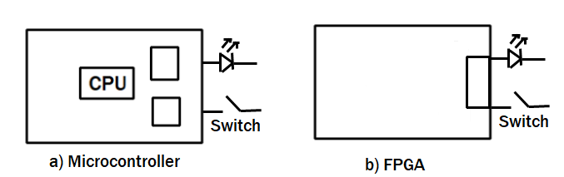
FPGA (Field Programmable Gate Arrays)
If we simply compare Microcontrollers and FPGAs
Microcontrollers has its own perphipael which let us open the switch at this figure. But in FPGA, we can connect switch directly to the LED, like we design an electronic circuit.

Slide 10
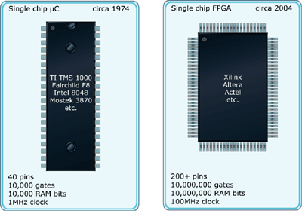
FPGA (Field Programmable Gate Arrays) Comparing FPGA and Microcontroller

Slide 11
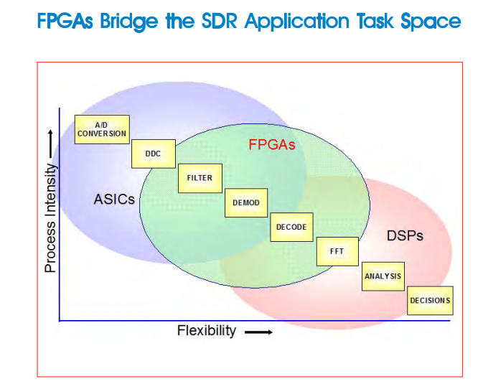
FPGA (Field Programmable Gate Arrays)

Slide 12
Difference between ASIC and FPGA
An ASIC is a unique type of integrated circuit meant for a specific application while an FPGA is a reprogrammable integrated circuit.
An ASIC can no longer be altered once created while an FPGA can.
It is common practice to design and test on an FPGA before implementing on an ASIC.
An ASIC wastes very little material compared to an FPGA and the recurring costs are low.
FPGA is better than an ASIC when building low volume production circuits.

Slide 13
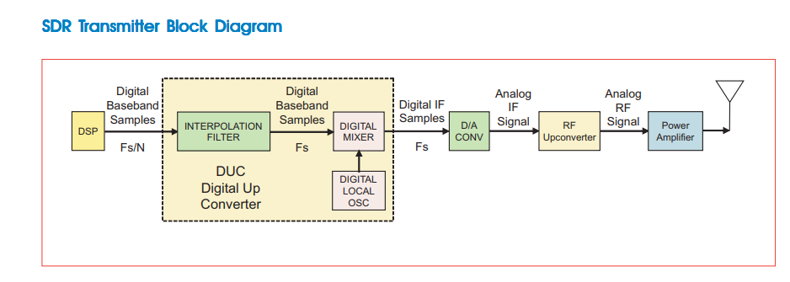
SDT (Software Defined Radio)

Slide 14
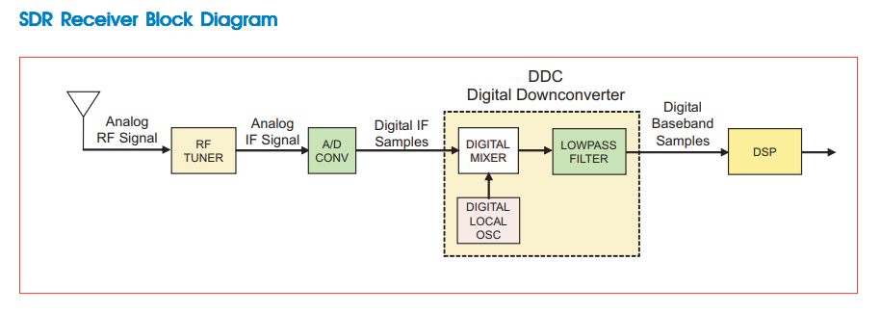
SDT (Software Defined Radio)

Slide 15
Features
Reconfigurability
Co-existence of mutiple software modules implemeting different standarts.
Dynamic configuration both in terminal and in infrastructure equipment
future-proof, multi-service, multi-mode, multiband, multi-standard terminals and infrastructure equipment

Slide 16
Features
Ubiquitous Connectivity
if the terminal is incompatible with the network technology, an appropriate software module is installed (over-the-air)
the infrastructure equipment can adjust to the legacy terminals

Slide 17
Features
Interoperability
SDR facilitates implementation of open architecture radio systems
End-users can use third-party applications seamlessly

Slide 18
Programmability
Hardware radio
No software changes
Software controlled radio
in Programmable Digital Radio, baseband operations and link layer protocols are implemented in software.
Software defined radio
SDR system is one in which the baseband processing as well as DDC / DUC modules are programmable.

Slide 19
Programmability
Ideal software radio
programmability is extended to the RF section
Ultimate software radio
in a single chip, no external antenna and no restrictions on operating frequency
intended for comparison purposes only

Slide 20
Architecture
The digital radio system consists of three main functional blocks
RF section
IF section
BB section
RF section is essentially analog hardware
IF and BB section are digital

Slide 21
Architecture
BB operations include
channel coding
source codding
control functionality
BB modem functionality
new and adaptive modulation schemes
self-adaptive or download control
IF signal processing
terminal capable to adapt to multiple radio interface standards

Slide 22
Architecture
Object-oriented approach
hardware abstraction
SW portability
definition of interfaces (API-Apllication Programming Interface)
Parameter approach
general structure is the same
modules configured by changing parameters

Slide 23
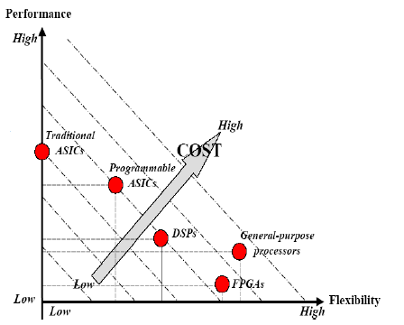
Implementation
Operations can be implemented with
ASIC, FPGA, DSP
Each has its benefits and drawbacks

Slide 24
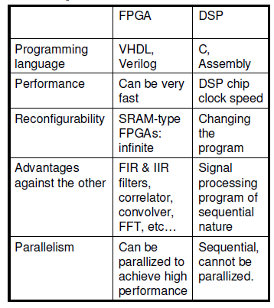
Implementation

Slide 25
Application Examples
Military
Real-time flexibility
Security
Civilian
Portable command for crisis management
Commerical
International connectivity
Prototyping
Bluetooth, WLAN, GPS, Radar, WCDMA, GPRS, GSM, AM, FM
Prototyping

Slide 26
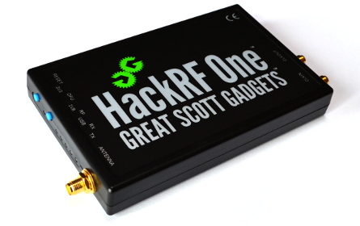
SDR Listening Example
We can use wireless devices in listening mode. When we use the wireless device as listener. We can collect datas which are turning around us. It is really easy to do by one wireless device and network tools in Linux systems. (For example Kali network Tools)

Slide 27
SDR Listening Example
As how we use wireless devices in listening mode, we can use the SDR technology in listening mode. It can be a greatful gagget to listen the RF signals.
In order to develop RF products, we can use SDR devices fo prototyping and testing.

Slide 28
Conclusions
With SDR anything is possible
within the current limits
From hardware desing to software desing
Reusability, reconfigurability, recycling
Multimode devices
single device is adequate
Cheaper

Slide 29
Thanks All
Ali Kaan TÜRKMEN

