Slide 1
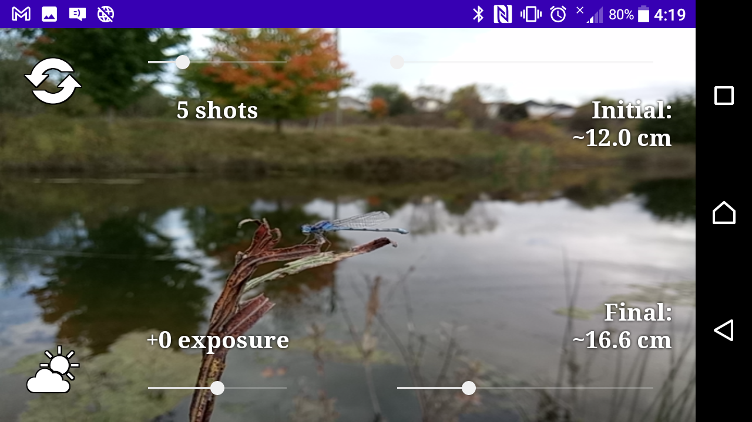








Tap to switch between the front- and rear-facing cameras.
Slide to set the number of successive shots to capture.
Slide to set the focus distance for the first shot in the sequence.
Tap to select the white balance.
Auto
Daylight
Cloudy Daylight
Shade
Twilight
Incandescent
Fluorescent
Warm Fluorescent
Slide to set the exposure compensation.
Slide to set the focus distance for the final shot in the sequence.

